Slide 1
Parameterized IO Type Blocks
Shane Flandermeyer^{1,2}
¹Advanced Radar Research Center, University of Oklahoma, Norman, Oklahoma, USA
²School of Electrical and Computer Engineering, University of Oklahoma, Norman, OK, USA

Slide 2
Problem Statement
Problem: We have written a C++ block to do some signal processing operation on a single data type. We want to perform the operation on a different input type with the same block.
Example: Rather than creating a separate addition block to add ints, floats, etc., we want to create a single block that allows the user to specify the input type.
C++ is a strongly typed language, but we can use function templates to implement our blocks for generic types.
Unfortunately, GNU Radio makes this a little complicated...

Slide 3
Tutorial Overview
To use function templates in our GNU Radio blocks, we must first edit the following files in the module:
grc/$(MODULE)_${BLOCK}.block.yml
include/$(MODULE)/${BLOCK}.h
lib/${BLOCK}_impl.h
swig/${MODULE}_swig.i
lib/${BLOCK}_impl.cc
For example, to edit the "add" block in a module called "test", we would first have to edit:
grc/$(MODULE)_${BLOCK).block.yml => grc/test_add.block.yml
Let's go through these files one at a time

Slide 4
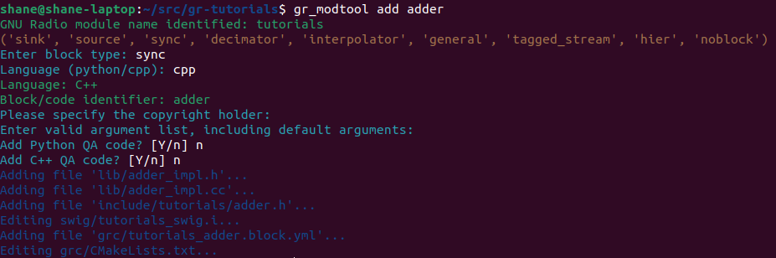
Example Block
In this tutorial, I will use a block with the following parameters
Takes two input streams and adds them together, allowing the user to specify the input type.

Slide 5


grc/$(MODULE)_${BLOCK).block.yml
First, we will fill out the YAML file as we have done in past
See OOT modules tutorial
We need to make a slight change to the block ID
This substitution will allow us to make a function template for each type in the implementation files.

Slide 6
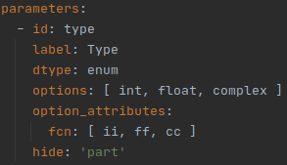



grc/$(MODULE)_${BLOCK).block.yml
We also need to add a parameter that holds the type options
The user can see these options in GRC. The two characters in the fcn attribute will be substituted into the "_xx" template from earlier

Slide 7
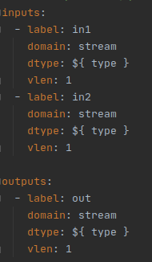
grc/$(MODULE)_${BLOCK).block.yml
Lastly, we need to make tell the input and output port which type they should be

Slide 8

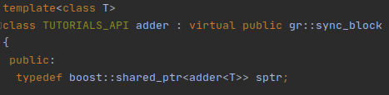

Include/${MODULE}/${BLOCK}.h
Now we need to make two changes to the block's API header file
1. Make the class a template class and make the shared pointer point to the template type
2. Define a unique type for each input type (will be used to make SWIG happy)
Add these definitions immediately outside the class from step 1
Notice that we reuse the suffixes from the YAML file (ii,ff,cc)!

Slide 9


lib/${BLOCK}_impl.h
We need to make a similar change to the implementation header file
The IDE initially throws an error because we changed the class definition in the previous slide

Slide 10


swig/${MODULE}_swig.i
Now we just need to tell SWIG about each of the templates
We need a GR_SWIG_MAGIC2_TMPL for each data type, as shown above
Notice that each type we defined in the header file is used as the second argument here

Slide 11
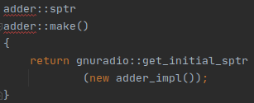
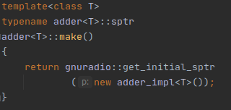
lib/${BLOCK}_impl.cc
With everything else complete, we can focus on the actual implementation
Requires more changes compared to the other files
First, we have to replace each reference to the "adder" or "adder_impl" namespace with its template counterpart
In our block, the make() function becomes

Slide 12
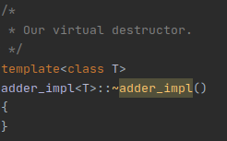
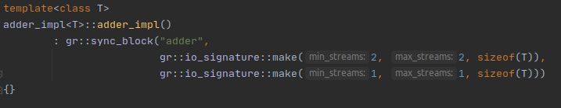
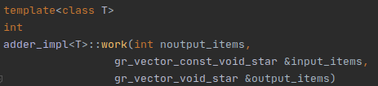
lib/${BLOCK}_impl.cc
The constructor and destructor become
The work function signature becomes
Since the block takes 2 inputs

Slide 13
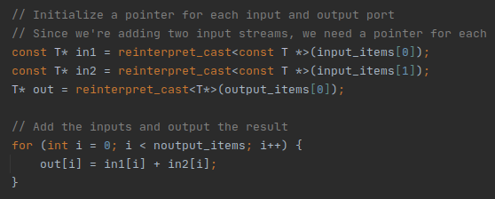
Work()
Now let's implement the work function
Almost identical to the normal way, but we need to call reinterpret_cast for the input and output pointers
With this, we can compile our block for GRC (see OOT tutorial)

Slide 14
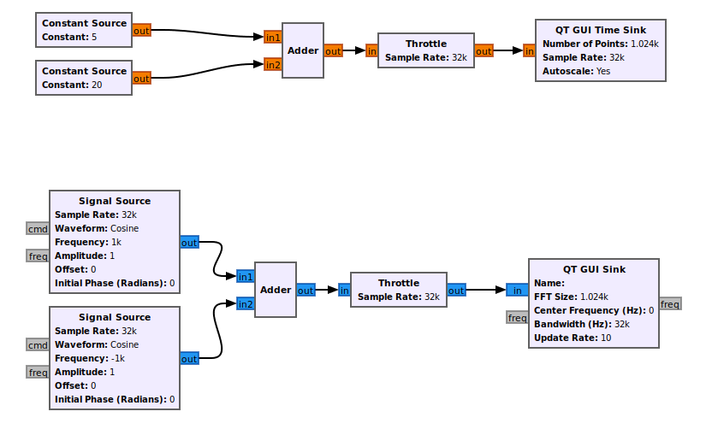
Examples/multi_IO_adder
We will show the output of float and complex addition with the flowgraph below

Slide 15
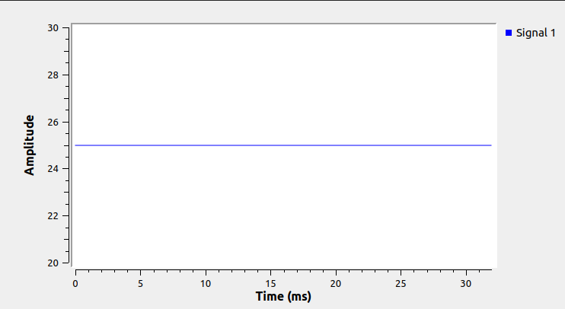
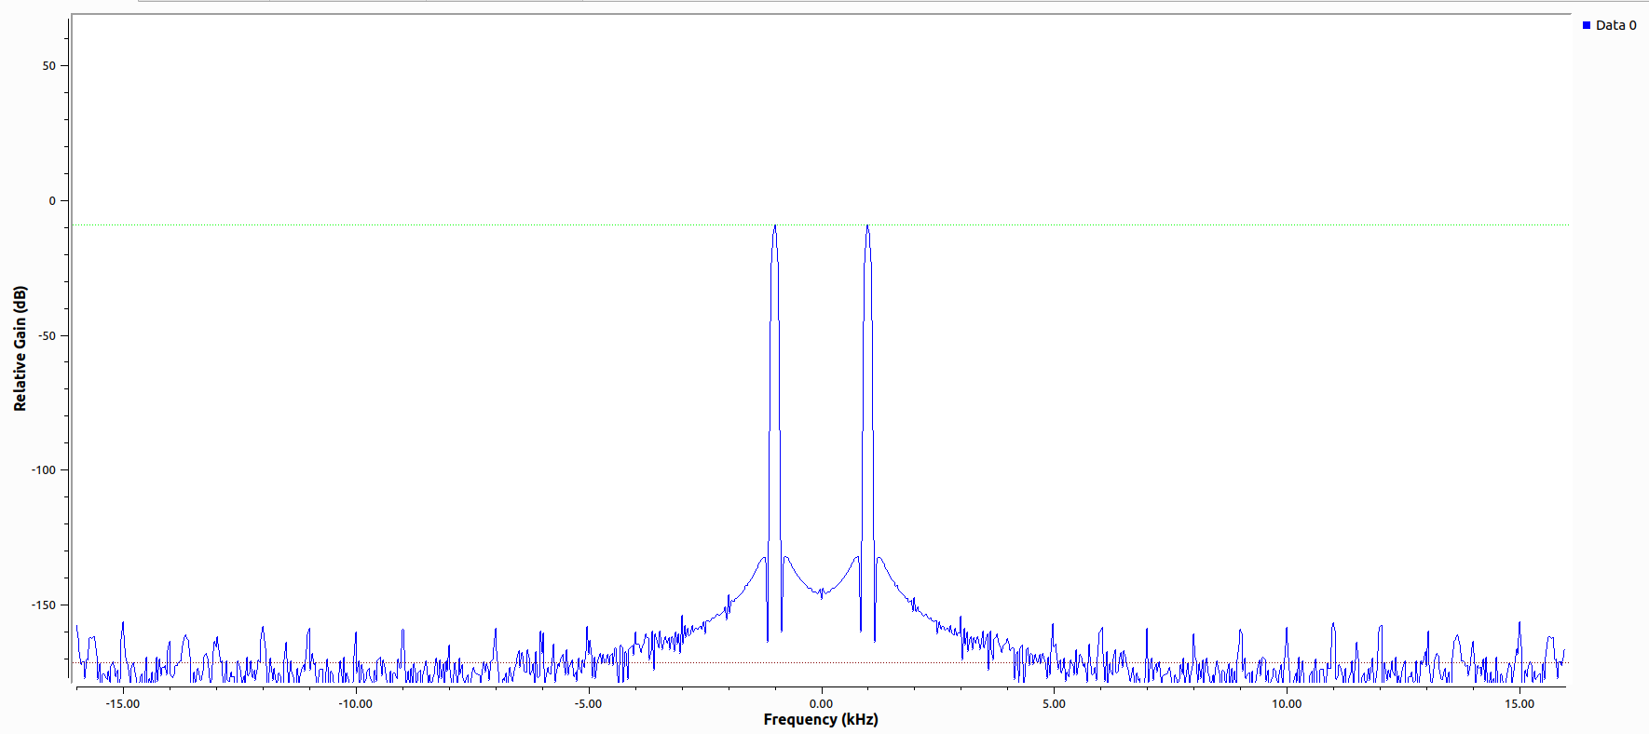
Examples/multi_IO_adder
The output of the top part should be a constant 25, and the bottom should be the FFT of two sinusoids at +/- 1 KHz
Running the flowgraph gives

