Slide 1
GNU Radio Guide
Shane Flandermeyer^{1,2}
¹Advanced Radar Research Center, University of Oklahoma, Norman, Oklahoma, USA
²School of Electrical and Computer Engineering, University of Oklahoma, Norman, OK, USA

Slide 2
GNU Radio Overview
GNU Radio is an open-source toolbox that allows us to perform signal processing tasks in real time
Flowchart based: Data samples follow the arrows
Most built-in signal processing can be performed with or without an SDR in the loop
Provides high-level interfacing with the SDR – we don’t have to care about what’s going on in the FPGA!
Signal processing functions contained in blocks
These are very similar to objects in an object-oriented programming language, and provide a layer of abstraction in the program

Slide 3
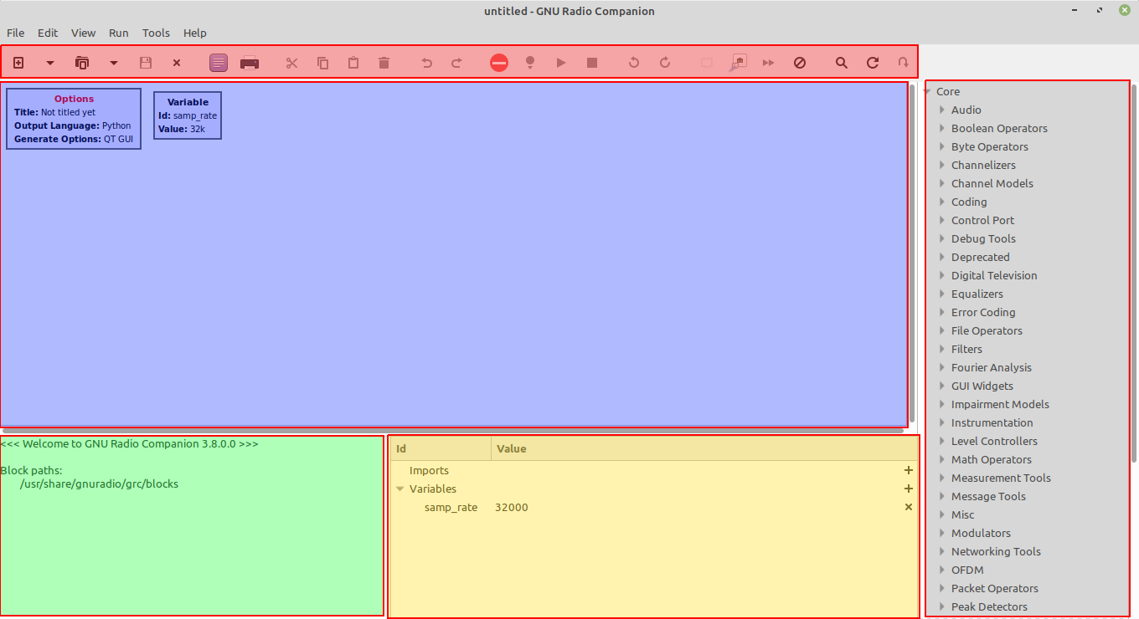
GNU Radio Companion
One of the main draws of GNU Radio is its intuitive GUI - GNU Radio Companion
The companion window has the following structure

Slide 4
GNU Radio Companion
One of the main draws of GNU Radio is its intuitive GUI - GNU Radio Companion
The companion window has the following structure
Toolbar

Slide 5
GNU Radio Companion
One of the main draws of GNU Radio is its intuitive GUI - GNU Radio Companion
The companion window has the following structure
Toolbar
Workspace

Slide 6
GNU Radio Companion
One of the main draws of GNU Radio is its intuitive GUI - GNU Radio Companion
The companion window has the following structure
Toolbar
Workspace
Terminal

Slide 7
GNU Radio Companion
One of the main draws of GNU Radio is its intuitive GUI - GNU Radio Companion
The companion window has the following structure
Toolbar
Workspace
Terminal
Variables

Slide 8
GNU Radio Companion
One of the main draws of GNU Radio is its intuitive GUI - GNU Radio Companion
The companion window has the following structure
Toolbar
Library
Workspace
Terminal
Variables

Slide 9
GNU Radio Companion
Toolbar: Standard GUI Toolbar. Hover over icons to explore functionality
Workspace: All blocks are placed and connected here.
Variables: Contains variable names and values
Library: Contains all blocks stored for use in GRC, sorted by the module from which the block originates. Ctrl+F to search for a block.
Terminal: All text output and error messages will appear here. This is just the Python terminal. If a block outputs a large amount of text, the terminal may cause the flowgraph to crash.

Slide 10
What GNU Radio Can Do
Easily interfaces with commercial SDRs
Osmocom SDRs (HackRF, BladeRF, RTL-SDR) pre-installed in most builds
Depending on your installation source, USRP blocks may have to be installed from a separate repository
Lots of Signal Processing Tools out of the box
Waveform generators, filters, modulators, file operators, etc.
Largest active SDR community, so there’s lots of documentation out there
Wiki: https://wiki.gnuradio.org/index.php/Main_Page
Library API: https://www.gnuradio.org/doc/doxygen/index.html
GitHub page: https://github.com/gnuradio/gnuradio

Slide 11
What GNU Radio Can’t Do
Main Problem: Lack of radar functionality
Beyond basic loopback from a file sink/source, we can’t do much radar signal processing
Not too surprising: SDRs are mostly made for communications applications
This is what we want to change!
Signal processing blocks designed to be as general as possible, so if you want to implement a specific function, you’ll likely have to add it yourself.
Windows
As of version 3.8, there is no standard way to add out-of-tree (OOT) modules in the windows version
Crashes at lower sample rates than Linux distributions

Slide 12
What GNU Radio Can’t Do
Unit Testing
GNU Radio is GUI-based at its core, and unit testing GUIs is not fun
Cannot perform unit tests on your blocks from companion
Must implement “QA” blocks in your custom module
These are basically Python flowgraph files, which we discuss next
Maximum Sample Rates
Unsurprisingly, GNU Radio adds overhead to any signal processing you’re trying to perform
Max sample rate reduced by several MS/s compared to the rate specified in the SDR’s documentation.

