Slide 1
Stream Tags and Messages
Shane Flandermeyer^{1,2}
¹Advanced Radar Research Center, University of Oklahoma, Norman, Oklahoma, USA
²School of Electrical and Computer Engineering, University of Oklahoma, Norman, OK, USA

Slide 2
Streaming Limitations
So far, we have only discussed data streaming from one block to another in the form of samples.
This architecture is sufficient for many applications, but what if we want our blocks to communicate with each other at a higher level than simply passing along raw data?
Example: If an SDR’s receive processing chain detects lots of interference at some center frequency, it should have a way to tell the transmitter to move to another one.
This is not possible with simple streaming; blocks can only send information forward, not backward.
GNU Radio has two tools that allow us to do this: stream tags and messages
Before diving into this discussion, there’s one topic we must cover.

Slide 3
PMTs
At higher levels of communication, information is sent as a Protocol Data Unit (PDU) rather than as a stream
This information may take the form of any data type
Python is weakly typed, so it can determine the data type dynamically
C++ is strongly typed, so it can only use a variable if its type is known (ignoring the auto keyword introduced in C++20)
Since a GNU Radio flowgraph has both Python and C++ elements, there must be a standardized way to share data between both.
This can be done with a Polymorphic Type (PMT) Object!

Slide 4
PMT Example
Let’s go to the Python interpreter to get a handle for how we can use PMT objects
>>> import pmt
>>> cnum = 1+1j
>>> type(cnum)
complex
>>> p = pmt.from_complex(cnum)
>>> type(p)
pmt.pmt_swig.swig_int_ptr
>>> print p
i+1i
>>> pmt.is_complex(p)
True
>>> p = pmt.to_complex(p)
>>> type(p)
complex

Slide 5
PMT Example
Let’s go to the Python interpreter to get a handle for how we can use PMT objects
>>> import pmt
>>> cnum = 1+1j
>>> type(cnum)
complex
>>> p = pmt.from_complex(cnum)
>>> type(p)
pmt.pmt_swig.swig_int_ptr
>>> print p
i+1i
>>> pmt.is_complex(p)
True
>>> p = pmt.to_complex(p)
>>> type(p)
complex
Import PMT Module into our session

Slide 6
PMT Example
Let’s go to the Python interpreter to get a handle for how we can use PMT objects
>>> import pmt
>>> cnum = 1+1j
>>> type(cnum)
complex
>>> p = pmt.from_complex(cnum)
>>> type(p)
pmt.pmt_swig.swig_int_ptr
>>> print p
i+1i
>>> pmt.is_complex(p)
True
>>> p = pmt.to_complex(p)
>>> type(p)
complex
Define a variable that holds a complex number

Slide 7
PMT Example
Let’s go to the Python interpreter to get a handle for how we can use PMT objects
>>> import pmt
>>> cnum = 1+1j
>>> type(cnum)
complex
>>> p = pmt.from_complex(cnum)
>>> type(p)
pmt.pmt_swig.swig_int_ptr
>>> print p
i+1i
>>> pmt.is_complex(p)
True
>>> p = pmt.to_complex(p)
>>> type(p)
complex
Verify that the variable is complex

Slide 8
PMT Example
Let’s go to the Python interpreter to get a handle for how we can use PMT objects
>>> import pmt
>>> cnum = 1+1j
>>> type(cnum)
complex
>>> p = pmt.from_complex(cnum)
>>> type(p)
pmt.pmt_swig.swig_int_ptr
>>> print p
i+1i
>>> pmt.is_complex(p)
True
>>> p = pmt.to_complex(p)
>>> type(p)
complex
Define a PMT object that can store our complex variable

Slide 9
PMT Example
Let’s go to the Python interpreter to get a handle for how we can use PMT objects
>>> import pmt
>>> cnum = 1+1j
>>> type(cnum)
complex
>>> p = pmt.from_complex(cnum)
>>> type(p)
pmt.pmt_swig.swig_int_ptr
>>> print p
i+1i
>>> pmt.is_complex(p)
True
>>> p = pmt.to_complex(p)
>>> type(p)
complex
The type of our object is now a general PMT pointer. Nice!

Slide 10
PMT Example
Let’s go to the Python interpreter to get a handle for how we can use PMT objects
>>> import pmt
>>> cnum = 1+1j
>>> type(cnum)
complex
>>> p = pmt.from_complex(cnum)
>>> type(p)
pmt.pmt_swig.swig_int_ptr
>>> print p
i+1i
>>> pmt.is_complex(p)
True
>>> p = pmt.to_complex(p)
>>> type(p)
complex
Note that we can just print PMT objects! They have their own function for typecasting to a string

Slide 11
PMT Example
Let’s go to the Python interpreter to get a handle for how we can use PMT objects
>>> import pmt
>>> cnum = 1+1j
>>> type(cnum)
complex
>>> p = pmt.from_complex(cnum)
>>> type(p)
pmt.pmt_swig.swig_int_ptr
>>> print p
i+1i
>>> pmt.is_complex(p)
True
>>> p = pmt.to_complex(p)
>>> type(p)
complex
We can also verify that the object knows its original type, so it can be recreated in C++

Slide 12
PMT Example
Let’s go to the Python interpreter to get a handle for how we can use PMT objects
>>> import pmt
>>> cnum = 1+1j
>>> type(cnum)
complex
>>> p = pmt.from_complex(cnum)
>>> type(p)
pmt.pmt_swig.swig_int_ptr
>>> print p
i+1i
>>> pmt.is_complex(p)
True
>>> p = pmt.to_complex(p)
>>> type(p)
complex
Conveniently, the PMT library also includes a function to convert back to the original type from a PMT pointer.

Slide 13
PMT Summary
For many data types, we can convert to and from PMT and C++ with the to_* and from_* functions, respectively.
Replace * with the data type (e.g. to_double and from_double)
If you’re using Python, we don’t have to worry about the types and can use the to_python and from_python functions to convert the data
Again, we don’t have to care since Python is weakly typed
PMT API: https://www.gnuradio.org/doc/sphinx-3.7.0/pmt/index.html
The PMT naming convention is the same in both languages, so the only difference is the :: that C++ uses to access functions. Replacing the . In these functions with a :: will give you (at least a single line of) working C++ code.

Slide 14
Stream Tags
Now that we have the PMT library to safely get data from one block to another, we need a way to move this data between blocks
A stream tag, which is a PMT message attached to a specific sample, is one of two standard tools that accomplishes this.
A stream tag is defined by three attributes:
Key: A PMT symbol that identifies the tag
Value: The (PMT) message that we want the tag to carry
Offset: The absolute offset (relative to the first sample received by the block) of the tag in the data stream
Source ID: A PMT symbol that identifies the alias of the block from which the tag originates (optional)

Slide 15
Stream Tags
Since tags must be attached to a specific sample, there is a separate stream of tags that runs parallel to the main data stream.
This means we can process the tag’s message immediately after the sample arrives at a block!
Creating a separate data stream for tags adds overhead, so we need to use them sparingly.
Since tags travel along the same path as the data samples, they have the same downside: they can only travel in one direction.
We’ll see later that we can use the message passing mechanism to send information up and down the flowgraph.

Slide 16
Creating Tags
To add tags to a stream, we can use the add_item_tag function

Slide 17
Creating Tags
To add tags to a stream, we can use the add_item_tag function
Python: add_item_tag(which_output, offset, key, [source_id])
In C++ there are two ways: in one you explicitly create a gr::tag_t object and in the other you do not (like above)
Optional

Slide 18
Creating Tags
To add tags to a stream, we can use the add_item_tag function
Python: add_item_tag(which_output, offset, key, [source_id])
In C++ there are two ways: in one you explicitly create a gr::tag_t object and in the other you do not (like above)
Tag object explicitly created (Best practice):
void add_item_tag(unsigned int which_output, const tag_t &tag);

Slide 19
Creating Tags
To add tags to a stream, we can use the add_item_tag function
Python: add_item_tag(which_output, offset, key, [source_id])
In C++ there are two ways: in one you explicitly create a gr::tag_t object and in the other you do not (like above)
Tag object explicitly created (Best practice):
void add_item_tag(unsigned int which_output, const tag_t &tag);
Create this with:
tag_t tag;
tag.offset = some int
tag.key = some PMT
tag.value = some PMT

Slide 20
Creating Tags
To add tags to a stream, we can use the add_item_tag function
Python: add_item_tag(which_output, offset, key, [source_id])
In C++ there are two ways: in one you explicitly create a gr::tag_t object and in the other you do not (like above)
Tag object explicitly created (Best practice):
void add_item_tag(unsigned int which_output, const tag_t &tag);
Tag object implicitly defined:
void add_item_tag(unsigned int which_output,
uint64_t abs_offset,
const pmt::pmt_t &key,
const pmt::pmt_t &value,
const pmt::pmt_t &srcid=pmt::PMT_F);
Optional

Slide 21
Retrieving Tags
We have two functions to retrieve existing tags from a stream

Slide 22
Retrieving Tags
We have two functions to retrieve existing tags from a stream
get_tags_in_range: Grab all tags from a particular input port within a certain range of items (in terms of absolute samples)
Python: get_tags_in_range(which_input, abs_start, abs_end, filter)
C++: void get_tags_in_range(std::vector<tag_t> &v,
unsigned int which_input,
uint64_t abs_start,
uint64_t abs_end,
const pmt::pmt_t &key);

Slide 23
Retrieving Tags
We have two functions to retrieve existing tags from a stream
get_tags_in_range: Grab all tags from a particular input port within a certain range of items (in terms of absolute samples)
Python: get_tags_in_range(which_input, abs_start, abs_end, filter)
C++: void get_tags_in_range(std::vector<tag_t> &v,
unsigned int which_input,
uint64_t abs_start,
uint64_t abs_end,
const pmt::pmt_t &key);
Note that in C++ we must declare a vector of tags before using these functions (Syntax: std::vector<tags> v;)
These are OPTIONAL arguments that allow us to filter tags by key

Slide 24
Retrieving Tags
We have two functions to retrieve existing tags from a stream
get_tags_in_window: Grab all tags from a particular input port within a certain range of items (relative to that particular call to the work function)
To call this function, we can use the same syntax as we used for get_tags_in_range, but we specify the start and end in terms of relative samples instead of absolute samples
The distinction between relative and absolute samples will make more sense once we’ve discussed the buffer system and out-of-tree modules
Now, let’s look at a simple example in Python

Slide 25
Stream Tag Example
Consider a 6-sample data stream in the flowgraph shown below
Block 2
Block 1
Block 3
0 1 2 3 4 5

Slide 26
Stream Tag Example
Consider a 6-sample data stream in the flowgraph shown below
Block 2 needs the 3rd sample of the stream to have a tag. Here’s how we can create this tag in block 1:
Samples are zero indexed;
Be careful!
Block 2
Block 1
Block 3
0 1 2 3 4 5

Slide 27
Stream Tag Example
Consider a 6-sample data stream in the flowgraph shown below
Block 2 needs the 3rd sample of the stream to have a tag. Here’s how we can create this tag in block 1:
key = pmt.intern("third sample")
value = pmt.to_pmt(3)
self.add_item_tag(0, 2, key, value)
Block 2
Block 1
Block 3
0 1 2 3 4 5

Slide 28
Stream Tag Example
Consider a 6-sample data stream in the flowgraph shown below
Block 2 needs the 3rd sample of the stream to have a tag. Here’s how we can create this tag in block 1:
key = pmt.intern("third sample")
value = pmt.to_pmt(3)
self.add_item_tag(0, 2, key, value)
Block 2
Block 1
Block 3
0 1 2 3 4 5
Use pmt.intern to convert string to PMT

Slide 29
Stream Tag Example
Consider a 6-sample data stream in the flowgraph shown below
Block 2 needs the 3rd sample of the stream to have a tag. Here’s how we can create this tag in block 1:
key = pmt.intern("third sample")
value = pmt.to_pmt(3)
self.add_item_tag(0, 2, key, value)
Block 2
Block 1
Block 3
0 1 2 3 4 5
Convert the value to PMT

Slide 30
Stream Tag Example
Consider a 6-sample data stream in the flowgraph shown below
Block 2 needs the 3rd sample of the stream to have a tag. Here’s how we can create this tag in block 1:
key = pmt.intern("third sample")
value = pmt.to_pmt(3)
self.add_item_tag(0, 2, key, value)
Block 2
Block 1
Block 3
0 1 2 3 4 5
Create a tag with the given key, value, and offset and add it to output stream zero (going into block 2)

Slide 31
Stream Tag Example
When Block 2 has received the samples, its input buffer looks like
How can we recover the information carried by the tag?
Use the get_tags_in_range or get_tags_in_window functions!
0 1 2 3 4 5
Key
Value

Slide 32
Stream Tag Example
When Block 2 has received the samples, its input buffer looks like
How can we recover the information carried by the tag?
Use the get_tags_in_range or get_tags_in_window functions!
tags = self.get_tags_in_window(0,0,len(input_items[0]),pmt.intern("third sample"))
tag = tags[0]
key = pmt.to_python(tag.key)
value = pmt.to_python(tag.value)
offset = pmt.to_python(tag.offset)
0 1 2 3 4 5
Key
Value

Slide 33
Stream Tag Example
When Block 2 has received the samples, its input buffer looks like
How can we recover the information carried by the tag?
Use the get_tags_in_range or get_tags_in_window functions!
tags = self.get_tags_in_window(0,0,len(input_items[0]),pmt.intern("third sample"))
tag = tags[0]
key = pmt.to_python(tag.key)
value = pmt.to_python(tag.value)
offset = pmt.to_python(tag.offset)
0 1 2 3 4 5
Key
Value
Get all tags in the input buffer with the key we want (“third sample”). Here, there’s only the one attached to sample #2

Slide 34
Stream Tag Example
When Block 2 has received the samples, its input buffer looks like
How can we recover the information carried by the tag?
Use the get_tags_in_range or get_tags_in_window functions!
tags = self.get_tags_in_window(0,0,len(input_items[0]),pmt.intern("third sample"))
tag = tags[0]
key = pmt.to_python(tag.key)
value = pmt.to_python(tag.value)
offset = pmt.to_python(tag.offset)
0 1 2 3 4 5
Key
Value
Get the first (and only in this case) tag from the list above

Slide 35
Stream Tag Example
When Block 2 has received the samples, its input buffer looks like
How can we recover the information carried by the tag?
Use the get_tags_in_range or get_tags_in_window functions!
tags = self.get_tags_in_window(0,0,len(input_items[0]),pmt.intern("third sample"))
tag = tags[0]
key = pmt.to_python(tag.key)
value = pmt.to_python(tag.value)
offset = pmt.to_python(tag.offset)
0 1 2 3 4 5
Key
Value
Store the tag’s key

Slide 36
Stream Tag Example
When Block 2 has received the samples, its input buffer looks like
How can we recover the information carried by the tag?
Use the get_tags_in_range or get_tags_in_window functions!
tags = self.get_tags_in_window(0,0,len(input_items[0]),pmt.intern("third sample"))
tag = tags[0]
key = pmt.to_python(tag.key)
value = pmt.to_python(tag.value)
offset = pmt.to_python(tag.offset)
0 1 2 3 4 5
Key
Value
Store the tag’s value

Slide 37
Stream Tag Example
When Block 2 has received the samples, its input buffer looks like
How can we recover the information carried by the tag?
Use the get_tags_in_range or get_tags_in_window functions!
tags = self.get_tags_in_window(0,0,len(input_items[0]),pmt.intern("third sample"))
tag = tags[0]
key = pmt.to_python(tag.key)
value = pmt.to_python(tag.value)
offset = pmt.to_python(tag.offset)
0 1 2 3 4 5
Key
Value
Store the tag’s offset

Slide 38
Stream Tag Example
When Block 2 has received the samples, its input buffer looks like
How can we recover the information carried by the tag?
Use the get_tags_in_range or get_tags_in_window functions!
tags = self.get_tags_in_window(0,0,len(input_items[0]),pmt.intern("third sample"))
tag = tags[0]
key = pmt.to_python(tag.key)
value = pmt.to_python(tag.value)
offset = pmt.to_python(tag.offset)
We can now use the tag’s information however we want!
0 1 2 3 4 5
Key
Value
Store the tag’s offset

Slide 39
TODO: A more Practical Example
Give a more practical example for using stream tags to process bursty data (i.e. pulsed radar waveform)

Slide 40
Message Passing
We can also use message passing to move data between blocks
Unlike stream tags, messages are not tied to a particular sample
This means that messages can move downstream and upstream!
It also means that they are processed asynchronously
There is no guarantee of when they’ll be processed
Like stream tags, messages are encapsulated in PMT objects
Messages cannot be transmitted or received by every block
Block must have a dedicated message port
Block must have a designated message handler function

Slide 41
Message Port Syntax
To add a message input or output port in a block, put the following in the block’s constructor:
C++:
Input port: void message_port_register_in(pmt::pmt_t port_id)
Output port: void message_port_register_out(pmt::pmt_t port_id)
Python:
Input port: self.message_port_register_in(pmt.intern("port name"))
Output port: self.message_port_register_out(pmt.intern("port name"))
The ports can now be referenced by their PMT ID
Great! We’ve got message ports, but how do we actually send a message?

Slide 42
Message Sending Syntax
To send a message, use the following syntax:
C++: void message_port_pub(pmt::pmt_t port_id, pmt::pmt_t msg);
Python: self.message_port_pub(pmt.intern("port name"), <pmt message>)
Note that the sending block doesn’t care which block the message is sent to, it only cares about the port through which the message is sent.

Slide 43
Message Receiving Syntax
After creating a message input port, we need to bind a message handler function to the port so we can process the messages
In C++:
set_msg_handler(pmt::pmt_t port_id,
[this](pmt::pmt_t msg) { this->message_handler_function(msg);});
In Python: self.set_msg_handler(pmt.intern("port name"), <msg handler function>);

Slide 44
Message Receiving Syntax
After creating a message input port, we need to bind a message handler function to the port so we can process the messages
In C++:
set_msg_handler(pmt::pmt_t port_id,
[this](pmt::pmt_t msg) { this->message_handler_function(msg);});
In Python: self.set_msg_handler(pmt.intern("port name"), <msg handler function>);
ID chosen when creating the port

Slide 45
Message Receiving Syntax
After creating a message input port, we need to bind a message handler function to the port so we can process the messages
In C++:
set_msg_handler(pmt::pmt_t port_id,
[this](pmt::pmt_t msg) { this->message_handler_function(msg);});
In Python: self.set_msg_handler(pmt.intern("port name"), <msg handler function>)
And the actual functions take the form:
C++: void block_class::message_handler_function(pmt::pmt_t msg);
Python: def handle_msg(self, msg):
There’s nothing else to it. Write these functions as you would any other!

Slide 46
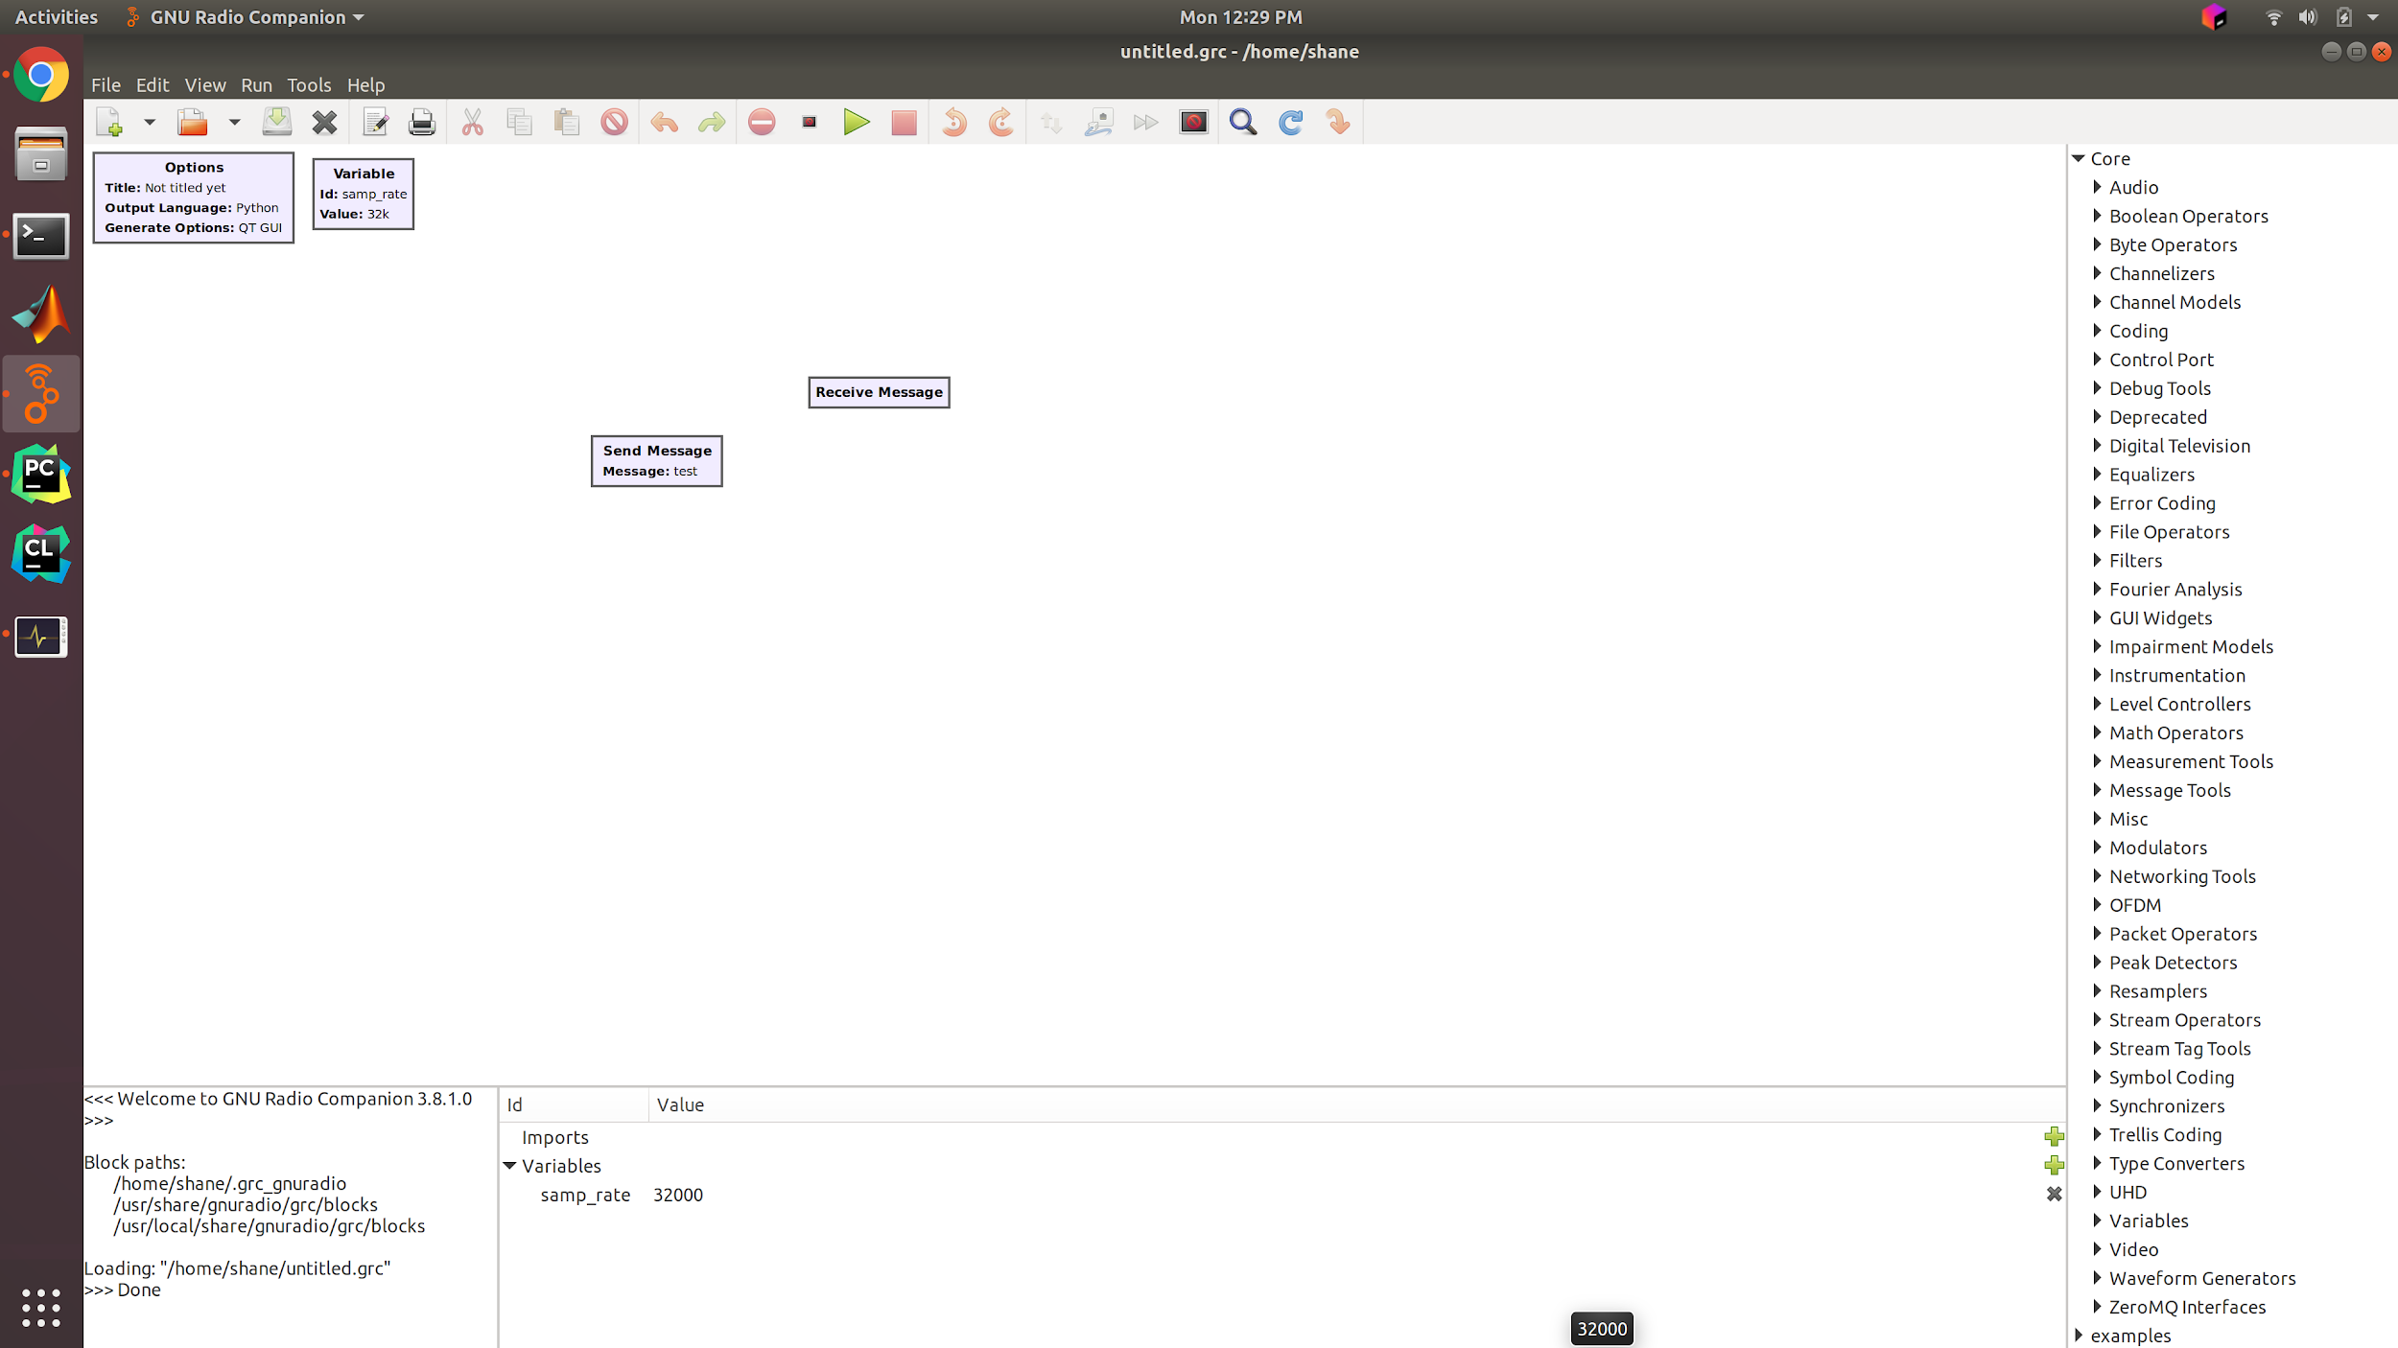
Message Passing Example
Consider this two-block flowgraph as an example
We want the block on the left to send the given message to the block on the right when a button is pressed.
As we have established, traditional data streams are unidirectional and continuous. Thus, we have to use messages to allow blocks to operate on a button press. Now, where do we start??

Slide 47
Message Passing Example
Consider this two-block flowgraph as an example
We want the block on the left to send the given message to the block on the right when a button is pressed.
As we have established, traditional data streams are unidirectional and continuous. Thus, we have to use messages to allow blocks to operate on a button press. Now, where do we start??
Add a message output port to the sending block
Add a message input port to the receiving block
Note: We haven’t learned how to create GUI elements, so assume that the “Send Message” block’s button has already been created.

Slide 48
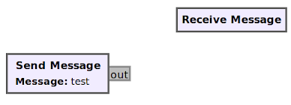
Message Passing Example
First, let’s create the message output port on the sending block
In the block’s constructor, just add the following:
self.msg_port_register(pmt.intern("out"))
We also have to make some changes to the block’s YAML file to make the change show up in companion, but don’t worry about that until we discuss out-of-tree modules
When we restart GNU Radio, the block will now look like

Slide 49
Message Passing Example
First, let’s create the message output port on the sending block
In the block’s constructor, just add the following:
self.msg_port_register(pmt.intern("out"))
We also have to make some changes to the block’s YAML file to make the change show up in companion, but don’t worry about that until we discuss out-of-tree modules
When we restart GNU Radio, the block will now look like
Ports made for messages are Gray. You may have already seen this on several other blocks!

Slide 50
Message Passing Example
Now let’s add a message input port to the receiving block
In the constructor, we add the following lines
self.message_port_register_in(pmt.intern("in"))
self.set_msg_handler(pmt.intern("in"), self.handle_msg)
Outside of the constructor (but still within the class scope), we also have to define the handle_msg function.

Slide 51
Message Passing Example
Now let’s add a message input port to the receiving block
In the constructor, we add the following lines
self.message_port_register_in(pmt.intern("in"))
self.set_msg_handler(pmt.intern("in"), self.handle_msg)
Outside of the constructor (but still within the class scope), we also have to define the handle_msg function.
We want to print out the message we receive. So the function is simple to write
def handle_msg(self, msg):
message = pmt.to_python(msg)
print("MESSAGE RECEIVED: ", message)

Slide 52
Message Passing Example
Now let’s add a message input port to the receiving block
In the constructor, we add the following lines
self.message_port_register_in(pmt.intern("in"))
self.set_msg_handler(pmt.intern("in"), self.handle_msg)
Outside of the constructor (but still within the class scope), we also have to define the handle_msg function.
We want to print out the message we receive. So the function is simple to write
def handle_msg(self, msg):
message = pmt.to_python(msg)
print("MESSAGE RECEIVED: ", message)
Function definition. See slide titled “Message Receiving Syntax”

Slide 53
Message Passing Example
Now let’s add a message input port to the receiving block
In the constructor, we add the following lines
self.message_port_register_in(pmt.intern("in"))
self.set_msg_handler(pmt.intern("in"), self.handle_msg)
Outside of the constructor (but still within the class scope), we also have to define the handle_msg function.
We want to print out the message we receive. So the function is simple to write
def handle_msg(self, msg):
message = pmt.to_python(msg)
print("MESSAGE RECEIVED: ", message)
Convert the PMT Object to its appropriate Python Type

Slide 54
Message Passing Example
Now let’s add a message input port to the receiving block
In the constructor, we add the following lines
self.message_port_register_in(pmt.intern("in"))
self.set_msg_handler(pmt.intern("in"), self.handle_msg)
Outside of the constructor (but still within the class scope), we also have to define the handle_msg function.
We want to print out the message we receive. So the function is simple to write
def handle_msg(self, msg):
message = pmt.to_python(msg)
print("MESSAGE RECEIVED: ", message)
Print the message to the command line

Slide 55
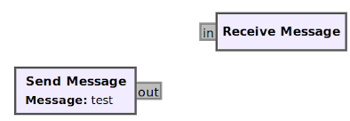
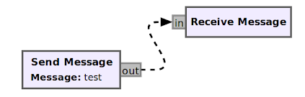
Message Passing Example
Now both blocks have message ports!
Now let’s connect the blocks
The connection between message ports is shown as a dotted line!
We also represent this differently in our Python flowgraph code, replacing the connect() function from before with a function called msg_connect()

Slide 56
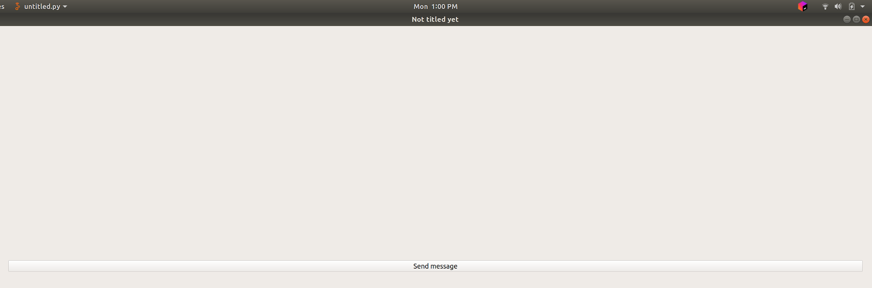
Message Passing Example
When we run the flowgraph, we are greeted with a GUI window containing only the button (as expected!)
Does the receive block output the correct message?

Slide 57
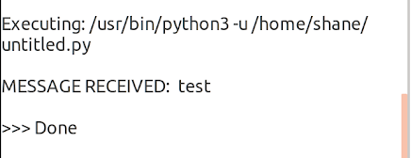
Message Passing Example
When we run the flowgraph, we are greeted with a GUI window containing only the button (as expected!)
Does the receive block output the correct message? YES!

