Slide 1
SolarLab vs. SCAPS-1D
Notes:
This deck reports a cross-validation of two 1D drift-diffusion solvers, not a comparison against experiment. Neither code is "truth"; we anchor realism against the literature. The headline question is why SolarLab's Voc sits 96 mV below SCAPS, and what is actually fixable.

Slide 2
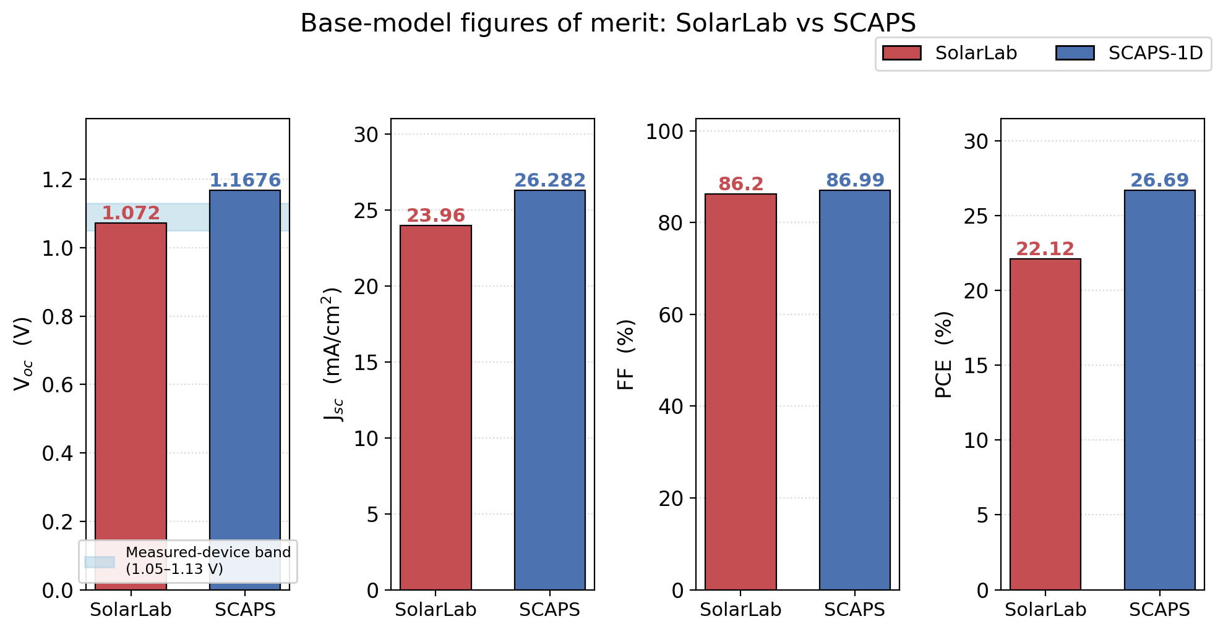
Base-Model Figures of Merit: V_{oc}, J_{sc}, FF, PCE
• V_{oc}: 1.072 vs. 1.1676 V (−96 mV, −8.2%) — primary gap
• J_{sc} genuine: 23.96 vs. 26.282 mA/cm² (table 25.73 is foreign)
• FF: ~86.2% vs. 86.99% (−1.4 pp)
• PCE genuine: 22.1% vs. 26.69% (the 25.73 splice inflates the table)
Notes:
The quoted Jsc=25.73 is a contaminant spliced from a separate N_grid=30 run; the genuine self-consistent value is 23.96. Using the real Jsc, all four FOMs lock algebraically. SCAPS obeys PCE = Voc*Jsc*FF to within rounding; so does the genuine SolarLab tuple.

Slide 3
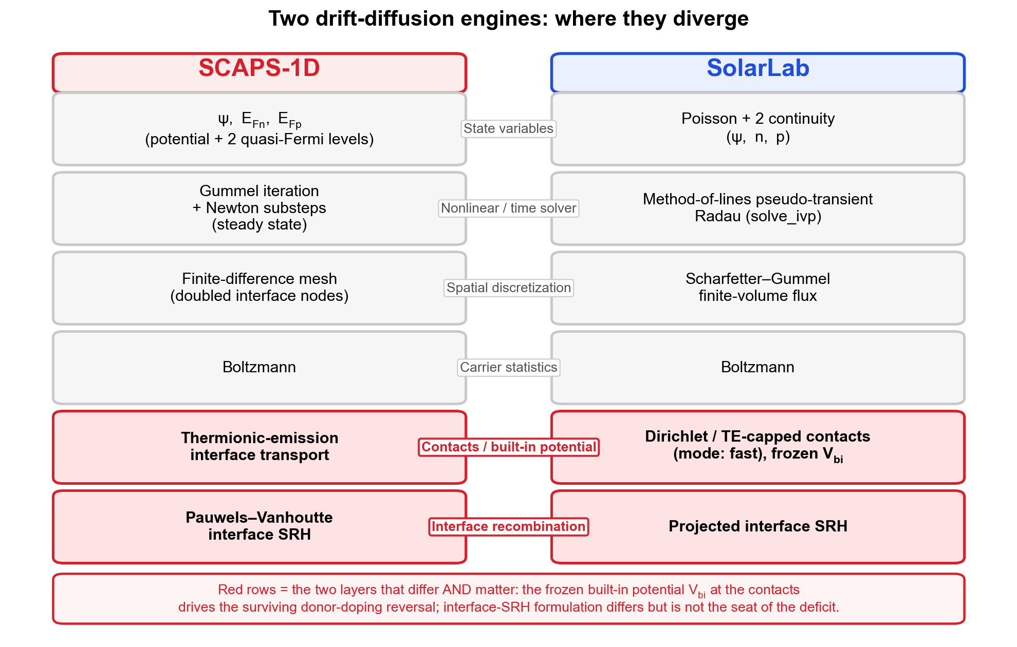
Two DD Solvers on the MAPbI₃ Base Model
• Stack: HTL 20 nm / MAPbI₃ 800 nm (E_{g}=1.53 eV) / ETL 25 nm
• SCAPS: Gummel+Newton, (Φ, E_{Fn}, E_{Fp}) [1]; SolarLab: method-of-lines Radau
• Both Boltzmann, Scharfetter–Gummel flux [5], tunnelling OFF [2]
• Same physics class; differ in boundary and interface treatments
Notes:
SCAPS-1D (Gent) is the de-facto reference; SolarLab is our Python perovskite_sim library. Both solve Poisson plus two continuity equations with SG flux. The divergences live in boundary conditions, interface recombination, and optics, not in the core formulation.

Slide 4
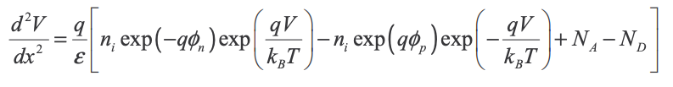



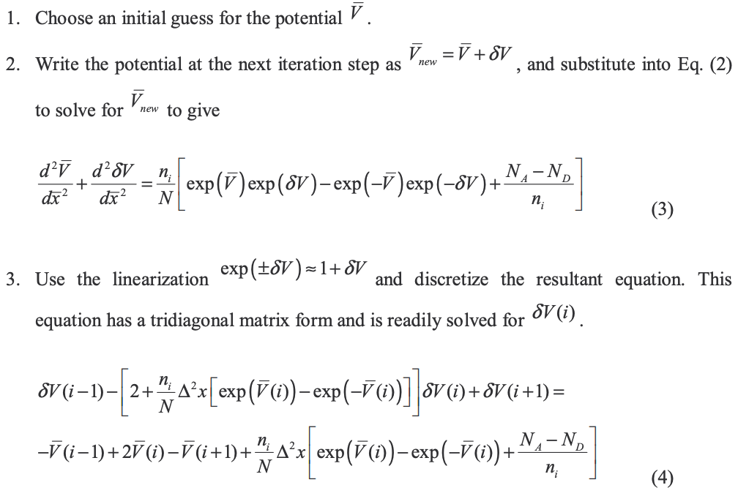
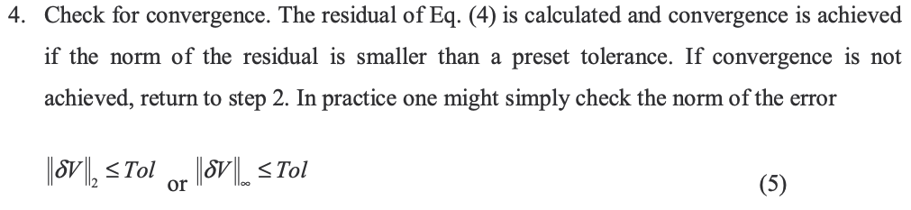

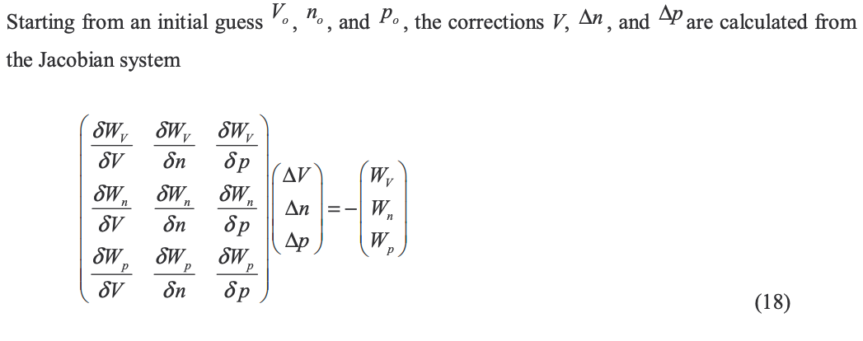
SCAPS DD Solvers on the MAPbI₃ Base Model
• SCAPS: Gummel+Newton, (Φ, E_{Fn}, E_{Fp}) [1]; SolarLab: method-of-lines Radau
Notes:
SCAPS-1D (Gent) is the de-facto reference; SolarLab is our Python perovskite_sim library. Both solve Poisson plus two continuity equations with SG flux. The divergences live in boundary conditions, interface recombination, and optics, not in the core formulation.

Slide 5
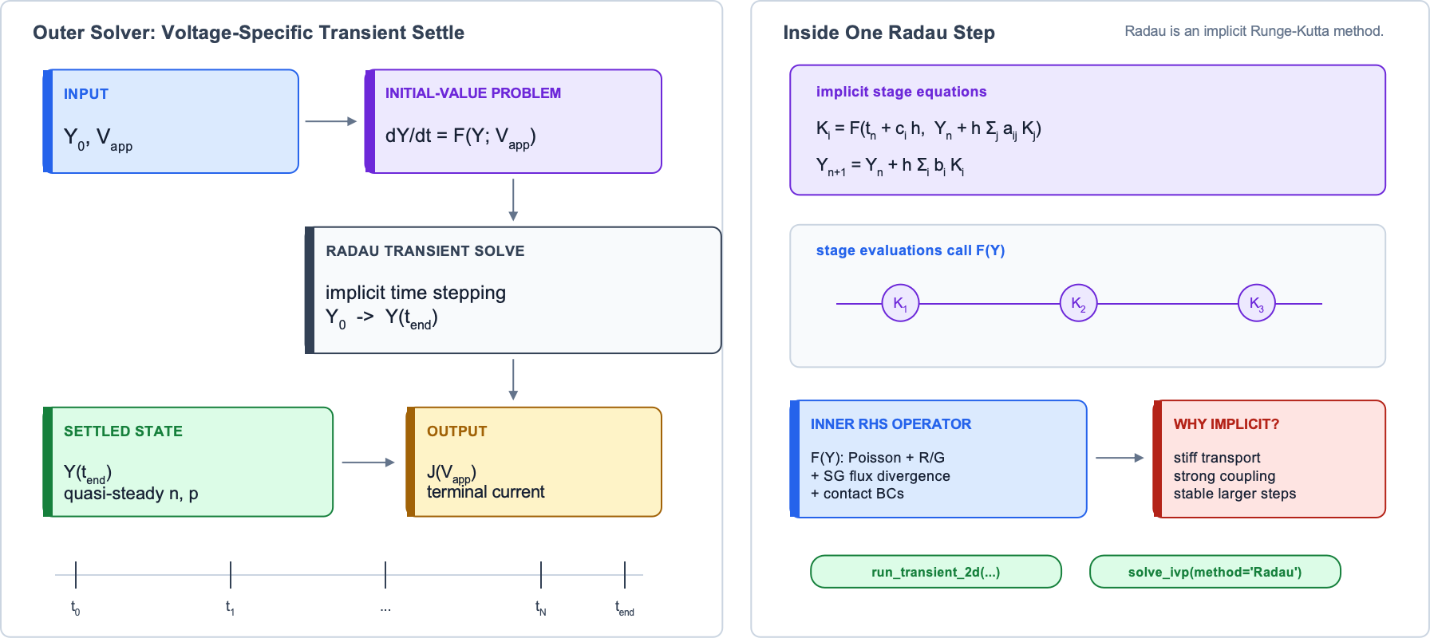
SolarLab DD Solvers on the MAPbI₃ Base Model
• SCAPS: Gummel+Newton, (Φ, E_{Fn}, E_{Fp}) [1]; SolarLab: method-of-lines Radau
Notes:
SCAPS-1D (Gent) is the de-facto reference; SolarLab is our Python perovskite_sim library. Both solve Poisson plus two continuity equations with SG flux. The divergences live in boundary conditions, interface recombination, and optics, not in the core formulation.

Slide 6
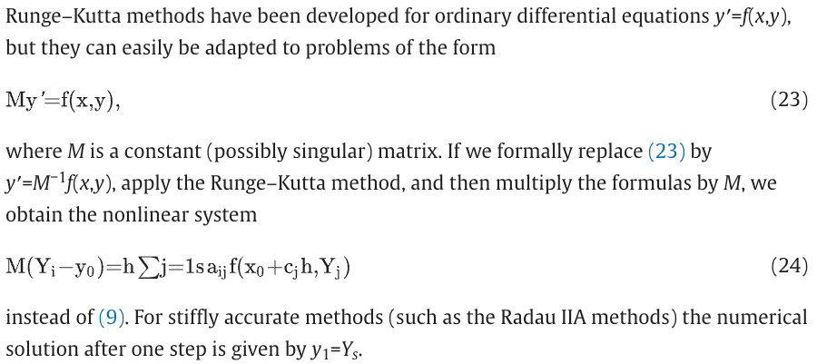
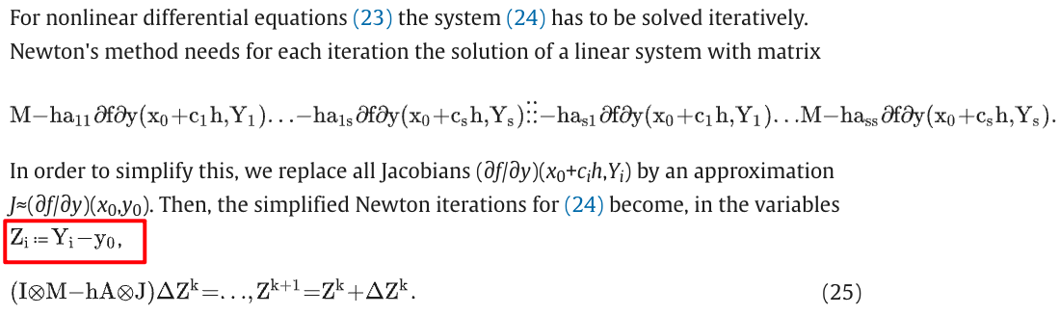
SolarLab DD Solvers on the MAPbI₃ Base Model
• SCAPS: Gummel+Newton, (Φ, E_{Fn}, E_{Fp}) [1]; SolarLab: method-of-lines Radau
Notes:
SCAPS-1D (Gent) is the de-facto reference; SolarLab is our Python perovskite_sim library. Both solve Poisson plus two continuity equations with SG flux. The divergences live in boundary conditions, interface recombination, and optics, not in the core formulation.

Slide 7
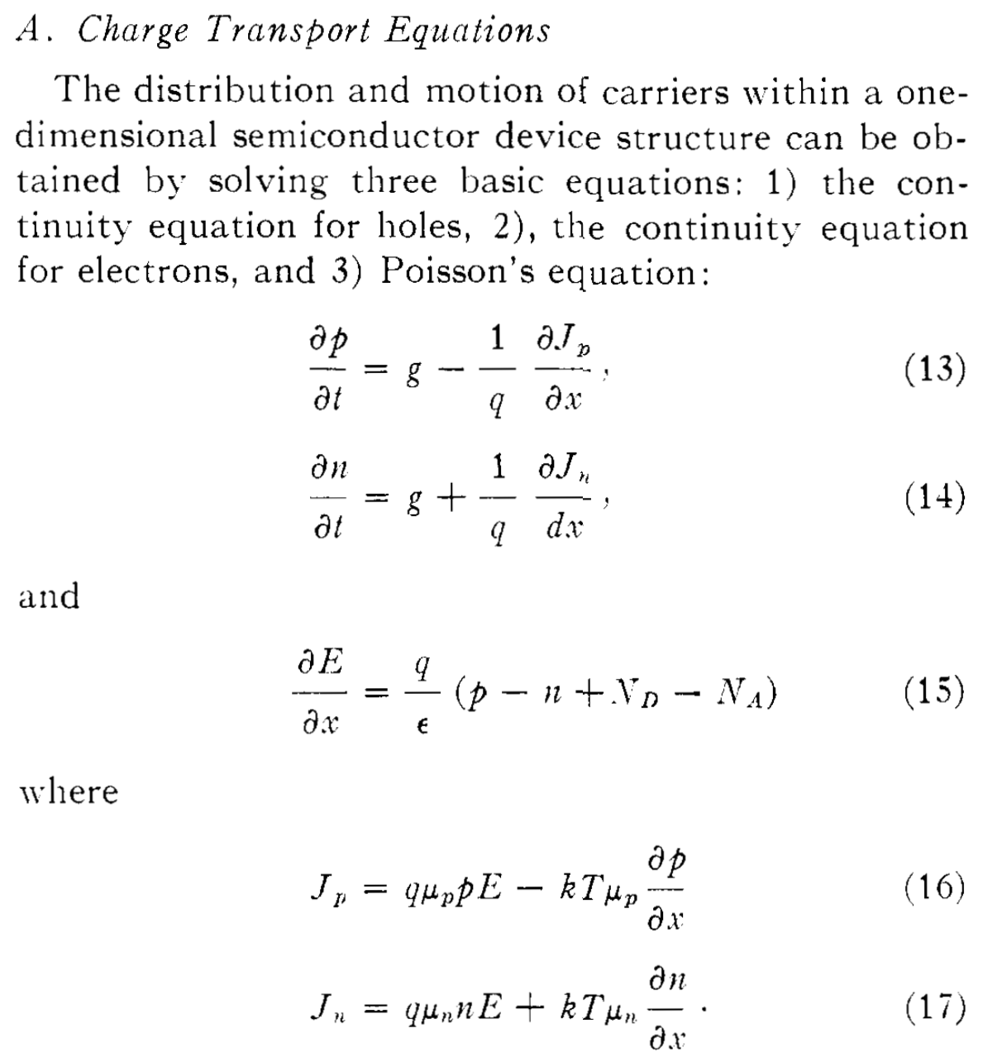
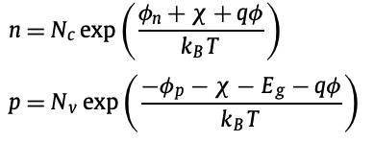
Two DD Solvers on the MAPbI₃ Base Model
• Both Boltzmann, Scharfetter–Gummel flux [5], tunnelling OFF [2]
Scharfetter–Gummel flux
The electron (n) and hole (p) densities are given by
Notes:
SCAPS-1D (Gent) is the de-facto reference; SolarLab is our Python perovskite_sim library. Both solve Poisson plus two continuity equations with SG flux. The divergences live in boundary conditions, interface recombination, and optics, not in the core formulation.

Slide 8
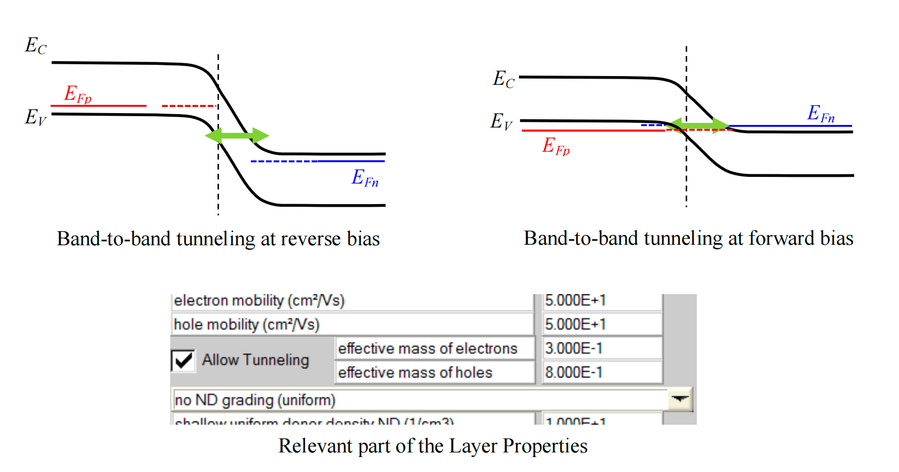
Tunnelling
Notes:
SCAPS-1D (Gent) is the de-facto reference; SolarLab is our Python perovskite_sim library. Both solve Poisson plus two continuity equations with SG flux. The divergences live in boundary conditions, interface recombination, and optics, not in the core formulation.

Slide 9
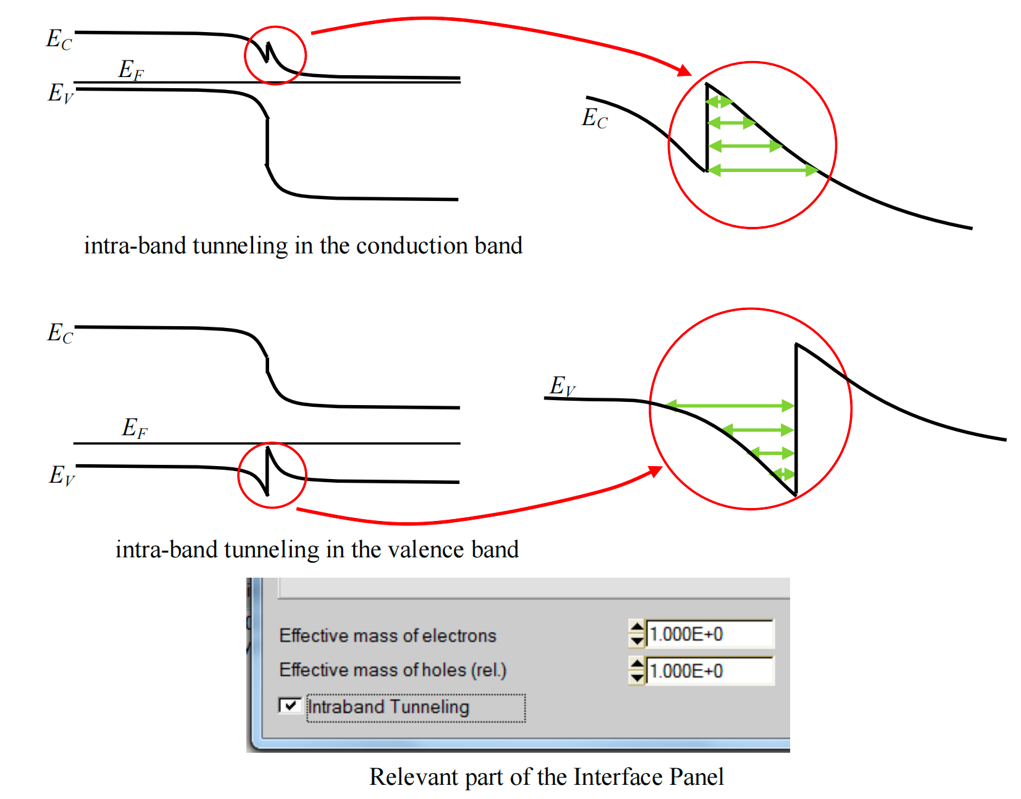
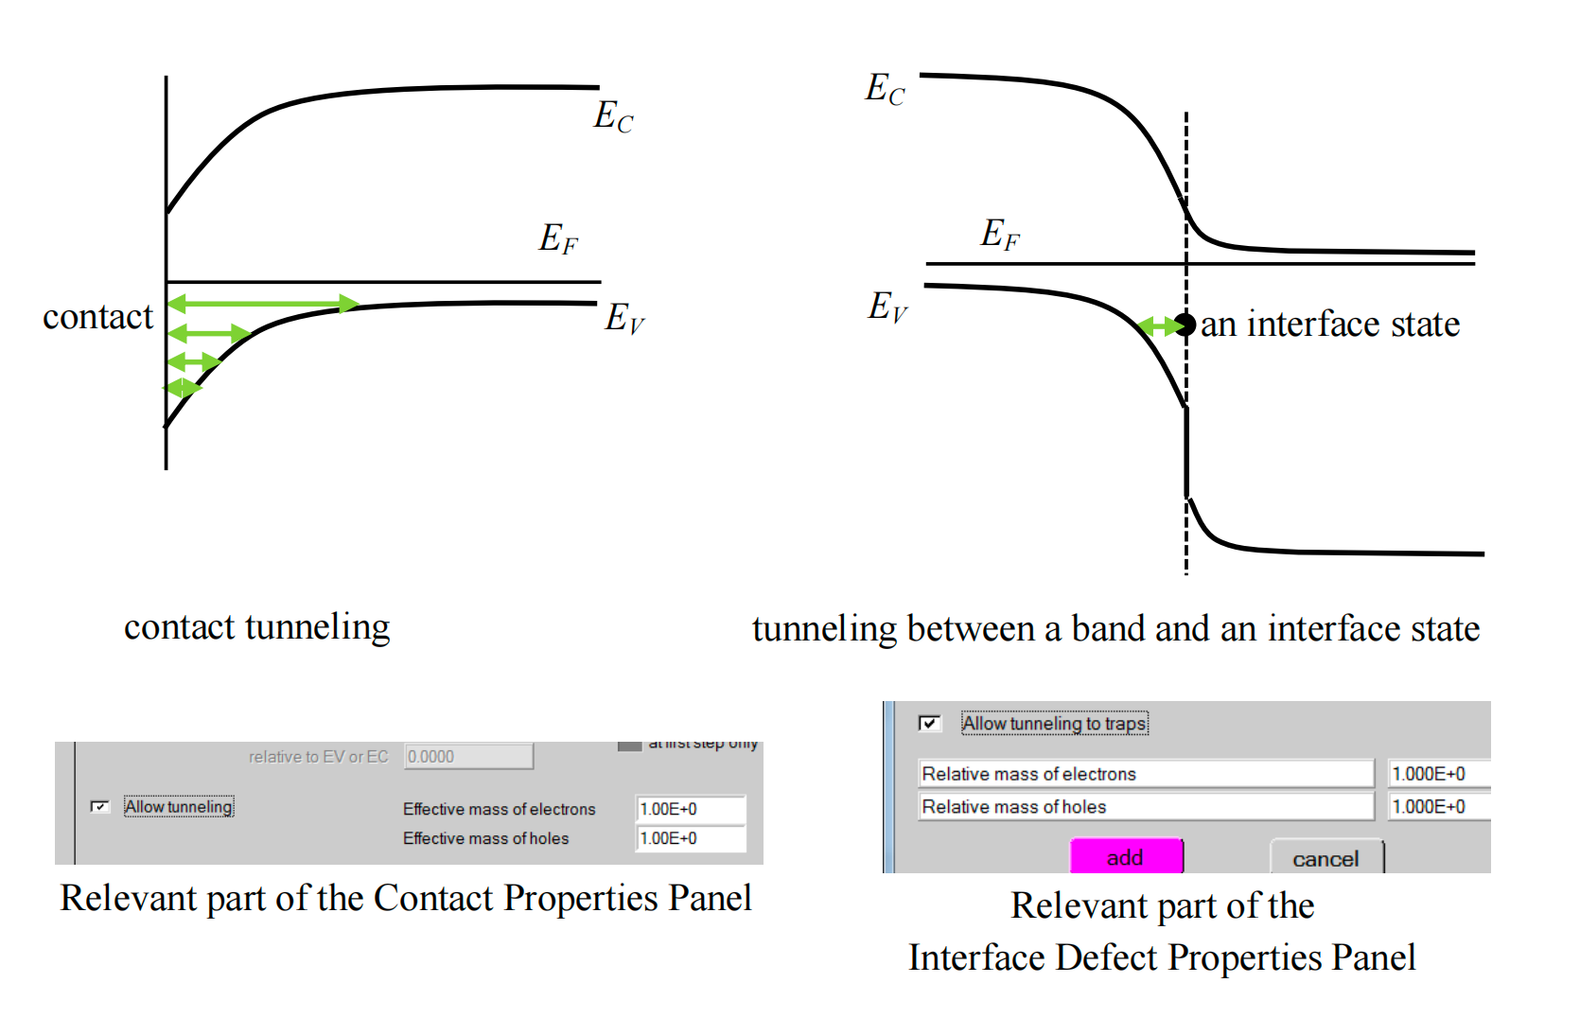
Tunnelling
Notes:
SCAPS-1D (Gent) is the de-facto reference; SolarLab is our Python perovskite_sim library. Both solve Poisson plus two continuity equations with SG flux. The divergences live in boundary conditions, interface recombination, and optics, not in the core formulation.

Slide 10
Where SolarLab and SCAPS Diverge
• V_{bi}: frozen scalar (SolarLab) vs. doping/band-tracking flatband (SCAPS) [1,6]
• Interface SRH: bulk-projected cross-carrier vs. single-plane Pauwels–Vanhoutte [8]
• Contacts: hard-Dirichlet ohmic vs. flatband work-function [6]
• Transport: TE flux-cap on SG vs. TE as the interface BC [4]
• Optics: TMM front reflection + finite absorber vs. R=0 ideal
Notes:
Five model-level differences feed the base-point discrepancy. The frozen Vbi drives the donor reversal; the interface-SRH difference is the leading suspect for the 96 mV deficit and the sweep shape mismatches; the optics difference explains the Jsc gap. Each is real, mostly by design.

Slide 11
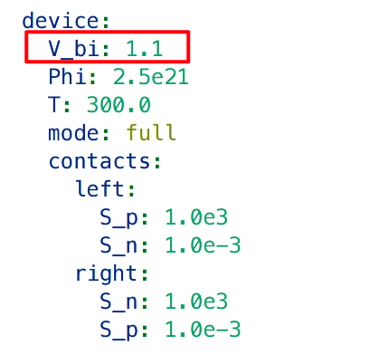
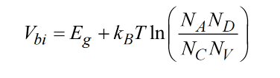
V_{bi}
• V_{bi}: frozen scalar (SolarLab) vs. doping/band-tracking flatband (SCAPS) [1,6]
Notes:
Five model-level differences feed the base-point discrepancy. The frozen Vbi drives the donor reversal; the interface-SRH difference is the leading suspect for the 96 mV deficit and the sweep shape mismatches; the optics difference explains the Jsc gap. Each is real, mostly by design.

Slide 12
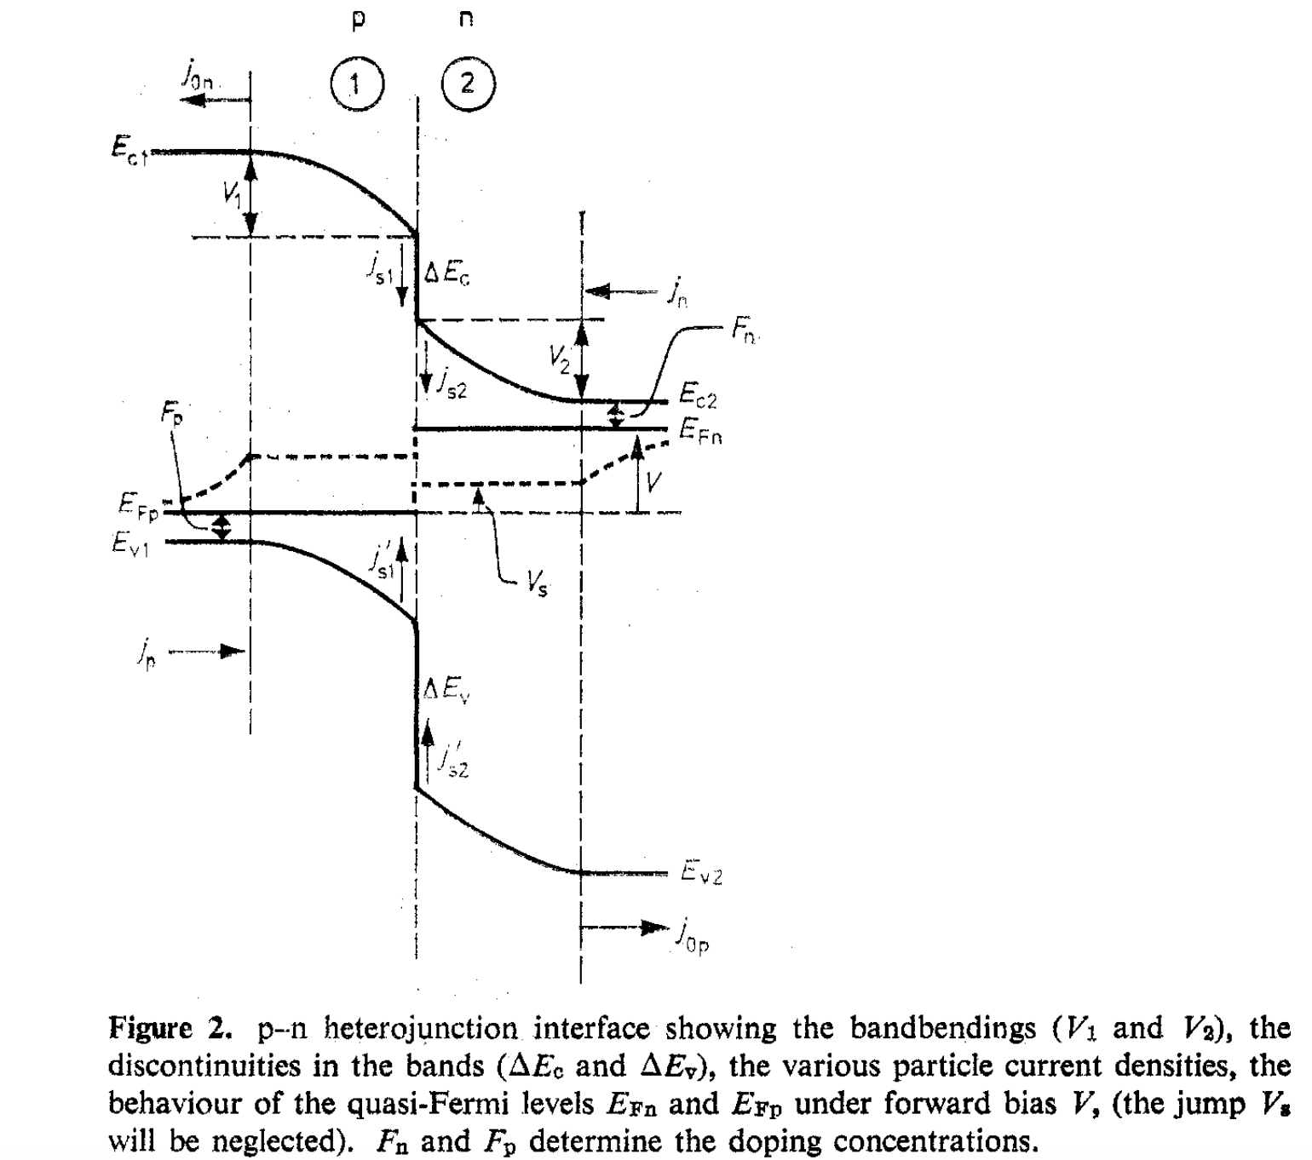
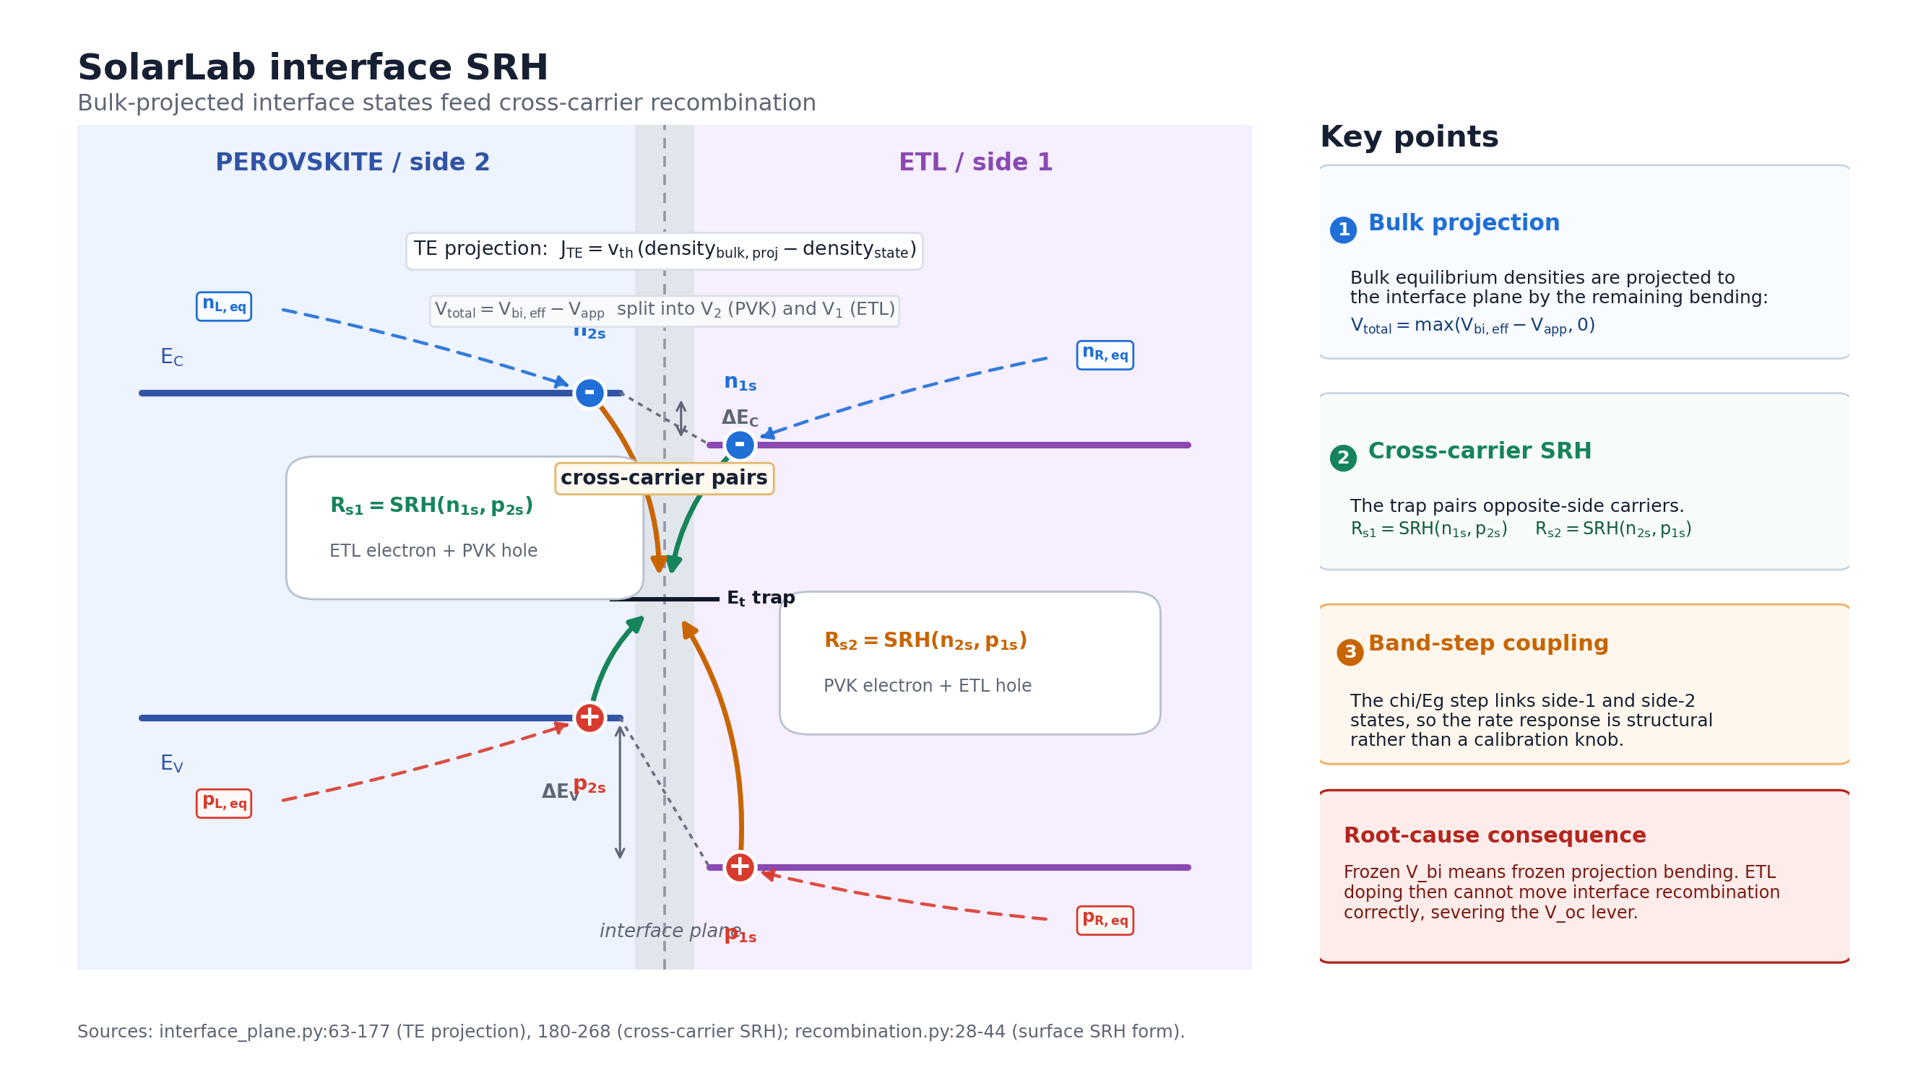
Interface SRH
• Interface SRH: bulk-projected cross-carrier vs. single-plane Pauwels–Vanhoutte [8]
Notes:
Five model-level differences feed the base-point discrepancy. The frozen Vbi drives the donor reversal; the interface-SRH difference is the leading suspect for the 96 mV deficit and the sweep shape mismatches; the optics difference explains the Jsc gap. Each is real, mostly by design.

Slide 13
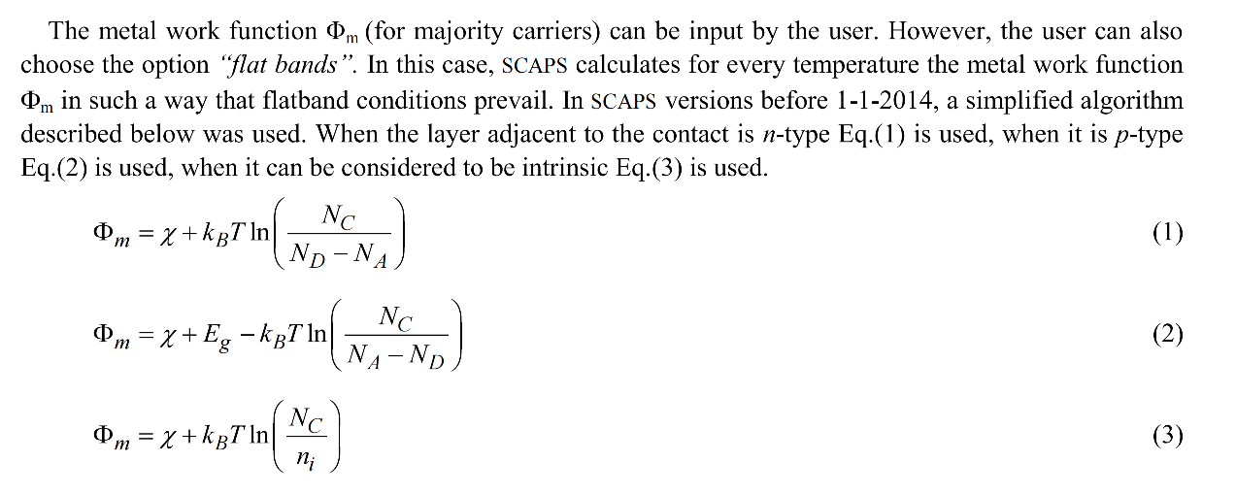
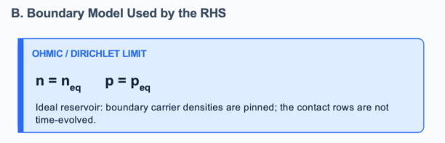
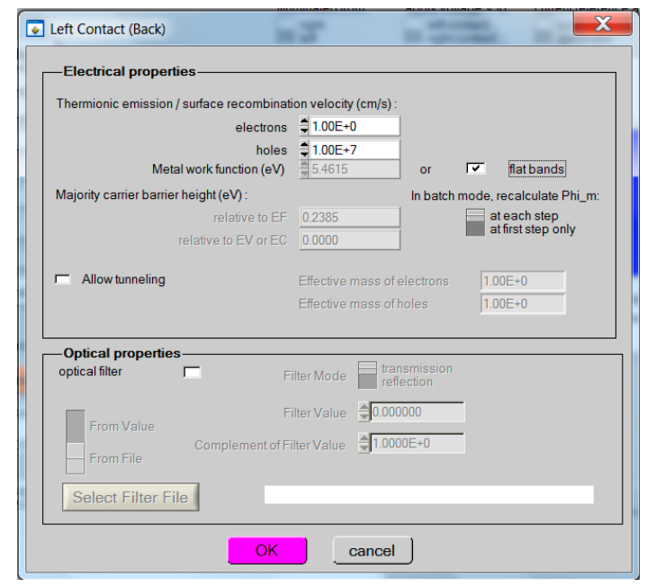
Contacts
• Contacts: hard-Dirichlet ohmic vs. flatband work-function [6]
Notes:
Five model-level differences feed the base-point discrepancy. The frozen Vbi drives the donor reversal; the interface-SRH difference is the leading suspect for the 96 mV deficit and the sweep shape mismatches; the optics difference explains the Jsc gap. Each is real, mostly by design.

Slide 14
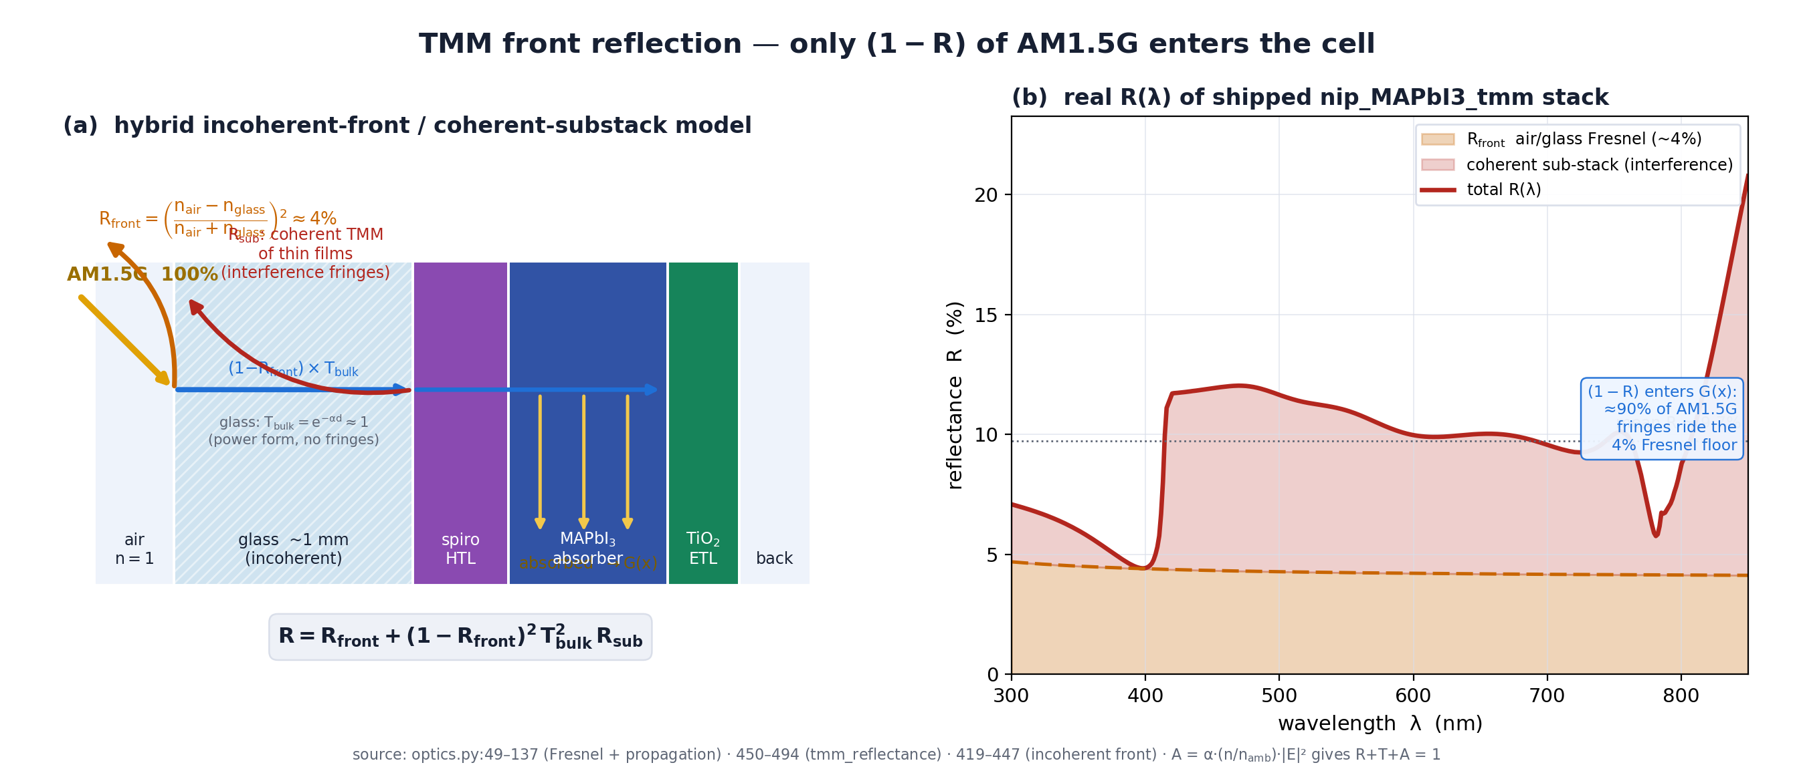
Optics
• Optics: TMM front reflection + finite absorber vs. R=0 ideal
Notes:
Five model-level differences feed the base-point discrepancy. The frozen Vbi drives the donor reversal; the interface-SRH difference is the leading suspect for the 96 mV deficit and the sweep shape mismatches; the optics difference explains the Jsc gap. Each is real, mostly by design.

Slide 15
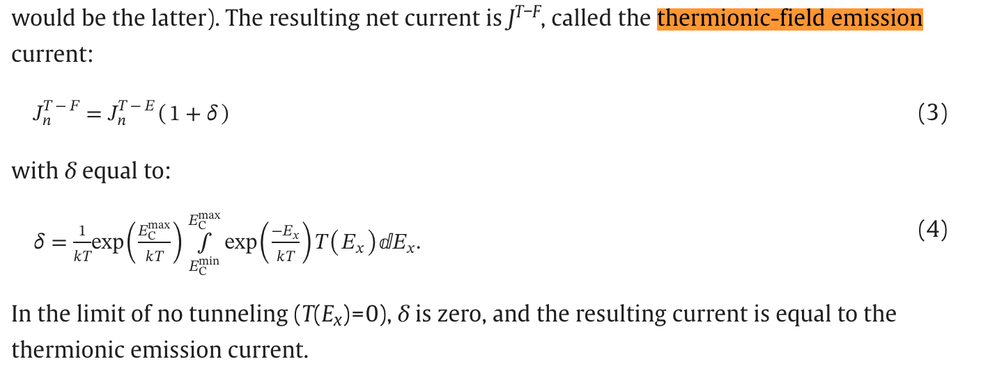
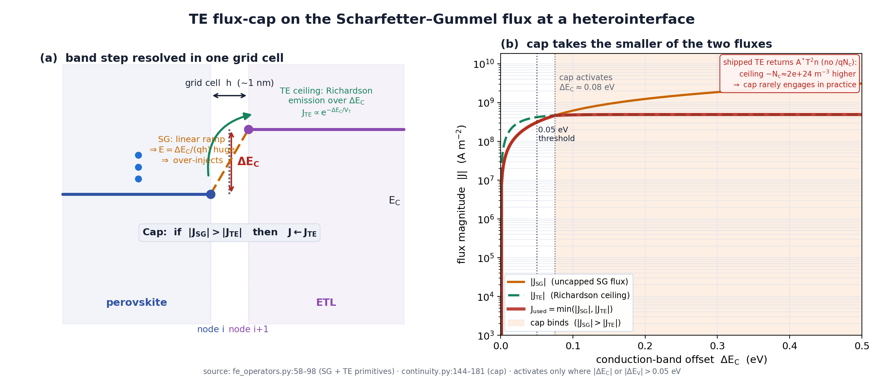
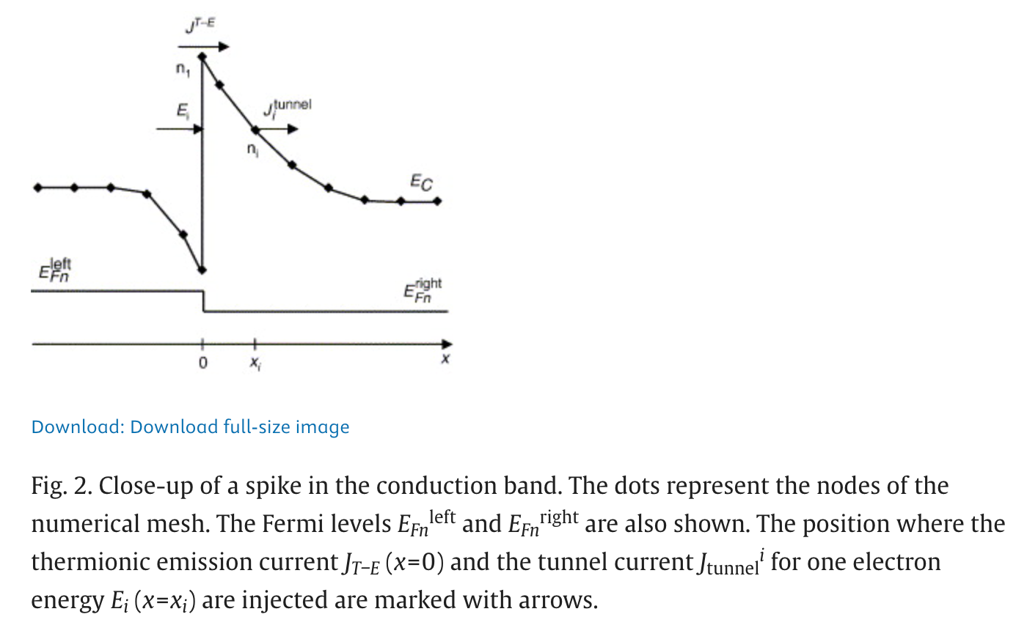
Transport
• Transport: TE flux-cap on SG vs. TE as the interface BC [4]
Notes:
Five model-level differences feed the base-point discrepancy. The frozen Vbi drives the donor reversal; the interface-SRH difference is the leading suspect for the 96 mV deficit and the sweep shape mismatches; the optics difference explains the Jsc gap. Each is real, mostly by design.

Slide 16
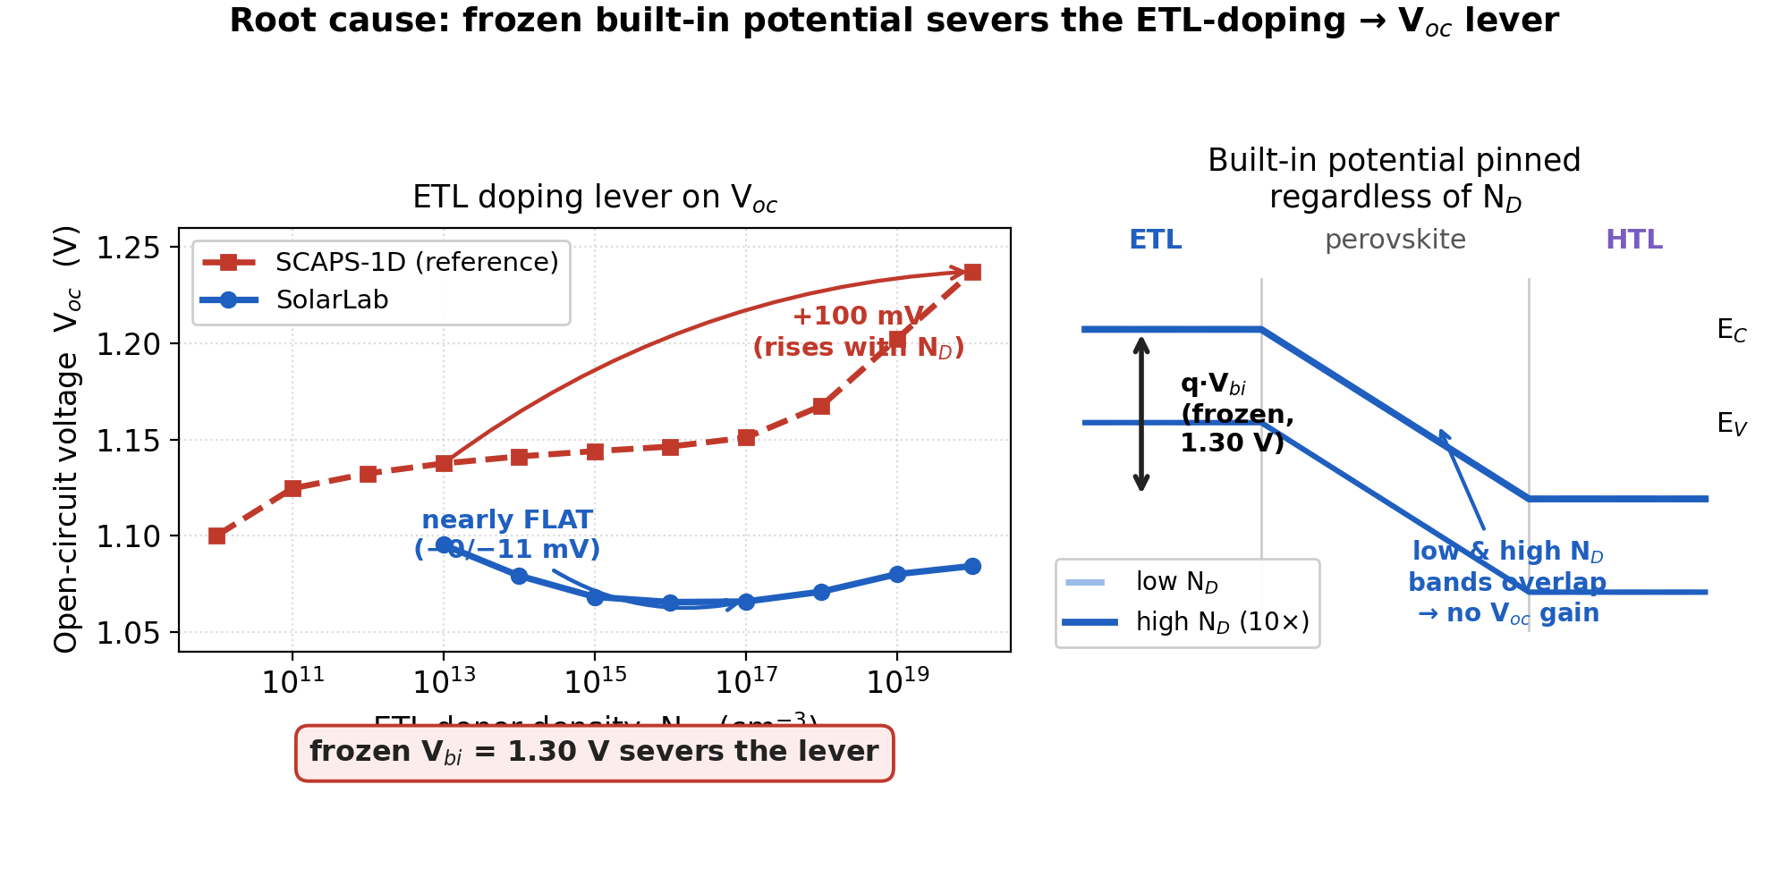
Frozen V_{bi} Severs the ETL-Doping Lever
• Poisson boundary hard-wired to V_{bi}=1.30 V (config line 40)
• Band-derived V_{bi,eff} computed but routed only to sweep range
• Raising N_{D} cannot lift built-in potential → V_{oc} flat
• SCAPS rises +100 mV; SolarLab nets −11 mV (direction reversal)
• Signature: V_{oc} falls 1.0954→1.0656 V then drifts to 1.0844 V
• Classification: numerical boundary, not interface recombination
Notes:
The donor-doping lever is severed because the built-in potential is frozen at the boundary. The only residual N_D channel is the ohmic pin p_R = ni^2/N_D, which actually suppresses splitting, giving the wrong sign. Projection ON keeps the wrong sign, confirming it is not an interface-recombination effect.

Slide 17
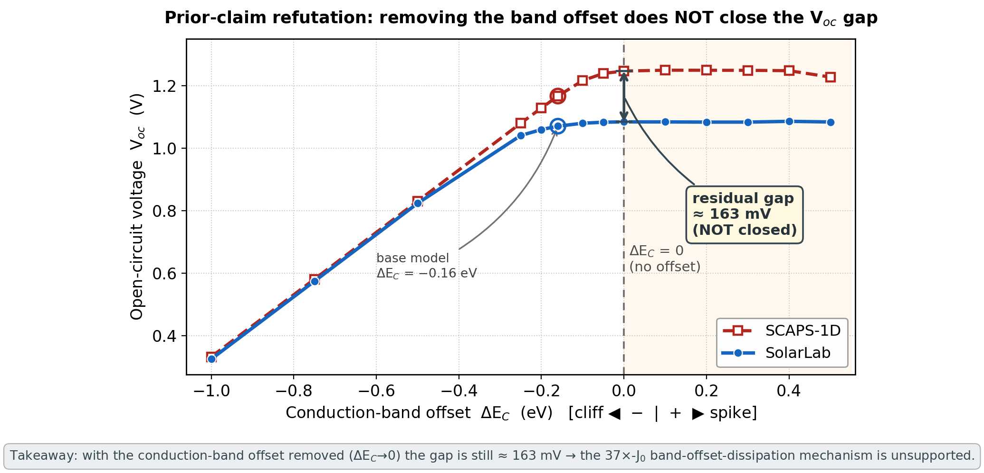
Refuting the Prior 37x-J₀ Claim: The CBO Gap Persists
• Prior report: 37x J₀ from QFL dissipated across band offsets
• Test: sweep the conduction-band offset to Delta-E_{C} → 0
• Removing the offset does NOT close the gap
• At Delta-E_{C}=0: SolarLab ~1.085 V vs. SCAPS ~1.248 V (~163 mV)
• Gap widens, not closes — the offset is not the seat of the deficit
• Prior central physical claim should be retracted
Notes:
If the deficit were driven by QFL loss across the band offset, removing the offset would close it. Instead the gap grows to ~163 mV at flat-band. SolarLab saturates near 1.085 V while SCAPS keeps climbing. This falsifies the prior mechanism and redirects attention to the interface-SRH model difference.

Slide 18
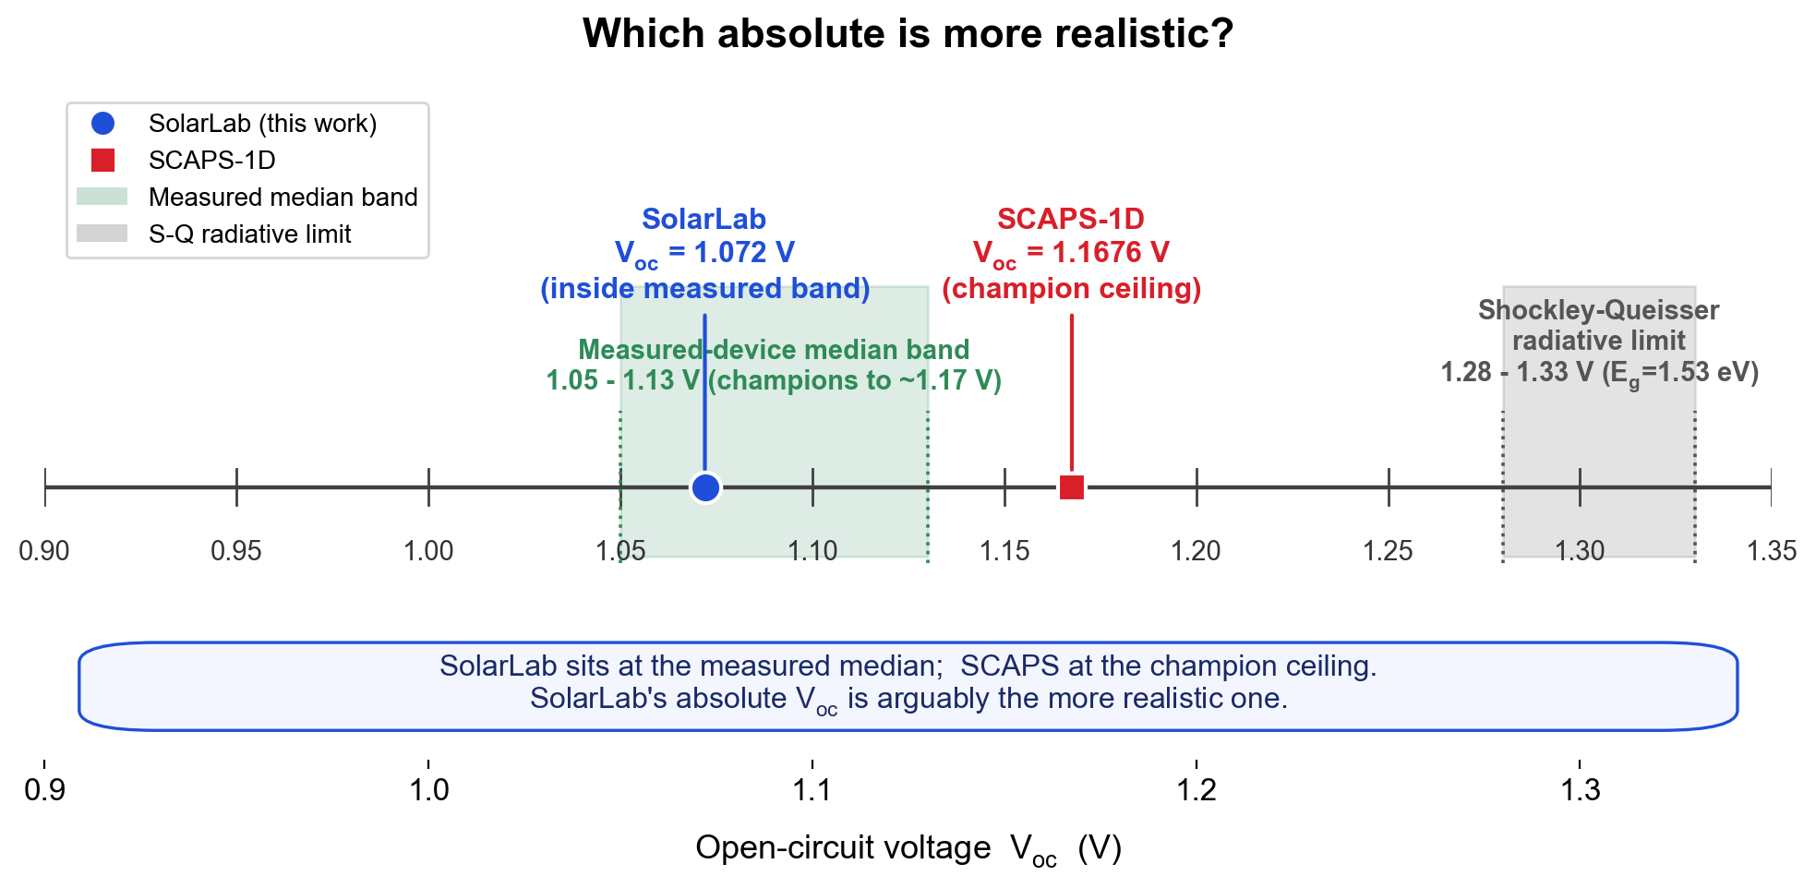
SolarLab Sits at the Measured Median
• Shockley–Queisser ceiling at E_{g}=1.53 eV: ~1.28–1.33 V [12,14,15]
• Measured-device V_{oc} median: ~1.05–1.13 V; champions to ~1.17 V [16,18]
• SolarLab 1.072 V sits inside the measured median band [13,18]
• SCAPS 1.1676 V is at the published champion ceiling [16,17]
• SCAPS PCE 26.69% exceeds the certified MAPbI₃ record (~21–23%) [16,17]
• On absolutes, SolarLab is the more conservative, representative value
Notes:
Neither solver is experiment, so we ask which absolute better represents a fabricated cell. SolarLab's 1.072 V implies a ~230-260 mV non-radiative deficit, typical for a routine stack. SCAPS's value implies champion-grade passivation. Tuning SolarLab up to match SCAPS would move it away from the experimental median.

Slide 19
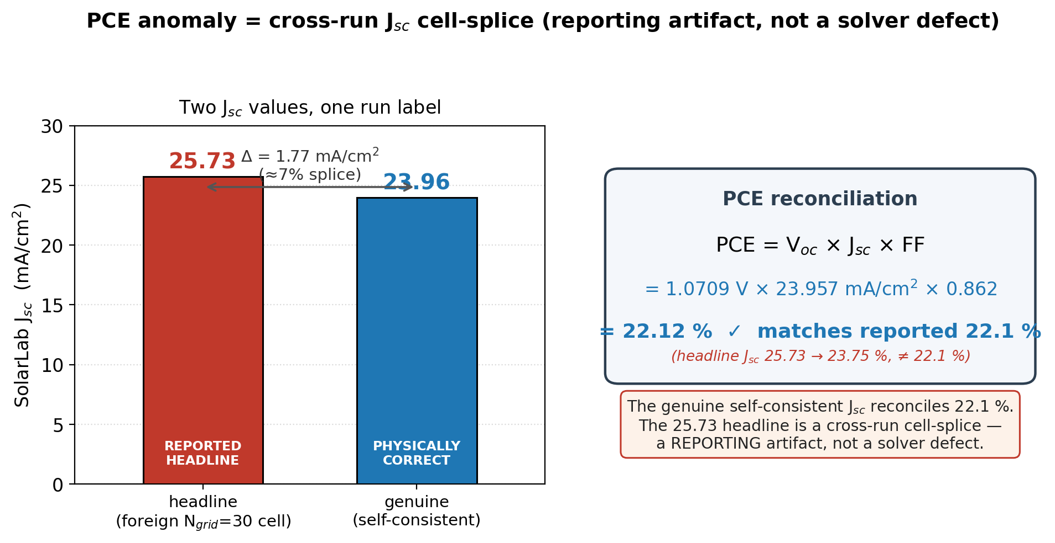
PCE Anomaly = A J_{sc} Cell-Splice
• PCE ≡ V_{oc}·J_{sc}·FF is algebraically locked per run
• Task tuple violates the lock by +1.51 pp → multi-source pairing
• Foreign cell is J_{sc}=25.73 (an N_{grid}=30 run), not PCE
• Genuine J_{sc}=23.96 → locked PCE = 22.1%
• Prior "true PCE ~23.6%" re-commits the splice — also wrong
• Classification: reporting artifact (held 3/3 at top level)
Notes:
The four FOMs must satisfy PCE = Voc*Jsc*FF in any single run. The partner table glued a coarse-grid Jsc onto a fine-grid Voc/FF/PCE triple. The fix is to re-extract all four from one J-V array; this alone erases the headline -4.6 pp PCE gap.

Slide 20
References
[1] M. Burgelman, P. Nollet, S. Degrave. Modelling polycrystalline semiconductor solar cells. Thin Solid Films 361–362, 527–532 (2000).
[2] M. Burgelman, J. Marlein. Analysis of graded band gap solar cells with SCAPS. Thin Solid Films 515(15), 6276–6278 (2007).
[3] K. Decock, S. Khelifi, M. Burgelman. Modelling multivalent defects in thin-film solar cells. Thin Solid Films 519(21), 7481–7484 (2011).
[4] J. Niemegeers, M. Burgelman. Thermionic-emission interface transport and numerical scheme (1998).
[5] D. L. Scharfetter, H. K. Gummel. Large-signal analysis of a silicon Read diode oscillator. IEEE TED 16(1), 64–77 (1969).
[6] SCAPS Manual (Feb 2016), University of Gent. pp. 9–10, 24/26, 30–31, 36–37, 39–41.
[7] W. Shockley, W. T. Read. Statistics of the recombinations of holes and electrons. Phys. Rev. 87(5), 835–842 (1952).
[8] R. J. Pauwels, G. Vanhoutte. Influence of interface state and energy barriers on heterojunction solar cell efficiency. J. Phys. D 11(5), 649 (1978).
[9] J. Nelson. The Physics of Solar Cells. Imperial College Press (2003).
[10] P. Calado et al. Evidence for ion migration in hybrid perovskite solar cells. Nat. Commun. 7, 13831 (2016) / Driftfusion.
[11] N. E. Courtier et al. IonMonger: a free and fast planar perovskite solar cell simulator. J. Comput. Electron. 18, 1435–1449 (2019).
[12] Effect of perovskite thickness on EL and conversion efficiency. J. Phys. Chem. Lett. (2020). doi:10.1021/acs.jpclett.0c02363.
[13] K. Tvingstedt et al. Radiative efficiency of lead iodide perovskite solar cells. Sci. Rep. 4, 6071 (2014). doi:10.1038/srep06071.
[14] L. M. Pazos-Outón et al. Fundamental efficiency limit of lead iodide perovskite. J. Phys. Chem. Lett. 9(7), 1703–1711 (2018).
[15] W. E. I. Sha et al. The efficiency limit of CH₃NH₃PbI₃ perovskite solar cells. Appl. Phys. Lett. 106, 221104 (2015). arXiv:1506.09003.
[16] Mesoporous-TiO₂/spiro champion. Energy Environ. Sci. (2016); PMC4705040. J_{sc} 24.6, V_{oc} 1.16 V, FF 0.73, PCE 20.8%.
[17] Low-loss MAPbI₃ stack: V_{oc} 1.21 V at 1.53 eV, certified 23.09% PCE. Sci. China Mater. (2025). doi:10.1007/s40843-025-3457-3.
[18] Single-crystal MAPbI₃ cells > 21% PCE, V_{oc} 1.0–1.1 V. ACS Energy Lett. 4(5), 1258 (2019). doi:10.1021/acsenergylett.9b00847.
Notes:
Full numbered list of 18 entries; numbering matches the report's Section 7 exactly. The inline [n] brackets placed on slides 2, 9, 11 and 12 all resolve into this list: [1,5] solver formulation and SG flux, [2] tunnelling-off, [4] thermionic-emission interface BC, [6] SCAPS contacts/flatband, [7,8] Shockley-Read-Hall and Pauwels-Vanhoutte interface SRH, and [12-18] the experimental MAPbI3 Voc / SQ realism cluster. Literature values are used only for realism-positioning and are flagged as such in the report.

