Slide 1
High-throughput DFT and small-sample ML for PV absorber discovery, with device-scale validation
Xuanyan Chen
Supervisor:
Prof. GAN Zecheng
Prof. YAN Chang

Slide 2
01
PROBLEM

Slide 3
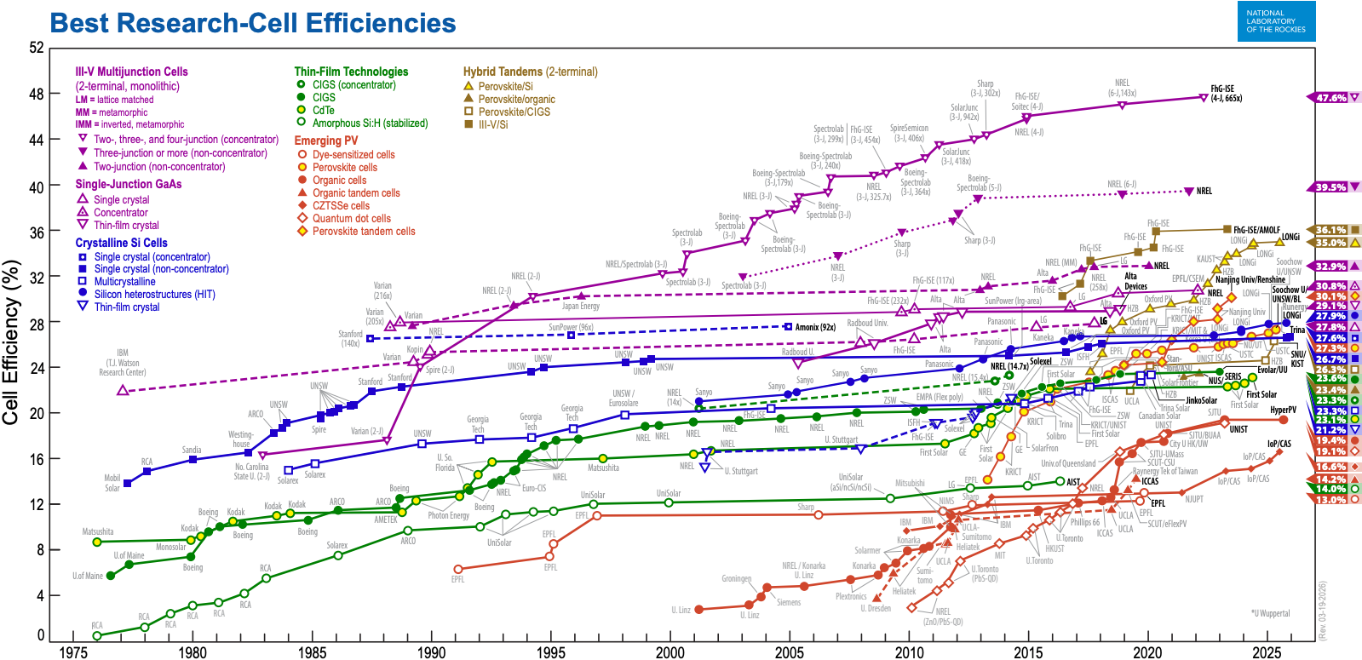

Slide 4
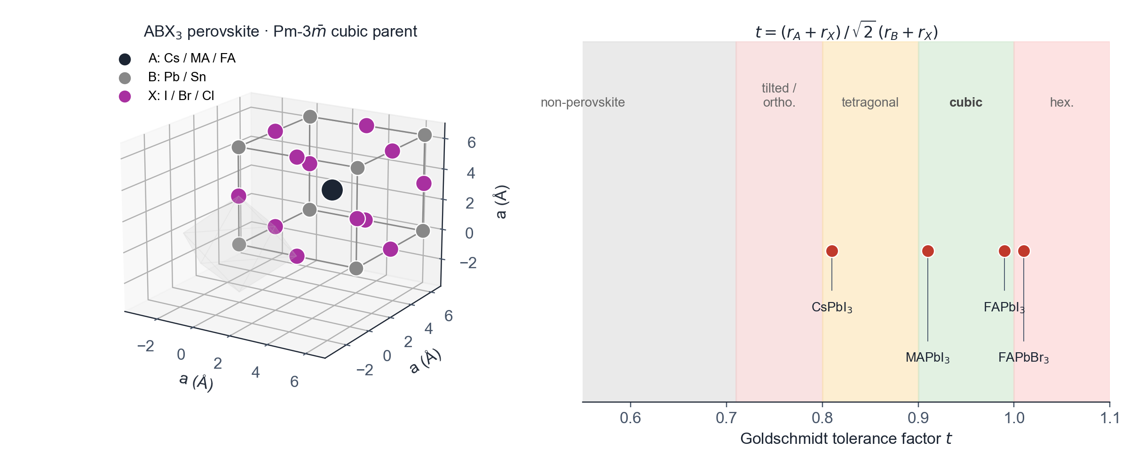
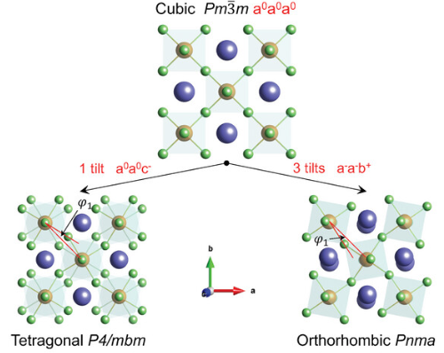
01 · PROBLEM
Perovskite — ABX₃ structural family
Pm-3m cubic parent · corner-sharing BX₆ octahedral framework
• General formula ABX₃: A = Cs⁺ / MA⁺ (CH₃NH₃⁺) / FA⁺ · B = Pb²⁺ / Sn²⁺ · X = I / Br / Cl
• BX₆ octahedra share corners; A cation occupies the 12-coordinated cuboctahedral void
• Stability set by Goldschmidt tolerance factor t = (r_{A} + r_{X}) / (√2 (r_{B} + r_{X})); cubic perovskite for 0.9 ≤ t ≤ 1.0
• Direct band gap, strong absorption (α ≈ 10⁵ cm⁻¹ near band edge), long carrier diffusion lengths
• Champion single-junction PCE 26.7 % (UNIST 2024); inverted PSC 22.3 % via ligand anchoring [Hou et al. Nat. Energy 2020]
• Tandem records: monolithic perovskite / Si tandem and 24.2 % all-perovskite tandem [Hou et al. Science 2020 · Nat. Energy 2020]
SOLARLAB

Slide 5
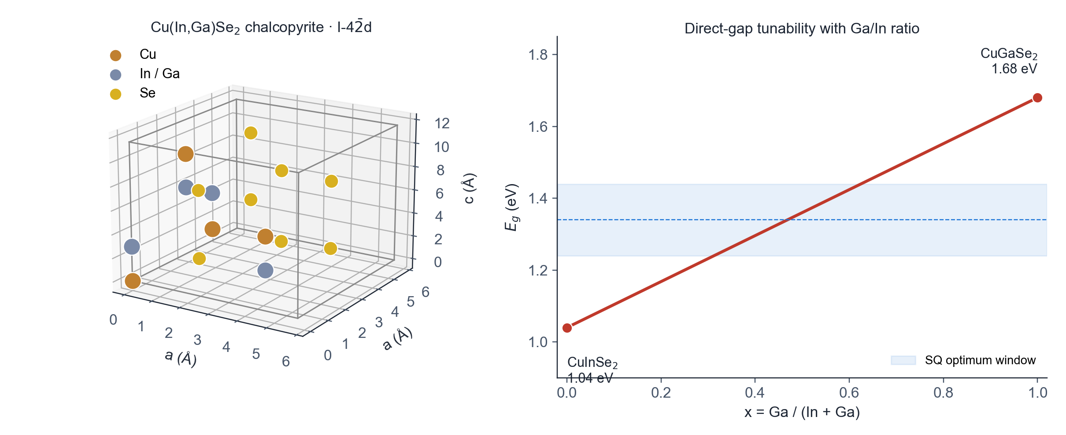
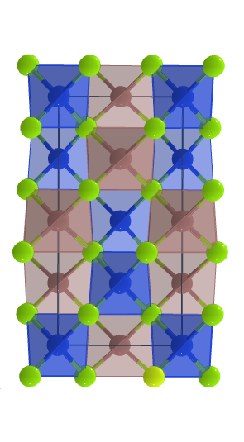

01 · PROBLEM
CIGS — Cu(In,Ga)Se₂ chalcopyrite absorber
Tetragonal I-42d · cation-ordered diamond-like sublattice · tunable direct gap
• Stoichiometry Cu(In,Ga)Se₂; In and Ga share a single cation site at composition x = Ga / (In + Ga)
• Lattice parameters a ≈ 5.78 Å · c ≈ 11.62 Å with c / a ≈ 2 (chalcopyrite = doubled zincblende)
• Direct band gap tunable approximately linearly from 1.04 eV (CuInSe₂) to 1.68 eV (CuGaSe₂)
• Polycrystalline thin-film absorber 1–3 µm on a Mo back contact; CdS / ZnO buffer + window stack
• Champion lab cell PCE 23.4 % (Solar Frontier 2019); module reliability T₈₀ > 25 yr in field
SOLARLAB

Slide 6
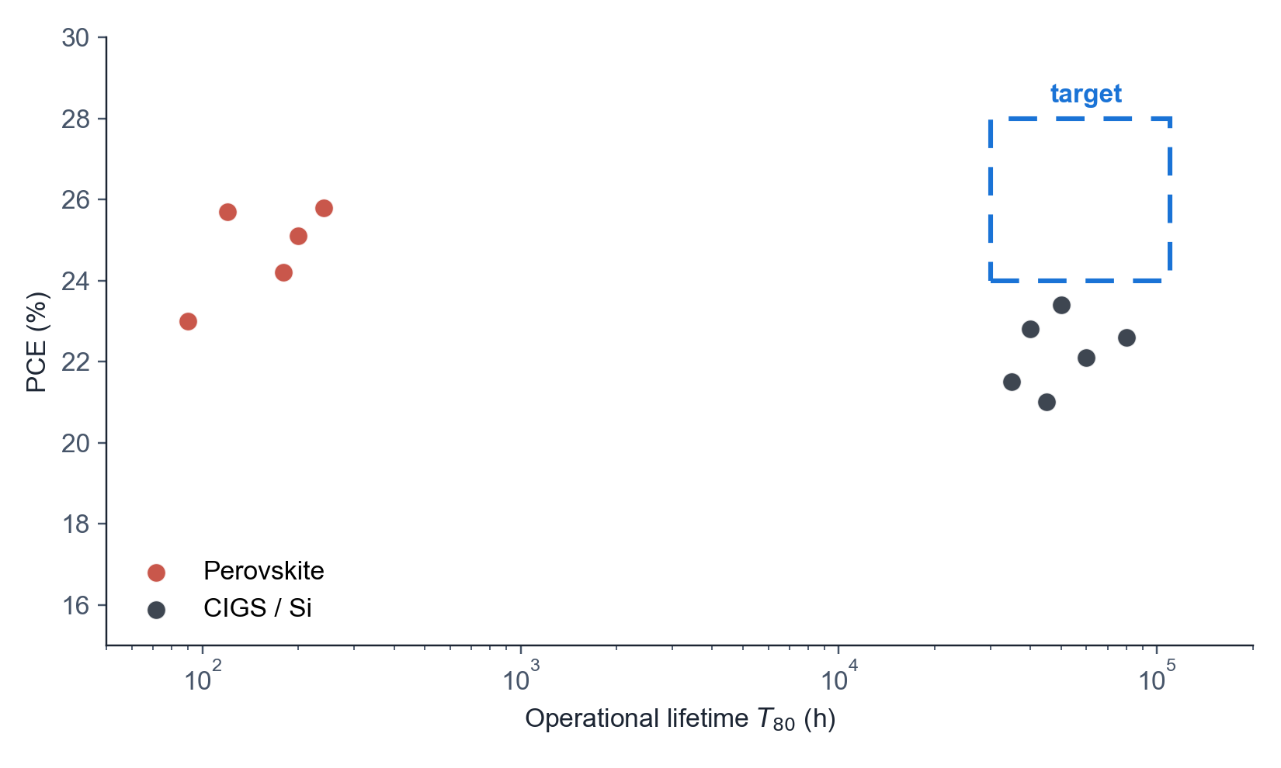
01 · PROBLEM
Efficiency–stability design space for thin-film photovoltaics
Two established regimes, one unoccupied region
• Si: indirect band gap, ~22 % single-junction PCE ceiling, T₈₀ > 10⁴ h
• CIGS: direct-gap chalcogenide, 23.4 % record, constrained by In and Ga reserves
• Perovskite: PCE > 26 %, T₈₀ frequently < 500 h under 1-sun, 85 °C
• Detailed-balance limit at E_{g} ≈ 1.34 eV reaches 33.7 % [Shockley & Queisser 1961]
• Target region: PCE > 25 % combined with T₈₀ > 10⁵ h is currently unoccupied
• These constraints motivate a third absorber class with a direct or near-direct gap
SOLARLAB

Slide 7
01 · PROBLEM
Limitations of the established absorbers
Record-cell PCE timeline and accelerated-aging stability gap
• Si record 27.6 % (UNSW 2024) — five decades of incremental improvement
• Perovskite record 26.7 % (UNIST 2024) — single-junction parity with Si in under a decade
• Stability gap remains > 100× under operating stress (ion migration, A-site loss, photo-induced degradation)
• Encapsulation mitigates ingress but does not address intrinsic absorber-side instability [Boyd et al. 2019]
• Module-scale commercial deployment requires both record-class efficiency and outdoor lifetime
• Motivates the discovery of new absorber chemistries that satisfy both criteria simultaneously
SOLARLAB

Slide 8
02
STRATEGY

Slide 9
02 · STRATEGY
Chalcogenide templates as the structural prior
AB₂C₄ and ABC₃ frameworks with heavy-p-block cations on chalcogen anions
• Anion sublattice: S, Se, Te. Selenides comprise 11 of 14 shortlisted candidates, including the top six
• Active cation: Sb, Sn, Bi (6s² / 5s² lone pair) producing dispersive valence-band maxima
• Spectator cation: Cs, Ca, Sr, K donate charge without contracting the valence-band dispersion
• Stoichiometry preference: AB₂C₄ ≫ ABC₃ ≈ ABC₂ in the screened subset
• Symmetry distribution: Pnma (SG 62) is dominant; followed by SG 12, 14, 72 and 15
• Constrains the > 10⁵ candidate pool to a physically plausible, synthetically accessible subspace
SOLARLAB

Slide 10
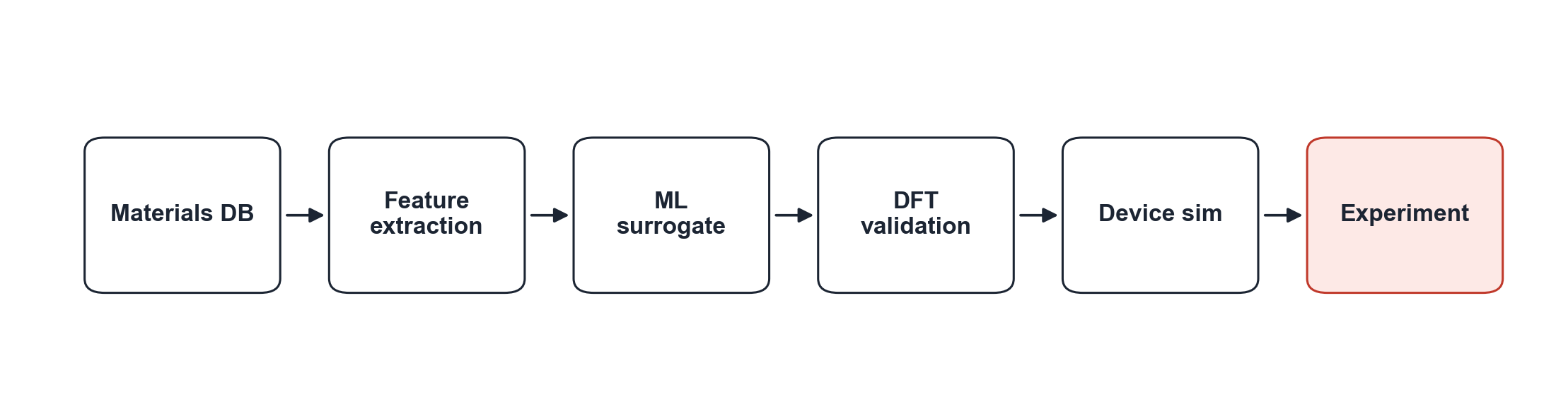
02 · STRATEGY
End-to-end pipeline
MP / OQMD → ML surrogate → DFT validation → device sim → expt
SOLARLAB

Slide 11
03
ML + FEATURES

Slide 12
03 · ML + FEATURES
Motivation for a learned surrogate
Four-stage HSE06 and DFPT workflow executed in VASP for each candidate
• Stage 1 PBE relaxation → Stage 2 SCF → Stage 3 DFPT dielectric tensor → Stage 4 HSE06 band structure
• DFPT and HSE06 dominate runtime, requiring 10⁰–10² CPU-hours per structure on a 64-core node
• PBE relaxation scales as O(N³) in plane-wave eigensolve; HSE06 adds ~10× overhead via exact exchange [Heyd et al. 2003]
• DFPT dielectric tensor obtained from the linear-response Sternheimer equation at ~2× SCF cost [Baroni et al. 2001]
• Combined MP and OQMD pool exceeds 10⁵ candidates, rendering full-DFT enumeration computationally infeasible
• Approach: train a learned surrogate on 473 DFT-labelled materials and use it to rank the unlabelled pool
SOLARLAB

Slide 13
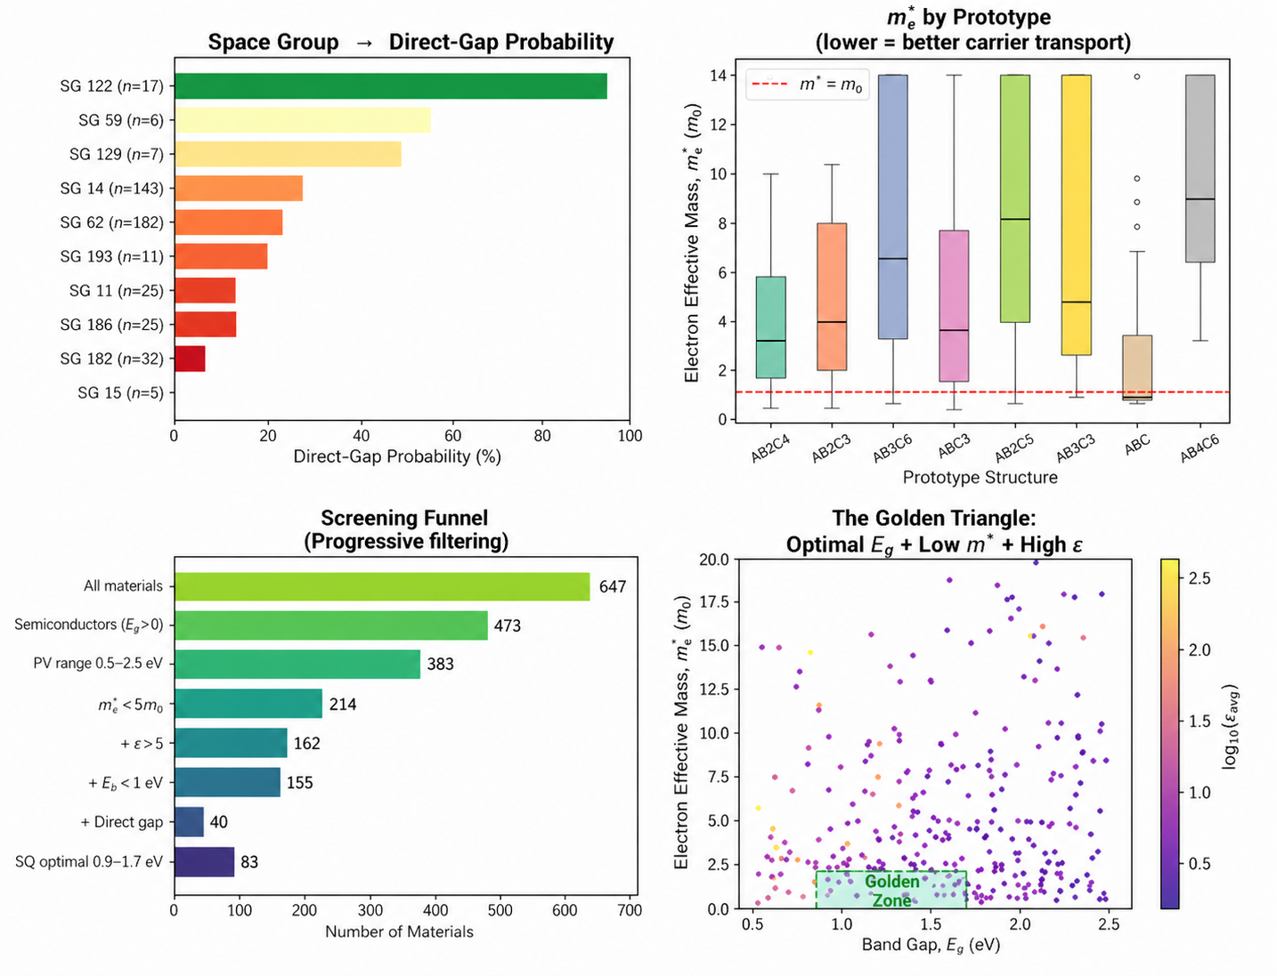
03 · ML + FEATURES
Hand-crafted feature set (167 D)
Composition · structure · symmetry — Magpie + matminer
• Composition (~27 D): Magpie statistics over Z, χ, atomic radius, row, group, mass [Ward et al. 2016]
• Magpie reduces a formula A_{a}B_{b}C_{c} to mean / std / min / max / mode of element properties weighted by stoichiometry
• Structure (140 D): CrystalNN site-fingerprint (122) + RDF + density + packing [matminer · Ward et al. 2018]
• All featurisers tolerate NaN — routed to the appropriate side of every HistGBR split
• Cached numpy matrices on disk → re-fits run in seconds, not minutes
• Frozen MEGNet 16-D embeddings give R² = 0.366 — below hand-features baseline [Chen et al. 2019]
SOLARLAB

Slide 14
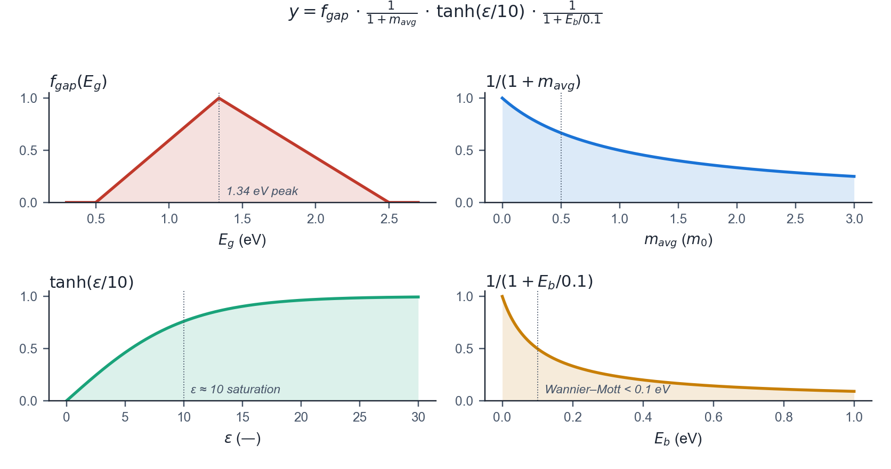
03 · ML + FEATURES
Composite photovoltaic figure of merit
Four physically motivated factors combined into a single scalar target y ∈ [0, 1]
• y = f_{gap}(E_{g}) · 1 / (1 + m_{avg}) · tanh(ε / 10) · 1 / (1 + E_{b} / 0.1)
• f_{gap}(E_{g}): triangular Shockley–Queisser window peaked at 1.34 eV, vanishing at 0.5 and 2.5 eV
• 1 / (1 + m_{avg}): monotonic decay rewarding low effective mass and therefore high mobility
• tanh(ε / 10): saturates above ε ≈ 10 to reflect diminishing returns from dielectric screening
• 1 / (1 + E_{b} / 0.1): favours Wannier–Mott regimes (E_{b} < 0.1 eV) and penalises Frenkel-exciton systems
• Bounded, differentiable, physically interpretable; replaces four independent regression heads with one
SOLARLAB

Slide 15
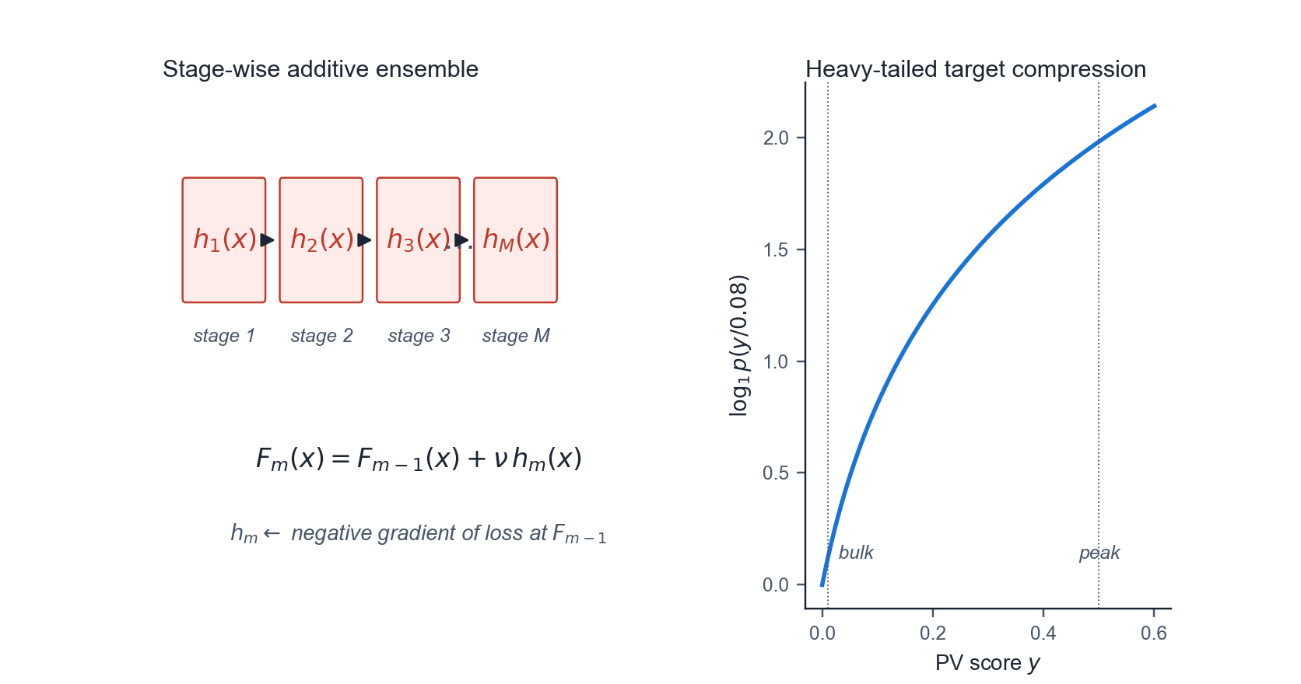
03 · ML + FEATURES
Histogram-based gradient boosting regression
Stage-wise additive function approximation [Friedman 2001 · Ke et al. 2017]
• F_{m}(x) = F_{m-1}(x) + ν · h_{m}(x), where h_{m} fits the negative gradient of the loss at F_{m-1}
• Histogram binning into 256 discrete buckets reduces a split scan from O(N) to O(B), yielding ~3× speedup
• Native NaN handling: missing values learn an independent split direction at each tree node
• Hyperparameters: 600 boosting iterations · maximum depth 4 · learning rate 0.05 · minimum samples per leaf 10
• Target wrapped in log₁p(y / 0.08) by TransformedTargetRegressor; inverse via 0.08 · expm1
• Logarithmic transform compresses the heavy-tailed PV-score distribution and equalises booster resolution near peak (y ≈ 0.5) and bulk (y ≈ 0.01)
SOLARLAB

Slide 16
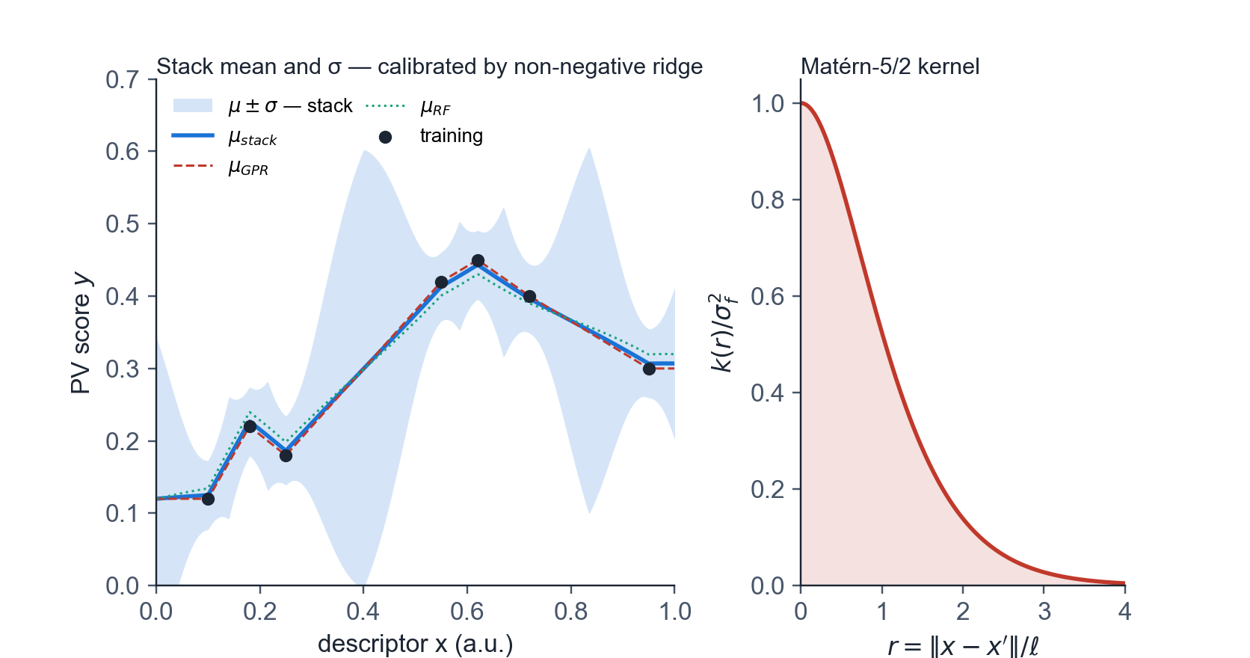
03 · ML + FEATURES
Gaussian-process and random-forest uncertainty stack
Matérn-5/2 kernel with additive white noise [Rasmussen & Williams 2006]
• k(x, x') = σ_{f}² (1 + √5 r + (5/3) r²) exp(−√5 r) + σ_{n}² δ(x − x')
• r = ‖x − x'‖ / ℓ; the anisotropic length-scale ℓ is optimised by L-BFGS-B on the marginal log-likelihood
• White-noise variance σ_{n}² absorbs DFT scatter, typically 0.02 – 0.05 on the log target
• A random-forest predictor (300 trees) compensates for GP underconfidence in sparsely sampled regions
• Stack mean: μ(x) = w_{GP} μ_{GPR} + w_{RF} μ_{RF} · variance: σ²(x) = w_{GP}² σ_{GPR}² + w_{RF}² σ_{RF}²
• Mixing weights are obtained via non-negative ridge regression on out-of-fold predictions, ensuring calibration
SOLARLAB

Slide 17
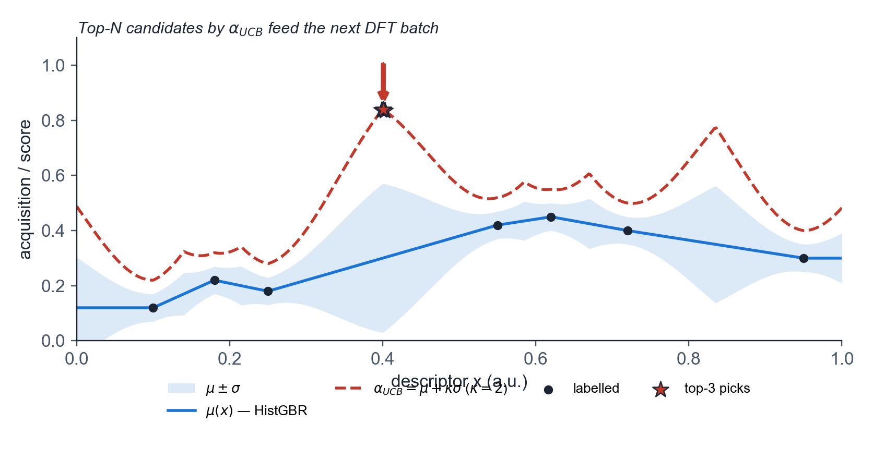
03 · ML + FEATURES
Upper-confidence-bound acquisition for active learning
Sequential selection of the next DFT batch [Snoek et al. 2012]
• α_{UCB}(x) = μ(x) + κ · σ(x), with κ = 2
• Posterior mean μ(x) is taken from HistGBR, the more accurate mean predictor on labelled data
• Posterior standard deviation σ(x) is taken from the GPR + RF stack as a calibrated uncertainty source
• κ = 2 balances exploitation (high μ) and exploration (high σ) and is standard in Bayesian optimisation
• Decoupling μ and σ between two models prevents GP underconfidence from suppressing the high-score tail
• Top-N entries by α become the next active-learning DFT batch; returned labels are fed back into both models
SOLARLAB

Slide 18
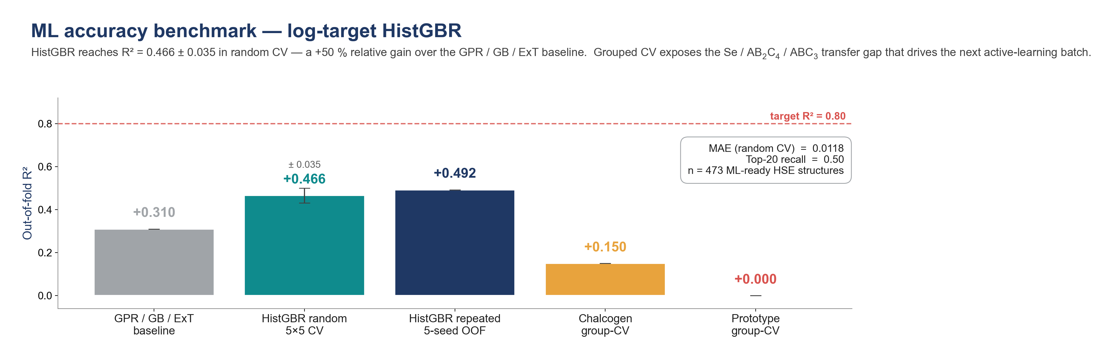
03 · ML + FEATURES
Validation under random and grouped cross-validation
5-fold × 5-seed random CV on n = 473 labelled materials
• HistGBR achieves R² = 0.466 ± 0.035 · MAE = 0.012 · top-20 recall 0.50
• Improves over the prior GPR / GB / ExtraTrees baseline by +50 % in R² (0.31 → 0.466)
• Ablation: GBR 0.399 · ExtraTrees 0.234 · MEGNet fine-tuned 0.307 · MEGNet frozen 0.366
• Repeated out-of-fold averaging across seeds yields global R² = 0.492 and top-20 recall 0.50
• Prototype-grouped CV gives R² ≈ 0, indicating poor extrapolation to unseen structural prototypes
• Chalcogen-family-grouped CV gives R² ≈ 0.15, with Se the most challenging hold-out
SOLARLAB

Slide 19
04
CANDIDATES

Slide 20
04 · CANDIDATES
Top-fourteen candidates (PV score y > 0.10)
All entries are chalcogenides; eleven of fourteen are selenides; AB₂C₄ is the dominant prototype
• Selenides preferred: 11 of 14 are Se-based and the top six are all Se
• AB₂C₄ supplies 7 of 14 entries; the remainder is split between ABC₃ and ABC₂
• Pnma (SG 62) accounts for 7 of 14; remaining entries fall in SG 12, 14, 72 and 15
• PV-score distribution spans 0.10 to 0.49 across the shortlist
• Aggregate descriptors: ⟨E_{g}⟩ = 1.32 eV · ⟨ε⟩ = 12.5 · ⟨m_{avg}⟩ = 0.58 m₀
• 24 % are direct-gap; the remaining 76 % are retained for combined low m*, high ε and low E_{b}
SOLARLAB

Slide 21
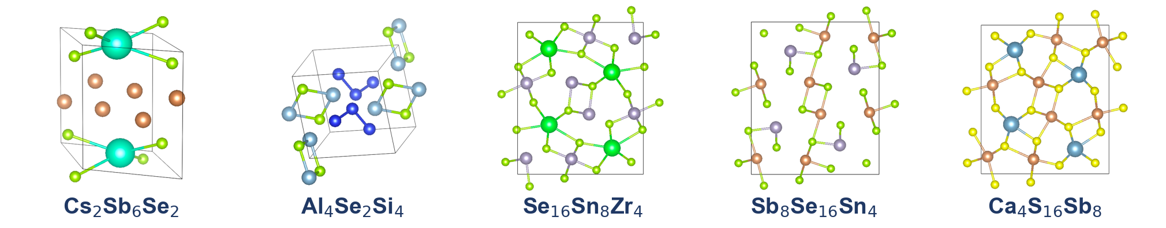
04 · CANDIDATES
Screening funnel
>10⁵ MP / OQMD → 647 DFT-screened → 473 ML-ready → 41 PV-promising → 14 shortlist
• Stage 1: > 10⁵ structures sourced from Materials Project and OQMD
• Stage 2: 647 candidates with HSE band structure and DFPT dielectric tensor completed
• Stage 3: 473 ML-ready candidates after removing metallic-band and missing-CONTCAR entries (174 excluded)
• Stage 4: 41 PV-promising candidates with composite score y > 0.05
• Stage 5: 14-candidate shortlist with y > 0.10 feeding the next active-learning DFT round
• Funnel narrows by approximately four orders of magnitude into a tractable shortlist for experimental verification
SOLARLAB

Slide 22
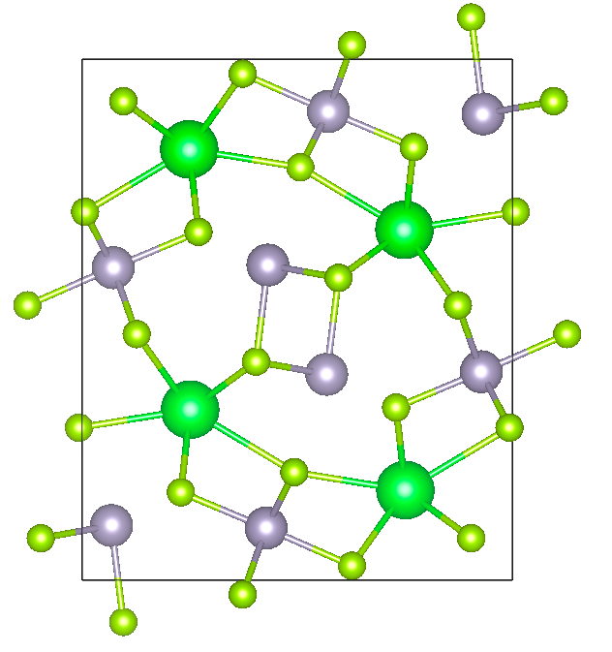
04 · CANDIDATES
Lead candidate — Se₁₆Sn₈Zr₄
AB₂C₄ prototype · Pnma (SG 62) · near-optimal Shockley–Queisser gap
• E_{g} = 1.12 eV, within 0.22 eV of the Shockley–Queisser optimum at 1.34 eV
• m_{avg} = 0.43 m₀, indicating low effective mass and high carrier mobility
• ε_{avg} = 19.5, providing strong dielectric screening and suppressing Frenkel-exciton formation
• E_{b} = 7 meV, well below k_{B}T at 300 K, placing the absorber in the Wannier–Mott regime
• Composite PV score y = 0.487, the highest in the screened set
• Sn–Zr–Se ternary phases have reported synthesis routes; no photovoltaic-device demonstration to date
SOLARLAB

Slide 23
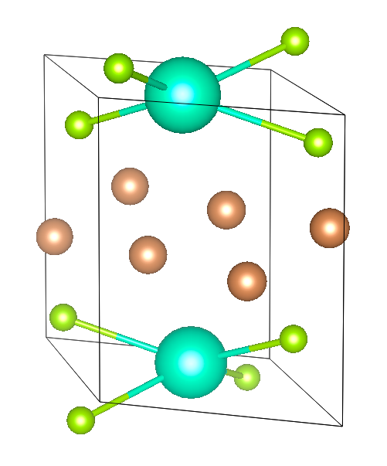
04 · CANDIDATES
Secondary candidate — Cs₂Sb₆Se₂
ABC₃ prototype · C2/m (SG 12) · Sb 5s² lone-pair active cation
• E_{g} = 1.28 eV, near the Shockley–Queisser optimum
• m_{avg} = 0.81 m₀, heavier than the lead candidate but within the device-relevant range
• ε_{avg} = 12.6, indicating moderate dielectric screening; E_{b} = 56 meV
• Composite PV score y = 0.298, complementing the lead candidate from a distinct structural prototype
• Sb 5s² lone-pair character produces a deep, dispersive valence-band maximum
• Cs–Sb–Se ternary phases have established solution-processing synthesis routes
SOLARLAB

Slide 24
05
DEVICE SIM

Slide 25
05 · DEVICE SIM
SCAPS-1D Input Parameters
SOLARLAB

Slide 26
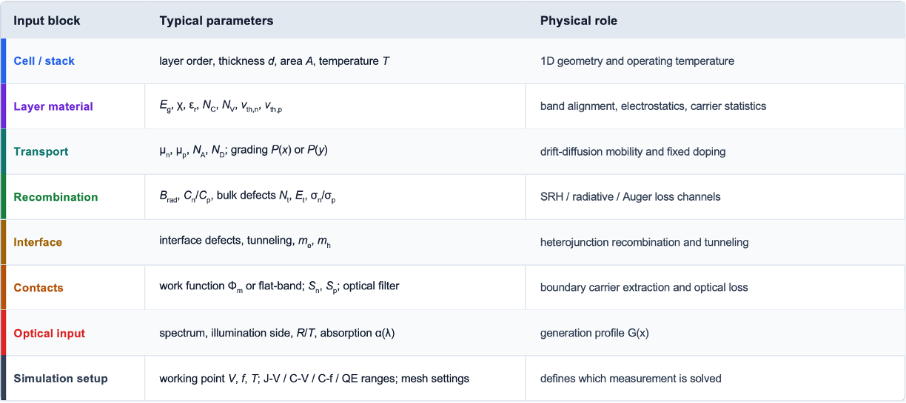
05 · DEVICE SIM
SCAPS-1D Input Parameters
SOLARLAB

Slide 27
05 · DEVICE SIM
SCAPS-1D Main Output Modules
Four primary characterization outputs used to evaluate solar-cell performance, junction electrostatics, defect response, and spectral collection.
A
I-V / J-V characteristics
B
C-V and Mott-Schottky analysis
Current density J (mA cm⁻²)
1.15 V
23.8
Normalized C, 1/C²
0.96 V
～10¹⁶
V_{oc}
J_{sc}
V_{bi}
N_{eff}
FF
78%
η
21.3%
Extract depletion capacitance, built-in voltage, and apparent doping.
light J-V
SCAPS core terminal output: light/dark curves and photovoltaic metrics.
dark J-V
Linear 1/C² versus V is used only in the depletion regime.
C(V)
I = J × area; sign convention controls whether the curve appears upward or downward.
1/C²
Fully depleted thin absorbers need careful interpretation.
Voltage V (V)
Bias V (V)
C
C-f / admittance spectroscopy
D
QE / spectral response
Normalized C / G
From admittance: Y = 1/Z = G + jωC
QE (%)
J_{sc,QE}
23.5
E_{g}
edge
C(f)
QE(λ)
G(f)
Frequency dispersion indicates slow traps, ions, or interfacial charging.
QE is plotted versus wavelength λ or photon energy hν, not electrical frequency.
Temperature-dependent C-f / G-f supports activation-energy analysis.
Integrated QE gives a consistency check on J_{sc} under AM1.5G illumination.
Here, C-f is derived from impedance/admittance.
Short- and long-wavelength roll-off locate optical and collection losses.
Frequency f (Hz)
Wavelength λ (nm)
SOLARLAB

Slide 28
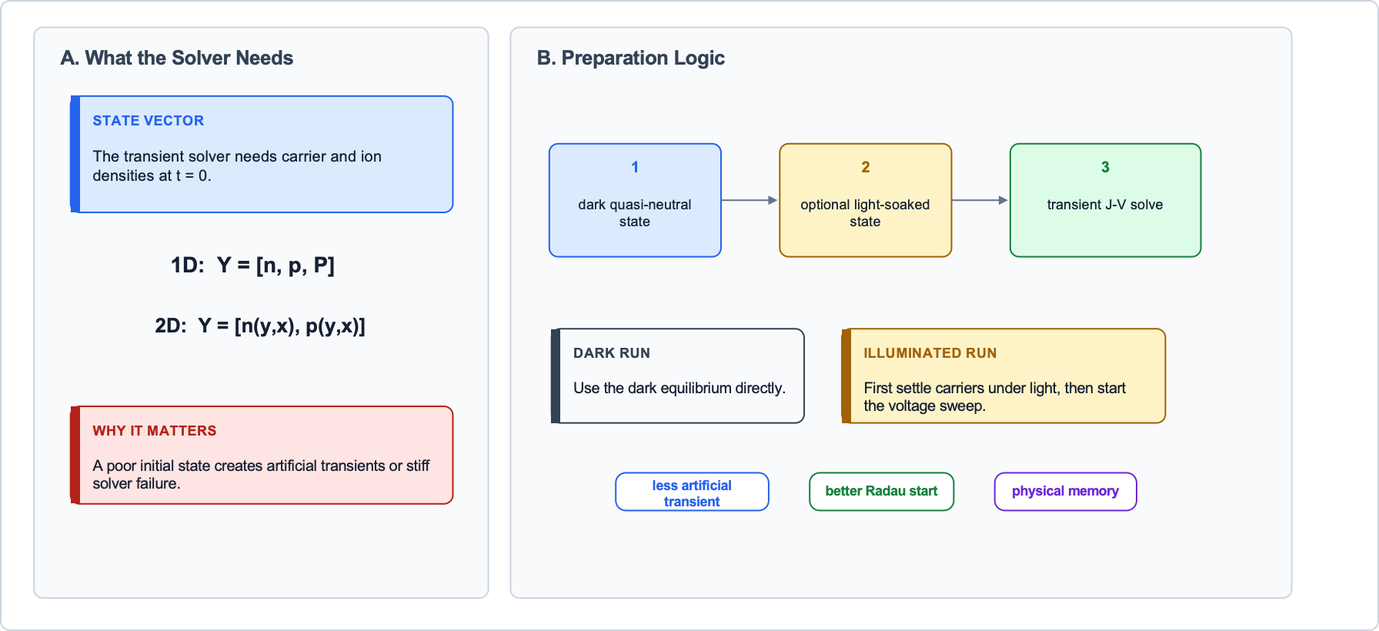
05 · DEVICE SIM
Initial Condition
SOLARLAB

Slide 29
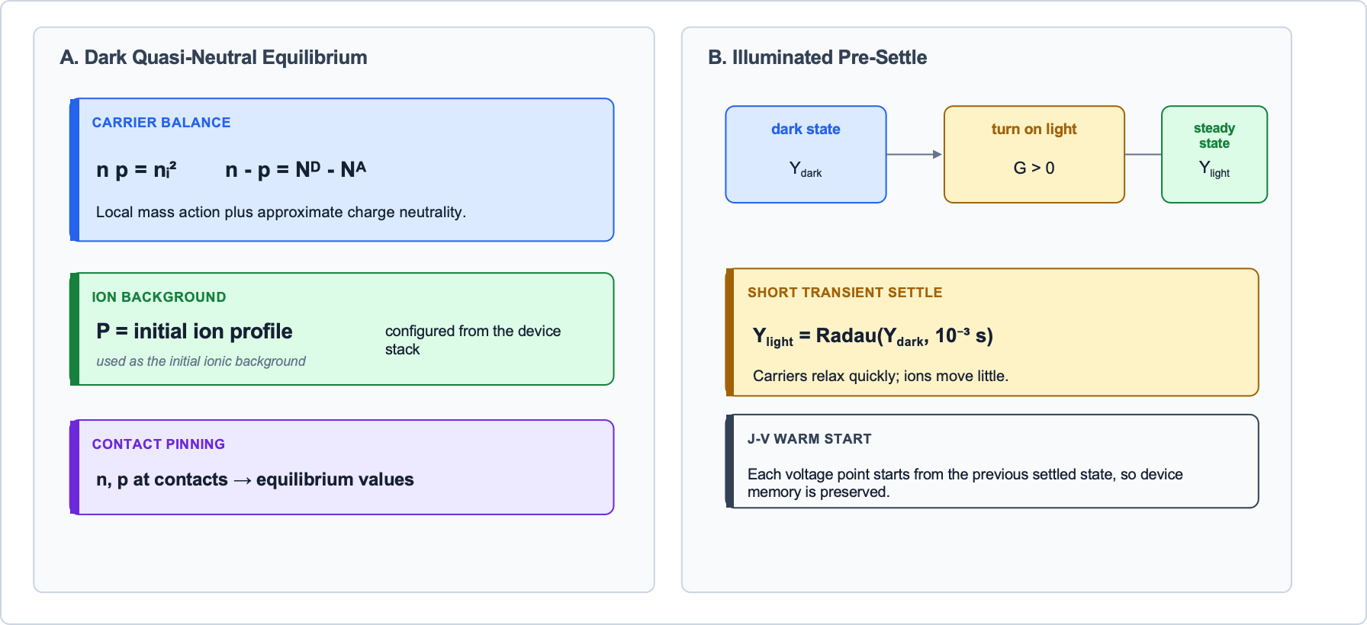
05 · DEVICE SIM
1D Initial Condition: Dark Equilibrium and Light-Soaked State
1D starts from quasi-neutral dark equilibrium;
illuminated runs first settle carriers under light.
SOLARLAB

Slide 30
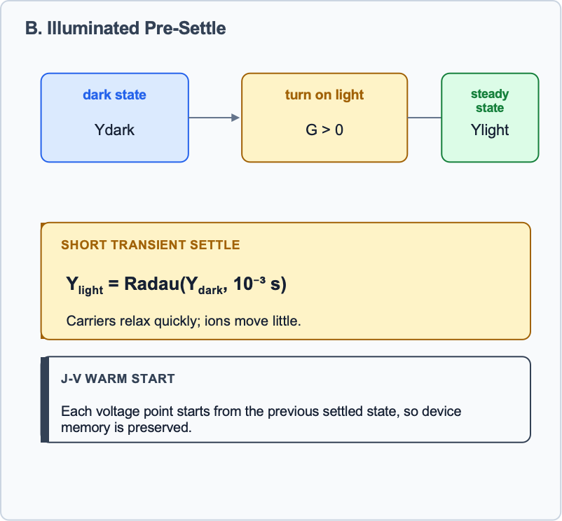
05 · DEVICE SIM
SOLARLAB

Slide 31
05 · DEVICE SIM
SOLARLAB

Slide 32
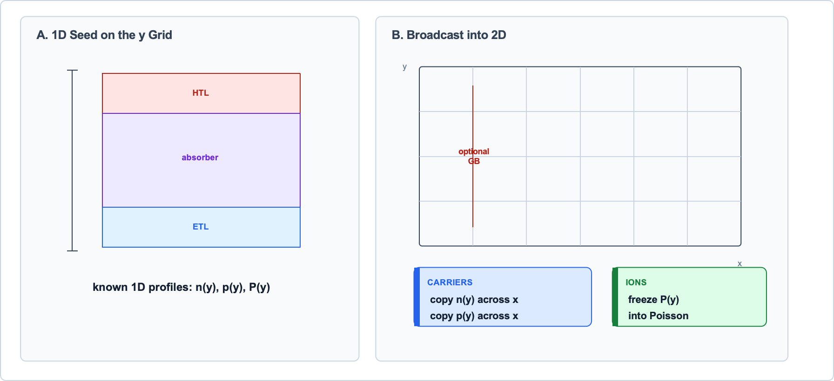
05 · DEVICE SIM
2D Initial Condition: Extrude the 1D State into a 2D Mesh
2D begins as a laterally uniform extrusion of the 1D prepared state;
2D physics then creates lateral variation.
SOLARLAB

Slide 33
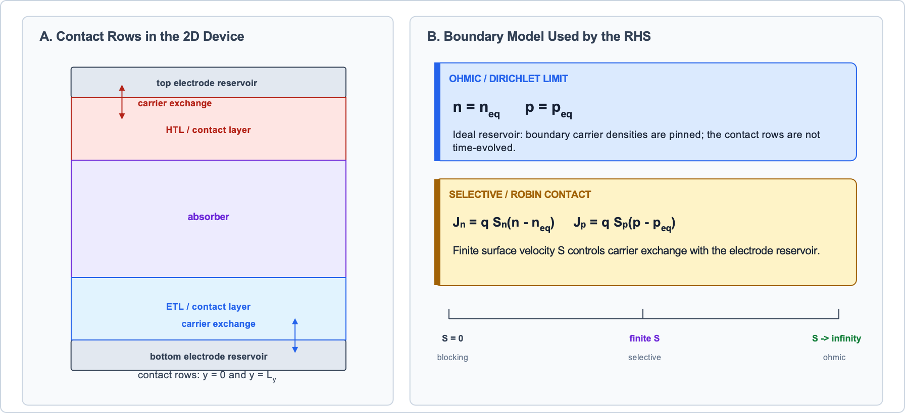
05 · DEVICE SIM
External Contact BC: Ohmic Pinning and Selective Robin Flux
External contact BCs model carrier exchange with electrodes;
Dirichlet pins densities, Robin uses finite surface velocity S.
SOLARLAB

Slide 34
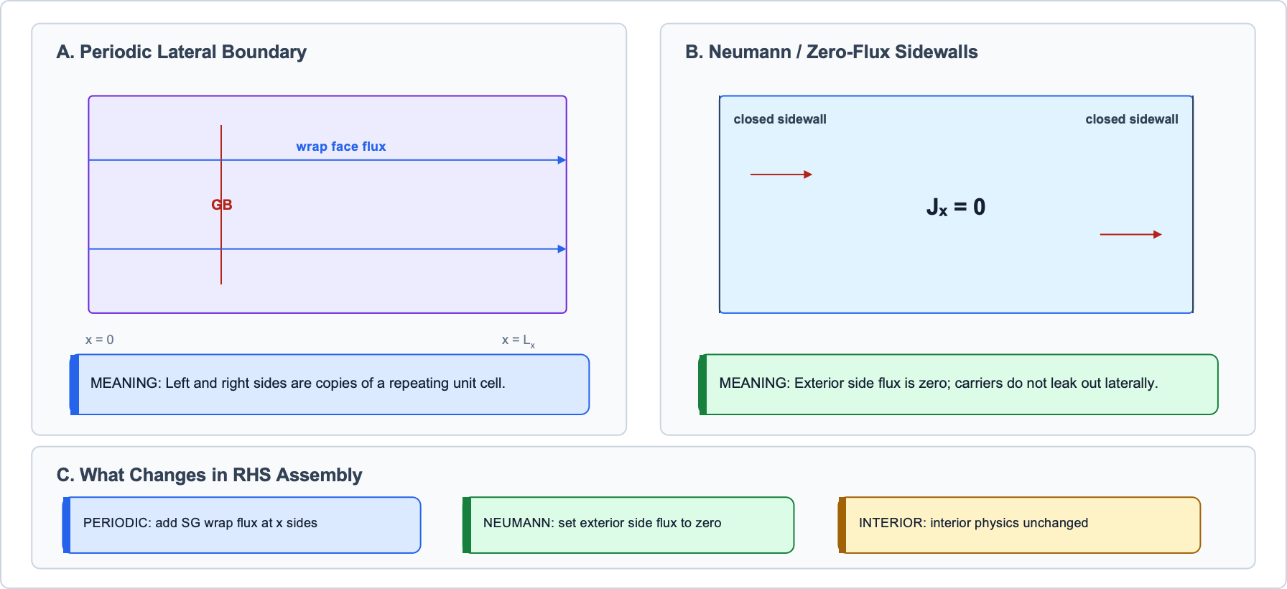
05 · DEVICE SIM
2D Lateral BC: Periodic Window and Zero-Flux Sidewalls
Periodic BC makes a repeating 2D unit cell;
Neumann BC closes the sidewalls with zero lateral flux.
SOLARLAB

Slide 35
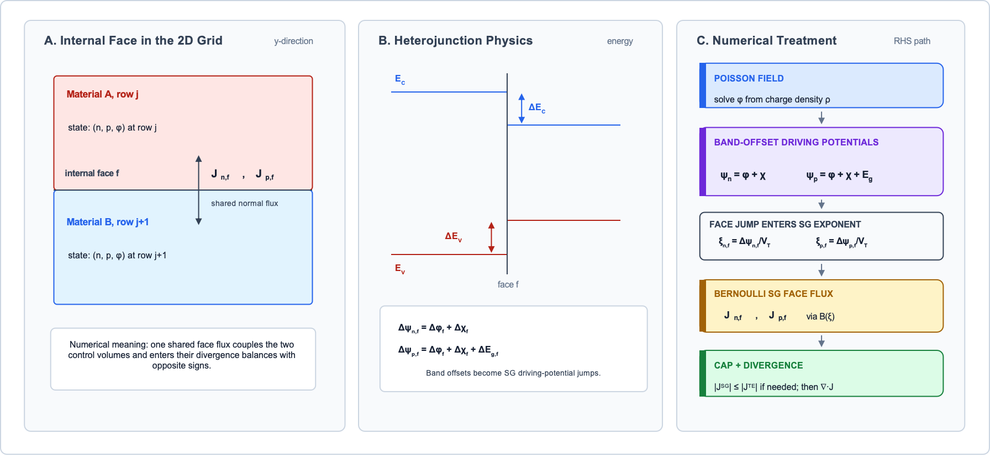
05 · DEVICE SIM
2D Internal Interface: SG Face Flux
Band parameters χ and Eg turn offsets into SG driving-potential jumps; Bernoulli flux plus cap gives a conservative face current.
SOLARLAB

Slide 36
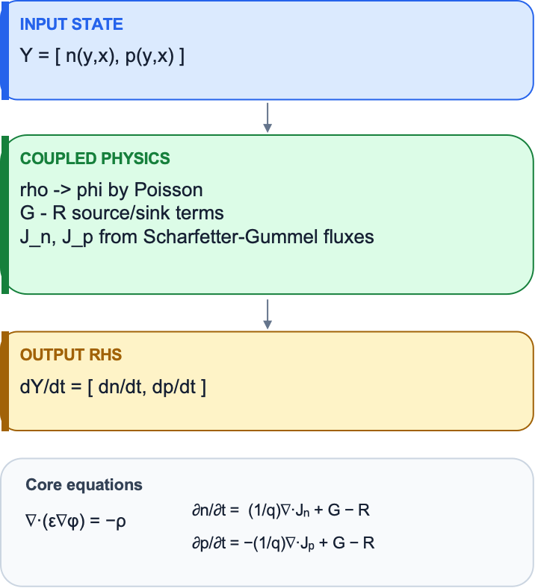
05 · DEVICE SIM
2D RHS Assembly: From Carrier Fields to Time Derivatives
RHS pipeline
Y -> rho -> phi -> R,G -> SG fluxes -> div J -> dn/dt, dp/dt -> dY/dt
RHS assembly is the physics-numerics operator F(Y); Radau repeatedly calls it to advance the 2D drift-diffusion-Poisson system in time.
SOLARLAB

Slide 37
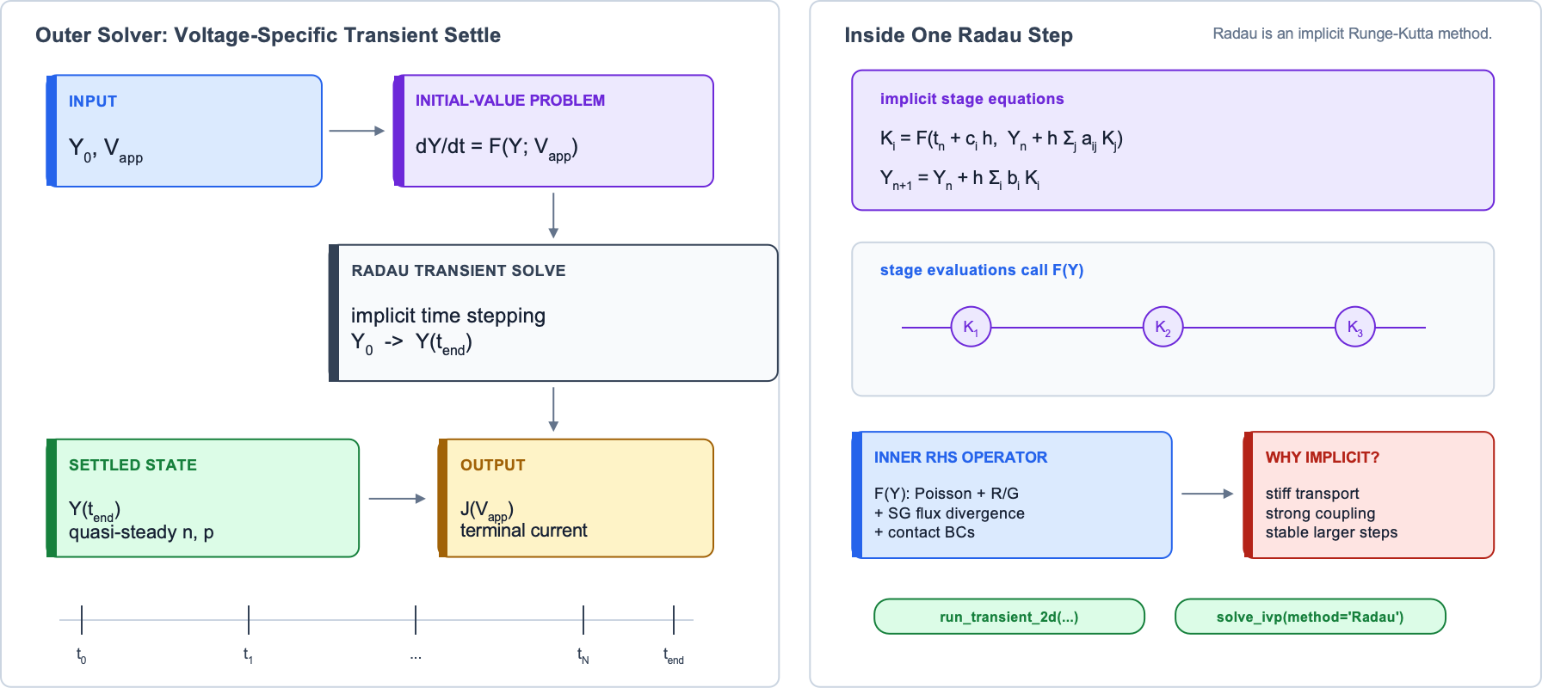
05 · DEVICE SIM
Implicit Radau Time Integration of the Semi-Discrete 2D Drift-Diffusion System
RHS assembly defines F(Y); Radau repeatedly evaluates F(Y) to advance the stiff 2D carrier-transport system toward a V_{app}-specific quasi-steady state.
SOLARLAB

Slide 38
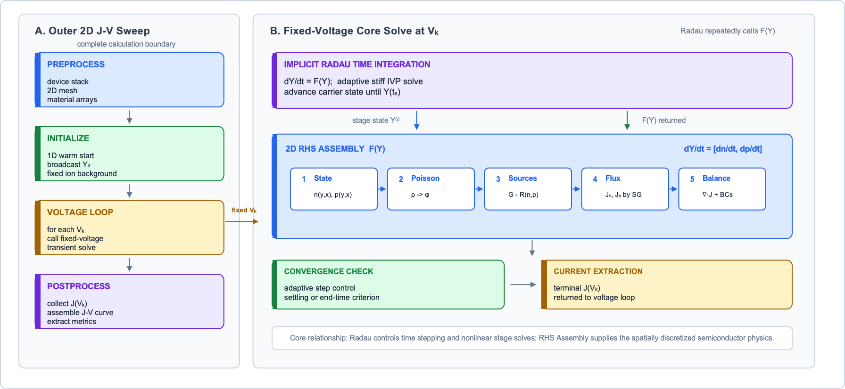
05 · DEVICE SIM
Complete 2D Solver Workflow: RHS Assembly + Radau Integration
RHS Assembly is the inner physics operator; Radau is the transient time integrator; The voltage sweep wraps both to produce the complete 2D J-V result.
SOLARLAB

Slide 39
05 · DEVICE SIM
J-V Sweep: Fixed-Voltage Radau Calls Chained in Time
Actual SolarLab mode: hold V_{k} fixed, integrate one transient, record J, then warm-start the next voltage.
V_arr = np.linspace(V_start, V_end, n_points)
dt = abs(V_end - V_start) / (v_rate * (n_points - 1))
STAIRCASE VOLTAGE
ONE RADAU CALL
STATE CARRY-OVER
sampled plateaus; not one continuous ramp
[t_{k}, t_{k+1}] at fixed V_{k}
Y_{k+1} seeds the next voltage point
SOLARLAB
Numerical mode: piecewise-constant V_{app}. Δt = |V_{k+1} - V_{k}| / scan rate; forward 0 -> V_{max}, reverse V_{max} -> 0.

Slide 40
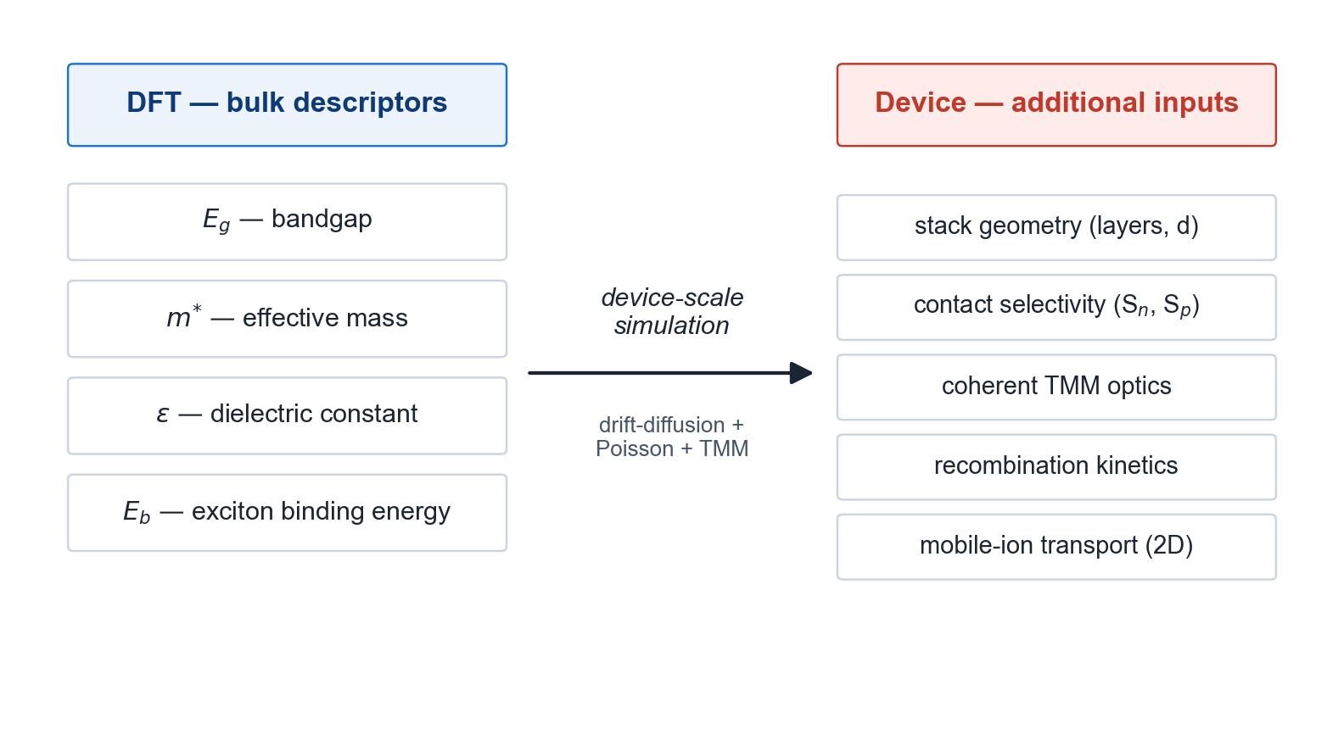
05 · DEVICE SIM
Motivation for device-scale simulation
Bulk material descriptors alone do not determine device-level performance
• DFT delivers E_{g}, m*, ε and E_{b} as bulk material-level descriptors
• Device performance additionally depends on stack geometry, contact selectivity, optical absorption and recombination kinetics
• Drift-diffusion coupled to the Poisson equation is required across the full HTL / absorber / ETL stack
• Coherent transfer-matrix-method (TMM) optics are required for thin-film interference [Pettersson et al. 1999]
• Two-dimensional effects (grain boundaries, lateral non-uniformity) cannot be captured in 1D
• Mobile-ion transport must be included to reproduce hysteresis in perovskite-class absorbers
SOLARLAB

Slide 41
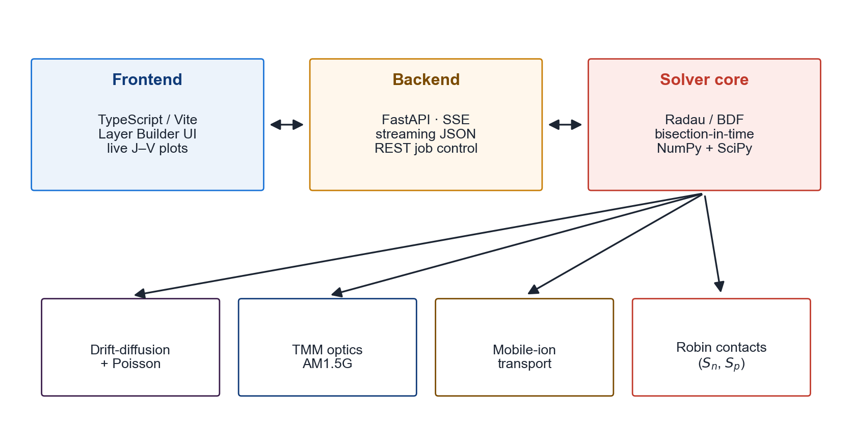
05 · DEVICE SIM
SolarLab device-simulation framework
1D + 2D drift-diffusion · TMM optics · mobile ions · selective Robin contacts
• Backend: Python solver with FastAPI server-sent events streaming intermediate results
• Frontend: TypeScript / Vite workstation with publication-quality figure rendering
• Numerical scheme: Radau implicit Runge–Kutta with BDF fallback and bisection-in-time on stiff steps
• Optics: coherent transfer-matrix-method using the ASTM G-173 AM1.5G reference spectrum
• Selective contacts: Robin formulation in S_{n} and S_{p}, validated against the 1D solver to 6 µV
• Open-source, scriptable and REST-driven; designed for integration into high-throughput screening pipelines
SOLARLAB

Slide 42
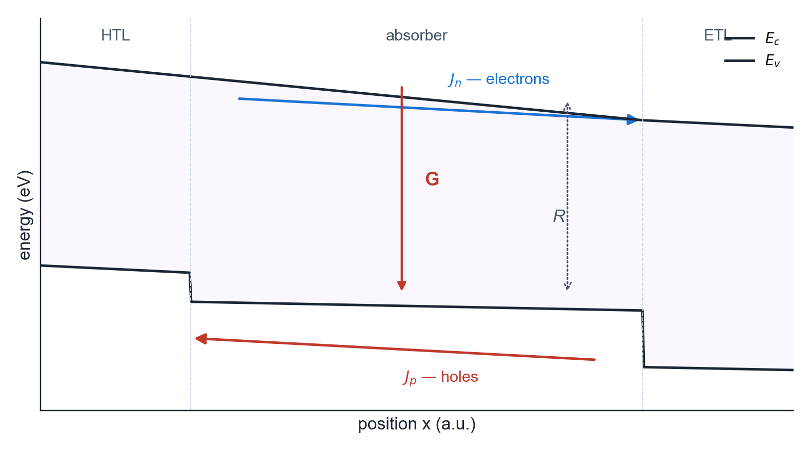
05 · DEVICE SIM
Drift-diffusion governing equations
Three coupled partial differential equations per absorber layer [Selberherr 1984]
• Electron continuity: ∂n/∂t = (1/q) ∇·J_{n} + G − R
• Hole continuity: ∂p/∂t = −(1/q) ∇·J_{p} + G − R
• Poisson equation: ∇·(ε_{r} ε₀ ∇φ) = −q (p − n + N_{D} − N_{A} + ρ_{ion})
• Current densities: J_{n} = q μ_{n} n E + q D_{n} ∇n · J_{p} = q μ_{p} p E − q D_{p} ∇p
• Recombination R: Shockley–Read–Hall, Auger and radiative channels; Einstein relation D = (k_{B}T/q) μ
• Generation G: optical generation profile from the TMM model integrated over the AM1.5G spectrum
SOLARLAB

Slide 43
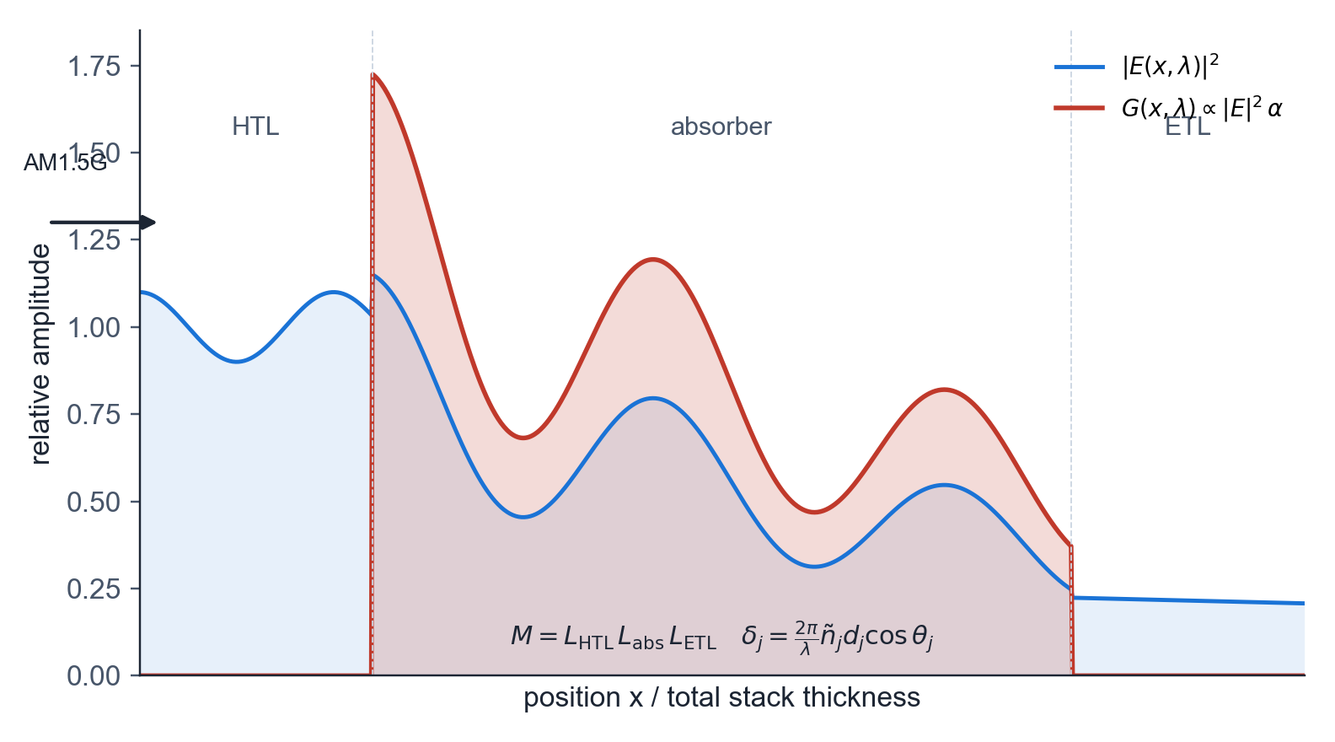
05 · DEVICE SIM
Transfer-matrix-method optics
Coherent multi-layer thin-film interference [Pettersson et al. 1999 · Born & Wolf]
• Each layer j is represented by a 2×2 characteristic matrix L_{j} acting on the tangential (E, H) field components
• L_{j} = [[cos δ_{j}, i sin δ_{j} / η_{j}], [i η_{j} sin δ_{j}, cos δ_{j}]]
• Phase thickness δ_{j} = (2π / λ) ñ_{j} d_{j} cos θ_{j} with complex refractive index ñ_{j} = n + i k
• System matrix M = L₁ L₂ … L_{N} yields wavelength-resolved R, T and A
• Generation profile G(x, λ) ∝ |E(x, λ)|² α(λ), integrated over the AM1.5G spectrum
• Supersedes the Beer–Lambert approximation by capturing interference, back-reflector and interface effects
SOLARLAB

Slide 44
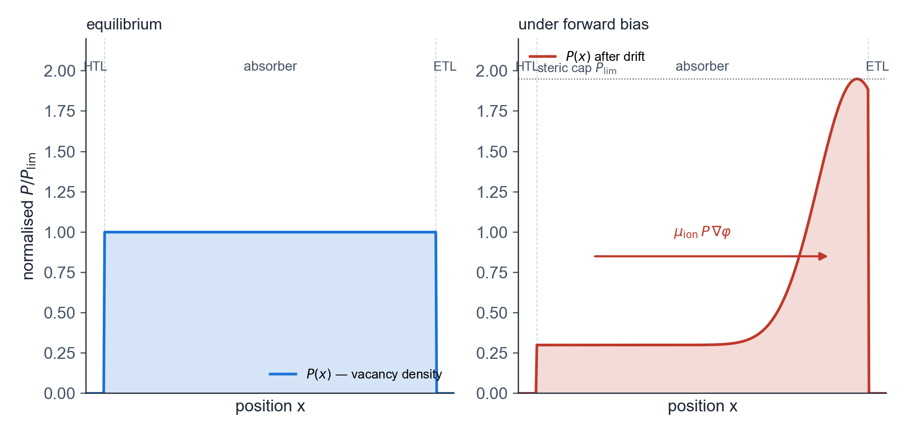
05 · DEVICE SIM
Mobile-ion transport
Origin of J–V hysteresis in perovskite solar cells [Calado et al. 2016 · van Reenen et al. 2015]
• Continuity for ion-vacancy density P: ∂P/∂t = ∇·(D_{ion} ∇P + μ_{ion} P (1 − P / P_{lim}) ∇φ)
• The steric factor (1 − P / P_{lim}) caps ion density at the available lattice-site limit
• Estimated P_{lim} is approximately 1 – 5 % of the cation-site density in MAPbI₃
• Ion drift under bias redistributes mobile charge, screens the electric field and modulates the recombination rate
• Couples into the Poisson equation via the source term ρ_{ion} = q (P − P_{eq})
• Characteristic time scale of 0.01 – 100 s reproduces the observed scan-rate dependence of perovskite J–V curves
SOLARLAB

Slide 45
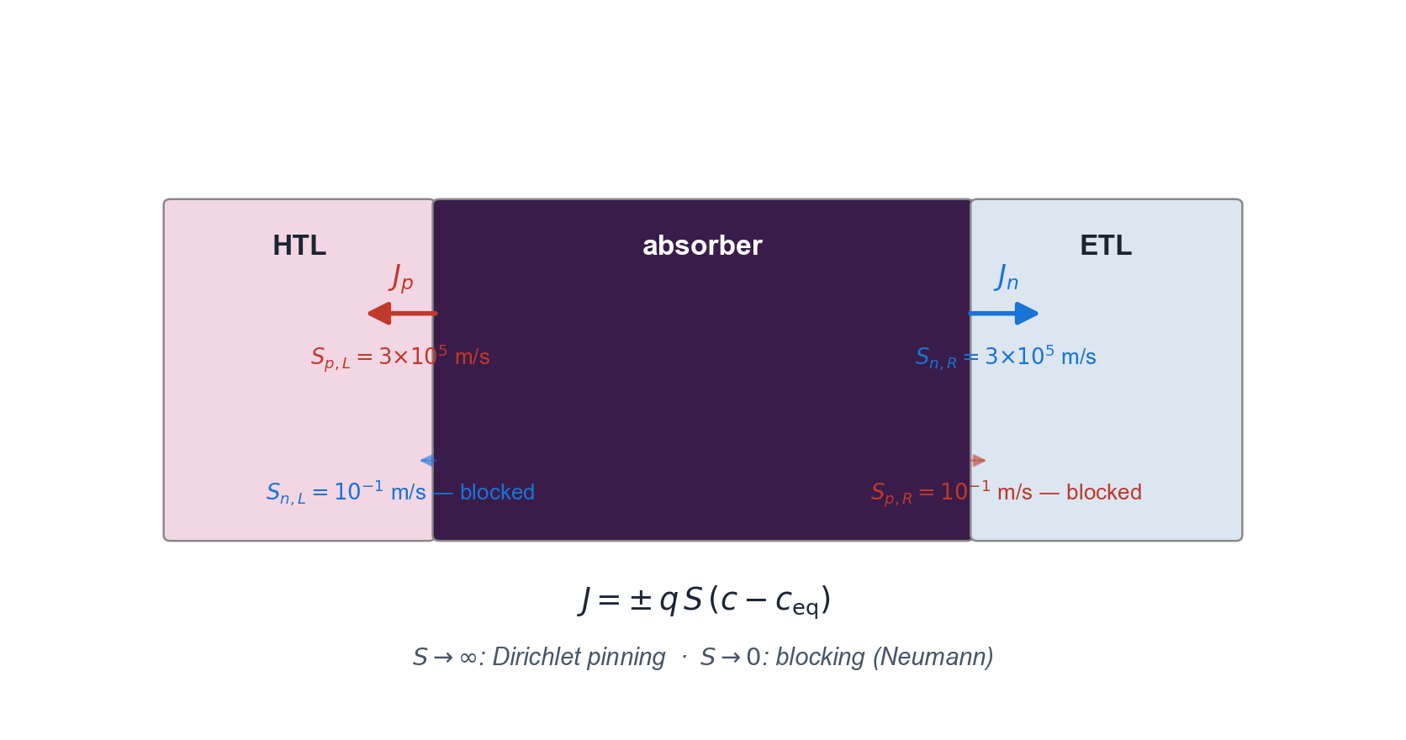
05 · DEVICE SIM
Selective Robin contact boundary conditions
Surface-recombination boundary conditions in place of Dirichlet pinning
• Left contact: J_{n} = −q S_{n,L} (n − n_{eq}) · J_{p} = +q S_{p,L} (p − p_{eq})
• Right contact: J_{n} = +q S_{n,R} (n − n_{eq}) · J_{p} = −q S_{p,R} (p − p_{eq})
• Contact selectivity: S_{n,L} ≪ S_{p,L} yields a hole-extracting (HTL-type) left contact
• Limit S → ∞ recovers the Dirichlet condition (carrier density pinned to equilibrium)
• Limit S → 0 yields a perfectly blocking (zero-flux Neumann) contact
• Captures the surface-recombination physics that SCAPS-1D approximates via Dirichlet pinning
SOLARLAB

Slide 46
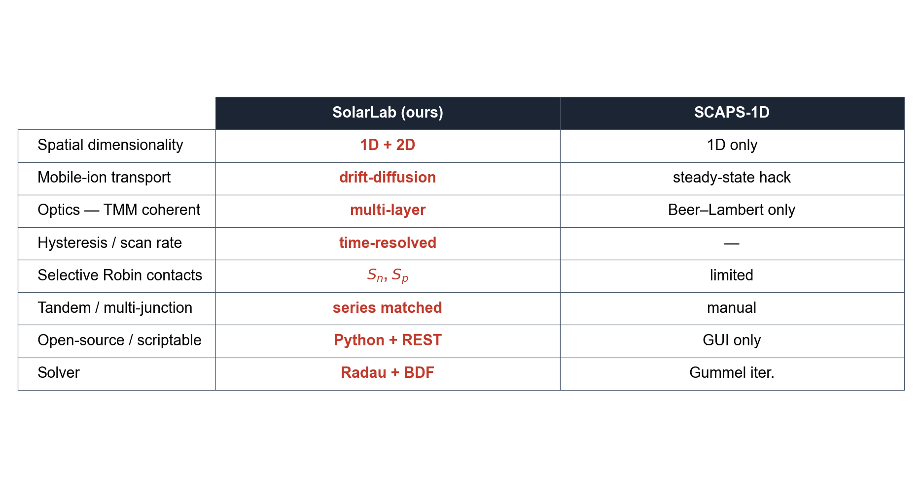
05 · DEVICE SIM
Capability comparison with SCAPS-1D
Capabilities absent from the SCAPS-1D reference solver [Burgelman et al. 2000]
SOLARLAB

Slide 47
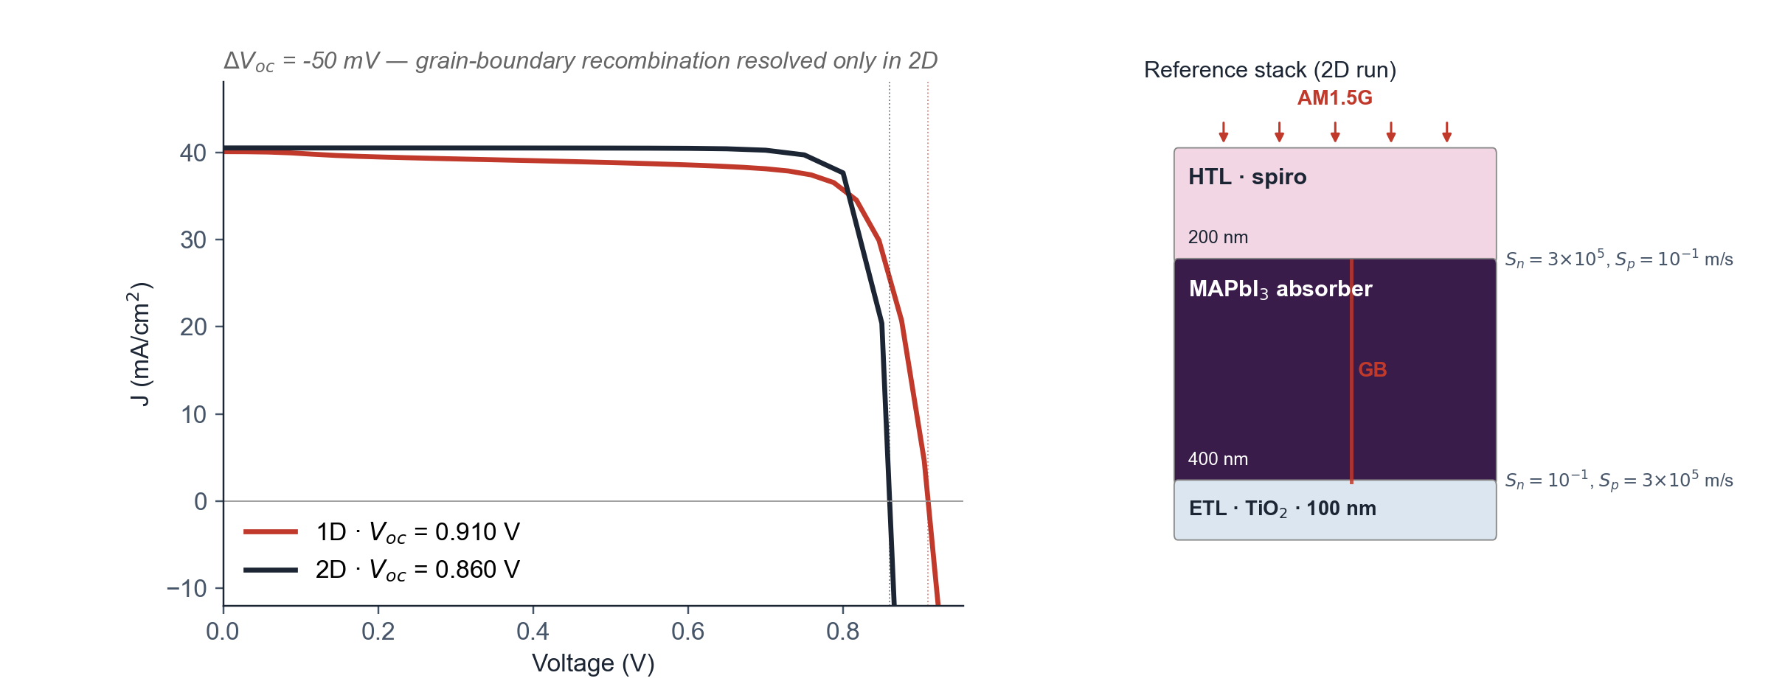
05 · DEVICE SIM
1D and 2D solver fidelity comparison
Reference MAPbI₃ stack — 50 mV V_{oc} reduction in 2D from grain-boundary recombination
• Stack: spiro HTL 200 nm / MAPbI₃ 400 nm / TiO₂ ETL 100 nm with selective Robin contacts
• 2D variant: a single vertical grain boundary at the lateral midplane of the absorber
• 1D V_{oc} = 0.910 V is reduced to 2D V_{oc} = 0.860 V (ΔV_{oc} = −50 mV)
• The reduction is the grain-boundary recombination channel resolved only by the 2D solver
• 1D models would misestimate device performance by omitting this loss channel
• Solver throughput: a 28-voltage 2D sweep completes in approximately 22 minutes on 4 CPU cores
SOLARLAB

Slide 48
06
OUTLOOK

Slide 49
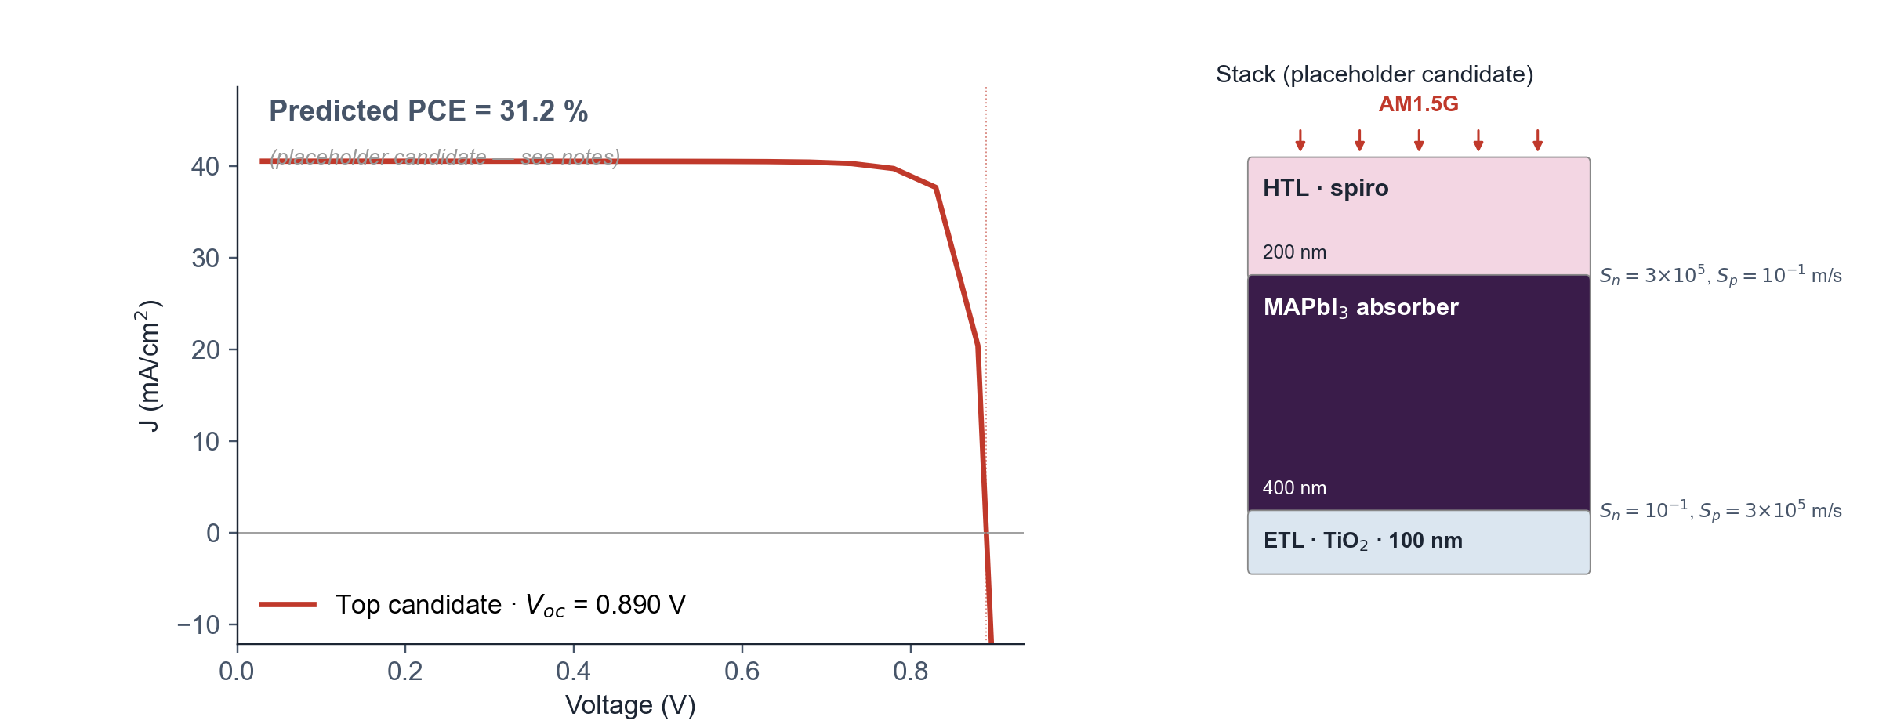
06 · OUTLOOK
Predicted device J–V for a leading candidate
DFT parameters → device simulation → predicted PCE
• Closes the workflow from > 10⁵ database scan to predicted device-level J–V
• Stack: same spiro HTL / MAPbI₃ / TiO₂ ETL reference as the 1D-vs-2D run
• Placeholder candidate: MAPbI₃ baseline with V_{oc} shifted by +30 mV (~candidate-gap surrogate)
• Real Se₁₆Sn₈Zr₄ J–V replaces the placeholder once n, k data and DFT parameters are wired into the 2D solver
• Predicted device PCE is the figure of merit relevant for synthesis decisions
• Establishes explicit, falsifiable performance targets for the experimental collaboration
SOLARLAB

Slide 50
06 · OUTLOOK
Outlook
Planned extensions
• Multi-task learning on the ~36 000 PBE gaps in Materials Project to close the prototype-grouped CV gap
• Spectroscopic Limited Maximum Efficiency (SLME) replacing the SQ upper bound, requiring the absorption coefficient α(E) [Yu & Zunger 2012]
• Targeted DFT batch on Se-rich AB₂C₄ and ABC₃ candidates in SG 62, 12, 72 and 15
• Closed-loop automation of DFT batch submission and surrogate re-fitting on label return
• Experimental collaboration to synthesise the top three candidates and feed measured J–V data back into the ML pipeline
SOLARLAB

Slide 51
06 · OUTLOOK
Summary
Principal findings
• Small-sample ML on 473 DFT-labelled materials improves the GPR / GB / ExtraTrees baseline by +50 % in R²
• Fourteen-candidate chalcogenide shortlist; Se₁₆Sn₈Zr₄ sits near the Shockley–Queisser optimum
• SolarLab 2D drift-diffusion provides the bridge from DFT-derived parameters to predicted device-level J–V
• Compact, physically motivated descriptor and small-sample model identify a tractable subspace under stringent grouped-CV diagnostics
• Experimental collaboration completes the discovery → simulation → experiment loop
SOLARLAB

Slide 52
06 · OUTLOOK
References
ML, device-sim and absorber-chemistry foundations
• Yan C. et al., Nat. Energy 3, 764 (2018) · ACS Energy Lett. 2, 930 (2017) — kesterite Cu₂ZnSnS₄
• Hou Y. et al., Nat. Energy 5, 131 (2020) · Science 367, 1135 (2020) · Nat. Energy 7, 229 (2022) — perovskite + tandem
• Friedman J.H., Ann. Stat. 29, 1189 (2001) — gradient boosting
• Ke G. et al., NeurIPS (2017) — LightGBM histogram binning
• Rasmussen C.E. & Williams C.K.I., MIT Press (2006) — GP for ML
• Snoek J. et al., NeurIPS (2012) — UCB acquisition
• Ward L. et al., npj Comput. Mater. 2, 16028 (2016) · CMS 152, 60 (2018) — Magpie · matminer
• Heyd J. et al., J. Chem. Phys. 118, 8207 (2003) — HSE06
• Yu L. & Zunger A., PRL 108, 068701 (2012) — SLME
• Selberherr S., Springer (1984) — semiconductor device simulation
• Pettersson L.A.A. et al., J. Appl. Phys. 86, 487 (1999) — TMM
• Burgelman M. et al., Thin Solid Films 361-362, 527 (2000) — SCAPS
• Calado P. et al., Nat. Commun. 7, 13831 (2016) · van Reenen S. et al., JPCL 6, 3808 (2015) — perovskite ion migration
• Chen C. et al., Chem. Mater. 31, 3564 (2019) — MEGNet
SOLARLAB

