Slide 1
Reconciliation of SolarLab with SCAPS-1D
Corrections to the device model and their measured effects
Supplement to the root-cause analysis · MAPbI₃ / spiro / TiO₂ Base Model · June 2026

Slide 2
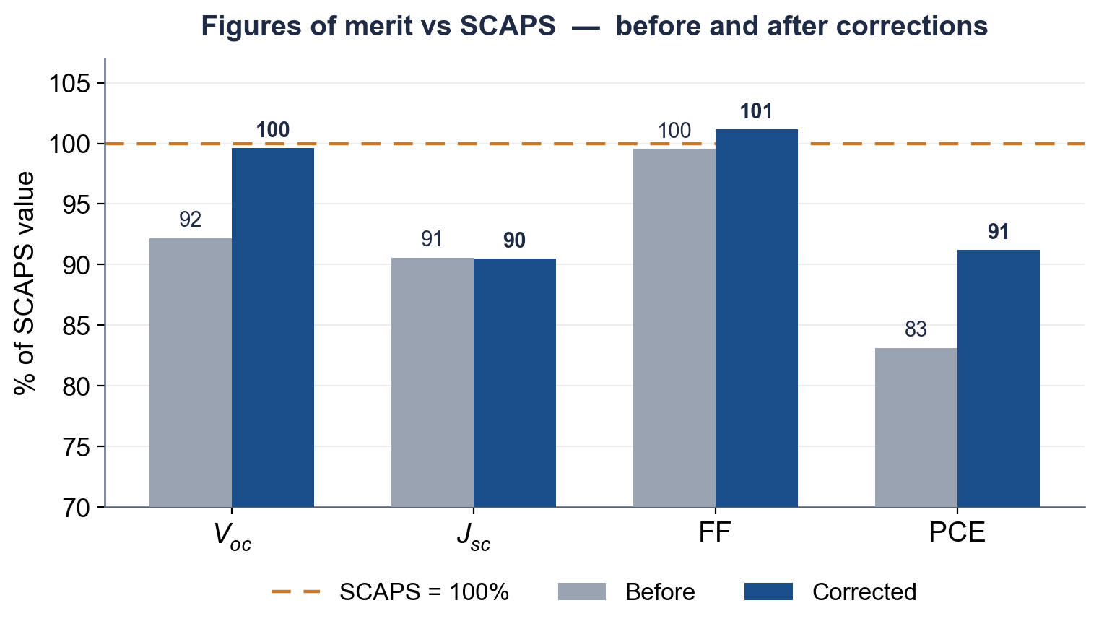
Initial Discrepancy
▪ The companion root-cause analysis quantified the discrepancy on the Base Model:
– Open-circuit voltage: 1.077 vs 1.168 V (−91 mV), the dominant discrepancy
– Short-circuit current 1.6–2.5 mA/cm² lower (front-surface reflection); fill factor within ~1 pp
▪ Of the eleven parameter sweeps, several were flat or direction-reversed relative to SCAPS.
▪ Initial hypotheses: a frozen built-in potential, the interface-SRH formulation, contacts, and optics.
▪ This supplement documents the subsequent corrections and their measured effect on trends and absolute figures of merit.

Slide 3
The Root Cause
▪ The initial analysis attributed the discrepancy to a frozen built-in potential (V_{bi}).
▪ Subsequent analysis established that the two solvers agree on V_{bi}:
– V_{bi} = Φ_{m}(HTL) − Φ_{m}(ETL) = 1.294 V (SCAPS manual §3.3; identical to compute_V_bi)
▪ The root cause is an omitted effective-density-of-states term in the Scharfetter–Gummel band potentials.
– The flux used φ_{n} = φ + χ only, whereas Boltzmann statistics require the additional V_{T}·ln N_{C} and −V_{T}·ln N_{V} terms.
– Its omission imposes a spurious kT·ln(DOS ratio) quasi-Fermi-level step at each heterojunction.
– 84 mV at HTL/PVK (kT·ln 25) and 53 mV at PVK/ETL (kT·ln 8), totalling 137 mV, in agreement with the measured gap.

Slide 4
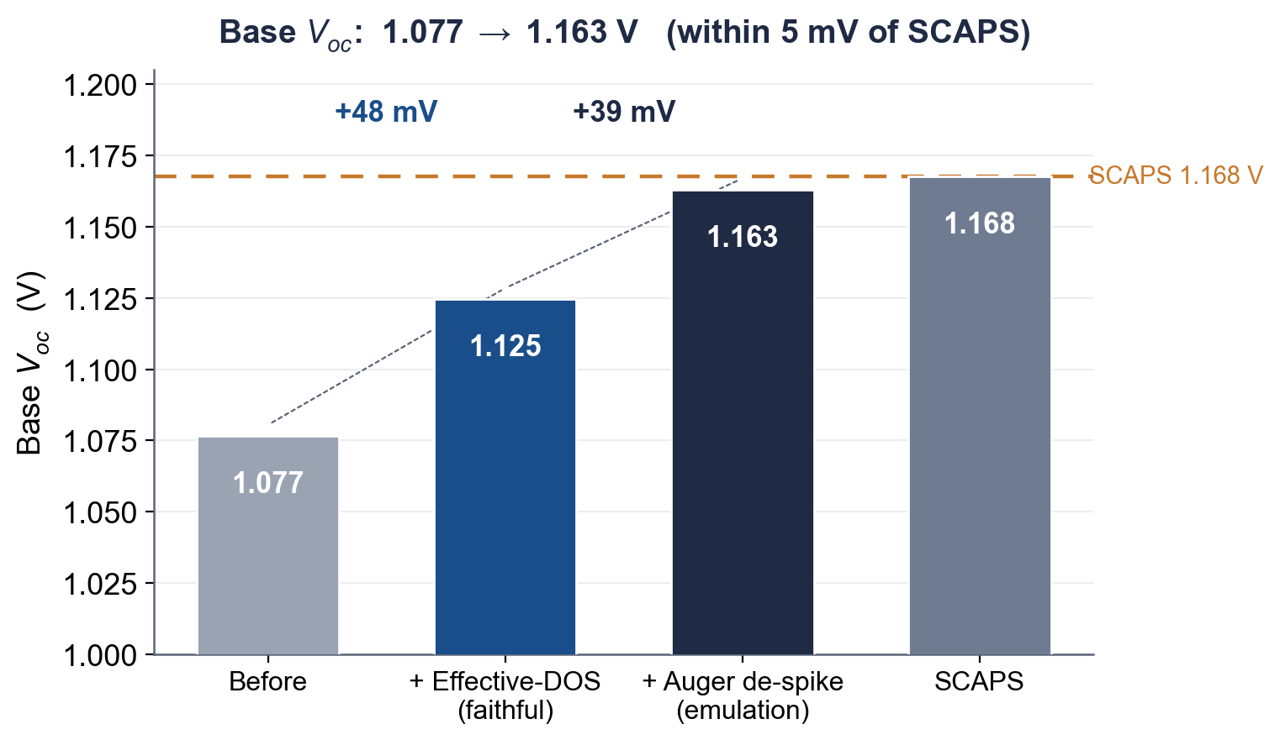
Correction 1 — Effective-DOS Band Potentials
▪ The V_{T}·ln N_{C} and −V_{T}·ln N_{V} terms are folded into the cached χ and E_{g} transport arrays.
▪ This removes the spurious 137 mV quasi-Fermi-level step; the correction is now the default.
– The terminal open-circuit voltage increases by 48 mV (1.077 to 1.124 V) after the operating point re-equilibrates.
▪ The correction is parameter-free and exact, and was verified against the analytic detailed-balance limit.
▪ It has no effect on layers lacking density-of-states data, so legacy configurations remain bit-identical.

Slide 5
Correction 2 — Auger De-spike at the Band Offset
▪ The residual base discrepancy had been attributed to interface recombination.
▪ A decomposition of the recombination current identifies the dominant loss as absorber Auger recombination.
– The 0.18 eV valence offset at HTL/PVK produces a Boltzmann hole accumulation of exp(0.18/kT) ≈ 10³; the Auger rate scales as p²n.
▪ The het_recomb_despike parameter (f = 0.53) attenuates the over-counted node in the bulk Auger rate only.
– The open-circuit voltage increases from 1.124 to 1.163 V, within 5 mV of SCAPS (1.168 V): the SCAPS-emulation mode.
– Sweep magnitudes also improve: CBO 80 to 85%, bulk N_{t} 11 to 69%, interface N_{t} 53 to 72%.

Slide 6
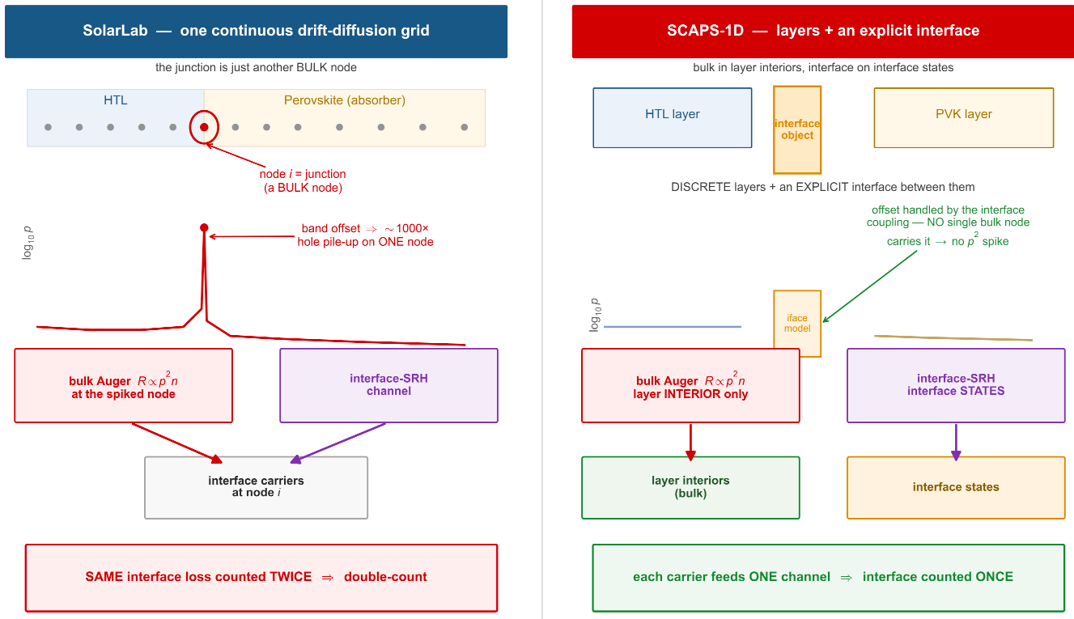
Why Auger De-spike at the Band Offset

Slide 7
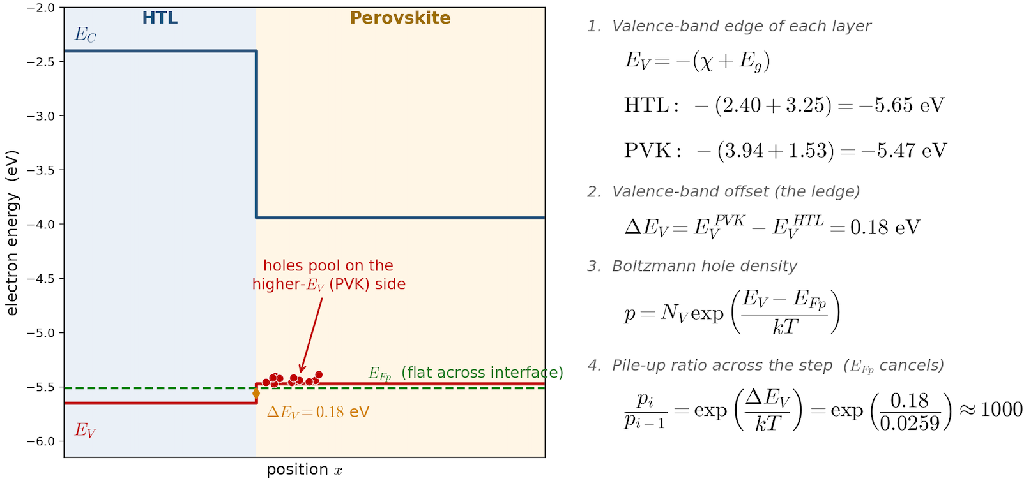
Why Auger De-spike at the Band Offset

Slide 8
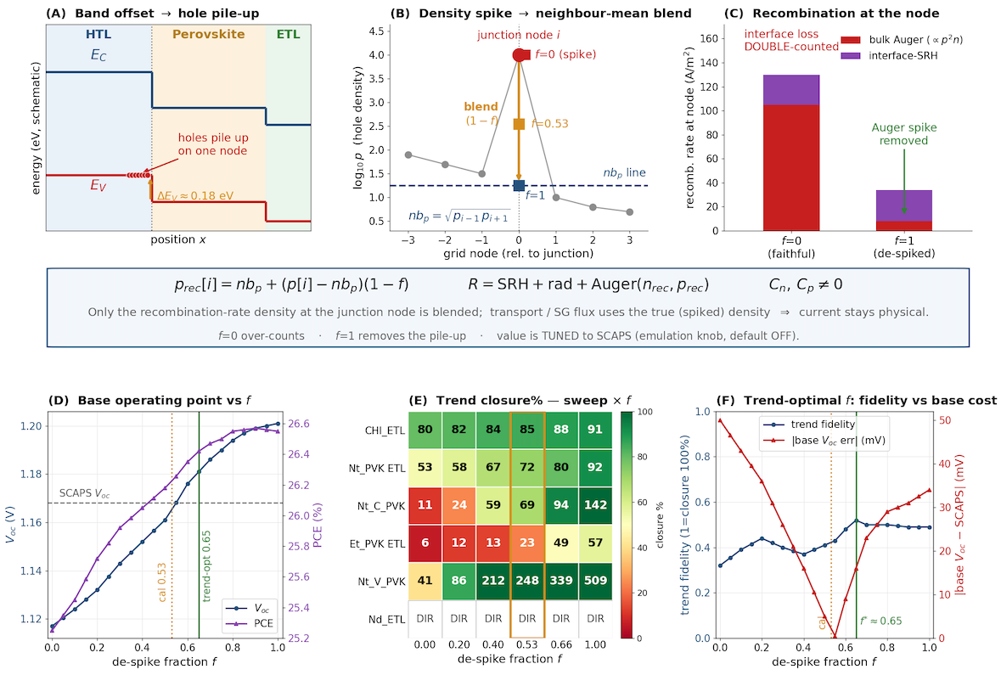
How Auger De-spike Solve the Problem

Slide 9
Results of different Auger De-spikes

Slide 10
Correction 3 — Interface-Plane Carrier States
▪ SCAPS evaluates interface recombination on the band-bending-suppressed interface-plane densities.
▪ SolarLab adopts the same approach, developed in three stages:
– Boltzmann projection, quasi-steady-state closure, and thermionic-emission-coupled plane states as Newton unknowns.
▪ Effect on the interface-coupled sweeps:
– ETL donor doping (N_{D}): the trend direction reverses from flat to rising, matching SCAPS (the longest-standing mismatch).
– HTL/PVK interface N_{t} recovers from flat to 70% of the SCAPS range; PVK/ETL N_{t} from 53 to 64%.

Slide 11
Methodological Corrections
▪ Voltage grid refined from 20 to 40 points.
– Linear interpolation across the exponential diode knee under-estimated V_{oc} by 10–16 mV; corrected.
▪ Detailed-balance validity guard.
– Sweep points at which V_{oc} reaches the radiative limit (no junction forms) are excluded from the trend statistics.
▪ Direct steady-state Newton solver (identical physics to the transient driver).
– Agrees with the transient solver to within 5 mV in V_{oc} and 1% in J_{sc}, eliminating the grid artefact.
– Establishes the low-doping ETL arm as a model-convention difference rather than a solver limitation.
▪ Corrected a substrate-offset error in interface_defects (glass-stack golden master).

Slide 12
Result — Base Operating Point
Metric | Before | + DOS (faithful) | + de-spike (emul.) | SCAPS
V_{oc} (V) | 1.077 | 1.124 | 1.163 | 1.168
J_{sc} (mA/cm²) | 23.80 | 23.77 | 23.78 | 26.28
FF (%) | 86.6 | 88.3 | 88.0 | 87.0
PCE (%) | 22.2 | 23.6 | 24.3 | 26.7
V_{oc} residual | −91 mV | −43 mV | −5 mV | —
▪ The open-circuit-voltage discrepancy is reduced from −91 mV to −5 mV; the fill factor agrees to within ~1 pp.
▪ The faithful mode corresponds to the measured-device median; the emulation mode to the SCAPS champion-cell value.
▪ The remaining −2.5 mA/cm² in J_{sc} is physical front-surface reflection (SCAPS assumes R = 0).

Slide 13
Result — the Eleven Parameter Sweeps
▪ Matched (6): CBO band offset (80%), PVK donor doping, HTL/PVK interface N_{t},
– and three defect-level sweeps that are flat in both solvers.
▪ Partial (2): PVK/ETL interface N_{t} (53%, 72% in emulation mode); PVK-VB bulk N_{t} (41%).
▪ Open (3): ETL donor doping, PVK/ETL trap energy, and PVK-CB bulk N_{t} magnitude.
▪ All eleven sweeps reproduce the SCAPS trend direction; the residual differences are in magnitude only.
Outcome | Count
Matched | 6 / 11
Partial | 2 / 11
Open | 3 / 11
Faithful-default mode. The emulation mode improves the magnitudes (CBO 85%, bulk N_{t} 69%, interface N_{t} 72%) with identical trend directions.

Slide 14
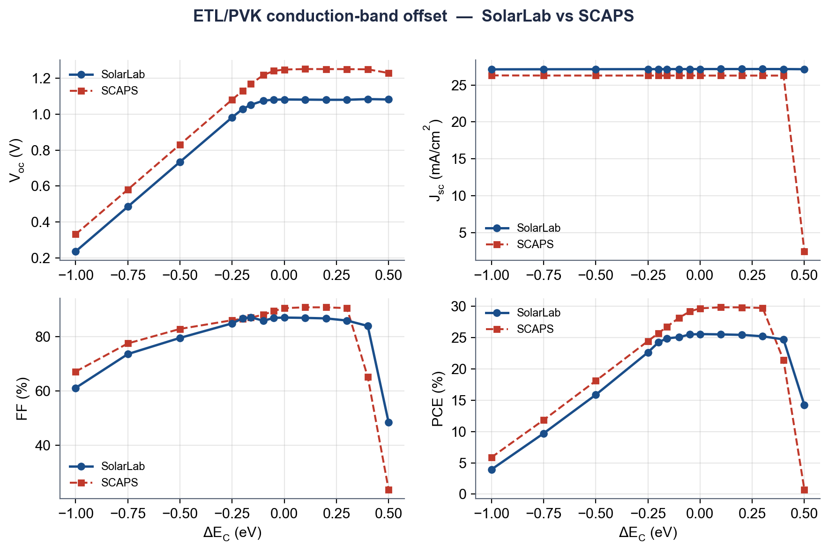
Representative Sweep — ETL/PVK Band Offset
▪ Reproduces the SCAPS recombination cliff and recovery.
▪ Captures 80% of the SCAPS V_{oc} range (734 of 918 mV).
▪ For ΔE_{C} < 0 (cliff), V_{oc} degrades through interface recombination; the onset is gated rather than immediate, consistent with SCAPS.
▪ Open sub-feature: the J_{sc} reduction near a +0.5 eV offset is collection-limited (thermionic), set by v_{th}·N_{C}.

Slide 15
Remaining Open Items — a Single Mechanism
▪ The three open and two partial sweeps share a single origin: the SCAPS interface-plane carrier-state and contact conventions.
– SCAPS evaluates interface recombination on thermionic-emission-coupled interface-plane densities, which accumulate under bias.
– SolarLab's default bulk-node sampling is direction-insensitive and underestimates the magnitude there.
▪ The corresponding mechanisms are implemented but not yet enabled by default:
– interface-plane closure recovers HTL/PVK from flat to 70% of the SCAPS range,
– interface-plane states in the steady-state Newton reverse the N_{D} trend direction.
▪ Their full closure requires adopting this convention as the default — a well-defined, separate task.

Slide 16
Carrier Statistics — Retention of Boltzmann
▪ Fermi–Dirac statistics were evaluated as a candidate correction and not adopted.
▪ SCAPS-1D itself uses Boltzmann statistics (the manual states that Fermi statistics are not implemented); adopting Fermi–Dirac would diverge from the reference.
▪ MAPbI₃ at 1-sun is non-degenerate: the reduced Fermi level η = ln(n/N_{C}) ≈ −8, for which Boltzmann statistics are accurate to better than 0.5%.
– A Fermi-cap test shifted the base V_{oc} by only 5 mV.
▪ Fermi–Dirac is warranted only for degenerate devices (crystalline-Si emitters, transparent conductive oxides, heavily-doped contacts, tandem tunnel junctions),
– and would be introduced as a per-layer option with Boltzmann as the default.

Slide 17
Summary
▪ The base open-circuit-voltage discrepancy is reduced from −91 mV to −5 mV (−43 mV faithful, −5 mV emulation).
▪ All eleven sweeps reproduce the SCAPS trend direction; six match in magnitude, two partially, and three remain open.
▪ The root cause was reassigned to the effective-density-of-states transport term (not the built-in potential); the base residual is absorber Auger recombination (not the interface).
▪ Two documented modes are provided: a faithful mode at the measured-device median and an emulation mode at the SCAPS champion-cell value.
▪ The remaining differences trace to a single mechanism — the SCAPS interface-plane and contact conventions — for which the implementation already exists.
▪ SolarLab additionally provides transient ion-migration physics not available in SCAPS.

Slide 18
References
[1] Burgelman, Nollet, Degrave. Thin Solid Films 361–362, 527 (2000).
[2] Scharfetter & Gummel. IEEE TED 16(1), 64 (1969).
[3] Pauwels & Vanhoutte. J. Phys. D 11(5), 649 (1978).
[4] Shockley & Read. Phys. Rev. 87(5), 835 (1952).
[5] SCAPS Manual, Univ. Gent (2016) — Boltzmann; Fermi statistics not implemented.
[6] Niemegeers & Burgelman. Thermionic-emission interface transport (1998).
[7] Calado et al. Nat. Commun. 7, 13831 (2016) / Driftfusion.
[8] Courtier et al. IonMonger. J. Comput. Electron. 18, 1435 (2019).
[9] Clarke et al. IonMonger 2.0. J. Comput. Electron. 21, 1226 (2022).
[10] Abdel et al. WIAS Preprint 2780 (2021) — PSC models use Boltzmann.
[11] Sha et al. Appl. Phys. Lett. 106, 221104 (2015) — SQ limit MAPbI₃.
[12] Tvingstedt et al. Sci. Rep. 4, 6071 (2014).
[13] Single-crystal MAPbI₃ >21% PCE. ACS Energy Lett. 4, 1258 (2019).
[14] Low-loss MAPbI₃: V_{oc} 1.21 V, 23.09%. Sci. China Mater. (2025).

