Slide 1
SolarLab and SCAPS-1D
Numerical formulation and physical models: a side-by-side comparison
Supplement to the validation report · June 2026

Slide 2
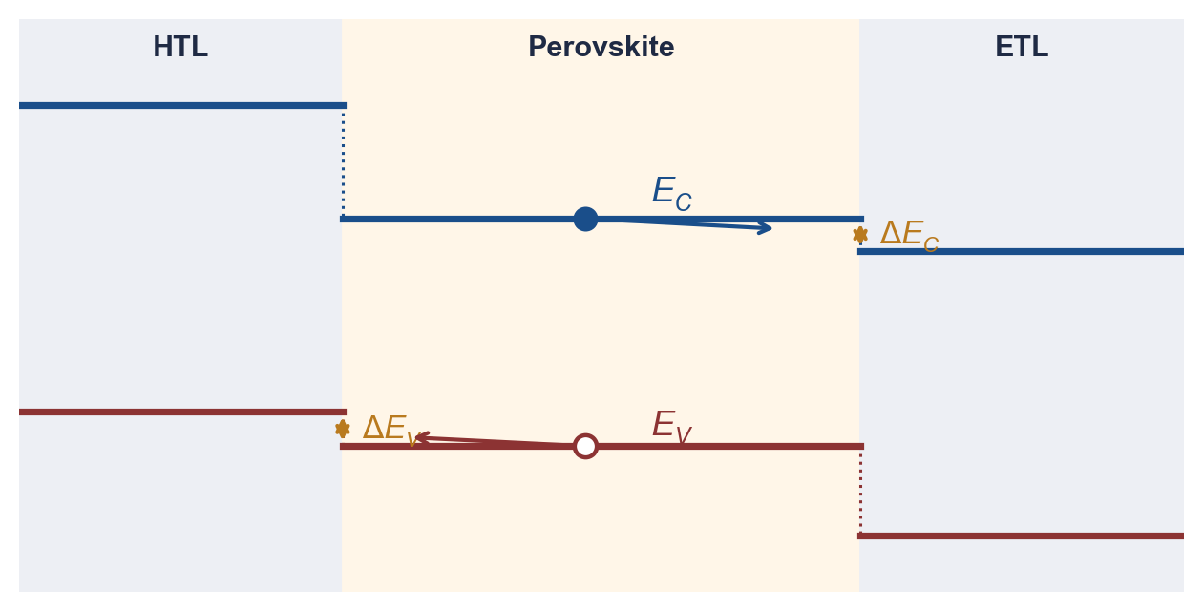
Background — Device-Level Simulation
▪ Under illumination, photogenerated electrons and holes are transported through the layer stack to the contacts.
▪ A drift-diffusion model resolves carrier transport under drift (electric field) and diffusion (concentration gradient), coupled self-consistently to Poisson's equation.
▪ Recombination accounts for carrier loss; the simulated output is the current–voltage characteristic and the derived figures of merit (V_{oc}, J_{sc}, FF, PCE).
▪ SolarLab and SCAPS-1D are both one-dimensional drift-diffusion device simulators of the identical cell.
▪ This supplement contrasts their numerical formulations and physical models, axis by axis.
Equilibrium band diagram of the n–i–p stack with conduction- and valence-band offsets.

Slide 3
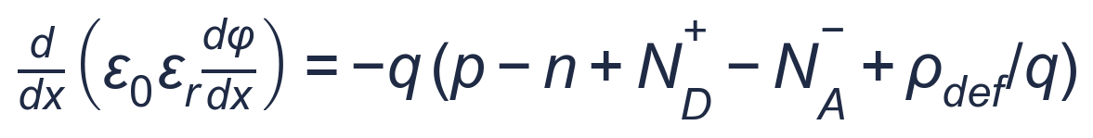
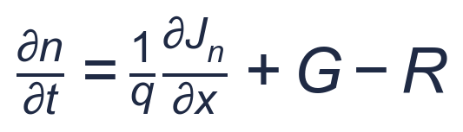
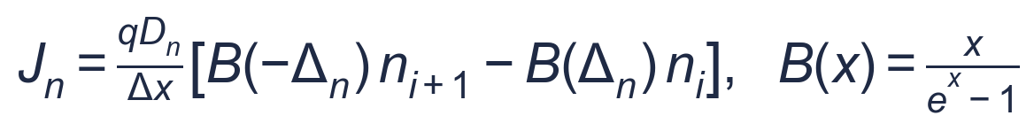
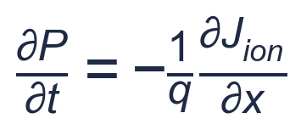
Governing Equations
Both solvers solve the same coupled Poisson–drift-diffusion system:
Poisson's equation — relates the space charge to the electrostatic potential.
Electron continuity — conserves carriers: divergence of current balanced by generation and recombination.
Scharfetter–Gummel current — exponentially-fitted discretization of the drift-diffusion flux.
Ion continuity (SolarLab only) — mobile ionic transport; absent in SCAPS.

Slide 4
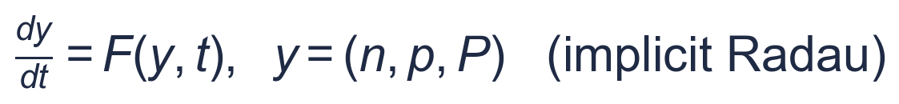

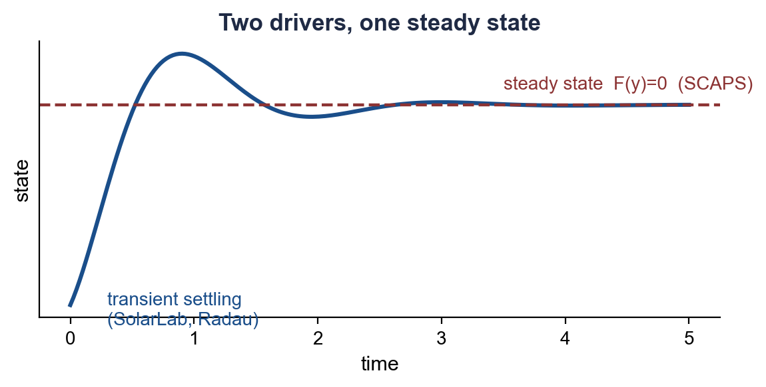
Overview — Common Formulation, Distinct Solver Architectures
Differ
Concept. Both tools solve the same drift-diffusion/Poisson system for the identical device; they differ in solution strategy and physical scope.
SolarLab
SCAPS-1D
▪ Time-dependent integration (method of lines, implicit Radau)
▪ Resolves ion migration, hysteresis and impedance
▪ Direct steady-state solution (Gummel + Newton–Raphson)
▪ Optional small-signal AC analysis
Comparison
SolarLab integrates the coupled equations in time, so transient phenomena—ion migration, scan-dependent hysteresis and impedance—are obtained directly, at greater computational cost per characteristic. SCAPS computes the DC steady state, which is more economical for static J–V analysis but does not represent time-dependent behaviour. A steady-state mode in SolarLab reproduces the SCAPS regime for direct comparison.

Slide 5
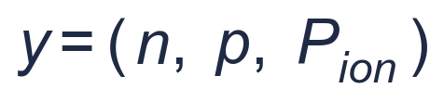
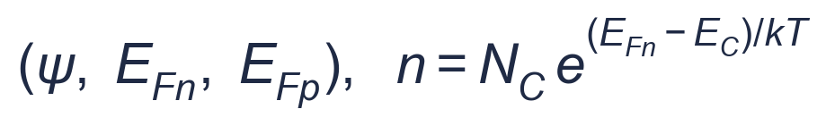
Numerical — Primary Unknowns
Differ
Concept. The choice of primary variables; the two formulations are equivalent under Boltzmann statistics.
SolarLab
SCAPS-1D
▪ Electrostatic potential and quasi-Fermi levels
▪ No ionic unknown
▪ Carrier densities (n, p, P_{ion}) as unknowns
▪ Electrostatic potential obtained by substitution
Comparison
Solving directly for densities (SolarLab) enforces positivity but is poorly conditioned in deep depletion, where densities span more than twenty orders of magnitude; solving for quasi-Fermi potentials (SCAPS) is better conditioned in that regime. The formulations are mathematically equivalent under Boltzmann statistics, so the distinction is one of numerical conditioning rather than physical content.

Slide 6
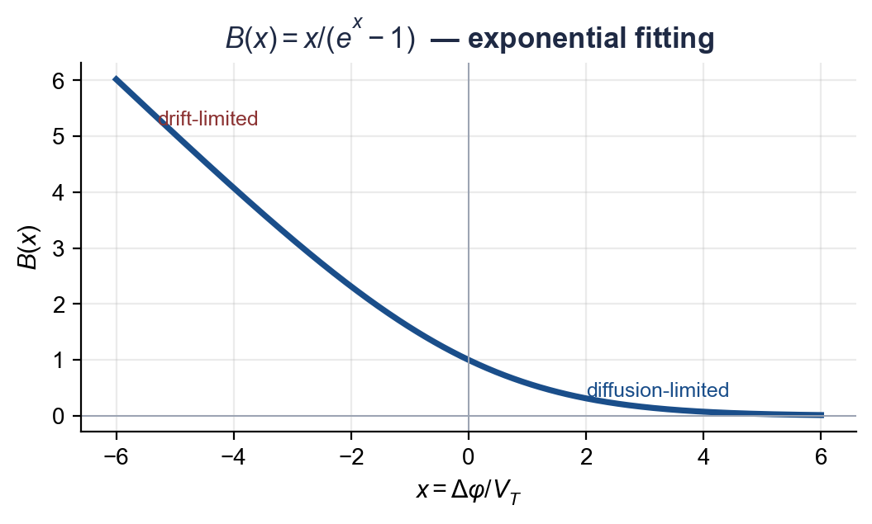
Numerical — Spatial Discretization and Flux
Shared
Concept. Computation of the inter-node current from the carrier densities and potential.
SolarLab
SCAPS-1D
▪ Bernoulli (Scharfetter–Gummel) flux on band-corrected potentials
▪ Non-uniform mesh refined at interfaces
▪ Identical Scharfetter–Gummel exponential-fitting scheme
▪ User-defined mesh; duplicated interface nodes
Comparison
Both employ the Scharfetter–Gummel exponentially-fitted discretization, the standard approach for resolving drift-dominated transport on a coarse mesh. Because the spatial scheme is common to both solvers, agreement at the discretization level is expected; the residual differences originate in the physical models rather than the flux scheme.

Slide 7
Numerical — Nonlinear Solution Strategy
Differ
Concept. Organization of the iterative solution of the coupled nonlinear system (both Newton-based).
SolarLab
SCAPS-1D
▪ Radau implicit stage couples the system (transient)
▪ Steady mode: damped Newton in log-density
▪ Gummel outer iteration with Newton inner solves
▪ Step clamping for difficult bias points
Comparison
Both solvers are Newton-based and converge to the identical steady-state solution; they differ only in how the iteration is organized, not in outcome. SCAPS applies a Gummel outer iteration with Newton–Raphson sub-solves to the steady state. SolarLab's primary (transient) driver resolves the same coupling implicitly within each Radau time step, and an optional steady-state Newton solver in log-density reproduces the SCAPS procedure directly. The distinction affects robustness and iteration count, not the computed result, and does not contribute to the SolarLab–SCAPS differences.

Slide 8
Numerical — Poisson Solution and Jacobian
Differ
Concept. Solution of Poisson's equation and construction of the Newton Jacobian.
SolarLab
SCAPS-1D
▪ Poisson coupled within the global Newton system
▪ Analytic Jacobian
▪ Decoupled Poisson solve; factorization cached and reused
▪ Jacobian by finite differences
Comparison
SolarLab solves Poisson's equation as a separate tridiagonal system and caches its factorization, which is efficient given the many right-hand-side evaluations required by the time integrator, but relies on finite-difference sensitivities. SCAPS incorporates Poisson into a single coupled Newton solve with analytic derivatives, reducing the iteration count per bias point. The approaches trade per-step cost against iterations per point.

Slide 9
Numerical — Parasitic Resistances
SCAPS only
Concept. Treatment of external series and shunt resistance.
SolarLab
SCAPS-1D
▪ Not represented; intrinsic device only
▪ Parasitics may be applied externally
▪ Lumped R_{s} / G_{sh} as a post-processing correction
▪ Maps internal to terminal voltage
Comparison
SCAPS provides built-in lumped series and shunt resistance, applied as a post-simulation correction that maps the internal voltage to the terminal voltage. SolarLab simulates the intrinsic semiconductor stack only; equivalent parasitics would be applied externally for comparison with measurement. As the present comparison uses the intrinsic device for both solvers, this difference does not affect the reported results.

Slide 10
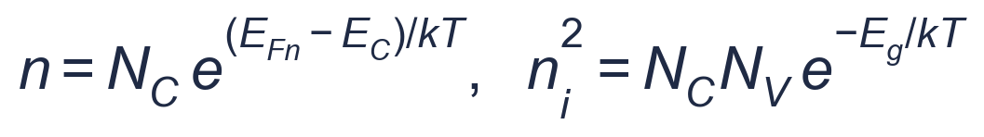
Physical — Carrier Statistics
Shared
Concept. The relation between quasi-Fermi level and carrier density.
SolarLab
SCAPS-1D
▪ Boltzmann statistics by default
▪ Fermi–Dirac and band-gap narrowing not implemented
▪ Boltzmann statistics throughout
▪ Fermi–Dirac evaluated and not adopted
Comparison
Both adopt Boltzmann statistics. SCAPS offers an optional Fermi–Dirac treatment for degenerate layers; SolarLab retains Boltzmann statistics, Fermi–Dirac having been evaluated and found to shift the open-circuit voltage by less than 5 mV for this device while diverging from the SCAPS reference. Consistent statistics are a prerequisite for quantitative agreement.

Slide 11
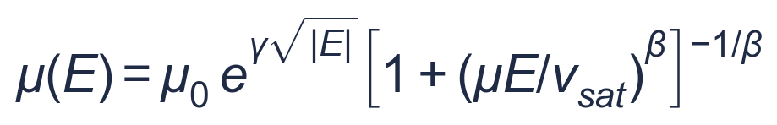
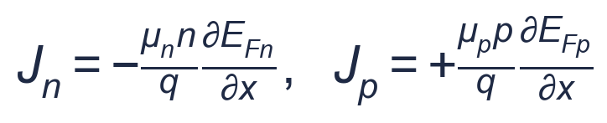
Physical — Carrier Mobility
Differ
Concept. Carrier mobility and its dependence on the electric field.
SolarLab
SCAPS-1D
▪ Constant mobility (Einstein relation), default
▪ Optional field-dependent mobility μ(E)
▪ Constant per-layer mobility
▪ No field-dependent model
Comparison
Both use constant per-layer mobilities in the baseline configuration. SolarLab additionally provides an optional field-dependent mobility (Poole–Frenkel enhancement with velocity saturation) appropriate to disordered transport layers at high field. This option is inactive in the parity configuration and therefore does not contribute to the comparison.

Slide 12
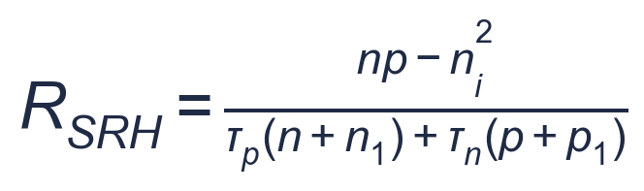
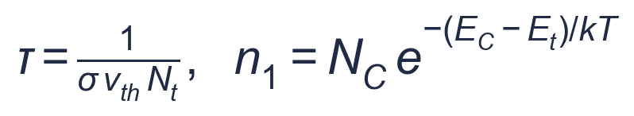
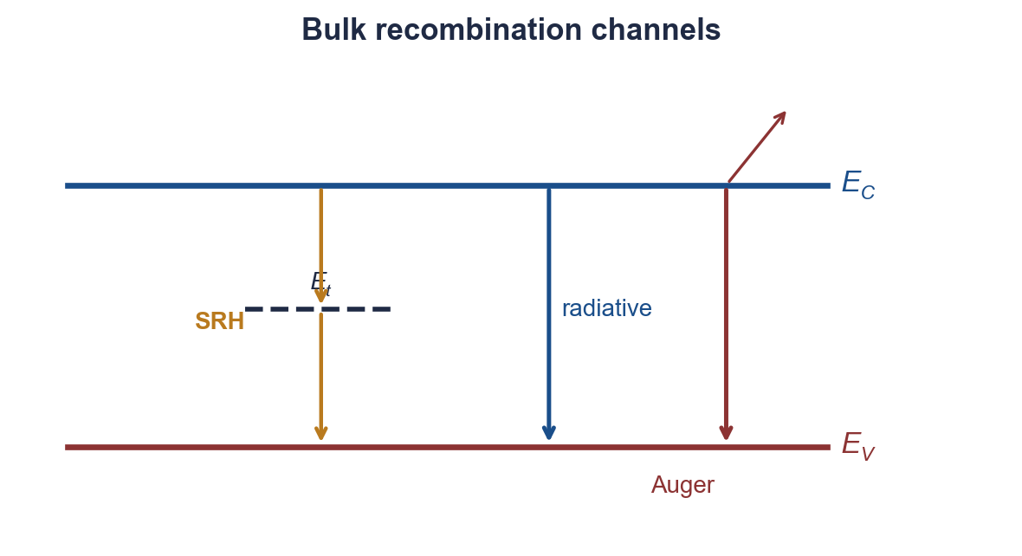
Physical — Bulk Recombination
Shared
Concept. Bulk carrier-loss mechanisms.
SolarLab
SCAPS-1D
▪ SRH, radiative and Auger recombination
▪ SRH parameterized by cross-section and defect density
▪ SRH, radiative and Auger recombination
▪ SRH parameterized by lifetime; optional photon recycling
Comparison
The two solvers implement the same three recombination channels and differ only in the parameterization of the SRH rate—lifetime (SolarLab) versus capture cross-section and defect density (SCAPS), which reduce to the same lifetime. SolarLab additionally supports photon recycling, whereas SCAPS treats radiative emission as a terminal loss.

Slide 13
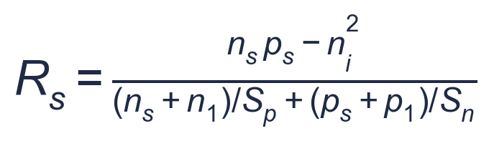
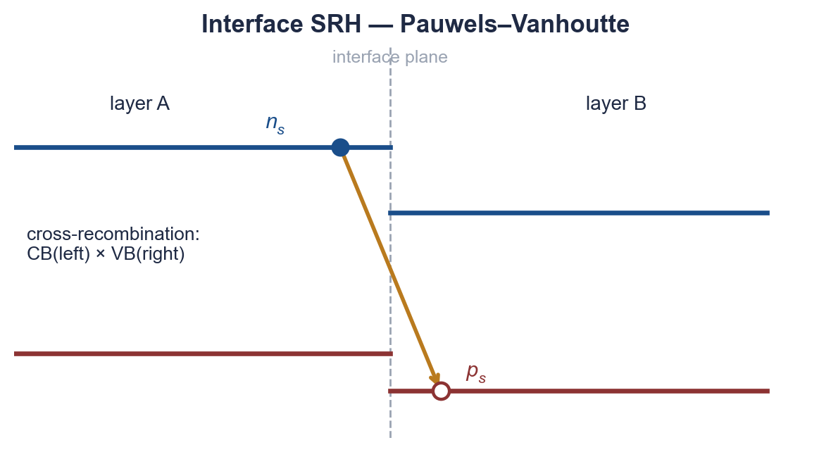
Physical — Interface Recombination
Differ
Concept. Recombination at heterointerfaces.
SolarLab
SCAPS-1D
▪ Surface recombination from near-interface densities
▪ Hierarchy up to interface-plane carrier states
▪ Single-plane Pauwels–Vanhoutte model
▪ Evaluated on interface-plane densities
Comparison
Interface recombination is the principal source of residual discrepancy. SCAPS evaluates the rate on the carrier densities at the interface plane, which are suppressed by band bending and accumulate under bias. SolarLab's default samples the adjacent interior nodes; a hierarchy of formulations, including thermionic-emission-coupled interface-plane states, was developed to reproduce the SCAPS treatment. Quantitative closure of this axis remains an open item.

Slide 14
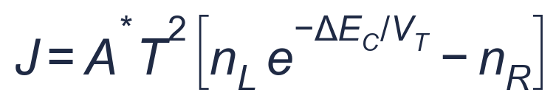
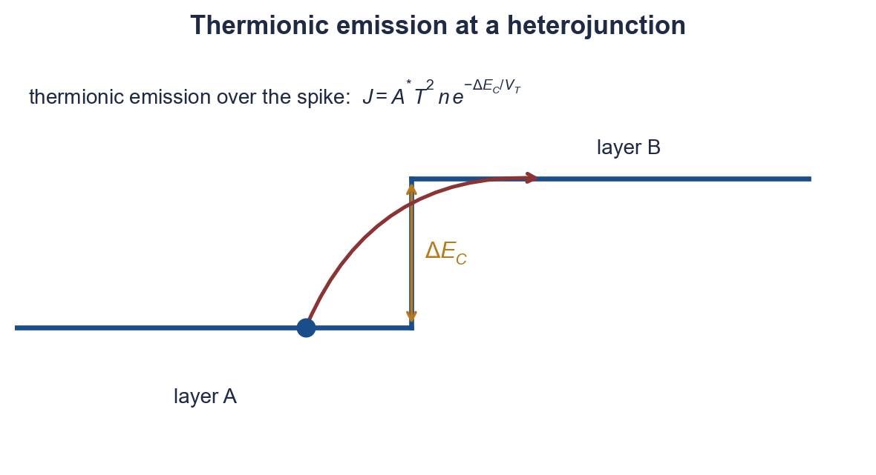
Physical — Thermionic Emission
Differ
Concept. Carrier transport across a band-edge discontinuity.
SolarLab
SCAPS-1D
▪ Thermionic-emission cap on the SG current
▪ Active for offsets exceeding 0.05 eV
▪ Thermionic emission as the interface boundary condition
▪ Finite quasi-Fermi step at all offsets
Comparison
At a band-edge discontinuity SolarLab limits the Scharfetter–Gummel current to the Richardson–Dushman thermionic value, activated above a 0.05 eV offset. SCAPS imposes thermionic emission as the interface boundary condition, retaining a small quasi-Fermi-level step even at zero offset. The formulations diverge at large conduction-band spikes, for example at the onset of the short-circuit-current reduction near a +0.5 eV ETL offset.

Slide 15
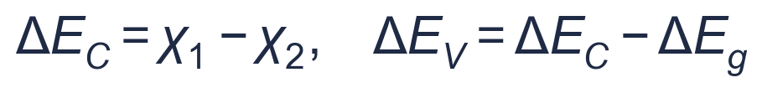
Physical — Band Offsets and Effective Density of States
Differ
Concept. Heterojunction band alignment and the density-of-states contribution to the band potential.
SolarLab
SCAPS-1D
▪ Band edges from χ, E_{g}; effective-DOS term included
▪ Term restored as the default
▪ χ, E_{g}, N_{C}, N_{V} applied directly
▪ Effective-DOS term inherent
Comparison
Both construct heterojunctions from the electron affinity and band gap. Under Boltzmann statistics the band potential carries an effective-density-of-states term (V_{T} ln N_{C}) at each junction. SCAPS incorporates this term implicitly; its omission in the original SolarLab formulation introduced a spurious 137 mV quasi-Fermi-level step that accounted for the open-circuit-voltage discrepancy. Restoring the term, now the default, removed the discrepancy.

Slide 16
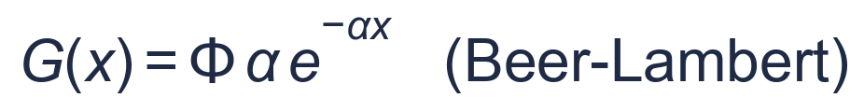
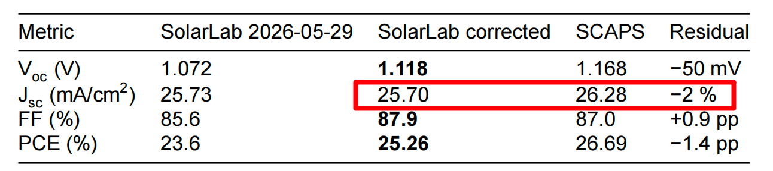
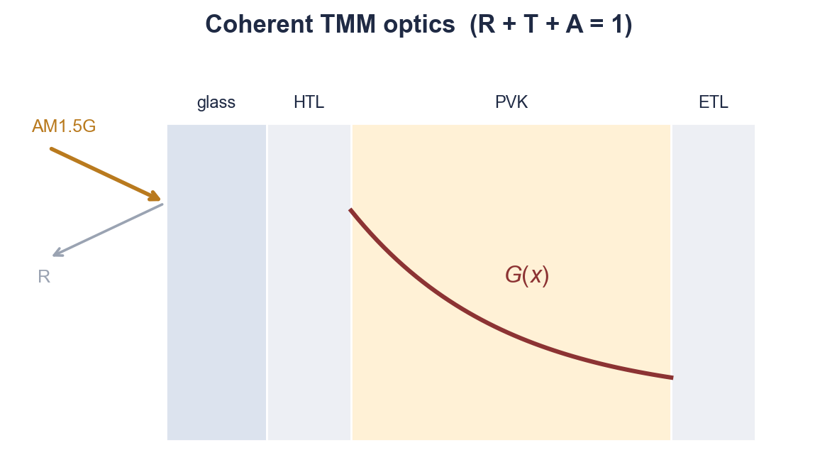
Physical — Optical Generation
Differ
Concept. Computation of the optical generation profile.
SolarLab
SCAPS-1D
▪ Coherent transfer-matrix optics (R+T+A=1)
▪ Includes front-surface reflection
▪ Beer–Lambert absorption; reflectionless front (R=0)
▪ External generation profile optional
Comparison
SolarLab computes the generation profile with a coherent transfer-matrix method that accounts for front-surface reflection and thin-film interference under energy conservation. SCAPS adopts Beer–Lambert absorption with an idealized reflectionless front by default. The resulting 2–3% higher SCAPS short-circuit current corresponds to the observed J_{sc} residual, the SolarLab optical model being the more physically complete.

Slide 17
Physical — Contact Boundary Conditions
Differ
Concept. Boundary conditions imposed at the electrodes.
SolarLab
SCAPS-1D
▪ Flat-band-metal electrodes (work function Φ_{m})
▪ Finite surface recombination velocities
▪ Ideal-ohmic contacts (IonMonger convention), default
▪ Selective and flat-band-metal options
Comparison
SolarLab applies ideal-ohmic Dirichlet contacts by default, following the IonMonger convention. SCAPS models flat-band-metal electrodes characterized by a work function and finite surface recombination velocities. SolarLab provides a flat-band-contacts mode that reproduces the SCAPS convention, so the difference is one of configuration.

Slide 18
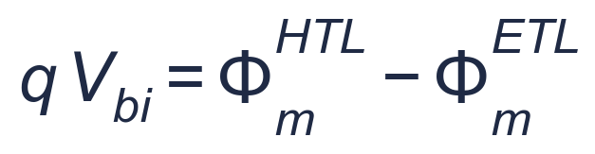
Physical — Built-in Potential
Shared
Concept. The equilibrium built-in potential.
SolarLab
SCAPS-1D
▪ From the Fermi-level difference across the stack
▪ Equals the work-function difference
▪ From the contact work-function difference
▪ Self-consistent with bands and doping
Comparison
Both derive the built-in potential from the contact work-function difference and obtain the same value (1.294 V for this device). An earlier hypothesis attributing the voltage discrepancy to the built-in potential was not supported: the two solvers agree on this quantity, and the discrepancy was traced to the density-of-states term.

Slide 19
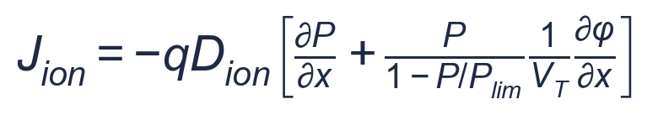
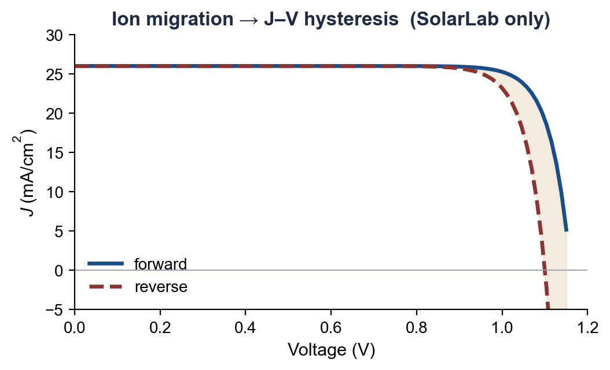
Physical — Mobile Ions
SolarLab only
Concept. Migration of ionic species in the perovskite absorber.
SolarLab
SCAPS-1D
▪ No mobile-ion model
▪ Fixed ionized dopants and defects only
▪ Mobile ions as drift-diffusion species
▪ Ionic charge coupled to Poisson; yields hysteresis
Comparison
Mobile ionic defects in the perovskite absorber migrate under bias and govern the scan-rate and scan-direction dependence of the J–V characteristic. SolarLab represents these as drift-diffusion species whose charge enters Poisson's equation, so hysteresis follows from the transport model. SCAPS is a purely electronic steady-state solver and does not represent ion migration. The capability is immaterial to static comparison but essential to dynamic perovskite behaviour.

Slide 20
Physical — Defect Representation
Differ
Concept. Representation of defect states.
SolarLab
SCAPS-1D
▪ Explicit defect density and cross-section; up to seven per layer
▪ Donor/acceptor/neutral, multivalent, distributed in energy
▪ Bulk SRH via lifetime; optional depth profiles
▪ Interface defects from trap energy and SRV
Comparison
Both describe the same loss physics. SCAPS supports up to seven defects per layer of donor, acceptor, neutral or multivalent character, with single, uniform, Gaussian or band-tail energy distributions. SolarLab employs a lumped lifetime with optional depth profiles. The descriptions are equivalent for the single-level defects of the validation case; the additional generality is relevant to complex defect spectra.

Slide 21
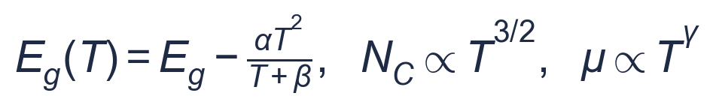
Physical — Temperature Dependence
Differ
Concept. Temperature dependence of the material parameters.
SolarLab
SCAPS-1D
▪ N_{C}, N_{V} (∝T^{3/2}), thermal velocity and kT scale
▪ Remaining parameters user-specified per temperature
▪ Built-in scaling of V_{T}, ni, μ, D_{ion} and Varshni E_{g}
▪ Applied consistently to bands and ni
Comparison
Both solvers operate at a specified temperature. SolarLab applies built-in temperature laws for the thermal voltage, intrinsic density, mobility, ionic diffusivity and the Varshni band gap, propagated self-consistently. In SCAPS only the effective densities of states, thermal velocity and thermal voltage scale automatically; the remaining parameters are specified by the user at each temperature. The distinction concerns automation rather than the underlying physics.

Slide 22
Physical — Tunnelling
SCAPS only
Concept. Quantum-mechanical transport through a potential barrier.
SolarLab
SCAPS-1D
▪ Not modeled; thermionic transport only
▪ Deferred to a future version
▪ Optional WKB tunnelling (four mechanisms)
▪ Disabled for the present study
Comparison
SCAPS provides optional WKB tunnelling—band-to-band, intra-band, trap-assisted and contact tunnelling—relevant to tunnel junctions and degenerate doping. SolarLab does not model tunnelling. As tunnelling is disabled in SCAPS for the present validation, this axis does not contribute to any difference in the reported results.

Slide 23
Summary
Both solvers share the same governing system and discretization; they differ in physical scope and a small number of interface and contact conventions.
Shared formulation
Principal differences
▪ Poisson and two carrier-continuity equations
▪ Scharfetter–Gummel exponential-fitting flux
▪ Boltzmann carrier statistics
▪ SRH, radiative and Auger recombination
▪ Heterojunction band offsets; thermionic emission
▪ Gummel/Newton steady-state solution
▪ Time-dependent versus steady-state formulation
▪ Mobile-ion transport and hysteresis (SolarLab)
▪ Transfer-matrix versus Beer–Lambert optics
▪ Interface recombination: plane-state hierarchy versus Pauwels–Vanhoutte
▪ Field-dependent mobility, photon recycling, temperature laws (SolarLab)
▪ Multivalent defects, tunnelling, parasitic resistance (SCAPS)

