Slide 1
High-throughput DFT and small-sample ML for chalcogenide PV absorber discovery, with device-scale validation
Xuanyan Chen et al.
HKUST(GZ) — 3rd JMI conference 2026

Slide 2
01
PROBLEM

Slide 3
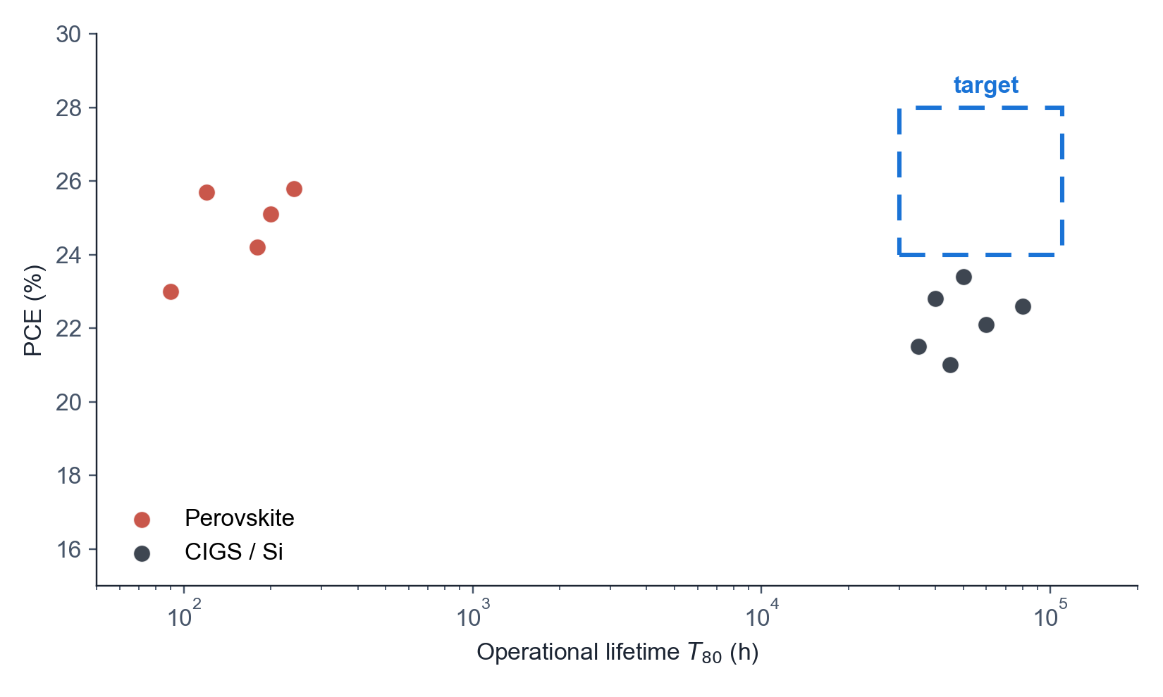
01 · PROBLEM
2 / 32
Efficiency–stability design space for thin-film photovoltaics
Two established regimes, one unoccupied region
• Si: indirect band gap, ~22 % single-junction PCE ceiling, T₈₀ > 10⁴ h
• CIGS: direct-gap chalcogenide, 23.4 % record, constrained by In and Ga reserves
• Perovskite: PCE > 26 %, T₈₀ frequently < 500 h under 1-sun, 85 °C
• Detailed-balance limit at E_{g} ≈ 1.34 eV reaches 33.7 % [Shockley & Queisser 1961]
• Target region: PCE > 25 % combined with T₈₀ > 10⁵ h is currently unoccupied
• These constraints motivate a third absorber class with a direct or near-direct gap
SOLARLAB

Slide 4
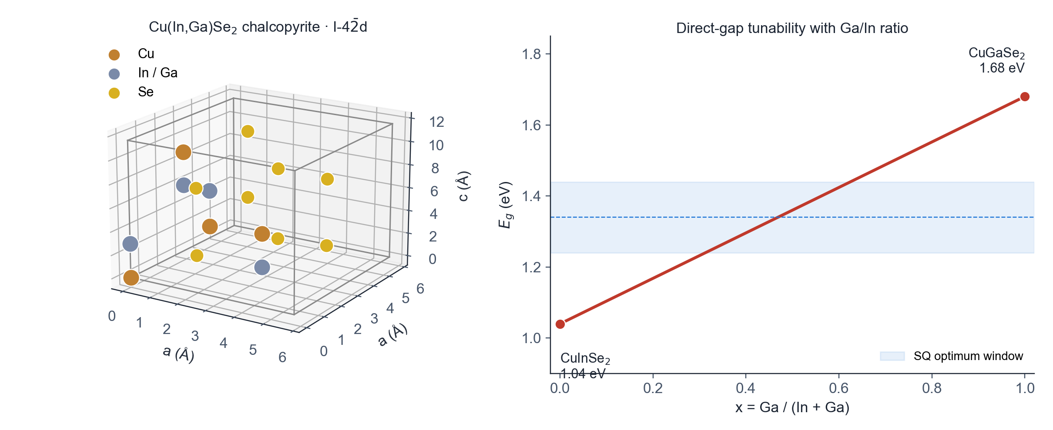
01 · PROBLEM
3 / 32
CIGS — Cu(In,Ga)Se₂ chalcopyrite absorber
Tetragonal I-4̄2d · cation-ordered diamond-like sublattice · tunable direct gap
• Stoichiometry Cu(In,Ga)Se₂; In and Ga share a single cation site at composition x = Ga / (In + Ga)
• Lattice parameters a ≈ 5.78 Å · c ≈ 11.62 Å with c / a ≈ 2 (chalcopyrite = doubled zincblende)
• Direct band gap tunable approximately linearly from 1.04 eV (CuInSe₂) to 1.68 eV (CuGaSe₂)
• Polycrystalline thin-film absorber 1–3 µm on a Mo back contact; CdS / ZnO buffer + window stack
• Champion lab cell PCE 23.4 % (Solar Frontier 2019); module reliability T₈₀ > 25 yr in field
• In-free sister chalcogenide kesterite Cu₂ZnSn(S,Se)₄ explored at HKUST(GZ) [Yan et al. Nat. Energy 2018 · ACS Energy Lett. 2017]
SOLARLAB

Slide 5
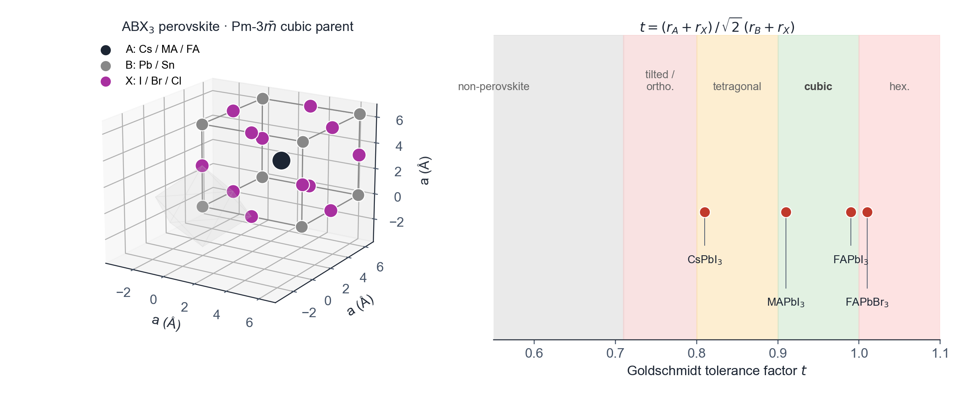
01 · PROBLEM
4 / 32
Perovskite — ABX₃ structural family
Pm-3̄m cubic parent · corner-sharing BX₆ octahedral framework
• General formula ABX₃: A = Cs⁺ / MA⁺ (CH₃NH₃⁺) / FA⁺ · B = Pb²⁺ / Sn²⁺ · X = I / Br / Cl
• BX₆ octahedra share corners; A cation occupies the 12-coordinated cuboctahedral void
• Stability set by Goldschmidt tolerance factor t = (r_{A} + r_{X}) / (√2 (r_{B} + r_{X})); cubic perovskite for 0.9 ≤ t ≤ 1.0
• Direct band gap, strong absorption (α ≈ 10⁵ cm⁻¹ near band edge), long carrier diffusion lengths
• Champion single-junction PCE 26.7 % (UNIST 2024); inverted PSC 22.3 % via ligand anchoring [Hou et al. Nat. Energy 2020]
• Tandem records: monolithic perovskite / Si tandem and 24.2 % all-perovskite tandem [Hou et al. Science 2020 · Nat. Energy 2020]
SOLARLAB

Slide 6
01 · PROBLEM
5 / 32
Limitations of the established absorbers
Record-cell PCE timeline and accelerated-aging stability gap
• Si record 27.6 % (UNSW 2024) — five decades of incremental improvement
• Perovskite record 26.7 % (UNIST 2024) — single-junction parity with Si in under a decade
• Stability gap remains > 100× under operating stress (ion migration, A-site loss, photo-induced degradation)
• Encapsulation mitigates ingress but does not address intrinsic absorber-side instability [Boyd et al. 2019]
• Module-scale commercial deployment requires both record-class efficiency and outdoor lifetime
• Motivates the discovery of new absorber chemistries that satisfy both criteria simultaneously
SOLARLAB

Slide 7
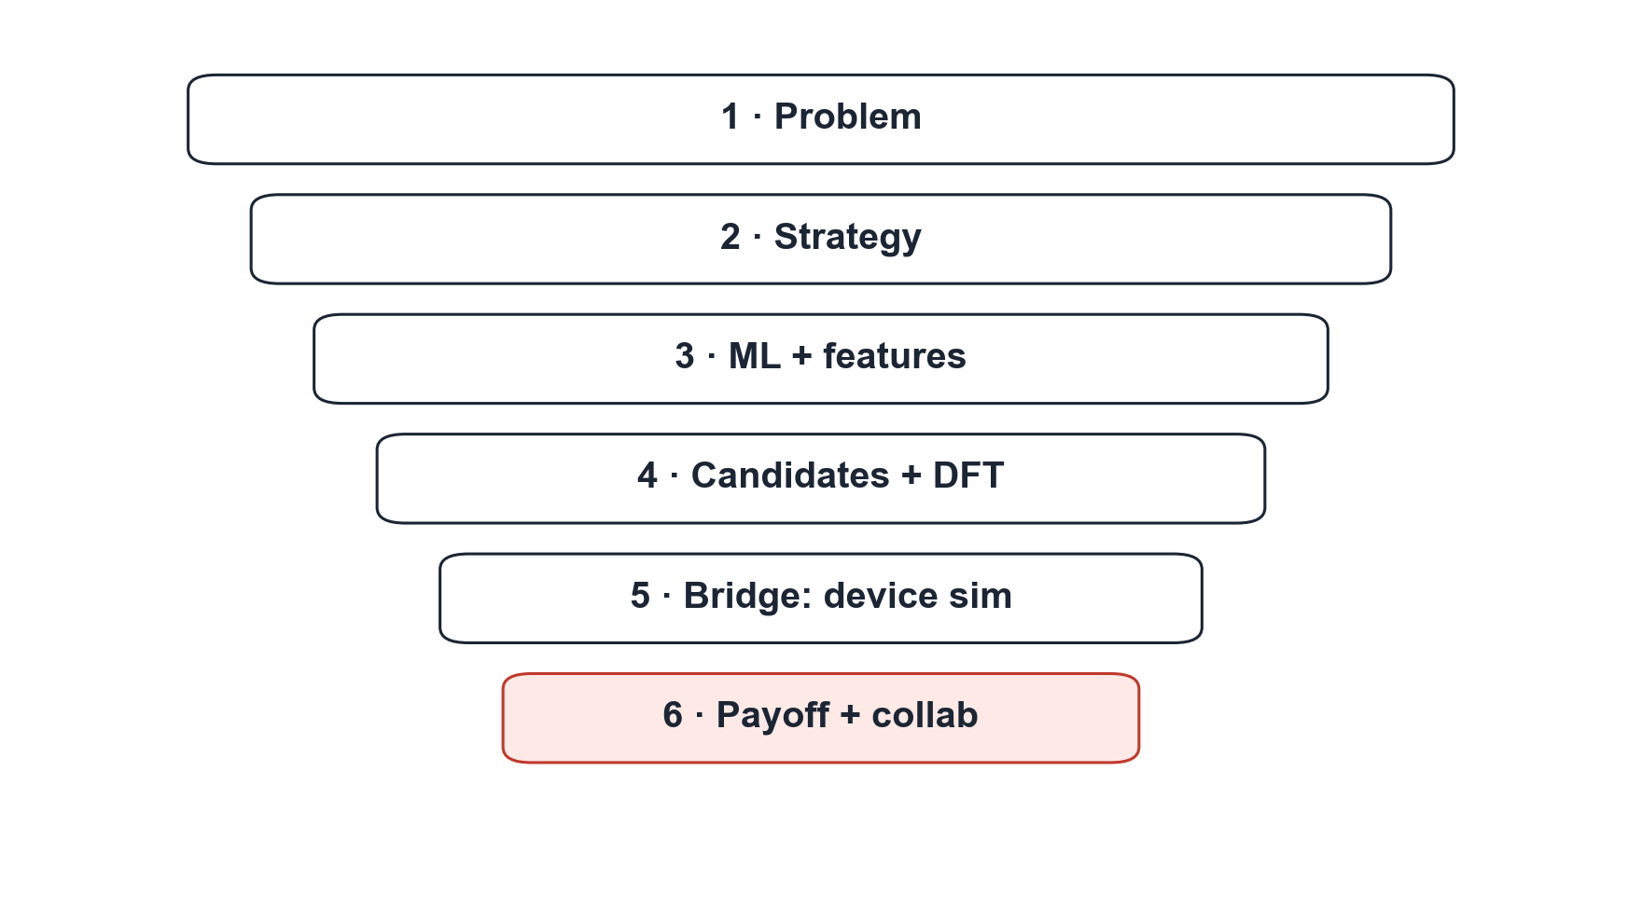
01 · PROBLEM
6 / 32
Talk outline
Six stages connecting the materials database to predicted device performance
• 01 PROBLEM — efficiency–stability tradeoff, CIGS and perovskite definitions (5 slides)
• 02 STRATEGY — chalcogenide structural template
• 03 ML AND FEATURES — small-sample HSE06 surrogate (8 slides)
• 04 CANDIDATES — fourteen-material shortlist
• 05 BRIDGE — 1D and 2D drift-diffusion device simulation (8 slides)
• 06 PAYOFF — predicted device J–V and outlook
SOLARLAB

Slide 8
02
STRATEGY

Slide 9
02 · STRATEGY
7 / 32
Chalcogenide templates as the structural prior
AB₂C₄ and ABC₃ frameworks with heavy-p-block cations on chalcogen anions
• Anion sublattice: S, Se, Te. Selenides comprise 11 of 14 shortlisted candidates, including the top six
• Active cation: Sb, Sn, Bi (6s² / 5s² lone pair) producing dispersive valence-band maxima
• Spectator cation: Cs, Ca, Sr, K donate charge without contracting the valence-band dispersion
• Stoichiometry preference: AB₂C₄ ≫ ABC₃ ≈ ABC₂ in the screened subset
• Symmetry distribution: Pnma (SG 62) is dominant; followed by SG 12, 14, 72 and 15
• Constrains the > 10⁵ candidate pool to a physically plausible, synthetically accessible subspace
SOLARLAB

Slide 10
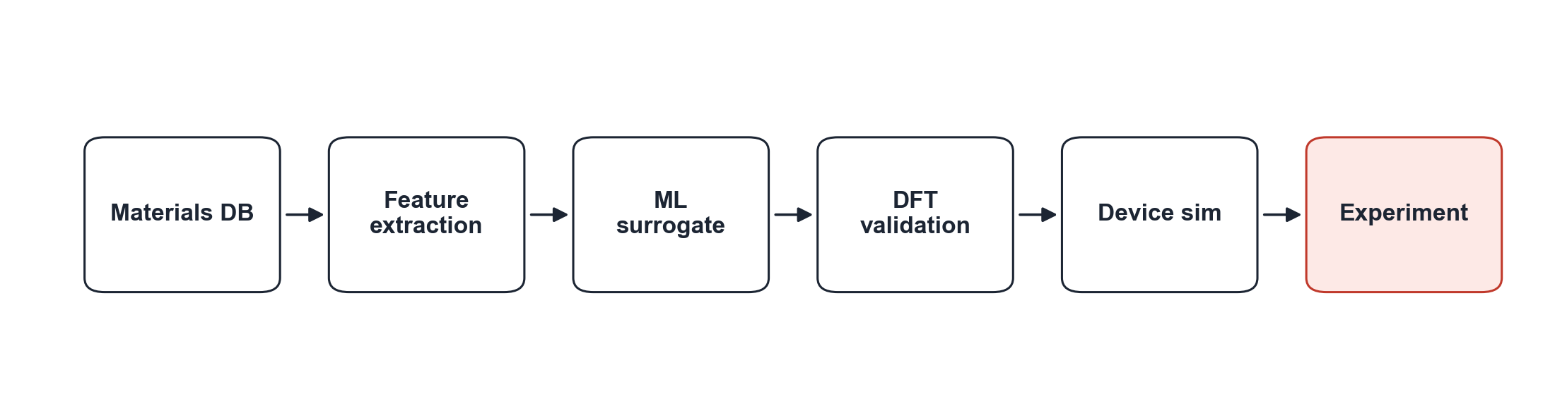
02 · STRATEGY
8 / 32
End-to-end pipeline
MP / OQMD → ML surrogate → DFT validation → device sim → expt
SOLARLAB

Slide 11
03
ML + FEATURES

Slide 12
03 · ML + FEATURES
9 / 32
Motivation for a learned surrogate
Four-stage HSE06 and DFPT workflow executed in VASP for each candidate
• Stage 1 PBE relaxation → Stage 2 SCF → Stage 3 DFPT dielectric tensor → Stage 4 HSE06 band structure
• DFPT and HSE06 dominate runtime, requiring 10⁰–10² CPU-hours per structure on a 64-core node
• PBE relaxation scales as O(N³) in plane-wave eigensolve; HSE06 adds ~10× overhead via exact exchange [Heyd et al. 2003]
• DFPT dielectric tensor obtained from the linear-response Sternheimer equation at ~2× SCF cost [Baroni et al. 2001]
• Combined MP and OQMD pool exceeds 10⁵ candidates, rendering full-DFT enumeration computationally infeasible
• Approach: train a learned surrogate on 473 DFT-labelled materials and use it to rank the unlabelled pool
SOLARLAB

Slide 13
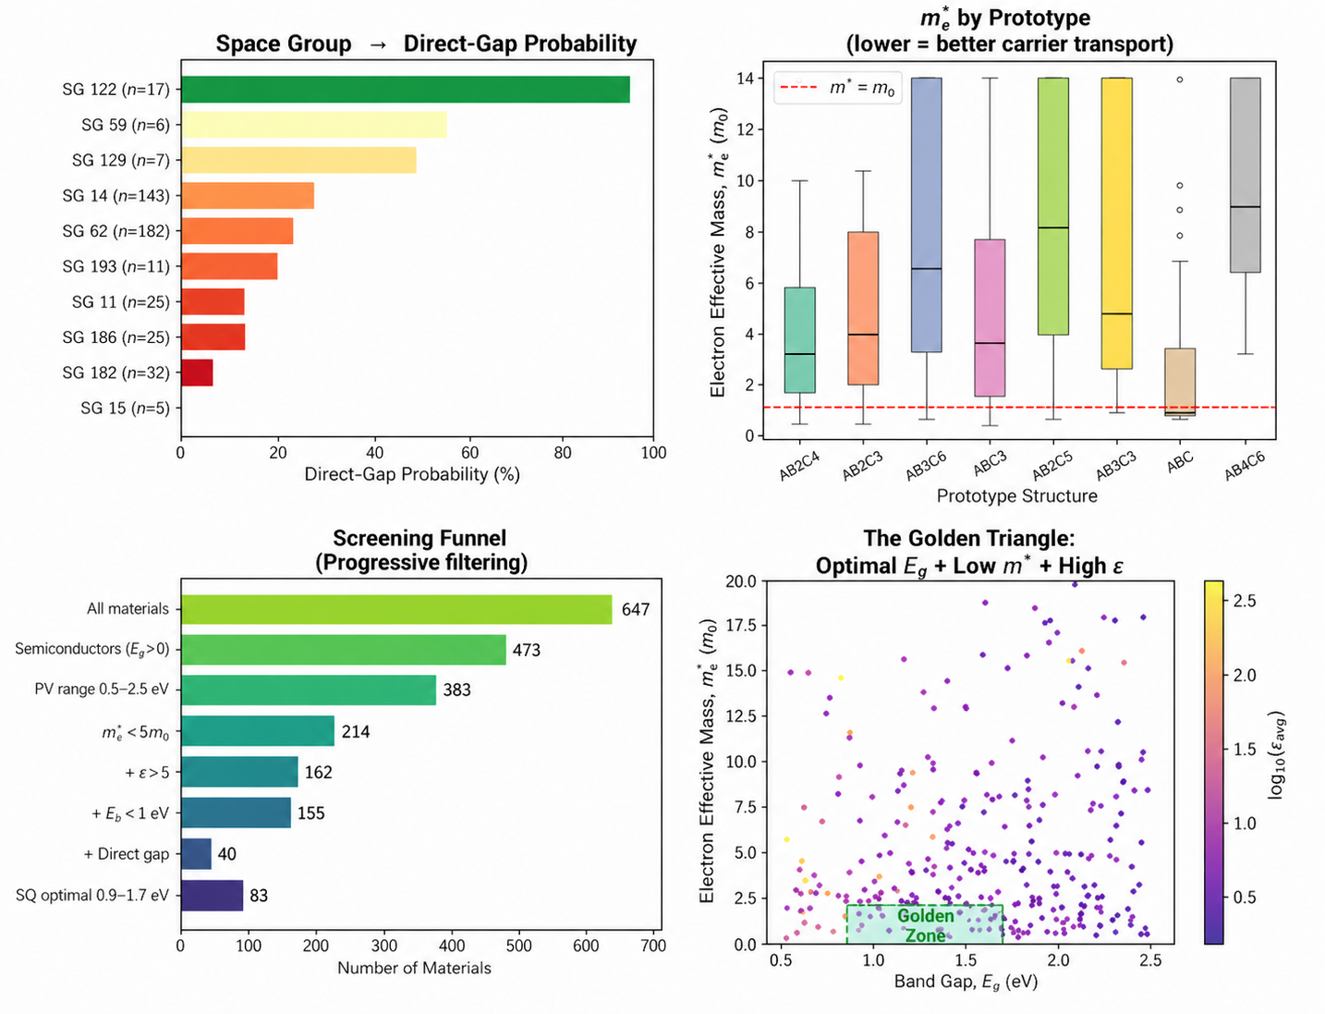
03 · ML + FEATURES
10 / 32
Hand-crafted feature set (167 D)
Composition · structure · symmetry — Magpie + matminer
• Composition (~27 D): Magpie statistics over Z, χ, atomic radius, row, group, mass [Ward et al. 2016]
• Magpie reduces a formula A_{a}B_{b}C_{c} to mean / std / min / max / mode of element properties weighted by stoichiometry
• Structure (140 D): CrystalNN site-fingerprint (122) + RDF + density + packing [matminer · Ward et al. 2018]
• All featurisers tolerate NaN — routed to the appropriate side of every HistGBR split
• Cached numpy matrices on disk → re-fits run in seconds, not minutes
• Frozen MEGNet 16-D embeddings give R² = 0.366 — below hand-features baseline [Chen et al. 2019]
SOLARLAB

Slide 14
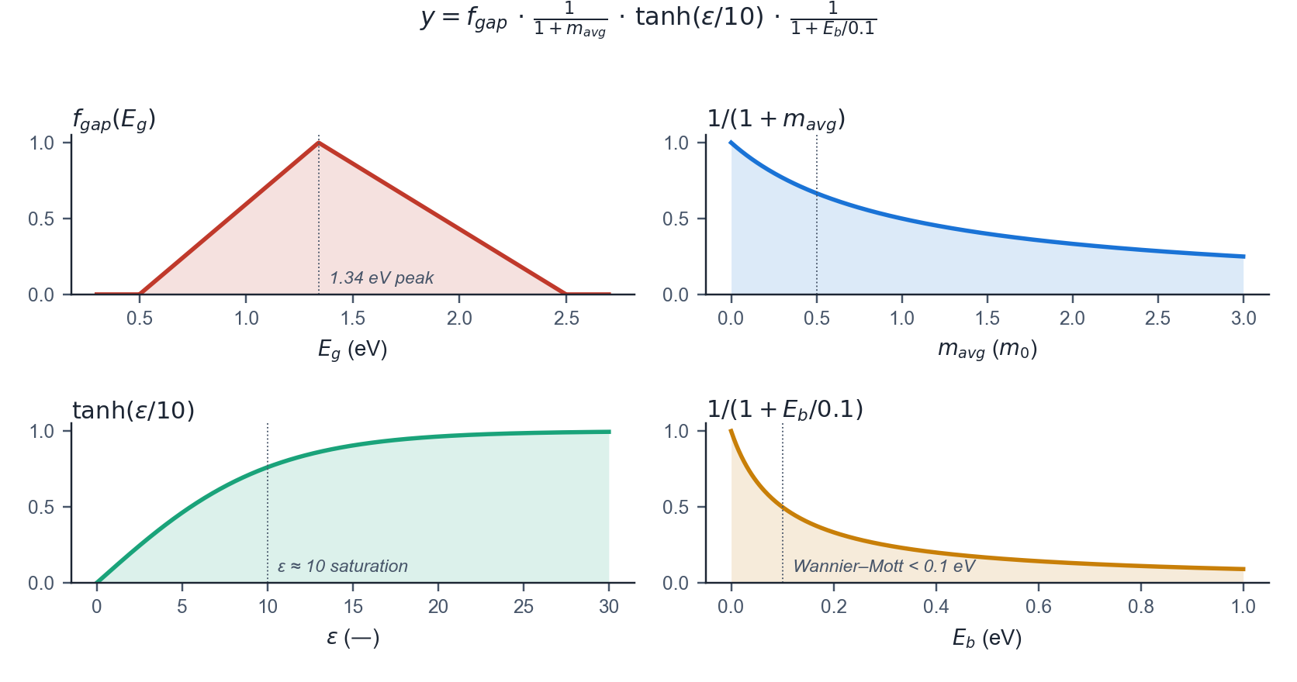
03 · ML + FEATURES
11 / 32
Composite photovoltaic figure of merit
Purpose: give the ML model one bounded scalar target — each factor bakes in a known PV constraint so a high score is hard to fake
• Why a single y: separate regressors for E_{g}, m*, ε and E_{b} would each pick its own optimum; the product enforces all four jointly
• y = f_{gap}(E_{g}) · 1 / (1 + m_{avg}) · tanh(ε / 10) · 1 / (1 + E_{b} / 0.1) — bounded in [0, 1], differentiable [Yu & Zunger 2012 · Lu et al. 2018]
• f_{gap}: triangular Shockley–Queisser window peaked at 1.34 eV — penalises wide-gap and narrow-gap absorbers [Shockley & Queisser 1961]
• 1 / (1 + m_{avg}): rewards low effective mass and therefore high carrier mobility
• tanh(ε / 10): saturates above ε ≈ 10 — reflects diminishing returns once free-carrier screening dominates
• 1 / (1 + E_{b} / 0.1): favours Wannier–Mott regimes (E_{b} < 0.1 eV) — penalises Frenkel-exciton systems
SOLARLAB

Slide 15
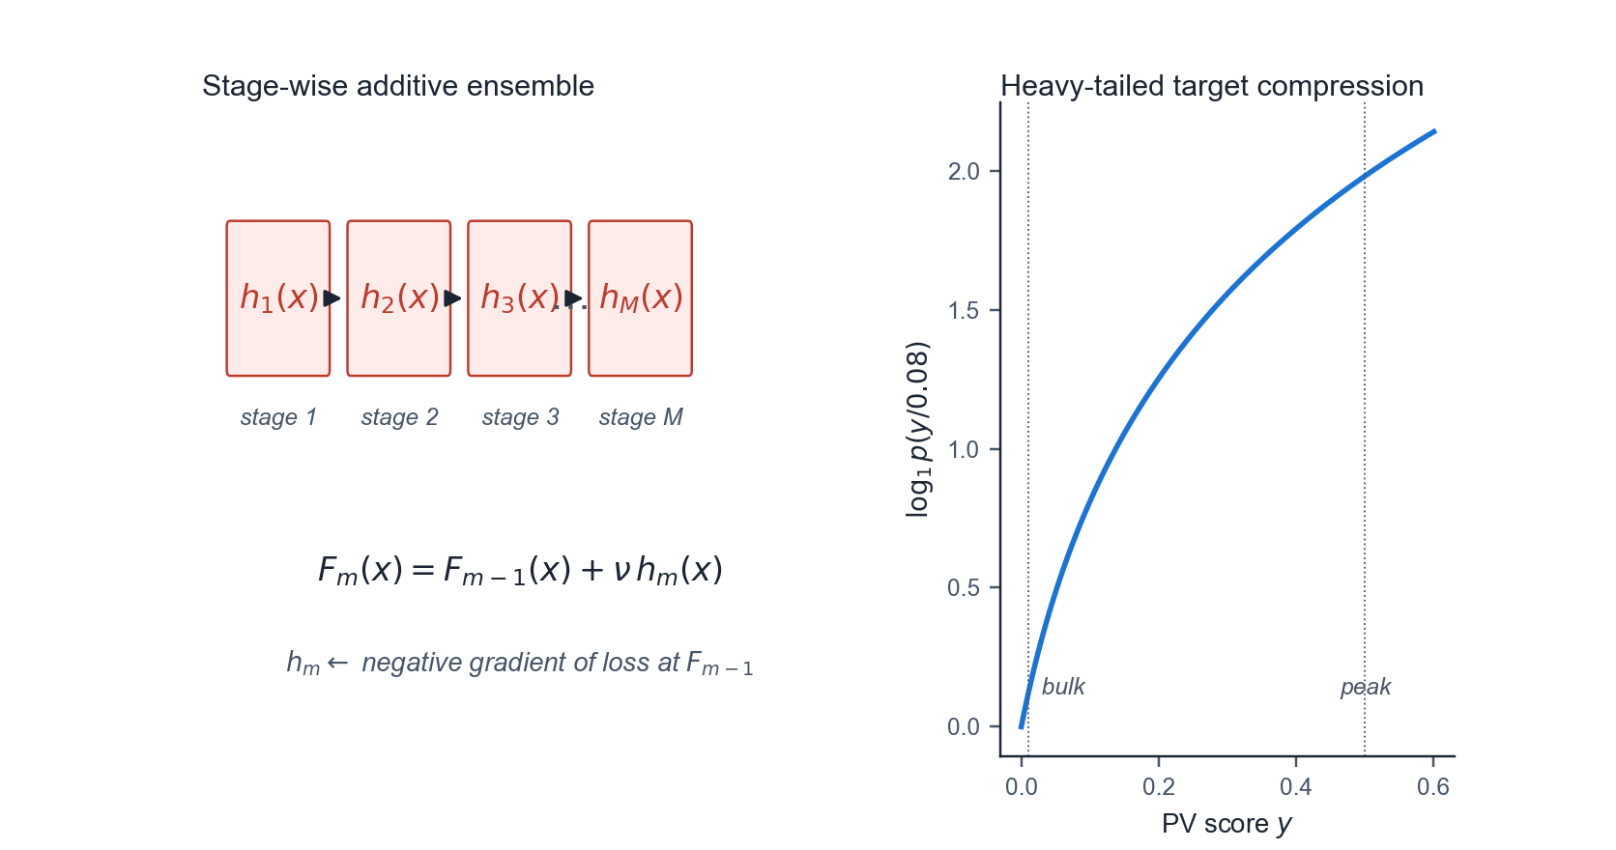
03 · ML + FEATURES
12 / 32
Histogram-based gradient boosting regression
Purpose: best-performing mean predictor on 473 heterogeneous tabular samples — each new tree corrects the previous tree's errors
• Why HistGBR: handles mixed compositional + structural features, native NaN, fast at our 473-sample scale [Friedman 2001 · Ke et al. 2017]
• Stage-wise additive: F_{m}(x) = F_{m-1}(x) + ν · h_{m}(x), where h_{m} fits the residual of stage m − 1
• Histogram binning (256 buckets) reduces a split scan from O(N) to O(B) — roughly a 3× speedup over standard GBR
• Native NaN: each missing value learns an independent split direction — no imputation step needed
• Hyperparameters: 600 boosting iterations · depth 4 · learning rate 0.05 · minimum 10 samples per leaf
• Target wrapped in log₁p(y / 0.08) — compresses the heavy-tailed PV-score distribution so the booster resolves the peak (y ≈ 0.5) and the bulk (y ≈ 0.01) equally well
SOLARLAB

Slide 16
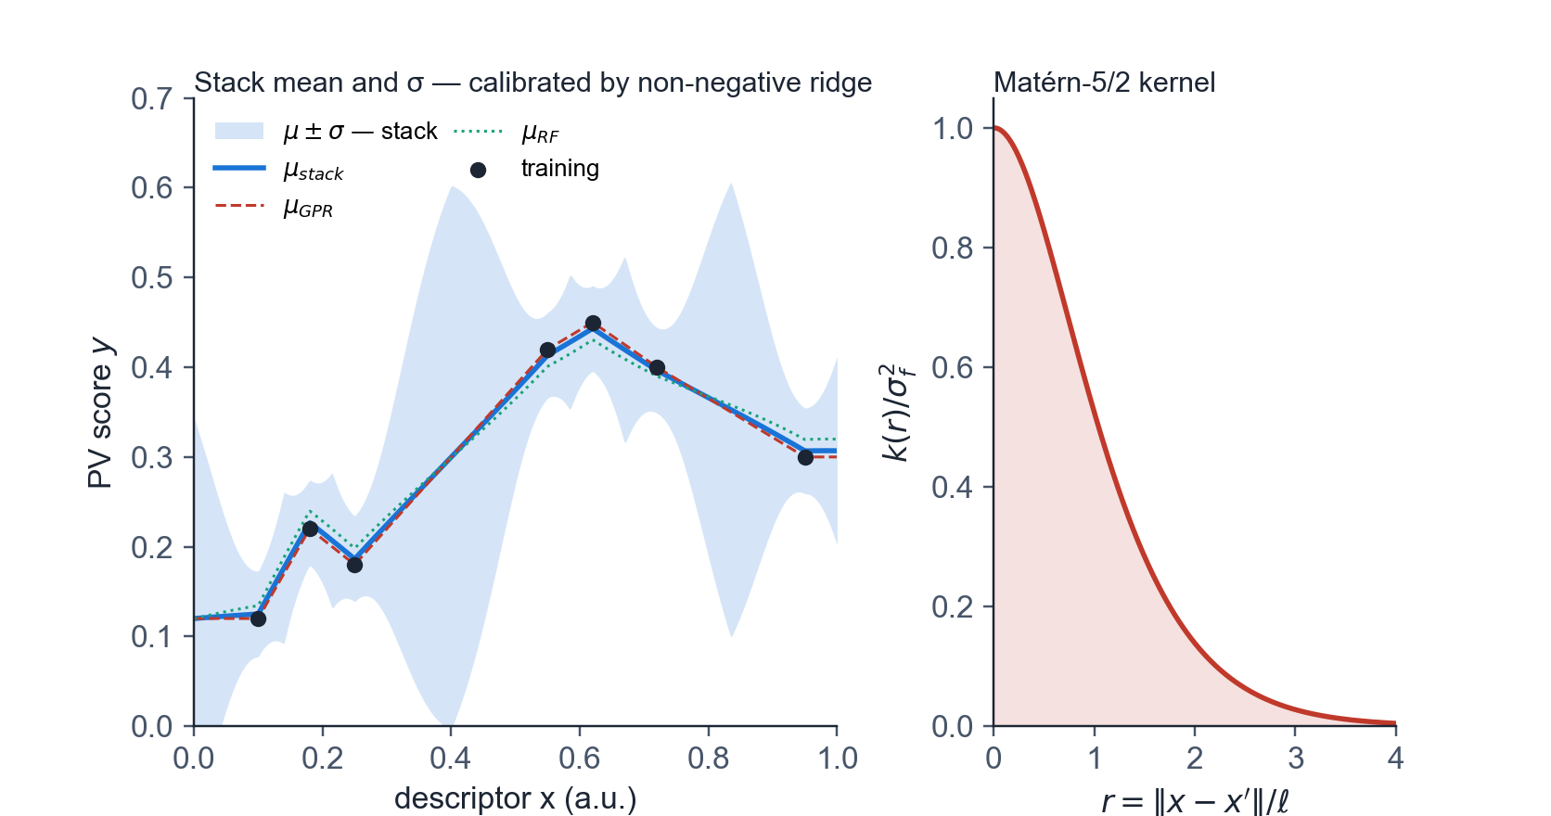
03 · ML + FEATURES
13 / 32
Gaussian-process and random-forest uncertainty stack
Purpose: produce a calibrated σ(x) for active learning — GP gives smooth posterior std, RF rescues it where training data is sparse
• Why a stack: a lone GP is overconfident in unsampled regions; a lone RF lacks closed-form σ — combining the two restores calibration
• GP kernel: Matérn-5/2 with anisotropic length scale ℓ optimised by L-BFGS-B on the marginal log-likelihood [Rasmussen & Williams 2006]
• White-noise variance σ_{n}² absorbs DFT scatter, typically 0.02 – 0.05 on the log target
• Random-forest predictor (300 trees) gives an empirical σ from per-tree variance — non-zero where the GP collapses to its prior
• Stack mean: μ = w_{GP} μ_{GPR} + w_{RF} μ_{RF} · variance: σ² = w_{GP}² σ_{GPR}² + w_{RF}² σ_{RF}²
• Mixing weights are fit by non-negative ridge regression on out-of-fold predictions — guarantees calibrated coverage
SOLARLAB

Slide 17
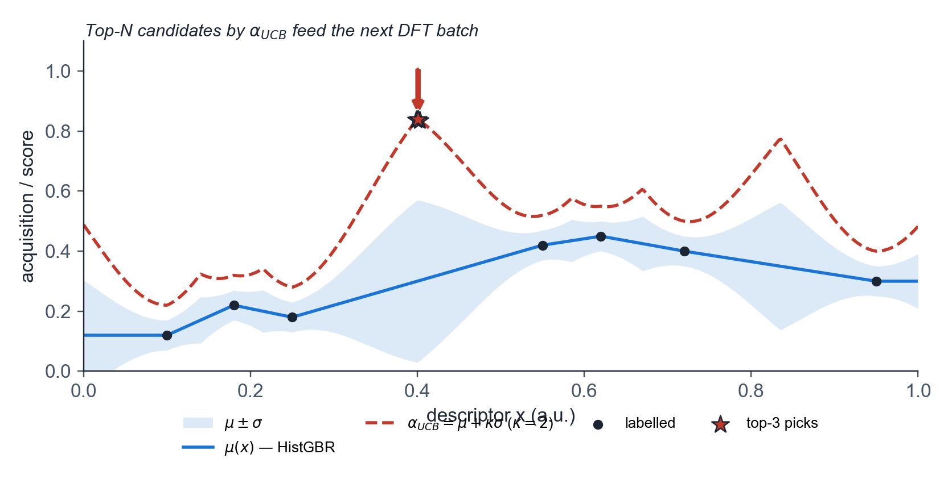
03 · ML + FEATURES
14 / 32
Upper-confidence-bound acquisition for active learning
Purpose: under a finite DFT budget, pick the N candidates that teach the model the most — high μ (likely winners) OR high σ (under-explored regions)
• Why UCB: closed-form, parameter-free, monotone in both μ and σ — well-studied limit of Bayesian-optimisation acquisition functions [Snoek et al. 2012]
• α_{UCB}(x) = μ(x) + κ · σ(x), with κ = 2 — standard exploitation / exploration trade-off
• Decoupled μ and σ: μ from HistGBR (accurate mean predictor); σ from the GPR + RF stack (calibrated uncertainty)
• Why decouple: a single model that gives both μ and σ has its mean degraded by uncertainty regularisation — separating the two avoids that loss
• Top-N entries by α become the next active-learning DFT batch; returned labels are fed back into both models
• Outcome: focuses DFT budget on the high-score tail and the structurally under-explored prototypes — exactly the residual-audit gaps from slide 16
SOLARLAB

Slide 18
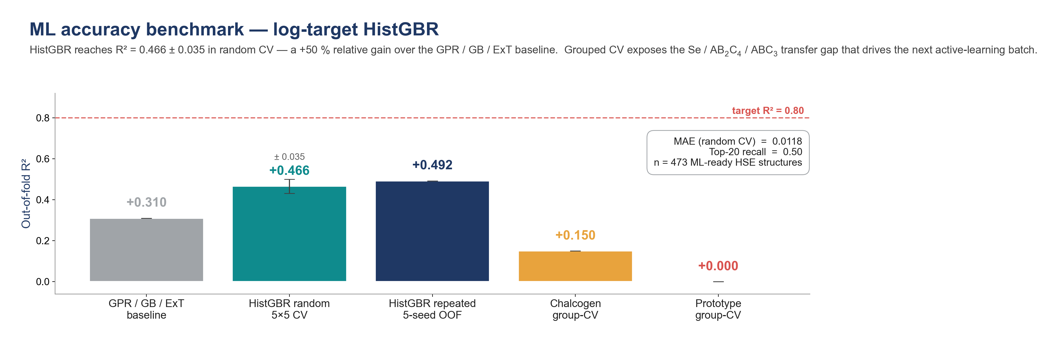
03 · ML + FEATURES
15 / 32
Validation under random and grouped cross-validation
5-fold × 5-seed random CV on n = 473 labelled materials
• HistGBR achieves R² = 0.466 ± 0.035 · MAE = 0.012 · top-20 recall 0.50
• Improves over the prior GPR / GB / ExtraTrees baseline by +50 % in R² (0.31 → 0.466)
• Ablation: GBR 0.399 · ExtraTrees 0.234 · MEGNet fine-tuned 0.307 · MEGNet frozen 0.366
• Repeated out-of-fold averaging across seeds yields global R² = 0.492 and top-20 recall 0.50
• Prototype-grouped CV gives R² ≈ 0, indicating poor extrapolation to unseen structural prototypes
• Chalcogen-family-grouped CV gives R² ≈ 0.15, with Se the most challenging hold-out
SOLARLAB

Slide 19
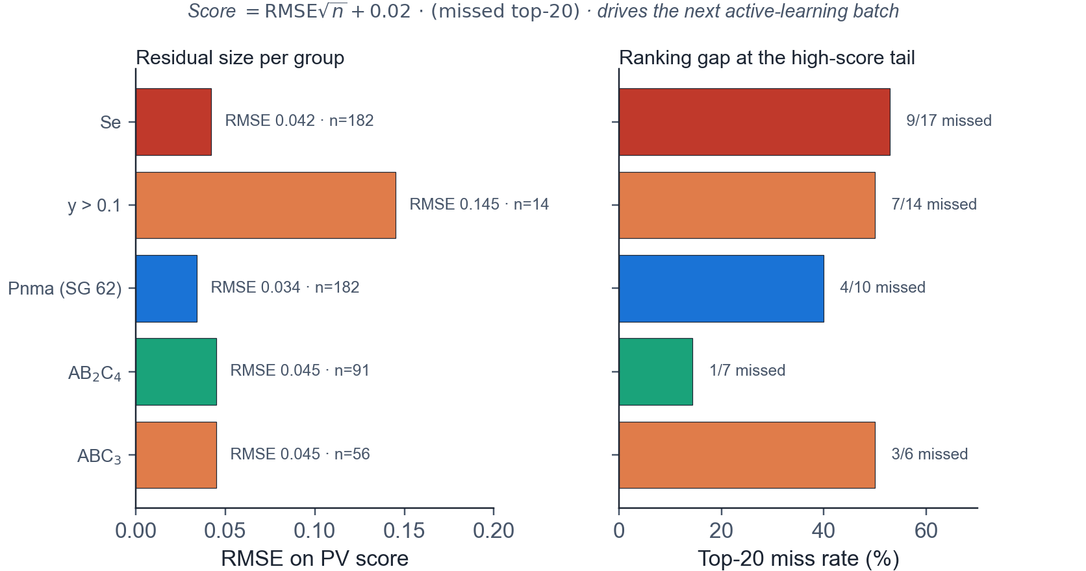
03 · ML + FEATURES
16 / 32
Per-group residual audit
Purpose: random CV says R² = 0.47 (good); grouped CV shows where the model still fails — those gaps drive the next DFT batch
• Priority score = RMSE · √n + 0.02 · (missed top-20) — penalises both regression error and ranking error at the high-score tail
• Se (n = 182): RMSE 0.042, 9 of 17 true top-20 missed — highest priority for the next DFT batch
• High-score bin (y > 0.1, n = 14): RMSE 0.145 — confirms the model under-fits the very tail we care about
• Pnma (SG 62, n = 182): RMSE 0.034, 4 of 10 true top-20 missed — dominant prototype, decent but not perfect
• AB₂C₄ (n = 91): RMSE 0.045, 1 of 7 true top-20 missed — best-covered prototype
• ABC₃ (n = 56): RMSE 0.045, 50 % top-20 miss rate — most pronounced data-coverage gap, top target for grouped expansion
SOLARLAB

Slide 20
04
CANDIDATES

Slide 21
04 · CANDIDATES
17 / 32
Top-fourteen candidates (PV score y > 0.10)
All entries are chalcogenides; eleven of fourteen are selenides; AB₂C₄ is the dominant prototype
• Selenides preferred: 11 of 14 are Se-based and the top six are all Se
• AB₂C₄ supplies 7 of 14 entries; the remainder is split between ABC₃ and ABC₂
• Pnma (SG 62) accounts for 7 of 14; remaining entries fall in SG 12, 14, 72 and 15
• PV-score distribution spans 0.10 to 0.49 across the shortlist
• Aggregate descriptors: ⟨E_{g}⟩ = 1.32 eV · ⟨ε⟩ = 12.5 · ⟨m_{avg}⟩ = 0.58 m₀
• 24 % are direct-gap; the remaining 76 % are retained for combined low m*, high ε and low E_{b}
SOLARLAB

Slide 22
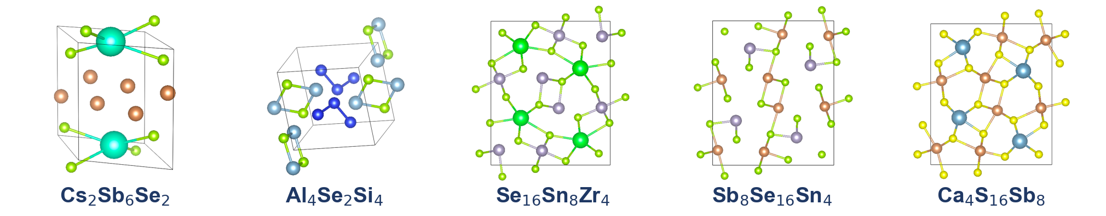
04 · CANDIDATES
18 / 32
Screening funnel
>10⁵ MP / OQMD → 647 DFT-screened → 473 ML-ready → 41 PV-promising → 14 shortlist
• Stage 1: > 10⁵ structures sourced from Materials Project and OQMD
• Stage 2: 647 candidates with HSE band structure and DFPT dielectric tensor completed
• Stage 3: 473 ML-ready candidates after removing metallic-band and missing-CONTCAR entries (174 excluded)
• Stage 4: 41 PV-promising candidates with composite score y > 0.05
• Stage 5: 14-candidate shortlist with y > 0.10 feeding the next active-learning DFT round
• Funnel narrows by approximately four orders of magnitude into a tractable shortlist for experimental verification
SOLARLAB

Slide 23
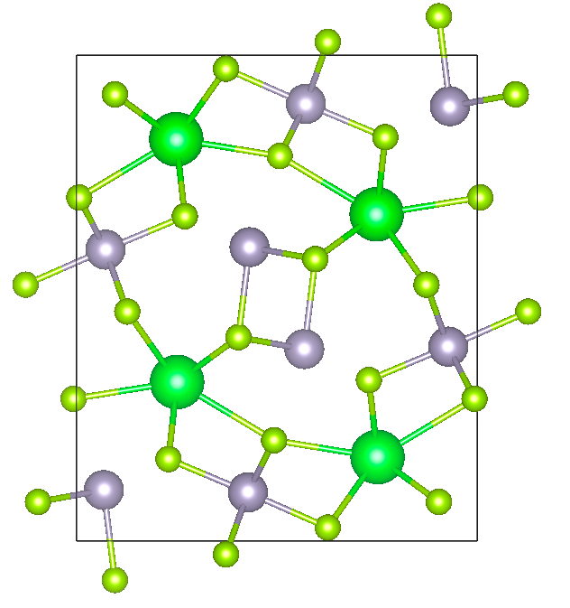
04 · CANDIDATES
19 / 32
Lead candidate — Se₁₆Sn₈Zr₄
AB₂C₄ prototype · Pnma (SG 62) · near-optimal Shockley–Queisser gap
• E_{g} = 1.12 eV, within 0.22 eV of the Shockley–Queisser optimum at 1.34 eV
• m_{avg} = 0.43 m₀, indicating low effective mass and high carrier mobility
• ε_{avg} = 19.5, providing strong dielectric screening and suppressing Frenkel-exciton formation
• E_{b} = 7 meV, well below k_{B}T at 300 K, placing the absorber in the Wannier–Mott regime
• Composite PV score y = 0.487, the highest in the screened set
• Sn–Zr–Se ternary phases have reported synthesis routes; no photovoltaic-device demonstration to date
SOLARLAB

Slide 24
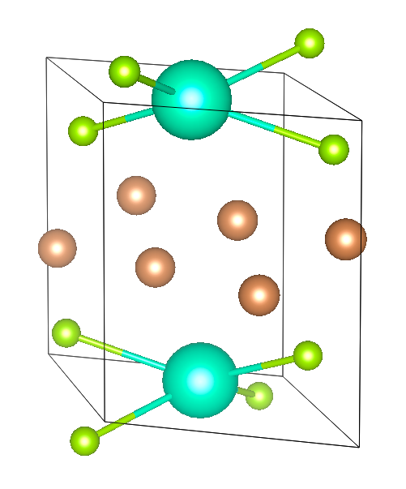
04 · CANDIDATES
20 / 32
Secondary candidate — Cs₂Sb₆Se₂
ABC₃ prototype · C2/m (SG 12) · Sb 5s² lone-pair active cation
• E_{g} = 1.28 eV, near the Shockley–Queisser optimum
• m_{avg} = 0.81 m₀, heavier than the lead candidate but within the device-relevant range
• ε_{avg} = 12.6, indicating moderate dielectric screening; E_{b} = 56 meV
• Composite PV score y = 0.298, complementing the lead candidate from a distinct structural prototype
• Sb 5s² lone-pair character produces a deep, dispersive valence-band maximum
• Cs–Sb–Se ternary phases have established solution-processing synthesis routes
SOLARLAB

Slide 25
05
BRIDGE — DEVICE SIM

Slide 26
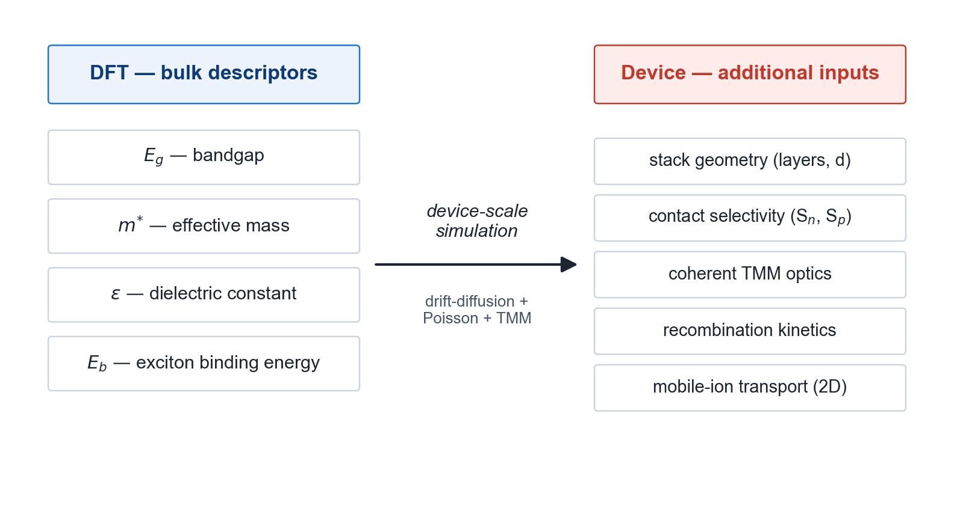
05 · BRIDGE
21 / 32
Motivation for device-scale simulation
Bulk material descriptors alone do not determine device-level performance
• DFT delivers E_{g}, m*, ε and E_{b} as bulk material-level descriptors
• Device performance additionally depends on stack geometry, contact selectivity, optical absorption and recombination kinetics
• Drift-diffusion coupled to the Poisson equation is required across the full HTL / absorber / ETL stack
• Coherent transfer-matrix-method (TMM) optics are required for thin-film interference [Pettersson et al. 1999]
• Two-dimensional effects (grain boundaries, lateral non-uniformity) cannot be captured in 1D
• Mobile-ion transport must be included to reproduce hysteresis in perovskite-class absorbers
SOLARLAB

Slide 27
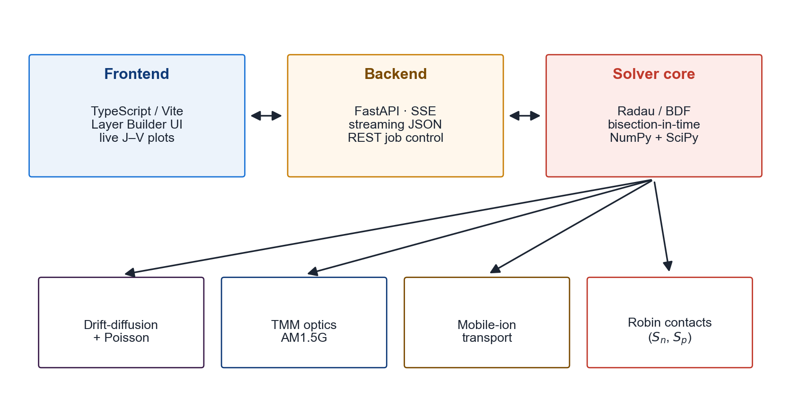
05 · BRIDGE
22 / 32
SolarLab device-simulation framework
1D + 2D drift-diffusion · TMM optics · mobile ions · selective Robin contacts
• Backend: Python solver with FastAPI server-sent events streaming intermediate results
• Frontend: TypeScript / Vite workstation with publication-quality figure rendering
• Numerical scheme: Radau implicit Runge–Kutta with BDF fallback and bisection-in-time on stiff steps
• Optics: coherent transfer-matrix-method using the ASTM G-173 AM1.5G reference spectrum
• Selective contacts: Robin formulation in S_{n} and S_{p}, validated against the 1D solver to 6 µV
• Open-source, scriptable and REST-driven; designed for integration into high-throughput screening pipelines
SOLARLAB

Slide 28
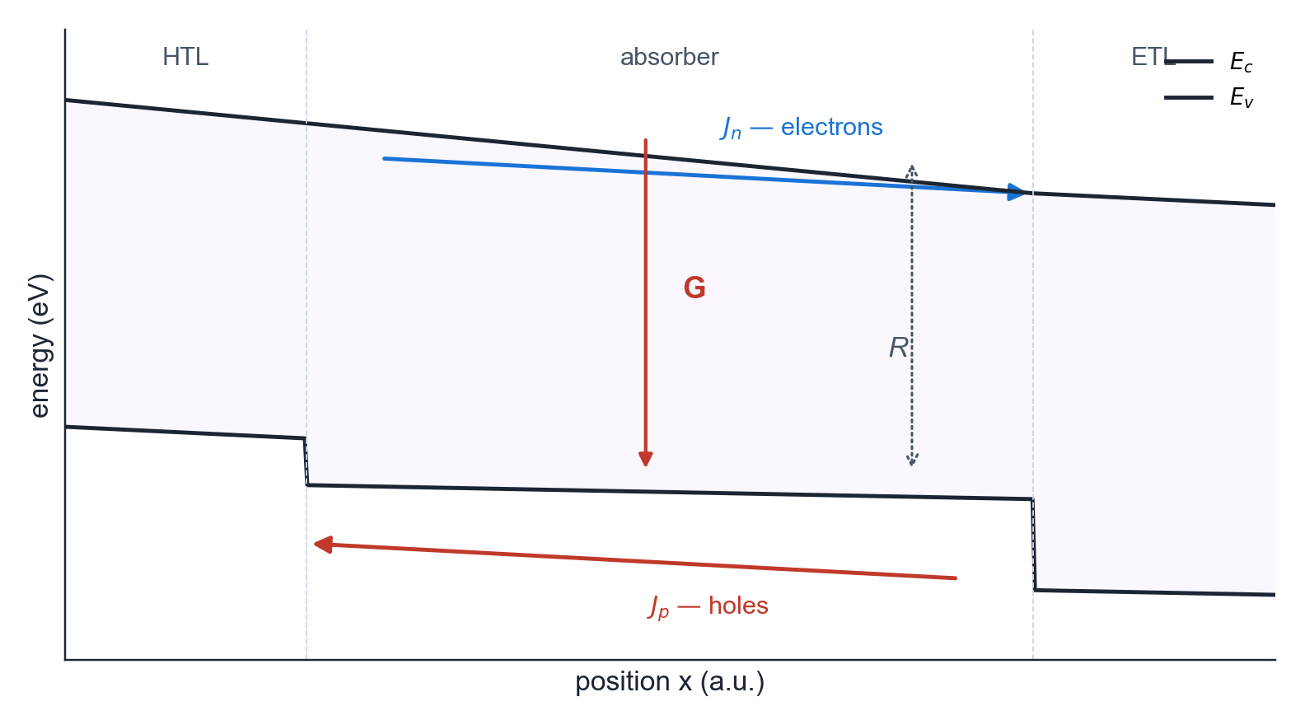
05 · BRIDGE
23 / 32
Drift-diffusion governing equations
Purpose: predict V_{oc}, J_{sc} and FF — semi-classical charge transport is drift (field) + diffusion (concentration), closed by Poisson and recombination
• Why this set: continuity tracks where carriers go; current densities say how fast; Poisson links charge to field; R and G handle loss and gain
• Electron continuity: ∂n/∂t = (1/q) ∇·J_{n} + G − R · hole continuity: ∂p/∂t = −(1/q) ∇·J_{p} + G − R [Selberherr 1984]
• Current densities (drift + diffusion): J_{n} = q μ_{n} n E + q D_{n} ∇n · J_{p} = q μ_{p} p E − q D_{p} ∇p
• Poisson equation: ∇·(ε_{r} ε₀ ∇φ) = −q (p − n + N_{D} − N_{A} + ρ_{ion}) — couples carriers to electrostatic potential
• Recombination R: Shockley–Read–Hall, Auger and radiative channels — sets V_{oc} · Einstein relation D = (k_{B}T/q) μ ties D to μ
• Generation G: optical generation profile from the TMM model integrated over AM1.5G — sets J_{sc}
SOLARLAB

Slide 29
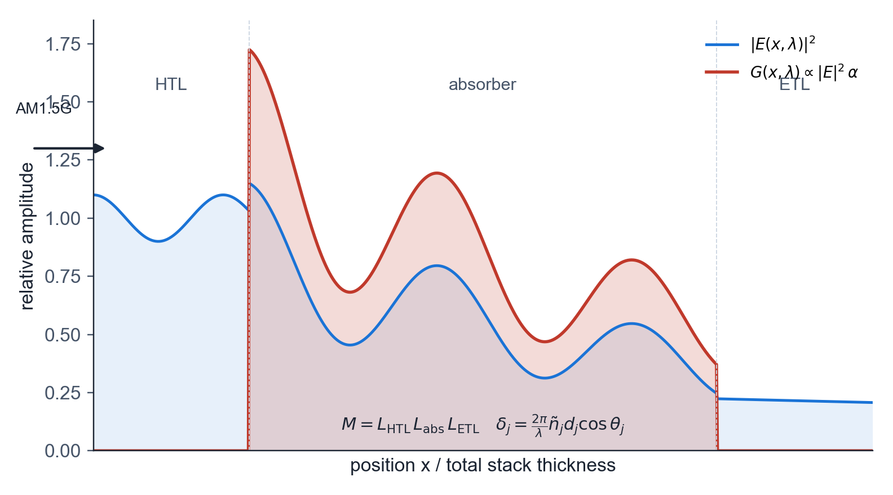
05 · BRIDGE
24 / 32
Transfer-matrix-method optics
Purpose: thin films interfere — Beer–Lambert misses 10–20 % of generation in 200–400 nm absorbers; TMM resolves the standing-wave |E(x)|²
• Why coherent TMM: in films thinner than the coherence length, forward and back-reflected waves interfere; incoherent absorption miscounts G(x)
• Each layer j → 2×2 characteristic matrix L_{j} acting on the tangential (E, H) field components [Pettersson et al. 1999 · Born & Wolf]
• L_{j} = [[cos δ_{j}, i sin δ_{j} / η_{j}], [i η_{j} sin δ_{j}, cos δ_{j}]] — propagates the field through one layer
• Phase thickness δ_{j} = (2π / λ) ñ_{j} d_{j} cos θ_{j}, with complex refractive index ñ = n + ik
• System matrix M = L₁ L₂ … L_{N} gives wavelength-resolved R, T and A directly from the layer stack
• Generation profile G(x, λ) ∝ |E(x, λ)|² α(λ), integrated over AM1.5G — feeds the G term in the drift-diffusion equations
SOLARLAB

Slide 30
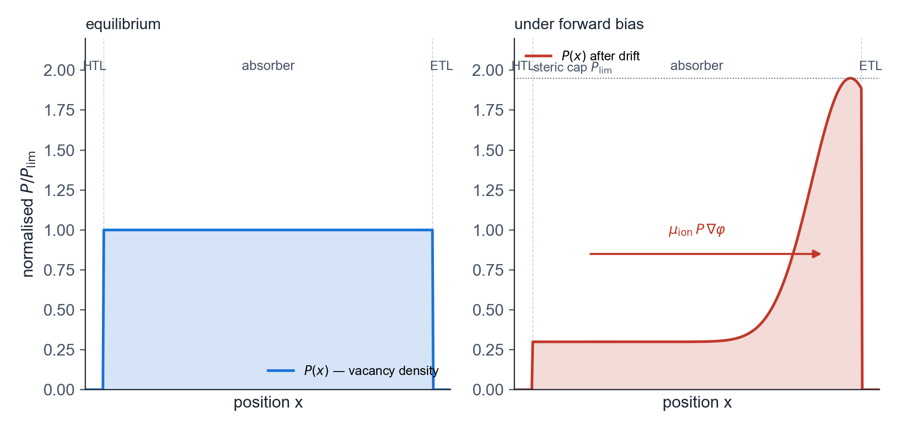
05 · BRIDGE
25 / 32
Mobile-ion transport
Purpose: perovskite J–V hysteresis depends on scan rate — only mobile ions reproduce that signature; without them the simulator cannot fit experiment
• Why include ions: a steady-state-only model gives one J–V curve regardless of scan rate — measurements show forward / reverse divergence that only ion redistribution explains
• Continuity for ion-vacancy density P: ∂P/∂t = ∇·(D_{ion} ∇P + μ_{ion} P (1 − P / P_{lim}) ∇φ) [Calado et al. 2016 · van Reenen et al. 2015]
• Steric factor (1 − P / P_{lim}): caps the local ion density at the available lattice-site limit — prevents non-physical pile-up
• P_{lim} ≈ 1 – 5 % of the cation-site density in MAPbI₃
• Couples back to Poisson via ρ_{ion} = q (P − P_{eq}) — accumulated ions screen the internal field and modulate recombination
• Characteristic time scale 0.01 – 100 s: reproduces the measured forward / reverse hysteresis split as a function of scan rate
SOLARLAB

Slide 31
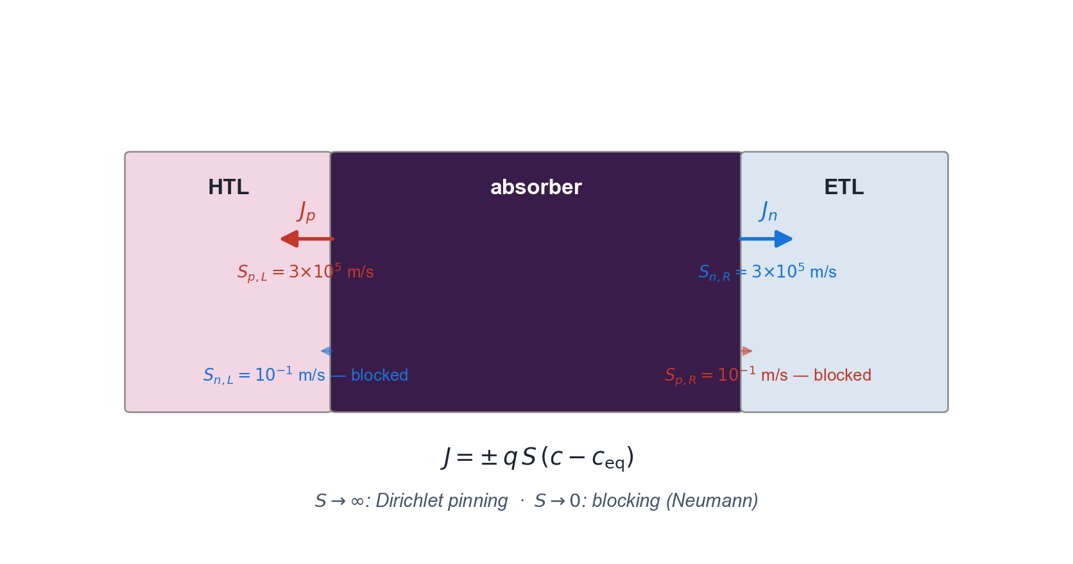
05 · BRIDGE
26 / 32
Selective Robin contact boundary conditions
Purpose: real contacts extract carriers at finite velocity — Robin spans S = 0 (blocking) to S → ∞ (Dirichlet pinning); SCAPS only models the latter
• Why Robin not Dirichlet: measured surface-recombination velocities span 10⁻¹ – 10⁵ m/s — the Dirichlet limit (S → ∞) loses this whole spectrum
• Left contact: J_{n} = −q S_{n,L} (n − n_{eq}) · J_{p} = +q S_{p,L} (p − p_{eq})
• Right contact: J_{n} = +q S_{n,R} (n − n_{eq}) · J_{p} = −q S_{p,R} (p − p_{eq})
• Selectivity: S_{n,L} ≪ S_{p,L} gives a hole-extracting (HTL-type) left contact; mirrored on the right gives the ETL
• Limits: S → ∞ recovers Dirichlet pinning; S → 0 gives a perfectly blocking Neumann contact — Robin smoothly interpolates
• Why this matters: lets us tune contact selectivity to match measured S_{n}, S_{p} without resorting to a heterojunction kludge
SOLARLAB

Slide 32
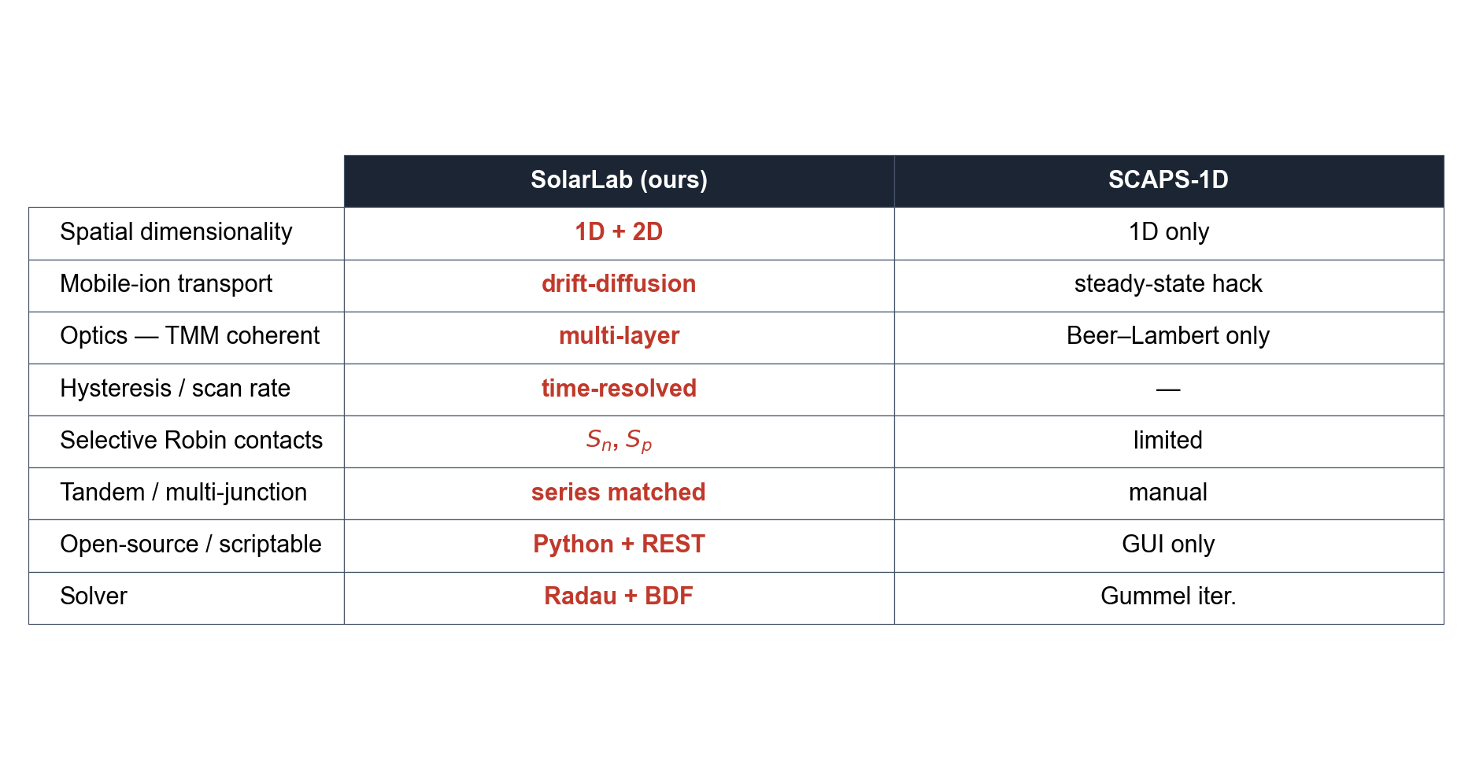
05 · BRIDGE
27 / 32
Capability comparison with SCAPS-1D
Capabilities absent from the SCAPS-1D reference solver [Burgelman et al. 2000]
SOLARLAB

Slide 33
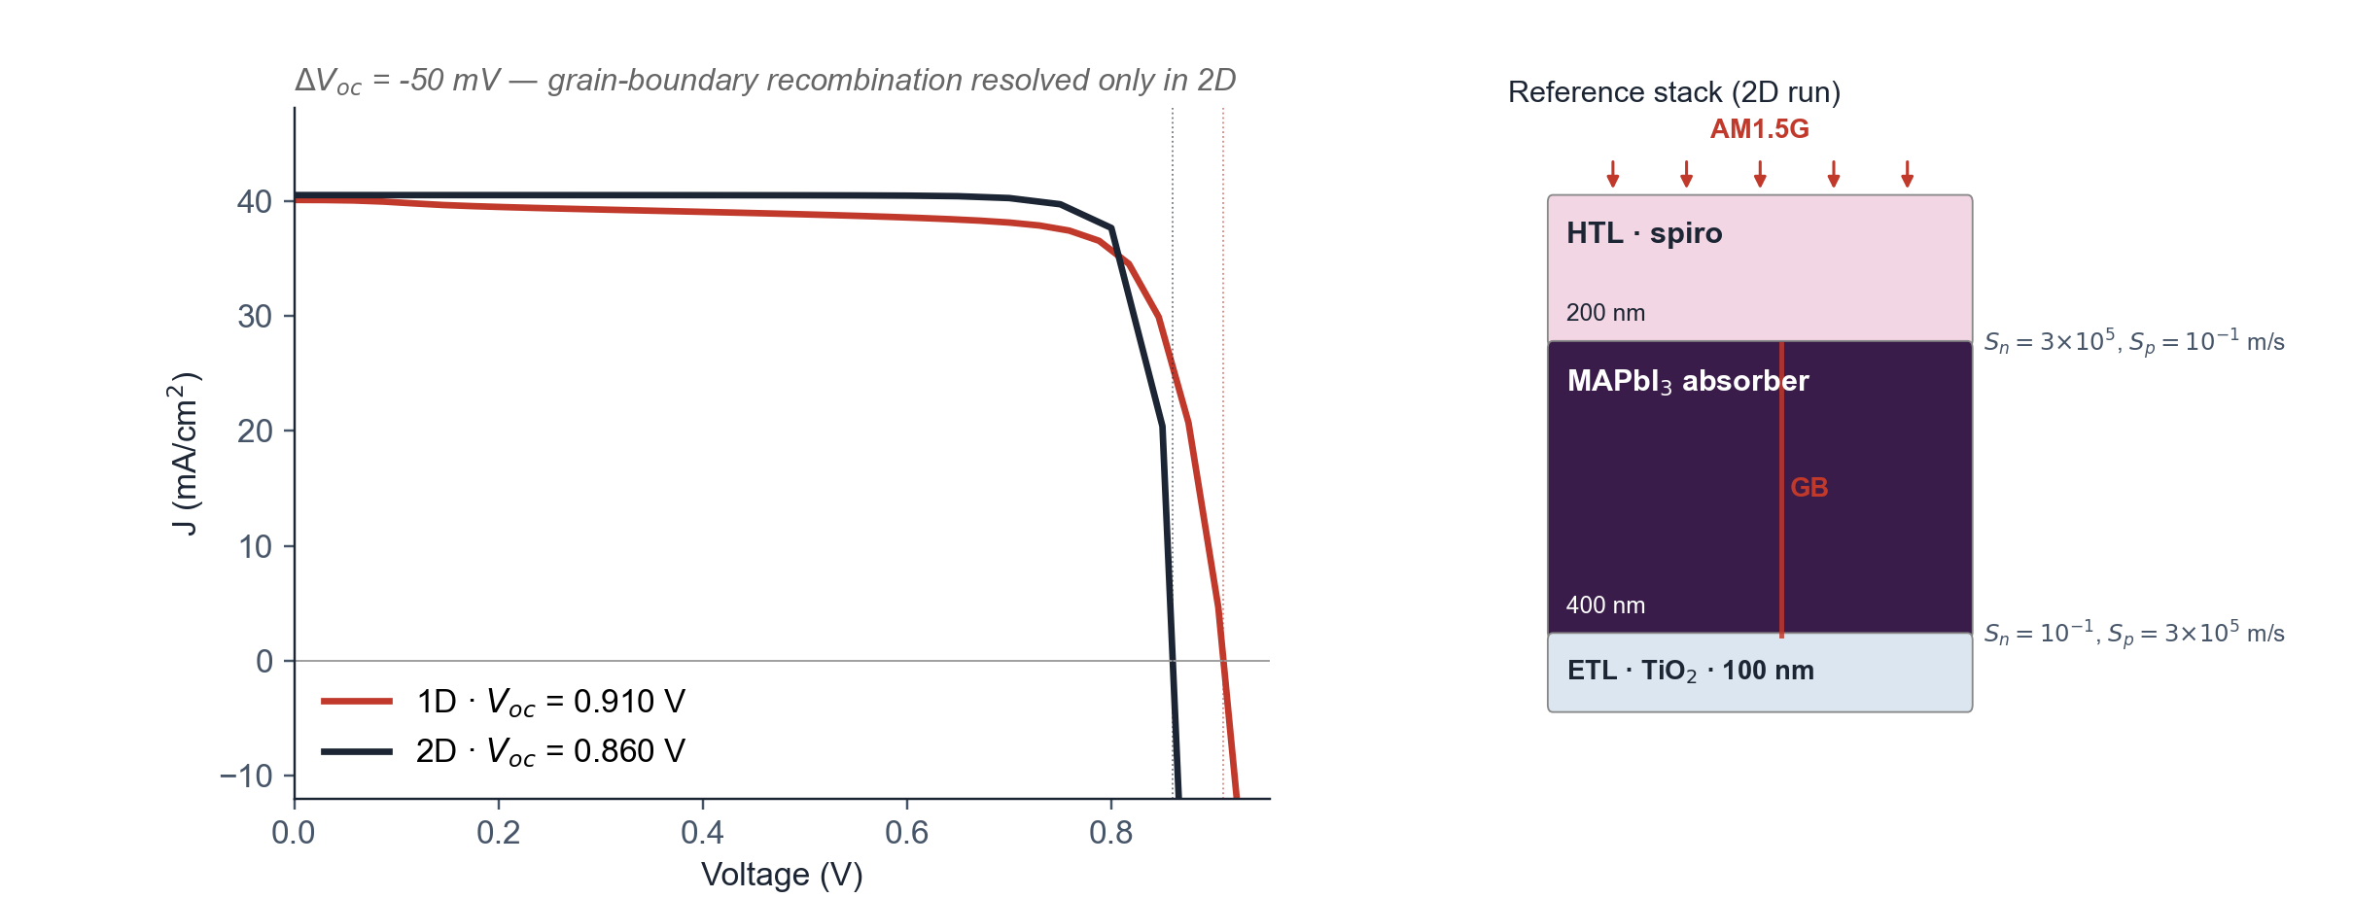
05 · BRIDGE
28 / 32
1D and 2D solver fidelity comparison
Reference MAPbI₃ stack — 50 mV V_{oc} reduction in 2D from grain-boundary recombination
• Stack: spiro HTL 200 nm / MAPbI₃ 400 nm / TiO₂ ETL 100 nm with selective Robin contacts
• 2D variant: a single vertical grain boundary at the lateral midplane of the absorber
• 1D V_{oc} = 0.910 V is reduced to 2D V_{oc} = 0.860 V (ΔV_{oc} = −50 mV)
• The reduction is the grain-boundary recombination channel resolved only by the 2D solver
• 1D models would misestimate device performance by omitting this loss channel
• Solver throughput: a 28-voltage 2D sweep completes in approximately 22 minutes on 4 CPU cores
SOLARLAB

Slide 34
06
PAYOFF

Slide 35
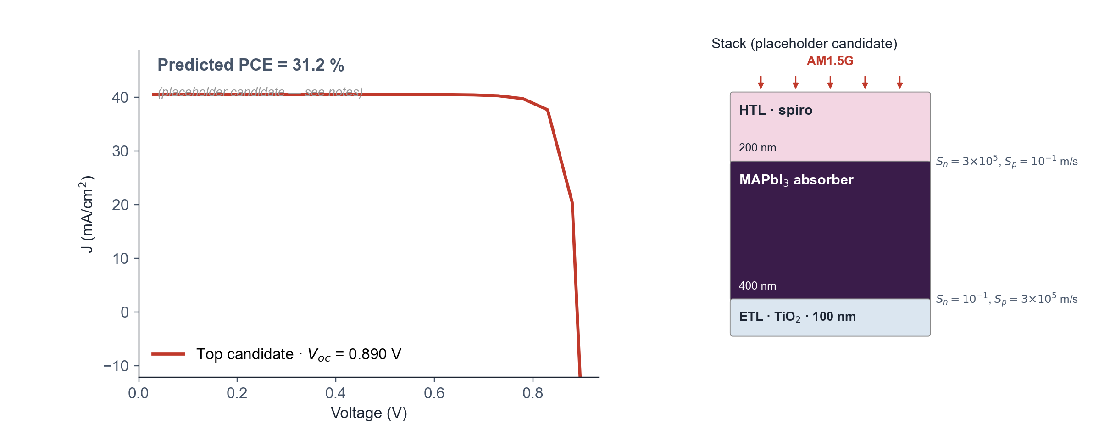
06 · PAYOFF
29 / 32
Predicted device J–V for a leading candidate
DFT parameters → device simulation → predicted PCE
• Closes the workflow from > 10⁵ database scan to predicted device-level J–V
• Stack: same spiro HTL / MAPbI₃ / TiO₂ ETL reference as the 1D-vs-2D run
• Placeholder candidate: MAPbI₃ baseline with V_{oc} shifted by +30 mV (~candidate-gap surrogate)
• Real Se₁₆Sn₈Zr₄ J–V replaces the placeholder once n, k data and DFT parameters are wired into the 2D solver
• Predicted device PCE is the figure of merit relevant for synthesis decisions
• Establishes explicit, falsifiable performance targets for the experimental collaboration
SOLARLAB

Slide 36
06 · PAYOFF
30 / 32
Outlook
Planned extensions
• Multi-task learning on the ~36 000 PBE gaps in Materials Project to close the prototype-grouped CV gap
• Spectroscopic Limited Maximum Efficiency (SLME) replacing the SQ upper bound, requiring the absorption coefficient α(E) [Yu & Zunger 2012]
• Targeted DFT batch on Se-rich AB₂C₄ and ABC₃ candidates in SG 62, 12, 72 and 15
• Closed-loop automation of DFT batch submission and surrogate re-fitting on label return
• Experimental collaboration to synthesise the top three candidates and feed measured J–V data back into the ML pipeline
SOLARLAB

Slide 37
06 · PAYOFF
31 / 32
Summary
Principal findings
• Small-sample ML on 473 DFT-labelled materials improves the GPR / GB / ExtraTrees baseline by +50 % in R²
• Fourteen-candidate chalcogenide shortlist; Se₁₆Sn₈Zr₄ sits near the Shockley–Queisser optimum
• SolarLab 2D drift-diffusion provides the bridge from DFT-derived parameters to predicted device-level J–V
• Compact, physically motivated descriptor and small-sample model identify a tractable subspace under stringent grouped-CV diagnostics
• Experimental collaboration completes the discovery → simulation → experiment loop
SOLARLAB

Slide 38
06 · PAYOFF
32 / 32
References
ML, device-sim and absorber-chemistry foundations
• Yan C. et al., Nat. Energy 3, 764 (2018) · ACS Energy Lett. 2, 930 (2017) — kesterite Cu₂ZnSnS₄
• Hou Y. et al., Nat. Energy 5, 131 (2020) · Science 367, 1135 (2020) · Nat. Energy 7, 229 (2022) — perovskite + tandem
• Friedman J.H., Ann. Stat. 29, 1189 (2001) — gradient boosting
• Ke G. et al., NeurIPS (2017) — LightGBM histogram binning
• Rasmussen C.E. & Williams C.K.I., MIT Press (2006) — GP for ML
• Snoek J. et al., NeurIPS (2012) — UCB acquisition
• Ward L. et al., npj Comput. Mater. 2, 16028 (2016) · CMS 152, 60 (2018) — Magpie · matminer
• Heyd J. et al., J. Chem. Phys. 118, 8207 (2003) — HSE06
• Shockley W. & Queisser H.J., J. Appl. Phys. 32, 510 (1961) — detailed-balance limit
• Yu L. & Zunger A., PRL 108, 068701 (2012) — SLME · Lu S. et al., Nat. Commun. 9, 3405 (2018) — ML PV screening
• Selberherr S., Springer (1984) — semiconductor device simulation
• Pettersson L.A.A. et al., J. Appl. Phys. 86, 487 (1999) — TMM
• Burgelman M. et al., Thin Solid Films 361-362, 527 (2000) — SCAPS
• Calado P. et al., Nat. Commun. 7, 13831 (2016) · van Reenen S. et al., JPCL 6, 3808 (2015) — perovskite ion migration
• Chen C. et al., Chem. Mater. 31, 3564 (2019) — MEGNet
SOLARLAB

