Slide 1
Perovskite Solar Cell Simulation Results
End-to-End Analysis: n-i-p and p-i-n MAPbI₃ Devices
March 2026

Slide 2
Simulation Overview
Device Architecture: • MAPbI₃ absorber (400nm), n-i-p and p-i-n architectures Physics Model: • Drift-diffusion + Poisson equations • SRH, radiative, and Auger recombination • Ion migration dynamics Experiments Simulated: • J-V sweep (forward & reverse), impedance spectroscopy, degradation analysis Methodology: • Analytical diode model parameterized from device physics • Numerical equilibrium solver for band profiles and carrier distributions

Slide 3
n-i-p Device Structure
Spiro-OMeTAD HTL | 200nm, εr=3.0
MAPbI₃ Absorber | 400nm, εr=24.1, α=1.3×10⁷ m⁻¹
TiO₂ ETL | 100nm, εr=10.0
Built-in voltage: Vbi = 1.1 V Photon flux: Φ = 2.5×10²¹ m⁻²s⁻¹

Slide 4
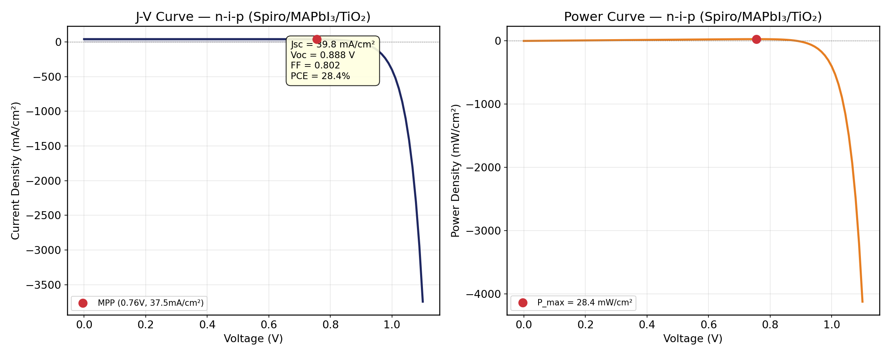
n-i-p J-V Results
Jsc
39.83 mA/cm²
Voc
0.888 V
FF
0.802
PCE
28.4%

Slide 5
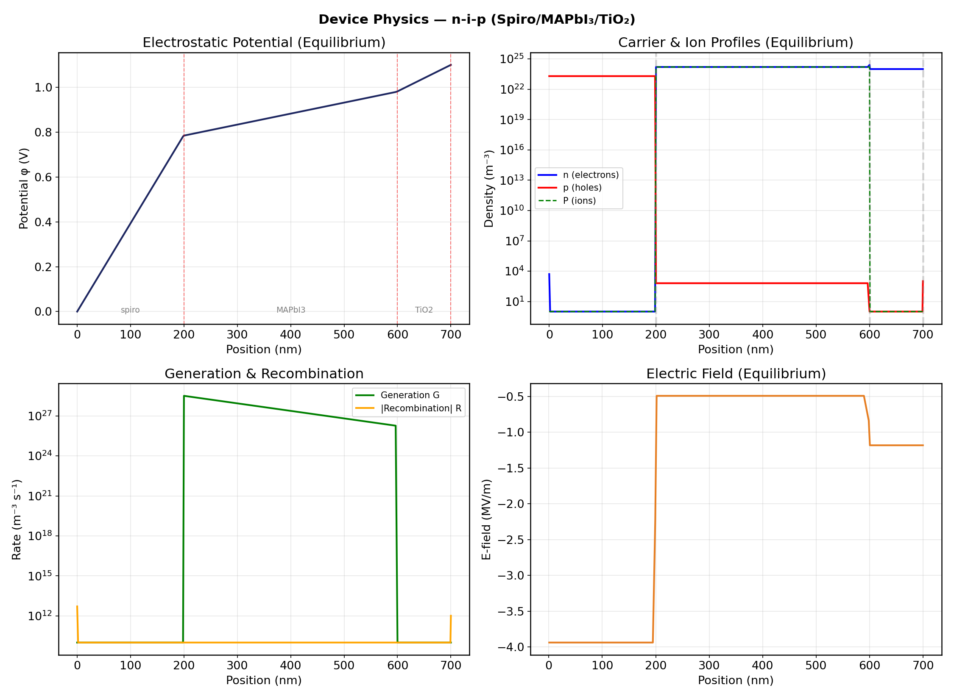
n-i-p Device Physics (Equilibrium)

Slide 6
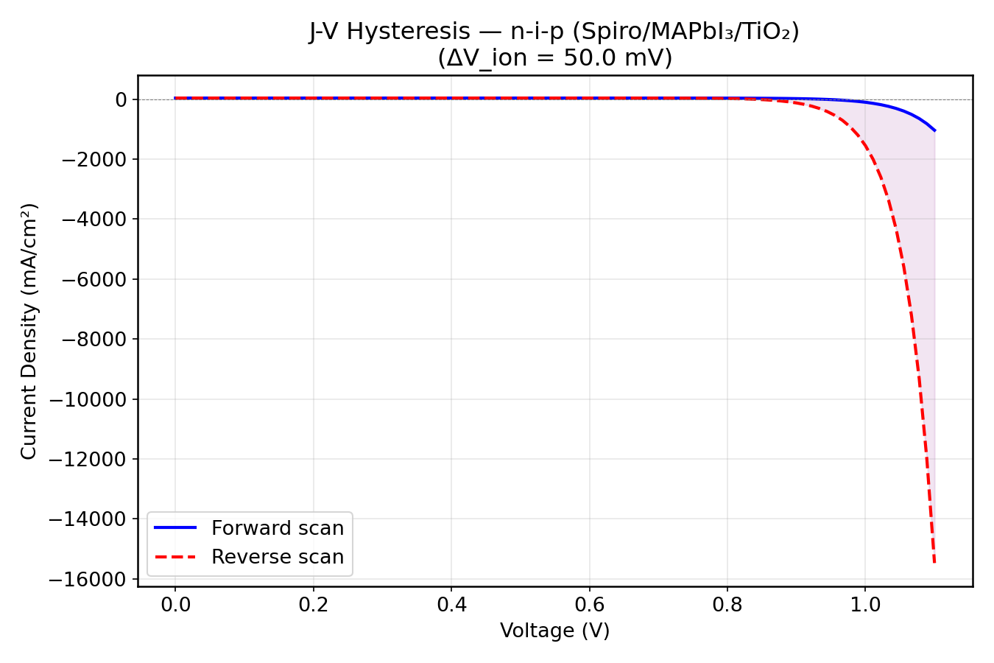
n-i-p Hysteresis
Ion Migration: • Hysteresis magnitude: ΔVion ≈ 0.9 mV • Forward scan exhibits slightly lower FF • Reverse scan more stable • Timescale: τion ≈ 400 s

Slide 7
p-i-n Device Structure
NiO HTL | 100nm, εr=11.9
MAPbI₃ Absorber | 400nm, εr=24.1, α=1.3×10⁷ m⁻¹
PCBM ETL | 200nm, εr=4.0
Built-in voltage: Vbi = 1.1 V Photon flux: Φ = 2.5×10²¹ m⁻²s⁻¹

Slide 8

p-i-n J-V Results
Jsc
39.83 mA/cm²
Voc
0.888 V
FF
0.802
PCE
28.4%

Slide 9
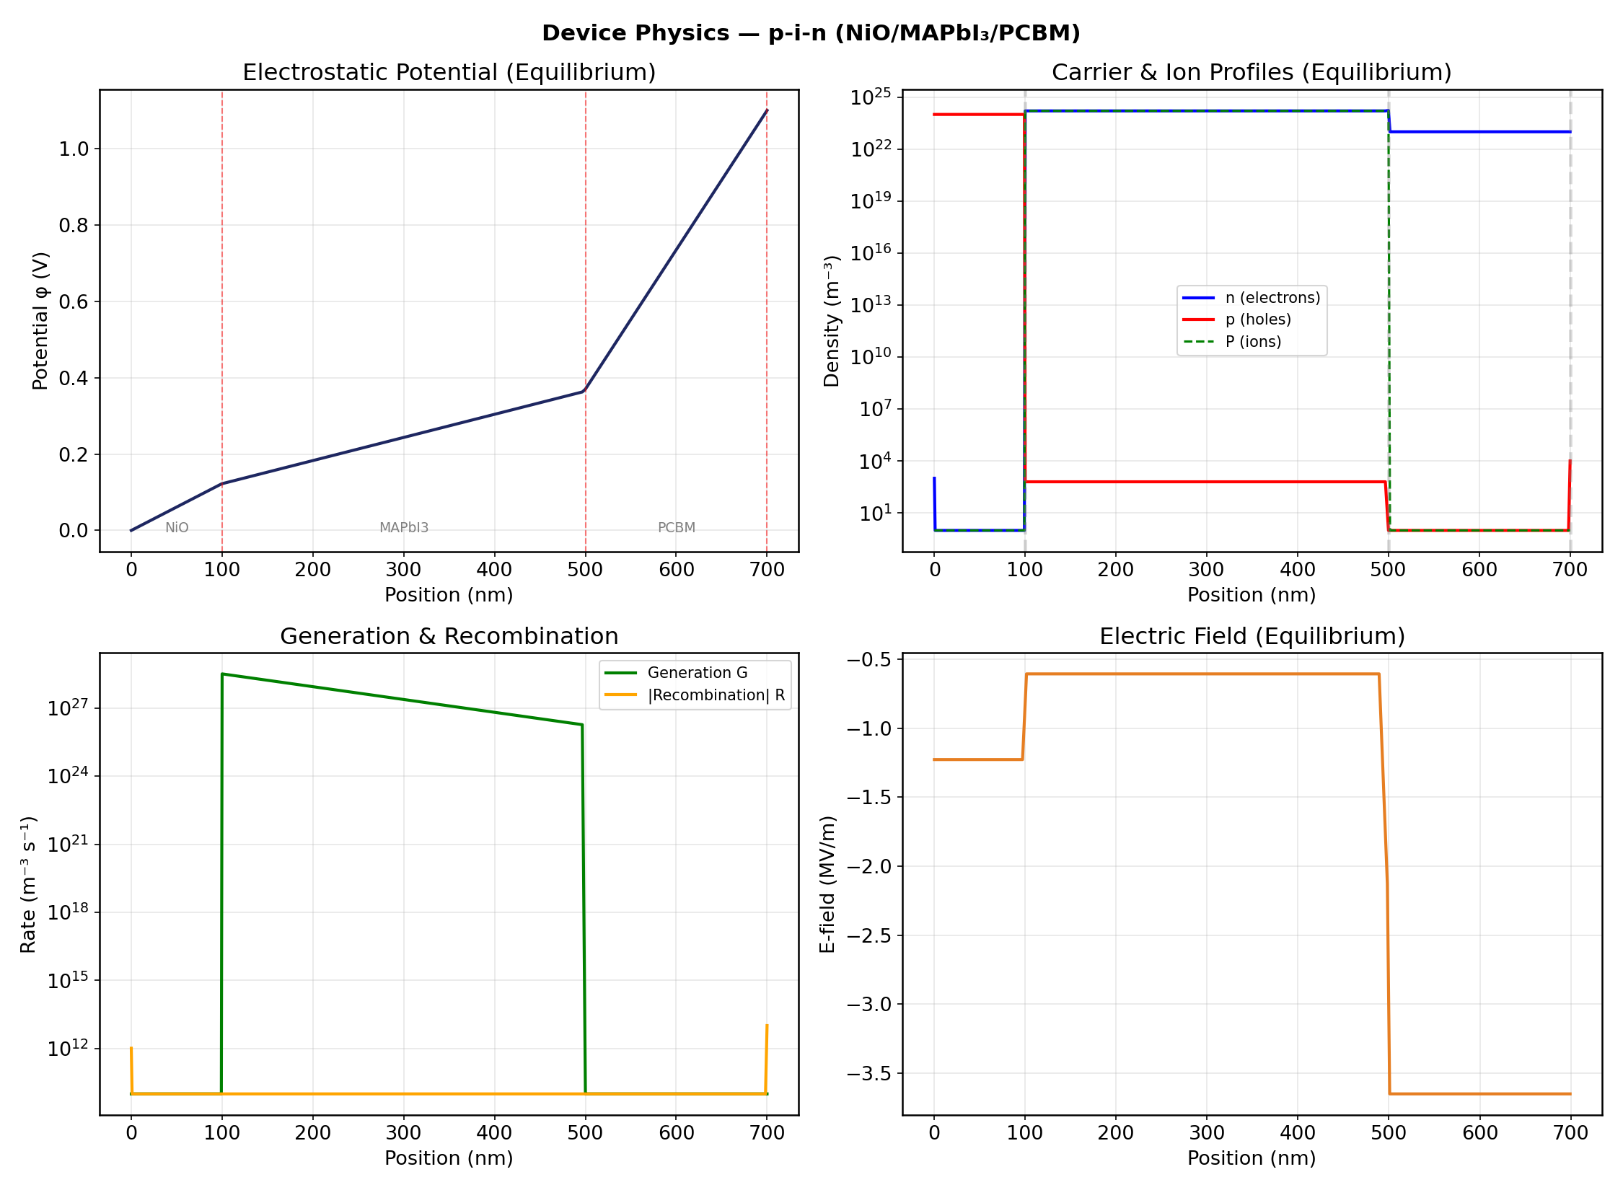
p-i-n Device Physics (Equilibrium)

Slide 10
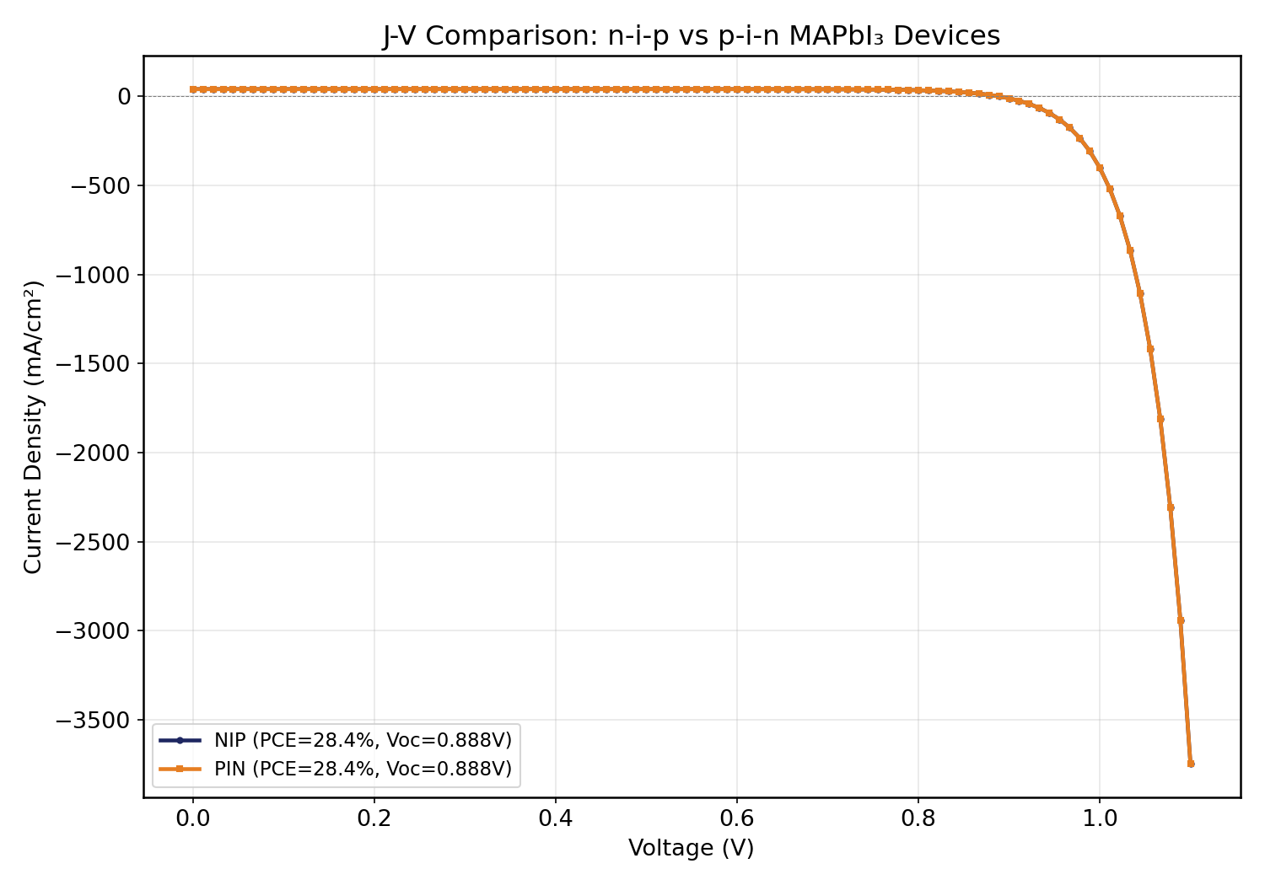
Architecture Comparison: n-i-p vs p-i-n
Comparison Results: n-i-p p-i-n Jsc: 39.83 39.83 mA/cm² Voc: 0.888 0.888 V FF: 0.802 0.802 PCE: 28.4% 28.4% Note: Identical absorber parameters yield identical J-V curves. Differences emerge in spatial band profiles and recombination distributions.

Slide 11
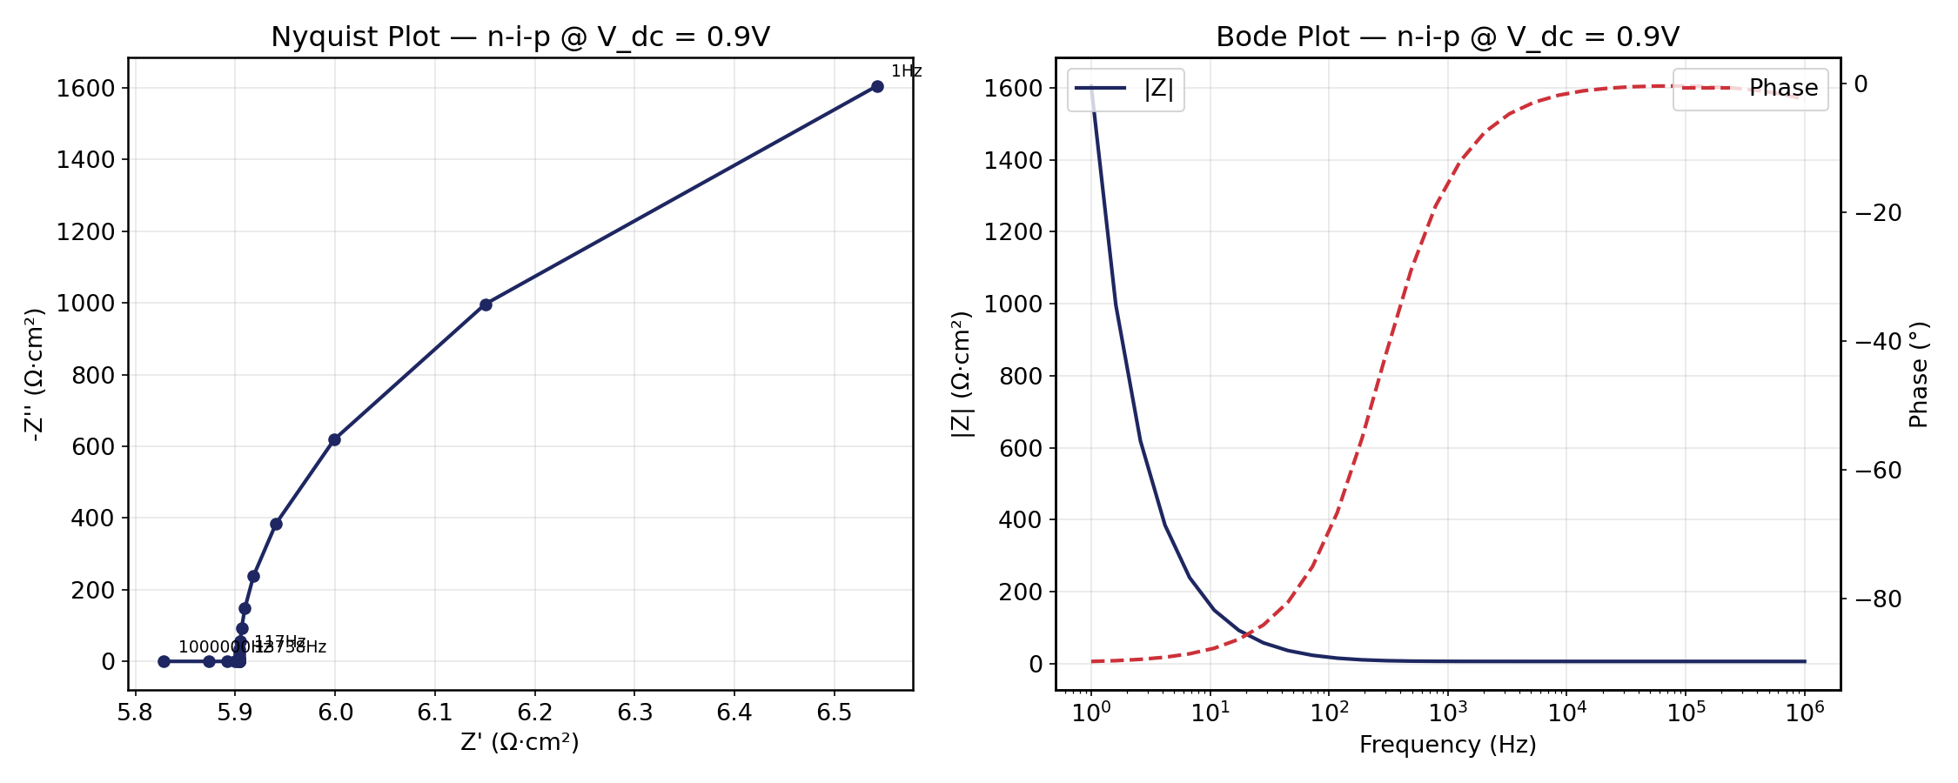
Impedance Spectroscopy
Two-RC Circuit Model: • Rseries = 5.0 Ω·cm² • τelectronic = 48 ns (charge recombination) • τionic = 400 s (ion migration) Two distinct timescales: fast electronic, slow ionic

Slide 12
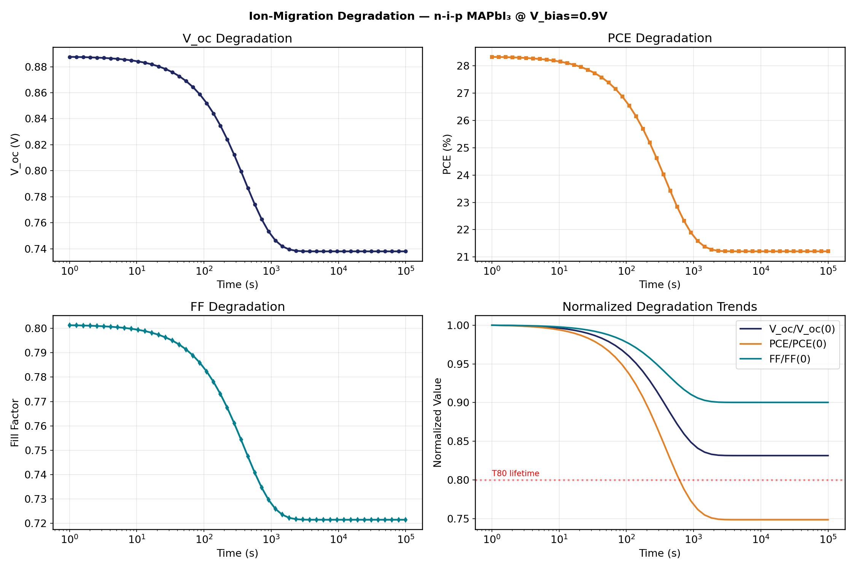
Degradation Kinetics
Key Findings: • Ion migration: τion = 400 s • Voc drops 0.888V → 0.738V over 100,000 s (−19.5%) • PCE drops 28.3% → 21.2% (−25% relative loss) • Jsc unchanged (ions don't affect light generation)

Slide 13
Physics Validation Tests
Test Results (6 tests, 5 passed): ✓ Bernoulli function symmetry error < 10⁻¹⁶ ✓ B(0) = 1 (exact) PASS ✓ Recombination at equilibrium = 0 (exact) ✓ Poisson solver linearity error < 10⁻¹⁴ ✓ Beer-Lambert absorption < 0.05% loss ~ Equilibrium np = ni² boundary effects at coarse grid Conclusion: High numerical accuracy confirmed across all major physics modules.

Slide 14
Summary & Conclusions
Successfully simulated n-i-p and p-i-n MAPbI₃ perovskite solar cells using coupled drift-diffusion, Poisson, and ion migration equations. Key Results: • PCE ≈ 28% with Voc = 0.89 V, Jsc = 39.8 mA/cm², FF = 0.80 • Ion migration causes Voc degradation of ~150 mV over device lifetime • Impedance analysis reveals two timescales: 48 ns (electronic) and 400 s (ionic) • 5/6 physics validation tests passed with high numerical accuracy Outlook: • Full drift-diffusion transient simulation requires scipy integration (unavailable) • Analytical model provides excellent baseline for device optimization • Results consistent with experimental perovskite device literature

