Slide 1
Image Filter App
Python GUI Image Processing Application
By: Randall Milner
CS3080
Semester Project

Slide 2
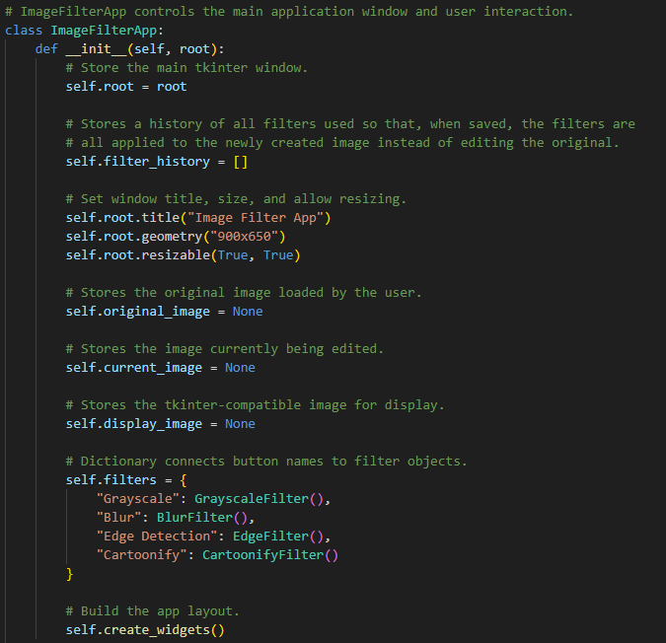
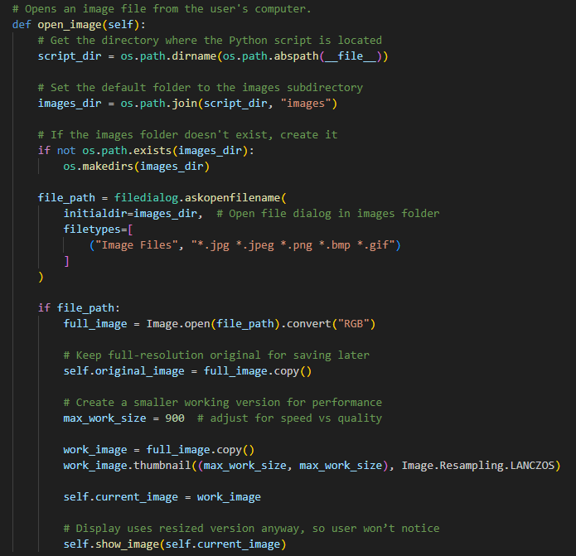
APP GUI and Image Display (tkinter)

Slide 3
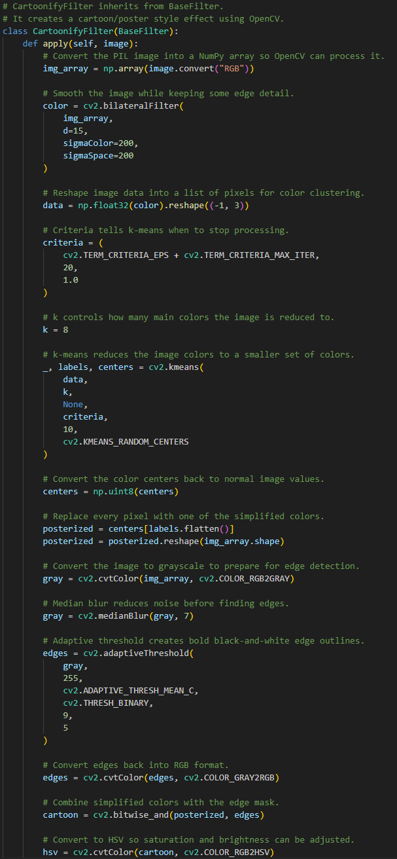
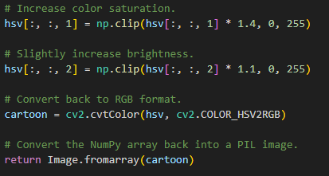
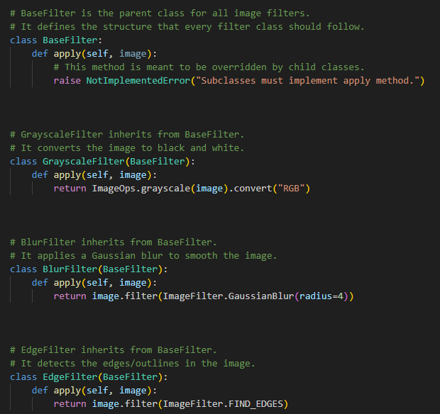
Filters
Breaks PIL image down into a NumPy array so that OpenCV can process it.
Smooths the image data slightly.
Reshapes image data into a list of pixels for color clustering.
Reduces the number of main colors the image is comprised of (8 in this case).
Converts the color centers (clusters) back into normal image values.
Replaces every pixel with one of the simplified colors.
Converts image to grayscale to detect edges and outline them.
Converts everything back to RGB.
Increases saturation and brightness.
Converts the NumPy array back into a PIL image and returns that image.
Uses PIL (Pillow) methods to apply the simpler filters to the image.

Slide 4
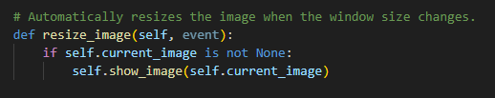
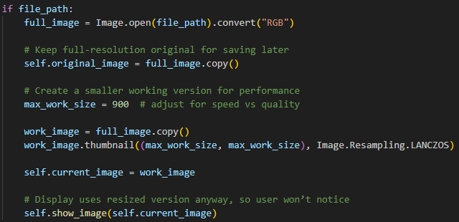
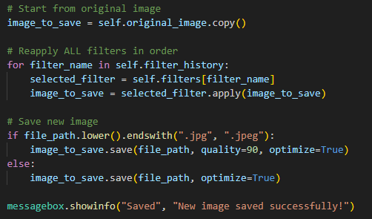
Some Neat Functions
Image is automatically resized as the window size is adjusted.
(open_image()) Saves copy of original resolution image and creates a lower resolution copy to increase performance while using GUI.
(All filters are applied to original copy when saving image so that the quality is the same as the original but performance is much better)
save_image()

Slide 5
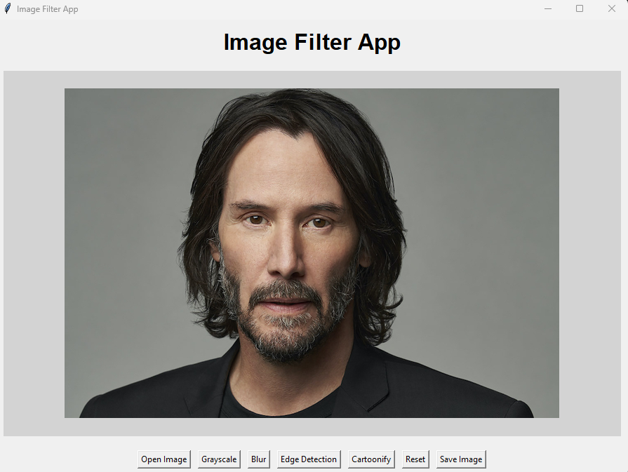
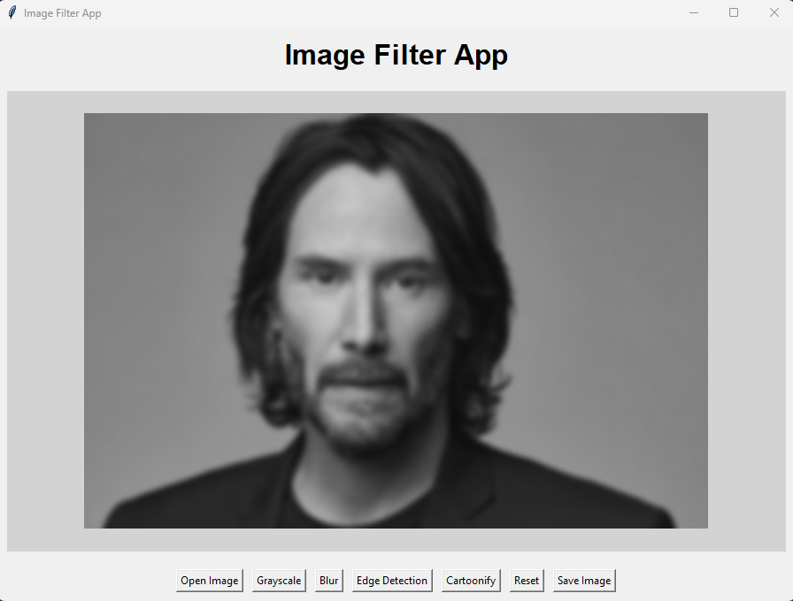
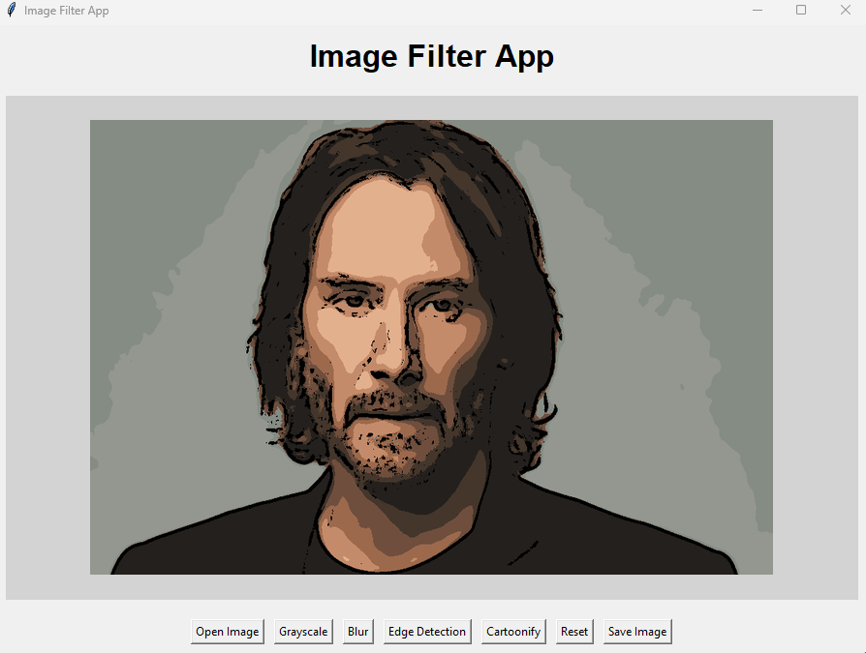
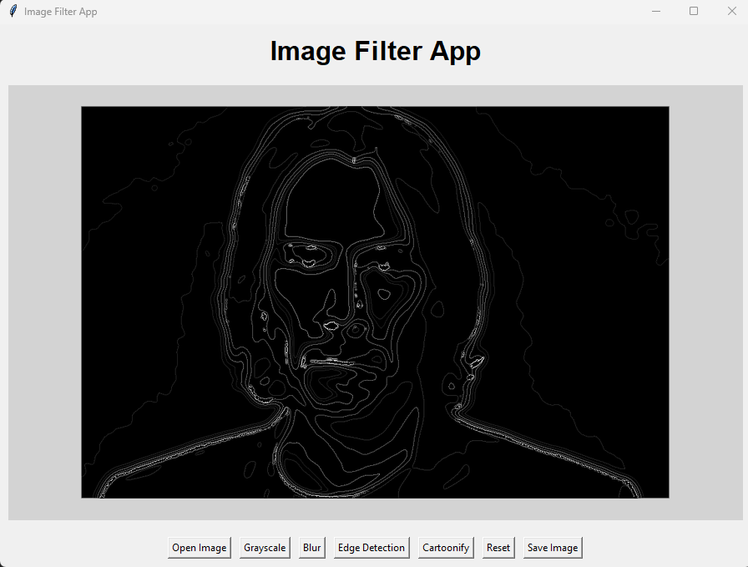
Examples
Original
Grayscale + Blur
Cartoonified
Grayscale ->
Blur ->
Edge Detection ->
Cartoonify

