Slide 1
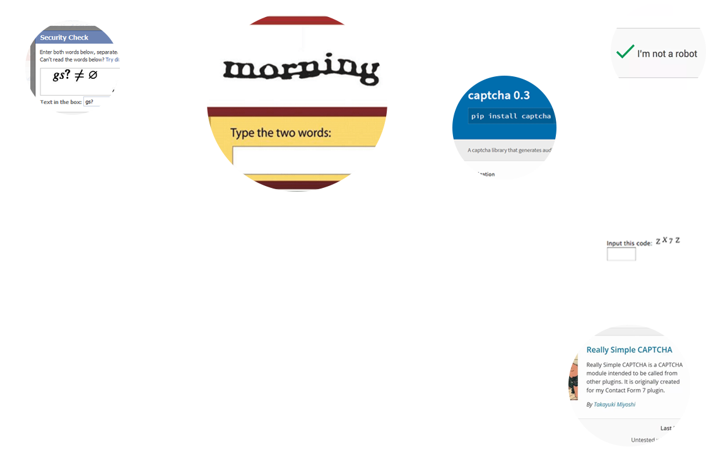
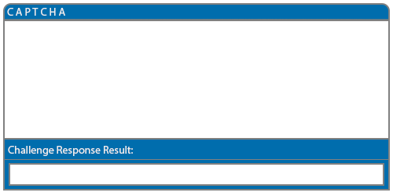
An Examination on the Robustness of
Alphanumeric CAPTCHA as a
Challenge Response Test using
Machine Learning
Shane Nolan, 4th Year Software Development Student
Shane Nolan, 4th Year Software Development Student

Slide 2
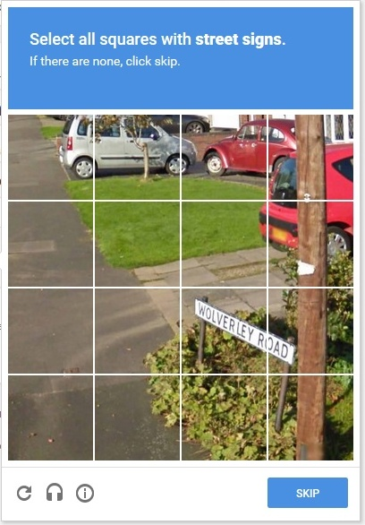
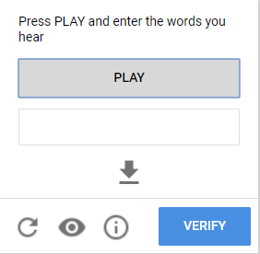


CAPTCHA
Completely Automated Public Turing Test to Tell Computers and Humans Apart
Was created by Andrei Broder and his colleagues in 1997.
Is a challenge response test generated by a program and grades these tests that most humans can easily pass and current computer programs cannot pass.
Many variations exist ranging from text, image, audio and alternative solutions such as Google’s reCAPTCHA which is image checkbox based.
The aim of this project is to automatically solve CAPTCHAs that are in use today, by creating a machine learning program and examining the robustness on these types of challenge response tests.
Google reCAPTCHA V3
Google reCAPTCHA Audio
Python CAPTCHA 0.3
Wordpress Simple CAPTCHA

Slide 3



CAPTCHA Noise Removal
Andrei’s CAPTCHA was quickly proven to be inadequate due to Optical character recognition (OCR) success rates improving.
OCR is a technology where characters are automatically recognised through an optical mechanism.
Therefore anti-automated recognition techniques for text based CAPTCHAs were developed. One of those techniques are anti-recognition.
Anti-recognition methods used are different text sizes, fonts and character rotation to reduce a classifiers accuracy.

Slide 4




CAPTCHA Segmentation
Segmentation aims to get individual characters from a CAPTCHA image after noise removal.
Anti-segmentation is another process which makes it difficult for automated processes to separate characters within a CAPTCHA.
Methods used to prevent segmentation are character overlapping, random dot sizes and counts, straight or wavy lines with different widths, etc.

Slide 5
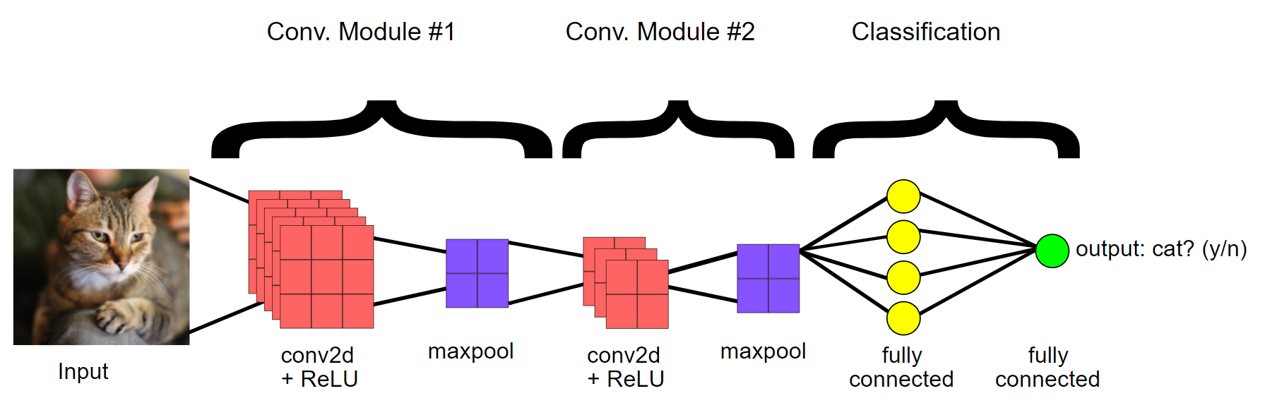
Convolution Neural Network
A Convolution Neural Network (CNN) is a machine learning model that are most commonly applied to analyzing visual imagery.
The model attempts to mimic how the human brain works by connecting artificial neurons, forming a network. The CNN will then observe, learn and detect patterns that are far too complex for a human programmer to extract and teach the machine to recognize.
CNNs are a feed-forward neural network, meaning that the output of each layer is forwarded to the next layer, forming a connection. The connection between layers never form a loop.
CNNs use supervised learning for classification. Supervised learning is when we want to map input data to output data.
0.95%
1
Source: Google Dev. (Modified).
Notes:
Source: https://developers.google.com/machine-learning/practica/image-classification/convolutional-neural-networks

Slide 6
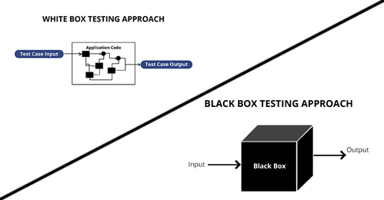

Project Development & Testing
The project will be developed mainly in Python.
Really Simple CAPTCHAs will be generated in PHP.
The Convolutional Neural Network will be developed in Keras, a high-level neural networks API, written in Python.
Testing types that will be used in this project are Black and White Box Testing.
Functional tests such as Unit, Integration and Acceptance will be tested.
Non functional tests such as Reliability and Performance will also be tested.

Slide 7
Therefore this project will focus on examining the robustness of alphanumeric CAPTCHAs with machine learning programs and provide additional research around CAPTCHA breaking.
Question and Answers?
Shane Nolan, 4th Year Software Development Student
Shane Nolan, 4th Year Software Development Student

