Slide 1
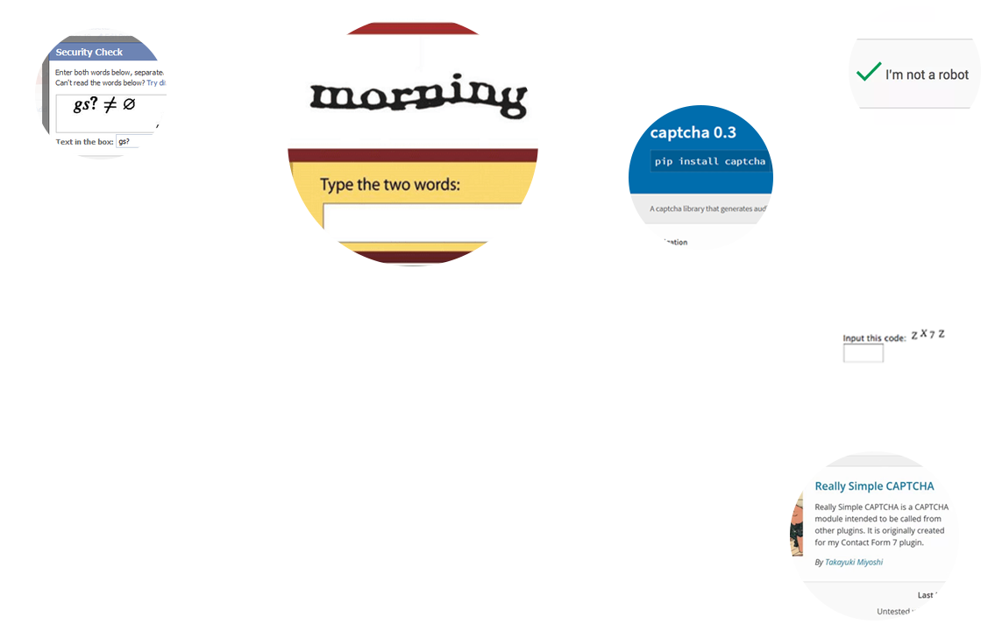
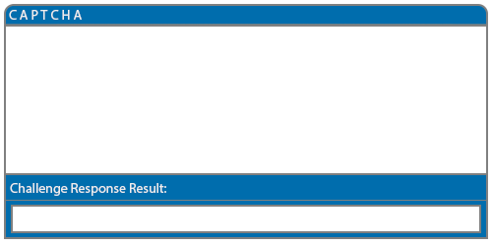
An Examination on the Robustness of
Alphanumeric CAPTCHA as a
Challenge Response Test using
Machine Learning
Shane Nolan, 4th Year Software Development Student
Shane Nolan, 4th Year Software Development Student

Slide 2


CAPTCHAs Examined
Really Simple CAPTCHA
Python CAPTCHA 0.3
Pastebin CAPTCHA

Slide 3



CAPTCHAs Examined
Really Simple CAPTCHA
Python CAPTCHA 0.3
Pastebin CAPTCHA
Extra
Superbuy CAPTCHA

Slide 4




CAPTCHA Usability

Slide 5



CAPTCHA 0.3 Image Processing

Slide 6
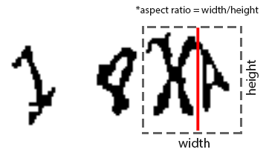
CAPTCHA Segmentation

Slide 7
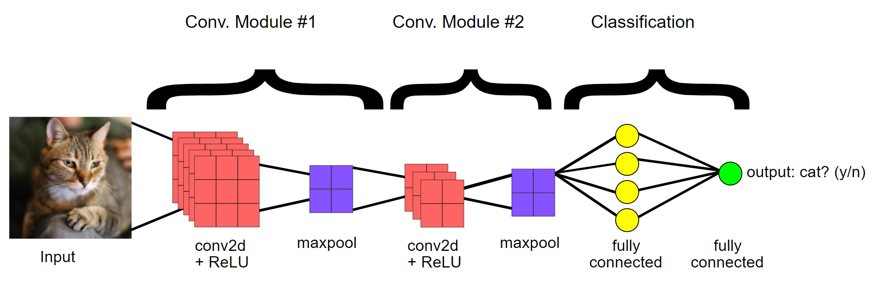

Convolution Neural Network
0.95%
1
Source: Google Dev. (Modified).
Notes:
Source: https://developers.google.com/machine-learning/practica/image-classification/convolutional-neural-networks

Slide 8
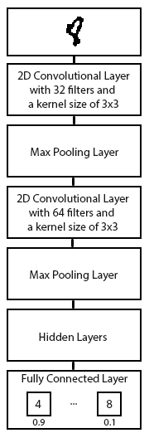

Slide 9
System Architecture

Slide 10
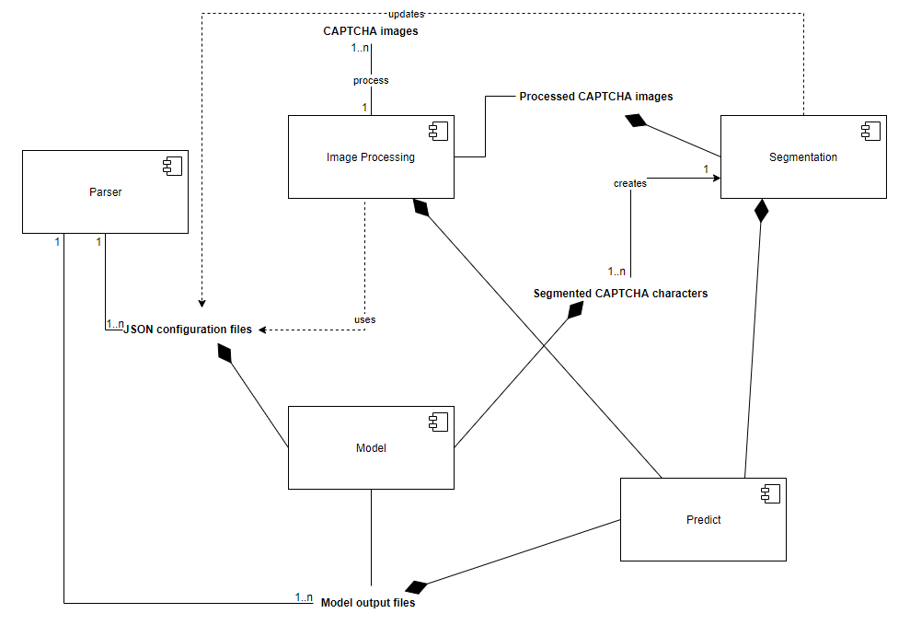
*Stack

Slide 11
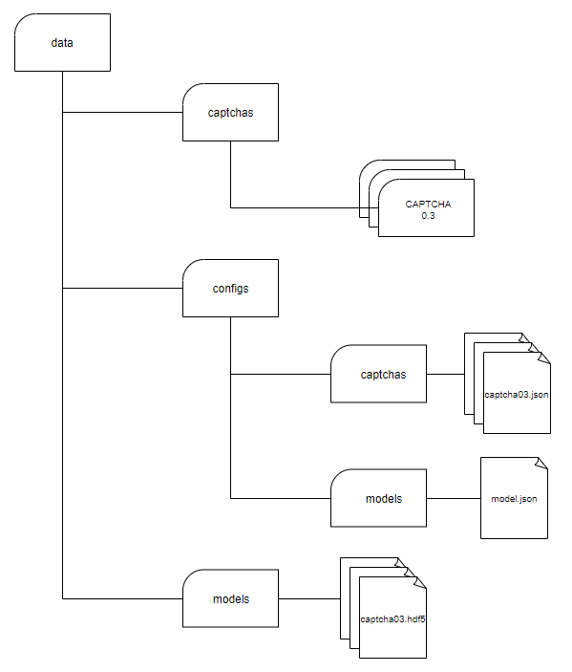

Slide 12
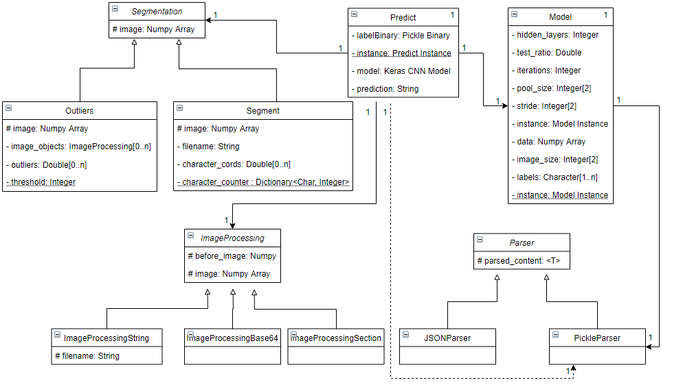

Slide 13
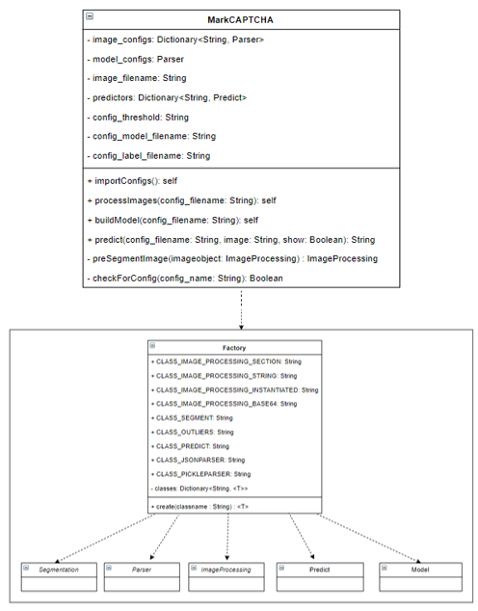

Slide 14
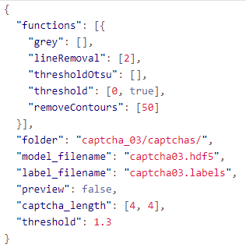
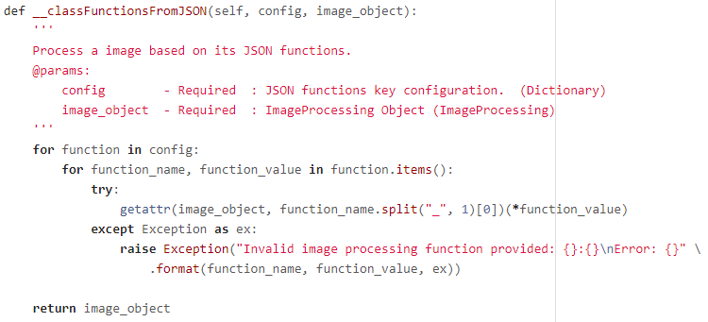

Slide 15
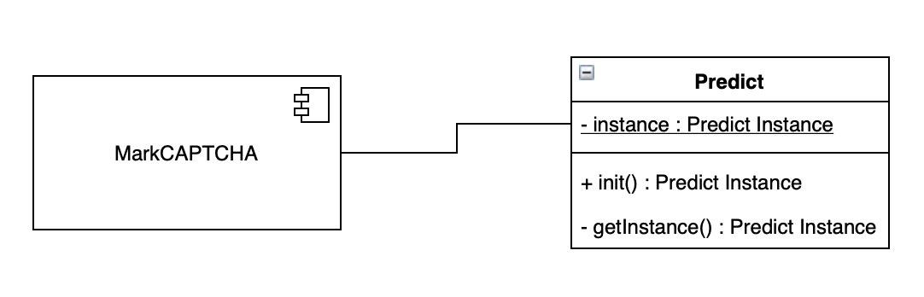
Implementing a Singleton prevented multiple loadings of a model,
resulting in accuracy prediction times decreasing by approximately 98%.
30 minutes for 100 CAPTCHA images -> 3 seconds

Slide 16
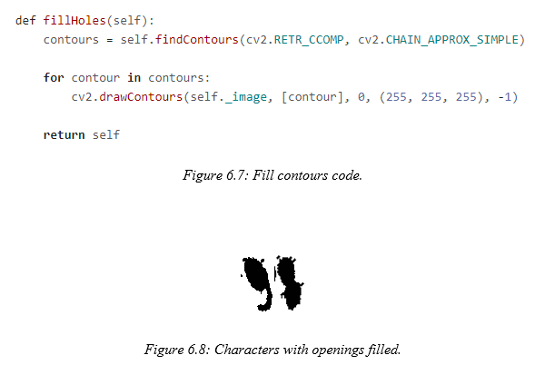

Slide 17
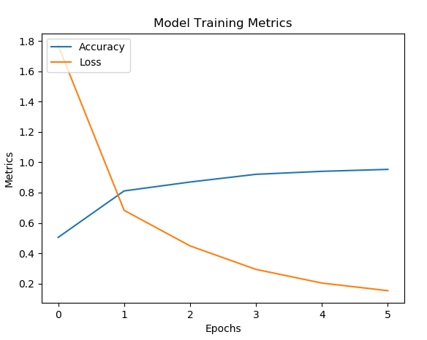
CAPTCHA 0.3

Slide 18
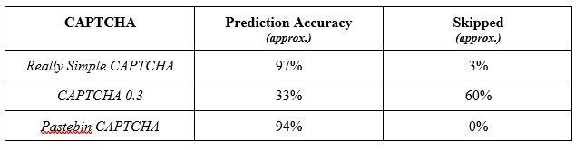
Final Prediction Accuracies

Slide 19



Future Work

