Slide 1
Capacity Planning
“How to Retire Early by Spending 2 Hours Forecasting the Future”
©2007 - 2014 Octopus Software
This work is licensed under a Creative Commons Attribution-ShareAlike 4.0 International License.

Slide 2
Agenda
Overview
  Planning Release
  Capacity Planning
Availability – The Foundation
  Assumptions
  Inputs
Adjustments
Planning Capacity
Other Aspects
©2007 - 2014 Octopus Software

Slide 3
Reality
OK, we won’t be teaching you about how to retire early. We will be talking about predicting the future
If all of my efforts to retire early by predicting the future have failed, why predict the future?
  “Plans are useless, planning is indispensable”
Just because our plans will be inaccurate to some extent, that does not mean we should abandon planning
We should be able to set some expectations on cost and timeframes while recognizing that reality will be different
©2007 - 2014 Octopus Software
Notes:
Quote by Dwight D. Eisenhower, From a speech to the National Defense Executive Reserve Conference in Washington, D.C. (November 14, 1957)

Slide 4
Overview - Questions to Answer
When are you going to be done?
  Reliably predict end dates
    Backlog - how much work do I have?
    Velocity - how quickly can I get the work done?
    Combination tells me when I will be done
How much will this cost me?
What will I get?
Is my team getting better over time?
  Performance
  Quality
How effective is my team?
  Story time, defect time and "overhead" time
Do we have special efforts around elevates/deployments?
©2007 - 2014 Octopus Software
Notes:
Part of agile is to go fast and deliver what people need, vs what they ask for. We also want to be predictable or reliable so when people engage us to deliver, we have built up a trust level so they are very comfortable giving us

Slide 5
Overview - Primary Focus
  Key Question: “When can I predict my team to deliver with high quality and reliability?”
  Two Part Answer:
  Capacity - How much can my team create and delivery with high quality?
    Availability - how much time does my team have and how efficient are they?
    Defects - how do I address and manage this effort?
    Ongoing velocity - am I getting better or worse?
    Team composition - expertise, experience and “heart”
    Predicted with a Capacity Plan, predicted with Story Points and evidence of previous performance
  Release Backlog - How much work do I have?
    Sized by estimating Stories and Epics with Story Points
©2007 - 2014 Octopus Software

Slide 6
Scrum Process
Stories Packaged
For Release
Team
System
Test?
Release Planning
Sprint Zero
Sprints
Sprint
Planning
Sprint
Review
Update Backlog
Release
Approved
And Moved
To Prod
Detail Stories
Capacity Plan
Tasks +
Estimates
Tested +
Accepted
Stories
Initial
Backlog
Priorities
Sprint
Execution
Timeframes
Feasibility +
Portfolio
Planning
Production
Verification
Operational
Feedback
& Needs
Business Need
+ Budget
©2007 - 2014 Octopus Software
Notes:
This diagram give the instructor a chance to talk about how Iteration Planning fits into the overall project.
This is the second planning step in an agile project.
This plan outlines which capabilities/ features are going to be developed in which iteration.
The processes reconciles conflicting priorities that the team may have.
Key players are the business owners, iteration manager, tech lead and test lead. (If the business person is not there, the meeting is postponed.).
Design
Measure
Analyze
Improve/ Design
Control/ Verify

Slide 7

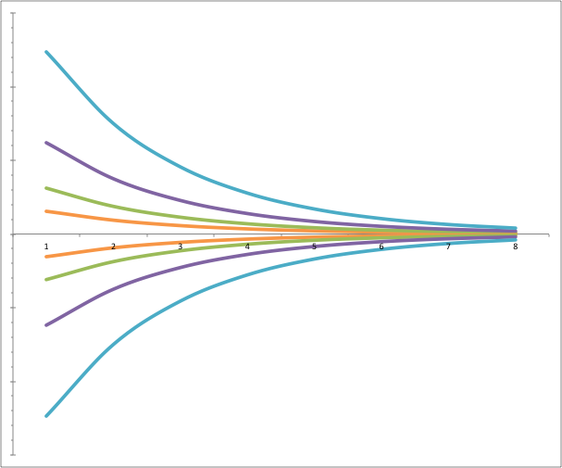

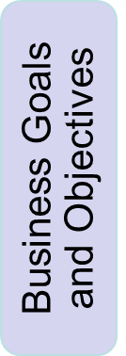


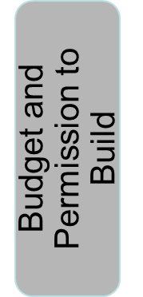


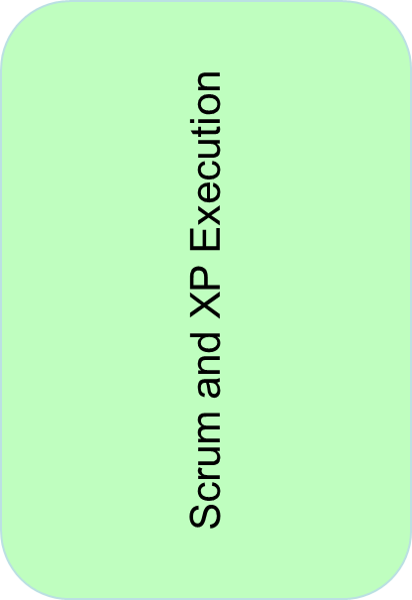

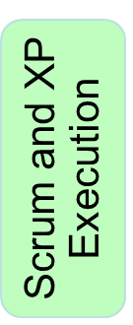

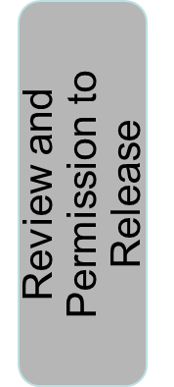

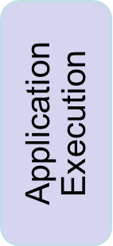
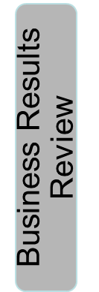
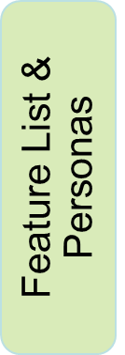
Overview - Cadence + Risk
Business Goals and Objectives
Next Project Execution
Feature List
Risk
Learning
©2007 - 2014 Octopus Software

Slide 8
Overview - What Is Capacity?
To understand capacity, we want to think of our team as a factory to build intellectual property
  Not widget builders
  Not typists
  But inventors, knowledge workers
So how do we measure the invention of software? Lets take a look at a software factory
©2007 - 2014 Octopus Software

Slide 9



High Level Software Factory
Velocity
Project
Backlog
One Cycle
C, size
J, size
N, size
V, size
Story
Story
Story
Story
1
2
1
2
1
2
1
ADDT
2
D, size
G, size
K, size
O, size
AA, size
Story
Story
Story
Story
R, size
Story
2
4
2
1
Story
1
2
4
2
1
1
1
ADDT
1
Capacity
A, size
Story
E, size
H, size
L, size
P, size
B2, size
CC, size
AB, size
Story
Story
Story
Story
S, size
Story
Story
Story
2
Story
2
2
2
2
2
4
2
2
2
2
2
2
ADDT
1
4
2
2
1
B, size
F, size
I, size
M, size
Q, size
BB, size
DD, size
AC, size
Story
Story
Story
Story
Story
U, size
Story
Story
Story
4
1
2
2
4
Story
1
2
2
4
1
2
2
4
2
1
2
2
ADDT
2
Week
Week
3
3
5
5
7
7
9
9
11
11
13
13
15
15
17
17
19
19
sprints
6
6
4
8
9
4
8
4
4
Velocity
-
Actual
Planned (Thanksgiving) Last 2 sprints
Original Backlog
-
53 points
Now
Release
Evolving Design
Preparation
System + Performance
Test
End date = Backlog divided by Planned Capacity (Velocity)
©2007 - 2014 Octopus Software

Slide 10
Overview - What Impacts
Capacity?
Team composition and structure
Expertise and experience
Tools and technology
Participation of our users/ business partners
Definition of done
Our experience with development and delivery tools
Our experience with the business area
©2007 - 2014 Octopus Software
Notes:
We need to take most of these into account. How?
For a long running team, how much of this stuff changes significantly in the scope of one or two releases?

Slide 11


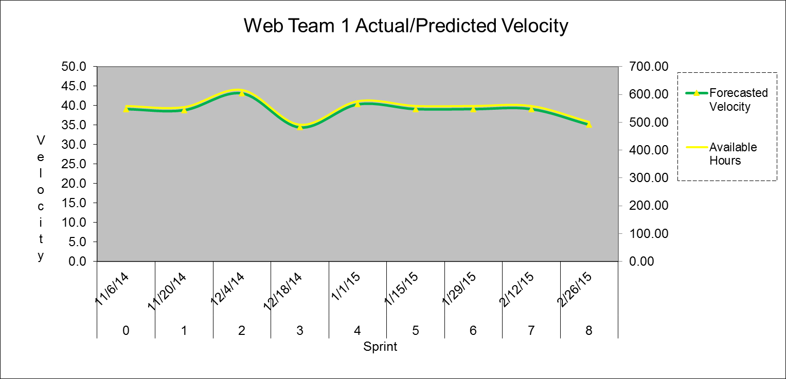
Overview – Team Time
As available time goes up, so does the potential to deliver.
Our goal is to predict velocity based on that information.
Co-located and
Complete
Team
Holidays,
Vacations,
Training,
Other
Projects,
Other
Absences
Defect
Time,
Support
Available
Time
Minus
Minus
Gives
Each Person
Contributes
Effort
Over Time
©2007 - 2014 Octopus Software
Notes:
So if the environment and composition of the team stays consistent, then here is our key assumption.

Slide 12
Lets Get Started!
We can plan capacity for 1 to 12 months in < 2 hours
Preparation:
  Download the spreadsheet
  Open the spreadsheet
  Put in your details and assumption
  See your capacity plan in story points
  We will start with some assumptions
©2007 - 2014 Octopus Software

Slide 13

Setup – Settings Tab
Define the basic sprint information – open the Settings tab:
  Starting number and date
  Sprint length in days
  Hours per Sprint
  Number of hours per sprint/day
1
Sprint Holiday time:
  Confirm sprint start and end dates
  Holidays for the year
2
You should notice a pattern where the green cells are cells you enter data.

Slide 14
Setup – Team Tab
Define the team:
Person’s name, role, start and end date
% commitment to the team
The start/end dates are computed
Hours available per person are computed
3
Define vacation/ramp up time:
By person’s name, date and days off with comment
Hours off and sprint are computed (non-green colored fields)
4

Slide 15
Foundation – Availability Tab
Define the team allocation:
Ensure the Team Allocation (column C) matches the summary by team (F1)
Review the Holiday and Vacation values
The available time per sprint and an FTE total is computed
5

Slide 16


Setup - WebTeam1 Tab
Name for the team:
Change the values in A1, the tab and the graphs to match your team name
6
Hide rows to control x-axis on charts:
Notice that the model can handle many sprints
7
Ensure Planning Velocity Ratio is appropriate:
Setting this value requires some judgment from the Scrum Master
Note that the Historical Values should start empty
8
©2007 - 2014 Octopus Software

Slide 17
Original Velocity Estimate
Questions:
  Prior experience
    As a team
    With specific tech
    In business area
  Iteration length
  Point factor
Pointing Model - 1, 2, 4 and 8, where 4 is two weeks of work, then factor in iteration length
Initial Estimate Calculation
  3 Developers x 4 point/iteration = max 12 team points, so reduce 40% as target for first iteration ~ 7 points

Slide 18
Calculate Hours to Points Factor
Now that we have an estimated velocity (7 points), we can create a conversion factor
3 developers @ 40 hours / week and a two week iteration = 240 total hours available
240 hours / x hours/point = 7 points
Conversion factor = 34.28 hours/point
If we loose one developer for 5 days of vacation the next iteration, we will be down to 200 hours
For this next iteration, 200 hrs/ 34.28 = 5.8 points. Round down for RPM

Slide 19
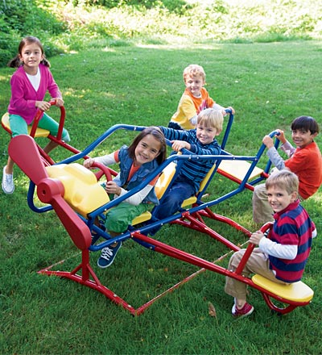

Setup - Planning Velocity Ratio
AC, size
Story
2
2
V, size
Story
2
2
DD, size
Story
2
2
R, size
Story
1
1
As you add/remove people you can see
a somewhat predictable change, to a limit
B2, size
Story
4
4
If you have good balance in your team and with your eco-system, you can avoid artificial throughput constraints
BB, size
Story
1
1
S, size
Story
1
1
U, size
Story
2
2
©2007 - 2014 Octopus Software

Slide 20
Setup – Velocity Stealers
Velocity “stealers” need to be set:
Note Defect Hours to reflect our best understanding of how many hours per iteration we need for defects (column D)
9
Note Support/Other Hours to reflect our best understanding of how many hours per sprint we need (column E)
©2007 - 2014 Octopus Software

Slide 21
Velocity Forecast
The model has computed a Velocity forecast based on the information we have put in. This forecast is in Column P
Recall that this is a plan of capacity and this does not include any risk-based analysis on other potential causes of velocity change
This is a primary input into release planning. We need to review this with the team to see if this forecast makes sense.
An S-Curve adjustment is possible for teams that are just starting up. This can adjust the specific sprint forecast in column P
10
©2007 - 2014 Octopus Software

Slide 22

Capacity / Planned Velocity
Capacity or velocity is a prediction of how much throughput my team can achieve
Simply, this is based on "yesterday's weather" - what they did last iteration is what they will do now.
The team may request to adjust it based on what they know
The iteration manager may adjust it, with the team, based on what they know
Story
2
Story
1
Story
4
Story
1
15
8 Points

Slide 23
Use of Forecast
Based on a desired end date, we can forecast what the total number of story points are possible
We can have very interesting discussions on what could be done in each sprint to set detailed expectations and cross-team coordination
C, size
J, size
N, size
V, size
Story
Story
Story
Story
1
2
1
2
1
2
1
ADDT
2
D, size
G, size
K, size
O, size
AA, size
Story
Story
Story
Story
R, size
Story
2
4
2
1
Story
1
2
4
2
1
1
1
ADDT
1
A, size
Story
E, size
H, size
L, size
P, size
B2, size
CC, size
AB, size
Story
Story
Story
Story
S, size
Story
Story
Story
2
Story
2
2
2
2
2
4
2
2
2
2
2
2
ADDT
1
4
2
2
1
B, size
F, size
I, size
M, size
Q, size
BB, size
DD, size
AC, size
Story
Story
Story
Story
Story
U, size
Story
Story
Story
4
1
2
2
4
Story
1
2
2
4
1
2
2
4
2
1
2
2
ADDT
2
Week
Week
3
3
5
5
7
7
9
9
11
11
13
13
15
15
17
17
19
19
sprints
©2007 - 2014 Octopus Software

Slide 24
Adjusted or Requested Velocity
Management, or the team, may request a level of throughput higher than what the model says. For whatever reason of variance, this value can be recorded in the Scheduled Story Points, column H
The Total Points requested for this timeframe is in cell H41. Our planned and requested points are in sync in this example
11
©2007 - 2014 Octopus Software

Slide 25
Picture View of Plan
As hours available change, then the planned output of the team changes
©2007 - 2014 Octopus Software

Slide 26
Tracking Progress To Plan
Track Release Plan:
Record the actual points completed in Actual Points Completed column J
Note the actual hours to points ratio is computed in the Actual Velocity Factor in column W
12
Record “new scope” in the Added Story Points column L which increases the overall total points
13
©2007 - 2014 Octopus Software

Slide 27
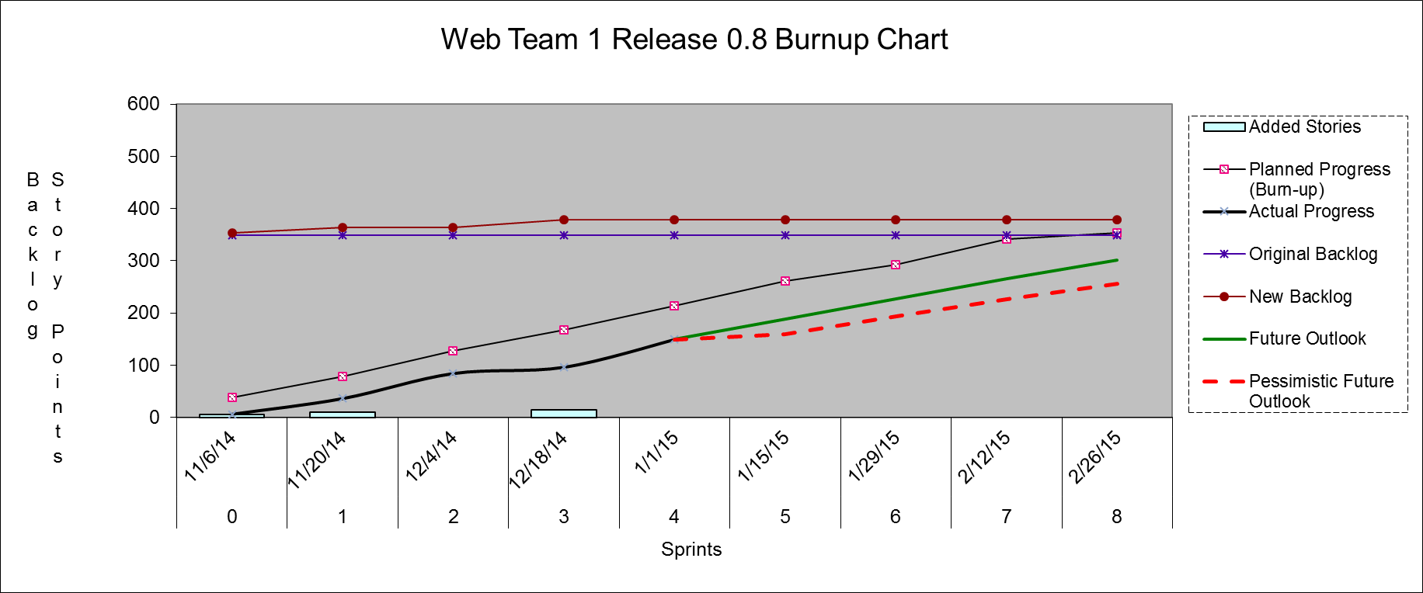
Progress In Pictures
©2007 - 2014 Octopus Software

Slide 28
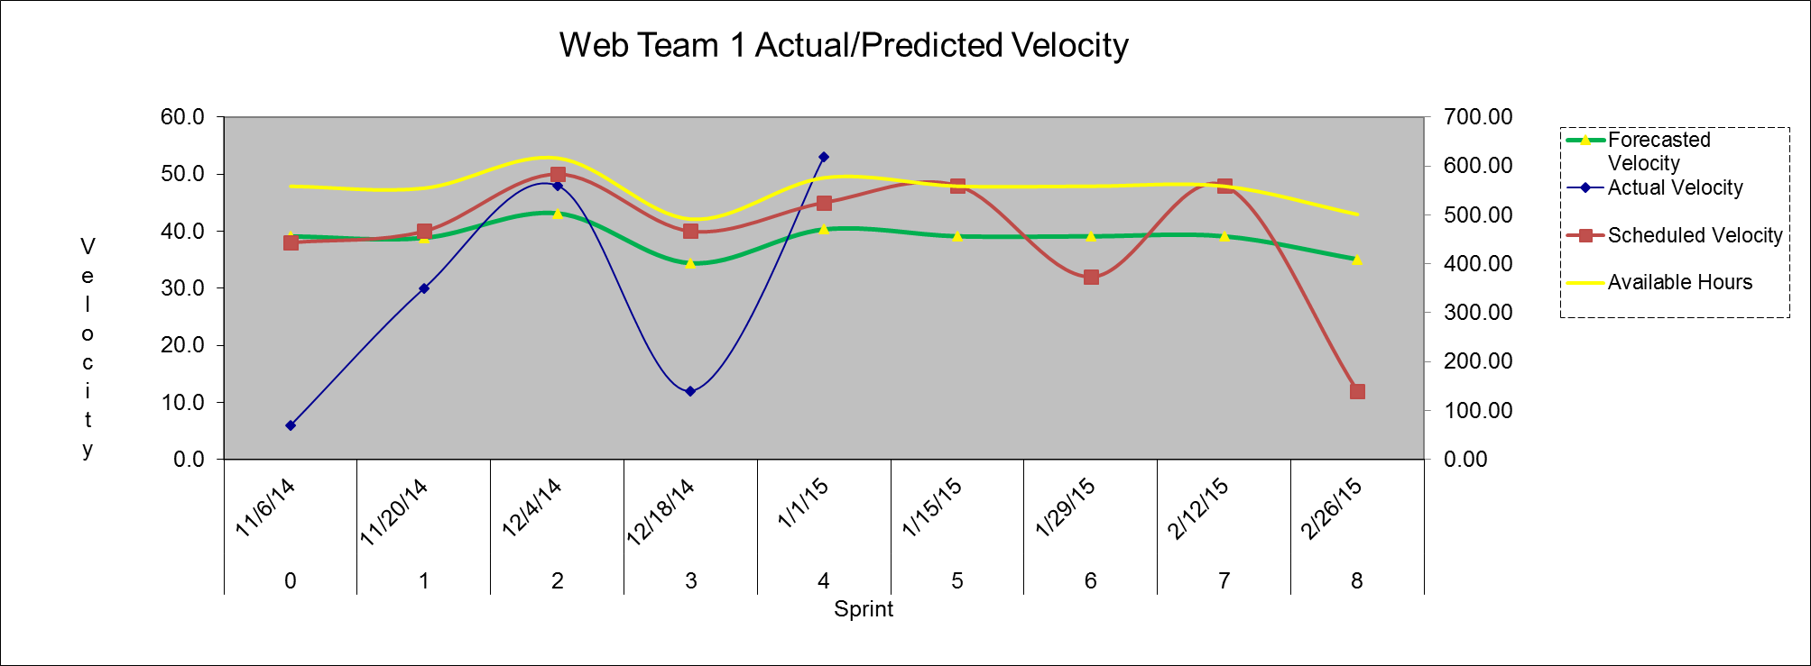
Velocity in Pictures
©2007 - 2014 Octopus Software

Slide 29
Related Ideas: Definition of Done
Is a referee between developers and business to enforce the definition of done
  Business defines how to measure "done"
  Developers say it is done
  Testers verify done
  Business agrees work is done
Done is an important concept to velocity - the team does not get "credit" unless the story really is done - we are measured by delivering production ready software
Story
2
Story
2
ADCT

Slide 30
Need for Capacity Planning
Critical to the release planning meeting (RPM):
  How many story points can I commit to for a given iteration?
  Business reps will then allocate stories to the iterations based on this capacity
  Done ahead of each release planning meeting
  Also useful for portfolio planning

Slide 31
Team Ratio Assumption
For every three or so developers:
  One Product Owner, business person
    Maybe a business analyst as well?
  One imbedded tester
  1/2 automated function test writer
  1/4 build/environment support person
Double the developers, double the other folks
Of course, your mileage may vary ☺

Slide 32
Capacity Adjustment Ideas
Defects - plan a minimum of 10% for defect work - don't allow high and med. defects to accumulate
Adjust capacity to ensure no defect inventory
Last two iterations, take 1/2 of capacity for defects
Holiday months, drop capacity by 10%
New people should not be planned at 100%, there is ramp up time

Slide 33
Summary
Basic team information was gathered
Some assumptions were entered
A forecast was created for our review
Adjustments could be made to the plan until we get everyone on the same page
We have completed our capacity plan as the foundation for a release plan
Actuals can be entered to see how we are progressing on our plan
©2007 - 2014 Octopus Software

Slide 34

Questions
Contact: Shane Hayes, shane @ Octopus – software. com

Slide 35
Copyright / License
This work is licensed under a Creative Commons Attribution-ShareAlike 4.0 International License.
©2007 - 2014 Octopus Software

