Slide 1
MANUAL HANDLING

Slide 2
SYMPTOMS
Back or neck pain
Pain in wrists shoulder or arms
Stabbing pains in arms or legs
Painful joints
Pain, tingling or numbness in hands or feet
Weakness or clumsiness
Heaviness
Burning sensations
Stiffness
Swelling
Weakness or clumsiness
Heaviness
Burning sensations
Stiffness
Swelling
If you start to experience any of these symptoms
don’t ignore them!

Slide 3
THREE STEPS TO REDUCING MANUAL TASK INJURIES
The three steps are:
Identifying manual task hazards
Assessing the risk of those manual task hazards identified causing injury
Eliminating the risk, or if not practicable reduce the risk to the lowest practicable level

Slide 4
HAZARD IDENTIFICATION
Identify all the plant, materials, equipment, premises, systems of work, the work environment and individual tasks which have the potential to contribute to a musculoskeletal disorder

Slide 5
HAZARD IDENTIFICATION
Manual task hazards can be identified in different ways:
Walk through the workplace and look for potential hazards
Talk over risk factors with co-workers
Reviewing previous accidents and near misses

Slide 6
ASSESSING THE RISKS
The next step is to assess which factors are contributing to the risk of injury.
Risk factors to be considered:
Body posture
Force
Repetition of movements
Speed of movements
Vibration
Duration
Workplace or workstation layout
Other work conditions
Characteristics of the item
Location of objects and distances moved
Work organisation and systems of work

Slide 7
ASSESSING THE RISKS
Type of work - some tasks require fixed postures for long periods of time
Layout of the work space - a poorly designed workspace may force people to maintain awkward postures, such as bending or twisting repetitively
Handling time - the more often an object has to be handled, the greater the chance of injury
Weight of the object - heavy objects that have to be lifted awkwardly, such as from ground level are more likely to cause injury than objects lifted from waist level
Equipment - more effort may be required to manipulate badly designed or poorly maintained equipment
The degree of effort - simply restraining an object such as an animal, can cause sprains and other injuries

Slide 8
Common risk control measures
Change the task - does this task need to be carried out? If so, does it have to be done this way?
Change the object - for example, repack a heavy load into smaller, more manageable parcels
Use mechanical aids - like hand trolleys or platform trolleys
Change the workspace - for example, use a work bench to limit bending or stretching
Change the nature of the work - take frequent breaks or multi-task
Seek proper training – incorrect lifting techniques may result in an injury

Slide 9
EVALUATION & RECORD KEEPING
Evaluation
Check the effectiveness of control measures in place and ensure no
new hazards have been introduced
Record Keeping
Records should be kept of hazard identification, risk assessment and control
measures including training records

Slide 10
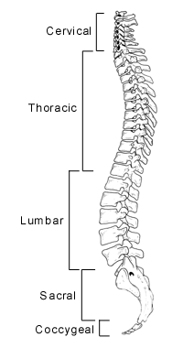
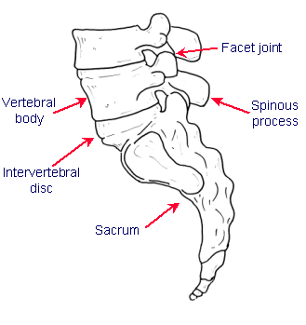
THE SPINE

Slide 11
Protecting your back
Your back is particularly vulnerable to manual task injuries. Suggestions to protect your back include;
Warm up cold muscles thoroughly before engaging in any manual work
Lift and carry heavy loads correctly, by keeping the load close to the body and lifting with the thigh muscles
Never attempt to carry or lift loads in excess of the recommended maximum limit for one person
Maintain correct posture and the natural curves of the spine
Organise the work area to reduce the amount of bending, twisting and stretching required
Get help to lift or carry a heavy load whenever possible, using another worker or appropriate mechanical aids
Cool down after heavy work with gentle, sustained stretches
Exercise regularly to strengthen muscles & ligaments
Take frequent breaks

Slide 12
Safe lifting technique
Plan the lift
Keep the load close to your body
Maintain the natural curves of your spine

Slide 13
stretching
Stretch prior to doing any manual handling tasks.
Exercise and take short breaks frequently
Cool down after any heavy lifting/manual handling.
Prevention is better than cure! You can do just a few of the exercises anytime during the day. Try some of them before you get stiff and sore.
Include a variety of movements in your workday.
Some stretches may cause you pain or discomfort. If this occurs, stop the stretch immediately.

