Slide 1
WORKSTATION ERGONOMICS

Slide 2
Common risks
Glare and lighting
  eye discomfort, eye strain and headaches
Poor working environment
  exposure to noise, poor air quality and uncomfortable temperature.
Long duration and lack of task variety
  musculoskeletal injury and occupational overuse syndrome
Poor posture
  back pain
  head and neck discomfort
  shoulder, arm, hand and wrist discomfort
  leg and foot discomfort
  circulation problems
  headaches

Slide 3
Workstation essentials
Office furniture
  Adjustable and supportive chair
  A fixed height desk with a height adjustable footrest, if required
Monitor
  Top of screen is at or below eye level
  Monitor positioned to reduce glare and reflections
Frequent changes in posture and regular
breaks from sitting
Sufficient work surface

Slide 4
Workstation essentials
Sufficient area to enter and move about the work area and allow for frequent changes in posture
Storage for personal items and work requirements
Work Environment
  satisfactory temperature
  not too noisy
  appropriate lighting
  good air quality

Slide 5
WORKSTATION ERGONOMIC SELF-ASSESSMENT
If you are worried about the comfort of your workstation you should carry out a
Workstation Ergonomics Self-Assessment
You can solve many workstation problems yourself by simply adjusting your workstation.

Slide 6
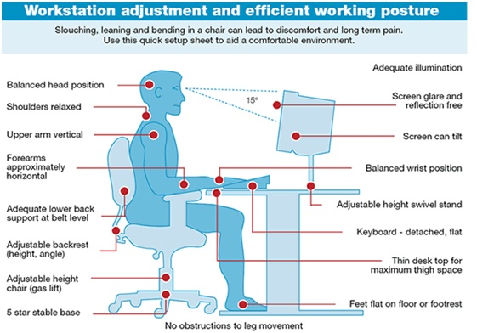

Slide 7
Workstation evaluation
If the results of your self assessment identify that problems exist with your workstation, you should in the first instance discuss these issues with the Operations/Office Manager.
If you have any further concerns or require further assistance, please contact a member of the OHS Committee.

Slide 8
In the meantime…
For further useful information on workstation ergonomics, please view Workplace Health and Safety Queensland’s Ergonomic Guide to Computer Based Workstations at the address below:
https://www.worksafe.qld.gov.au/__data/assets/pdf_file/0006/83067/guide-ergo-comp-workstations.pdf

