Slide 1

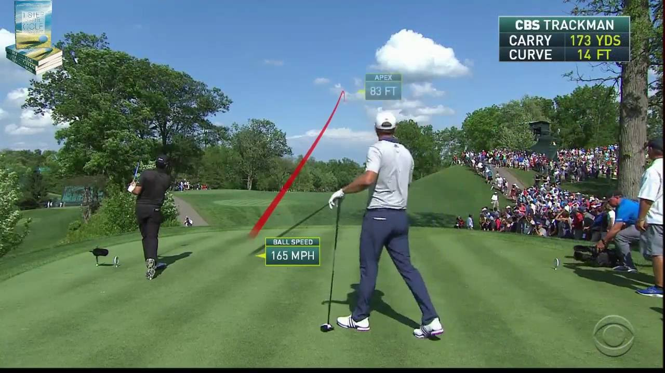
Fantasy Golf Using a
Data Driven Genetic Algorithm
By: Shane Rooney Supervisor: Mr. Matthias Glowatz

Slide 2
Agenda
Business Problem
Background
Data Requirements & Methods
Results & Analysis
Contribution
Conclusions & Lessons Learned
Notes:
May require more than one slide

Slide 3
Business Problem - Aim
Fantasy Golf and golf data growing exponentially so how to take advantage?
Aim – gain an advantage over other users by using business analytics, namely statistical analysis of form and a genetic algorithm
Irish standard fantasy golf game
Select 10 golfers
Total budget <= €100 million

Slide 4
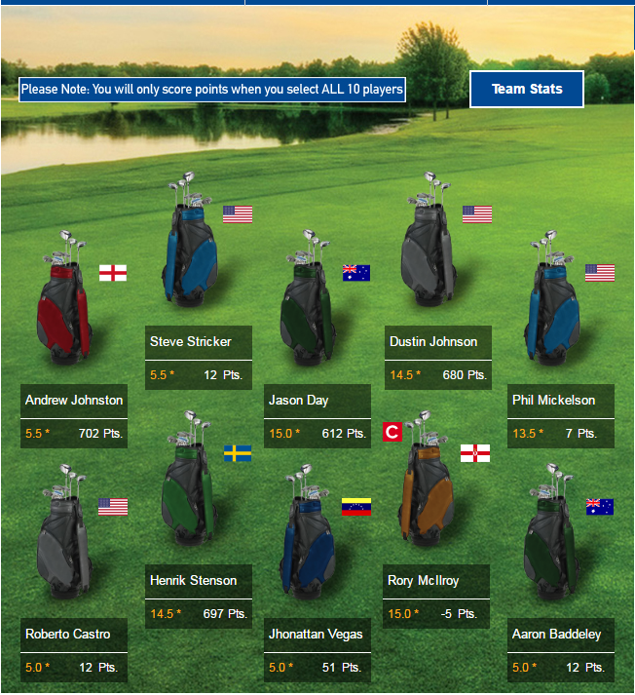
Background
Fantasy Sports and Daily Fantasy Sports (DFS)
$1 billion prize funds 2015 ($30m fantasy golf)
Revenue to reach $15-20 billion (Forbes) by 2020
51.8M fantasy sports players in North America
DFS players up 7M in 2 years (FSTA.org)
ShotLink and Golf Analytics
Laser technology since 2003
500+ data points
Strokes Gained Statistic (Broadie, 2008)
Academic Justification
New Application of Genetic Algorithm
GA chosen as it solves combinatorial
optimisation problem

Slide 5
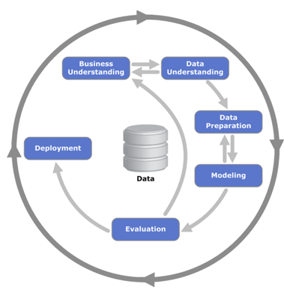
Data Sources & Methods
ShotLink Data
Fantasy Golf Data¹
Data Mining CRISP-DM
Tukeys Exploratory Data Analysis
Explore Correlations and Classifications
Feature Reduction
Moving YTD Averages
Decision Trees, Regression
Produce “Form Indicator”
Genetic Algorithm (GA)
Input relevant golfers with value and “Form Indicator”
Maximise Form (team value < €100 Million)
Output Fantasy Golf Team of 10 Golfers
¹ http://fantasygolf.irishtimes.com
Notes:
May require more than one slide

Slide 6
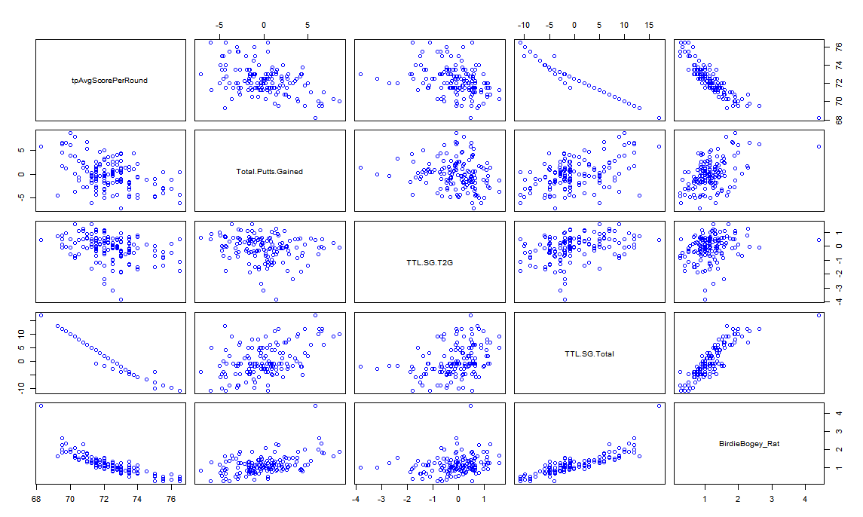
Results – Data Mining
Notes:
May require more than one slide

Slide 7
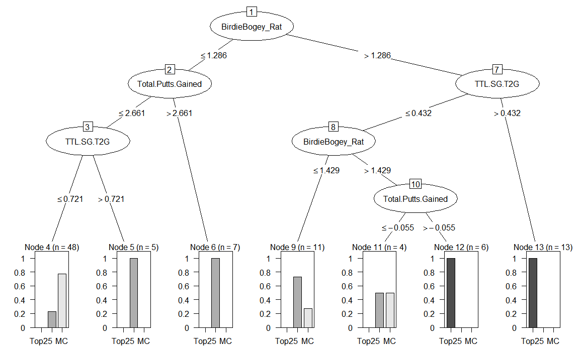
Results – Data Mining
Notes:
May require more than one slide

Slide 8
Results – Best Performing Features
Best Performing Features
Strokes Gained Tee-to-Green
Strokes Gained Putting
Adjusted Average Score
Birdie:Bogey
Average Position
YTD Fantasy Points
Course History
Notes:
May require more than one slide

Slide 9

Results – GA Form Indicator
$$f\left(x\right)= SGT2G+SGPutt$$
$f\left(x\right)= [(AvgScore−BirdieBogey −SGT2G −SGPutt)/AvgPos]$
$+ωFGPoints+ωCourseHistory$
Notes:
May require more than one slide

Slide 10
Results – GA Form Indicator
$$f\left(x\right)= SGT2G+SGPutt$$
$f\left(x\right)= [(AvgScore−BirdieBogey −SGT2G −SGPutt)/AvgPos]$
$+ωFGPoints+ωCourseHistory$
Player Name | Value (€M) | GA Form | Actual Finish
Grace, Branden | 14.5 | 15.74024
Kuchar, Matt | 12.5 | 13.86964
Hatton, Tyrrell | 7 | 12.76544
Koepka, Brooks | 13.5 | 12.29943
Summerhays, Daniel | 7 | 12.16567
Furyk, Jim | 14 | 9.147143
Reed, Patrick | 14.5 | 8.98657
Holmes, J.B. | 13 | 8.948611
Lowry, Shane | 13 | 8.863678
Johnson, Zach | 13.5 | 8.773282
Notes:
May require more than one slide

Slide 11
Results – GA Form Indicator
$$f\left(x\right)= SGT2G+SGPutt$$
$f\left(x\right)= [(AvgScore−BirdieBogey −SGT2G −SGPutt)/AvgPos]$
$+ωFGPoints+ωCourseHistory$
Player Name | Value (€M) | GA Form | Actual Finish
Grace, Branden | 14.5 | 15.74024 | MC
Kuchar, Matt | 12.5 | 13.86964 | Top25
Hatton, Tyrrell | 7 | 12.76544 | Top25
Koepka, Brooks | 13.5 | 12.29943 | Top25
Summerhays, Daniel | 7 | 12.16567 | Top25
Furyk, Jim | 14 | 9.147143 | Top25
Reed, Patrick | 14.5 | 8.98657 | Top25
Holmes, J.B. | 13 | 8.948611 | MC
Lowry, Shane | 13 | 8.863678 | MC
Johnson, Zach | 13.5 | 8.773282 | 26th-CUTLINE
Notes:
May require more than one slide

Slide 12
Results – Genetic Algorithm
Genetic Algorithm
Input relevant golfers with value and “Form Indicator”
Maximise Form (team value < €100 Million)
Output Fantasy Golf Team of 10 Golfers
Notes:
May require more than one slide

Slide 13
Results – Genetic Algorithm
Genetic Algorithm
Input relevant golfers with value and “Form Indicator”
Maximise Form (team value < €100 Million)
Output Fantasy Golf Team of 10 Golfers
Player Name | Value (€M) | GA Form | Actual Finish
Grace, Branden | 14.5 | 15.74024
Kuchar, Matt | 12.5 | 13.86964
Summerhays, Daniel | 7 | 12.16567
Simpson, Webb | 8.5 | 8.435362
Molder, Bryce | 5.5 | 7.465838
Furyk, Jim | 14 | 9.147143
Chappell, Kevin | 7 | 7.993202
Koepka, Brooks | 13.5 | 12.29943
Hoffman, Charley | 10 | 8.195456
Hatton, Tyrrell | 7 | 12.76544
Notes:
May require more than one slide

Slide 14
Results – Genetic Algorithm
Genetic Algorithm
Input relevant golfers with value and “Form Indicator”
Maximise Form (team value < €100 Million)
Output Fantasy Golf Team of 10 Golfers
Player Name | Value (€M) | GA Form | Actual Finish
Grace, Branden | 14.5 | 15.74024 | MC
Kuchar, Matt | 12.5 | 13.86964 | Top 25
Summerhays, Daniel | 7 | 12.16567 | Top 25
Simpson, Webb | 8.5 | 8.435362 | 26-CutLine
Molder, Bryce | 5.5 | 7.465838 | 26-CutLine
Furyk, Jim | 14 | 9.147143 | Top 25
Chappell, Kevin | 7 | 7.993202 | MC
Koepka, Brooks | 13.5 | 12.29943 | Top 25
Hoffman, Charley | 10 | 8.195456 | Top 25
Hatton, Tyrrell | 7 | 12.76544 | Top 25
Notes:
May require more than one slide

Slide 15
Results – Genetic Algorithm
Statistical Analysis using Students t-test
H₀ : Difference between participant mean and GA mean is zero
H_{A} : GA mean is greater than participant mean
Null Hypothesis rejected for all tournaments
Significant evidence to suggest GA performs better than the mean
Tournament | 95% C.I. for Mean | Sample Mean | GA Mean | p-value | Null Hypothesis
Open Championship | [783, 1024] | 903 | 1018 | 0.03128 | Rejected
Canadian Open | [292, 455] | 374 | 854 | 2.2x10-16 | Rejected
PGA Championship | [671, 880] | 775 | 1453 | 2.2x10-16 | Rejected
Notes:
May require more than one slide

Slide 16
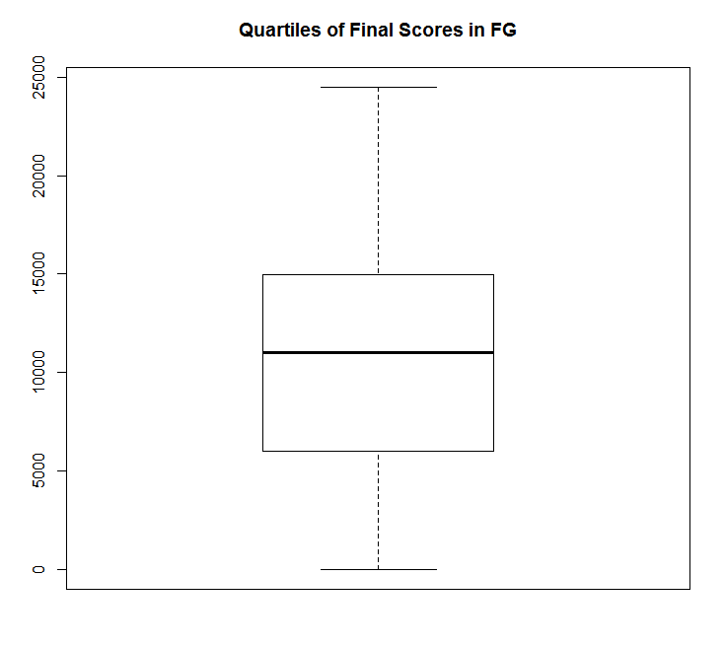

Results – Genetic Algorithm
Full Season Mean Score (GA) $\text{≈ }18841$
Full Season Mean Score (Human)$\text{≈} 11628$
Quartile 1 ≈ 0-7500 points
Median ≈ 10000 points
Quartile 3 ≈ 10000-13000 points
Quartile 4 ≈ 13000-24500 points
Top 10 Percentile ≈ 17500-24500
Notes:
May require more than one slide

Slide 17
Measure Success
Aim – gain an advantage over other users by using business analytics, namely statistical analysis of form and a genetic algorithm
Successfully created form indicator and GA to select Fantasy Golf team
GA with fitness function based on statistical analysis and data mining performs better than the average human player and could potentially finish in the top 10 percentile
Need to run over full season to measure true benefit

Slide 18
Contribution
Academic Contribution
Form Indicator for golf
New use of Genetic Algorithm
Business Contribution
Utilise as professional fantasy golf player (DFS)
Insight into player form
Golfers themselves may analyse their form to choose what to work on
Summary tables help identify in-form golfers
Design of GA and data sources with moving averages allow for customisable weights

Slide 19
Conclusions, Learnings and Future Work
Conclusions and Learnings
ShotLink data good indicator of form
GA is a good fit for fantasy sport team optimisation
Learned Importance of EDA and Data Preparation, new commands in R
Future Work
Run over more tournaments and try GA with DFS
Investigate other factors e.g. weather, course layout, seasonal peaks, strength of field
Expand to match-play and Ryder cup team
Investigate user interface for weighting features depending on the tournament

Slide 20



Thank You !!
Questions?

