Slide 1
Backpropagation Using Computational Graphs

Slide 2
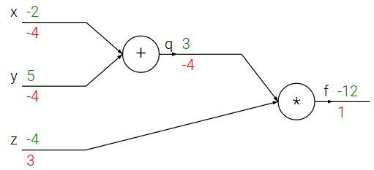

Backpropagation: a simple example
e.g. x = -2, y = 5, z = -4

Slide 3





Backpropagation: a simple example
e.g. x = -2, y = 5, z = -4
Want:

Slide 4

Backpropagation: a simple example
e.g. x = -2, y = 5, z = -4
Want:

Slide 5
Backpropagation: a simple example
e.g. x = -2, y = 5, z = -4
Want:

Slide 6

Backpropagation: a simple example
e.g. x = -2, y = 5, z = -4
Want:

Slide 7
Backpropagation: a simple example
e.g. x = -2, y = 5, z = -4
Want:

Slide 8

Backpropagation: a simple example
e.g. x = -2, y = 5, z = -4
Want:

Slide 9
Backpropagation: a simple example
e.g. x = -2, y = 5, z = -4
Want:

Slide 10

Backpropagation: a simple example
e.g. x = -2, y = 5, z = -4
Want:

Slide 11


Backpropagation: a simple example
e.g. x = -2, y = 5, z = -4
Chain rule:
Want:

Slide 12

Backpropagation: a simple example
e.g. x = -2, y = 5, z = -4
Want:

Slide 13
Backpropagation: a simple example
e.g. x = -2, y = 5, z = -4
Chain rule:
Want:

Slide 14


f

Slide 15


f
“local gradient”

Slide 16

f
“local gradient”
gradients

Slide 17
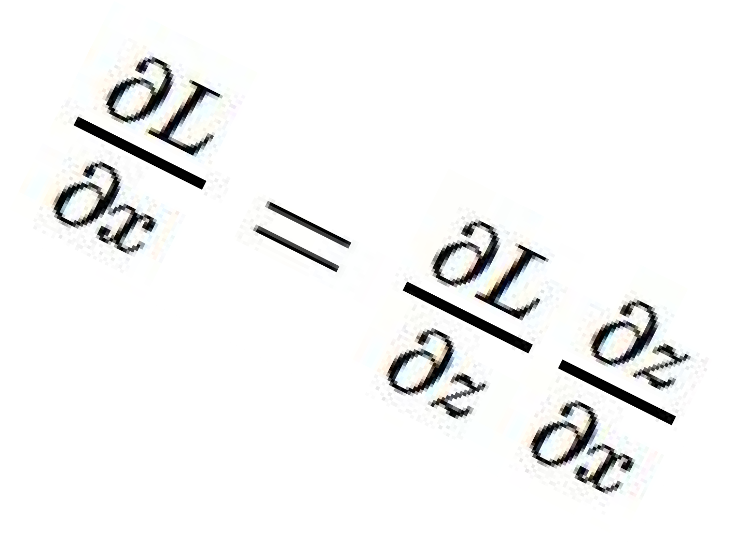
f
“local gradient”
gradients

Slide 18
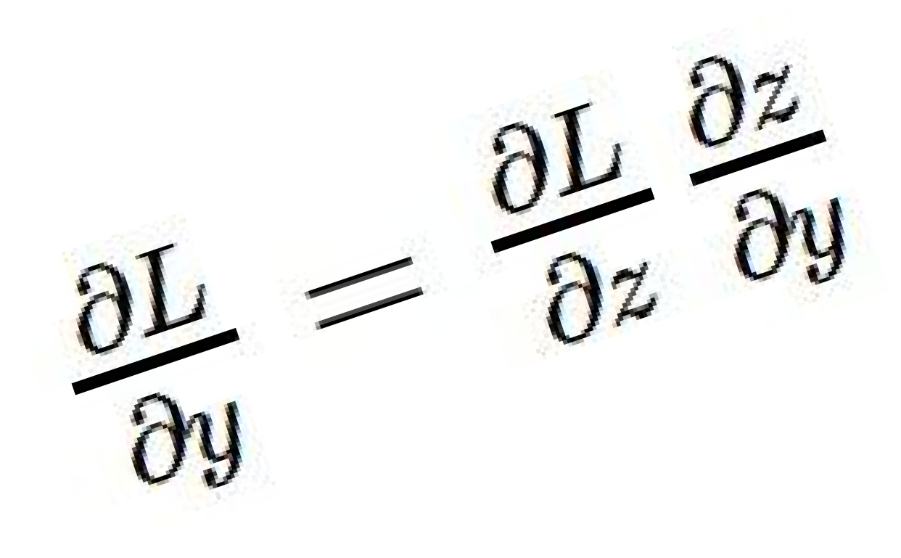
f
“local gradient”
gradients

Slide 19
f
“local gradient”
gradients

Slide 20

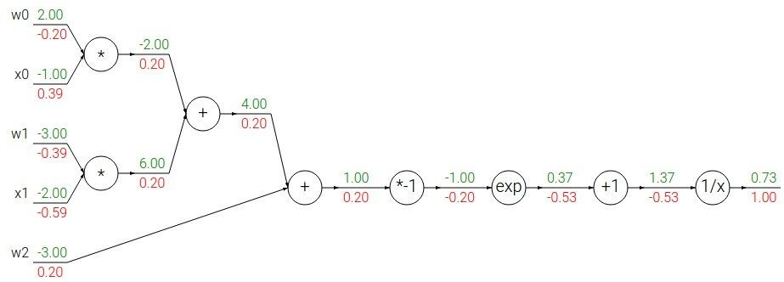
Another example:

Slide 21
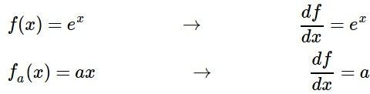
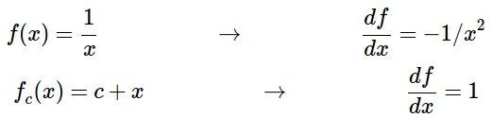
Another example:

Slide 22
Another example:

Slide 23

Another example:

Slide 24
Another example:

Slide 25

Another example:

Slide 26
Another example:

Slide 27

Another example:

Slide 28
Another example:

Slide 29
Another example:
(-1) * (-0.20) = 0.20

Slide 30
Another example:

Slide 31
Another example:
[local gradient] x [upstream gradient] [1] x [0.2] = 0.2
[1] x [0.2] = 0.2 (both inputs!)

Slide 32
Another example:

Slide 33
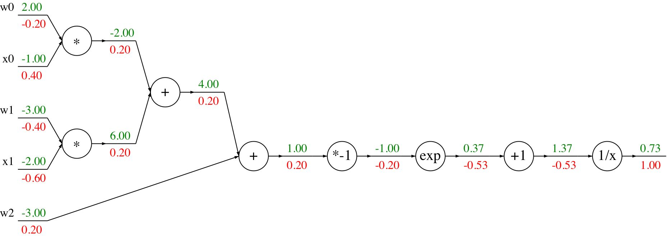
Another example:
[local gradient] x [upstream gradient] x0: [2] x [0.2] = 0.4
w0: [-1] x [0.2] = -0.2

Slide 34

sigmoid function
sigmoid gate

Slide 35
sigmoid function
sigmoid gate
(0.73) * (1 - 0.73) = 0.2

Slide 36
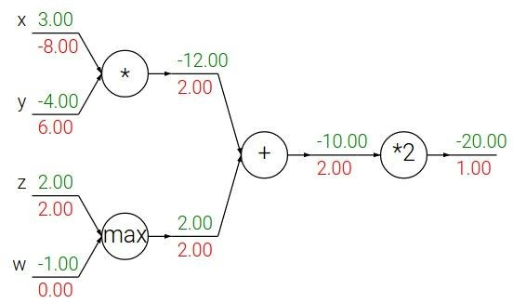
Patterns in backward flow
add gate: gradient distributor

Slide 37
Patterns in backward flow
add gate: gradient distributor Q: What is a max gate?

Slide 38
Patterns in backward flow
add gate: gradient distributor
max gate: gradient router

Slide 39
Patterns in backward flow
add gate: gradient distributor
max gate: gradient router Q: What is a mul gate?

Slide 40
Patterns in backward flow
add gate: gradient distributor max gate: gradient router mul gate: gradient switcher

Slide 41
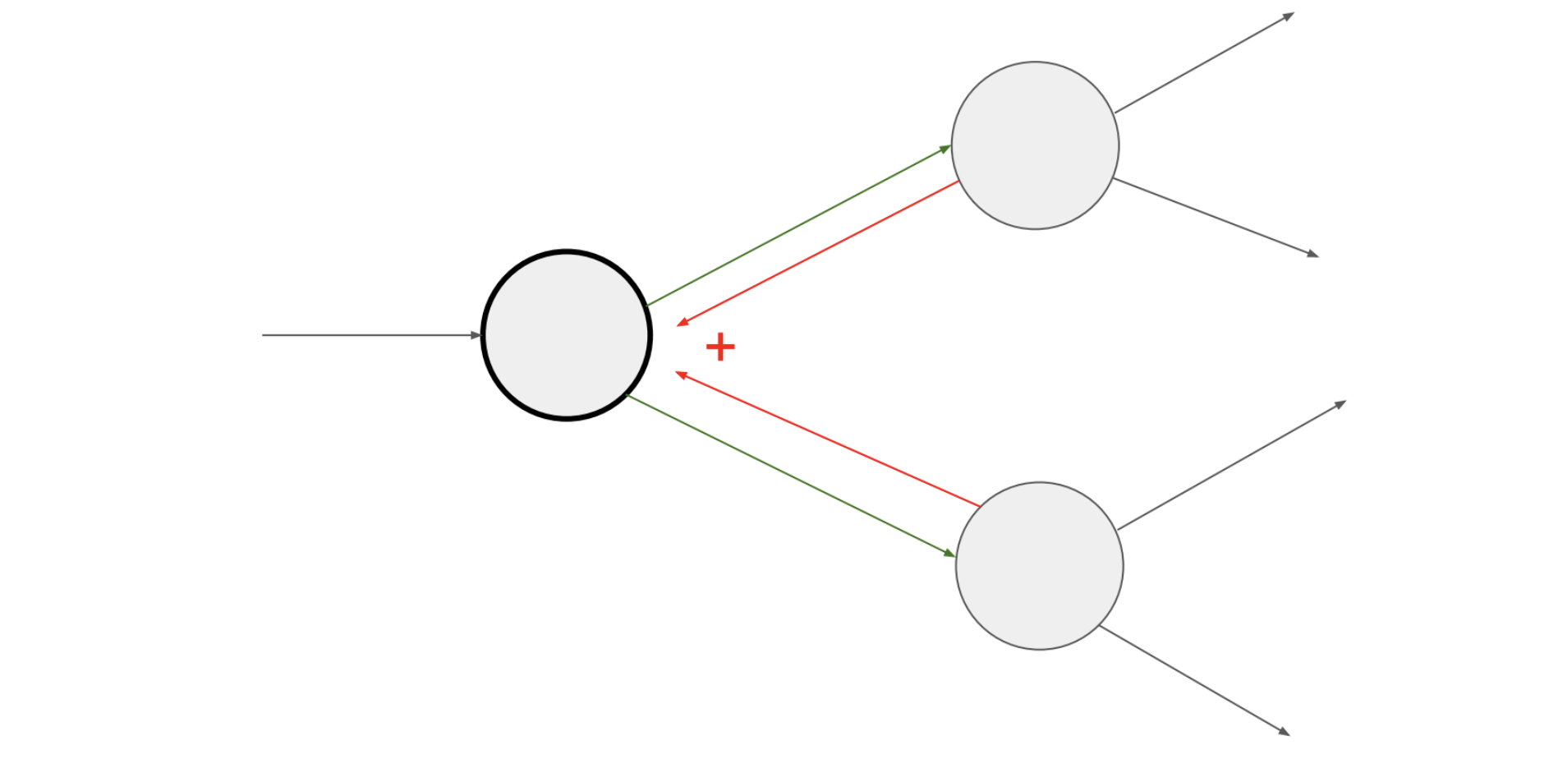
Gradients add at branches

Slide 42



Recap: Backprop equations
Learning rule:
For logistic/softmax and X-entropy
Hidden units
Output units
Here:
How much does the loss change wrt the net input into the j’th neuron?

Slide 43
We can derive these equations using computational graphs!
*
*
+
*
+
*
*

Slide 44
We can derive these equations using computational graphs!
*
*
+
*
+
*
Remember that by definition, the gradient of (-Loss) wrt , is
*

Slide 45
We can derive these equations using computational graphs!
*
*
+
*
+
*
The plus gate simply lets the gradient pass through
*

Slide 46
We can derive these equations using computational graphs!
*
*
+
*
+
*
The multiply gate means we need to multiply the gradient with the other input, ie
*

Slide 47
We can derive these equations using computational graphs!
*
*
+
*
+
*
Similarly for all the other neurons to which the output of neuron j was “sent”
*

Slide 48

We can derive these equations using computational graphs!
*
*
+
*
+
*
Since there are multiple outputs out of neuron j, to calculate the net effect, we add all the gradients.
*

Slide 49
We can derive these equations using computational graphs!
*
*
+
*
+
*
Again, the plus gate lets the gradient pass through
*

Slide 50
We can derive these equations using computational graphs!
*
*
+
*
+
*
Finally, we have the value of the gradient derivative wrt w_ij! Same as the backprop equation.
*

Slide 51
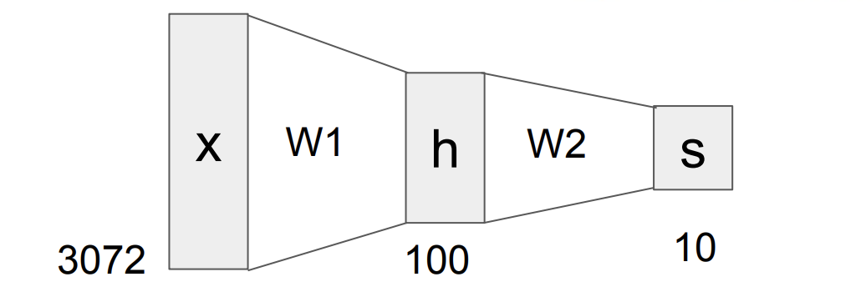
Compact View of a Neural Network
X : Vector (3072) W₁ : Matrix (3072 X 100), W₂ : Matrix (100, 10), S : Vector (10)
h = W₁.X; S = W₂(sigmoid(h))
How to backpropagate dS??

Slide 52
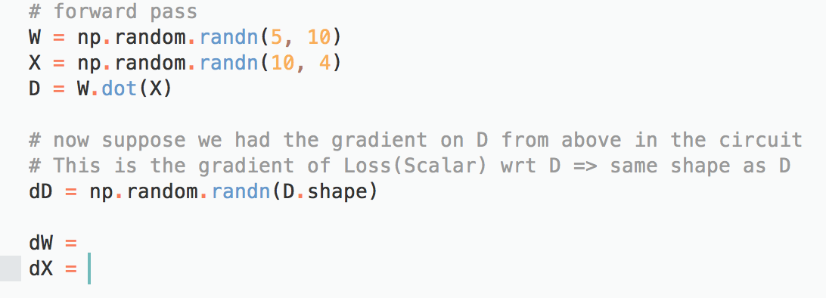
Gradients for Vectorized Operations
dW and dX are the gradients of Loss wrt W and X respectively.
Shape of dW, dX ?
dW :
dX :

Slide 53
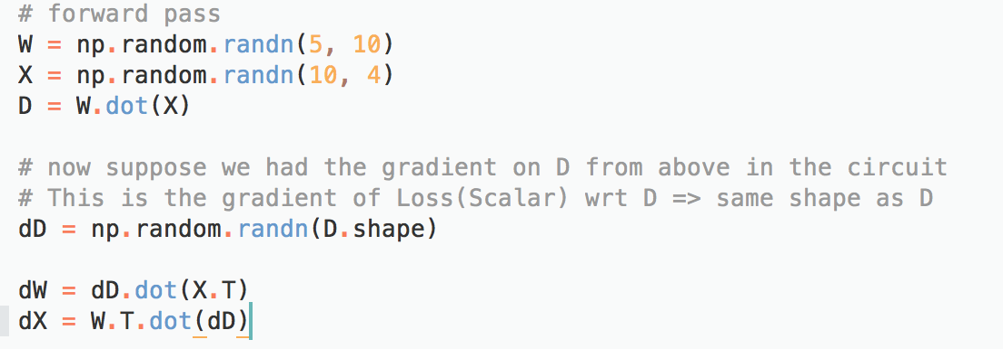
Gradients for Vectorized Operations
dW and dX are the gradients of Loss wrt W and X respectively.
Shape of dW, dX ?
dW : (5,10)
dX : (10,4)

Slide 54
Gradients for Vectorized Operations
dW and dX are the gradients of Loss wrt W and X respectively.
Shape of dW, dX ?
dW : (5,10)
dX : (10,4)

Slide 55
Gradients for Vectorized Operations
D_{ij} = Σ_{k}(W_{ik} * X_{kj})

Slide 56
Gradients for Vectorized Operations
D_{ij} = Σ_{k}(W_{ik} * X_{kj})
dW_{ik} = Σ_{j}( dD_{ij} * X_{kj} )
dW_{ik} = Σ_{j}( dD_{ij} * X^{T}_{jk} )
dW = dD.dot(X^{T})
Notes:
W_{ik} flows into Dij (for all j) during the forward pass with local gradient X_{kj}. During the backward pass we add the gradient at the branches to obtain dW_{ik}.

Slide 57
Gradients for Vectorized Operations
D_{ij} = Σ_{k}(W_{ik} * X_{kj})
dW_{ik} = Σ_{j}( dD_{ij} * X_{kj} )
dW_{ik} = Σ_{j}( dD_{ij} * X^{T}_{jk} )
dW = dD.dot(X^{T})
How to remember this?
Use Dimensionality Analysis!

Slide 58
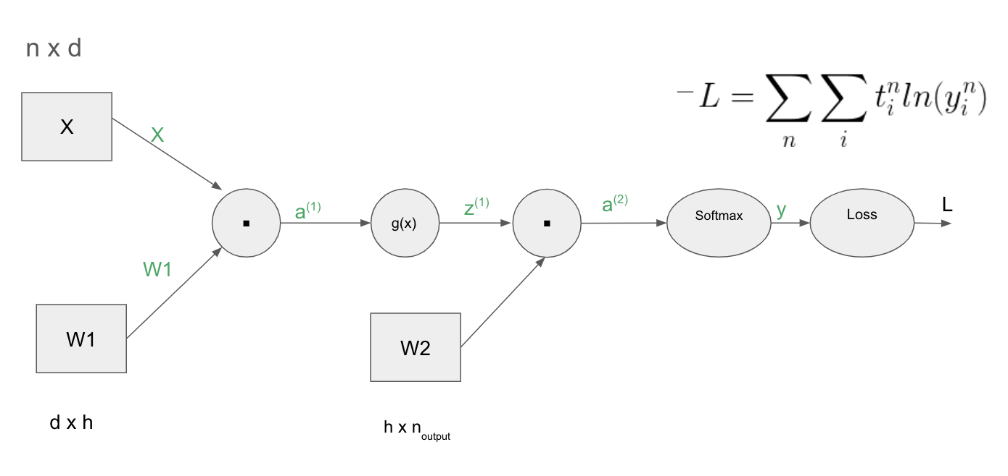
Neural Network - As a vectorized Computational Graph

Slide 59

Neural Network - As a vectorized Computational Graph
n x d
X
X
.
a⁽¹⁾
g(x)
z⁽¹⁾
.
a⁽²⁾
Softmax
y
Loss
L
𝛿⁽²⁾ ⁼ t - y
W1
W1
W2
d x h
h x n_{output}

Slide 60
Neural Network - As a vectorized Computational Graph
n x d
X
X
.
a⁽¹⁾
g(x)
z⁽¹⁾
.
a⁽²⁾
Softmax
y
Loss
L
𝛿⁽²⁾.(W2)^{T}
𝛿⁽²⁾ ⁼ t - y
W1
W1
W2
z^{T}.𝛿⁽²⁾
d x h
h x n_{output}

Slide 61
Neural Network - As a vectorized Computational Graph
n x d
X
X
.
a⁽¹⁾
g(x)
z⁽¹⁾
.
a⁽²⁾
Softmax
y
Loss
L
𝛿⁽²⁾.(W2)^{T}
𝛿⁽²⁾ ⁼ t - y
W1
𝛿⁽¹⁾ ⁼ g’(a⁽¹⁾)*𝛿⁽²⁾.(W2)^{T}
W1
W2
z^{T}.𝛿⁽²⁾
d x h
h x n_{output}

Slide 62
Neural Network - As a vectorized Computational Graph
n x d
X
X
𝛿⁽¹⁾.(W1)^{T}
.
a⁽¹⁾
g(x)
z⁽¹⁾
.
a⁽²⁾
Softmax
y
Loss
L
𝛿⁽²⁾.(W2)^{T}
𝛿⁽²⁾ ⁼ t - y
W1
𝛿⁽¹⁾ ⁼ g’(a⁽¹⁾)*𝛿⁽²⁾.(W2)^{T}
W1
X^{T}.𝛿⁽¹⁾
W2
z^{T}.𝛿⁽²⁾
d x h
h x n_{output}

Slide 63
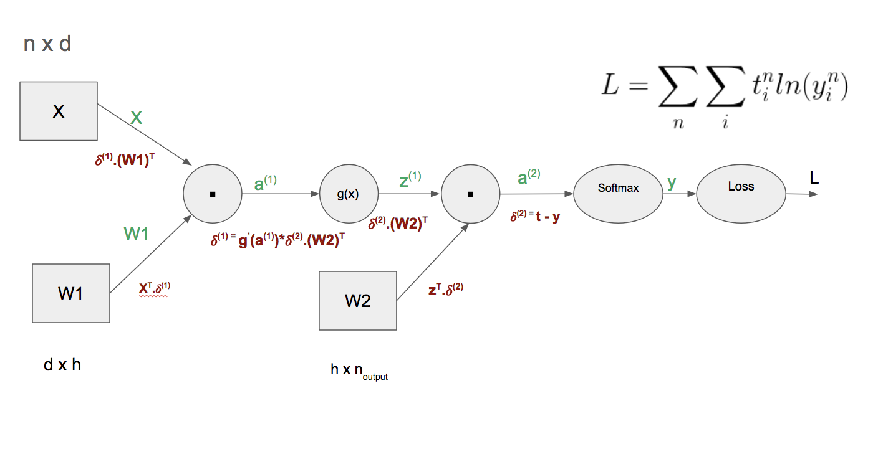
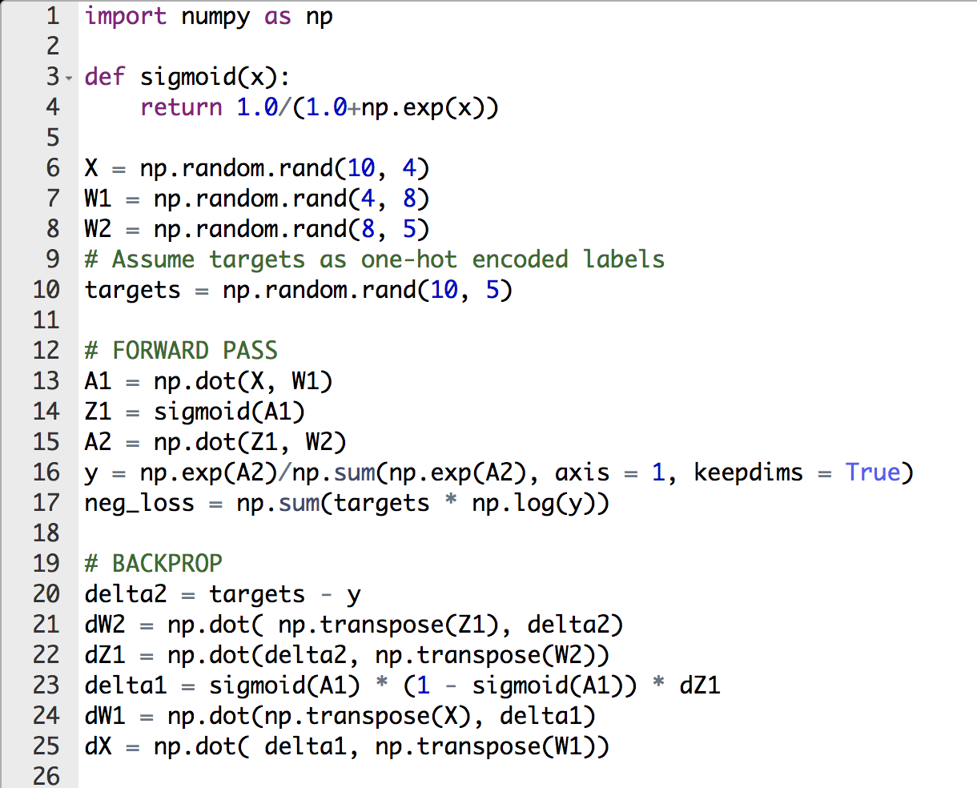
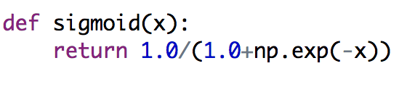
Computational Graph in Numpy

Slide 64
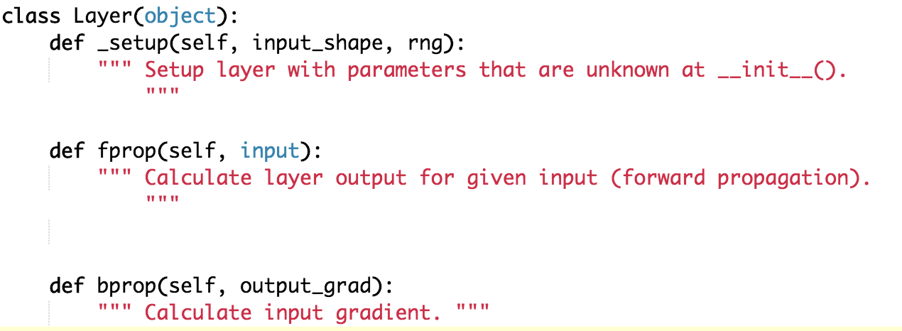
Modularized implementation: forward / backward API
Source : https://github.com/andersbll/nnet

Slide 65
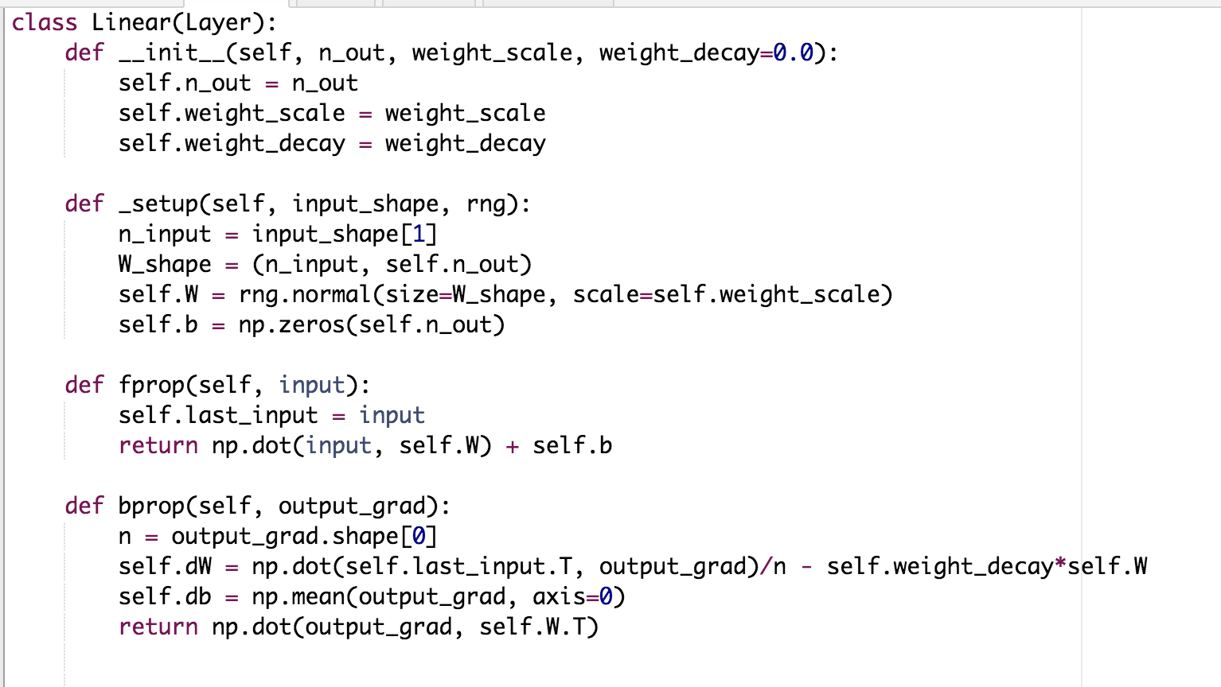
Modularized implementation: forward / backward API
Source : https://github.com/andersbll/nnet
Cache the input during forward pass

Slide 66
Modularized implementation: forward / backward API
Source : https://github.com/andersbll/nnet
Cache the input during forward pass
Gradient Backpropagated by the next layer

Slide 67
Modularized implementation: forward / backward API
Source : https://github.com/andersbll/nnet
Cache the input during forward pass
Gradient Backpropagated by the next layer
Gradient w.r.t x backpropgated

Slide 68
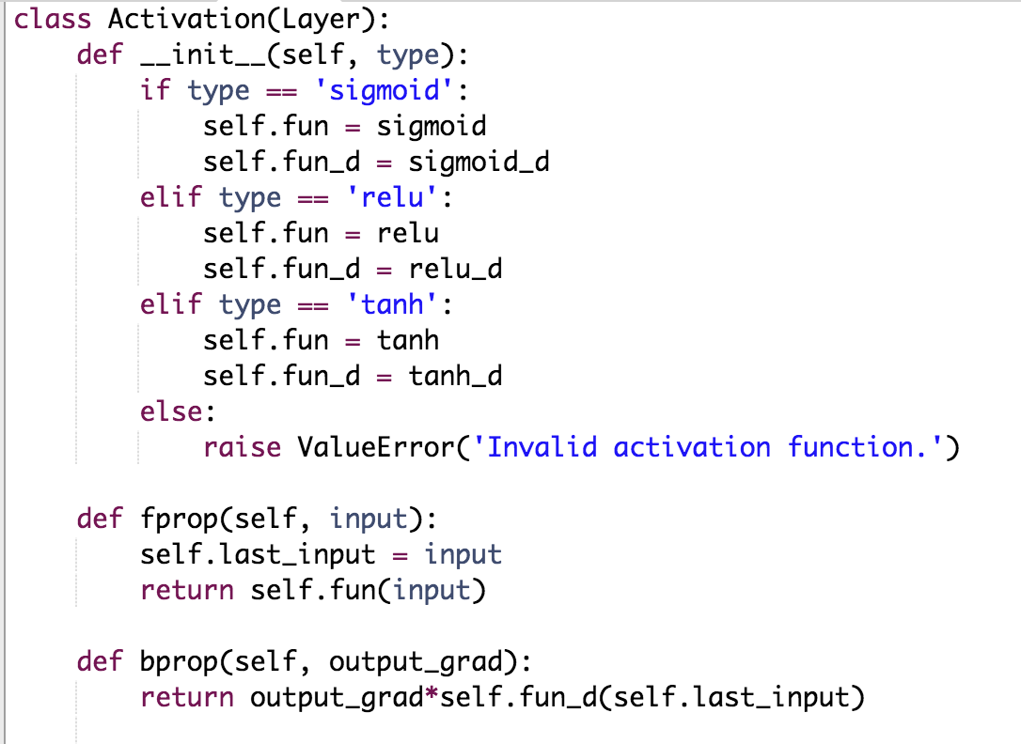
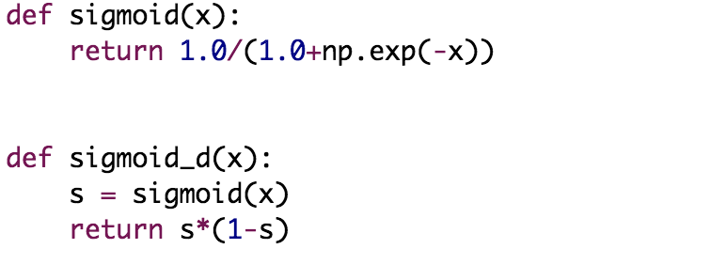
Implementation of Activation Layers
Source : https://github.com/andersbll/nnet

Slide 69
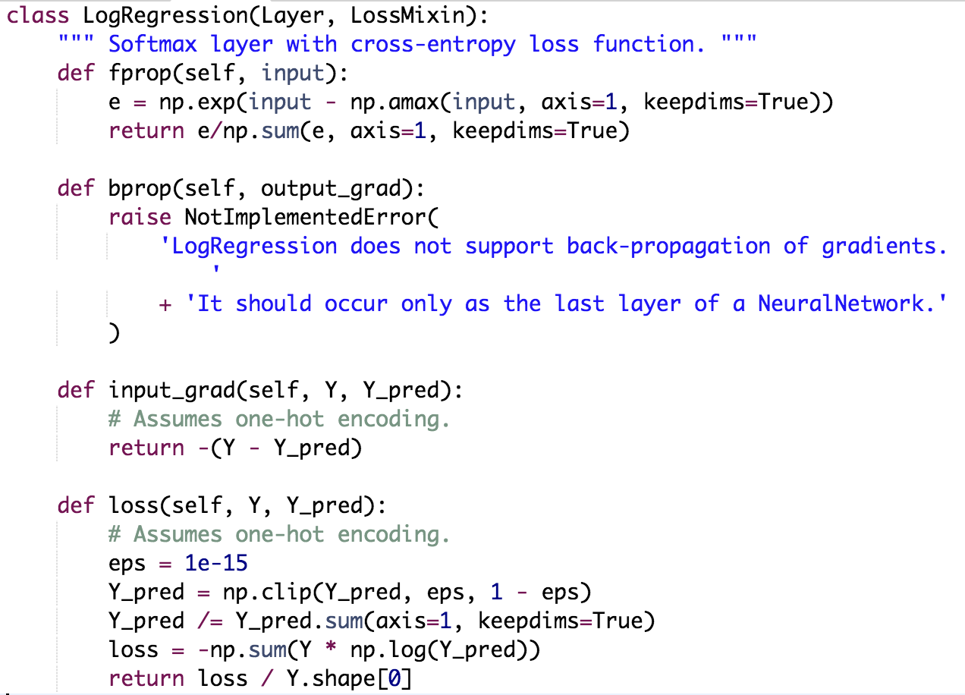
Last Layer - Softmax
Source : https://github.com/andersbll/nnet

