Slide 1
Neural Networks for Pattern Recognition
CSE 253
A.K.A. The “deep nets” course

Slide 2
Statistical Pattern Recognition
CSE 253
Complementary courses, different content:
Anything taught by Manmohan Chandraker, Hao Su, Kamalika Chaudhury, Sanjoy Dasgupta, Yoav Freund, Julian McAuley, Lawrence Saul, Zhuowen Tu (Cog Sci) or Nuno Vasconcelos (ECE)
Related courses taught by
Virginia de Sa (CogSci), Ndapa Nakashole, Laurel Riek

Slide 3
Outline of today
Pattern recognition: Some examples
Classification vs. Regression
Pre-processing and feature extraction
Polynomial curve fitting
Model complexity

Slide 4
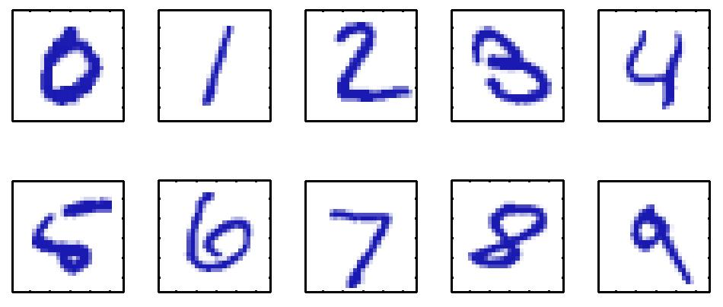
The standard example: Handwritten digits (MNIST)

Slide 5
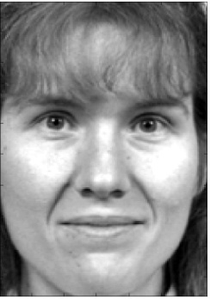
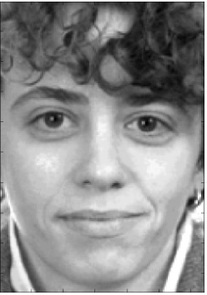
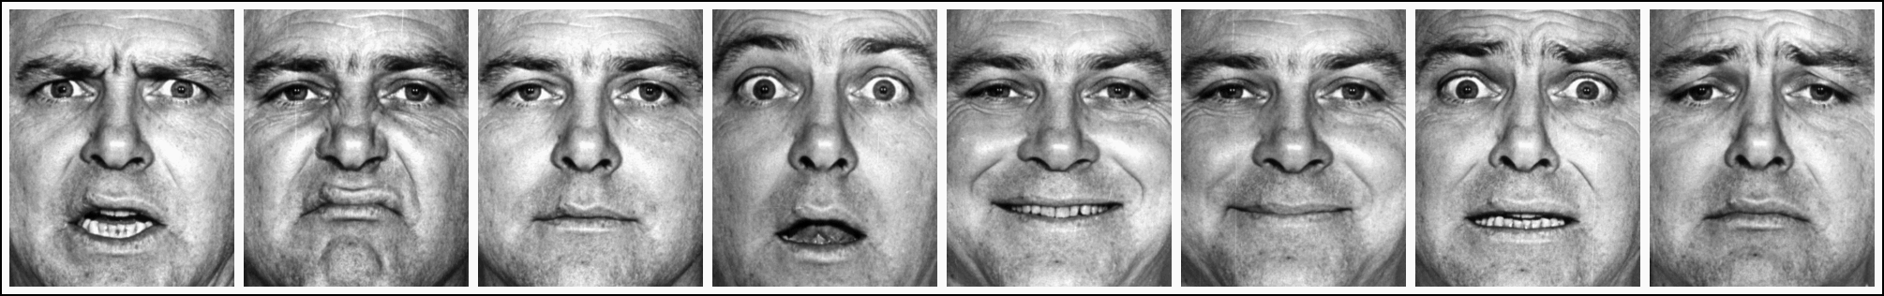
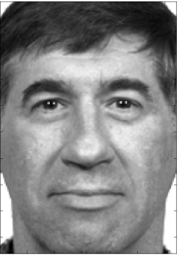
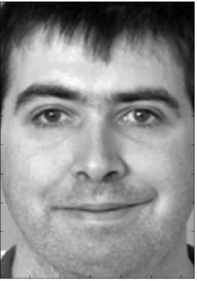
Facial Expression & Identity

Slide 6
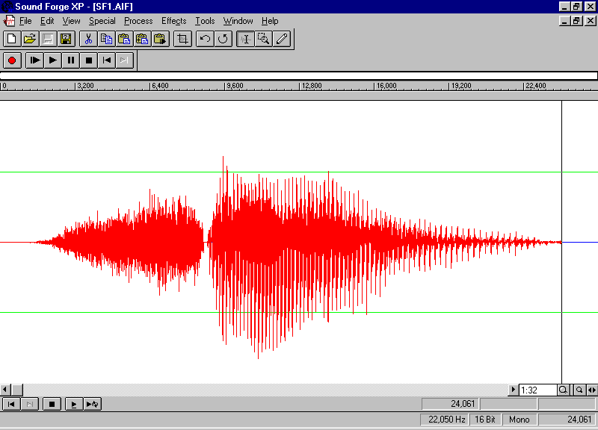

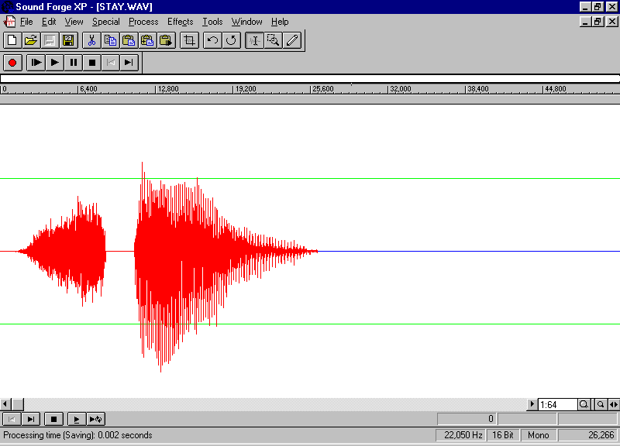
Speech recognition
Frequency
100 ms
Time (milliseconds)
Requires subtle temporal information: Note these wave forms are nearly identical except for the artificially inserted gap!
Notes:
Time matters for processing. These two wave forms are identical except for a gap in one. Notice how we hear completely different words.

Slide 7
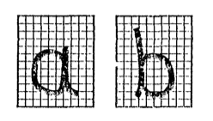
A simpler example
Distinguish handwritten “a”s from “b”s
Input: An array of pixel values (vector x)
Output: A class label Y_{k}, k=1, 2: often we use -1, 1
Training Set: A large number of input/output examples
Goal: Develop a classifier that assigns class labels to novel images with minimal mistakes. (i.e., a classifier that generalizes well)

Slide 8
A simpler example
Problem: High dimensionality:
Given a 256X256 image with 8 bit pixels =>
Inputs are of dimensionality 65,536 =>
There are approximately 10^{158,000} possible images
This has been called the curse of dimensionality
This implies we need to extract features that are of smaller dimension than the original images.
Idea: Use ratio of height to width as a "feature". Call it x₁.
Notes:
Time matters for processing. These two wave forms are identical except for a gap in one. Notice how we hear completely different words.

Slide 9
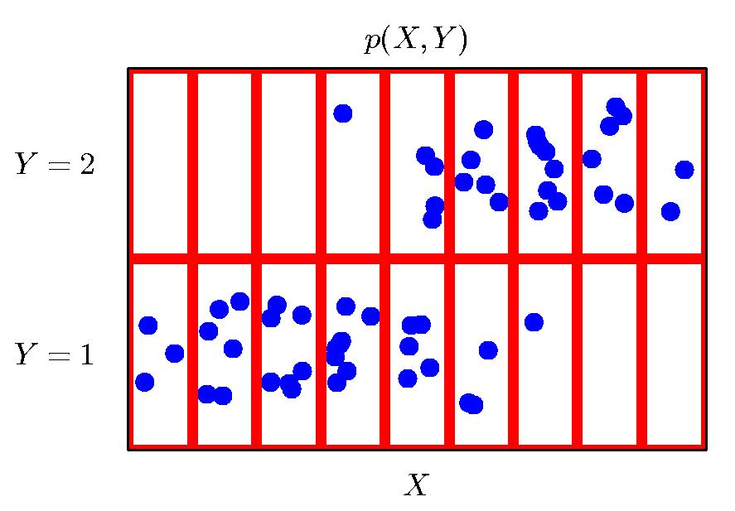
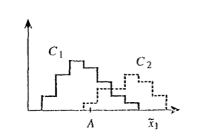
A simpler example
Hypothetical distribution of values of x₁ from the training set:
Classifer #1: Pick threshold A₁ that minimizes mistakes.
Notes:
Time matters for processing. These two wave forms are identical except for a gap in one. Notice how we hear completely different words.

Slide 10
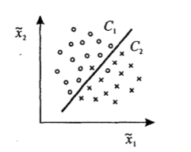
A simpler example
Problem #2: Still will be a lot of mistakes!
Idea 2: (we don’t have a lot of ideas yet):
Add another feature. Call it x₂.
Now, in "feature space", we need a decision boundary, in this case a line:
Notes:
Time matters for processing. These two wave forms are identical except for a gap in one. Notice how we hear completely different words.

Slide 11

A simpler example
If we had to do all 26 letters, then we would need functions that give (for example) the probability of the category, k = {1,…,c}, where c is the number of categories.
We can do this by a set of k functions:
where the functions are parameterized by w.
The category decision is k=argmax_{j} y_{j}(x;w)
(i.e., the maximum y_{k})

Slide 12
The curse of Dimensionality
Feature extraction is one way to deal with this curse:
Feature extraction reduces the dimensionality of the data
This reduces the size of the required training set
Feature extraction recognizes that most data actually lies on a lower-dimensional manifold of the "ambient space."

Slide 13
Statistical Pattern Recognition: Classification vs. Regression
These examples are classification problems
This is in contrast to regression problems:
The output is the value of a continuous variable: exchange rates, amount of an emotion being expressed, etc.
Or: The average of a random quantity.
Both of these (classification and regression) are examples of function approximation:
In classification, often we want the probability of class membership - a function approximation problem.

Slide 14
Statistical Pattern Recognition: Classification vs. Regression
Usually, the data we are trying to approximate has:
Some underlying regularity
Some noise
Often, the function we are using to approximate the data is not from the same class as the one that generated the data:
There will be a loss
There will be parameters we are trying to fit to minimize the loss.

Slide 15
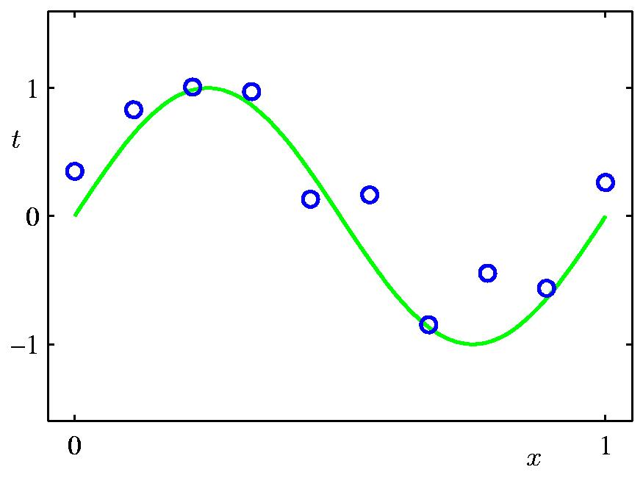
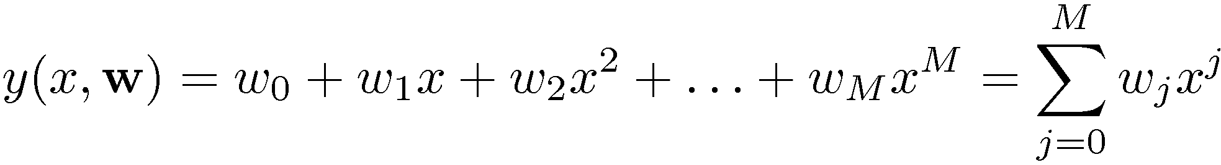
A regression example: Polynomial Curve Fitting
Note: this is linear in the parameters w:
We can use linear regression techniques to solve for w

Slide 16
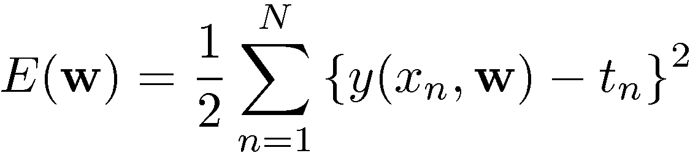
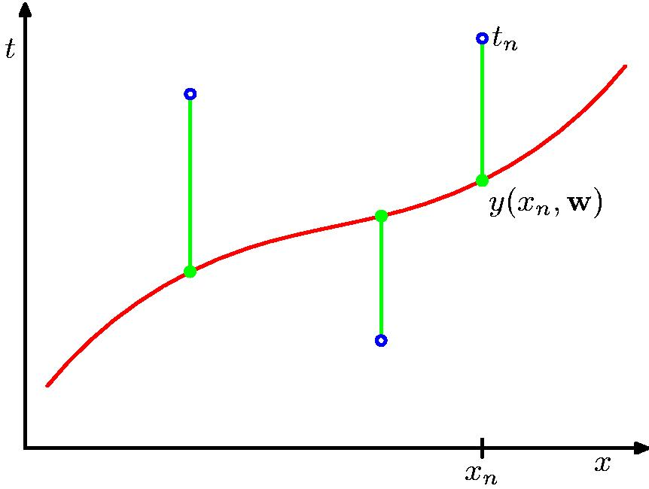
Now, we need a loss function: Sum-of-Squares Error Function
Note that what we want to do is minimize this:
take the derivative and set it to 0.
Since this is linear in the variables,
this leads to a closed form solution (more on that in the next lecture)

Slide 17
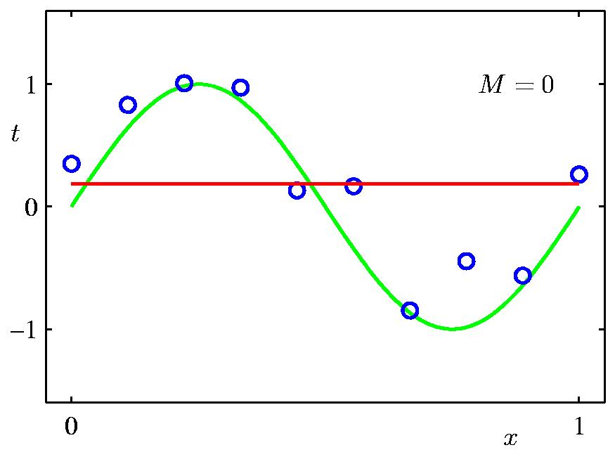
0th Order Polynomial

Slide 18
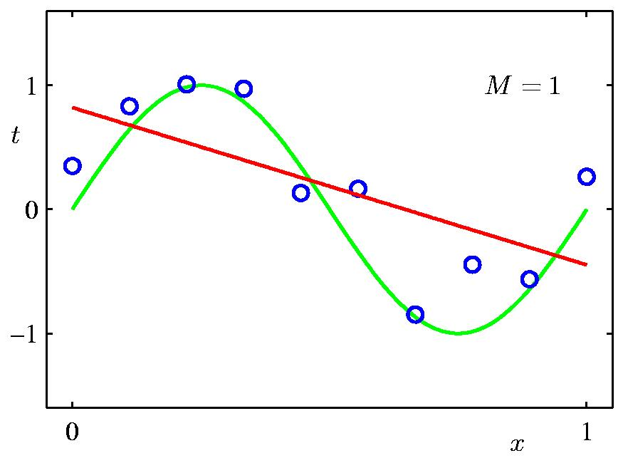
1st Order Polynomial

Slide 19
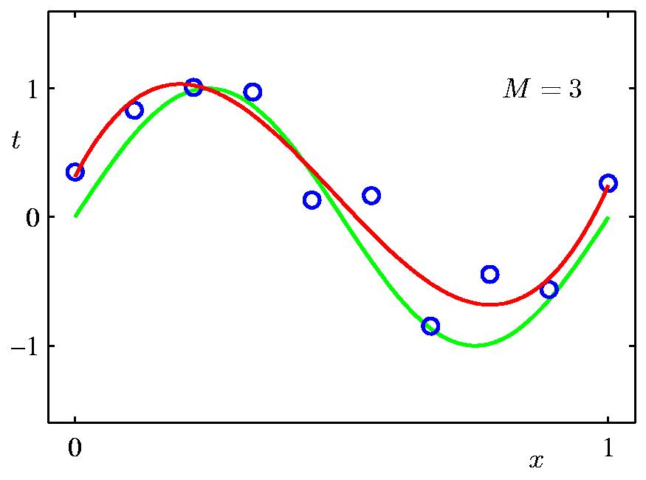
3rd Order Polynomial

Slide 20
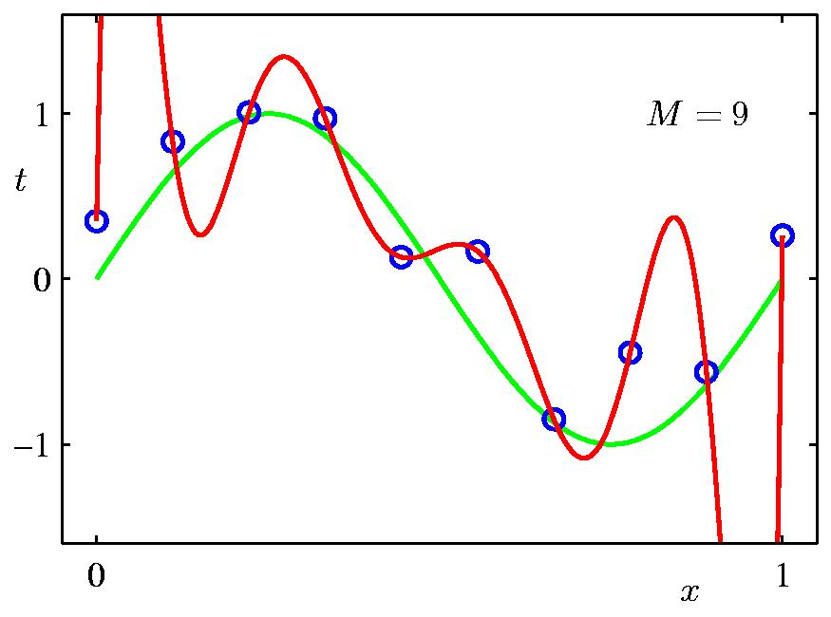
9th Order Polynomial
Note, we have fit the training data perfectly.
But we would like the solution to generalize to new examples,
and here we are fitting the noise!

Slide 21
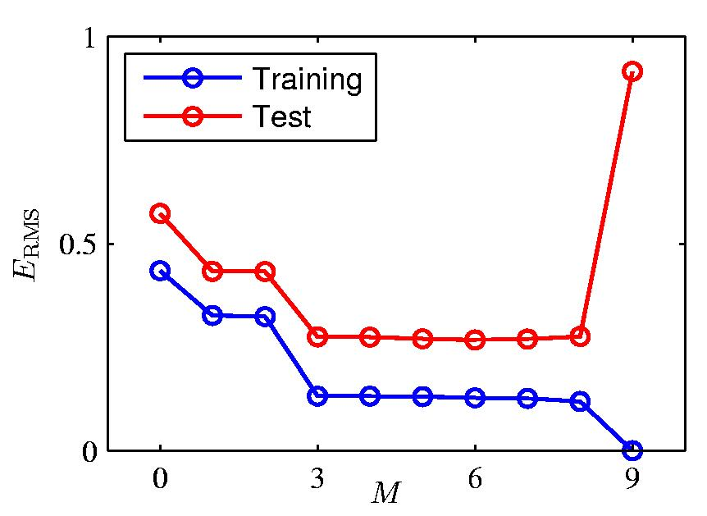
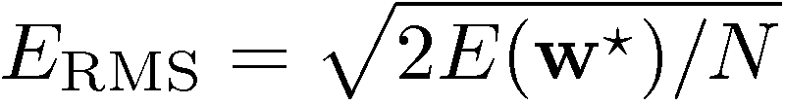
The problem: Over-fitting
Root-Mean-Square (RMS) Error:

Slide 22
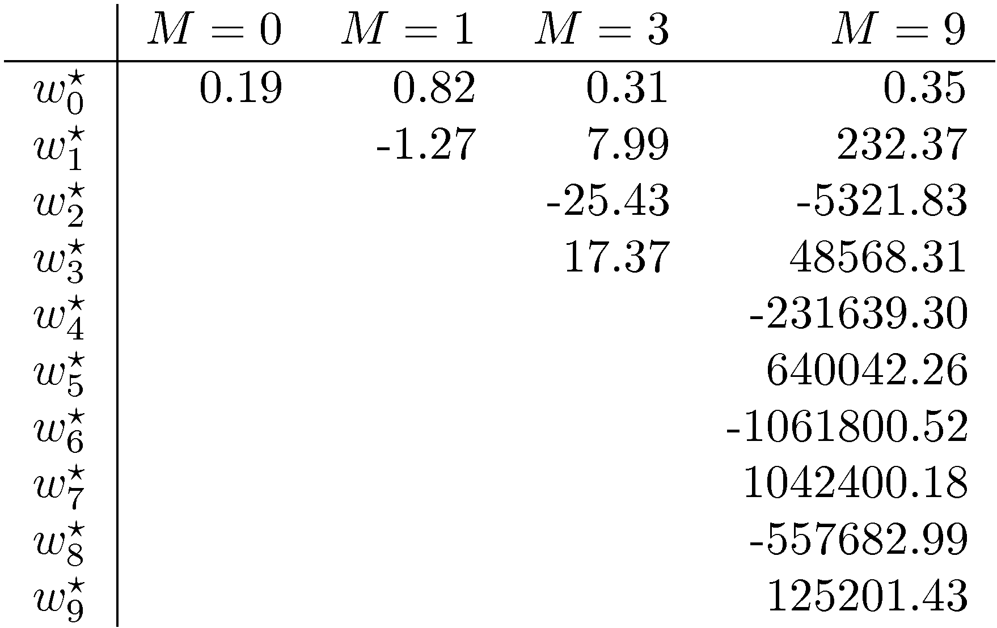
The Polynomial Coefficients

Slide 23
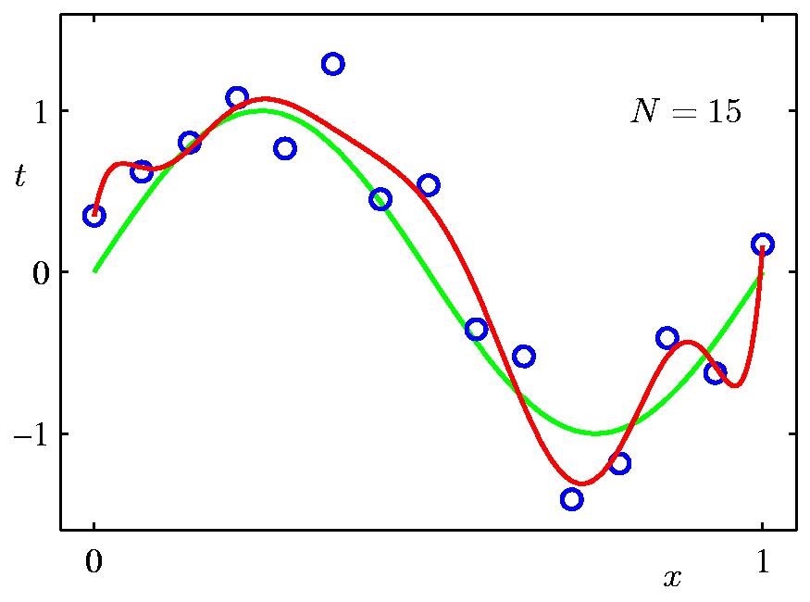
Effects of Data Set Size
9th Order Polynomial

Slide 24
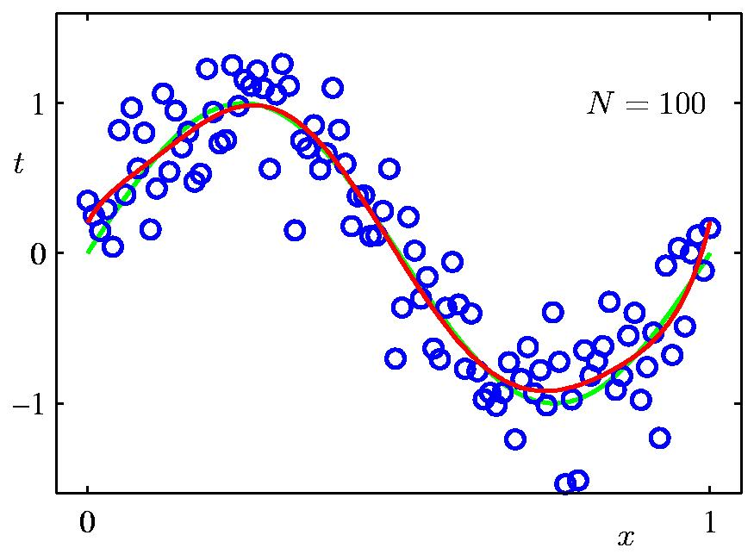
Effects of Data Set Size
9th Order Polynomial

Slide 25
How to deal with overfitting?
The best way: Get more data! (Or, manufacture more data...)
Otherwise, to eliminate overfitting, one idea it to use “Occam’s (or Ockham’s) Razor”:
The simplest hypothesis is the best.
Applying this to a model, we change our objective function:
Minimize J=E+λC where E is the error and C is a measure of model complexity.
This is called regularization.
In neural networks, for example, we might use:
C = w²/ (w²+1)
(Penalizes big weights very little, small weights are eliminated.)

Slide 26
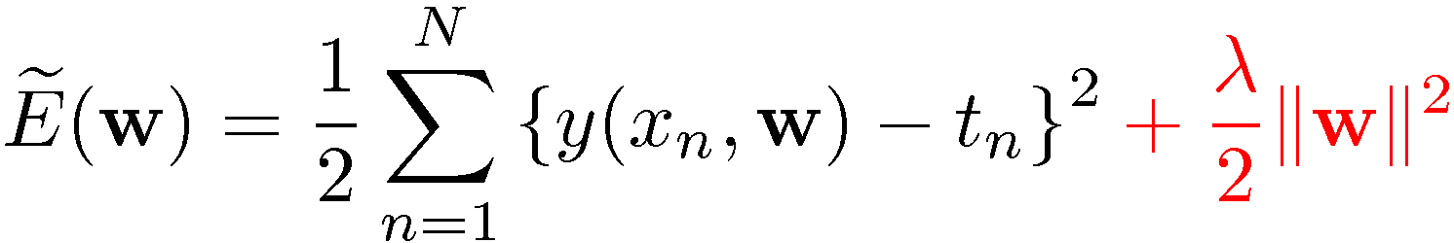
How do we prevent overfitting? Regularization
Penalize large coefficient values

Slide 27

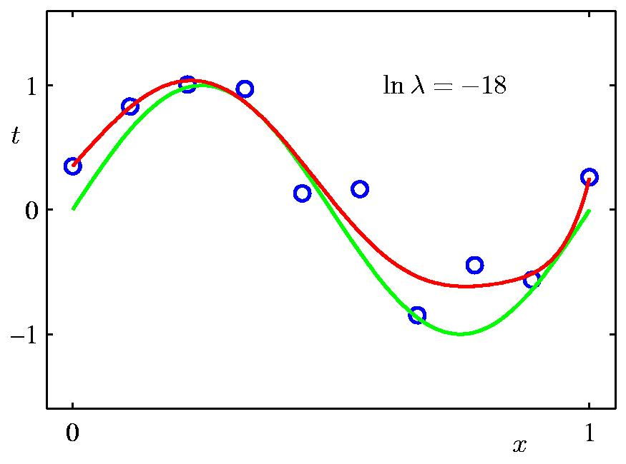
Regularization: (9th order polynomial)
(.00000015)

Slide 28

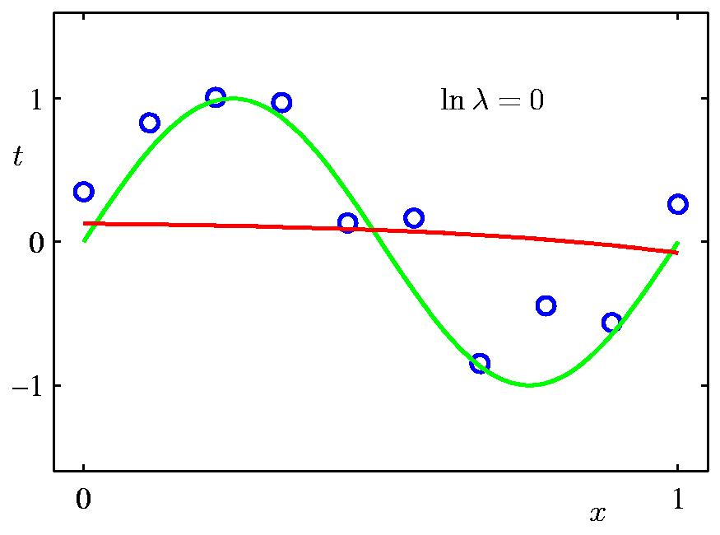
Regularization: (9th order polynomial)
(λ=1)

Slide 29


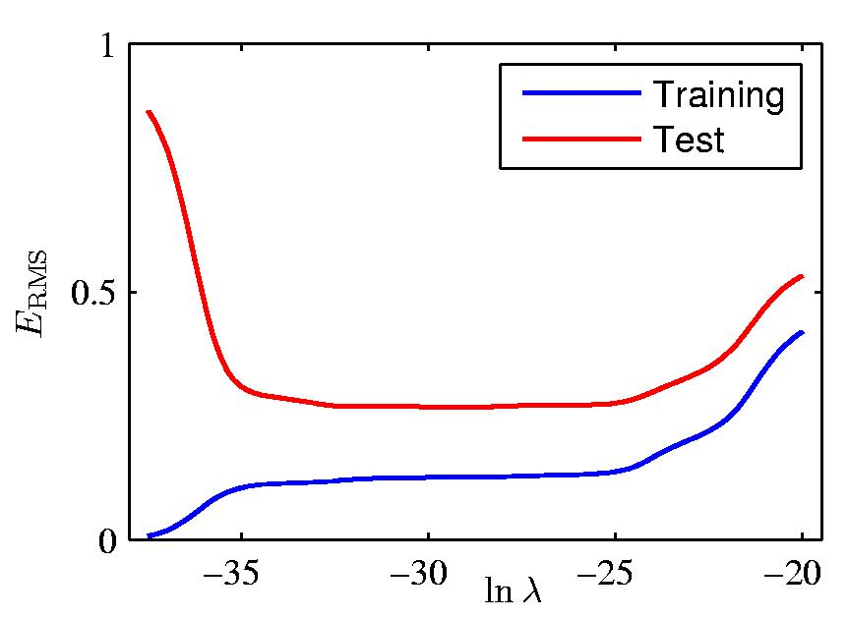
Regularization: vs.

Slide 30
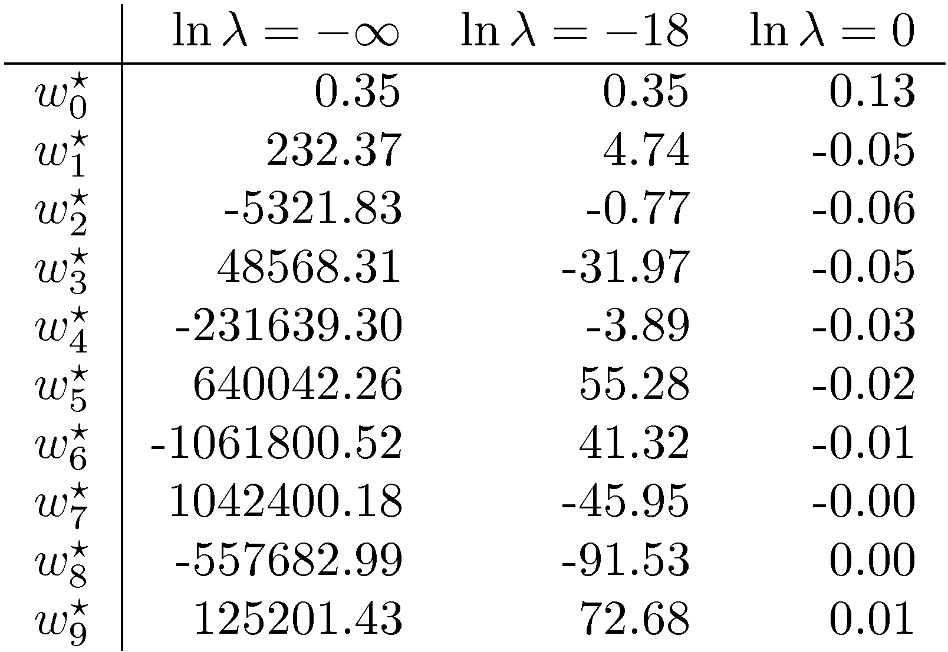
Polynomial Coefficients

Slide 31
How to deal with overfitting?
The best way: Get more data! (Or, manufacture more data...)
Minimize J=E+λC where E is the error and C is a measure of model complexity (regularization).
Early stopping:
Have a hold out set (some fraction of the training set) – this is a stand-in for the unseen test set
Use the remaining portion of the training set to change the weights
Watch the error on the holdout set and stop when it starts to rise.

Slide 32
Statistical Pattern Recognition: Pre-processing and feature extraction
• Pattern classsification is usually a multi-step process:
• Preprocessing (normalization, feature extraction)
• processing by the neural network
• possible post-processing of the network output.

Slide 33
Statistical Pattern Recognition: Pre-processing and feature extraction
For example, in face recognition, in the bad old days, before deep nets, we first:
Normalize the brightness (and possibly variance) of the image.
Find particular feature points in the image (mouth, eyes)
Normalize these features to fixed positions (translation, size invariance)
Crop the image (eliminate irrelevant features)
Extract features from the resulting image for processing by the neural network (e.g., Gabor filtering followed by PCA).
Use a linear classifier on the result (e.g., softmax regression)
This is what computer vision did for the 50 years or so before 2012.

Slide 34
Statistical Pattern Recognition: Pre-processing and feature extraction
Nowadays, with deep nets, we might just subtract the mean of the pixels, and divide by the standard deviation (z-scoring)
Or just subtract the mean over the whole dataset.
Then we let the deep network learn the features.

Slide 35
Final Points/Summary
Neural networks are function approximators that can do both classification and regression: This class focuses on classification
Logistic regression and linear regression are examples of very simple neural networks
Regression is trying to fit a function as closely as possible, while generalizing well to new points.
Classifiers create decision boundaries, such as a line, that separate classes in a feature space.
Pattern recognition involves
Extracting features from the input to reduce dimensionality
The resulting function returns a value that could be
A real number in the case of regression
A probability of being in a category, or a hard decision, in the case of classification

Slide 36
Final Points/Summary
Typical confusion:
Logistic regression is called regression because you are fitting a continuous function that is the probability of being in a category – so we use it for classification!

Slide 37
Final Points/Summary
Since there is usually noisy data, we will make errors. Our goal is to minimize them.
We achieve this by defining an objective function (a.k.a. a loss or cost function), such as sum-squared error that when minimized, minimizes errors in some sense.
However, we can’t just minimize errors on the training set! This can lead to overfitting (as in the case of the 9th order polynomial, which reduces errors to 0 on the training set).
To deal with overfitting, we can
Get more data
Penalize complexity of our function approximator (regularization)
Use a hold-out set as a stand-in for the unseen test set, and (for example) choose the complexity of our model based on it.

