Slide 1
PCA: Principal Component Analysis
Sources: https://stats.stackexchange.com/q/219344
https://stats.stackexchange.com/q/140579

Slide 2
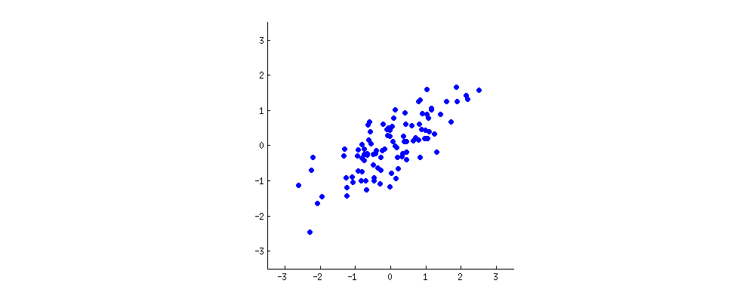
Principal Component Analysis
Dimensionality Reduction using a linear transformation that chooses a new coordinate system for the data set such that greatest variance by any projection of the data set comes to lie on the first axis (then called the first principal component), the second greatest variance on the second axis, and so on.

Slide 3
PCA Theorem
Let X_{NXD} be the centered data matrix where
N: number of examples, D: Total number of dimensions
C_{DXD}: Covariance matrix = 1/(n-1) * X^{T}X
We wish to find a find a projection vector w such that, the projection given by projection Xw has the highest variance.
Variance in projection Xw =
we are looking for a vector w having unit length, ‖w‖=1, such that w⊤Cw is maximal.

Slide 4
PCA Theorem Contd
We are looking for a vector w having unit length, ‖w‖=1, such that w⊤Cw is maximal.
because C is symmetric matrix, it is diagonal in its eigenvector basis- spectral theorem.
So we can choose an orthogonal basis, namely the one given by the eigenvectors, where C is diagonal and has eigenvalues λi on the diagonal. In that basis, w⊤Cw simplifies to ∑λ_{i}w²_{i}, or in other words the variance is given by the weighted sum of the eigenvalues.
It is almost immediate that to maximize this expression one should simply take w=(1,0,0,…,0), i.e. the first eigenvector, yielding variance λ1 (indeed, deviating from this solution and "trading" parts of the largest eigenvalue for the parts of smaller ones will only lead to smaller overall variance).
Note that the value of w⊤Cw does not depend on the basis! Changing to the eigenvector basis amounts to a rotation, so in 2D one can imagine simply rotating a piece of paper with the scatterplot; obviously this cannot change any variances.

Slide 5
PCA: Steps
Find the centered matrix X
Take the mean of all examples
Subtract it from each example
X_{N X D}
Find the covariance matrix C = 1/(n-1)X^{T}X
Find the eigen-values, eigen-vectors of C_{D X D}
Make the eigen-vectors unit length by dividing them with their norm.
Choose top m eigen-vectors with the highest eigen values to obtain a matrix M of shape D X m : M_{D X m}
Project the data to m dimensions using
X_{N X D} . M_{D X m}

Slide 6
Trick!! When number of dimensions >> Number of Examples
x : Eigen-vector of A•A'
A•A'•x = lam * x
Multiplying with A'
A'•A•A'•x = A' • (lam *x)
=> A'•A•(A'•x) = lam * (A'•x)
(A'•x) : Eigen-vector of A'•A
This means, You may find eigen-vectors of XX^{T} in the previous case and use them to obtain eigen-vectors of X^{T}X by multiplying them with X^{T}

