Slide 1
A Few Notes on Improving Generalization
Gary Cottrell
Deep Learning

Slide 2
Recall from Week 1: How to deal with overfitting?
The best way: Get more data! (Or, manufacture more data...) this is what all those transformations in PyTorch do.
Minimize J=E+λC where E is the error and C is a measure of model complexity (regularization).
Early stopping:
Have a hold out set (some fraction of the training set) – this is a stand-in for the unseen test set
Use the remaining portion of the training set to change the weights
Watch the error on the holdout set and stop when it starts to rise.

Slide 3
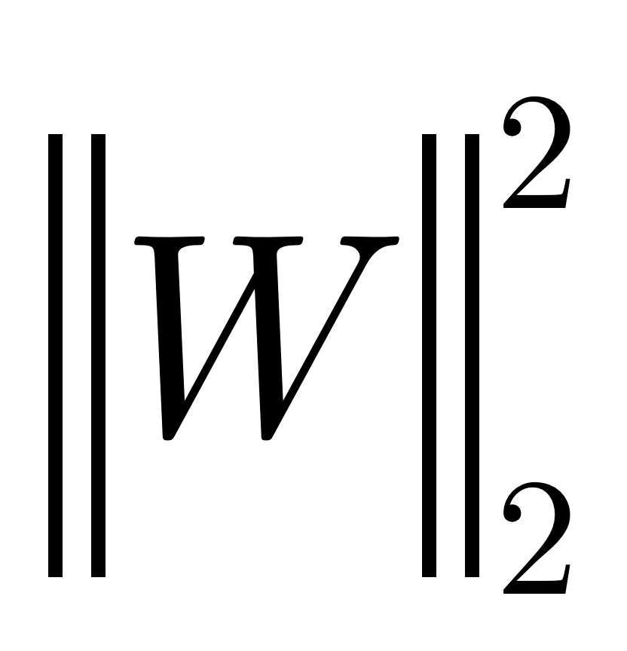

What form can C take?
General Idea: Make the model “smaller”
L₂ regularization: Minimize
Derivative: 2W - Make the weight smaller in proportion to its size,
L₁ regularization: Minimize
Derivative: 1 –Make the weight smaller at a constant rate.
Rumelhart’s idea: Minimize C = ||w||²/ (||w||²+1)
Penalizes big weights less while penalizing small weights more, driving them to 0.

Slide 4
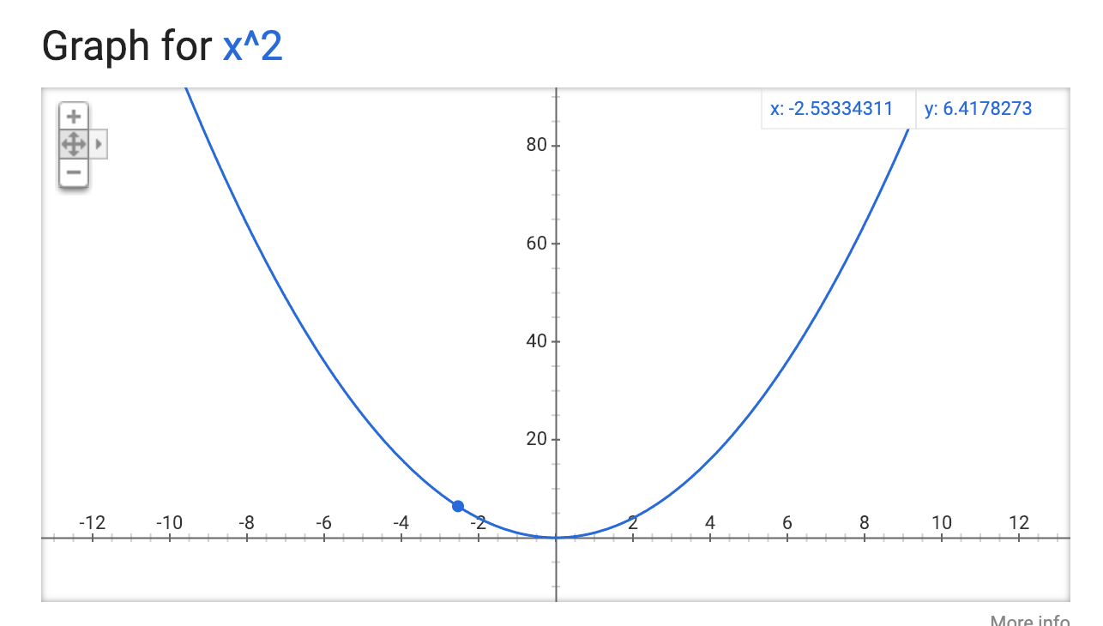
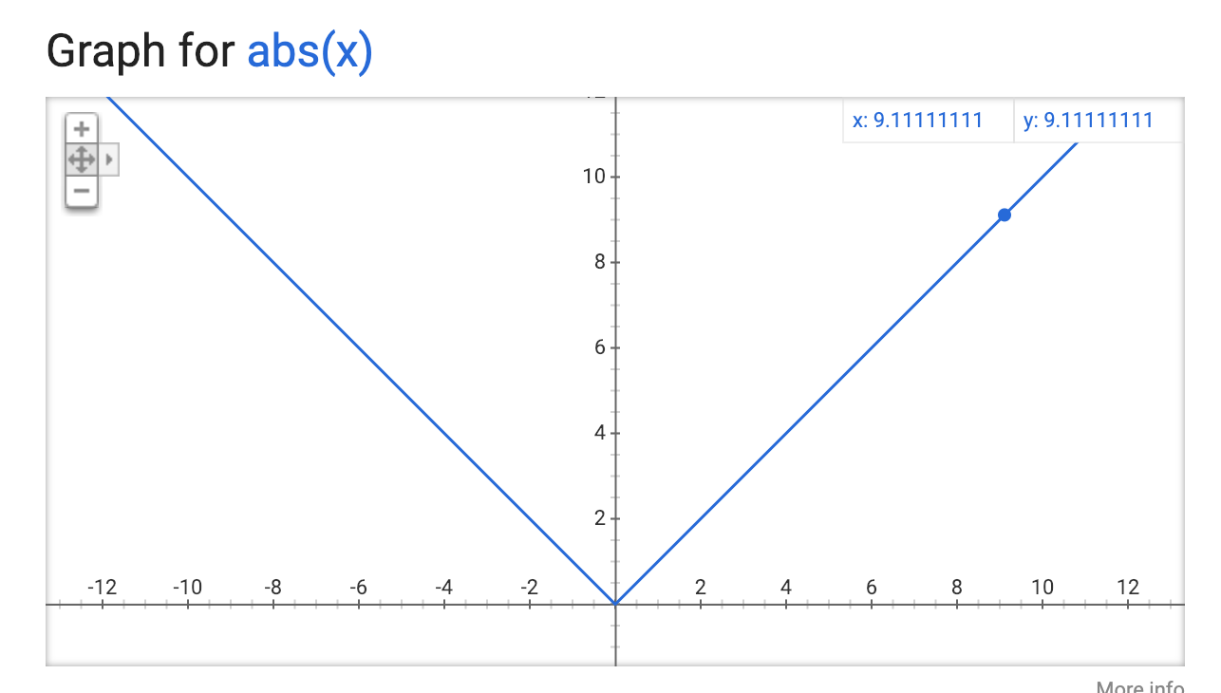
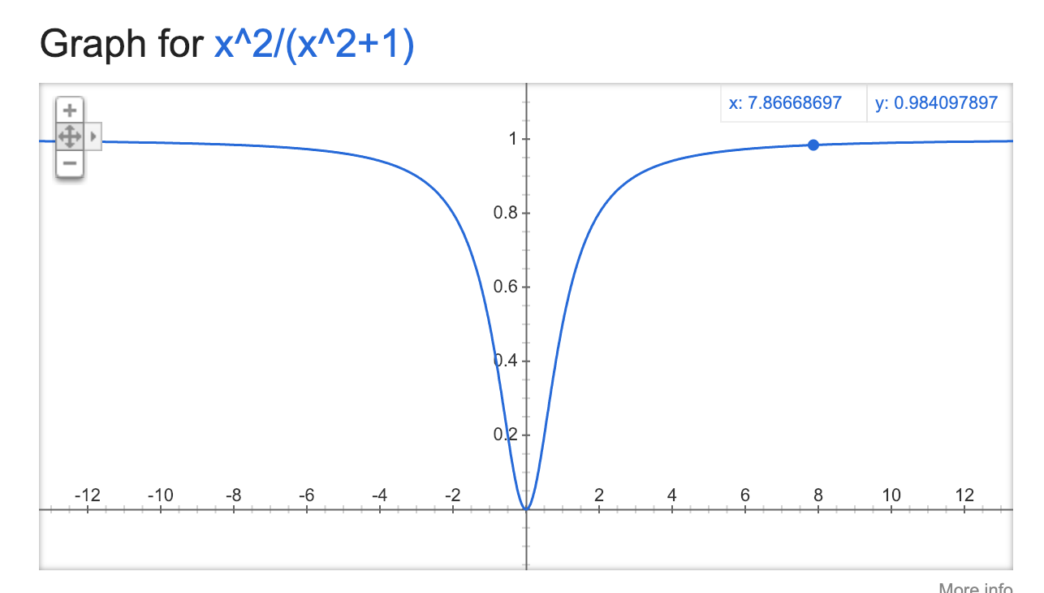
What form can C take?
L₂ regularization:
Big weights more
L₁ regularization:
All weights the same
Rumelhart’s idea:
Small weights more

Slide 5
Another idea: Dropout
For any hidden layer, probabilistically turn off some fraction of the hidden units
This makes it so that no hidden unit can depend on any other
Explores an exponential number of models

Slide 6
Another idea: Dropout
Explores an exponential number of models
Assume dropout rate is 0.5
What happens if we have 4 hidden units:
Can have (Assuming exactly half turn off)
0011
1001
1010
1100
0101
0110
This is 4 choose 2 (6)

Slide 7
Another idea: Dropout
4 choose 2: 6
8 choose 4: 70
10 choose 5: 252
12 choose 6: 924
100 choose 50: e²⁹
So if exactly half turn off, we won’t actually investigate an exponential number of models, (unless we train for e²⁹ epochs...) but we’ll try.

Slide 8
Add noise to the training set or the model:
Add a small amount of gaussian random noise to the inputs
Add a small amount of gaussian random noise to the hidden unit activations
Both make the model more robust to perturbations: makes them generalize better.

Slide 9
So: to improve generalization
Early stopping
Get more data or create more data artificially
Complexity minimization (regularization)
Dropout
Add noise to the input or the model
(I don’t know if anyone has tried adding noise to the output...)

