Slide 1
Generative Modeling with RNNs
Most slides by Zack Lipton
Critical Review of RNNs:
http://arxiv.org/abs/1506.00019
Conditional Generative RNNS:
http://arxiv.org/abs/1511.03683
Andrej Karpathy Blogpost on RNNs:
http://karpathy.github.io/2015/05/21/rnn-effectiveness/

Slide 2
Outline
Motivation
Generative Text Model
Sequence to Sequence
Image Captioning
Supervised Character Model (Beer Reviews)

Slide 3
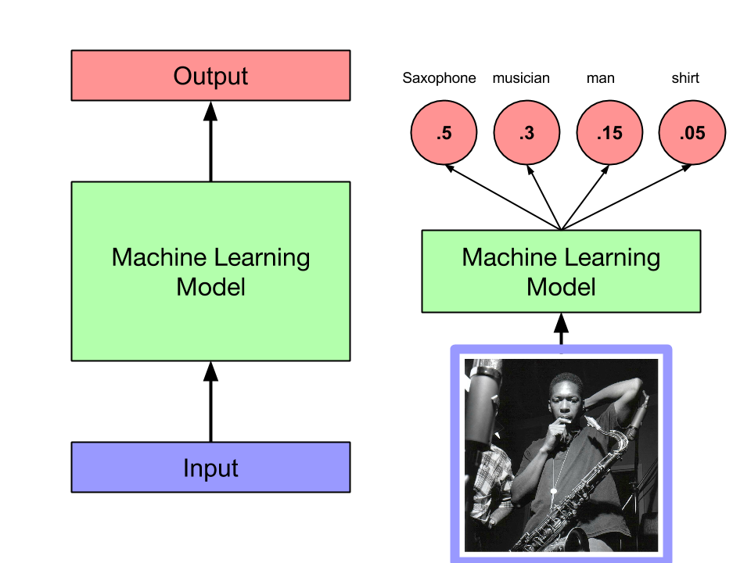
We Have Great Tools for Fixed-Size Data (vector in, vector out)

Slide 4
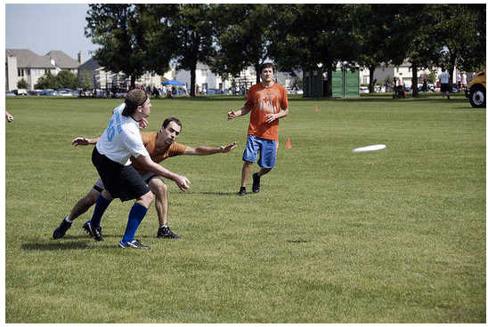
We’d Prefer a System that Could output Structured Data
“A group of young people playing a game of Frisbee.”
(Karpathy 2014)

Slide 5
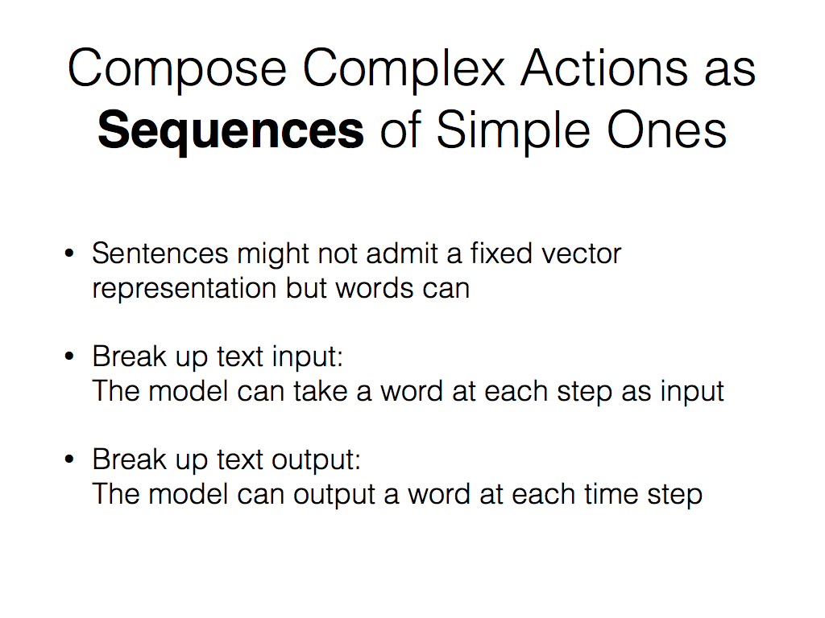

Slide 6
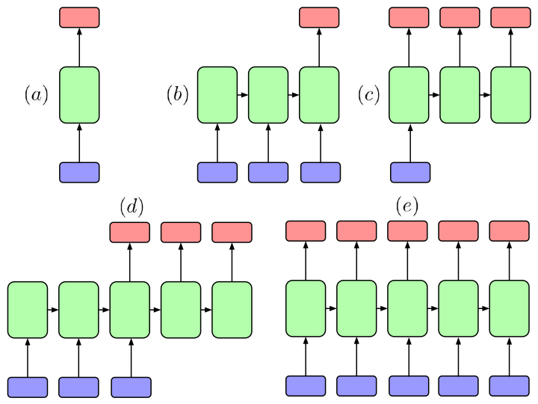
Basic RNN Architectures
Notes:
Why it is not a good idea to use e for translation:
“I arrived at the bank after crossing the…” You can’t know the meaning of “bank” before you see whether the next word is “street” or “river”.

Slide 7
Outline
Motivation
Generative Text Model
Sequence to Sequence
Image Captioning
Supervised Character Model (Beer Reviews)

Slide 8
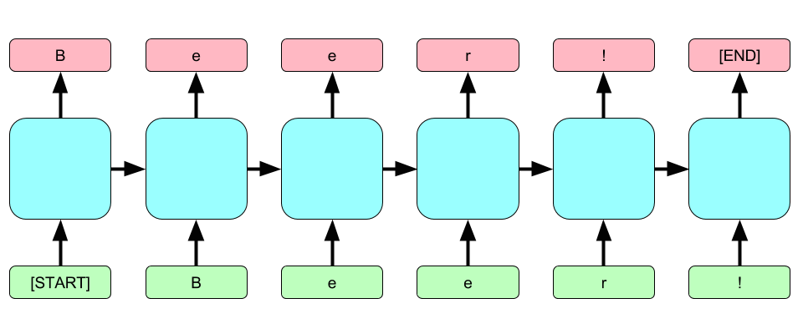
RNN Generative Model

Slide 9
Shakespeare Generation
PANDARUS: Alas, I think he shall be come approached and the day When little srain would be attain'd into being never fed, And who is but a chain and subjects of his death, I should not sleep.
Second Senator: They are away this miseries, produced upon my soul, Breaking and strongly should be buried, when I perish The earth and thoughts of many states.
DUKE VINCENTIO: Well, your wit is in the care of side and that.
Second Lord: They would be ruled after this chamber, and my fair nues begun out of the fact, to be conveyed, Whose noble souls I'll have the heart of the wars.
Clown: Come, sir, I will make did behold your worship.
VIOLA: I'll drink it.
Training Data:
All of Shakespeare
Size: 4.4MB
Text generated one
character at a time!
Notes:
Here the system is trained on a dataset containing all of Shakespeare.

Slide 10
Guided Generation (Sutskever et al., 2011)
Recurrent network with the Stiefel information for logistic regression methods Along with either of the algorithms previously (two or more skew precision) is more similar to the model with the same average mismatched graph. Though this task is to be studied under the reward transform, such as (c) and (C) from the training set, based on target activities for articles a ? 2(6) and (4.3). The PHDPic (PDB) matrix of cav’va using the three relevant information contains for tieming measurements. Moreover, because of the therap tor, the aim is to improve the score to the best patch randomly, but for each initially four data sets. As shown in Figure 11, it is more than 100 steps, we used ?? \to \infty with 1000
Training Data:
Machine Learning papers (NIPS and JMLR)
Initialized with “Recurrent”
Again, text generated one letter at a time!
Notes:
Here the system is trained on a dataset containing all of Shakespeare.

Slide 11
Guided Generation (Sutskever et al., 2011)
The meaning of life is the tradition of the ancient human reproduction: it is less favorable to the good boy for when to remove her bigger. In the show’s agreement unanimously resurfaced. The wild pasteured with consistent street forests were incorporated by the 15th century BE. In 1996 the primary rapford undergoes an effort that the reserve conditioning, written into Jewish cities, sleepers to incorporate the .St Eurasia that activates the population. Mar??a Nationale, Kelli, Zedlat-Dukastoe, Florendon, Ptu’s thought is. To adapt in most parts of North America, the dynamic fairy Dan please believes, the free speech are much related to the
Training Data:
Wikipedia
Initialized with the bold phrase.
Again, text generated one
character at a time!
Notes:
Here the system is trained on a dataset containing all of Shakespeare.

Slide 12
Outline
Motivation
Generative Text Model
Sequence to Sequence
Image Captioning
Supervised Character Model (Beer Reviews)

Slide 13
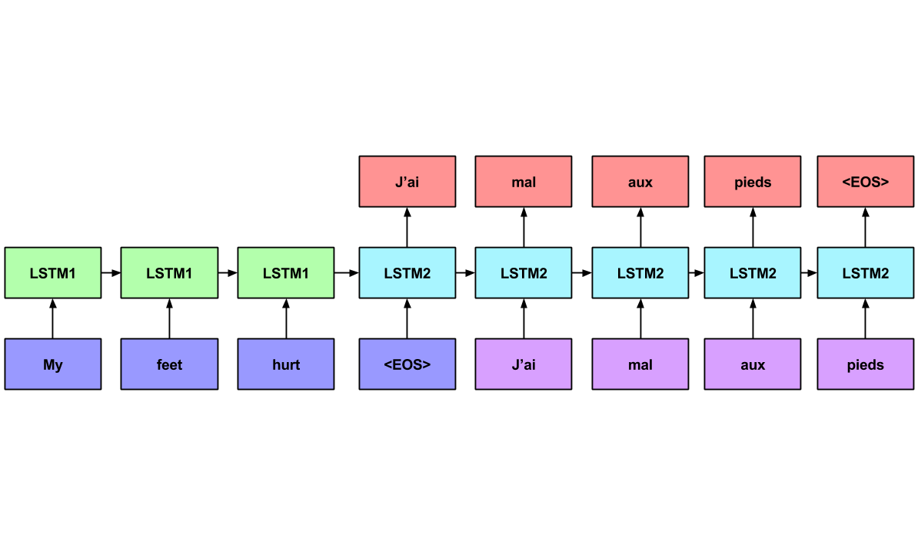
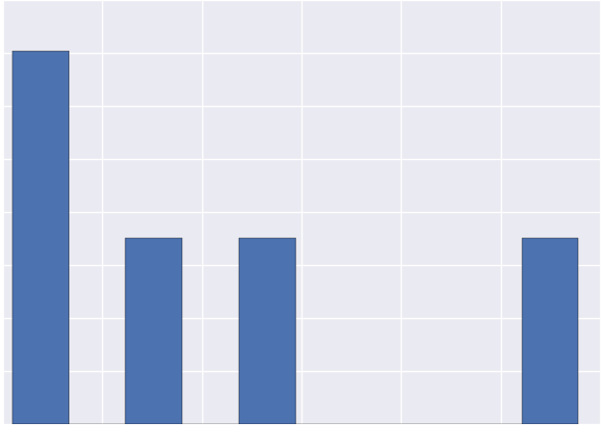
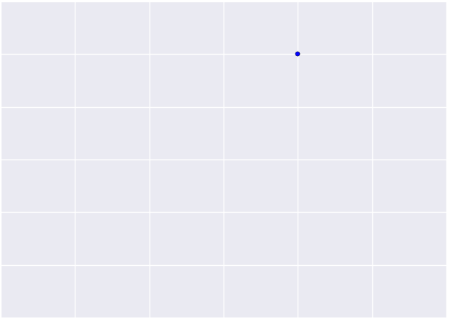

Sequence to Sequence
(Sutskever et al. 2014)

Slide 14
Scale
Sutskever et al. trained Deep LSTMs with four layers.
Each layer had 1000 cells
384M parameters
Input Vocabulary 160,000 words
Output Vocabulary: 80,000 words
Training Algo: Vanilla SGD, attenuated learning rate
Training time: 10 days with 8 GPUS (4 for Softmax)

Slide 15
Results
Achieved BLEU (measure of translation quality) comparable to best state of the art systems
Hybrid approaches and ensembling LSTMs led to scores even better than state of the art systems
No information about language was explicitly modeled or hardwired (besides the vocabulary itself)

Slide 16
Outline
Motivation
Generative Text Model
Sequence to Sequence
Image Captioning
Supervised Character Model (Beer Reviews)

Slide 17
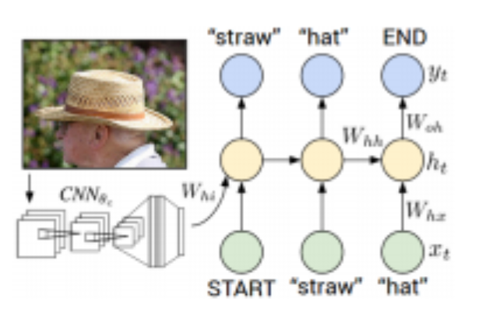
Image to Text
( Karpathy et al. 2014), (Mao et al., 2014), (Vinyals et al., 2014)

Slide 18
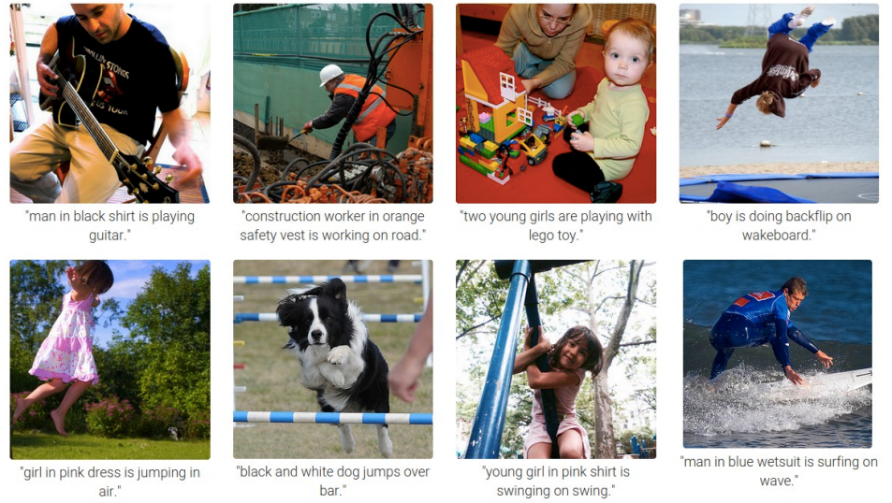
Image Captioning
(slide from Karpathy et al. 2014)

Slide 19
Outline
Motivation
Generative Text Model
Sequence to Sequence
Image Captioning
Supervised Character Model (Beer Review Demo)

Slide 20
Recall Unsupervised Character Model

Slide 21
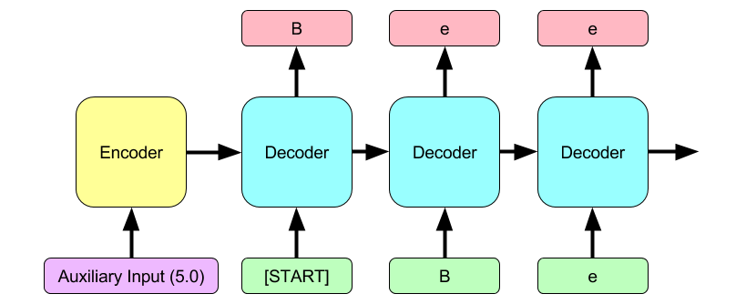
Past Supervised Approaches relied upon Encoder-Decoder Model

Slide 22
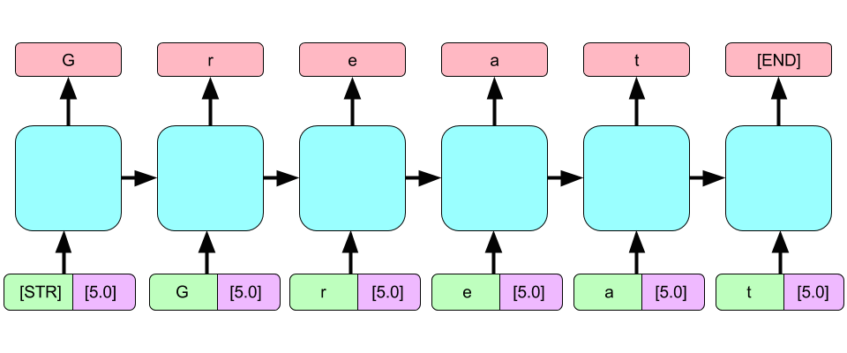
Bridging Long Time Intervals with Concatenated Inputs

Slide 23
Example
A.5 FRUIT/VEGETABLE BEER:
<STR>On tap at the brewpub. A nice dark red color with a nice head that left a lot of lace on the glass. Aroma is of raspberries and chocolate. Not much depth to speak of despite consisting of raspberries. The bourbon is pretty subtle as well. I really don’t know that I find a flavor this beer tastes like. I would prefer a little more carbonization to come through. It’s pretty drinkable, but I wouldn’t mind if this beer was available. <EOS>
IF the above link doesn’t work, cut and paste:
http://deepx.ucsd.edu/#/home/beermind

Slide 24
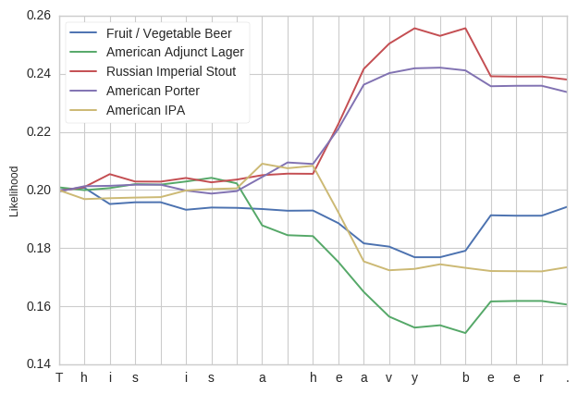
Character-based Classification

Slide 25
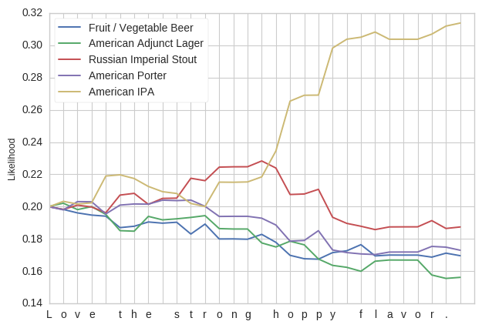
“Love the Strong Hoppy Flavor”

Slide 26
Summary
We can use recurrent networks as generators of data.
A standard way to do this is to train it on a large corpus, and then let it “hallucinate” text by sampling from its output, and using that as the next input
We can use recurrent networks to transform sequences, leading to state of the art translation models
We can “bolt together” a convnet and a language model:
- the convnet gets a representation of an image,
- the language model generates the image caption.
Using biasing input, we can exert some control over the generation: Beer Reviews

Slide 27
Supplementary Slides (LSTM Basics)

Slide 28
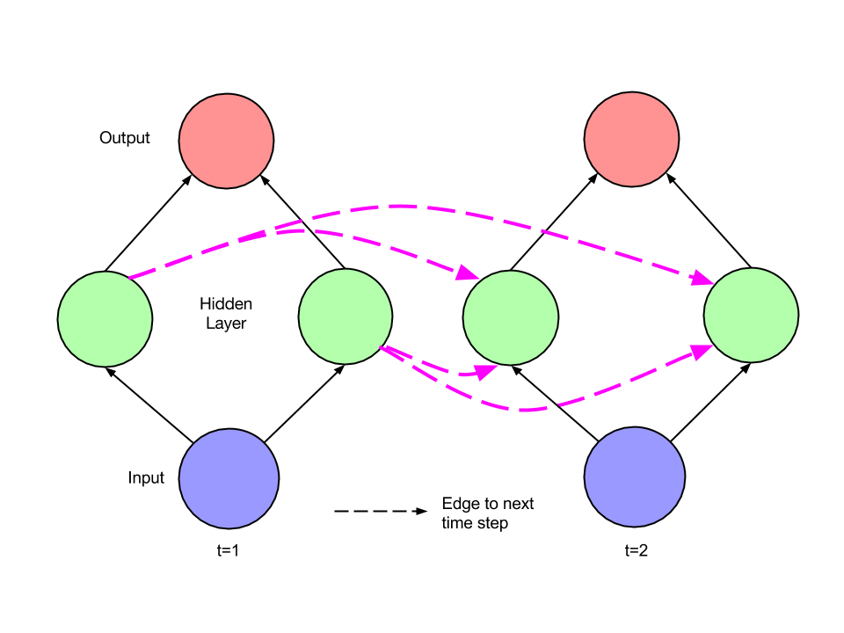

Recurrent Net (Unfolded)
Notes:
Can view the recurrent neural network as a deep network with an output at each layers, and weight tying across time steps.
Each hidden layer depends both on the input and the previous state’s hidden layer.
Notice that it’s essentially a feedforward network in this view.

Slide 29
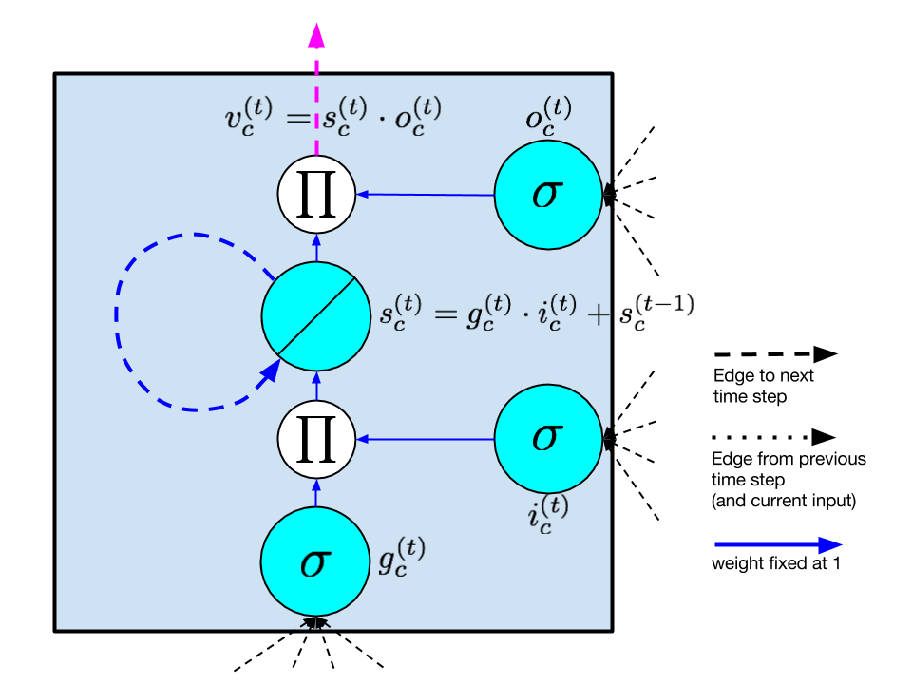

LSTM Memory Cell
(Hochreiter & Schmidhuber, 1997)

Slide 30
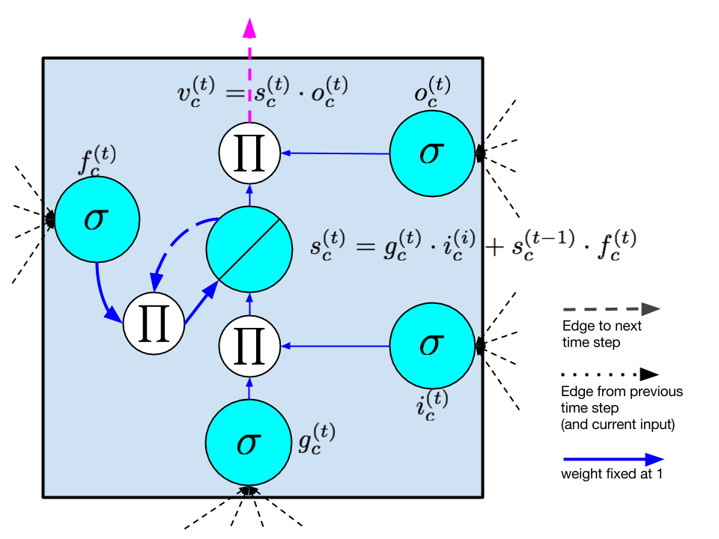
Memory Cell with Forget Gate
(Gers et al., 2000)

Slide 31
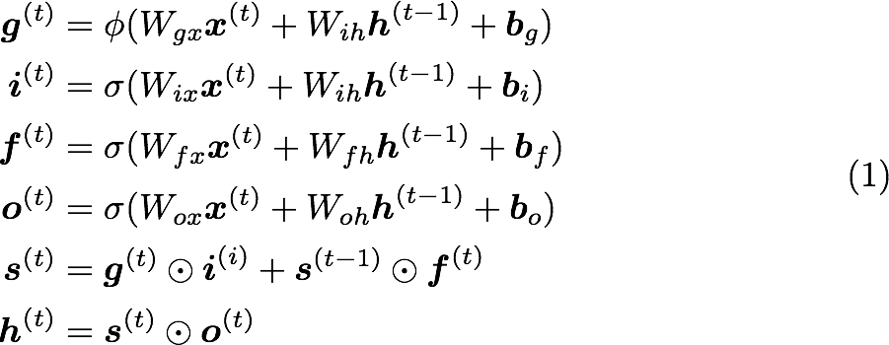
LSTM Forward Pass

Slide 32
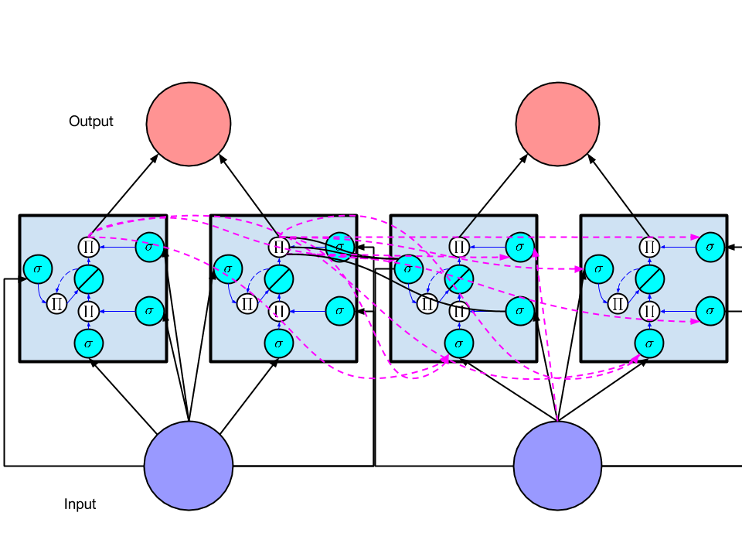
LSTM (full network)
Notes:
LSTM cells composed to form a network in the same way as ordinary hidden nodes in normal RNNs

