Slide 1
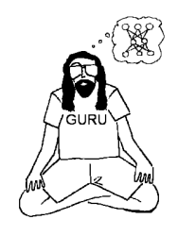
Tricks of the trade
Garrison W. Cottrell
Gary's Unbelievable Research Unit (GURU)
UCSD

Slide 2
This lecture
Tricks of the Trade:
These “tricks” are somewhat outdated at this point
BUT, they illustrate a lot of good points/issues, some of which have been “solved”, or at least eliminated as issues.
These ideas led to “batch normalization” which has made training deep nets much easier

Slide 3
This lecture
Tricks of the Trade:
Stochastic gradient descent versus batch learning
Shuffling the examples
Perform PCA of the inputs
Change the sigmoid
Initialize the weights
Adaptive learning rates
Momentum

Slide 4
This lecture
Tricks of the Trade:
Stochastic gradient descent versus batch learning
Shuffling the examples
Perform PCA of the inputs
Change the sigmoid
Initialize the weights
Adaptive learning rates
Momentum

Slide 5
Why Stochastic gradient descent?
It tends to learn faster due to redundancy in the training set
It tends to gets better solutions
It can adapt to a changing environment
It can be used easily for VERY large datasets due to its online nature.

Slide 6
Why Batch learning?
convergence conditions are better understood
better optimization techniques exist (Conjugate gradient, BFGS, etc. – but, since 2012, all sorts of new online approaches have been developed).
theoretically better understood

Slide 7
Why Mini-Batch learning?
Often for real problems, there is a lot of redundancy in the training set.
The gradient for the first half of the training set is nearly identical to that of the second half.
A useful approximation is to use a “mini-batch” – say, 128 examples.
Compute the gradient for each example using the same weights (like batch learning).
Change the weights once.
This can be very efficient on GPUs, using matrix-matrix multiplication – a matrix of 128 inputs, times the weights...

Slide 8
This lecture
Tricks of the Trade:
Stochastic gradient descent versus batch learning
Shuffling the examples
Perform PCA of the inputs
Change the sigmoid
Initialize the weights
Adaptive learning rates
Momentum

Slide 9
Shuffle the examples
In particular, shuffling means that we will see patterns from different classes.
It is important that a minibatch have most of the categories in it.
A possible heuristic: present examples with more error more often – but use with caution! Sometimes the hard examples are hard because:
there is an error in the training set – a pattern is incorrectly labeled!
more has to be learned about the easy examples before the hard ones can be tackled
but, this approach can improve performance on infrequent examples, e.g., /z/ in phoneme recognition.

Slide 10
This lecture
Tricks of the Trade:
Stochastic gradient descent versus batch learning
Shuffling the examples
Perform PCA of the inputs
Change the sigmoid
Initialize the weights
Adaptive learning rates
Momentum

Slide 11
This lecture
Tricks of the Trade:
Stochastic gradient descent versus batch learning
Shuffling the examples
Perform PCA of the inputs: But first, some intuition...
Change the sigmoid
Initialize the weights
Adaptive learning rates
Momentum

Slide 12
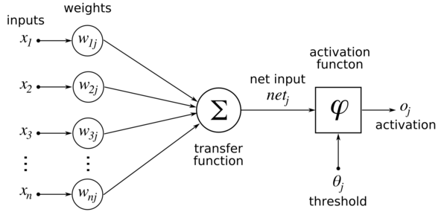

What’s wrong with all positive inputs?
What happens to the weight changes for all of the incoming weights to one hidden unit, call it j? Here, all the x_{i}’s are positive:
a_{j}
y_{j}
g(a_{j})

Slide 13
Clicker Question
During learning, δ_{j} is associated with:
The input on the line w_{jk}
The activation function of y_{j}
The unit j
The weight w_{jk}

Slide 14
Clicker Question
During learning, δ_{j} is associated with:
The input on the line w_{jk}
The activation function of y_{j}
The unit j
The weight w_{jk}

Slide 15
So I ask again, What’s wrong with all positive inputs?
Recall the weight change rule is: w_{ij}=w_{ij}+αδ_{j}x_{i}
a_{j}
a_{j}
g(a_{j})
y_{j}
g(a_{j})
δ_{j}

Slide 16
What’s wrong with all positive inputs?
The weight change rule is: w_{ij}=w_{ij}+αδ_{j}x_{i}
δ_{j} is the same sign for all of these weights. The x_{i}’s are all positive ➔ the weight changes are all + or -.
a_{j}
a_{j}
g(a_{j})
y_{j}
g(a_{j})
δ_{j}

Slide 17
Weight changes all positive or negative: where can the weights go? (See previous slide: this is for one unit’s incoming weights)
w₂
w₁
X
Only changing to be more positive or more negative...never one positive and one negative.

Slide 18
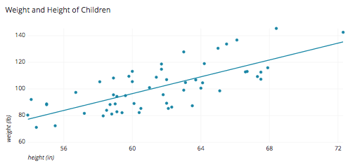
What’s wrong with correlated inputs?
size
adiposity
These two highly correlated variables very similar information: size
If we did PCA (decorrelated them), we would get two different kinds of information: size and adiposity (fatness)

Slide 19
What’s wrong with very different scale of inputs?
100, -300, 150,...
Inputs from different examples
-1, 0.6, -0.25,...
The largest weight changes will be for the large inputs.
If these two inputs are equally important, it will take a long time for the weights to the second input to become big enough to matter...

Slide 20
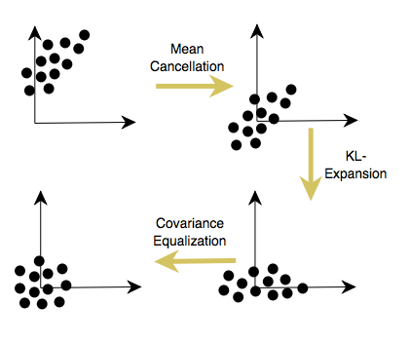
So why PCA of the inputs?
PCA shifts the mean of the input variables to be 0 – not all positive or negative!
PCA decorrelates the inputs
And...you can throw away the dimensions with the smallest eigenvalues – achieving dimensionality reduction.
If you then divide by the standard deviation, makes them all of equal “size” – the last step is not part of PCA
(Note: KL-Expansion=PCA)

Slide 21

Difference between PCA and z-scoring
Z-scoring shifts the mean of the input variables to be 0 – not all positive or negative!
Z-scoring does not decorrelate the inputs – because it is applied to each variable independently.
And...you cannot throw away the dimensions with the smallest eigenvalues –because you don’t compute the eigenvectors.
Z-scoring divides by the standard deviation, makes them all of equal “size”
X

Slide 22
Side Note: A linear autoencoder essentially does PCA
It’s minimizing the same thing: squared error
A hidden unit is like a principal component, and so the input is projecting onto that is its coordinate on that component
But the variance is spread across all of them.

Slide 23
This lecture
Tricks of the Trade:
Stochastic gradient descent versus batch learning
Shuffling the examples
Perform PCA of the inputs
Change the sigmoid
Initialize the weights
Adaptive learning rates
Momentum

Slide 24
Ok, we’ve done all these good things
And now...we put these nicely formatted inputs into the logistic sigmoid????
What will the activations be?
Then the next layer up gets all positive inputs again!!!
BAD!!!

Slide 25
We need a different activation fn.
So, change the sigmoid to have the same properties as before - because these are inputs to the next layer.
Standard sigmoid makes all inputs to the next layer positive - BAD.
a “bipolar” sigmoid - one symmetric around 0 - is better.

Slide 26
Recommended sigmoid:
f(x) = 1.7159*tanh(2/3x).
Why? If x has unit variance, then the output will have unit variance – the output is “formatted” for the next layer up.
In particular, this sigmoid has the following properties:
f(+/-1) = +/-1.
second derivative is max at x=1, so the slope is changing fastest there.
effective gain is 1 over the linear range.

Slide 27
Note!
ReLU units don’t have the same properties!
Need a different analysis for these.

Slide 28
This lecture
Tricks of the Trade:
Stochastic gradient descent versus batch learning
Shuffling the examples
Perform PCA of the inputs
Change the sigmoid
Initialize the weights
Adaptive learning rates
Momentum

Slide 29
Weight initialization
Initialize the weights so that the properties achieved above are achieved for the next level up.
Need them to be random, not zero (why?)
Too small: no gradient
Too large: no gradient

Slide 30
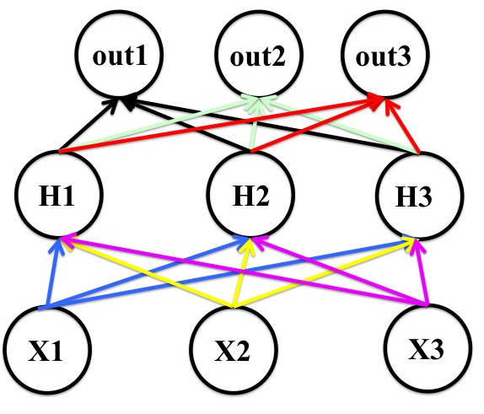
Weight initialization
Why can’t the weights start at zero?
Recall: w_{ij}=w_{ij}+αδ_{j}z_{i}
Assume a logistic
hidden unit function:
σ(0)=0.5 (all same)
Different outputs will
have different targets
And thus different δ’s

Slide 31
Weight initialization
Why can’t the weights start at zero?
Recall: w_{ij}=w_{ij}+αδ_{j}x_{i}
Assume a logistic
hidden unit function
So the incoming wts
from each hidden
will be the same...and
The δ’s of the
hiddens will all be
the same...

Slide 32
Weight initialization
Why can’t the weights start at zero?
Recall: w_{ij}=w_{ij}+αδ_{j}x_{i}
Assume a logistic
hidden unit function
The δ’s of the
hiddens will all be
the same...
Inputs will be
different...

Slide 33
Weight initialization
Why can’t the weights start at zero?
Recall: w_{ij}=w_{ij}+αδ_{j}x_{i}
Assume a logistic
hidden unit function
So outgoing weights
from each input
will be the same...
...and the hidden units
will all compute the same
feature!

Slide 34
Weight initialization
We want the weighted sum of the inputs (a_{j}) to be in the linear range of the sigmoid, because:
gradients will be largest and
the network can learn the linear part of the mapping before the non-linear part.
So, we want the a_{j} to be 0 mean and unit standard deviation (with the recommended sigmoid)
Weight initialization needs to be coordinated with
a. the input normalization
b the choice of sigmoid.
So, we have achieved 0 mean and unit standard deviation with the inputs (PCA did this) – we *also* want this to be true for the outputs of the first hidden layer, etc.

Slide 35
Weight initialization
If the x_{i} are mean 0 and unit standard deviation, and the w_{ij} have mean 0, then on average, the standard deviation of a_{j} =XW will be (assuming X and W are independent, and E means expectation):
Var(XW) = Var(X)Var(W)+Var(X)(E(W))² +Var(W)(E(X))²
= 1*Var(W)+Var(X)*0+Var(W)*0² (X,W are mean 0,
= Var(W). and X has unit σ)
So, the standard deviation of a_{j} = sqrt(Var(W))
=sqrt(Σ_{i}(w_{ij})²)
(because mean is 0)

Slide 36
Weight initialization
Ok, so we’ve figured out that: s.d.(a_{j})=sqrt(Σ_{i}(w_{ij})²)
Suppose the number of inputs to unit j is m (we call this the fan-in to unit)
So, if we set the standard deviation of the w’s to be 1/(m)^{1/2}, we will get:
s.d.(a_{j}) = sqrt(Σ_{i}(1/(m)^{1/2})²)
= sqrt(Σ_{i}(1/m))
= sqrt(1) (since there are m weights)

Slide 37
Weight initialization
SO, assuming that:
The inputs have been normalized to 0 mean and unit standard deviation, and
The sigmoid is f(x) = 1.7159*tanh(2/3x),
THEN:
The weights w_{ij} into a node j should be drawn from a distribution with 0 mean and standard deviation=(1/m)^{1/2},
where m is the fan-in to node j.

Slide 38
Weight initialization
The point being, that after normalizing the inputs via PCA, by combining the particular weight initialization with the right sigmoid, we get normalized inputs to the next layer up!
Note: This makes intuitive sense: If a hidden unit has a big fan-in, small changes on many of its incoming weights can cause the learning to overshoot.
We generally want smaller incoming weights when the fan-in is big, and vice-versa, so initialize the weights to be proportional to 1/sqrt(fan-in).

Slide 39
Batch Normalization
But all this careful work won’t survive all the weight changes during learning...things will no longer be zero mean and unit s.d.
...enter batch normalization.
Batch normalization uses all of these insights – but dynamically, as the network is being trained.

Slide 40
Batch Normalization
Batch normalization normalizes all of the activations in the network – the outputs of each hidden unit throughout the network,
on a per unit basis,
over each minibatch.

Slide 41
Batch Normalization: The Cliff Notes version...
Batch normalization takes a minibatch and
z-scores each variable (hidden layer outputs)– at every layer of the network individually, over the mini-batch
Then gives the network the chance to undo batch normalization by giving it adaptive parameters

Slide 42
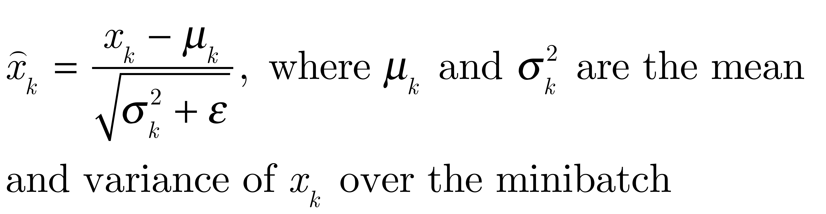
Batch Normalization: The Cliff Notes version...
Batch normalization takes a minibatch and
z-scores each variable (input or hidden unit activation) over the mini-batch
Again – x_{k} can be the activation of a hidden unit at any layer of the network.

Slide 43
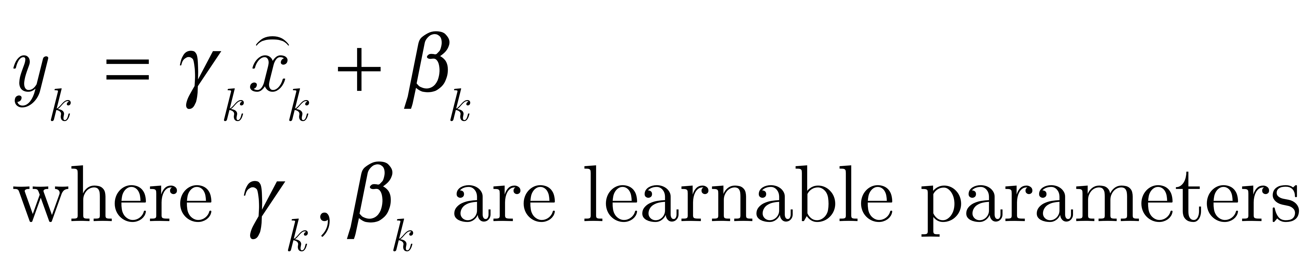
Batch Normalization: The Cliff Notes version...
Batch normalization takes a minibatch and
Allows the network to learn to undo this if necessary:
So, the original x_{k} is replaced by y_{k}
This whole transform can be back-propagated through...because it is all differentiable.

Slide 44
However....
There is some discussion on the web as to how applying batch normalization to the inputs of a unit – instead of the outputs – seems to work better.
I don’t know if this has been resolved yet...
We are still in “empirical mode” with deep learning...

Slide 45
Adapting the learning rate & Momentum: Hinton Slides...

Slide 46
Ways to speed up mini-batch learning
Geoff Hinton’s idea: rmsprop: Divide the learning rate for a weight by a running average of the magnitudes of recent gradients for that weight.
This normalizes the learning rate...
These ideas will be explained in the following slides...after some intuition...
Use “momentum”
Instead of using the gradient to change the weights, keep a running average of the weight changes.
Use separate adaptive learning rates for each parameter
Slowly adjust the rate using the consistency of the gradient for that parameter.

Slide 47
Reminder: The error surface for a linear neuron
The error surface lies in a space with a horizontal axis for each weight and one vertical axis for the error.
For a linear neuron with a squared error, it is a quadratic bowl.
Vertical cross-sections are parabolas.
Horizontal cross-sections are ellipses.
For multi-layer, non-linear nets the error surface is much more complicated.
But locally, a piece of a quadratic bowl is usually a very good approximation.
E
w1
w2

Slide 48
Clicker Question
Why is the error surface of a linear neuron a quadratic?
Quadratics are good approximations to most curves
Because of Sum Squared Error – it has to be a quadratic
Cross-entropy error leads to a quadratic
Linear neurons used squared inputs

Slide 49
Clicker Question
Why is the error surface of a linear neuron a quadratic?
Quadratics are good approximations to most curves
Because of Sum Squared Error – it has to be a quadratic
Cross-entropy error leads to a quadratic
Linear neurons used squared inputs

Slide 50
Convergence speed of full batch learning when the error surface is a quadratic bowl
Going downhill reduces the error, but the direction of steepest descent does not point at the minimum unless the ellipse is a circle.
The gradient is big in the direction in which we only want to travel a small distance.
The gradient is small in the direction in which we want to travel a large distance.
Even for non-linear multi-layer nets, the error surface is locally quadratic, so the same speed issues apply.

Slide 51
How the learning goes wrong
If the learning rate is big, the weights slosh to and fro across the ravine.
If the learning rate is too big, this oscillation diverges.
What we would like to achieve:
Move quickly in directions with small but consistent gradients.
Move slowly in directions with big but inconsistent gradients.
E
w

Slide 52
The intuition behind the momentum method
Imagine a ball on the error surface. The location of the ball in the horizontal plane represents the weight vector.
The ball starts off by following the gradient, but once it has velocity, it no longer does steepest descent.
Its momentum makes it keep going in the previous direction.
It damps oscillations in directions of high curvature by combining gradients with opposite signs.
It builds up speed in directions with a gentle but consistent gradient.

Slide 53
The equations of the momentum method
The effect of the gradient is to increment the previous average. The average also decays by α which is slightly less than 1.
The weight change is equal to the current average.
The weight change can be expressed in terms of the previous weight change and the current gradient.

Slide 54
The behavior of the momentum method
If the error surface is a tilted plane, the ball reaches a terminal velocity.
If the momentum is close to 1, this is much faster than simple gradient descent.
At the beginning of learning there may be very large gradients.
So start with a small momentum (e.g. 0.5).
Once the large gradients have disappeared and the weights are stuck in a ravine the momentum can be smoothly raised to its final value (e.g. 0.9 or even 0.99)
We can learn at a rate that would oscillate without the momentum.

Slide 55
A better type of momentum (Nesterov 1983)
The standard momentum method first computes the gradient at the current location and then takes a big jump in the direction of the updated accumulated gradient.
Ilya Sutskever suggested a new form of momentum that often works better.
Inspired by the Nesterov method for optimizing convex functions.
First make a big jump in the direction of the previous accumulated gradient.
Then measure the gradient where you end up and make a correction.
Its better to correct a mistake after you have made it!

Slide 56
A picture of the Nesterov method
First make a big jump in the direction of the previous accumulated gradient.
Then measure the gradient where you end up and make a correction.
brown vector = jump, red vector = correction, green vector = accumulated gradient
blue vectors = standard momentum

Slide 57
The intuition behind separate adaptive learning rates
In a multilayer net, the appropriate learning rates can vary widely between weights:
The magnitudes of the gradients are often very different for different layers, especially if the initial weights are small.
The fan-in of a unit determines the size of the “overshoot” effects caused by simultaneously changing many of the incoming weights of a unit to correct the same error.
Gradients can get very small in the early layers of very deep nets.
The fan-in often varies widely between layers.

Slide 58
The intuition behind separate adaptive learning rates
In a multilayer net, the appropriate learning rates can vary widely between weights:
So use a global learning rate (set by hand) multiplied by an appropriate local gain that is determined empirically for each weight.
Gradients can get very small in the early layers of very deep nets.
The fan-in often varies widely between layers.

Slide 59
One way to determine the individual learning rates
Start with a local gain of 1 for every weight.
Increase the local gain if the gradient for that weight does not change sign.
Decrease the local gain if the gradient for that weight is changing sign

Slide 60
One way to determine the individual learning rates
Use small additive increases and multiplicative decreases (for mini-batch)
This ensures that big gains decay rapidly when oscillations start.
If the gradient is totally random the gain will hover around 1 when we increase by plus half the time and decrease by times half the time. (you can try this at home!)

Slide 61
Tricks for making adaptive learning rates work better
Adaptive learning rates can be combined with momentum.
Use the agreement in sign between the current gradient for a weight and the momentum for that weight (Jacobs, 1989).
Adaptive learning rates only deal with axis-aligned effects.
Momentum does not care about the alignment of the axes.
Limit the gains to lie in some reasonable range
e.g. [0.1, 10] or [.01, 100]
Use full batch learning or big mini-batches
This ensures that changes in the sign of the gradient are not mainly due to the sampling error of a mini-batch.

Slide 62
rprop: Using only the sign of the gradient
The magnitude of the gradient can be very different for different weights and can change during learning.
This makes it hard to choose a single global learning rate.
For full batch learning, we can deal with this variation by only using the sign of the gradient.
The weight updates are all of the same magnitude.
This escapes from plateaus with tiny gradients quickly.

Slide 63
rprop: Using only the sign of the gradient
rprop: This combines the idea of only using the sign of the gradient with the idea of adapting the step size separately for each weight.
Increase the step size for a weight multiplicatively (e.g. times 1.2) if the signs of its last two gradients agree.
Otherwise decrease the step size multiplicatively (e.g. times 0.5).
Limit the step sizes to be less than 50 and more than a millionth

Slide 64
Why rprop does not work with mini-batches
The idea behind stochastic gradient descent is that when the learning rate is small, it averages the gradients over successive mini-batches.
Consider a weight that gets a gradient of +0.1 on nine mini-batches and a gradient of -0.9 on the tenth mini-batch.
We want this weight to stay roughly where it is.

Slide 65
Why rprop does not work with mini-batches
rprop would increment the weight nine times and decrement it once by about the same amount (assuming any adaptation of the step sizes is small on this time-scale).
So the weight would grow a lot.
Is there a way to combine:
The robustness of rprop.
The efficiency of mini-batches.
The effective averaging of gradients over mini-batches.

Slide 66
rmsprop: A mini-batch version of rprop
rprop is equivalent to using the gradient but also dividing by the size of the gradient.
The problem with mini-batch rprop is that we divide by a different number for each mini-batch. So why not force the number we divide by to be very similar for adjacent mini-batches?

Slide 67
rmsprop: A mini-batch version of rprop
rmsprop: Keep a moving average of the squared gradient for each weight
Dividing the gradient by makes the learning work much better (Tijmen Tieleman, unpublished).

Slide 68
Summary of learning methods for neural networks
For small datasets (e.g. 10,000 cases) or bigger datasets without much redundancy, use a full-batch method.
Conjugate gradient, LBFGS ...
adaptive learning rates, rprop ...
For big, redundant datasets use mini-batches.
Try gradient descent with momentum.
Try the adam optimizer
Try LeCun’s latest recipe.
Why there is no simple recipe:
Neural nets differ a lot:
Very deep nets (especially ones with narrow bottlenecks).
Recurrent nets.
Wide shallow nets.
Tasks differ a lot:
Some require very accurate weights, some don’t.
Some have many very rare cases (e.g. words).

