Slide 1
Software Engineering Group Project User Interface Specification
Author: Shane Waters,
Config Ref: User-Inter_GP15
Date: 7th March 2020
Version: 1.1
Status: Release

Slide 2
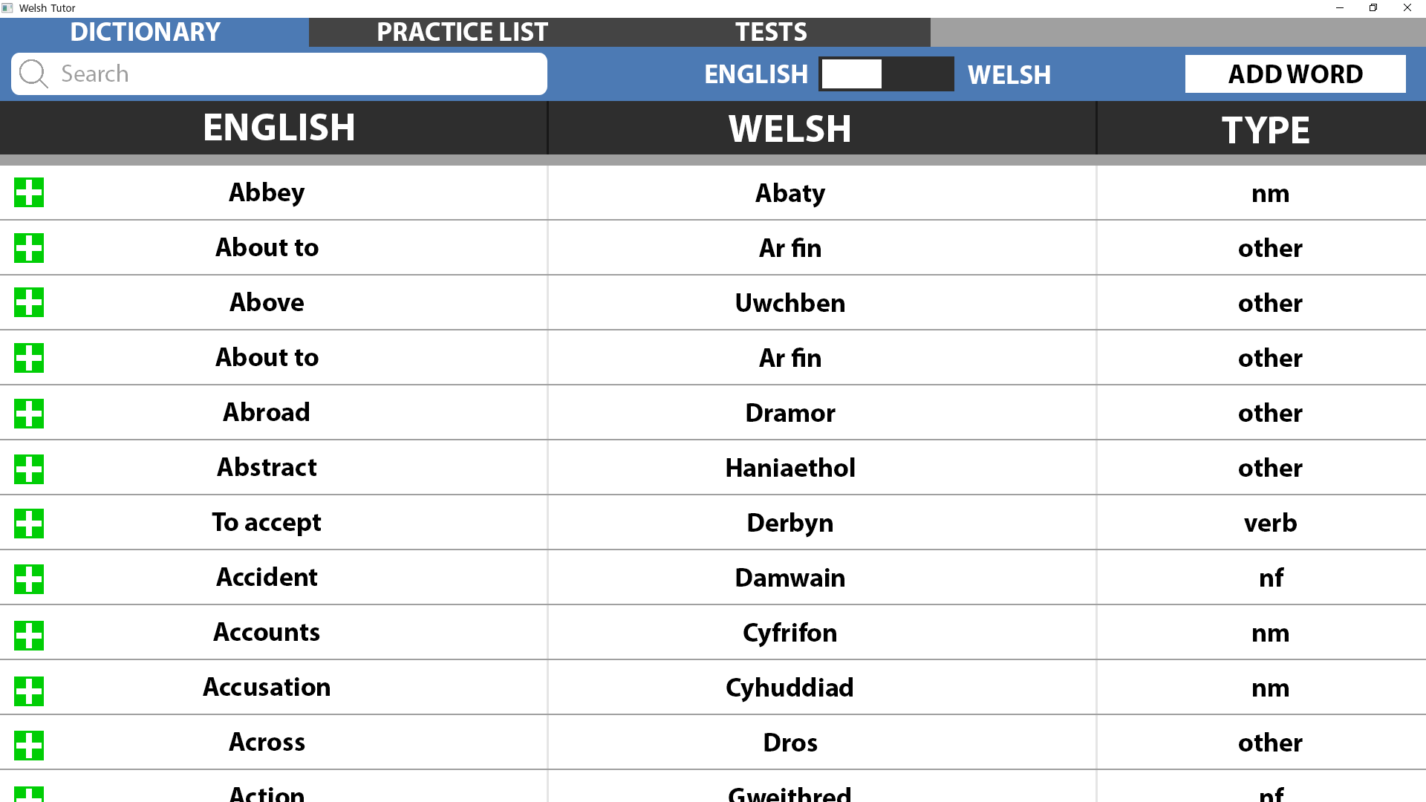
Ref 1.0
This is the first screen which will be loaded when the program is ran. It displays the dictionary which was loaded from the JSON file.
At the top there are 3 tabs, these allow the user to navigate between the main sections of the program.
The search bar lets the user search for the word they want, it will update the dictionary below in real time displaying words which match the prefix.
The English and Welsh toggle sorts the dictionary alphabetically depending on the option they have selected.
The ‘Add Word’ button will create a popup window on top of the current window which will allow the user to add a new word.
The main body of the page contains the dictionary, it is a series of rows containing each word loaded from the JSON file. Each header is clearly distinguished and the plus icon on the left will add the word from the dictionary to the users practice list and will no longer be displayed on the dictionary tab.
This page is fully interactive using hyperlinks:
Clicking the tabs at the top will change the current page to the one selected.
Clicking the search bar will show a preview of prefix searching.
Clicking the English, Welsh toggle will change the sorting of the dictionary.
Clicking the ‘Add Word’ button will display the popup window.

Slide 3
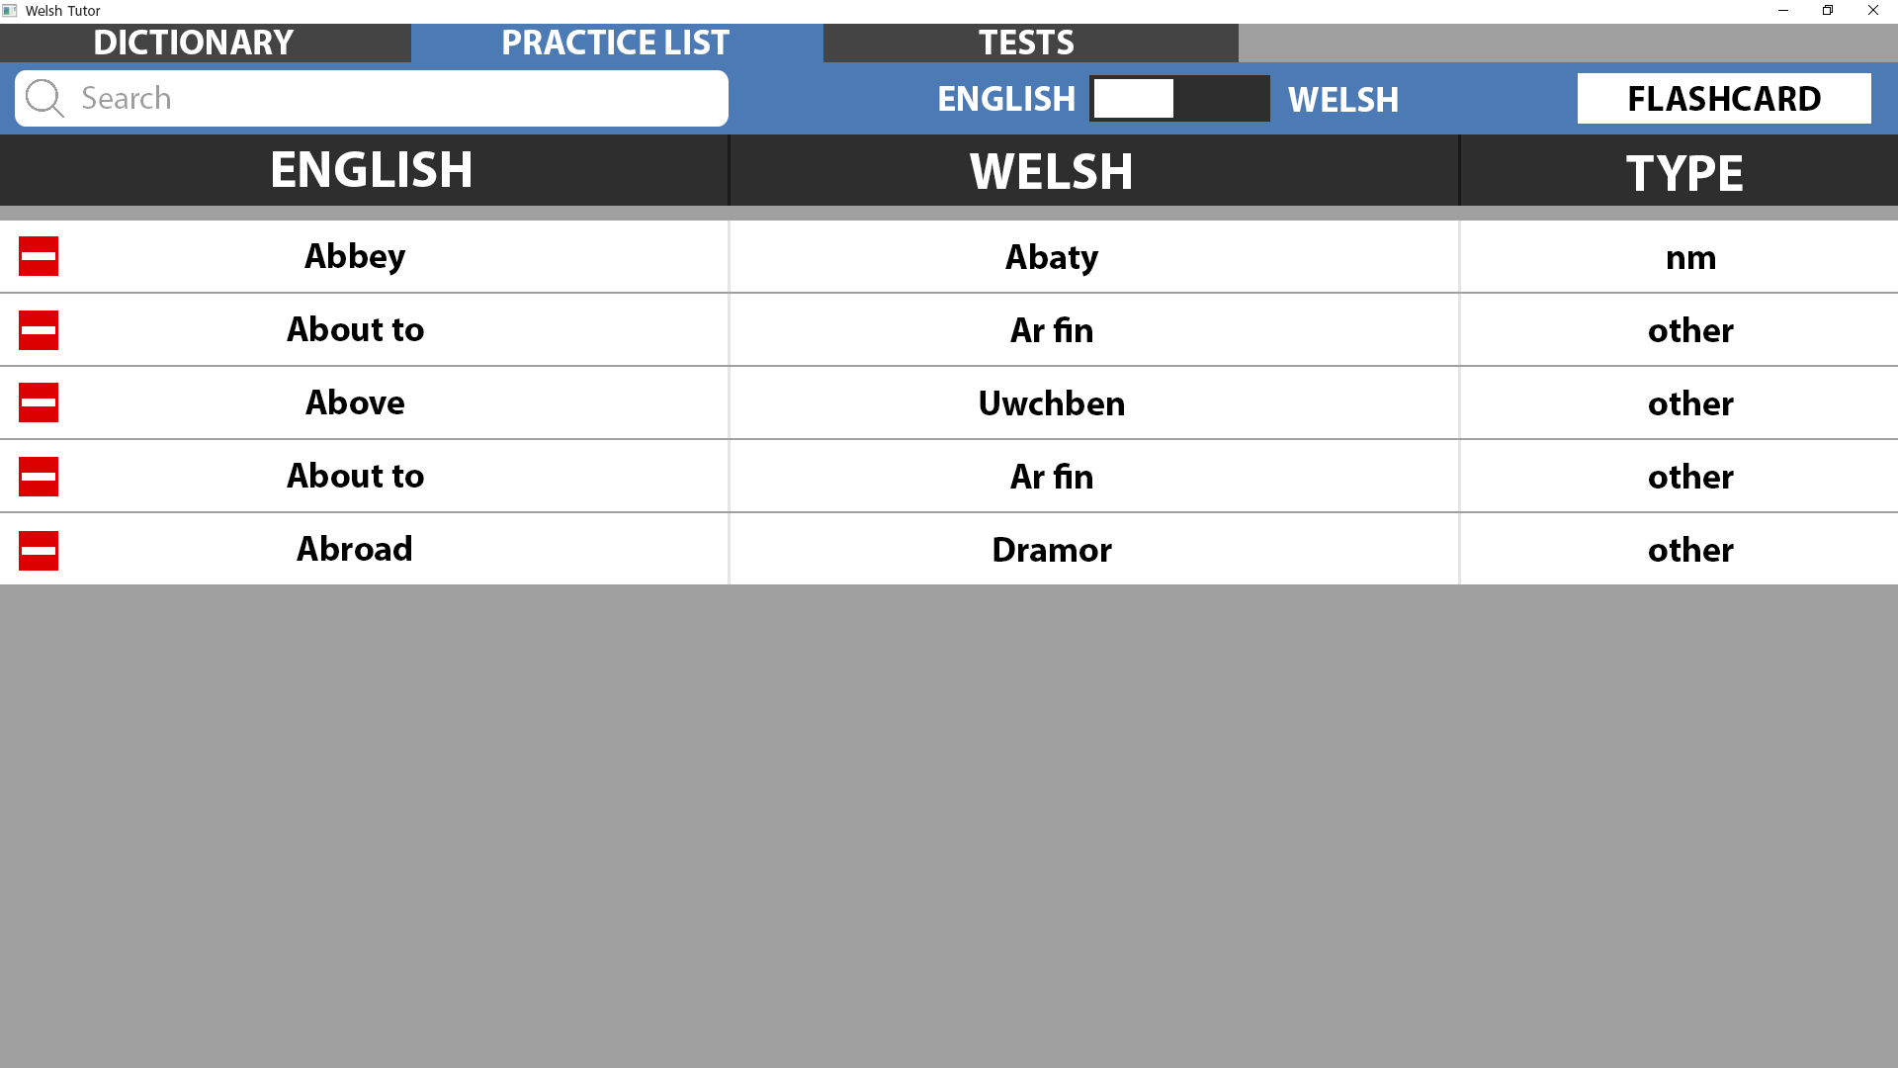
Ref 2.0
This is the practice list which will show the user the words they have added to their list.
This page shares the exact same functionality as the dictionary page for:
Navigation tabs
Displaying words
Searching
English and Welsh order toggle
The ‘Flashcard’ button will create a popup window on top of the current window which will allow the user to generate flashcards.
The main body of the page contains the practice list, it is a series of rows containing each word which was marked in the dictionary. Each header is clearly distinguished and the minus icon on the left will remove the word from the practice list and will be added back to the dictionary page.
This page is fully interactive using hyperlinks:
Clicking the tabs at the top will change the current page to the one selected.
Clicking the ‘Flashcard’ button will display the popup window.

Slide 4
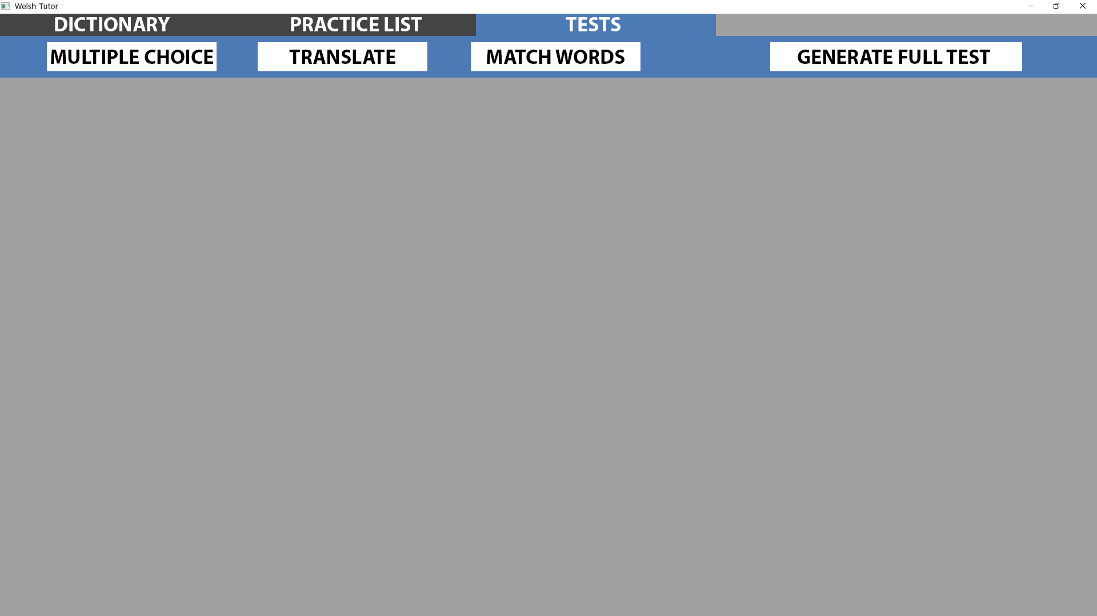
Ref 3.0
This is the tests page which will allow the user to start tests with questions generated using their practice list.
This page shares the exact same functionality as the dictionary page for:
Navigation tabs
Along the top there are 4 buttons, each button will generate a test corresponding to the type labelled on them. These tests will be displayed in the empty body below.
This page is fully interactive using hyperlinks:
Clicking the tabs at the top will change the current page to the one selected.
Clicking one of the 4 test buttons will start the corresponding test.

Slide 5
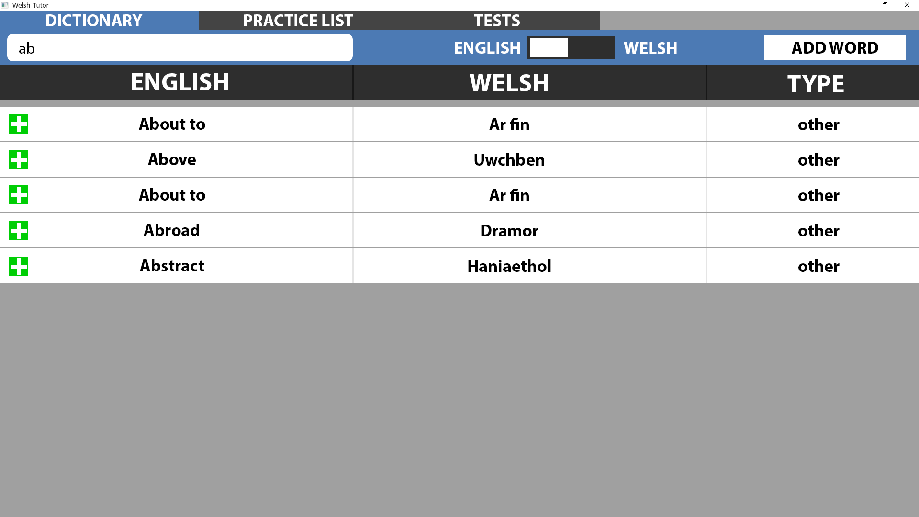
Ref 1.1
This page shows the user has written the prefix ‘ab’. By searching the dictionary, the corresponding results where displayed below.
The user is able to add the words which they search for to their practice list by pressing the plus icon on the left of each row.
This page is fully interactive using hyperlinks:
Clicking the tabs at the top will change the current page to the one selected.
Clicking the search bar will show a preview of prefix searching.
Clicking the English, Welsh toggle will change the sorting of the dictionary.
Clicking the ‘Add Word’ button will display the popup window.

Slide 6
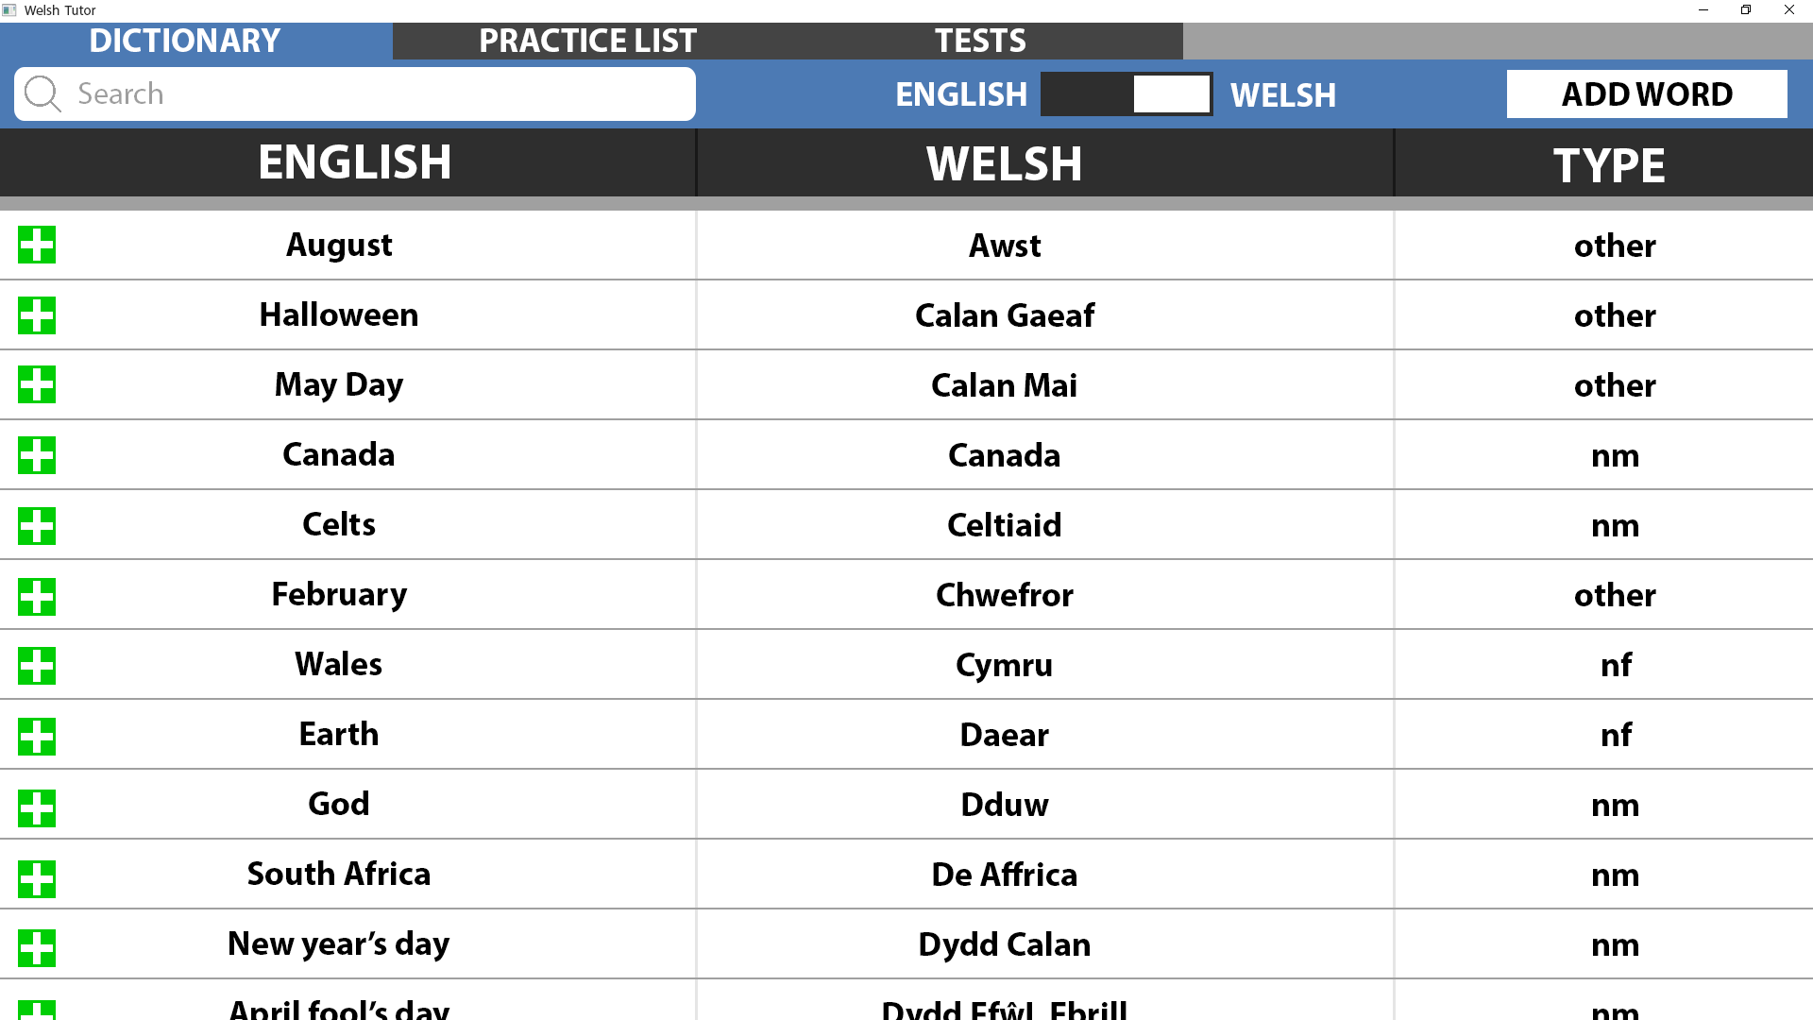
Ref 1.2
This page shows the dictionary being sorted in welsh as the user has pressed the toggle at the top of the page.
This page is fully interactive using hyperlinks:
Clicking the tabs at the top will change the current page to the one selected.
Clicking the search bar will show a preview of prefix searching.
Clicking the English, Welsh toggle will change the sorting of the dictionary.
Clicking the ‘Add Word’ button will display the popup window.

Slide 7
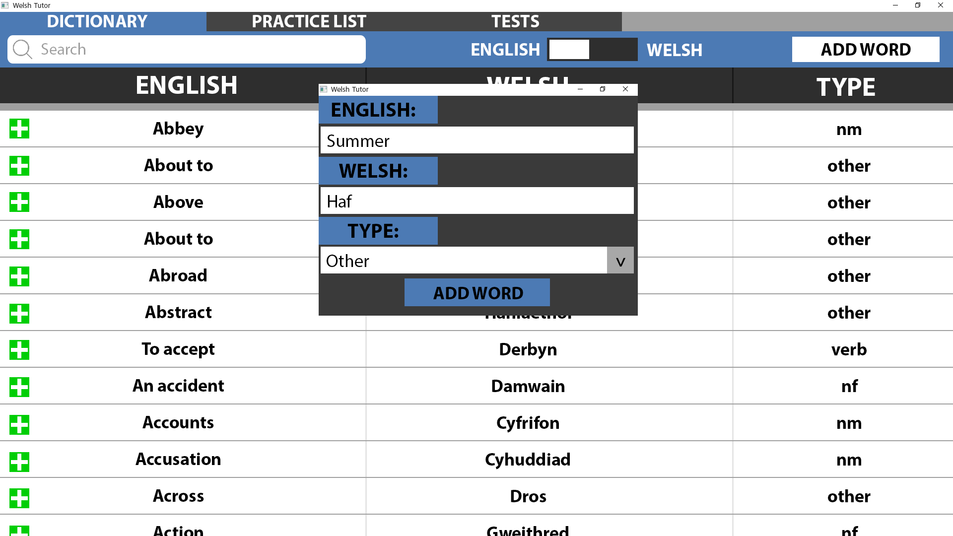
Ref 1.3
This page shows the ‘add word’ popup which appears after pressing the corresponding button.
On this new window there are 2 textboxes which allow the user to input the English and Welsh versions of the word they wish to add.
The type of the word will be selected using a combo box with pre-set types.
The ‘add word’ button will take the values within all the fields and create / add a new word into the dictionary.
This page is fully interactive using hyperlinks:
Clicking the tabs at the top will change the current page to the one selected.
Clicking the search bar will show a preview of prefix searching.
Clicking the English, Welsh toggle will change the sorting of the dictionary.
Clicking the ‘Add Word’ button will display the popup window.
The popup has no interactions.

Slide 8
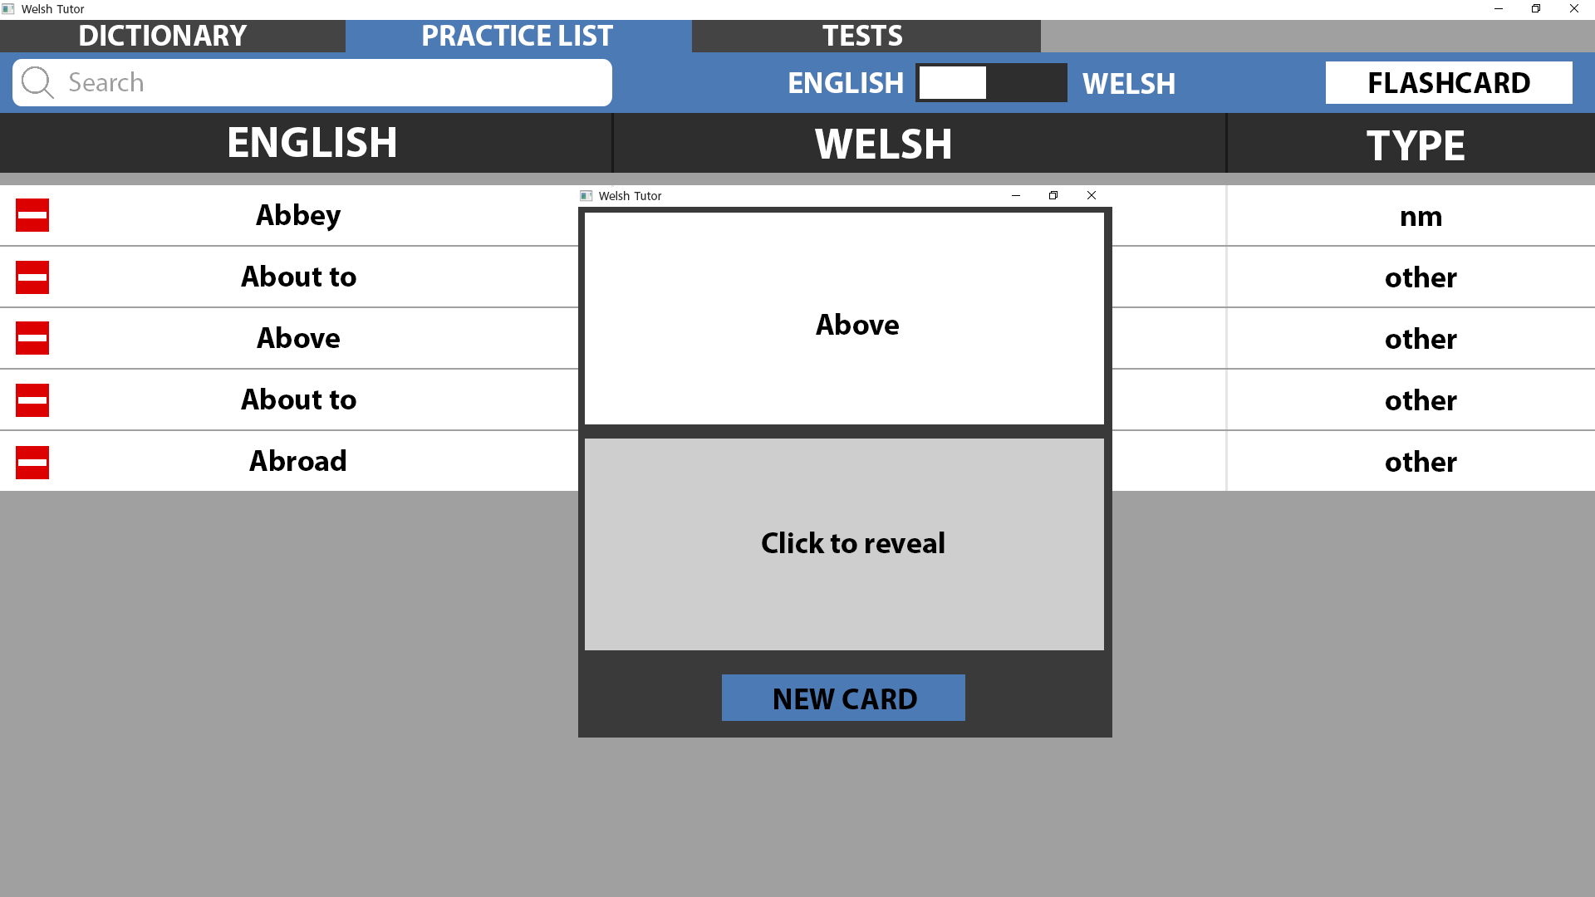
Ref 2.1
This page shows the ‘flashcard’ popup which appears after pressing the corresponding button.
On this new window there is a panel containing the word which was selected from the practice list. Below this panel is a ‘click to reveal’ button, pressing this will display the welsh version of the word.
The ‘New card’ button will display a new flashcard by randomly choosing another word from the practice list.
This page is fully interactive using hyperlinks:
Clicking the tabs at the top will change the current page to the one selected.
Clicking the ‘Flashcard’ button will display the popup window.
Clicking ‘Click to reveal’ will display the welsh version of the word.
Clicking ‘New Card’ will show a new card.

Slide 9
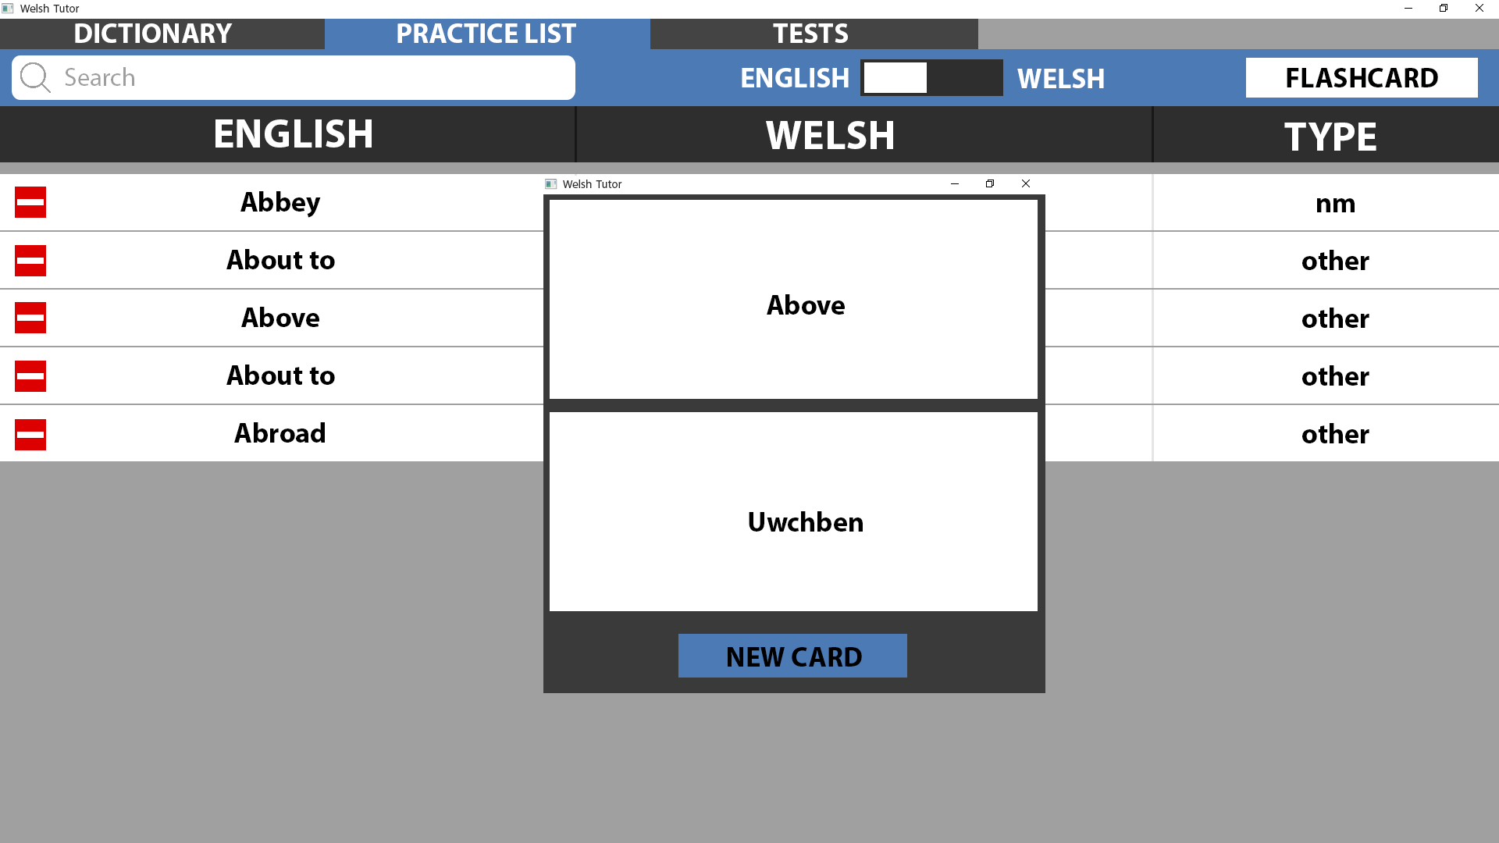
Ref 2.1.1
This page shows the ‘flashcard’ popup after the ‘click to reveal’ button has been pressed.
In place of the ‘click to reveal’ button is now a panel displaying the welsh version of the word.
The ‘New card’ button will display a new flashcard by randomly choosing another word from the practice list.
This page is fully interactive using hyperlinks:
Clicking the tabs at the top will change the current page to the one selected.
Clicking the ‘Flashcard’ button will display the popup window.
Clicking ‘New Card’ will show a new card.

Slide 10

Ref 2.2
This page shows the ‘flashcard’ popup which appears after pressing the corresponding button.
On this new window there is a panel containing the word which was selected from the practice list. Below this panel is a ‘click to reveal’ button, pressing this will display the welsh version of the word.
The ‘New card’ button will display a new flashcard by randomly choosing another word from the practice list.
This page is fully interactive using hyperlinks:
Clicking the tabs at the top will change the current page to the one selected.
Clicking the ‘Flashcard’ button will display the popup window.
Clicking ‘Click to reveal’ will display the welsh version of the word.
Clicking ‘New Card’ will show a new card.

Slide 11

Ref 2.2.1
This page shows the ‘flashcard’ popup after the ‘click to reveal’ button has been pressed.
In place of the ‘click to reveal’ button is now a panel displaying the welsh version of the word.
The ‘New card’ button will display a new flashcard by randomly choosing another word from the practice list.
This page is fully interactive using hyperlinks:
Clicking the tabs at the top will change the current page to the one selected.
Clicking the ‘Flashcard’ button will display the popup window.
Clicking ‘New Card’ will show a new card.

Slide 12
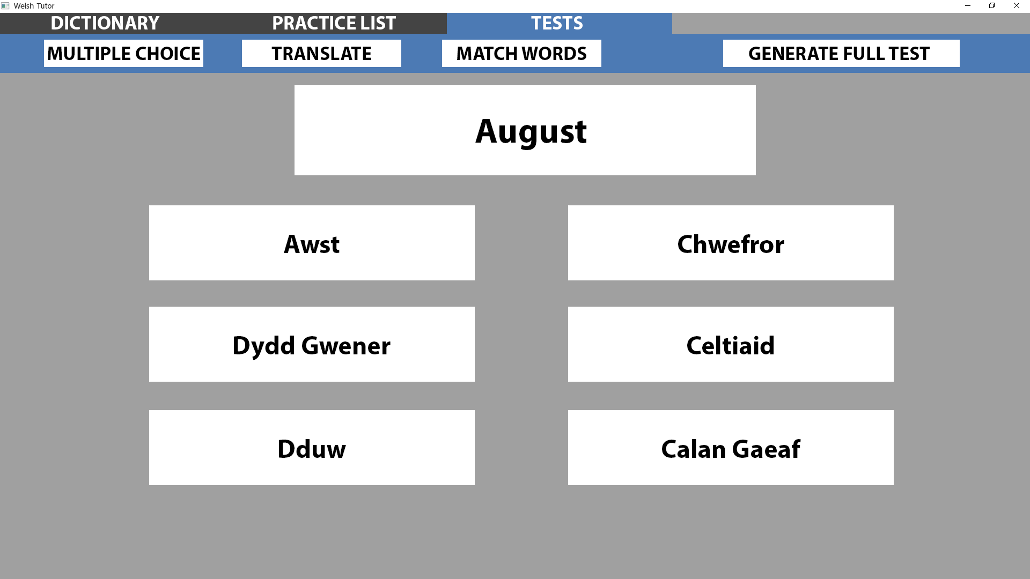
Ref 3.1
This page shows the ‘Multiple Choice’ test.
In the large white panel near the top of the body, the randomly selected English word is displayed.
On the 6 buttons below, random meanings in Welsh will be assigned to each one with one button having the correct meaning corresponding to the word in the top panel.
The user is able to select any one of the 6 buttons, the correct button will display the user got the correct answer while the other buttons will display the user got the wrong answer and show what the correct answer was.
This page is fully interactive using hyperlinks:
Clicking the tabs at the top will change the current page to the one selected.
Clicking one of the 4 test buttons will start the corresponding test.
Clicking ‘Awst’ which is the correct answer will display the answer was correct.
Clicking any other button will display the answer was incorrect and display the correct answer at the top.

Slide 13
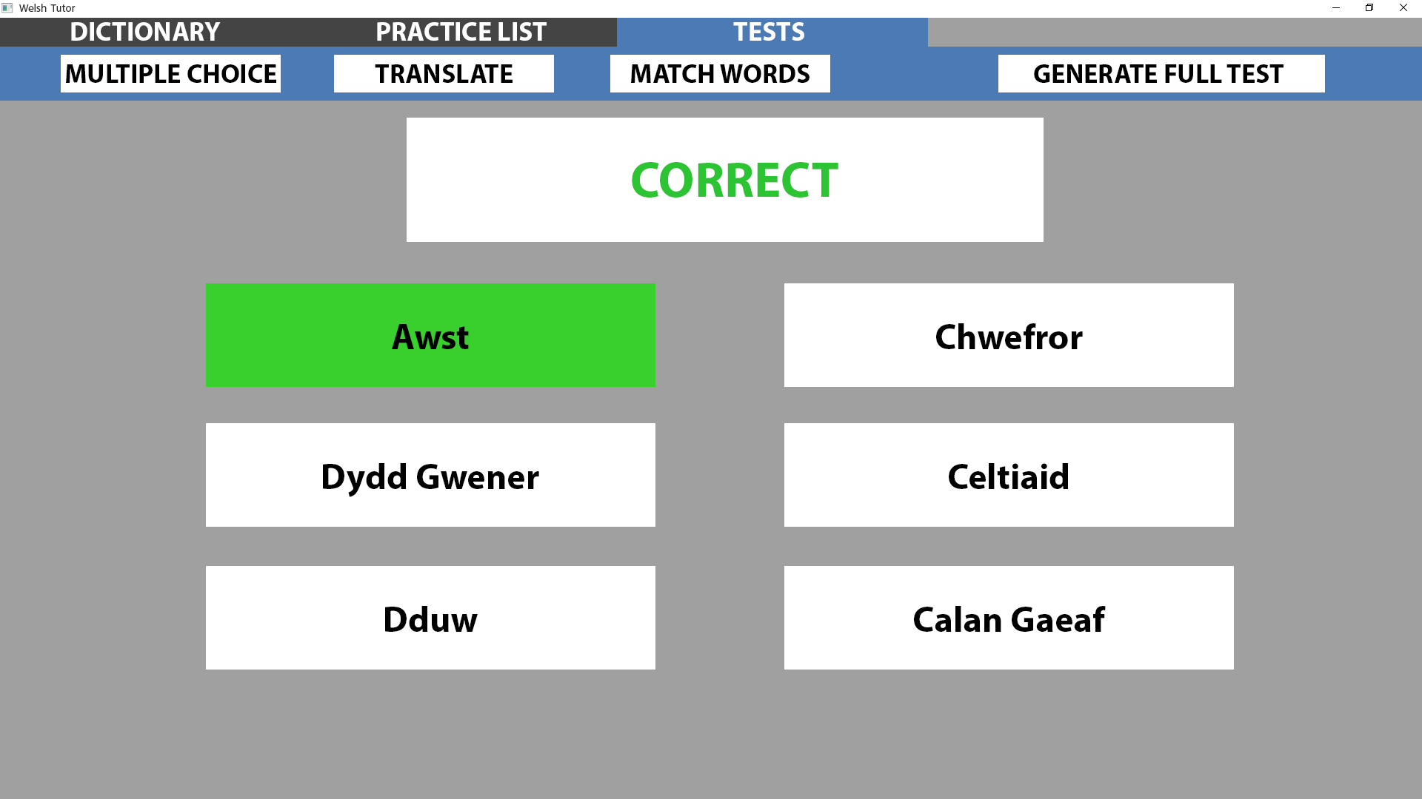
Ref 3.1.1
This page shows the user has selected the correct answer.
The corresponding button has been coloured green and the word at the top has been changed to correct for visual feedback.
A new question will be displayed after a certain amount of time has passed.
This page is fully interactive using hyperlinks:
Clicking the tabs at the top will change the current page to the one selected.
Clicking one of the 4 test buttons will start the corresponding test.

Slide 14
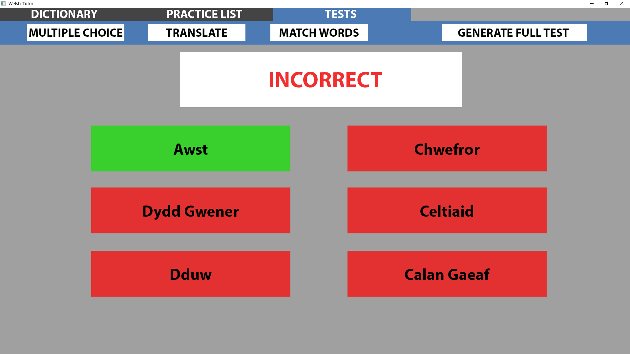
Ref 3.1.2
This page shows the user has selected the wrong answer.
All the incorrect answers have been coloured red and the word at the top has been changed to correct for visual feedback. The correct answer was coloured green.
A new question will be displayed after a certain amount of time has passed.
This page is fully interactive using hyperlinks:
Clicking the tabs at the top will change the current page to the one selected.
Clicking one of the 4 test buttons will start the corresponding test.

Slide 15
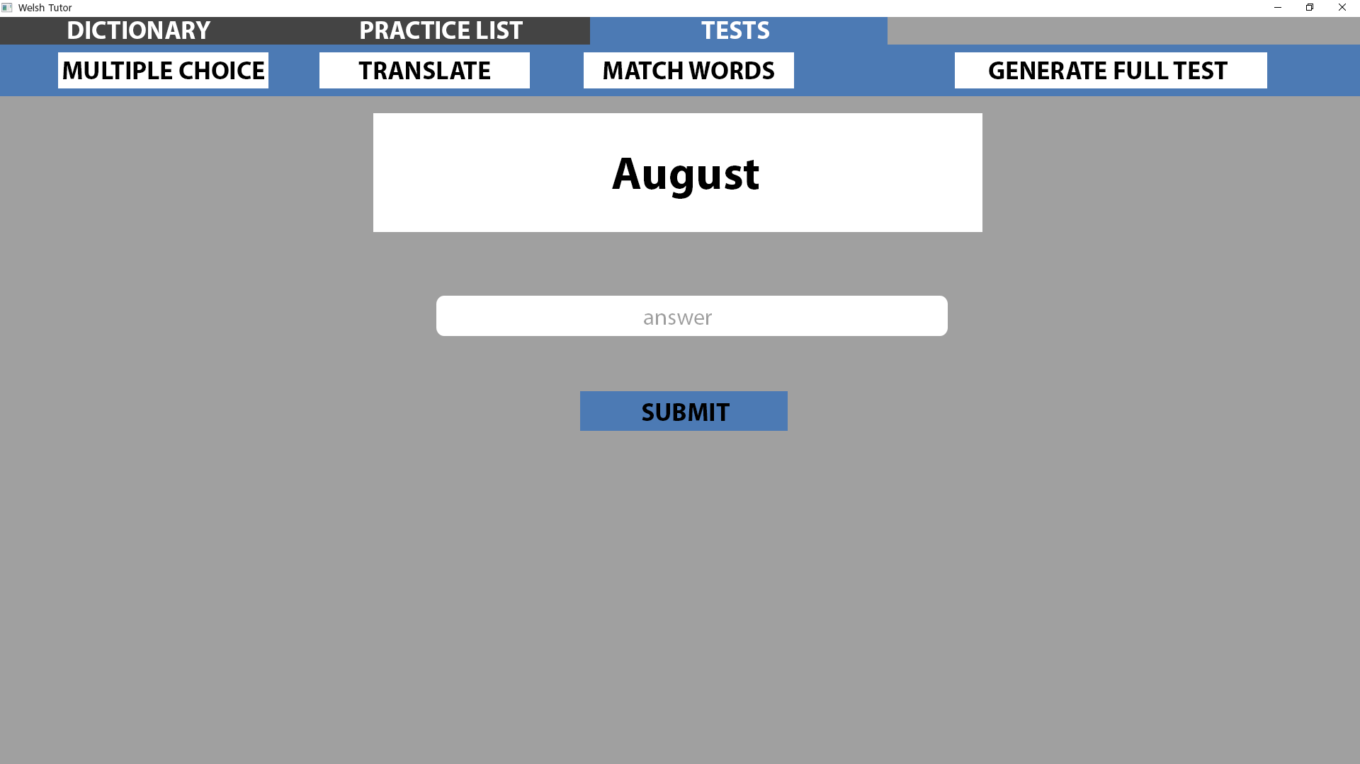
Ref 3.2
This page shows the ‘Translate’ test.
In the large white panel near the top of the body, the randomly selected English word is displayed.
Below is a textbox which the user will type their answer in
The ‘Submit’ button will check their answer and display if they were correct or not.
This page is fully interactive using hyperlinks:
Clicking the tabs at the top will change the current page to the one selected.
Clicking one of the 4 test buttons will start the corresponding test.
Clicking submit will show a preview of the user inputting the correct answer.

Slide 16
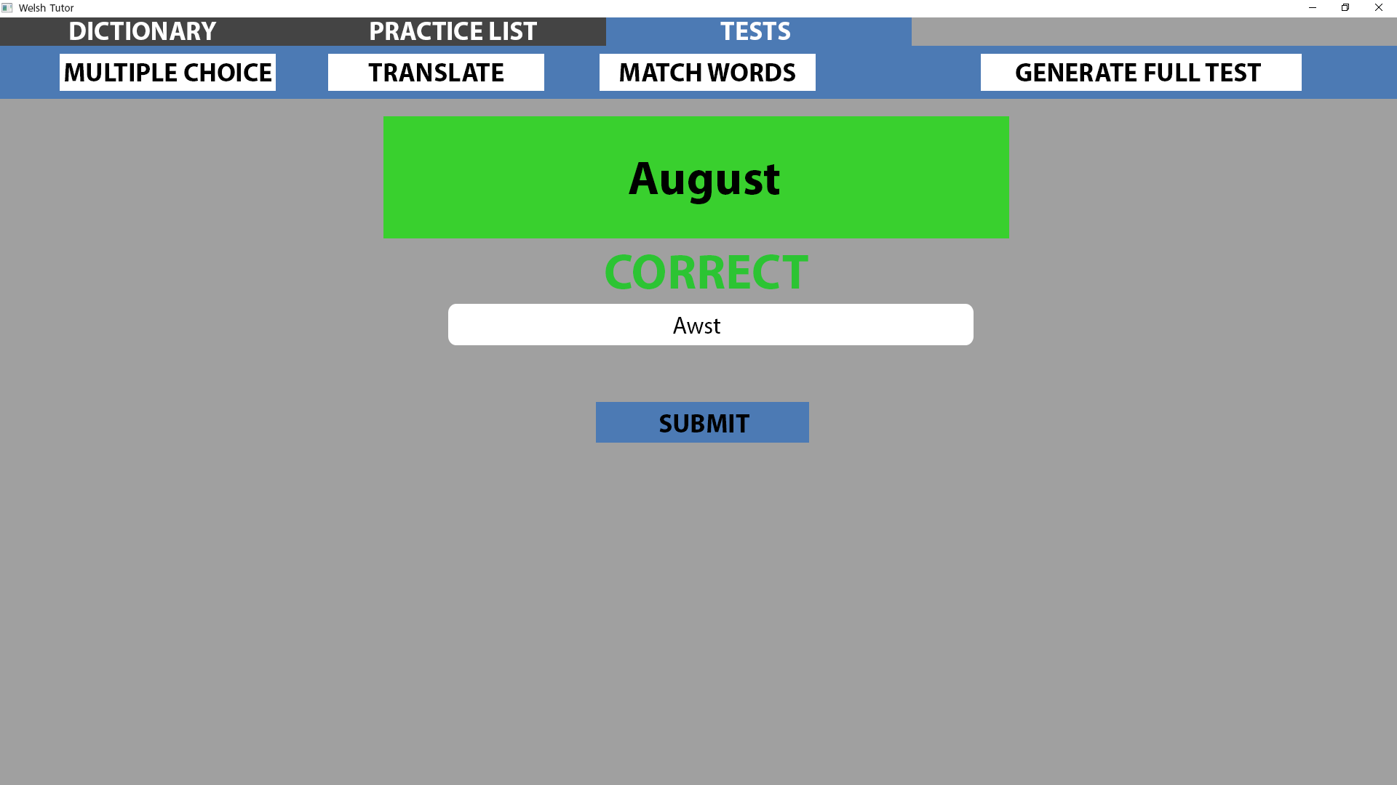
Ref 3.2.1
This page shows the user has entered the correct answer.
The panel at the top has gone green and the word correct was displayed for visual feedback.
A new question will be displayed after a certain amount of time has passed.
This page is fully interactive using hyperlinks:
Clicking the tabs at the top will change the current page to the one selected.
Clicking one of the 4 test buttons will start the corresponding test.
Clicking submit will show a preview of the user inputting the wrong answer. (This is presentation specific as in actuality their answer will determine what they’re shown.)

Slide 17
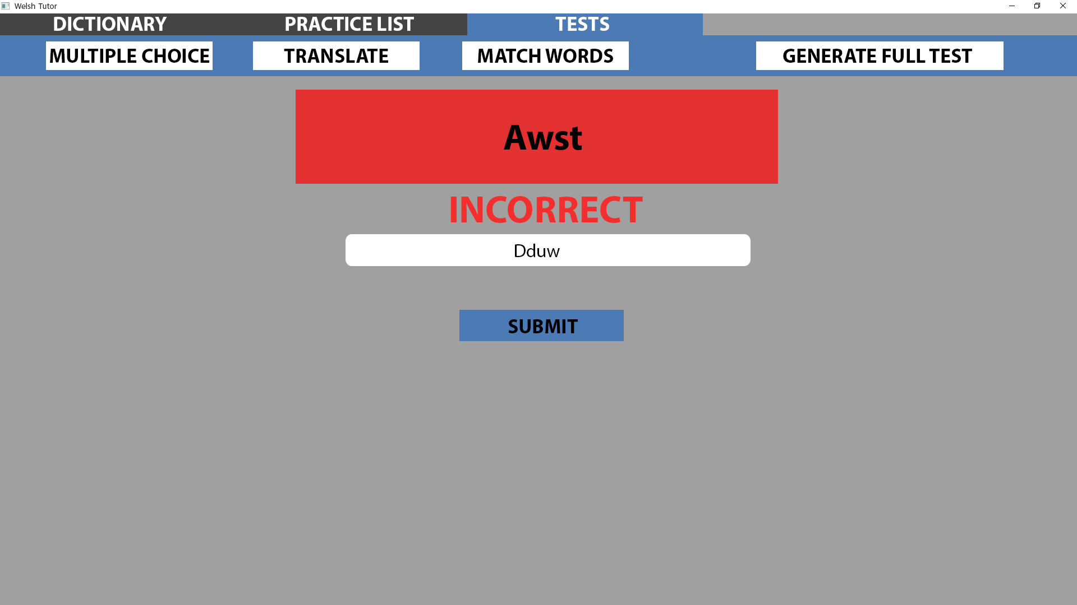
Ref 3.2.2
This page shows the user has entered the wrong answer.
The panel at the top has gone red and the word incorrect was displayed for visual feedback.
A new question will be displayed after a certain amount of time has passed.
This page is fully interactive using hyperlinks:
Clicking the tabs at the top will change the current page to the one selected.
Clicking one of the 4 test buttons will start the corresponding test.

Slide 18
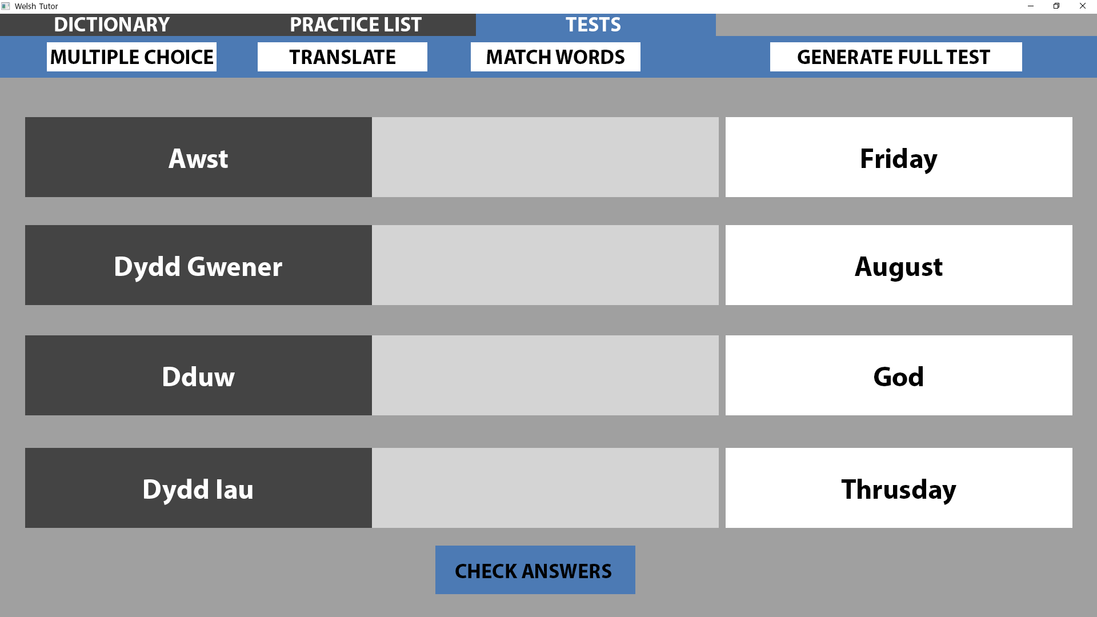
Ref 3.3
This page shows the ‘Match Words’ test.
On the left in the dark grey panels are 4 words randomly selected from their practice list in welsh.
Next to each dark grey panel is a light grey panel which will hold the word that they drag into it.
On the right there are 4 white panels which contain the English meanings of the welsh words but are in a random order. The user can click and drag these panels into the light grey areas so they can match the words.
The ‘check answers’ button will check if the user has matched the words correctly. If a word is matched correctly the panels will go green, if the are wrong then they will go red.
This page is fully interactive using hyperlinks:
Clicking the tabs at the top will change the current page to the one selected.
Clicking one of the 4 test buttons will start the corresponding test.
Clicking anywhere in the centre of the body will go to the next stage of a preview which shows the user inputting the correct answers one by one. (Slideshow)

Slide 19
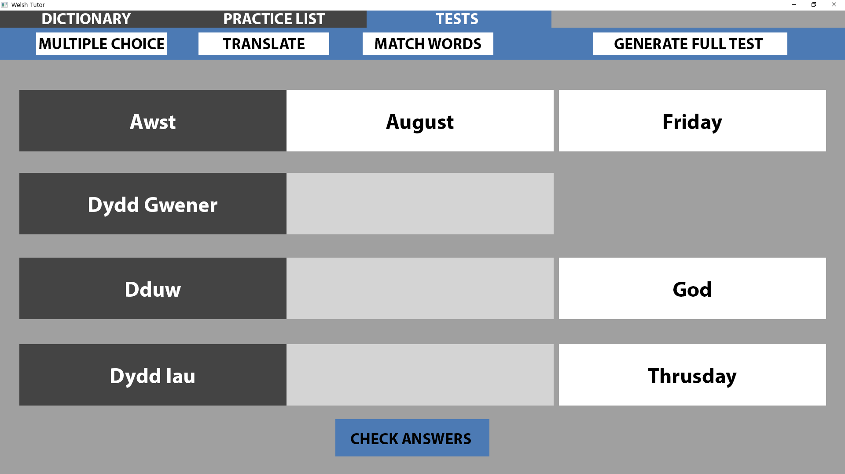
Ref 3.3.1
This page shows the user has dragged the word ‘August’ and matched it with ‘Awst’.
This page is fully interactive using hyperlinks:
Clicking the tabs at the top will change the current page to the one selected.
Clicking one of the 4 test buttons will start the corresponding test.
Clicking anywhere in the centre of the body will go to the next stage of a preview which shows the user inputting the correct answers one by one. (Slideshow)

Slide 20
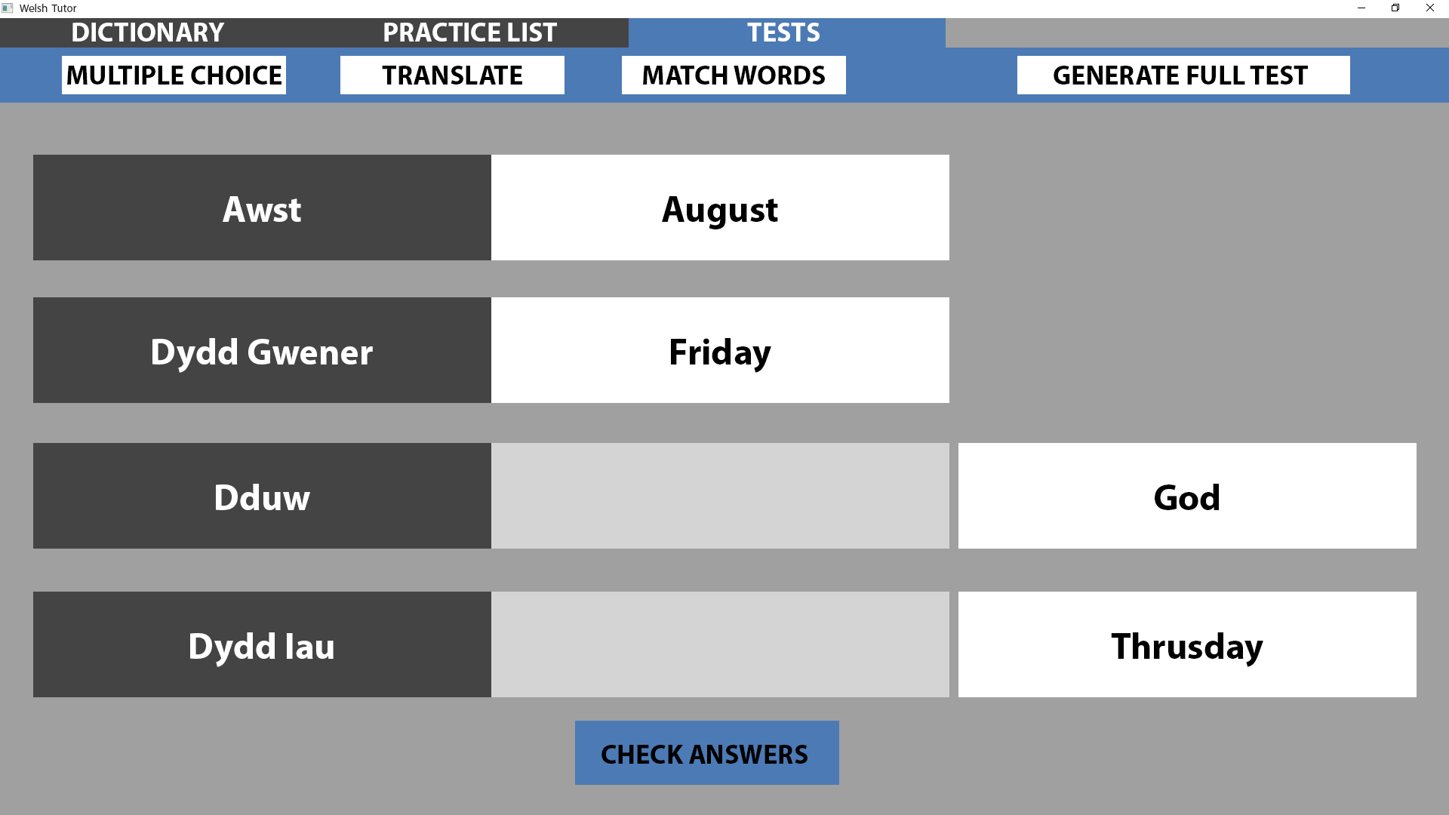
Ref 3.3.2
This page shows the user has dragged the word ‘Friday’ and matched it with ‘Dydd Gwener’.
This page is fully interactive using hyperlinks:
Clicking the tabs at the top will change the current page to the one selected.
Clicking one of the 4 test buttons will start the corresponding test.
Clicking anywhere in the centre of the body will go to the next stage of a preview which shows the user inputting the correct answers one by one. (Slideshow)

Slide 21
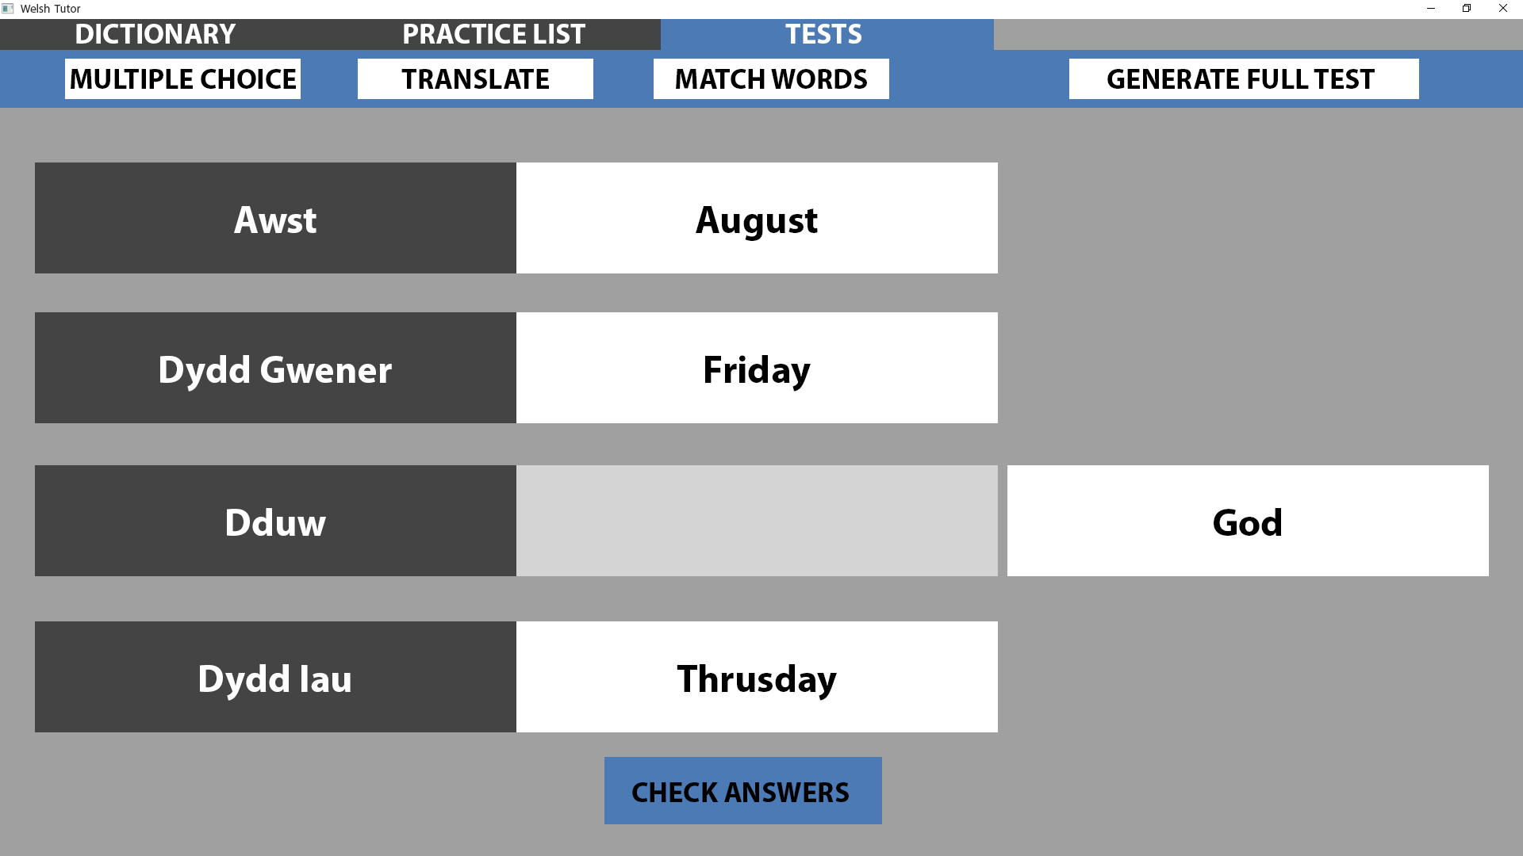
Ref 3.3.3
This page shows the user has dragged the word ‘Thursday’ and matched it with ‘Dydd lau’.
This page is fully interactive using hyperlinks:
Clicking the tabs at the top will change the current page to the one selected.
Clicking one of the 4 test buttons will start the corresponding test.
Clicking anywhere in the centre of the body will go to the next stage of a preview which shows the user inputting the correct answers one by one. (Slideshow)

Slide 22
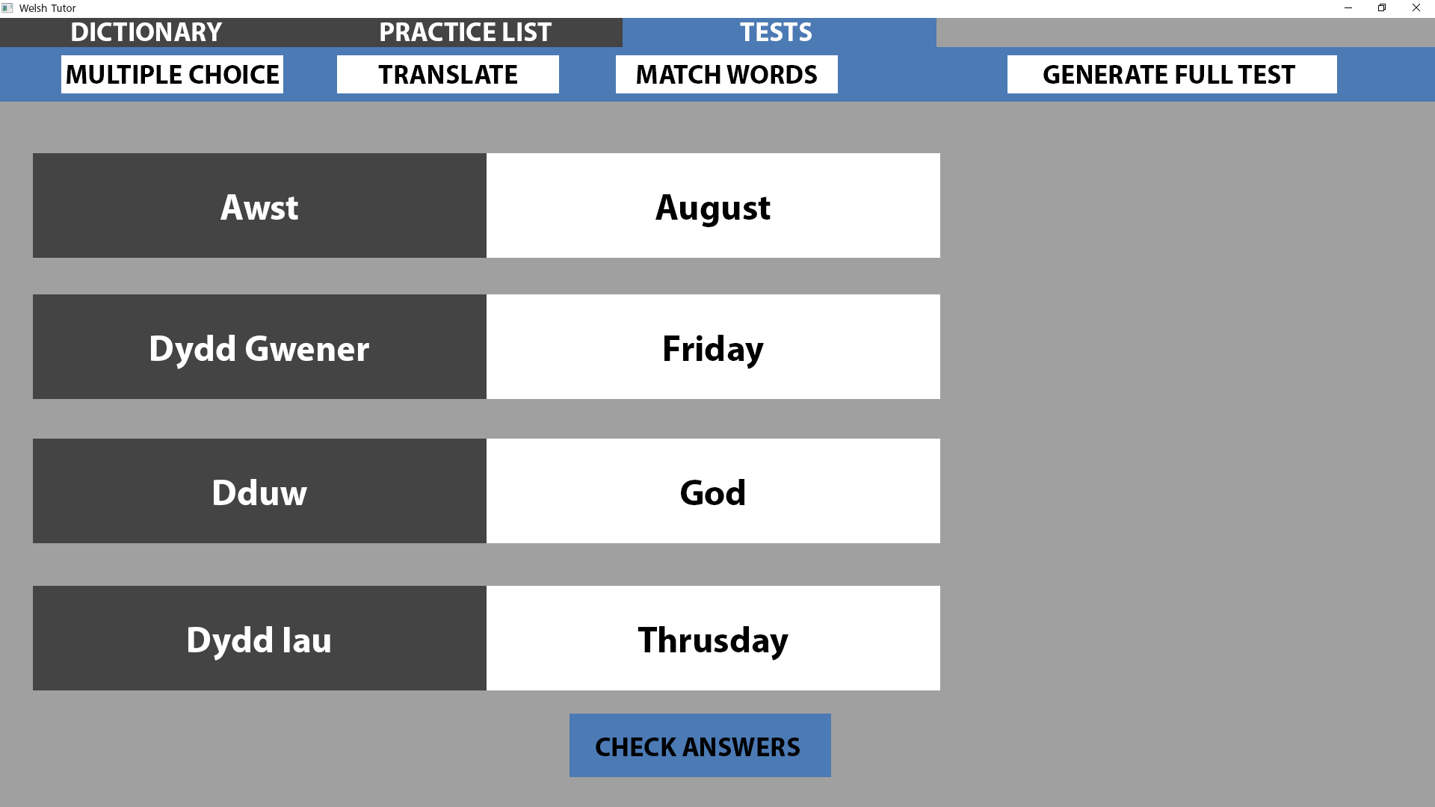
Ref 3.3.4
This page shows the user has dragged the word ‘God’ and matched it with ‘Dduw’.
This page is fully interactive using hyperlinks:
Clicking the tabs at the top will change the current page to the one selected.
Clicking one of the 4 test buttons will start the corresponding test.
Clicking ‘Check Answers’ will show a preview of the user getting the correct answers as they have successfully matched each word with it’s correct translation.

Slide 23
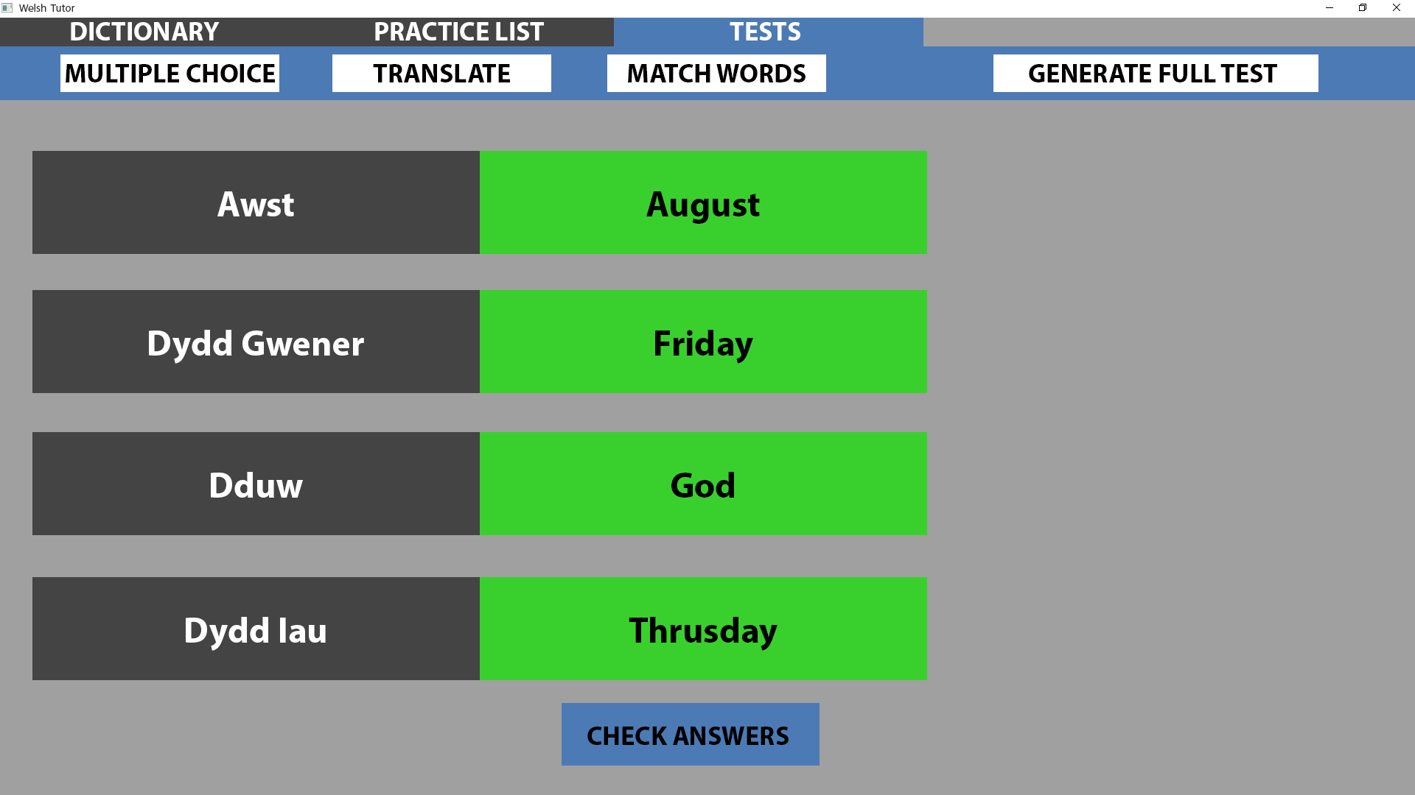
Ref 3.3.5
This page shows the user has entered 4 correct answers.
Each panel has gone green for visual feedback.
A new question will be displayed after a certain amount of time has passed.
This page is fully interactive using hyperlinks:
Clicking the tabs at the top will change the current page to the one selected.
Clicking one of the 4 test buttons will start the corresponding test.
Clicking ‘Check Answers’ will show a preview of the user getting the wrong answers as they have only matched 2 words with it’s correct translation. (This is presentation specific as in actuality their answer will determine what they’re shown.)

Slide 24
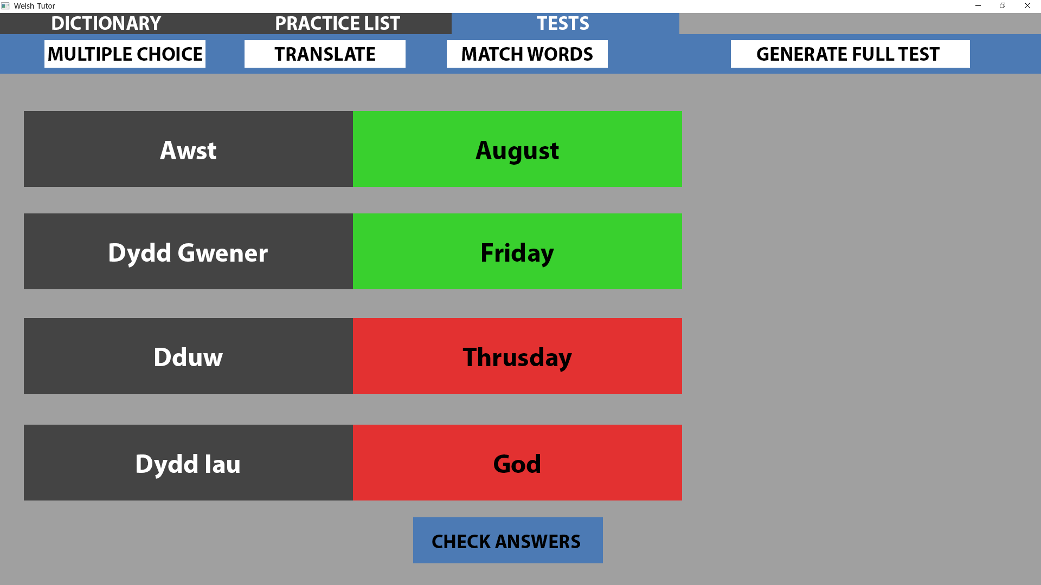
Ref 3.3.6
This page shows the user has entered 2 correct answers and 2 incorrect answers.
The 2 correct matchings have had their panels turn green whereas the 2 incorrect matchings have had their panels turn red.
A new question will be displayed after a certain amount of time has passed.
This page is fully interactive using hyperlinks:
Clicking the tabs at the top will change the current page to the one selected.
Clicking one of the 4 test buttons will start the corresponding test.
Clicking ‘Check Answers’ will show a preview of what the correct answers were. (This is presentation specific as in actuality the correct answers will be shown after a timer.)

Slide 25
Ref 3.3.7
This page shows the user what the correct answers were.
Each panel has gone green for visual feedback.
A new question will be displayed after a certain amount of time has passed.
This page is fully interactive using hyperlinks:
Clicking the tabs at the top will change the current page to the one selected.
Clicking one of the 4 test buttons will start the corresponding test.

Slide 26
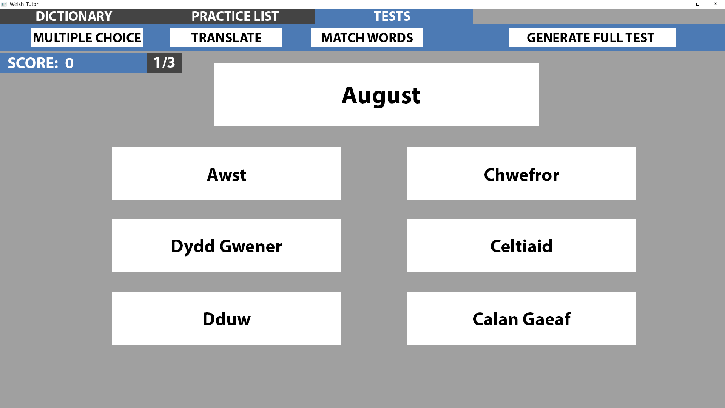
Ref 3.4
This page shows the ‘Full Test’ which is a series of questions created by the 3 tests.
At the top left of the body is the users score which will increase by 1 for every correct answer. Next to it inside the dark grey box is the question number which they are currently on so the user can track their progress through the test.
In the body, the first question was randomly selected from the 3 test types, in this preview multiple choice was selected first.
The multiple choice test is explained in Ref 3.1 to 3.1.2
This page is fully interactive using hyperlinks:
Clicking the tabs at the top will change the current page to the one selected.
Clicking one of the 4 test buttons will start the corresponding test.
Clicking anywhere in the centre of the body will go to the next stage of a preview which shows the user inputting the correct answers one by one. (Slideshow)

Slide 27
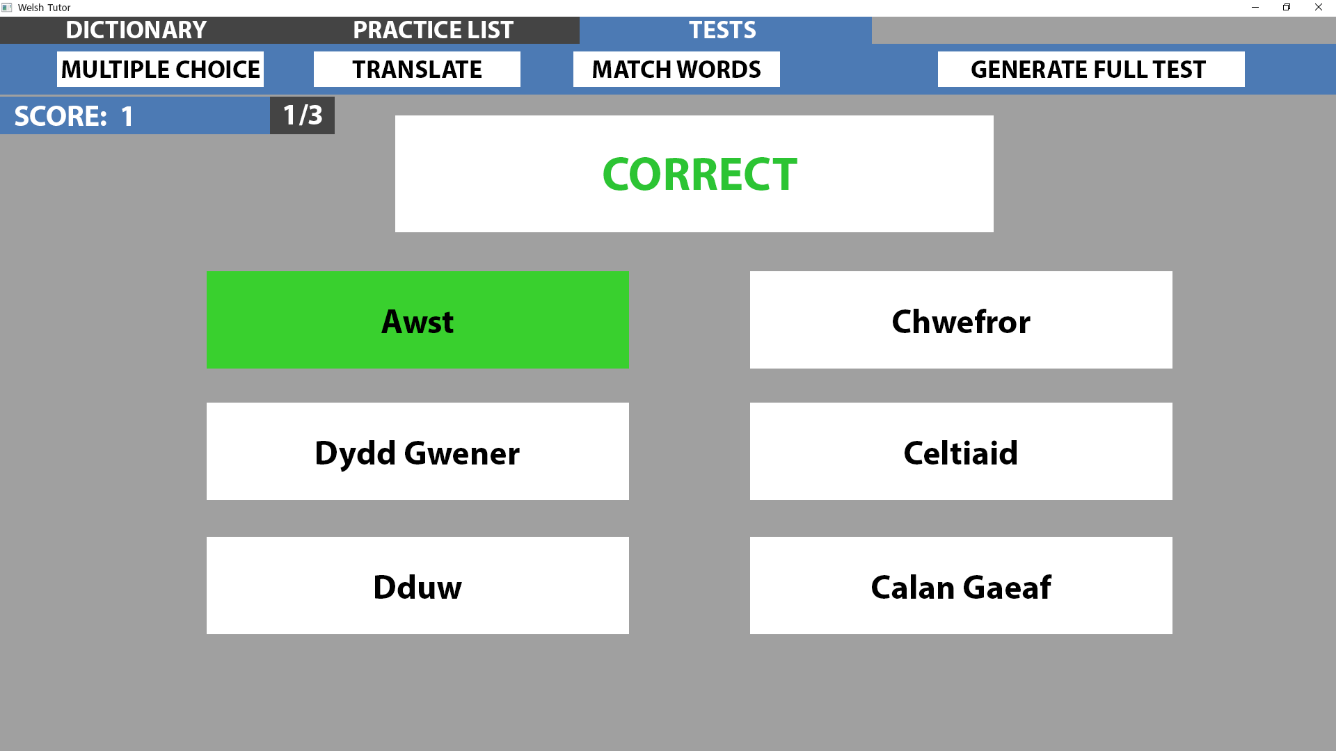
Ref 3.4.1
This page shows the user has selected the correct answer. Their score at the top left has been incremented by 1.
This page is fully interactive using hyperlinks:
Clicking the tabs at the top will change the current page to the one selected.
Clicking one of the 4 test buttons will start the corresponding test.
Clicking anywhere in the centre of the body will go to the next stage of a preview which shows the user doing the next test. (Slideshow)

Slide 28
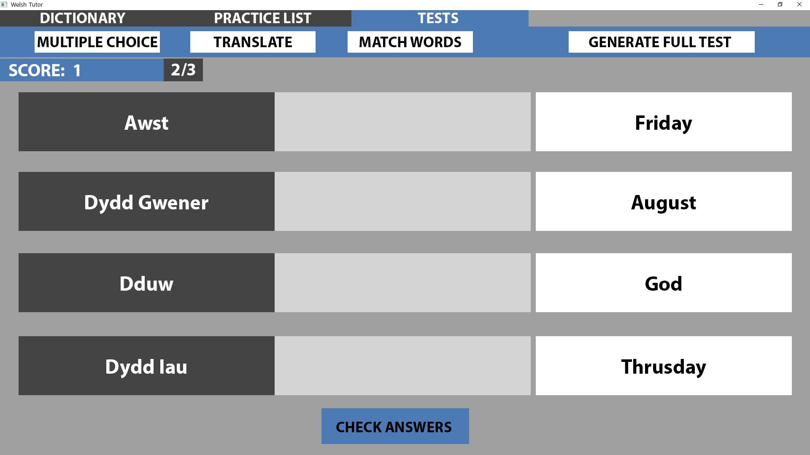
Ref 3.4.2
In the body, the second question was randomly selected from the 3 test types, in this preview match words was selected.
At the top left of the body the question number was incremented by 1 to show ‘2/3’.
The match words test is explained in Ref 3.3 to 3.3.6
This page is fully interactive using hyperlinks:
Clicking the tabs at the top will change the current page to the one selected.
Clicking one of the 4 test buttons will start the corresponding test.
Clicking anywhere in the centre of the body will go to the next stage of a preview which shows the user inputting the correct answers. (Slideshow)

Slide 29
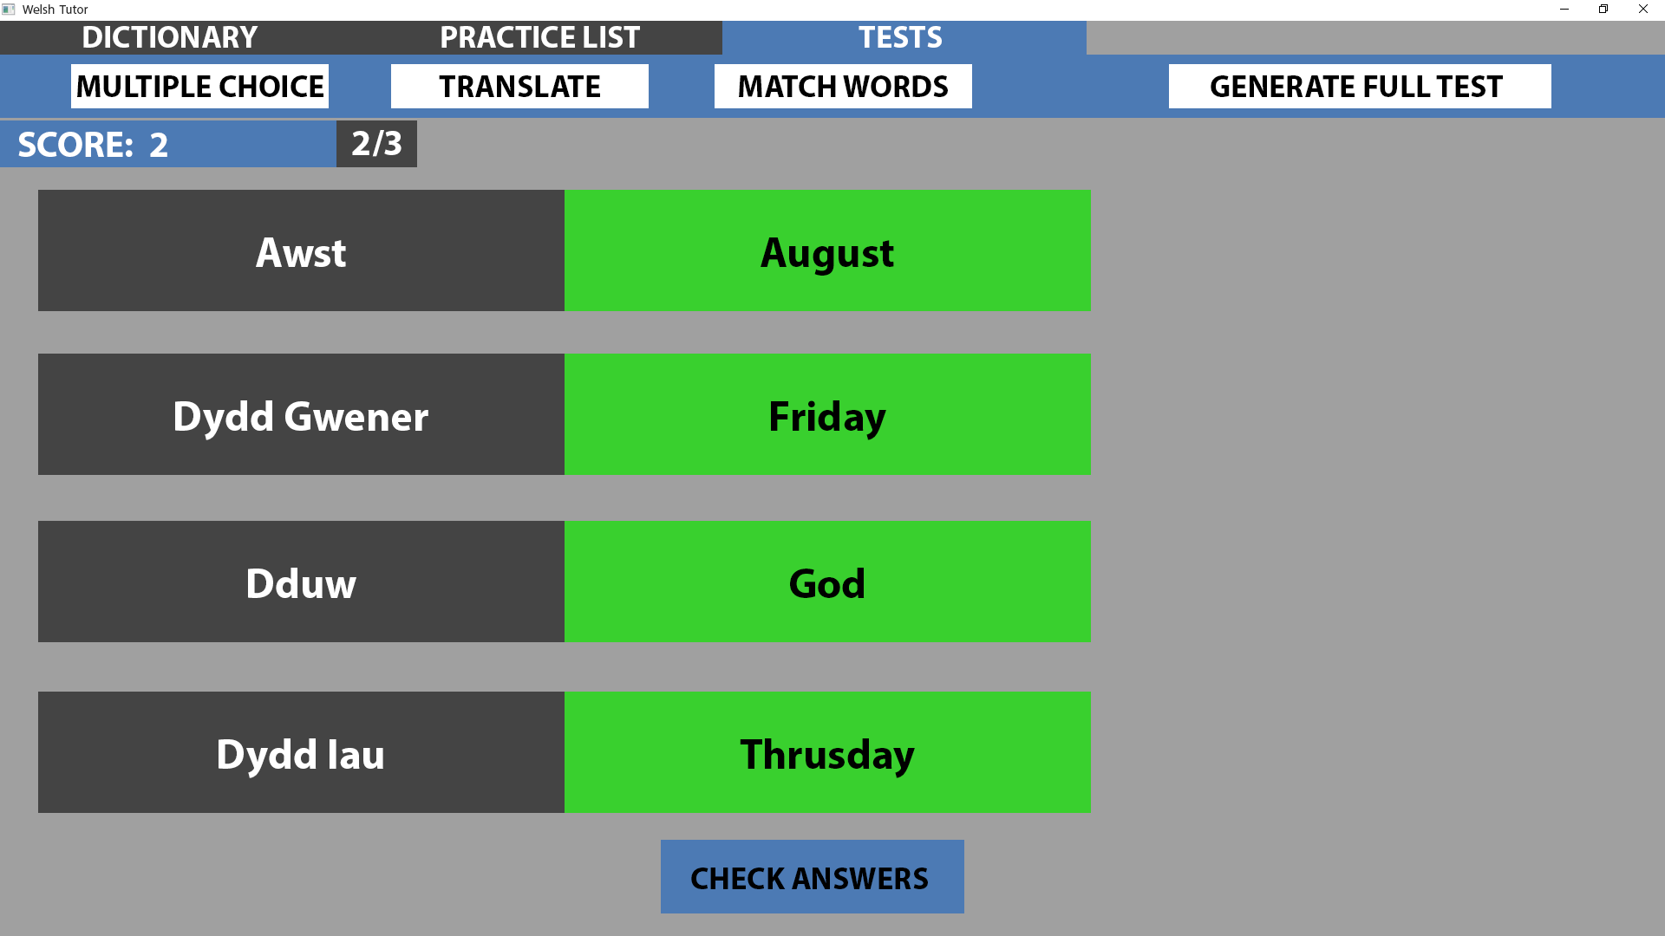
Ref 3.4.3
This page shows the user has selected the correct answers. Their score at the top left has been incremented by 1.
This page is fully interactive using hyperlinks:
Clicking the tabs at the top will change the current page to the one selected.
Clicking one of the 4 test buttons will start the corresponding test.
Clicking anywhere in the centre of the body will go to the next stage of a preview which shows the user doing the next test. (Slideshow)

Slide 30
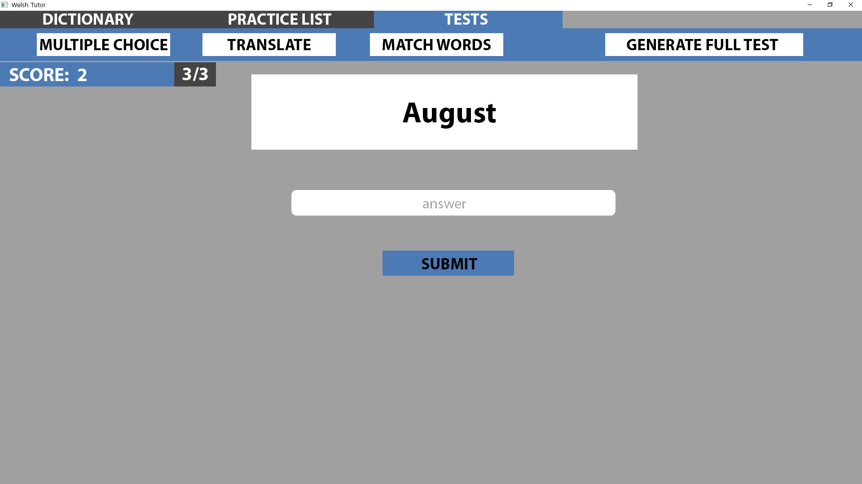
Ref 3.4.4
In the body, the final question was randomly selected from the 3 test types, in this preview translate was selected.
At the top left of the body the question number was incremented by 1 to show ‘3/3’.
The translate test is explained in Ref 3.2 to 3.2.2
This page is fully interactive using hyperlinks:
Clicking the tabs at the top will change the current page to the one selected.
Clicking one of the 4 test buttons will start the corresponding test.
Clicking anywhere in the centre of the body will go to the next stage of a preview which shows the user inputting the correct answers. (Slideshow)

Slide 31
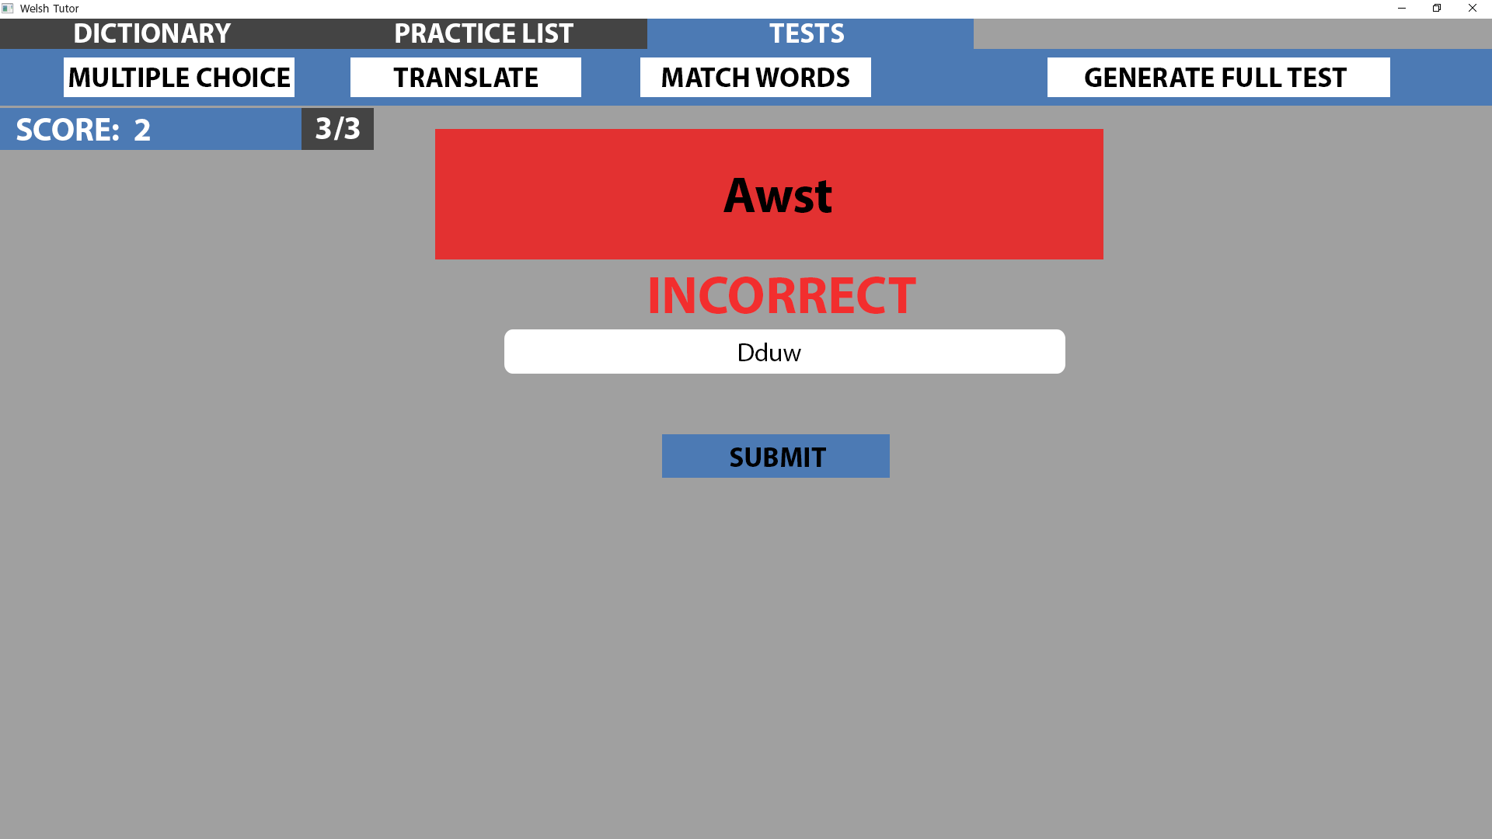
Ref 3.4.5
This page shows the user has entered the wrong answer. Their score at the top left has been not been incremented.
This page is fully interactive using hyperlinks:
Clicking the tabs at the top will change the current page to the one selected.
Clicking one of the 4 test buttons will start the corresponding test.
Clicking anywhere in the centre of the body will go to the next stage of a preview which shows the users final score. (Slideshow)

Slide 32
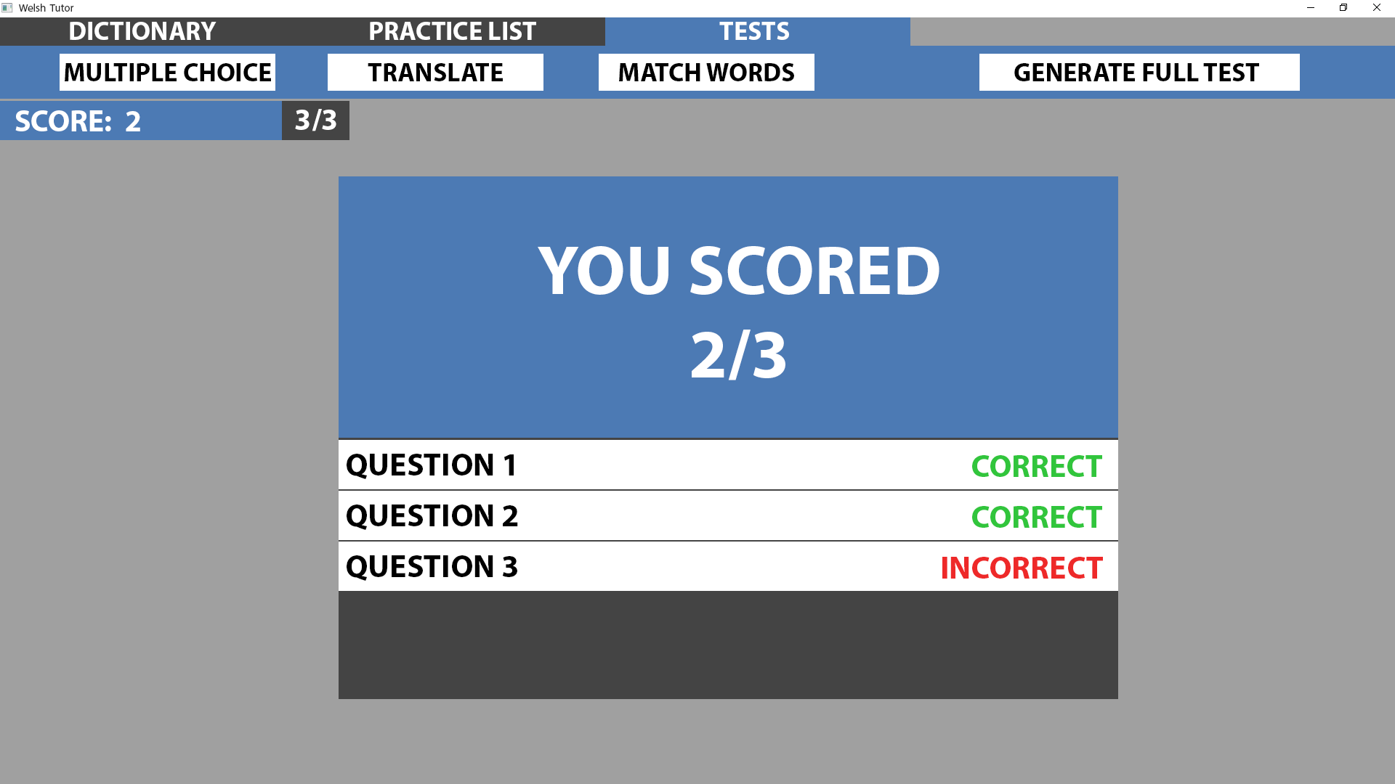
Ref 3.4.6
In the body, the users total score is displayed. Underneath is a list of the questions which they got correct and incorrect.
This page is fully interactive using hyperlinks:
Clicking the tabs at the top will change the current page to the one selected.
Clicking one of the 4 test buttons will start the corresponding test.

