Slide 1
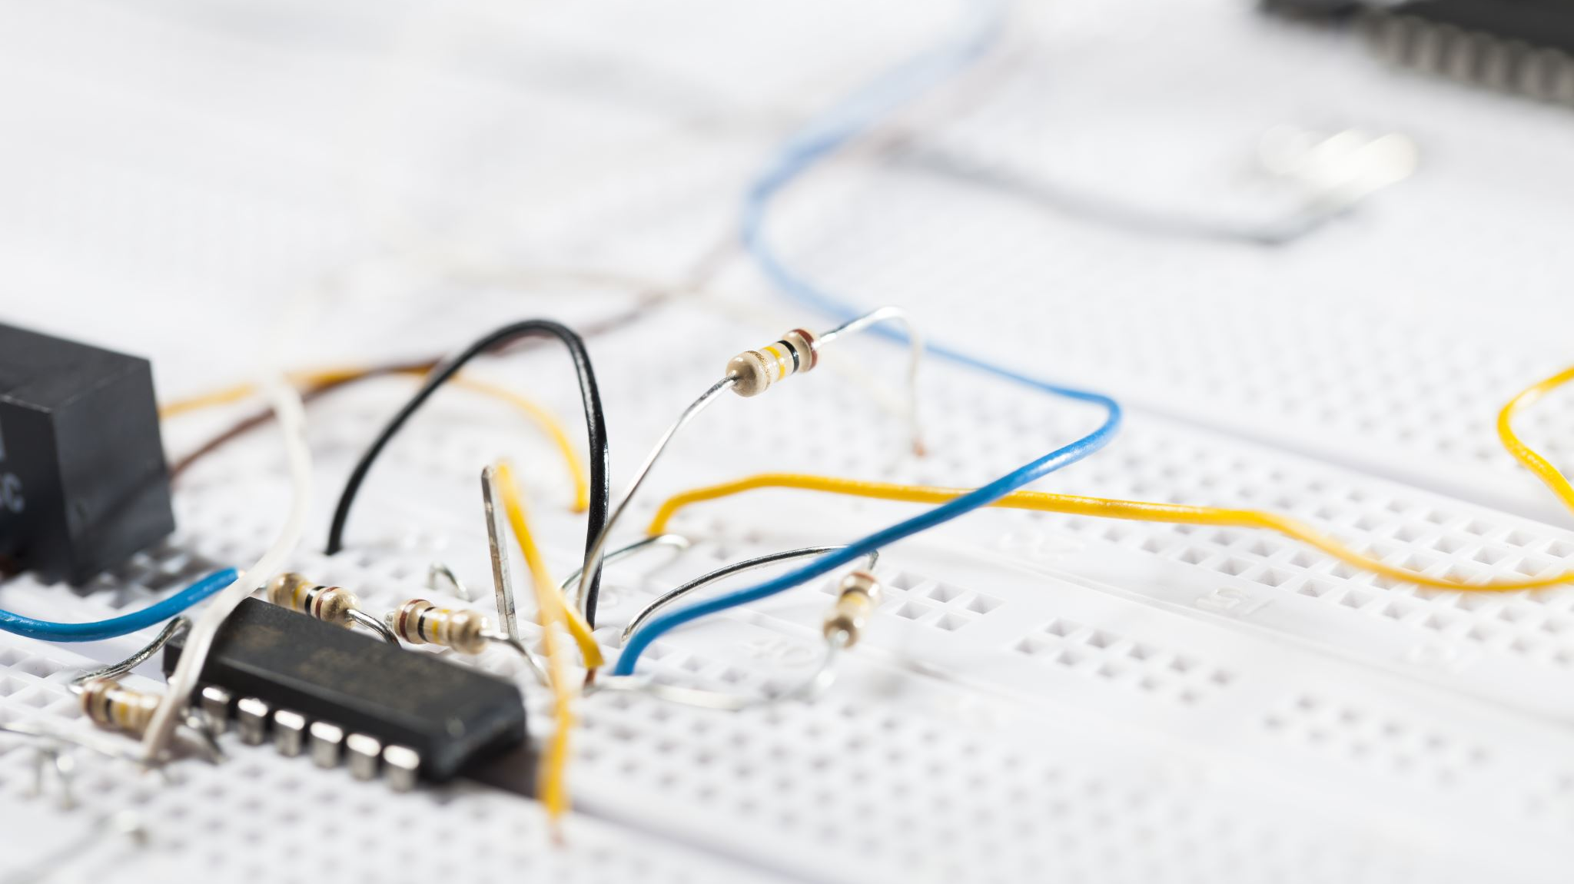
Hardware & Flowcharts

Slide 2
Quick note from last weeks meeting
Go forward for Sun Life Awards
“There are three awards namely the Innovation Award, the Enterprise Awards and the Intellectual Curiosity.”

Slide 3
Project Methodology
KanBan – To/Do , Doing, Done lists https://trello.com/
Scrum – complete work in short time, backlog for incomplete work
GANNT chart – visualise the time line of the project (can change over time)
Productivia – setting reminders & Deadlines

Slide 4
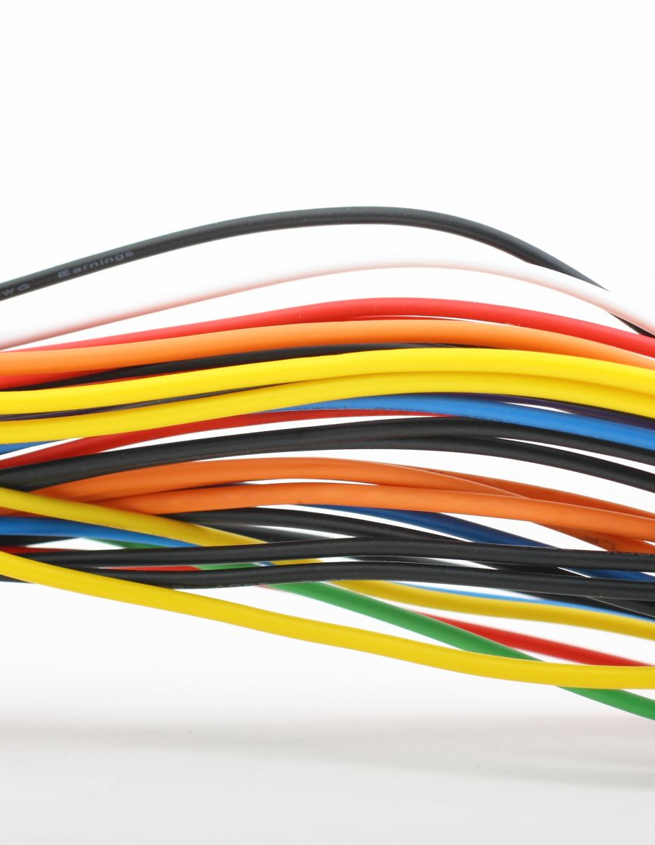
Equipment
2 ESP32
4 Servos
1 EMG Sensor
Filament
3D Printer
Jumper Wires

Slide 5

Software
Arduino IDE
Fusion 360
Creality Slicer
Prusa Slicer
GrabCad = https://grabcad.com/library/t-800-terminator-endoarm-1

Slide 6
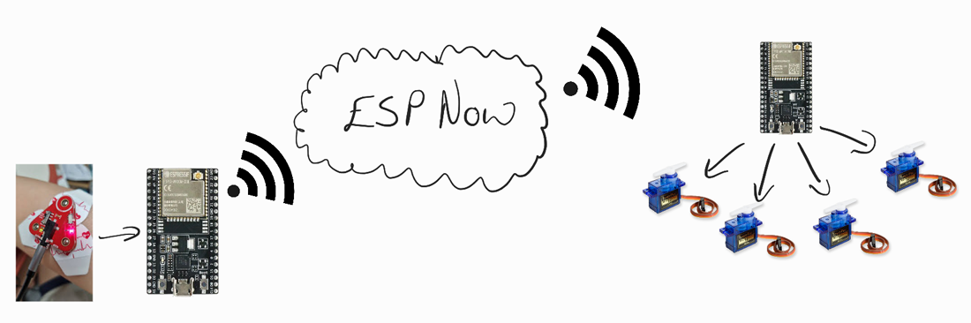
FlowChart/Model

Slide 7
Messaging Protocol
ESP NOW
https://www.espressif.com/en/solutions/low-power-solutions/esp-now

Slide 8
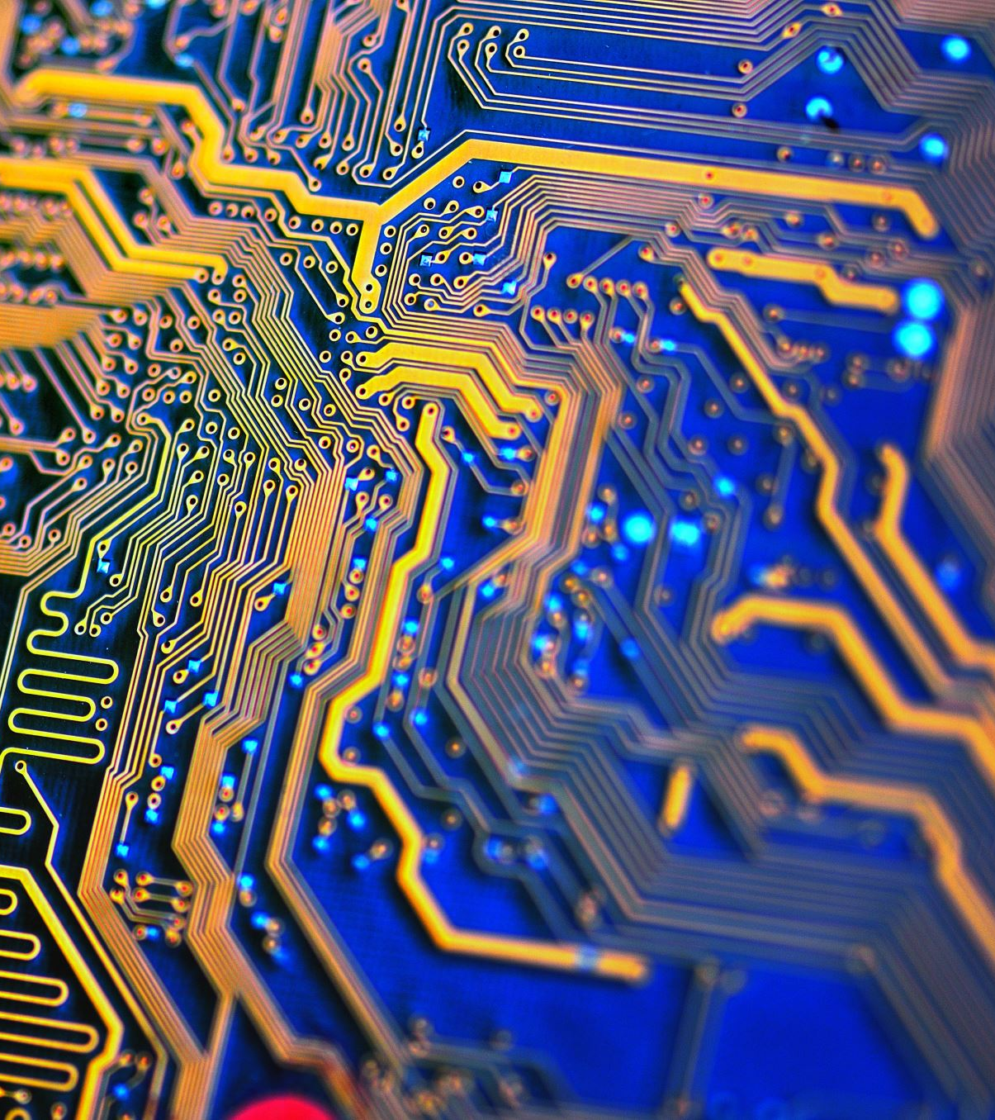
Hardware

Slide 9
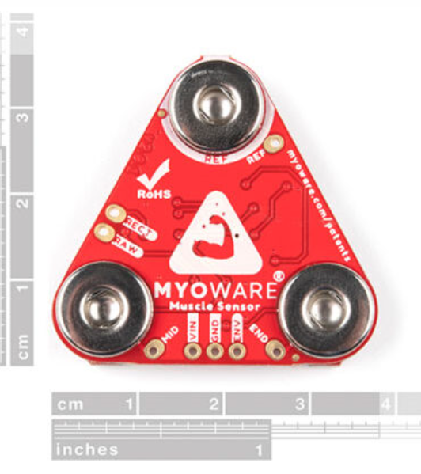
Sensor
https://myoware.com/products/muscle-sensor/
“MYOWARE 2.0 Muscle Sensor measures muscle activity through the electric potential of the muscle, commonly referred to as surface electromyography (EMG or sEMG for short). When your brain tells your muscle to flex, it sends an electrical signal to your muscle to start recruiting motor units (the bundles of muscle fibers that generate the force behind your muscles).”
“Note: MyoWare and the Muscle Sensor are not intended for use in the diagnosis of disease or other conditions, or in the cure, mitigation treatment, or prevention of disease, in a man or other animals.”

Slide 10
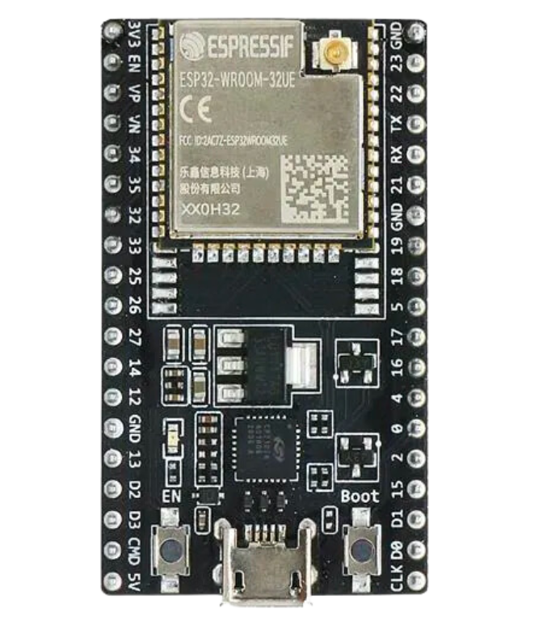
ESP32
Development board for prototyping circuits and projects
Key Features:
Wifi & Bluetooth
Breadboard Friendly
Connects with AWS (FREERTOS)

Slide 11
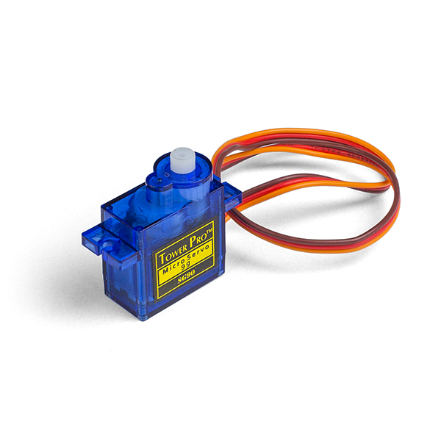
Servo
Small 9g servos
Use plastic gears
Fit in palm of hand

Slide 12
Software

Slide 13
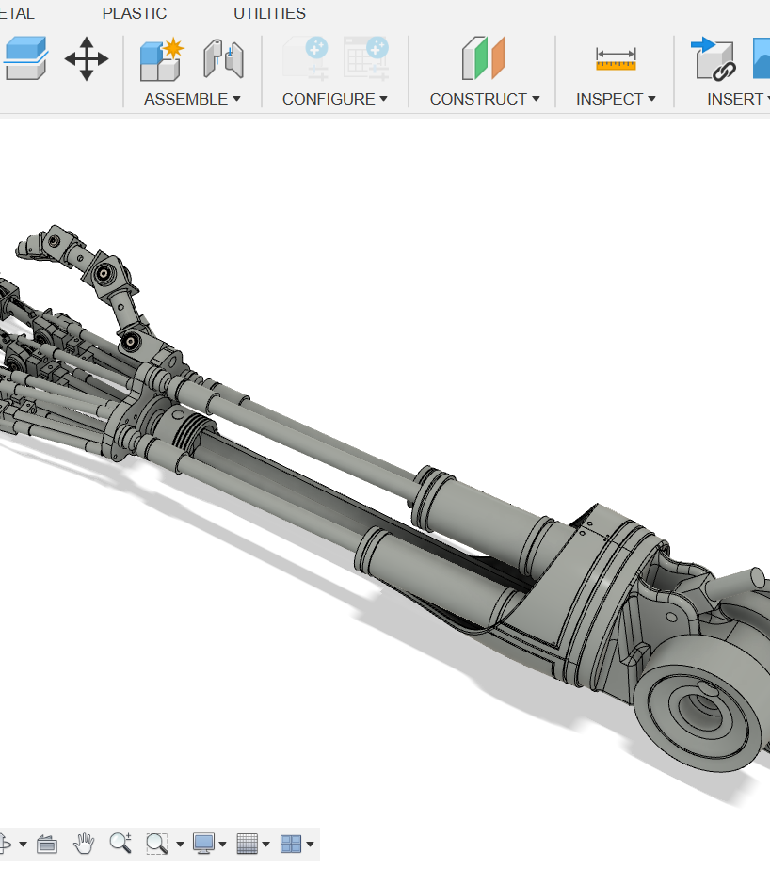
Fusion 360
File Taken from GrabCad
Edits must be made so it functions as a prosthetic
Parts do not fit together (must edit to incorporate screws and threaded inserts)

Slide 14
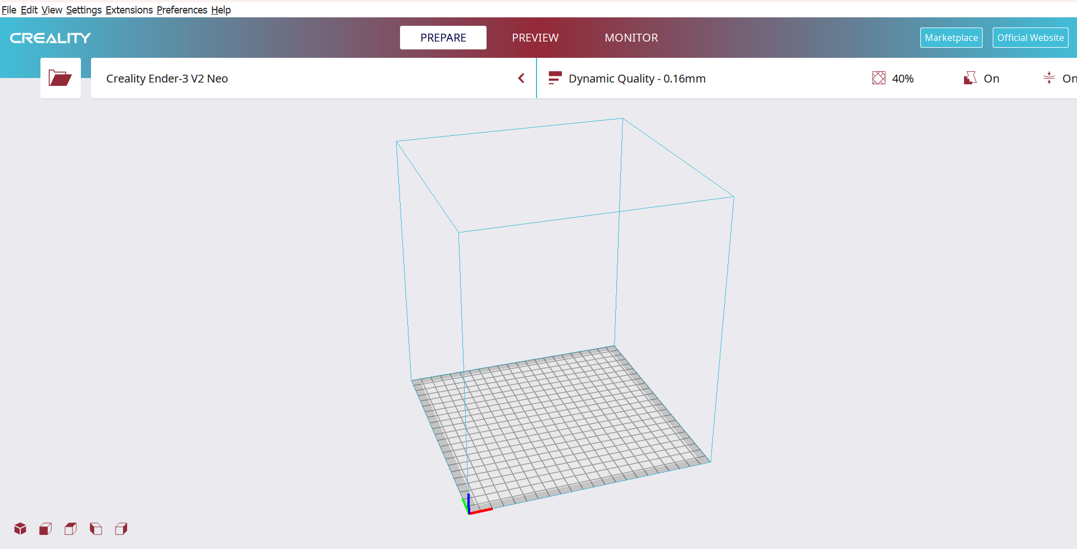
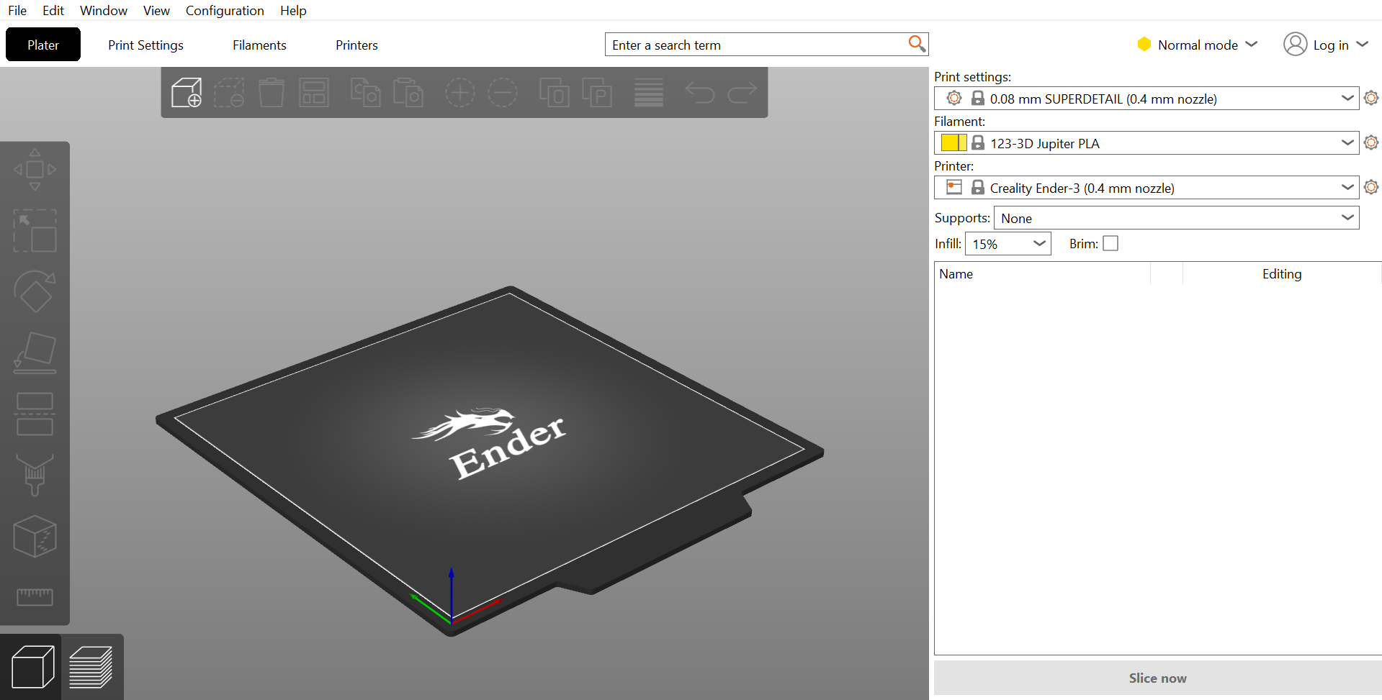
Slicing Software
Used for turning fusion 360 files into gcode for 3d Printing

Slide 15
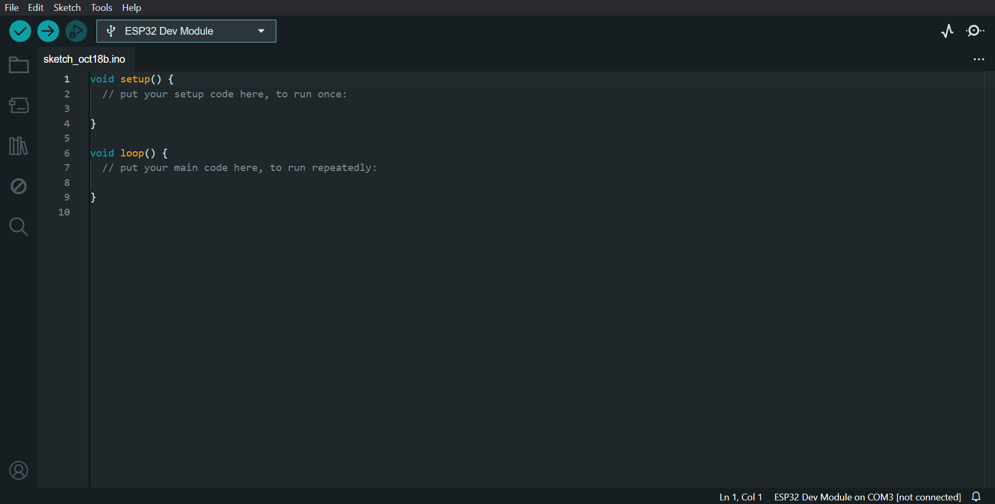
Arduino IDE
Used for programming ESP32

Slide 16
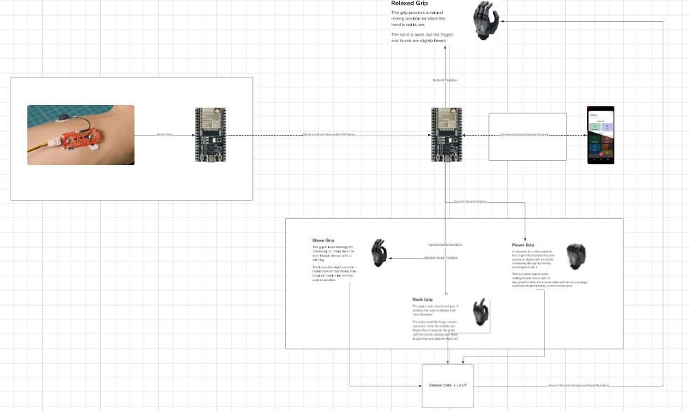
Prosthetic Hand Gesture Flow Chart
https://lucid.app/lucidchart/d1b3ad20-2382-4677-aced-4cb23cfde9be/edit?viewport_loc=-1664%2C-943%2C5346%2C2156%2C0_0&invitationId=inv_00010740-8333-48ab-8778-3adf66b9e8c1

Slide 17
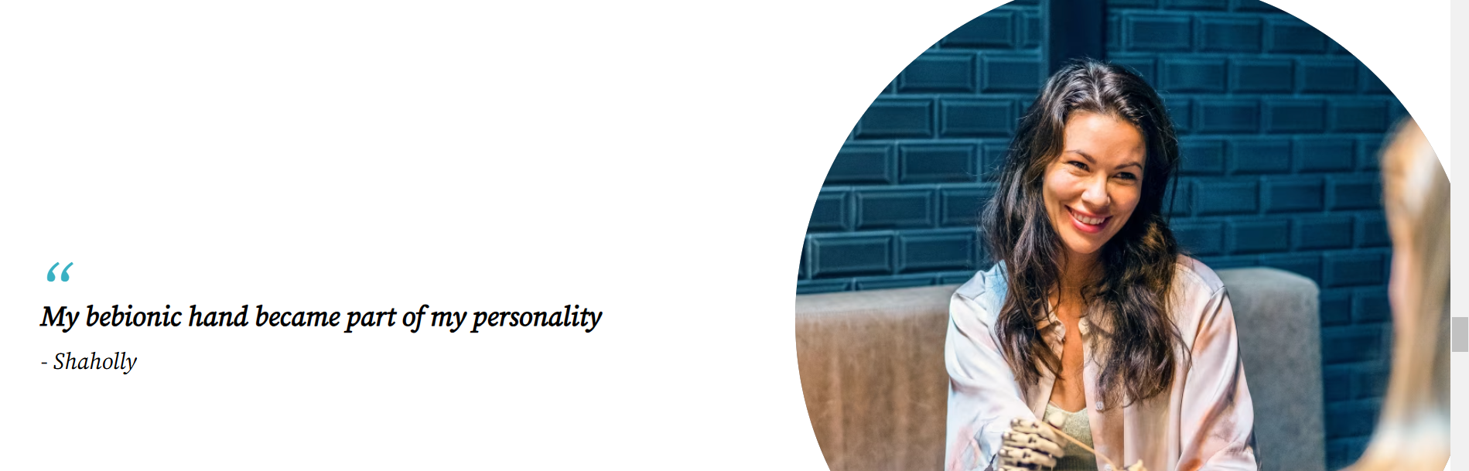
More on similar Companys
https://www.ottobock.com/en-sc/prosthetics/upper-limb-prosthetics/bebionic
“Each wrist option offers a varying degree of motion, helping to reduce shoulder pain from overcompensation.”
https://www.youtube.com/watch?v=tCAgGVcxrb8

