Slide 1

MUSIC STORE
SHANELLE HAYE

Slide 2
OBJECTIVE
Create a Music Store site.
Including: a home page, products page, orders page, shopping cart, login, log out, contact us.
The user will be able to view the product on a separate page, add the item to their cart and purchase their item. While logged in they can view their order history.

Slide 3
TOOLS
VISUAL STUDIO COMMUNITY
ASP.NET CORE
C#
REACT FRAMEWORK

Slide 4
USER FLOW
HOME
PRODUCTS
CART
ORDERS
LOGOUT
LOGIN/REGISTER
CONTACT US
ABOUT US
PRODUCT PAGE

Slide 5
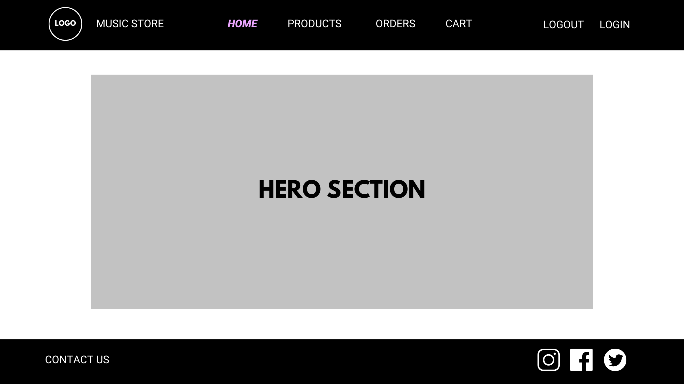
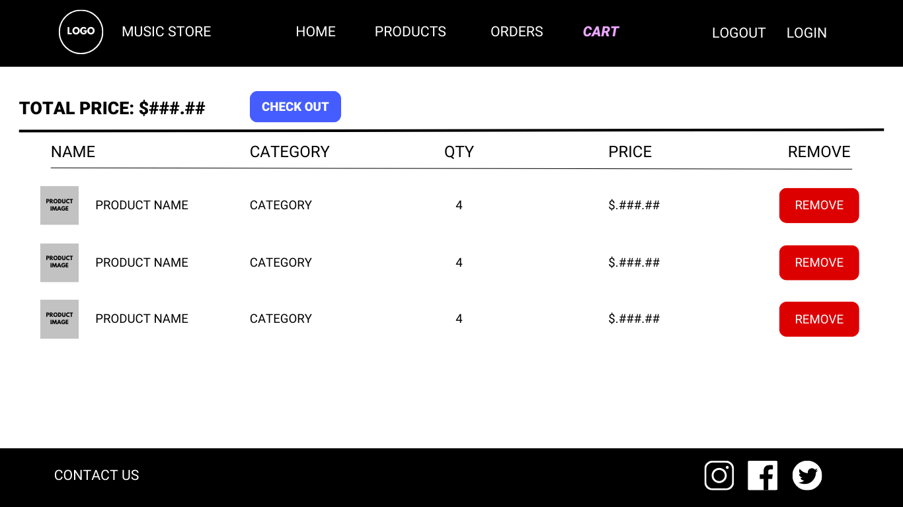
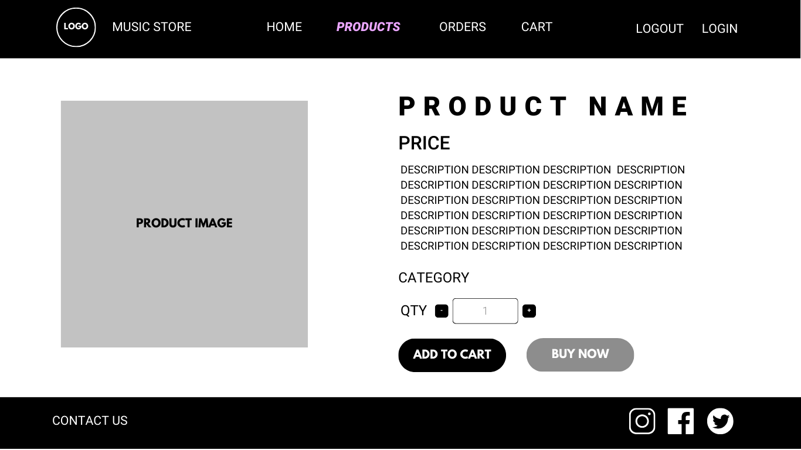
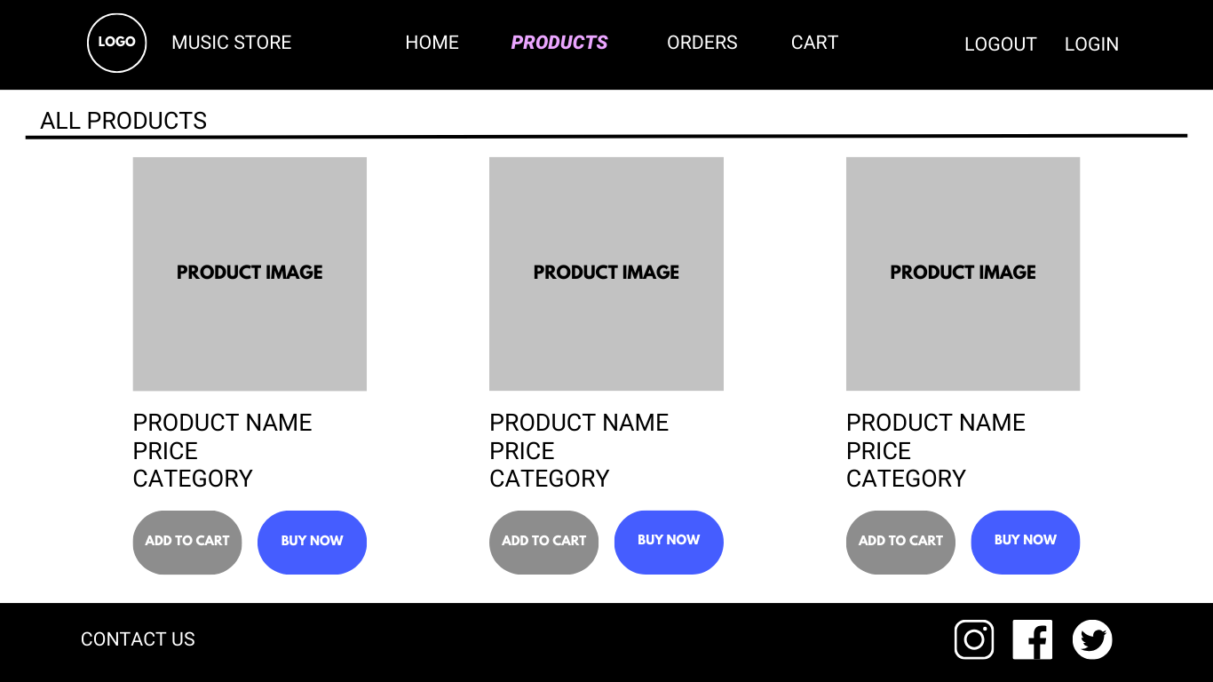
HOME PAGE
CART PAGE
PRODUCTS PAGE
PRODUCT PAGE

Slide 6
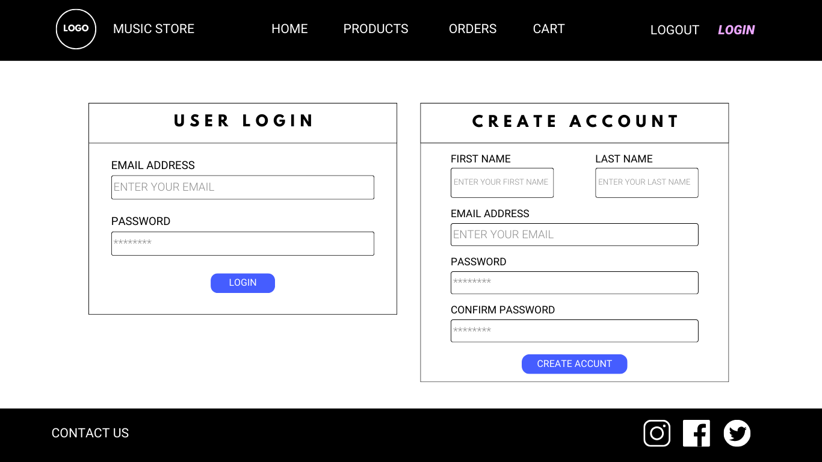
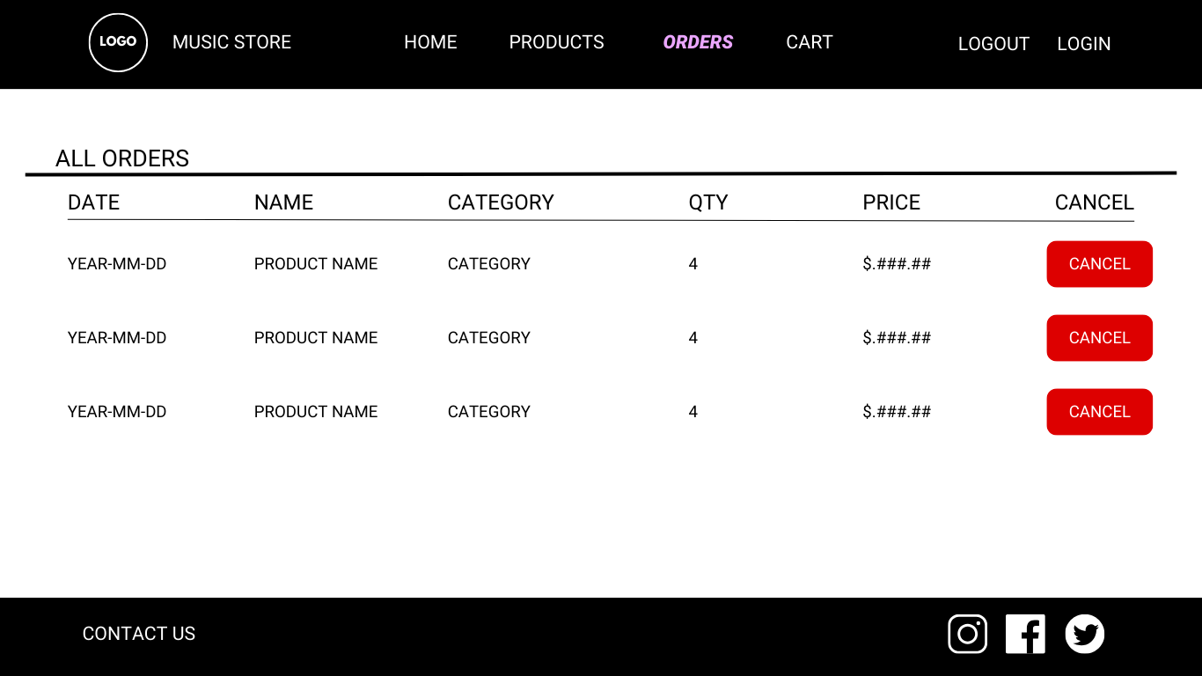
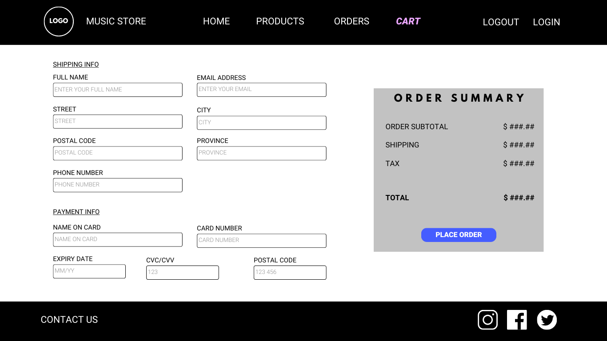
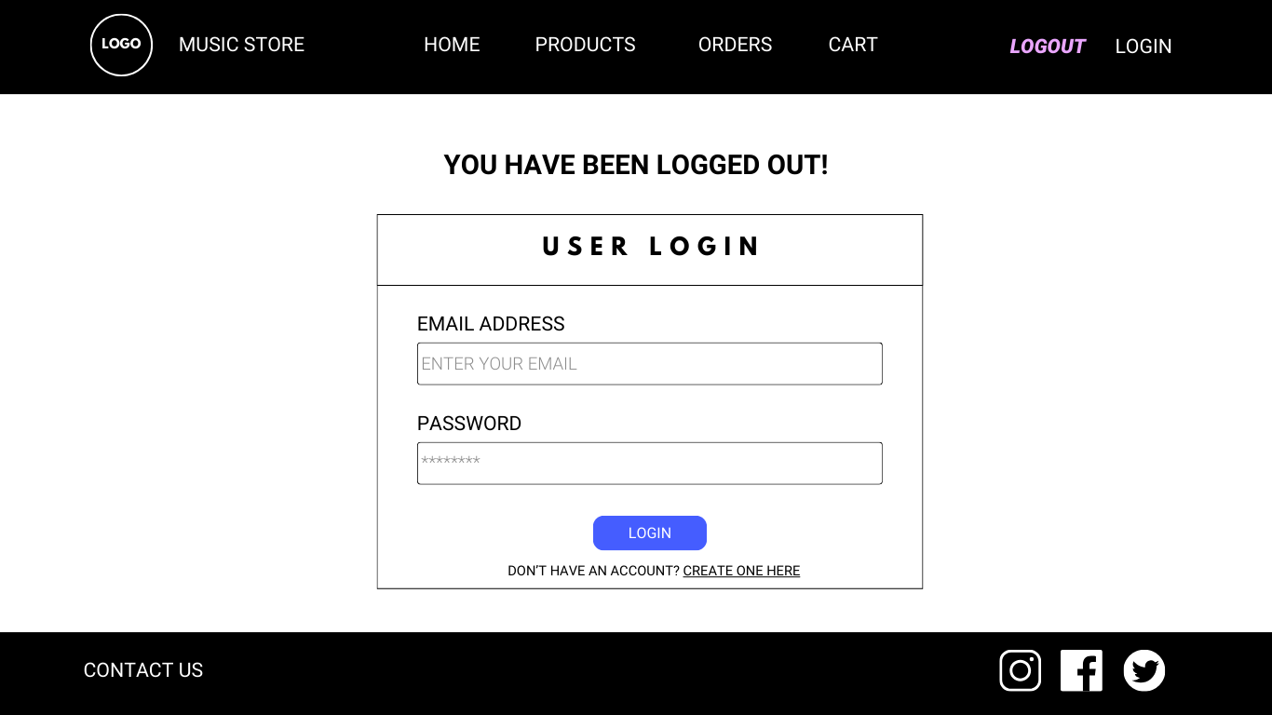
LOGIN PAGE
ORDERS PAGE
CART PAGE
LOGOUT PAGE

Slide 7
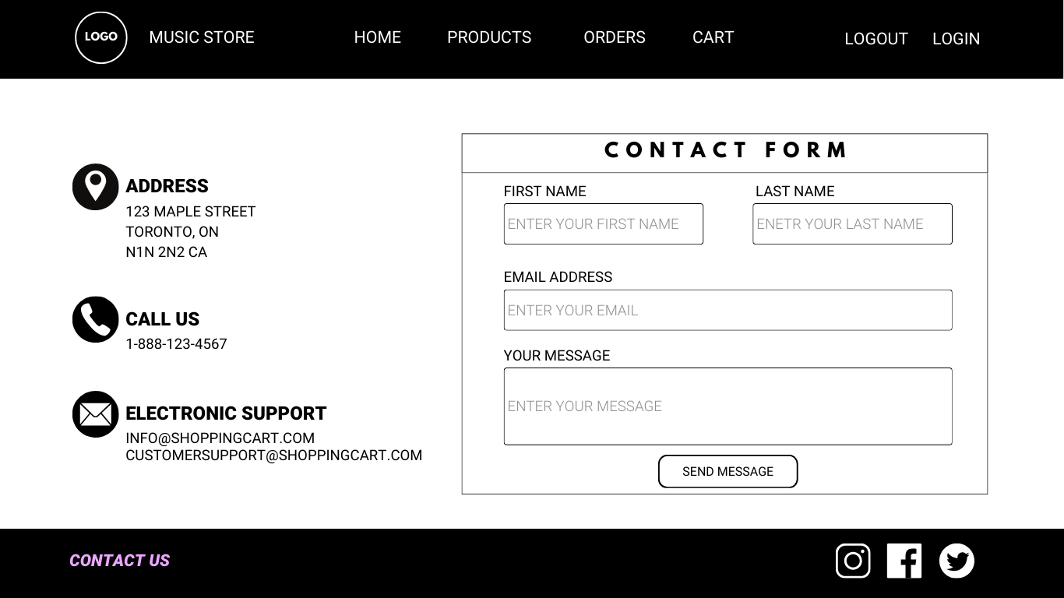
CONTACT PAGE

Slide 8
UML DIAGRAMS
UserDoa
+ createUser()
+ getUser()
+ updateUser()
+ deleteUser()
ProductDoa
+ getSingleProduct()
+ getTotalCartPrice()
+ getCartProducts()
+ getAllProducts()
OrderDoa
+ insertOrder()
+ userOrders()
+ cancelOrder ()
+ updateOrder()
Cart
- items: List<CartItem>
+ addToCart()
+ removeFromCart()
+ clearCart()
User - Class
- userId: int
- username: String
- password: Strin
- email: String
- role: UserRole
Product - Class
- productId: int
- name: String
- category: String
- price: double
Order - Class
- orderId: int
- userId: int
- status: OrderStatus
- date: String
- items: List<CartItem>
Cart - Class
- productId: int
- quantity: int
- price: double

Slide 9
DATABASE DIAGRAMS
Orders
- OrderID PK
- PurchaseID
- UserID FK
- OrderQuantity
- OrderDate
Users
- UserID PK
- Name
- Email
- Password
Products
- ProductID PK
- Name
- CategoryID FK
- Price
- Image
Categorgies
- CategoryID PK
- Name
- Category
Messages
- MessageID PK
- Name
- Category

