Slide 1
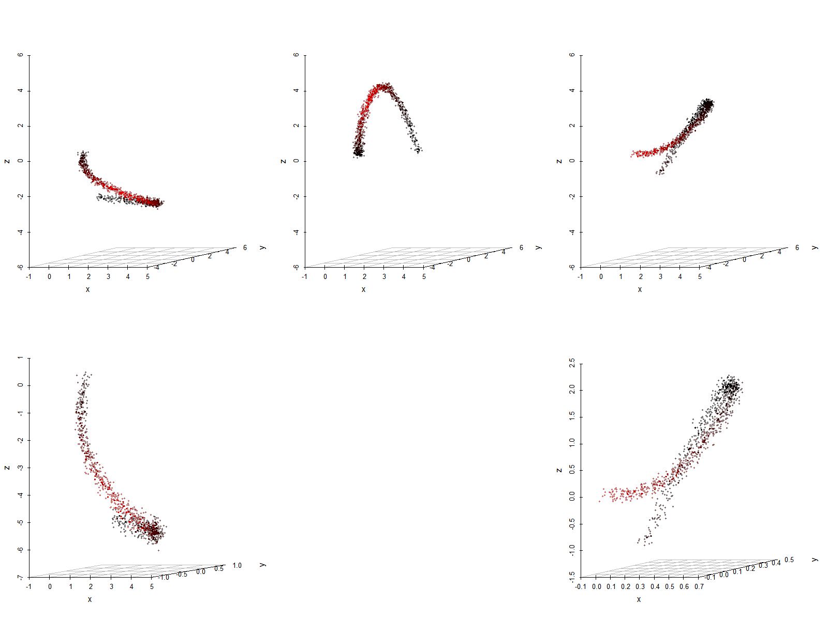

Slide 2
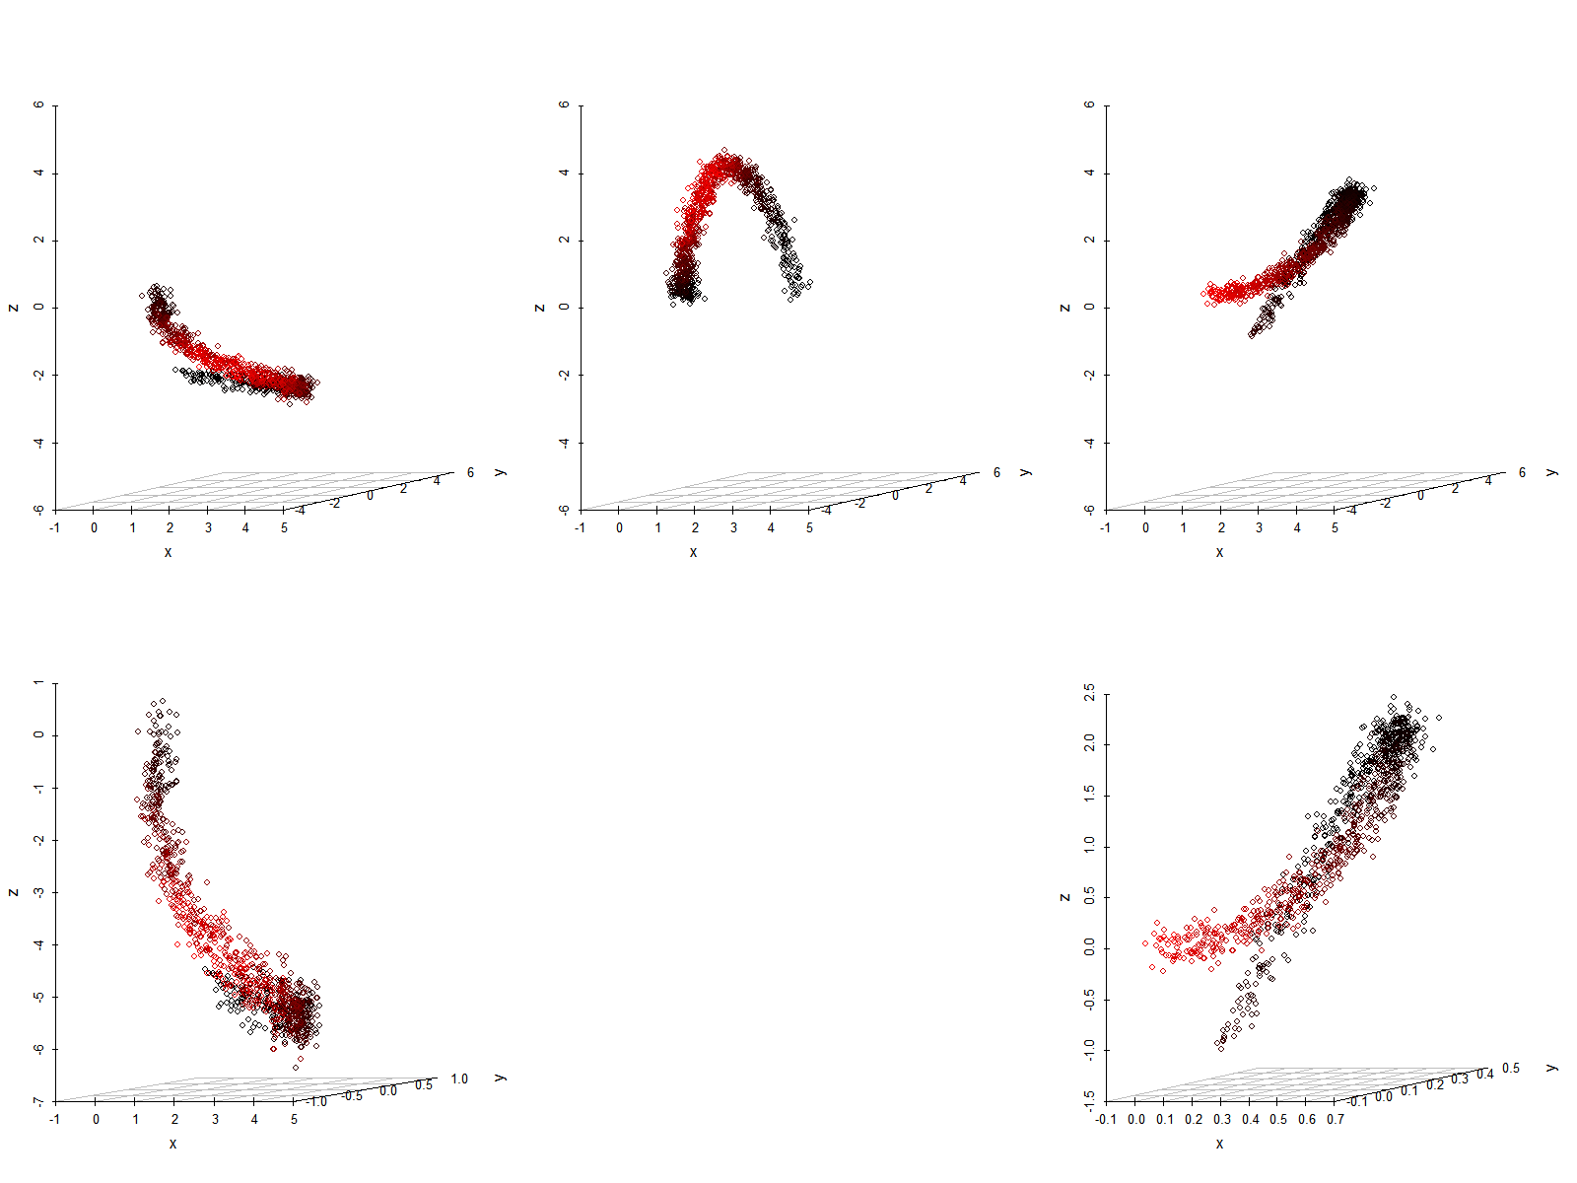
State 2 Projection
State 1
State 3 Projection
State 2 Scaling
State 3 Scaling

