Slide 1
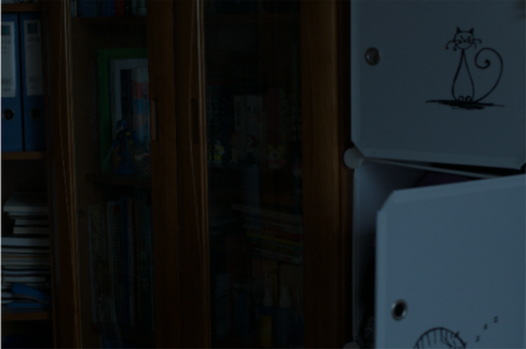
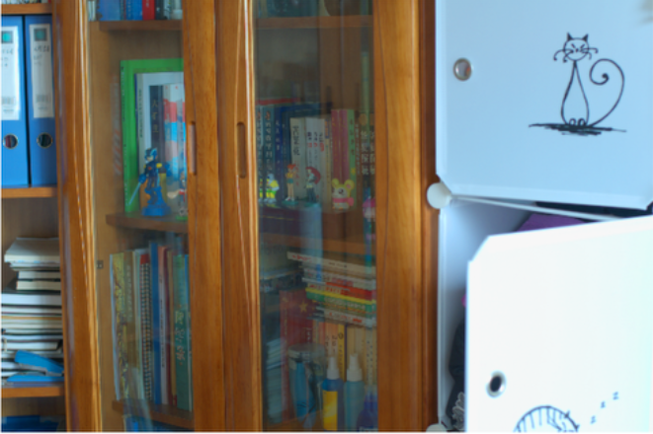
EC601 / SPRINT 1
Fidelity-Aware
Low-Light Image
Enhancement
LOW LIGHT
A prototype for enhancement and
spatial reliability assessment
REFERENCE
TEAM Fidelity-Aware LLIE • MEMBER Shangde Liu
Notes:
Good afternoon. I am Shangde Liu, and I am working individually on Fidelity-Aware Low-Light Image Enhancement. My project explores not only how to make a dark image more visible, but also how to assess which parts of an enhanced result may need extra inspection. Today I will show what I built in Sprint 1, what the experiment taught me, and what I plan to do next.

Slide 2
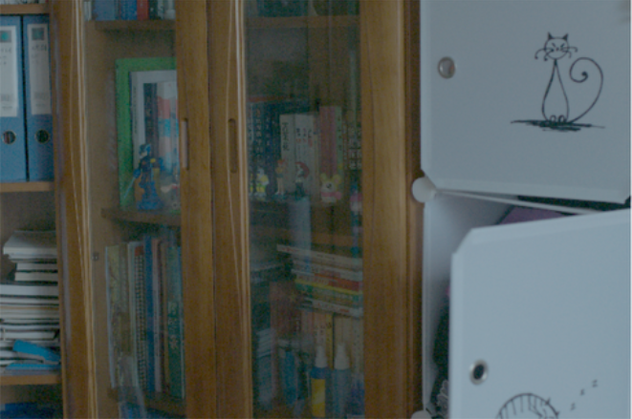
02 / MISSION
Enhance the image. Question the result.
Primary user / photographers editing underexposed images
OUR MISSION
Help photographers enhance low-light images while indicating which regions of the result may be less reliable.
INPUT
ENHANCED
THE RESEARCH QUESTION
Can a spatial indicator flag regions that deserve closer inspection?
No claim of pixel-level truth: the indicator is an experimental proxy.
EC601 / FIDELITY-AWARE LLIE
02 / 07
Notes:
My mission is to help photographers enhance low-light images while providing information about regions that may be less reliable. As a photographer, I know that a brighter picture is not always a more faithful picture. Enhancement may amplify noise or introduce plausible-looking details. My research question is whether a spatial indicator can help us decide where to inspect the output more carefully. At this stage, I am not claiming that the indicator proves which pixels are correct.

Slide 3
03 / USER STORIES
Five stories. One end-to-end workflow.
Sprint 1 touched all five stories; three are implemented in the initial prototype.
01
Load paired low-light images
DONE
Input and reference load successfully
02
Enhance a low-light image
IN PROGRESS
Gamma works; stronger LLIE pending
03
Generate output sensitivity
DONE
Controlled input perturbation
04
Visualize image and maps
DONE
Aligned six-panel comparison
05
Validate indicator vs. error
IN PROGRESS
One-image pilot; multi-image next
EC601 / FIDELITY-AWARE LLIE
03 / 07
Notes:
I defined five user stories. First, load a low-light image. Second, enhance it. Third, generate an output-sensitivity indicator. Fourth, visualize the results. Finally, validate the indicator against paired reference data. Sprint 1 touched all five. Image loading, the initial sensitivity map, and visualization are working. Enhancement and validation remain in progress because gamma correction is only a basic baseline, and the validation so far covers one image.

Slide 4
04 / TOOLS
A small, reproducible local pipeline.
Each tool has a clear purpose; no paid API or cloud dependency.
PYTHON
NUMPY
PILLOW
Pipeline and evaluation
Pixel-level arrays + statistics
Image loading and saving
MATPLOTLIB
LOL DATASET
GITHUB + VS CODE
Maps and comparisons
Paired low / reference images
Version control and workflow
INITIAL ENHANCEMENT BASELINE
Gamma correction (γ = 0.4) • not a trained LLIE model
EC601 / FIDELITY-AWARE LLIE
04 / 07
Notes:
The implementation is intentionally lightweight. I use Python for the pipeline, NumPy for pixel calculations and correlations, Pillow for image input and output, and Matplotlib for visualization. The LOL dataset provides paired low-light and normal-light images for reference-based evaluation. GitHub and VS Code support reproducibility and project management. Everything currently runs locally. Gamma correction is my first baseline, not a state-of-the-art low-light enhancement model.

Slide 5
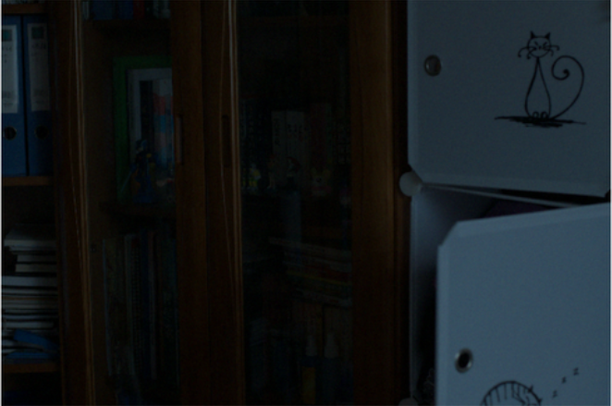
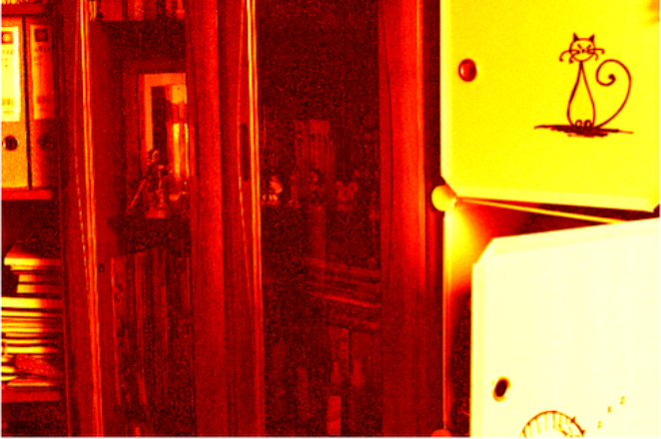
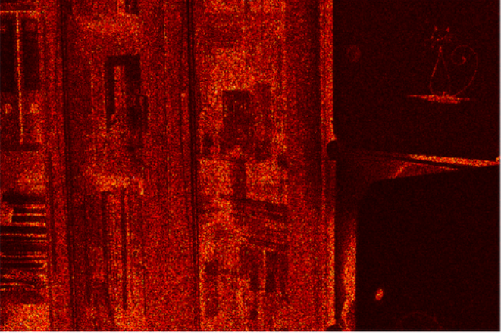
05 / PROGRESS — SHOW, DON’T TELL
The prototype runs end to end.
Actual LOL evaluation image • gamma baseline • controlled Gaussian perturbation
ONE-IMAGE PILOT
−0.564
SENSITIVITY ↔ ERROR
LOW-LIGHT INPUT
PERTURBED INPUT
GAMMA ENHANCEMENT
+0.569
SENSITIVITY ↔ DARKNESS
−0.969
ERROR ↔ DARKNESS
NORMAL-LIGHT REFERENCE
REFERENCE ERROR MAP
OUTPUT SENSITIVITY MAP
3 focal papers: SID · Retinex-Net · MR. Illuminate
Pilot only — one image, one perturbation realization; not a validated reliability result.
EC601 / FIDELITY-AWARE LLIE
05 / 07
Notes:
Here is the working prototype, using a real paired image from the LOL evaluation set. The top row shows the low-light input, a slightly perturbed input, and gamma enhancement. The bottom row shows the normal-light reference, a reference-error map, and an output-sensitivity map. I compute reference error by comparing the enhanced result with the paired reference. Sensitivity comes from the difference between enhanced outputs before and after a small input perturbation. In this single-image pilot, sensitivity versus error had a correlation of negative zero point five six four. Sensitivity versus darkness was positive zero point five six nine, and error versus darkness was negative zero point nine six nine. I also studied three focal papers: SID, Retinex-Net, and MR. Illuminate. One key insight is that better-looking enhancement does not guarantee faithful recovery.

Slide 6
06 / WHAT I LEARNED
A useful-looking map can measure the wrong thing.
The first experiment challenged our original assumption.
INITIAL HYPOTHESIS
OBSERVATION
Higher output sensitivity
may indicate larger enhancement error.
Sensitivity and error were negatively correlated in the pilot; brightness is a likely confound.
WHAT CHANGED
A correlation is not enough. First ask whether the reference-error target is valid — then test whether sensitivity adds information beyond brightness.
Important: r = −0.969 comes from one image; it is a warning sign, not a dataset-wide conclusion.
EC601 / FIDELITY-AWARE LLIE
06 / 07
Notes:
The most important lesson surprised me. I initially expected regions with high output sensitivity to also have high enhancement error. But the first test showed a negative sensitivity-error correlation. Sensitivity was also related to darkness. This suggests that the map may reflect the gamma operator or image brightness rather than fidelity. A second lesson came from reviewing the plan with ChatGPT and Claude. We realized that even the reference-error map is only a proxy, because paired images may differ in color, exposure, or alignment. So my next test must ask whether sensitivity adds information beyond brightness, and whether the reference-based target is appropriate. These are preliminary observations, not general conclusions.

Slide 7
07 / SPRINT 2 GOALS
From a working prototype to a falsifiable test.
Next two weeks / one reproducible evaluation and a clear pivot decision
01
EVALUATE
CURRENT BLOCKER
Run on multiple LOL image pairs
Choosing a robust LLIE baseline and checking whether reference error is a meaningful target.
02
COMPARE
Sensitivity vs. darkness; two perturbation strengths
03
STRENGTHEN
Try one reproducible pretrained LLIE model
SPRINT 2 DEMO SENTENCE
Show a reproducible multi-image evaluation and decide whether sensitivity adds value beyond brightness.
EC601 / FIDELITY-AWARE LLIE
07 / 07
Notes:
For Sprint 2, I will focus on validation rather than polishing the visualization. First, I will run the pipeline on multiple LOL image pairs. Second, I will compare sensitivity with a darkness-only baseline, including more than one perturbation strength. Third, I will try to integrate one reproducible pretrained low-light enhancement model. My current challenge is choosing that model and deciding how to interpret reference-based error when the paired reference is imperfect. At the end of two weeks, I want to show a reproducible multi-image evaluation and make a clear decision: continue with sensitivity if it adds value beyond brightness, or pivot if it does not. Thank you.

