Slide 1
Early Warning System for Defaults
Group H
呂辰祐412410075
易威丞410410090

Slide 2
Dataset
•Dataset: Home Credit Default Risk (Kaggle)
•Multi-table structure (7 tables)
–application, bureau, credit_card_balance, etc.
•Preprocessing
–Multi-table join via SK_ID_CURR
–Feature construction:
•Late payment rate (last 6 months)
•Credit usage trend (slope)
•Data cleaning
–Handle anomalies (e.g., DAYS_EMPLOYED = 365243)
–Missing value imputation

Slide 3
Techniques & methods
LightGBM
XGBoost
CatBoost

Slide 4
Expect experimental results
•Evaluation Metrics
•Confusion Matrix
•ROC Curve (AUC)
•Precision-Recall Curve (focus on Recall)

Slide 5
Final Project 25%
• Motivation (10%) • Original and Innovation • Practical Application
• Method (20%) • Suitability of the Method for the Data • Completeness of the Approach
• Experiments (20%) • Completeness of Experimental Data • Visualization of Experimental Results
• Conclusion and Analysis (20%) • Reasonable discussion • How to overcome difficulties
• Presentation (20%) • Completeness of Report Content • Clarity of Presentation
• Others (10%) • Alignment with the Proposal • Answer question clearly
• Dataset (20%) • Dataset Complexity • Data Preprocessing
Total 120%

Slide 6
Motivation
Credit default risk prediction is an important problem in financial decision-making.
Home Credit Default Risk: This dataset is complex(7 tables), realistic, and suitable for a complete ML pipeline.

Slide 7
Method
model :
LightGBM
XGBoost
CatBoost
baseline: only main table (application_train)
keep asking Gemini how to reach AUC score 0.8 (first place on kaggle leaderboard)
adding more feature step by step
check the AUC-ROC score

Slide 8
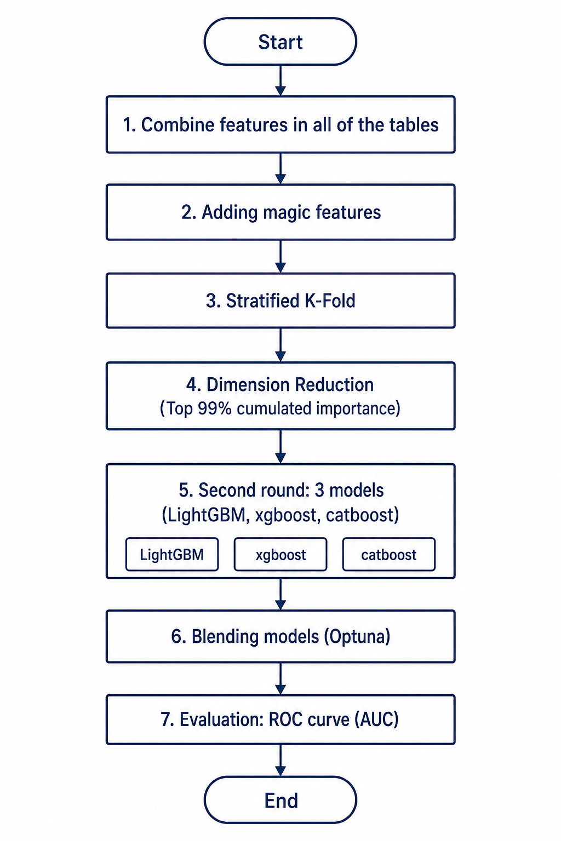
Method
Notes:
Combine features in all of the tables
Adding magic features
Stratified K-Fold (你採用了 Stratified K-Fold（分層交叉驗證），就是為了在極度不平衡的標籤下，維持本地驗證（CV）的穩定度，這方向完全正確。 )
Dimension Reduction (Top 99% cumulated importance)
Second round: 3 models (LightGBM, xgboost, catboost)
Blending models (Optuna)
Evaluation: ROC curve (AUC),same as Home Credit Default Risk competition. In addition, performing PR curve since the labels in original dataset are extremely imbalanced.

Slide 9
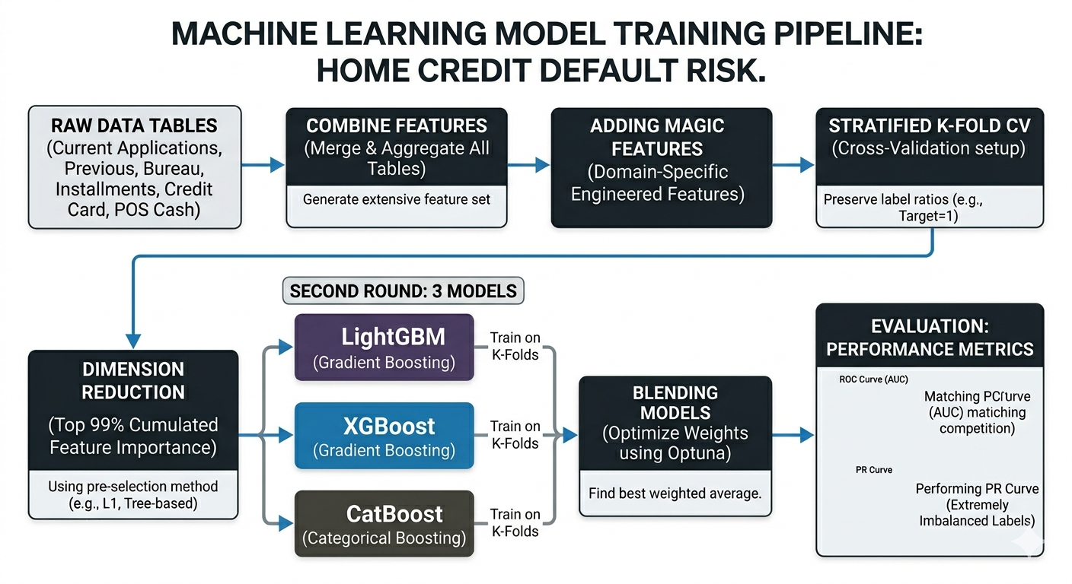
Method
Combine features in all of the tables
Adding magic features
Stratified K-Fold
Dimension Reduction (Top 99% cumulated importance)
Second round: 3 models (LightGBM, xgboost, catboost)
Blending models (Optuna)
Evaluation: ROC curve (AUC),same as Home Credit Default Risk competition. In addition, performing PR curve since the labels in original dataset are extremely imbalanced.
Notes:
Combine features in all of the tables
Adding magic features
Stratified K-Fold (你採用了 Stratified K-Fold（分層交叉驗證），就是為了在極度不平衡的標籤下，維持本地驗證（CV）的穩定度，這方向完全正確。 )
簡單直接地說：Fold 數（折數）直接影響的是模型「看資料的完整度」以及「最終預測的穩定度」。
在機器學習中，我們常聽到的 K-Fold 交叉驗證（Cross Validation），就是把訓練資料像切蛋糕一樣，平均切成 $K$ 塊（Folds）。
當你把 Fold 數從 5-Fold 調整到 10-Fold 時，會在底層引發以下三大核心轉變：
1. 模型單次訓練「看過的資料量」變多了（更聰明）
5-Fold：每次訓練時，模型拿 80% 的資料來學習，留 20% 當驗證集。
10-Fold：每次訓練時，模型拿高達 90% 的資料來學習，只留 10% 當驗證集。
💡 風控賽事的硬核邏輯：
在 Home Credit 這種高度不平衡的資料集中（違約的人極少，大約僅 8%），資料量越大，模型能抓到的「極端壞蛋特徵」就越精準。當你讓模型單次訓練多看 10% 的資料，它對黑天鵝事件的防禦力就會顯著提升。
Dimension Reduction (Top 99% cumulated importance)
Second round: 3 models (LightGBM, xgboost, catboost)
Blending models (Optuna)
Evaluation: ROC curve (AUC),same as Home Credit Default Risk competition. In addition, performing PR curve since the labels in original dataset are extremely imbalanced.

Slide 10
Method
Combine features in all of the tables
Adding magic features
Stratified K-Fold
Dimension Reduction (Top 99% cumulated importance)
Second round: 3 models (LightGBM, xgboost, catboost)
Blending models (Optuna)
Evaluation: ROC curve (AUC),same as Home Credit Default Risk competition. In addition, performing PR curve since the labels in original dataset are extremely imbalanced.

Slide 11
Chart name | Description
application_{train|test} (main chart) | This is the primary data file, where each row represents a loan application. Target Variable (TARGET): A value of 1 indicates default, while 0 indicates that the borrower repaid on time without issues. Contents: The dataset includes the applicant’s demographic and financial information, loan-related characteristics, and external credit assessment scores.
bureau & bureau_balance | Historical credit records from other financial institutions, obtained from the credit bureau.
previous_application | Loan application history with Home Credit, including both approved and rejected.
POS_CASH_balance | Monthly phone bill usage or point-of-sale (POS) cash balances from past loans.
credit_card_balance | Monthly statements of credit card activity previously held by the applicant at Home Credit.
installments_payments | Actual repayment records of past loans, which can be used to determine whether payments were made late or partially (i.e., underpaid).
Notes:
核心數據：這是最主要的檔案。每一行代表一個貸款申請案。 目標變數 (TARGET)：1 代表違約（有還款困難），0 代表正常按時還款。 內容：申請人的基本資料（年齡、性別、職業、收入）、貸款行為（貸款金額、年金）以及外部評分。
包含申請人在其他金融機構過往的信用紀錄（來自信用局 Credit Bureau）
申請人過去在 Home Credit 的所有貸款申請歷史（不論最後是核准還是拒絕）。
過去貸款的每月通話費或銷售點（POS）現金餘額快照。
申請人過去在 Home Credit 持有的信用卡月度明細。
過去貸款的實際還款紀錄（可以看出有沒有遲到、少給錢）。

Slide 12
Experiments
=== 開始進行特徵重要性篩選 ===
--- 前 10 大核心特徵 (對預測違約最關鍵) ---
feature importance cumulative_importance
0 EXT_SOURCE_3 44885.387609 0.132849
1 EXT_SOURCE_2 43382.461914 0.261249
2 EXT_SOURCE_1 15710.935300 0.307749
3 DAYS_BIRTH 8791.091294 0.333768
4 PREV_CNT_PAYMENT_MEAN 5534.621908 0.350149
5 AMT_ANNUITY 5298.297277 0.365831
6 AMT_CREDIT 5248.410231 0.381365
7 AMT_GOODS_PRICE 4988.308230 0.396129
8 DAYS_EMPLOYED 4647.467375 0.409884
9 PREV_NAME_CONTRACT_STATUS_Refused_MEAN 4565.145148 0.423395
總共有 72 個特徵的貢獻度完全為 0。
🎉 降維成功！特徵欄位數從 632 個 成功精簡至 406 個！
下一輪準備就緒！特徵形狀: (307511, 406)
bu+prev
(bureau + previous application before adding magic feature)

Slide 13
Experiments
final version
=== 開始進行特徵重要性篩選 ===
--- 前 10 大核心特徵 (對預測違約最關鍵) ---
feature importance cumulative_importance
0 MAGIC_EXT_SOURCES_MEAN 44577.958178 0.164677
1 MAGIC_EXT_SOURCES_MIN 16465.286496 0.225502
2 MAGIC_EXT_SOURCES_MAX 7913.668931 0.254736
3 MAGIC_ANNUITY_TO_CREDIT_RATIO 6087.959786 0.277225
4 EXT_SOURCE_3 4385.693044 0.293427
5 CC_6M_CC_LIMIT_USE_RATIO_MAX 4226.744103 0.309041
6 DAYS_BIRTH 4204.079051 0.324571
7 MAGIC_CREDIT_TO_GOODS_RATIO 4030.467817 0.339460
8 POS_6M_CNT_INSTALMENT_FUTURE_MEAN 3492.832447 0.352363
9 BUREAU_DAYS_CREDIT_MAX_y 2504.324166 0.361615
總共有 72 個特徵的貢獻度完全為 0。
🎉 降維成功！特徵欄位數從 632 個 成功精簡至 406 個！
下一輪準備就緒！特徵形狀: (307511, 406)
訓練集形狀: (307511, 632),
測試集形狀: (48744, 632)
Fold 1 AUC: 0.78487
Fold 2 AUC: 0.79321
Fold 3 AUC: 0.78543
Fold 4 AUC: 0.79072
Fold 5 AUC: 0.78362
整體 OOF AUC: 0.78747

Slide 14
Top 10 Features
Feature | Meaning | Importance
MAGIC_EXT_SOURCES_MEAN | Mean score from external data sources | 44577.958178
MAGIC_EXT_SOURCES_MIN | Min score from external data sources | 16465.286496
MAGIC_EXT_SOURCES_MAX | Max score from external data sources | 7913.668931
MAGIC_ANNUITY_TO_CREDIT_RATIO | 1 / Repayment period | 6087.959786
EXT_SOURCE_3 | Normalized score from external data source | 4385.693044
CC_6M_CC_LIMIT_USE_RATIO_MAX | Max credit usage rate in past 6 months | 4226.744103
DAYS_BIRTH | Client's age in days at the time of application | 4204.079051
MAGIC_CREDIT_TO_GOODS_RATIO | Down Payment Ratio | 4030.467817
POS_6M_CNT_INSTALMENT_FUTURE_MEAN | MEAN installments left in past 6 months | 3492.832447
BUREAU_DAYS_CREDIT_MAX_y | Latest (max) days before current application did client apply for Credit Bureau credit | 2504.324166

Slide 15
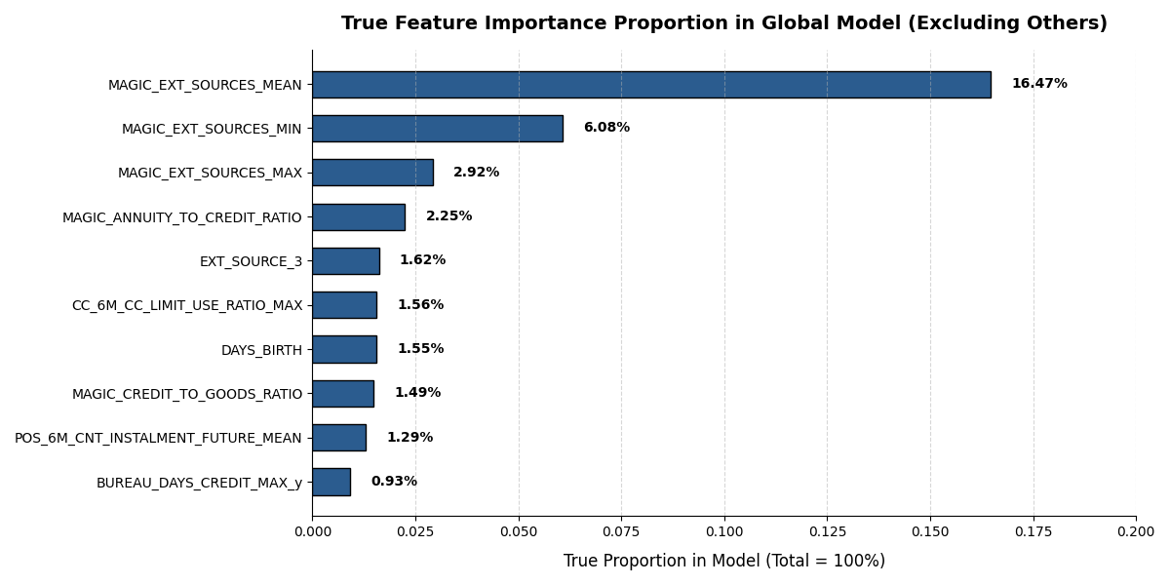
Top 10 Features

Slide 16
Magic feature in top 10
Related features
Feature | Description | Source
EXT_SOURCE_1 | Normalized score from external data source | main chart
EXT_SOURCE_2 | Normalized score from external data source | main chart
EXT_SOURCE_3 | Normalized score from external data source | main chart
Feature | Formula | Description
MAGIC_EXT_SOURCES_MEAN | mean (EXT_SOURCE_1, EXT_SOURCE_2, EXT_SOURCE_3) | -
MAGIC_EXT_SOURCES_MAX | max (EXT_SOURCE_1, EXT_SOURCE_2, EXT_SOURCE_3) | -
MAGIC_EXT_SOURCES_MIN | min (EXT_SOURCE_1, EXT_SOURCE_2, EXT_SOURCE_3) | -
Notes:
LightGBM 7th place solution

Slide 17
Magic feature in top 10
Related features
Feature | Description | Source
AMT_ANNUITY | Annuity of previous application | previous_application
AMT_CREDIT | Final credit amount on the previous application | previous_application
Feature | Formula | Description
MAGIC_ANNUITY_TO_ CREDIT_RATIO | AMT_ANNUITY / AMT_CREDIT | It can be interpret as the repayment rate (equivalent to the reciprocal of the loan term). A higher value indicates a shorter repayment period, meaning that the borrower faces greater repayment pressure in each installment.
Notes:
金融邏輯：還款速率（相當於借款期數的倒數）。當這個比值越高，代表還款期數越短，每一期的還款壓力就越大。 LightGBM 7th place solution

Slide 18
Magic feature in top 10
Related features
Feature | Description | Source
AMT_CREDIT | Final credit amount on the previous application | previous_application
AMT_GOODS_PRICE | Goods price of good that client asked for (if applicable) on the previous application | previous_application
Feature | Formula | Description
MAGIC_CREDIT_TO_ GOODS_RATIO | AMT_CREDIT / AMT_GOODS_PRICE | Measures the down payment ratio. If the approved loan amount is lower than the purchase price, the borrower has contributed part of the purchase cost as a down payment. Borrowers who are willing to make a down payment generally exhibit a significantly lower propensity to default.
Notes:
衡量頭期款比例（Down Payment Ratio）。如果核貸金額大於商品價格（差額為正，比率 $>1$），代表這筆貸款包含了其他消費性支出（信用套現）；若核貸金額低於商品價格，代表申請人自己出了一部分頭期款。願意出頭期款的客戶，違約意願通常顯著較低
LightGBM 7th place solution

Slide 19
Time window in top 10
Related features
Feature | Description | Source
MONTHS_BALANCE | Month of balance relative to application date | credit_card_balance
AMT_BALANCE | Balance during the month of previous credit | credit_card_balance
AMT_CREDIT_LIMIT_ACTUAL | Credit card limit during the month of the previous credit | credit_card_balance
Feature | Formula | Description
CC_6M | MONTHS_BALANCE >= -6 | Past 6 months
CC_LIMIT_ USE_RATIO | AMT_BALANCE / AMT_CREDIT_LIMIT_ACTUAL | Credit usage rate
CC_6M_CC_ LIMIT_USE_ RATIO_MAX | max CC_LIMIT_USE_RATIO in CC_6M | A customer with a previously healthy credit profile who suddenly begins to consistently max out their credit card limits over the past six months may be exhibiting early signs of financial distress. The point at which a borrower starts fully utilizing their available credit is often associated with a sharp increase in default risk.
Notes:
在銀行眼裡，一個本來好好的客戶，如果近半年突然連續把信用卡額度用到極限，往往是失業、經商失敗、或財務即將崩潰的前兆（即將破產）。樹狀模型非常喜歡這個特徵，因為刷爆卡的瞬間，往往就是違約風險飆高的起點。
Home Credit: Putting All the Steps Together

Slide 20
Time window in top 10
Related features
Feature | Description | Source
MONTHS_BALANCE | Month of balance relative to application date | POS_CASH_balance
CNT_INSTALMENT_FUTURE | Installments left to pay on the previous credit) | POS_CASH_balance
Feature | Formula | Description
POS_6M | MONTHS_BALANCE >= -6 | Past 6 months
POS_6M_CNT_INSTALMENT_FUTURE_MEAN | mean CNT_INSTALMENT_FUTURE in POS_6M | If this average value is high, it indicates that the borrower has accumulated multiple long-term debts over the past six months. Such a borrower has limited financial flexibility, and may substantially increase the likelihood of default.
Notes:
如果這個平均值很大（例如高達 20 幾期）：代表這客戶在過去半年內，身上背滿了剛借不久、而且需要還很久的中長期債務。他的財務黏滯性極高，未來兩三年內每個月都必須雷打不動地掏出錢來還債，只要未來稍微遇到一點景氣風吹草動，違約機率就會大幅大增
Home Credit: Putting All the Steps Together

Slide 21
Other features in top 10
Feature | Description | Source
EXT_SOURCE_3 | Normalized score from external data source | main chart
DAYS_BIRTH | Client's age in days at the time of application | main chart
BUREAU_DAYS_ CREDIT_MAX_y | Latest (max) days before current application did client apply for Credit Bureau credit | DAYS_CREDIT in bureau
Notes:
代表還款能力與社會穩定度：年齡是人口統計學中最關鍵的風控指標。
年輕人（20-25歲）：通常工作不穩定、儲蓄較少、流動性高，且缺乏長期的信用紀錄，違約風險相對較高。
中年人（35-50歲）：通常事業步入軌道、收入穩定、有家庭負擔，違約的機會成本（代價）非常高，因此還款意願最強、最穩定。
Represents repayment capacity and social stability: Age is one of the most important demographic variables in credit risk modeling.
Borrowers aged 20–25 typically have less stable employment, limited savings, higher labor mobility, and short or thin credit histories, which are associated with a higher default risk.
Borrowers aged 35–50 are generally more financially established, with stable income streams and family responsibilities. The opportunity cost of default is also higher for this group, leading to stronger repayment incentives and more stable credit behavior.
How many days before current application did client apply for Credit Bureau credit (negative value)
在信貸風控中，「最近一次申請貸款的時間」是一個極度敏感的危險指標。如果一個客戶在 7 天前或 2 星期前才剛在其他銀行申請過貸款（數值非常接近 0），今天又來申請，通常暗示了強烈風險: 資金鏈極度緊張：客戶此時此刻非常缺錢，才會短期內連續向不同機構申貸。
In credit risk modeling, the time since the most recent loan application is a highly sensitive risk indicator. If a customer applied for a loan at another financial institution just 7 days or 2 weeks ago (i.e., the value is very close to zero), and is applying again today, it often signals elevated risk. This pattern may indicate severe liquidity stress, where the borrower is actively seeking funds from multiple lenders within a short period due to urgent financial needs.

Slide 22
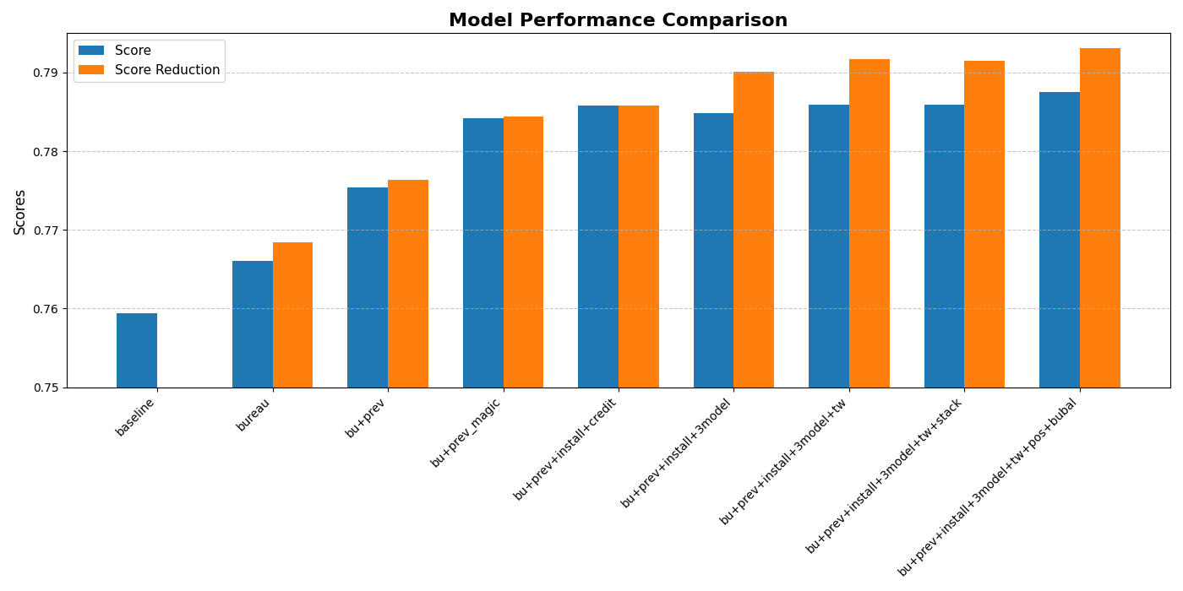
Experiments
Notes:
model, score, score_reduction
baseline, 0.75943,
bureau, 0.76602, 0.76844
bu+prev, 0.77540, 0.7764
bu+prev_magic, 0.78415, 0.78439 (adding magic)
bu+prev+install+credit, 0.78581, 0.78580
bu+prev+install+credit+3model, 0.78480, 0.79010 (3 model with fixed blending weight)
bu+prev+install+credit+3model+timewindow, 0.78590, 0.79171 (time window + Optuna)
bu+prev+install+credit+3model+timewindow+stacking, 0.78590, 0.79147 (time window + stacking)
(skip) bu+prev+install+credit+3model+timewindow+off, 0.78537, 0.79158
bu+prev+install+credit+3model+timewindow+pos+bubalance, 0.78747, 0.79313
important step: more feature, magic, blending model
final weight: LGB: 0.293, CAT: 0.397, XGB: 0.310, AUC: 0.79325
這完全符合預期！你觀察到了一個非常資深、只有老練的 Kaggle 玩家才會注意到的硬核現象：在模型數量很少（只有 3 個）且模型彼此都非常強大的情況下，簡單的線性權重搜尋（Optuna/Scipy）往往會擊敗 Stacking（Logistic Regression）
Optuna (SLSQP)：它不是機器學習模型，它只是一個「純數學優化器」。它唯一的目標就是看著整體的 OOF AUC，去微調那三個數字。它沒有截距（Bias），也沒有任何非線性的想像空間。
Logistic Regression：它有截距項，而且它試圖去擬合極大似然估計（Maximum Likelihood）。當特徵只有 3 個（LGB, CAT, XGB 的預測值）時，這個模型太容易在 OOF 資料集的某些局部樣本上過度擬合（Overfitting），導致整體的泛化 AUC 反而下降。
💡 Kaggle 金律：
當你只有 3~5 個模型時 $\rightarrow$ 用 Optuna 尋找權重 (Blending) 是無敵的。
當你手頭有 20~50 個模型（包含各種不同隨機種子的橡樹、神經網路、SVM）時 $\rightarrow$ Stacking 才能展現威力。

Slide 23
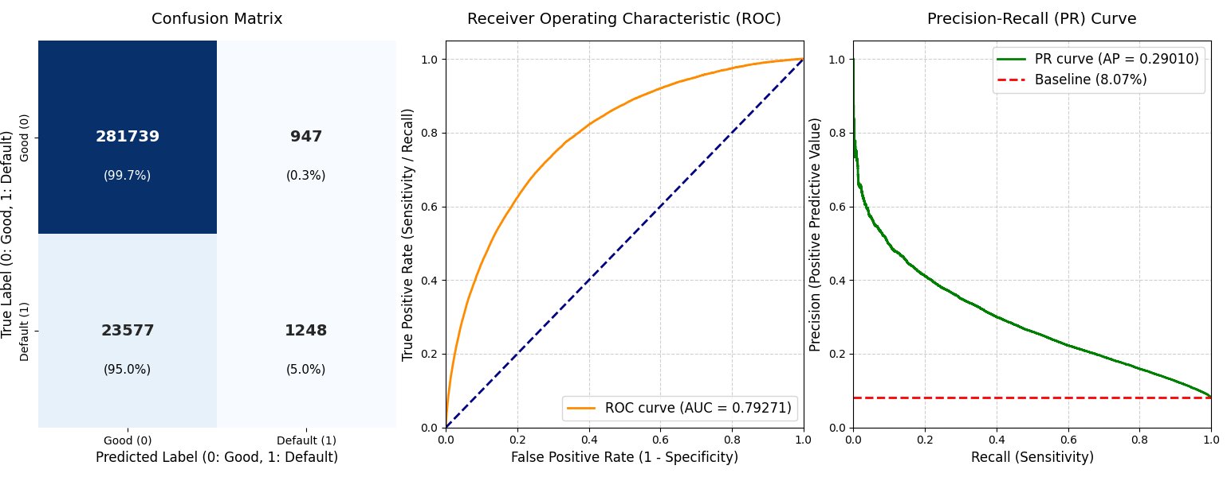
Experiments

Slide 24
Conclusion and Analysis
Difficulties | Solution
Too slow (xbg and cat) | Use gpu, increase learning rate and reduce max depth

Slide 25
Conclusion and Analysis
discussion:
score after feature reduction usually increase
the weight of blending found by Optuna not always the same
the score of Stacking is lower than Optuna
high ROC-AUC combined with low PR-AUC

Slide 26
source
Time Window, Stratified K-Fold: Kernel for my (relative) beginner's 561st place solo submission | Kaggle
EXT_SOURCES_MEAN / MIN / MAX: [DN] Home Credit Default Risk
MAGIC_ANNUITY_TO_CREDIT_RATIO、MAGIC_CREDIT_TO_GOODS_RATIO: LightGBM 7th place solution
BUREAU_DAYS_CREDIT_MAX_y: Introduction to Manual Feature Engineering
CC_6M_CC_LIMIT_USE_RATIO_MAX, POS_6M_CNT_INSTALMENT_FUTURE_MEAN Home Credit: Putting All the Steps Together

