Slide 1
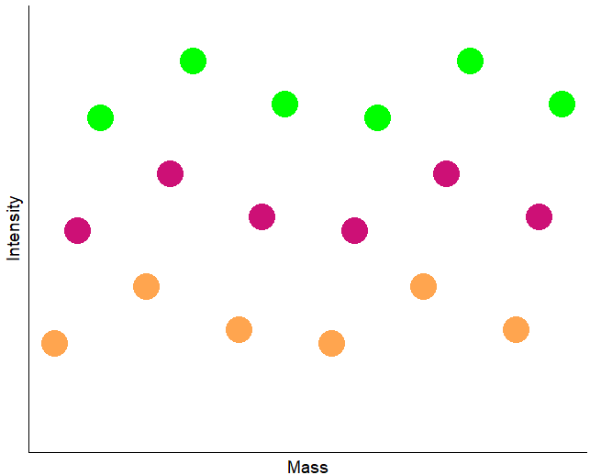

Slide 2
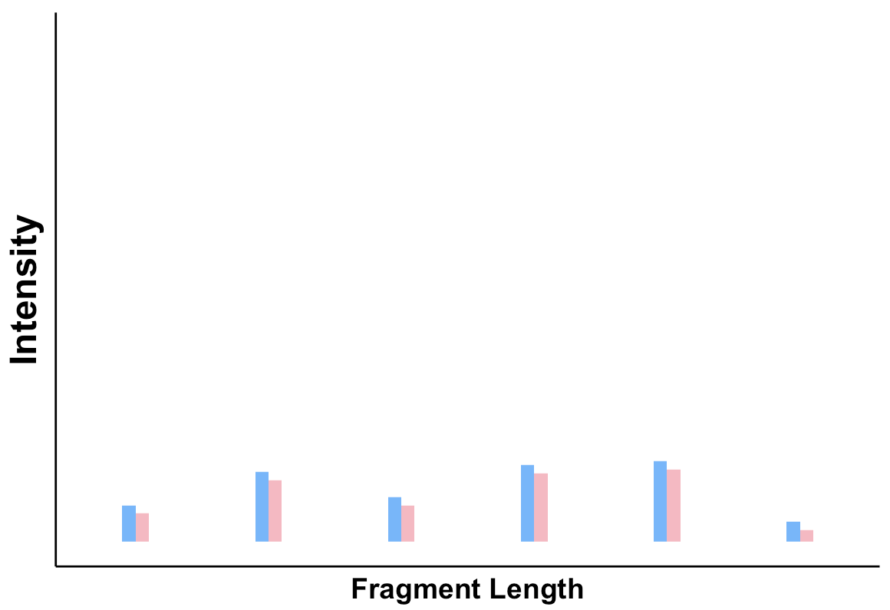
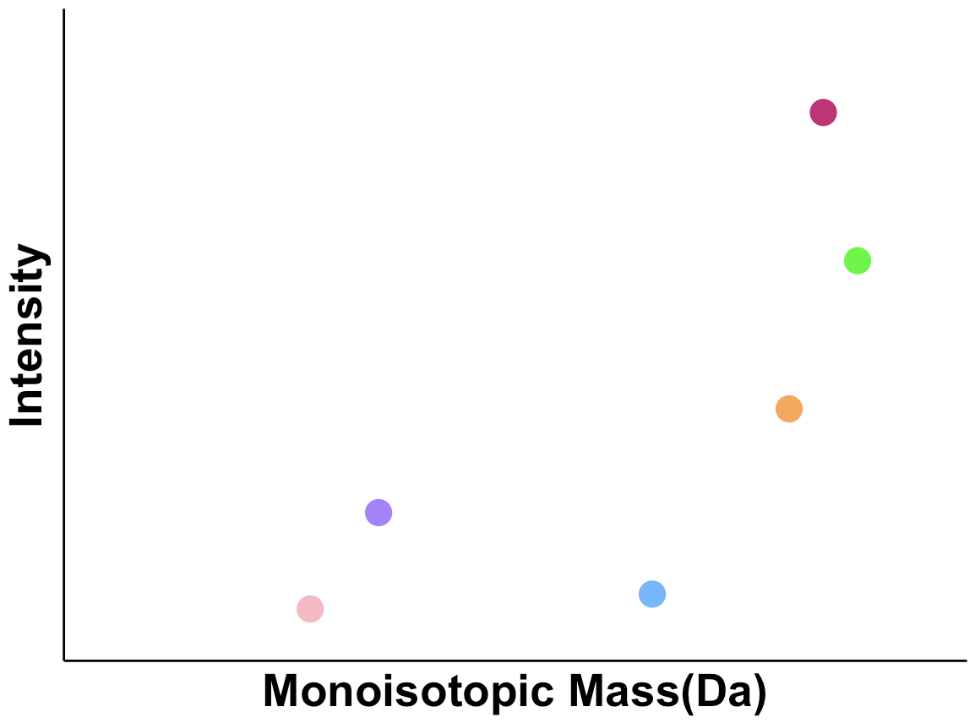
Control Runs
C1: no acid treatment
C2: add formic acid
LC-MS
Dots: different RNAs
: ~10% of the most abundant RNA intensity
Ladders were acquired layer-by-layer, ensuring the sequencing of all RNAs above exhaustion threshold
a: determine the number of RNAs and their relative abundances.
b: determine otimal experimental conditions
Mixture of RNAs with different abundances

Slide 3
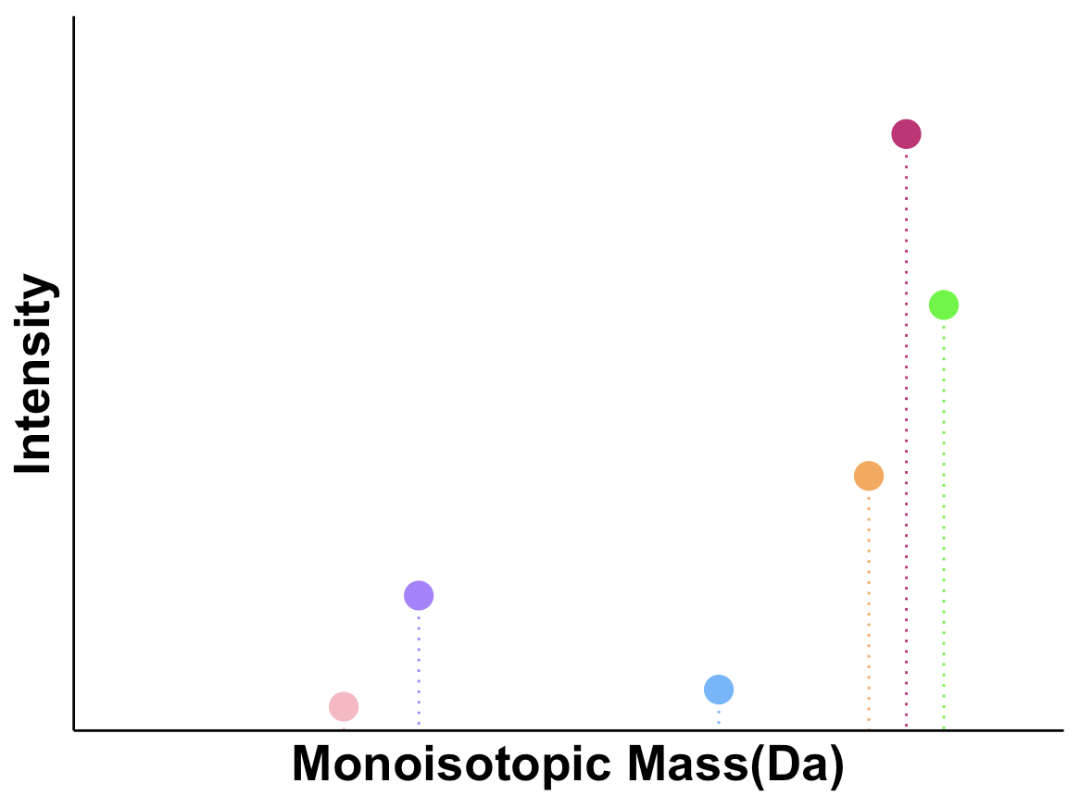
Dots: different RNAs
: ~10% of the most abundant RNA intensity

Slide 4
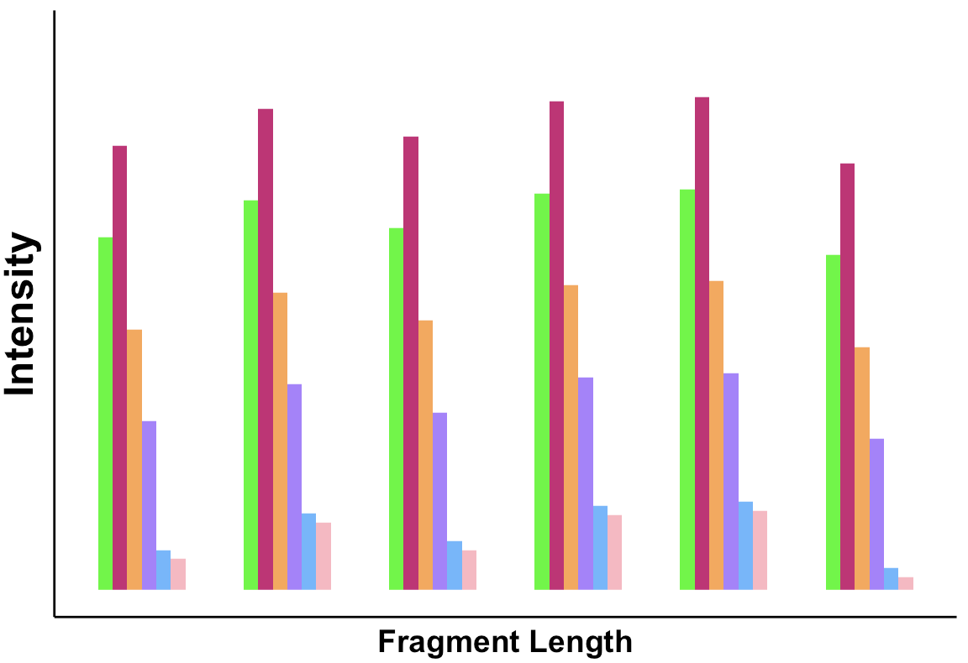
Analytical Run
Optimal sample amount and acid hydrolysis conditions to generate ladder fragments
Bars: different RNA fragments
: ~10% of the most abundant RNA intensity
5’ ladder 3’ ladder

Slide 5
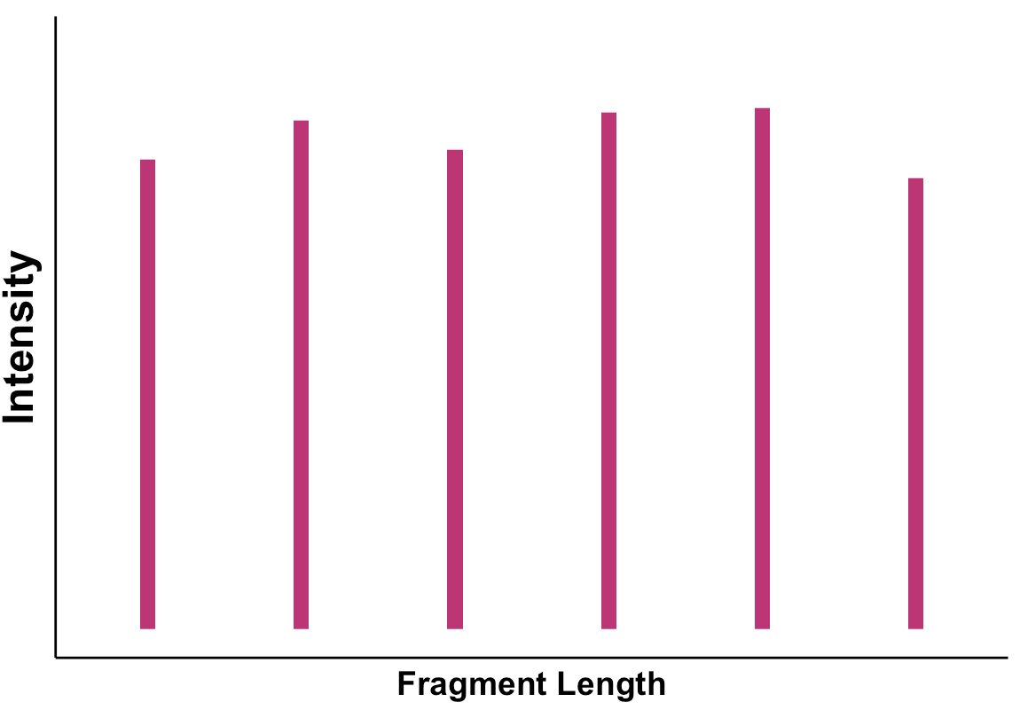
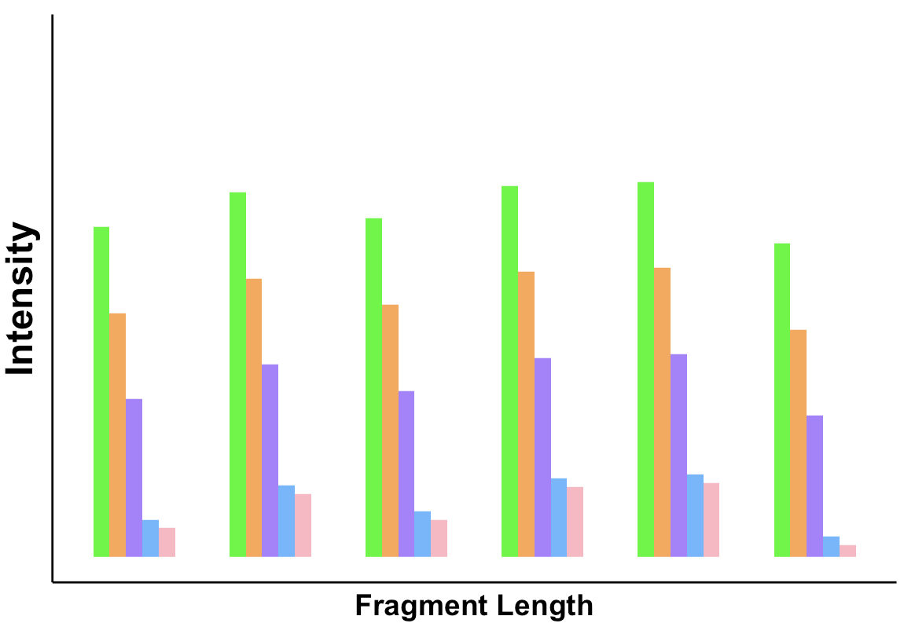
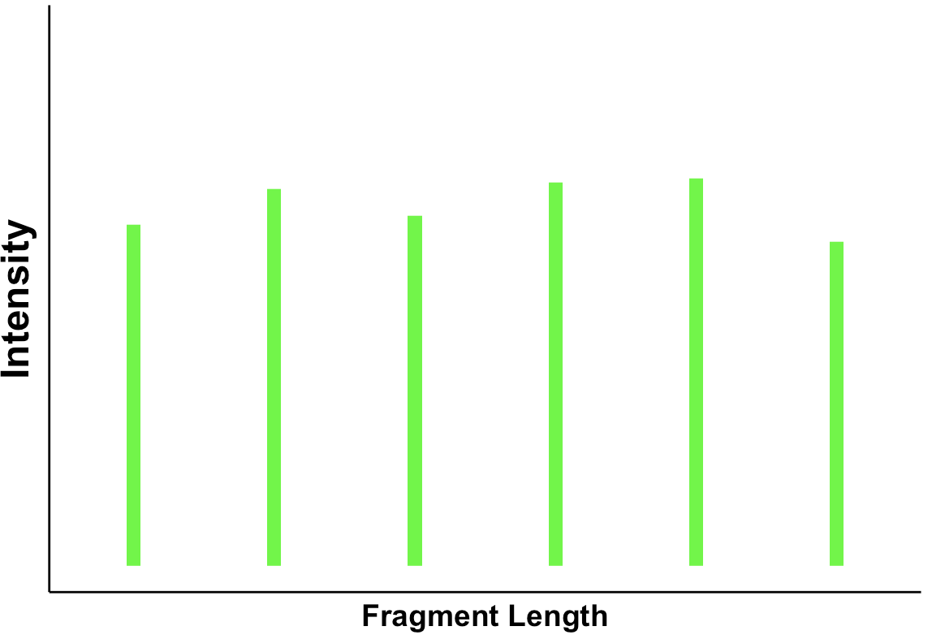
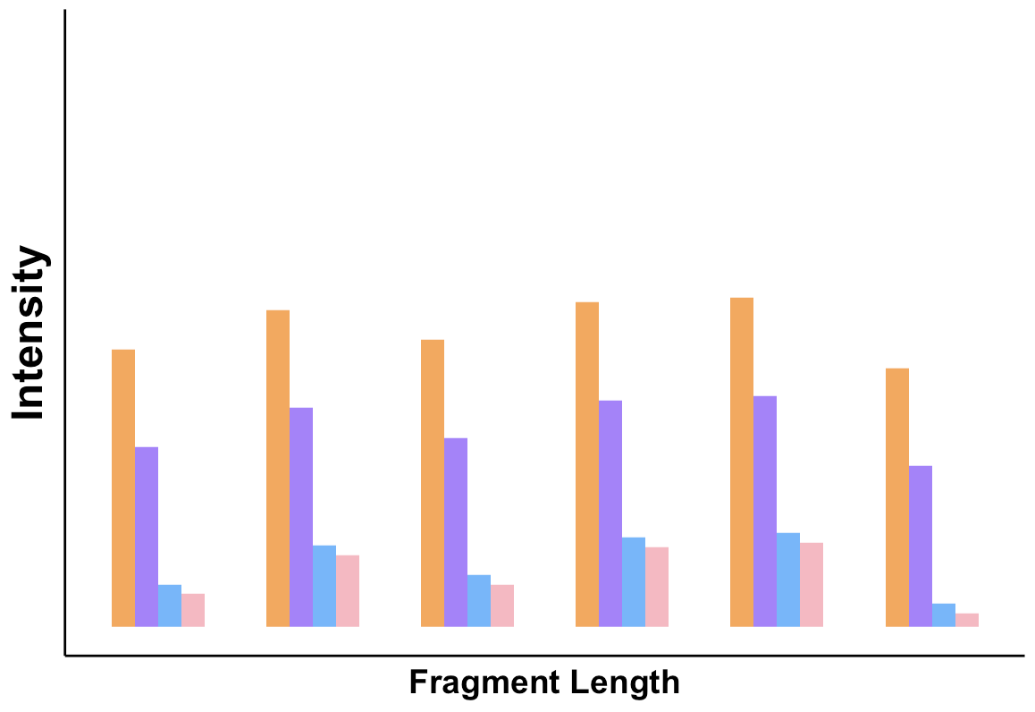

Slide 6
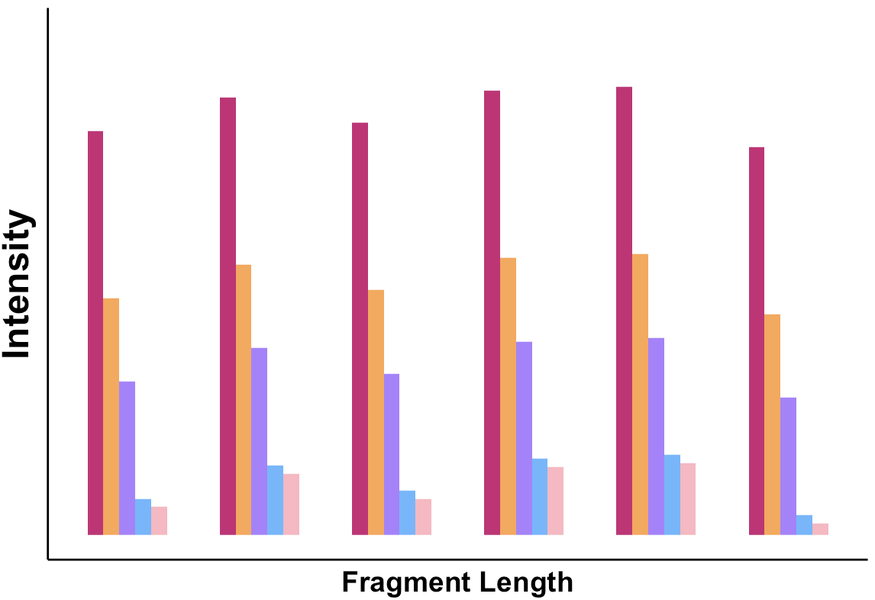
Analytical Run
Optimal sample amount and acid hydrolysis conditions to generate ladder fragments
Bars: different RNA fragments
: ~10% of the most abundant RNA intensity
5’ ladder 3’ ladder

Slide 7
