Slide 1
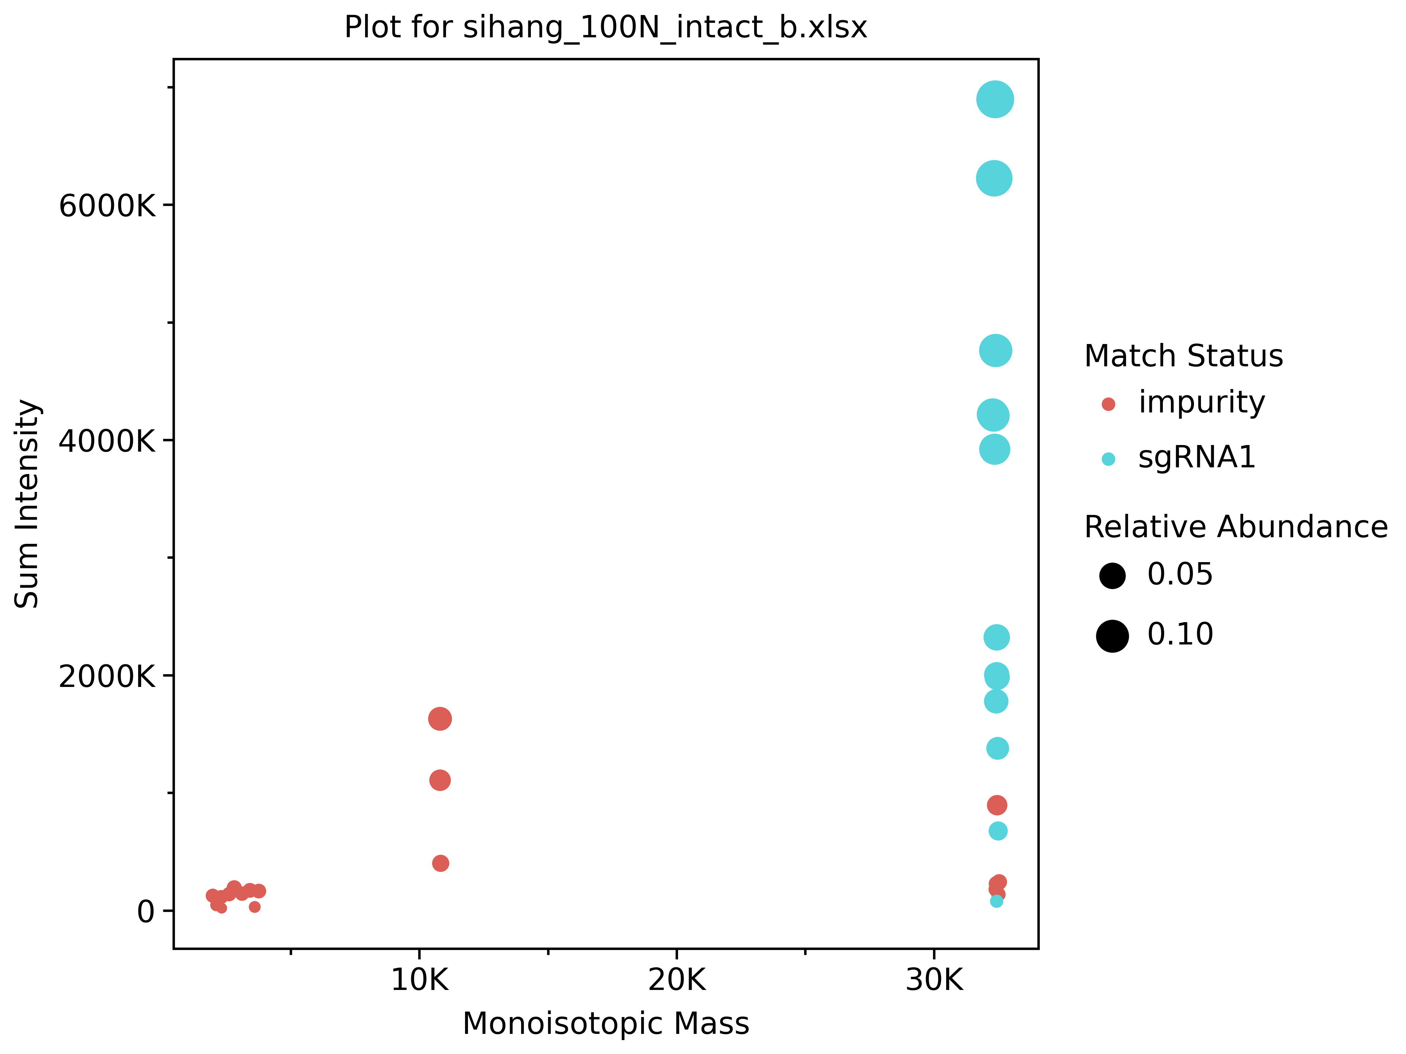
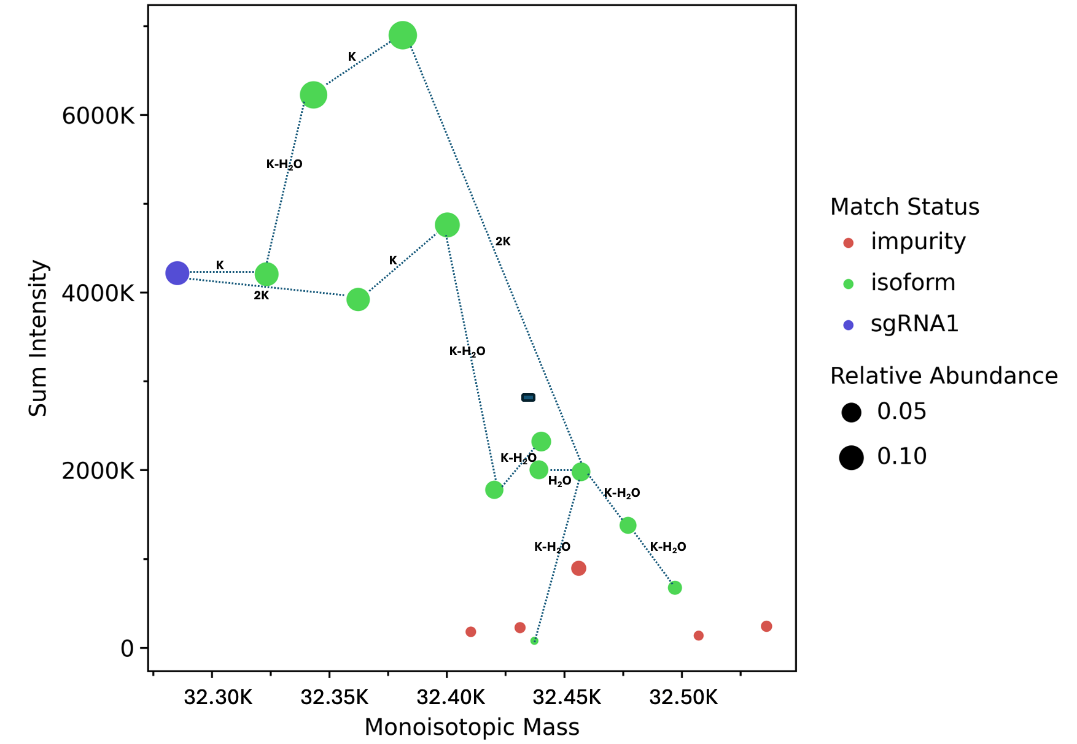
10K
20K
30K

Slide 2
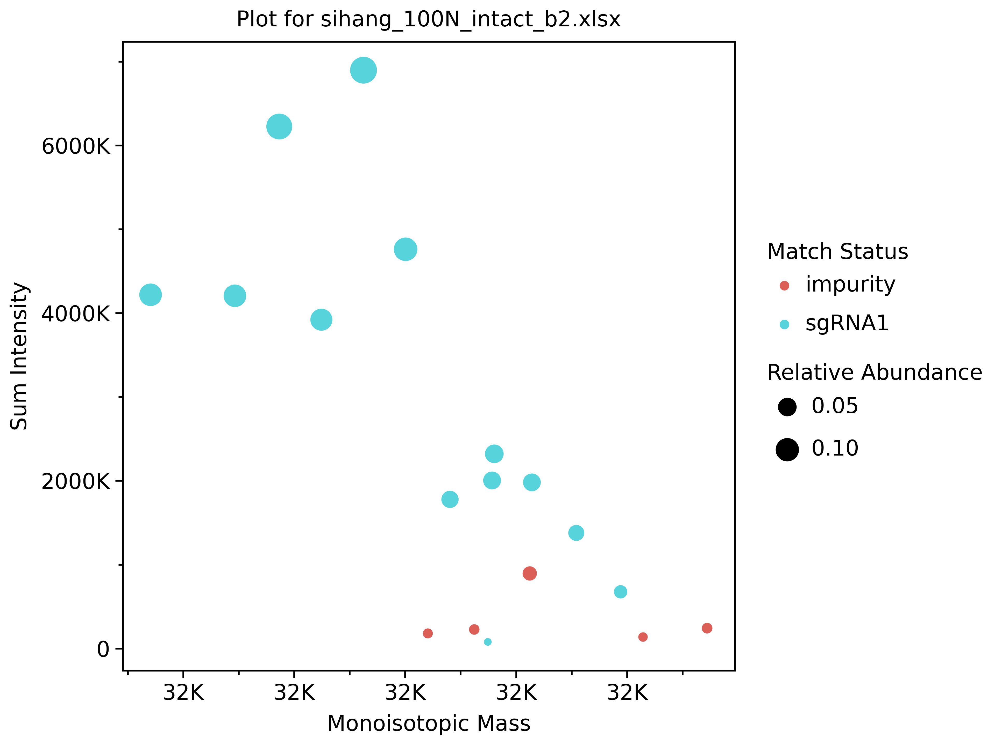
K
K-H₂O
2K
K
K
2K
K-H₂O
K-H₂O
H₂O
K-H₂O
K-H₂O
K-H₂O

Slide 3
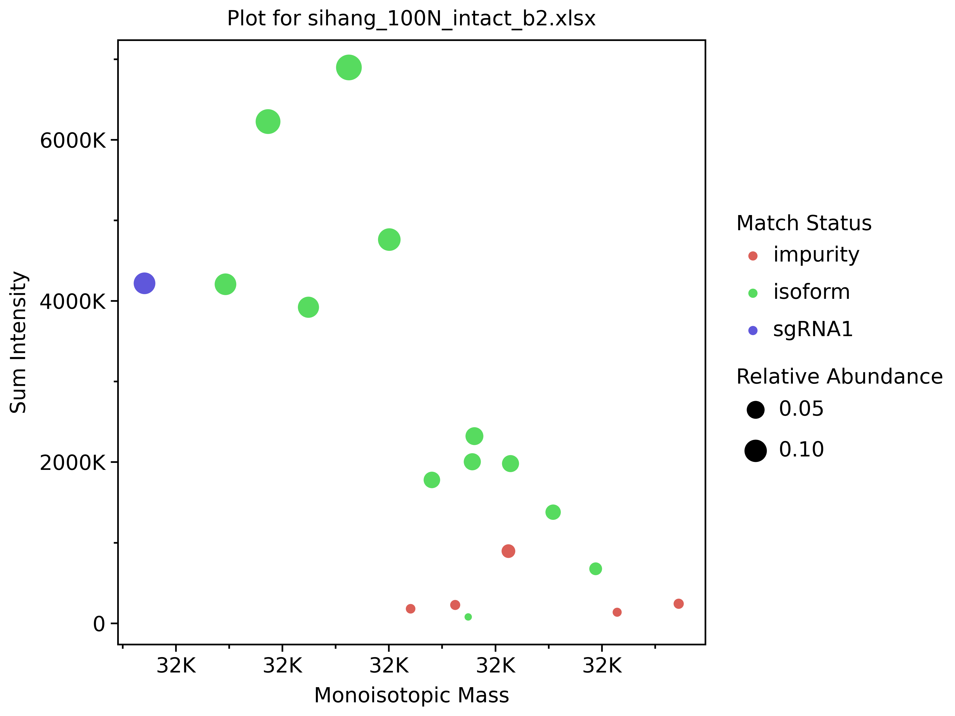
K
K-H₂O
2K
K
K
2K
K-H₂O
K-H₂O
H₂O
K-H₂O
K-H₂O
K-H₂O
32.30K
32.35K
32.40K
32.45K
32.50K

Slide 5
32381.27
32343.30
32285.32
32400.23
32323.32
32362.27
32440.197
32439.198
32457.134
32420.22
32477.143
32456.154
32497.113
32431.17
32536.090
32410.24
32437.28
32507.203

Slide 7
