Slide 1
Athena App ECE 564 Final Presentation By Sportcraft
Lianjun Zheng
Shangxing Sun
Weijia Duan

Slide 2
Agenda
1. Development Scenario
2. App Design & Implementations
2.1 Implementation Logics & Functions
2.2 Other Functions & Highlighted Features
3. System Architecture
4. Project Prospects
5. Demo

Slide 3
Development Scenario
◉ Increasing number of people interested in playing sports
◉ Hard to find players, book courts and find time
◉ Reduce physical inactivity is necessary
◉ Encourage sports participation is necessary
◉ Target customer in specific area/group (e.g. IBM, Duke)
◉ Needs solutions to resolve current situation

Slide 4

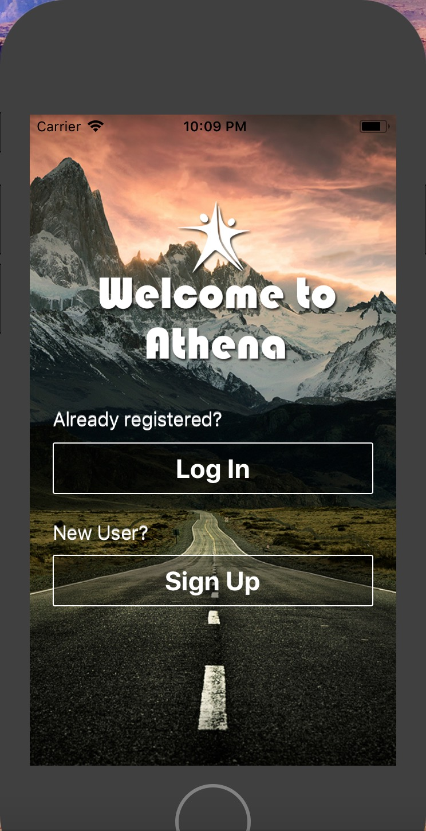
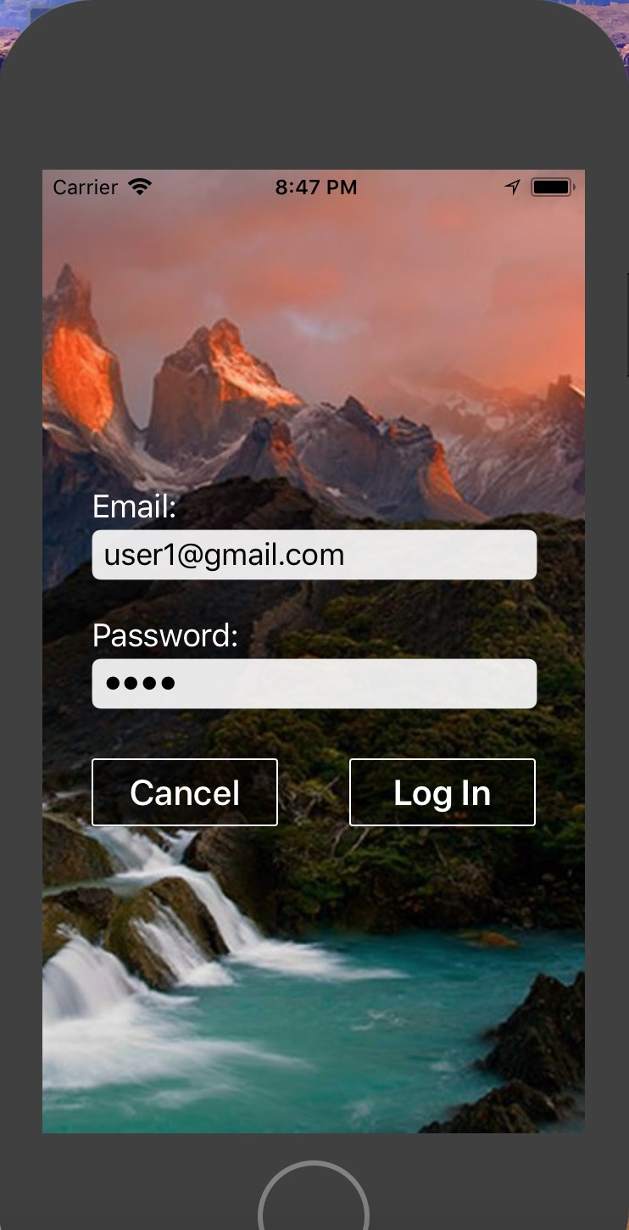
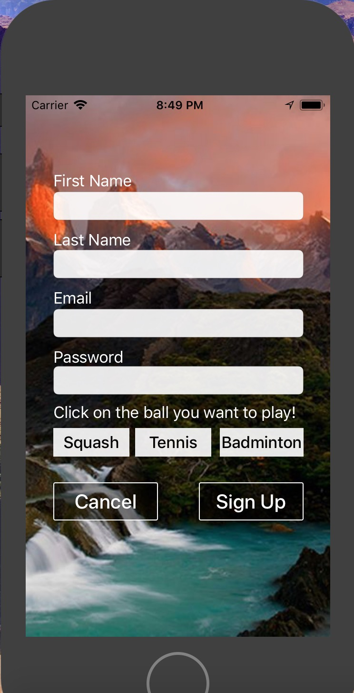
App Design & Implementation
Implementation Logics & Functions

Slide 5
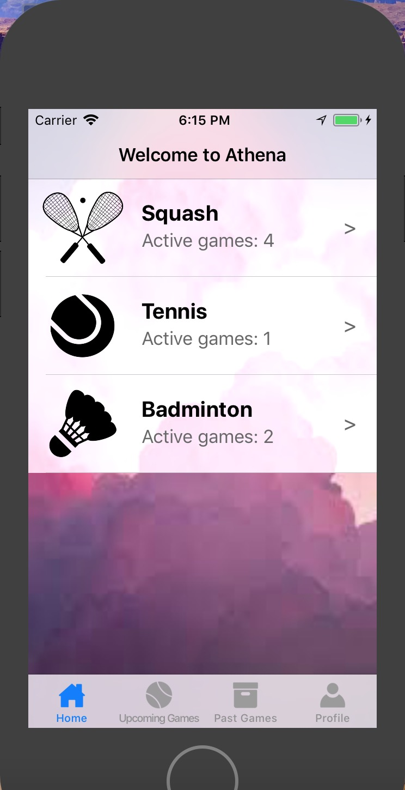
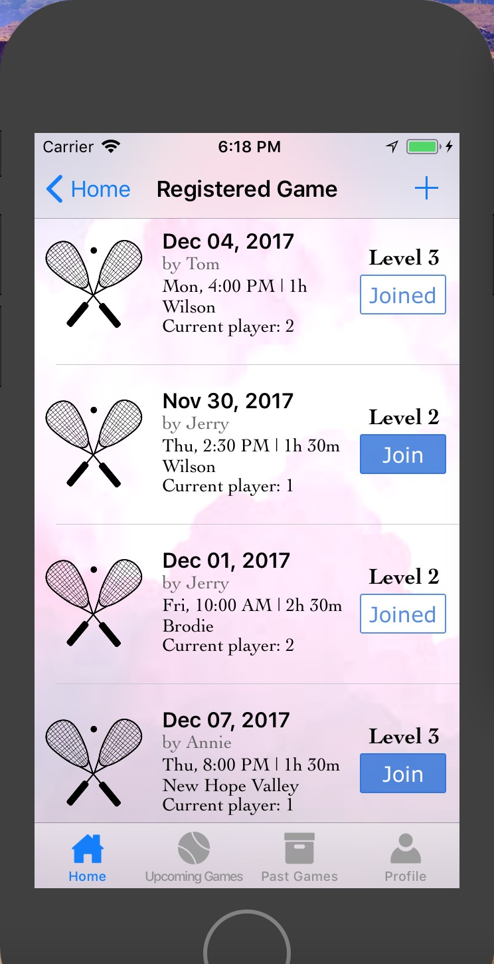
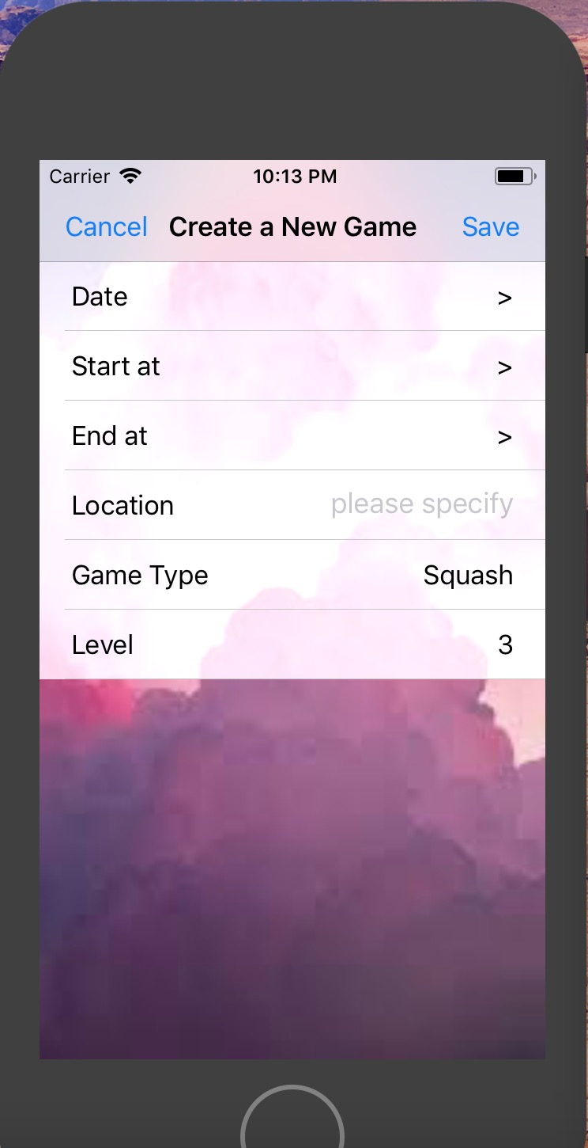
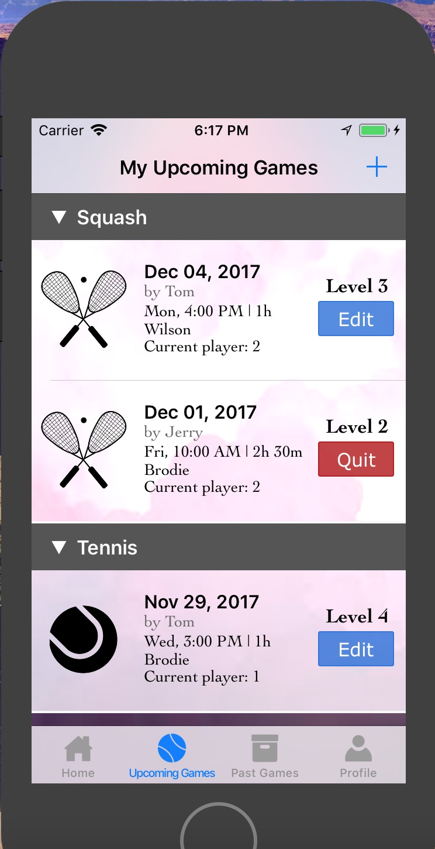
App Design & Implementation
Implementation Logics & Functions

Slide 6
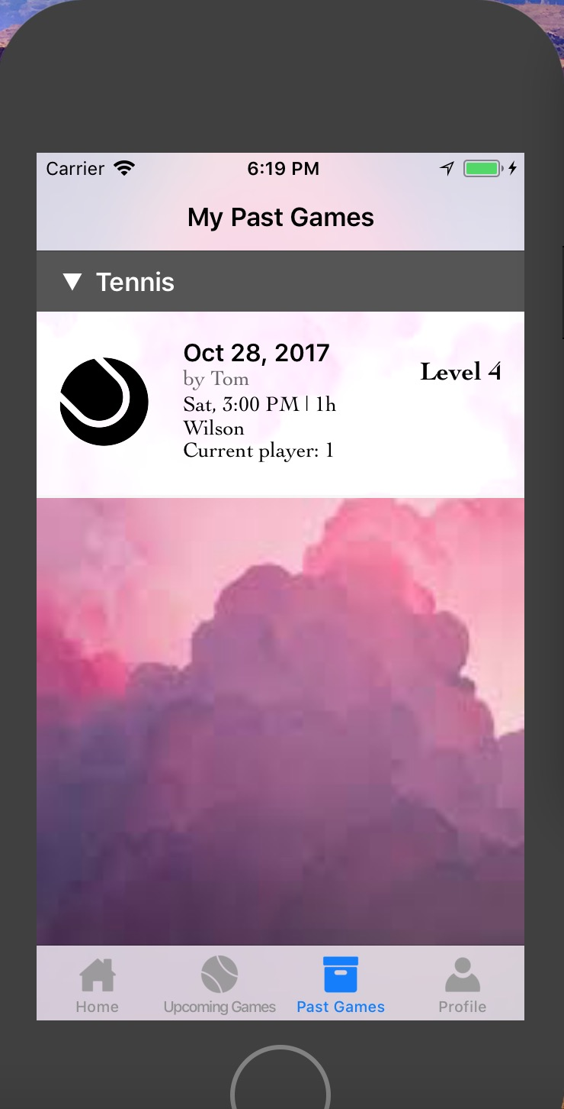
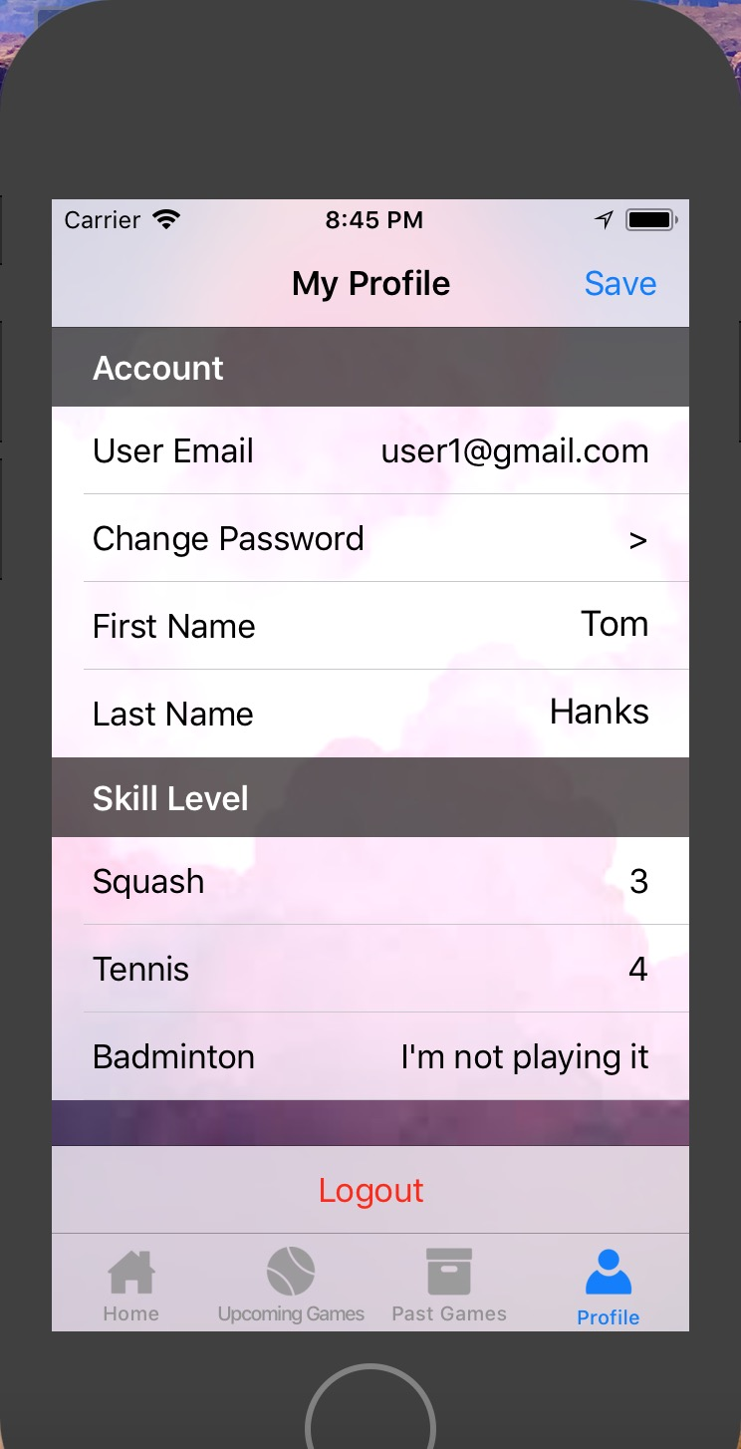
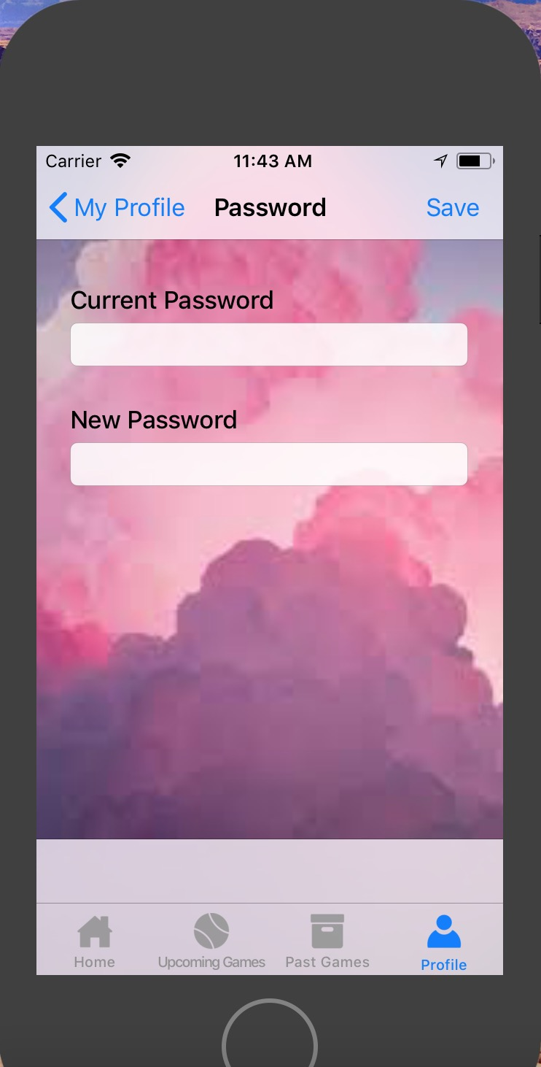
App Design & Implementation
Implementation Logics & Functions

Slide 7
App Design & Implementation
Other Functions & Highlighted Features
◉ Rating your skill levels
◉ Refresh Page (Fetch updating data from database)
◉ Validation when create new games
◉ Button configuration (Define the behavior for button actions)
◉ Expandable header view

Slide 8
System Architecture
Firebase Real-time Database
Read
In Memory Array:
Current User: User
Current All Games: [Game]
Application
Game Class
handler.refresh:
getUserGame(), getAllGame()
User Class
gameId: String
gameName: gameName
location: String
startTime: NSDate
endTime: NSDate
owner: String
level: Int
maxPlayer: Int
firstName: String
LastName: String
email: String
password: String
myGame: [String]
gameDict: [GameName: Int]
User.saveUser()
User.loadUser()
Game.saveGame()
Game.loadGame()

Slide 9
Project Prospects
◉ Feedback collections for App improvements
◉ Notification for all involved players when game edited
◉ Increasing variety of games
◉ Cloud storage, real-time data updating
◉ Game Invitation between friends (Profile sharing)

Slide 10
Demo

