Slide 1

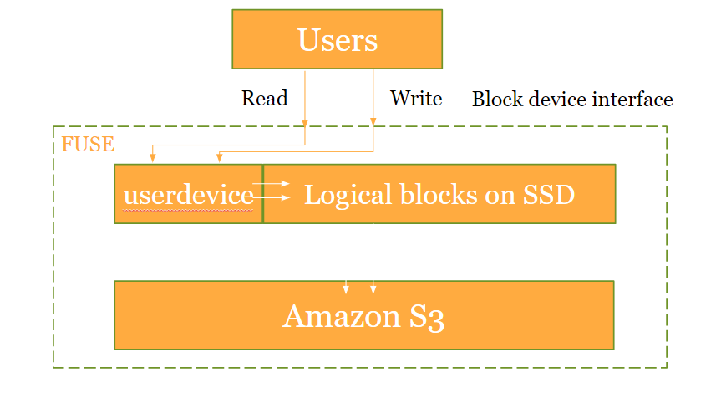
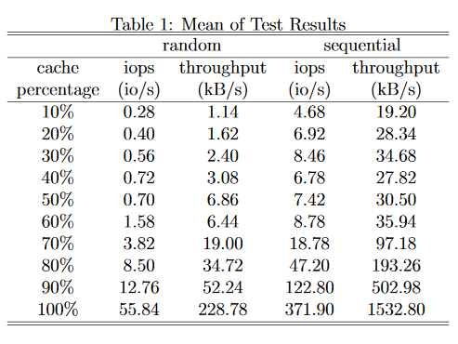
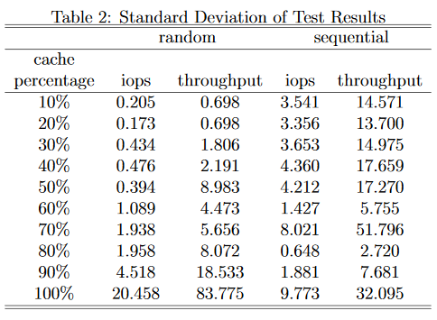
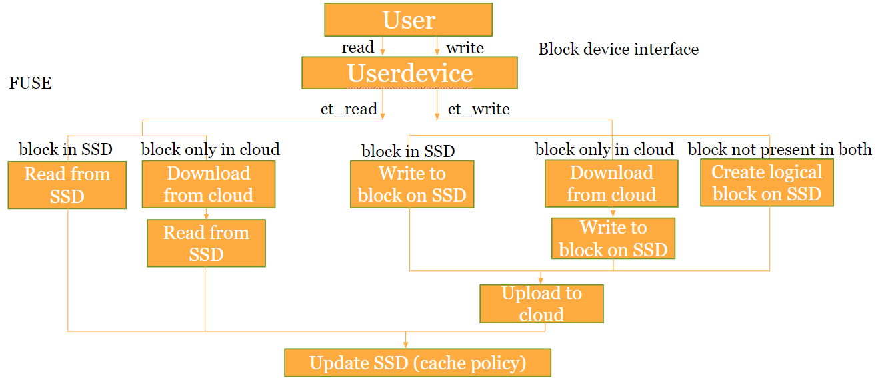
Cloud Cache System Shangxing Sun Group member: Nian Liu, Jiankun Chen, Yuchen Zhou
Project Introduction
Cache Policy
Cloud storage is useful and cheap storage, however the reading and writing speed is often limited by internet latency and bandwidth. This project, the cloud cache system, will automatically cache hot data into SSD from cloud service to greatly improve data reading and writing speed. The project is developed in c++ with the use of FUSE( File system in user space).
The following graph is an overview of the project.
We used LRU cache with linked list and hashed map as the cache policy. Here are the two data structure we created:
list<Block_num>
unordered_map<Block_num,list<Block_num>::iterator >
When a block is accessed, the system will get the location of the block by checking the map according to its block number. Then the system will move the block to the start of the list. When a new block is needed, the system will use the block at end of the list.
The combination of linked list and hashed map gives a fast access to block information while tracking the least recently used block.
When the system starts, it will initialize these two data structure. It first uses function readdir to read all block’s information. Then it will sort it by last-access time and initialize these two structure according to the sort result.
The result basic meets our expectation, but the performance however is not ideal. From Table 1, we can find that when cache percentage increase from 10% to 50%, the iops and throughput of random access increase from 0.28 (io/s) and 1.14 (kb/s) to 0.70 (io/s) and 6.68 (kb/s), which is increased by 150% and 480% respectively. The iops and throughput of sequential access increase from 4.68 (io/s) and 19.20 (kb/s) to 7.42 (io/s) and 30.50 (kb/s), which is increased by 58% and 58% respectively. This suggests that by increasing the cache size, the performance of our system is greatly improved.
The entire system is still limited by the internet speed. We can also find that the system performance increases greatly with a high cache percentage but much less with a low cache percentage. We wish our system could perform greatly even with low cache percentage.
Here are some improvement we can do to our system:
Prefetch
We can try to predict what the user is going to read and prefetch that block when internet is not busy.
Multi-thread and write back buffer
Currently, the system will upload data into cloud immediately after write into SSD. However, we may be able to upload data asynchronously like a write-back buffer so that data waiting to be uploaded will be handled later by another thread and will not contend internet resource with data waiting to be downloaded.
Hard disk as second tier cache
Using hard disk as a second tier cache can greatly improve cache percentage since hard disks are much cheaper storage than SSD.
This project aims at implementing a program which enable a server to use its SSD as caches of cloud storage. After deploying the program, a special file system should be generated. The entire file system should be defined in FUSE. Every time the user writes into the file system, data should be divided into blocks and updated into cloud. Every read should read data from SSD drives if data exists in SSD drives or update the blocks on SSD from cloud according to cache policy if data does not exist in SSD drives. The iops and throughput of data reading and writing should be significantly improved after deploying the system.
We benchmarked our system using IOPS and got the following result:
The benchmark was based on the following settings:
•block size: 4k
•cloud maximum size: 4M (1000 blocks)
•each test is repeated 5 times
•all tests implemented with warm cache
•test implemented with debug mode
•all blocks are populated before starting test
Project Architecture
Here is the project architecture in detail:
Gitlab link for this project:
https://gitlab.oit.duke.edu/ss811/EnterpriseStorageArchitectureProject
Github link for FUSE (filesystem in user space) :
https://github.com/libfuse/libfuse
Gihub link for IOPS ( the benchmark tool we used) :
https://github.com/cxcv/iops

