Slide 1
Reproduce Becker et al. and Discussions

Slide 2
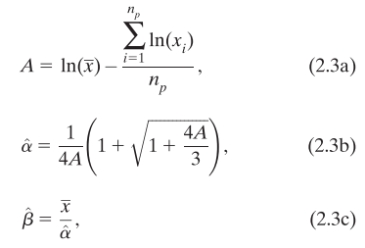
Data: CPC, 0.25*0.25, 1979-2005 (27years)
Precipitation: days with >1.0mm/day
Gamma distribution estimation: maximum likelihood estimators (MLE)
Goodness of fit test: Chi-square
0.05 level

Slide 3
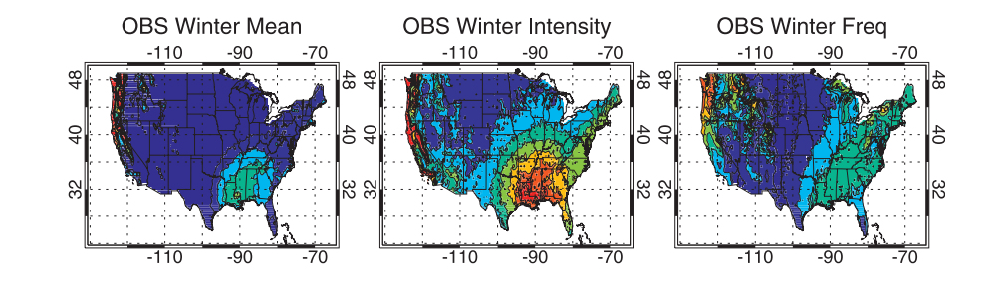
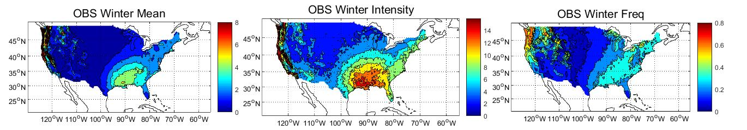
Becker et al. Fig.1
My Reproduction

Slide 4
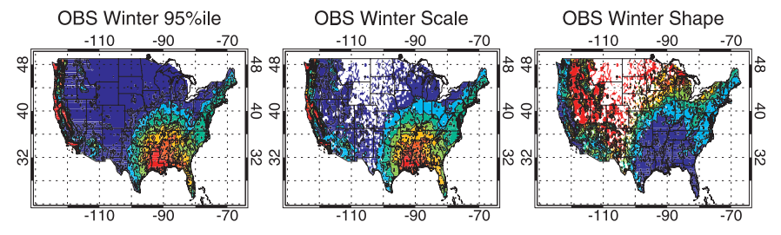
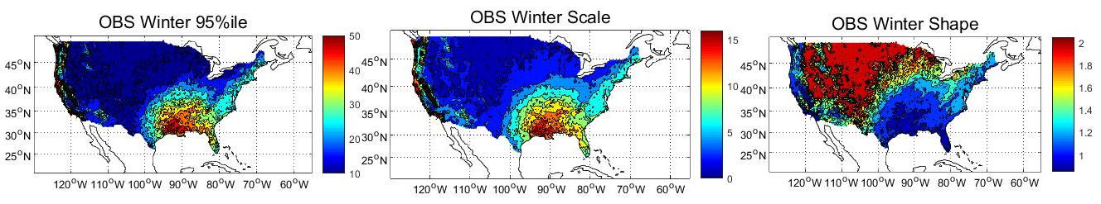
Becker et al. Estimated Gamma Ditribution Parameters
My Reproduction (No Goodness-of-fit test)

Slide 5
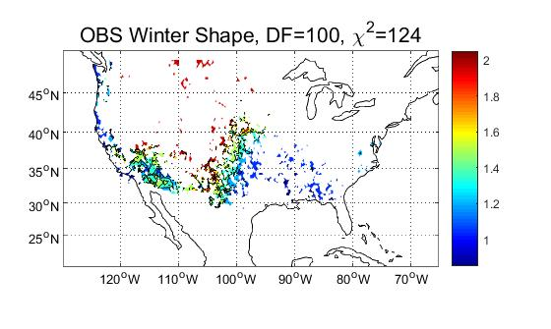
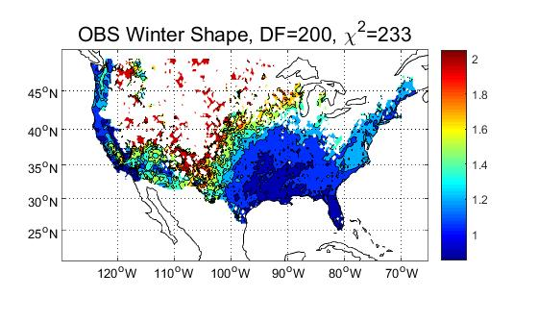
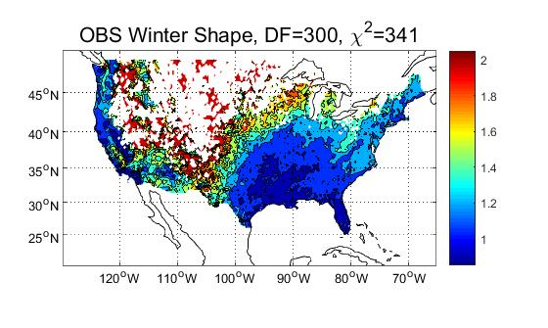
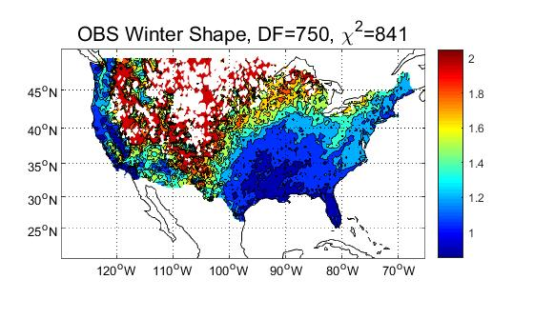
Selection of Degree of Freedom
Chi-Square Test with Different Degree of Freedom

Slide 6
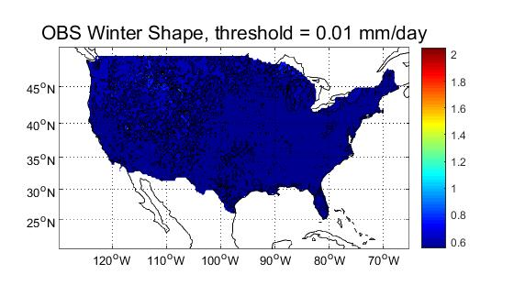
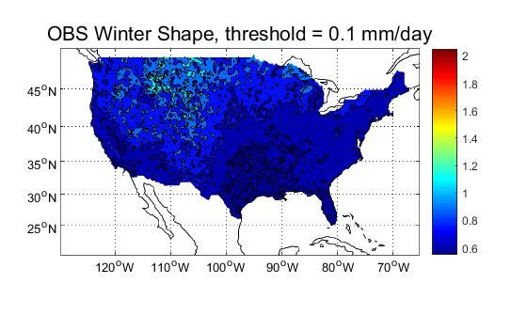
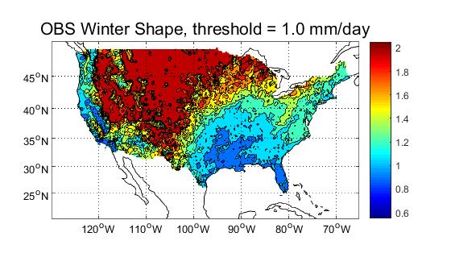
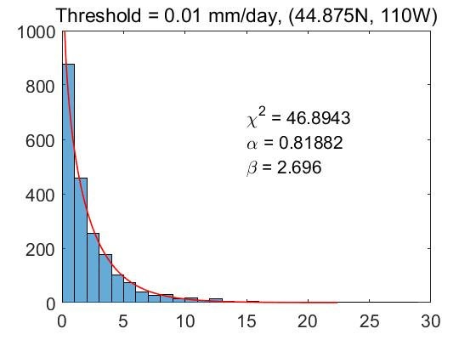
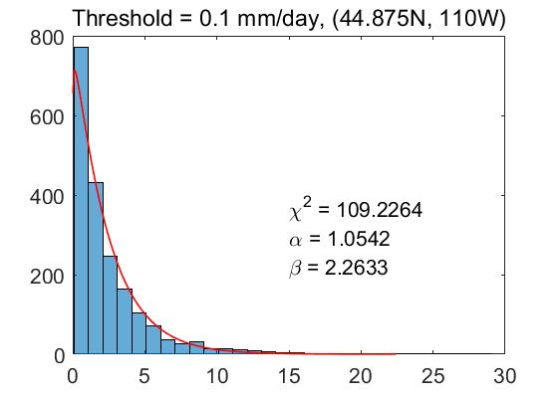
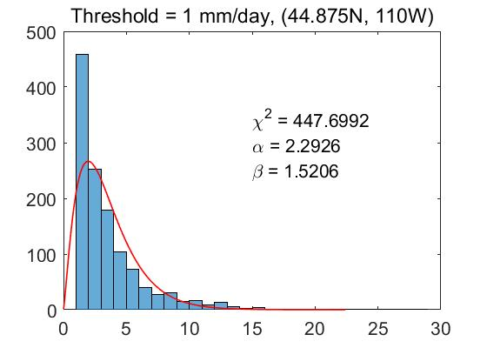
Selection of Threshold

Slide 7
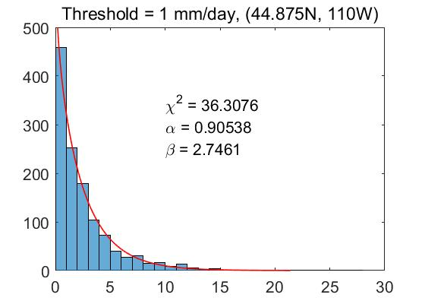
Fit to shifted series
Fit to x>1
Fit to x'=x-1

Slide 8
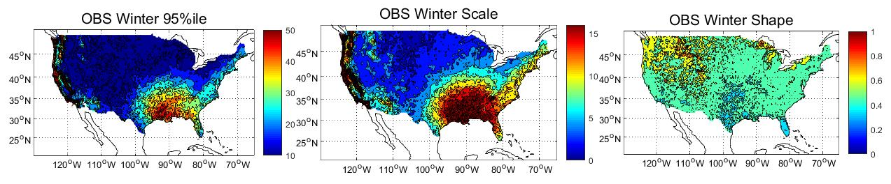
My Reproduction (No Goodness-of-fit test)
Fit to shifted series (x-1) (No Goodness-of-fit test)

Slide 9
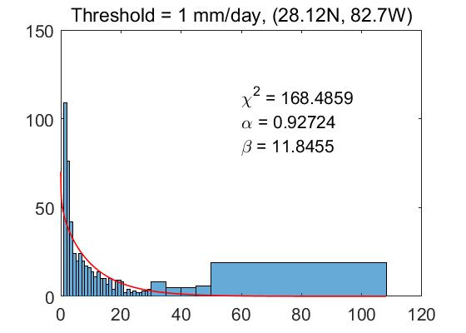
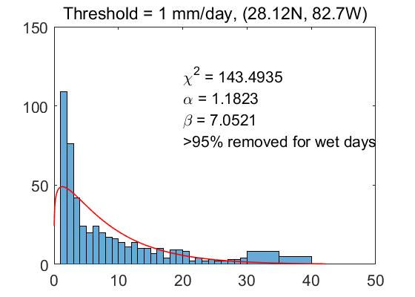
Remove Extreme Value

Slide 10
Extreme Precipitation

Slide 11
Method
Wet day threshold: 0.1 mm/day | 1mm/day
Fit gamma distribution to (wet day data - 0.1) | wet day data
Define degree of freedom for each grid:
(number of wet days)/4
0.05 significance level

Slide 12
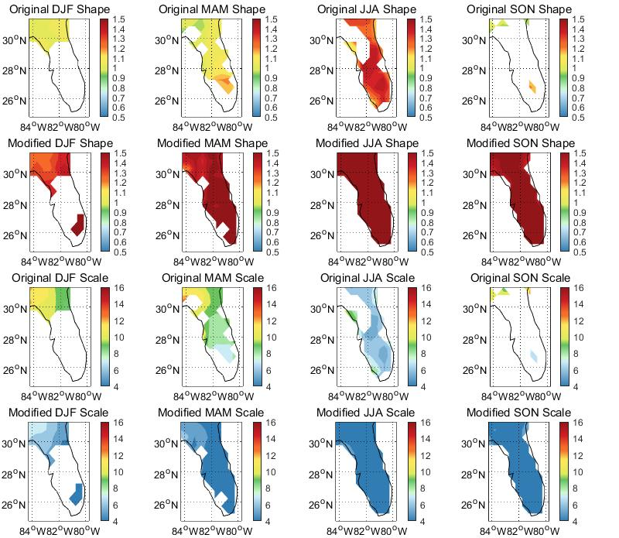
1 mm/day
no shift

Slide 13
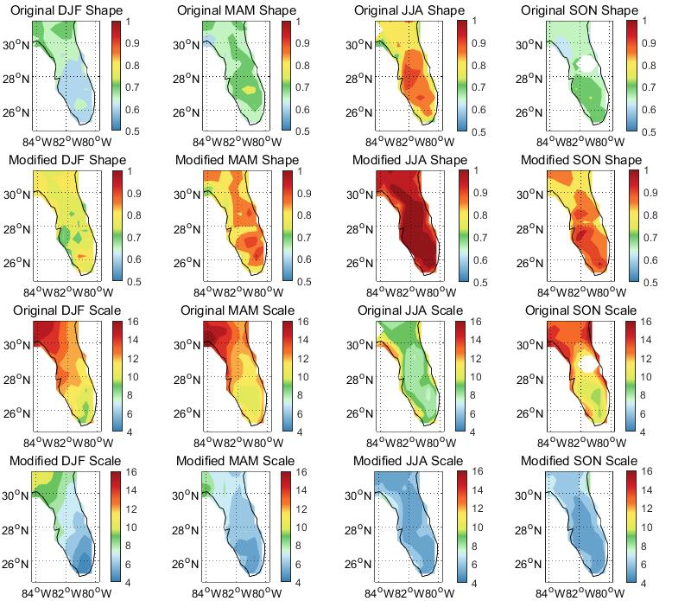
1 mm/day
shifted

Slide 14
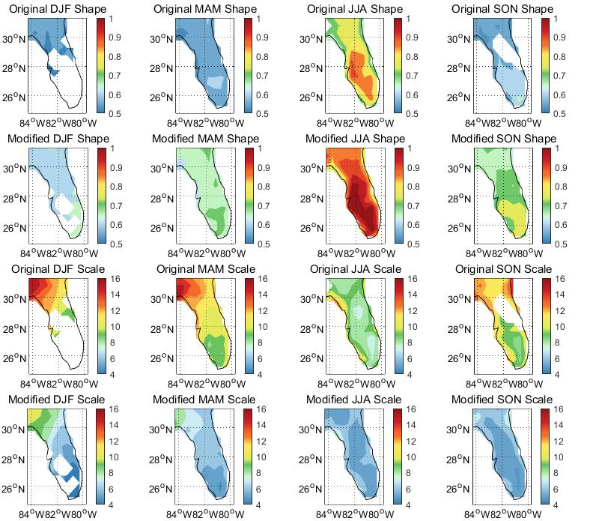
0.1 mm/day
no shift

Slide 15
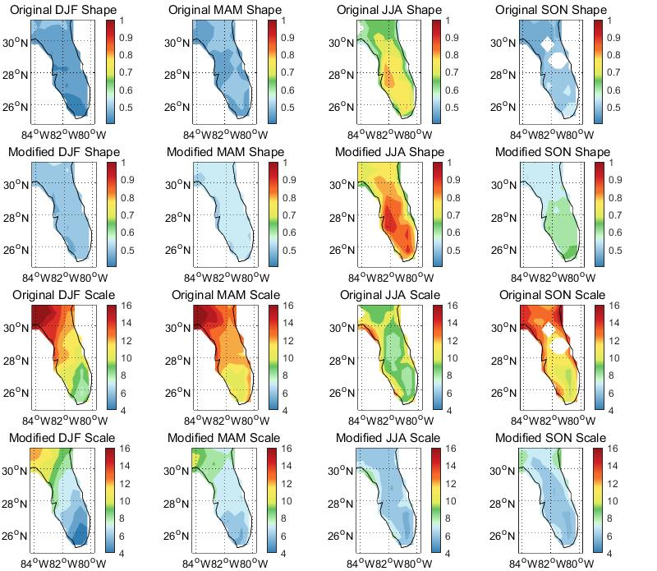
1 mm/day
shifted

Slide 16
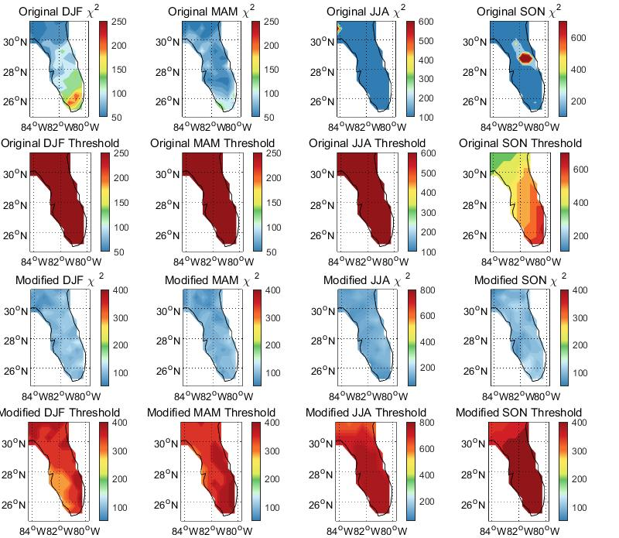
Chi2 and threshold
0.1 mm/day
shifted

Slide 17
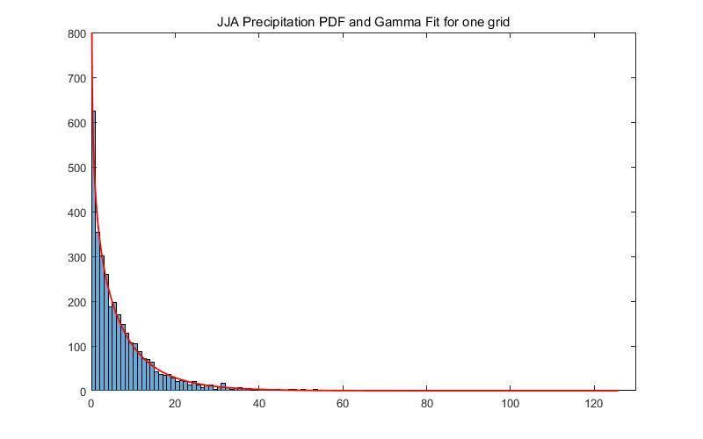
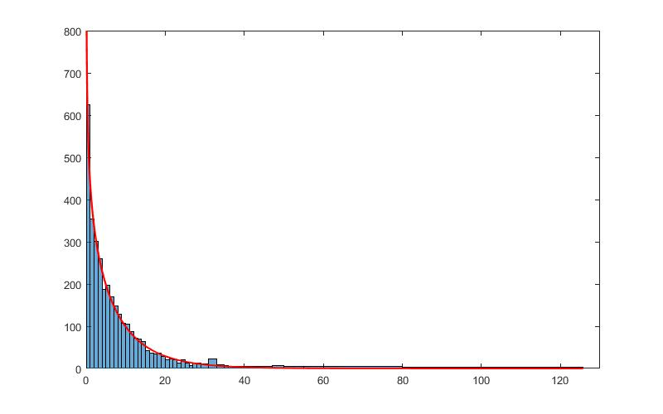
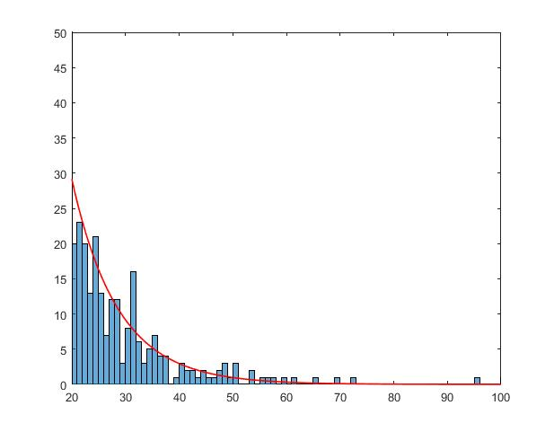
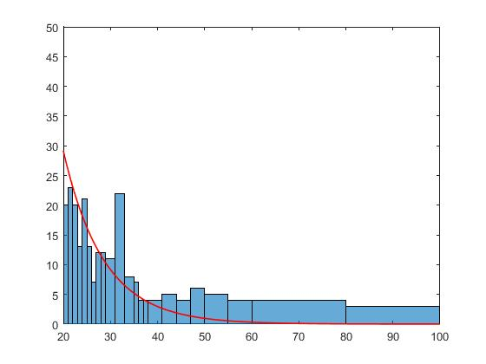
PDF for one grid in peninsular florida
uniform bins 1mm
chi2: 4646
inuniform bins
chi2: 63.1
details:

