Slide 1
Features of Fuchsia
Fuchsia vs Linux & Android

Slide 2


Outline
1
2
Differences between Fuchsia and Linux
IdeaExtracted from Publications

Slide 3

Overview
Architecture
Component
Driver System
Filesystem
Security
Others

Slide 4
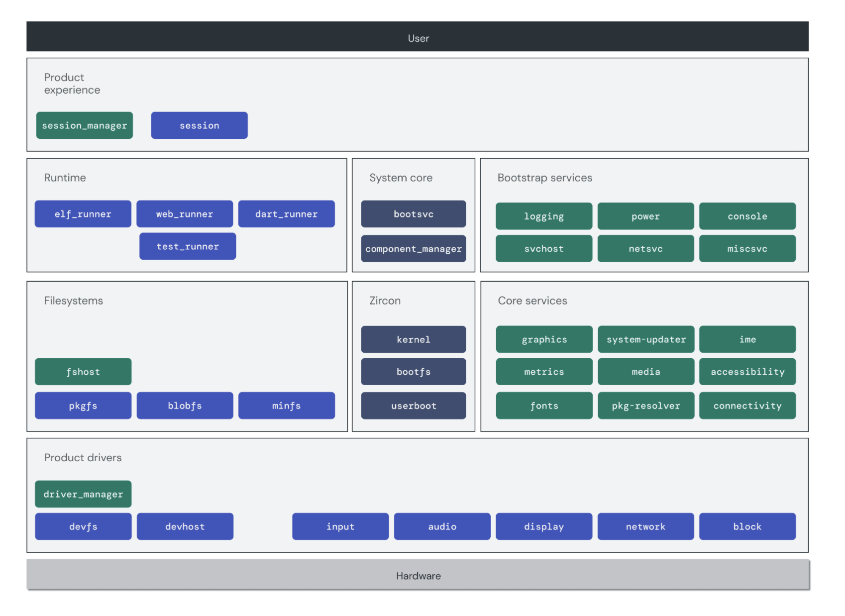
architecture
1. Fuchsia is based on a microkernel called Zircon, it is designed based on LK (Little Kernel) which is for embedded devices.
Zircon mainly concerns with Inter-process communication(IPC) , system start up and bootstrap
3. Component，kernel，driver and other modules in fuchsia work separately in user space and can be updated separately. They communicate with each other through IPC

Slide 5
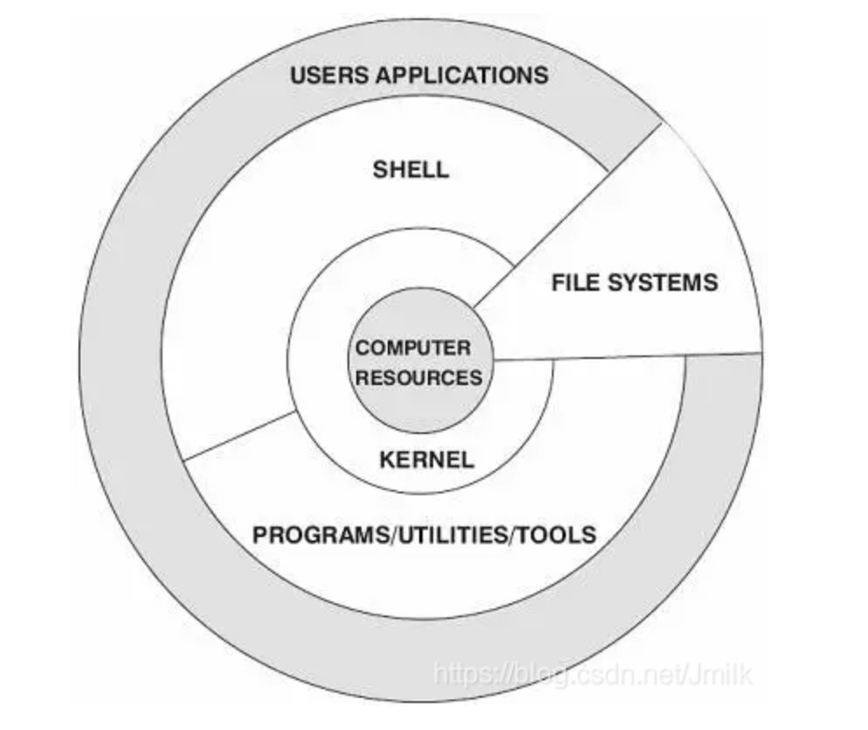
architecture
Linux is based on a monolithic kernel， even the Android is still based on Linux kernel，just added some layers on the top
Each layer uses the interface provided by the lower layer and provides service for upper layers
Communication between layers are calling APIs
System App
java API Framework
c/c++ library
Android runtime
HAL
Linux kernel

Slide 6
Component (concepts)
Components are the basic unit of executable software on Fuchsia，it runs on Fuchsia in its own sandbox
Fuchsia is a capability-based operating system, components interact with each other through the use of capabilities, like some APIs provided by applications in Linux. Capabilities owned by a component can be exposed to other components in the same realm or may be to the whole system.
Components use route to gain access to use capabilities exposed and offered by other components
A common representation of a capability is a channel that speaks a particular FIDL protocol.

Slide 7
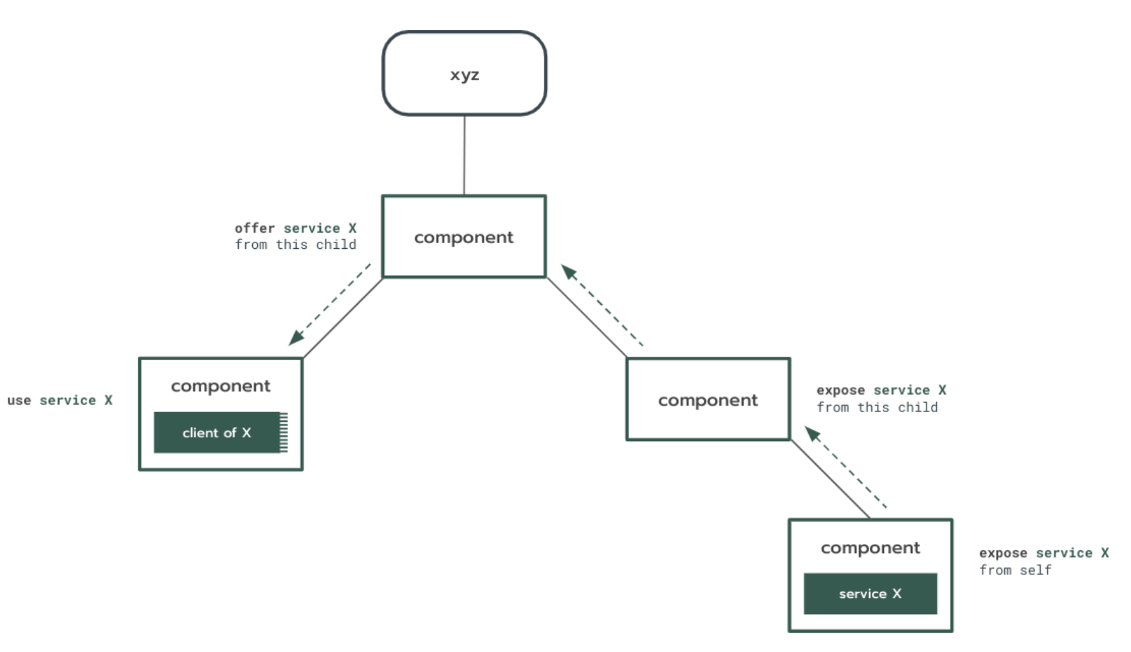
Component (route)
The root of each realm receives certain privileges to influence the behavior of components
Component framework use the information in component manifest to determine if the component exposes capabilities or use capabilities exposed by other components
The parent components offer
capabilities that are available for
it’s child components
The component routing is different from the app components in Android, Android use Intent to bind individual components to each other, Fuchsia use the component topology and the capabilities can only be exposed to it’s realm by default.

Slide 8
Component (route)
The component routing is different from the app components in Android, Android use Intent to bind individual components to each other, Fuchsia use the component topology and the capabilities can only be exposed to it’s realm by default.

Slide 9
driver
In Linux the driver is controlled by Linux framework, the driver can be designed as a kernel module, it can be loaded on demand; or it can be designed as static which can be loaded during system boot.
In Fuchsia, drivers are components, they can only be loaded on demand.
As drivers are components in Fuchsia, drivers can communicate with other drivers or non-driver components, However, in Linux, driver-to-driver communication may be a little bit difficult.

Slide 10
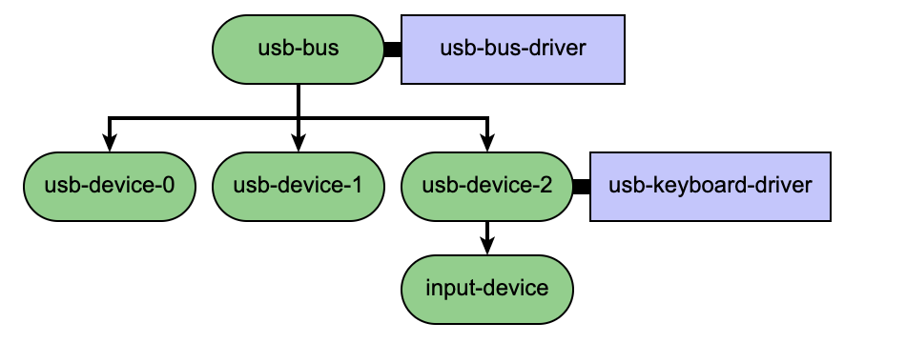
driver
In Linux the information of devices are stored in the device tree, the device tree will be stored in a file, then compiled and resolved by the kernel
In Fuchsia, drivers are also stored in the form of a tree, but this topology is created at boot time, kept by driver manager
The binding process in Linux is that the kernel will find the root device in the device tree and visit each node in the tree, if the name of the device matches the driver, the driver will be bind to the device, the driver only provides services to the device
In Fuchsia, the device manager will find the root device in the topology and visit each node, but the parent driver which has already bind to the device in the upper layer will be responsible to create new nodes in the topology and then ask the driver manager to
bind a driver to the node

Slide 11
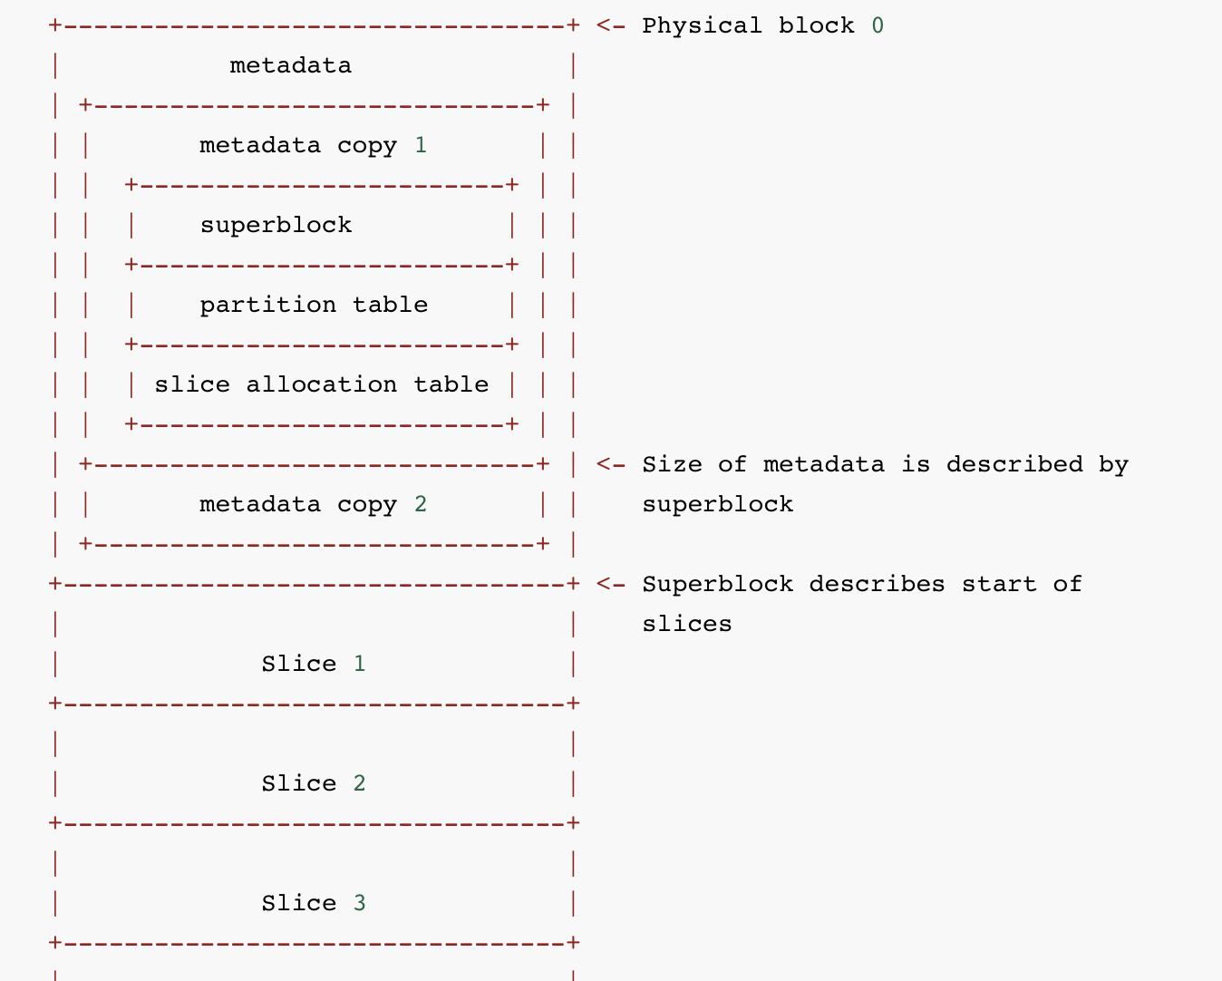
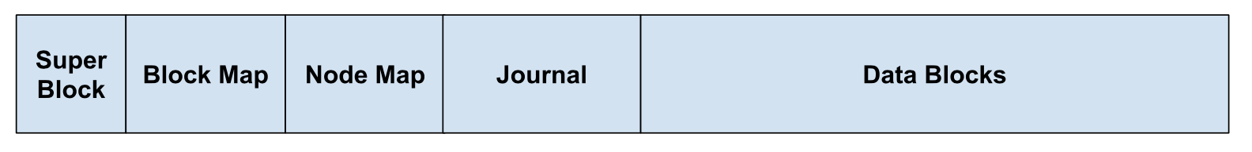
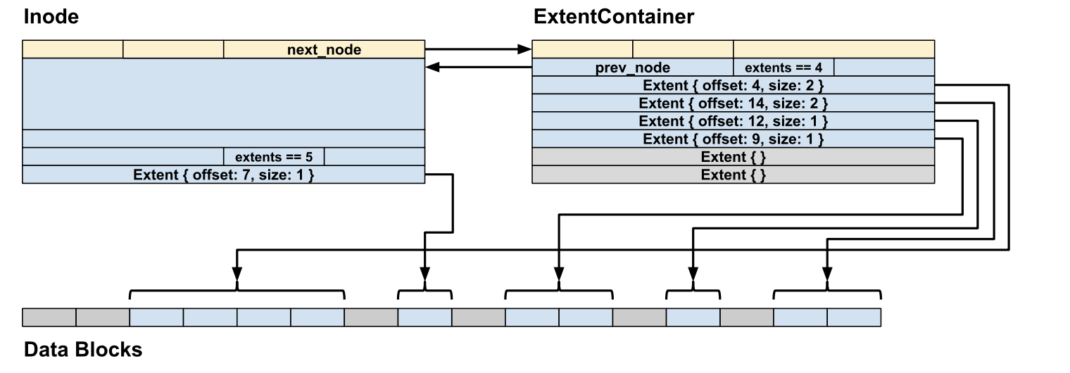
filesystem
In fuchsia, filesystem is also a component
To open a file, Fuchsia programs (clients) send RPC requests to filesystem servers using a FIDL to build a connection(a channel)
Subsequent operations are also transmitted using RPC messages
At boot, the filesystem will find the FVM, the members in FVM points to other filesystems like BlobFS.

Slide 12
filesystem
Random access compression in BlobFS:
To prevent random access into files, The BlobFS transparently compresses files in order to save disk space with zstd.
Problems may occur when files are demand paged because maybe only part of the file will be loaded in to the memory, but the file can not be decompressed partly
The chunked-compression format and library in Fuchsia breaks compressed files up into frames that can be independently decompressed
2. fast block i/o
When writing to a file, a filesystem (representing the file as a VMO) could simply send a small FIFO message indicating “write N bytes directly from offset X of VMO Y to offset Z on a disk”, thus, system won’t have to copy all of the bytes to the RPC message
3. .. Is considered harmful
use .. may lead to unexpected visit to upper dictionaries
4. Use merkle tree(hash code) to assure the data in the blocks are correct

Slide 13
security
1. Verified Execution
The Verified Boot Security Model
Goal: eliminate untrustworthy states (code and data) in which attackers could persist control across reboots, so that a computer can recover from any compromise by simply rebooting
1. all executed code is trustworthy according to an “anchor” (for example, code in ROM)
2. all data that serves as input to code is trustworthy according to the same anchor.
Anti-rollback
Hardware-based anti-rollback : the system refuses to boot an out-of-date version of Fuchsia once the vulnerability has been patched. (prevent attacker from flashing an older, vulnerable version and replay the vulnerability)
The running software model
code cannot execute unless it is digitally signed by a trusted party.

Slide 14
security
Verification
Code and data are deemed trustworthy after verification using a hash-and-sign paradigm
At boot time, some of the code and data in the system should be verified using a trusted public key

Slide 15
security
Safe Stack
The unsafe stack is used for arrays or variables that are passed by reference
The safe stack is used for storing the return address of a function call and compiler's register spills
Shadow Call Stack
There is a normal stack in the system and it is used for arrays or variables that are passed by reference
The Shadow Call Stack is only used for storing the return address of a function call

Slide 16
others
1
2
Features similar to Linux
Other features
Trace
The concept of process/thread
Memory management
Error and exceptions
1. Session
2. Third-party resource
3. Packages

Slide 17

part2
Publications about Fuzzing test on Android OS
A lot of them focus on IPC like RPC and the intent object
They extract the valid template of input data by static analyze the source code or some manifest files
They analyze the code server side or the Intent object instead of the client side code to extract the type/name of the valid input
The summary of idea used in publications
Find all the interfaces or components that may be used to establish connection
Use the AIDL file/ AST(abstract syntax tree)/static analyze to extract information of the valid input data
Determine the dependence between applications or transactions
Generate inputs and start the fuzz test
Collect the log information
Interface discovery
Input extract
Dependency extraction
Generate input data
Collect log

Slide 18
Interface & communication
Information like the input data type/size/name of the interface can be extracted from the component manifest ---a FIDL file
The dependency relationship between components can also be extract from component manifest or from the realm topology
There are top-level interfaces and deep nested multi-level interfaces, we can check the component manager to get the information about the nested interfaces
The document mentions that the size of RPC message is limited, there might be other limitations.

Slide 19
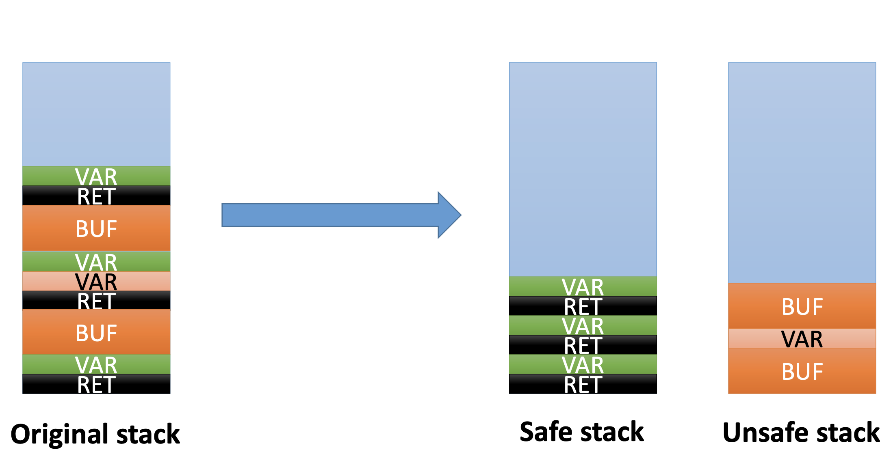
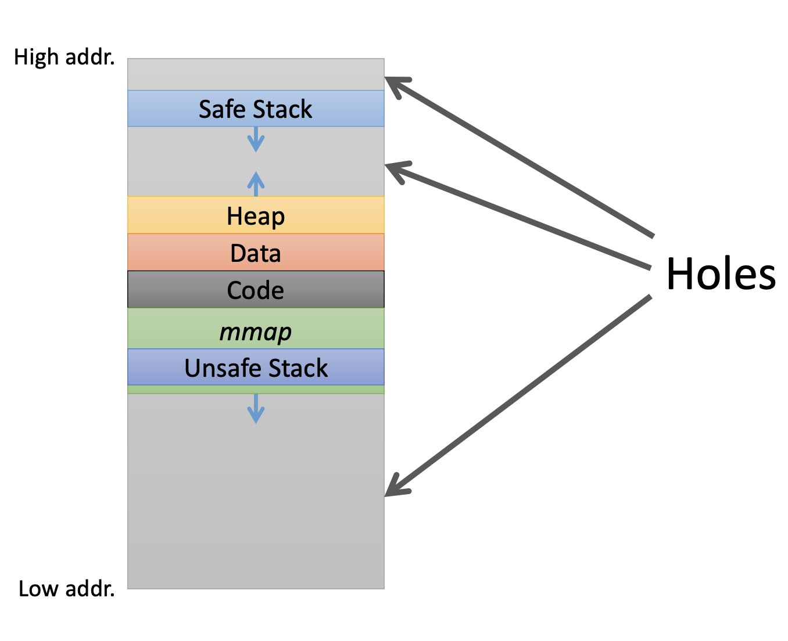
Security strategy
Might can be used in our input generation

Slide 20
Thanks

