Slide 1
NYX: Grey-box Hypervisor Fuzzing using Fast Snapshots and Affine Types
Sergej Schumilo, Cornelius Aschermann, Ali Abbasi, Simon Wörner, and Thorsten Holz, Ruhr-Universität Bochum
2021 USENIX
Presenter: Shangzhi Xu

Slide 2
Outline
Abstraction & Challenges
Basic concepts
Design
Evaluation
Related work & Discussion

Slide 3
Abstraction & Challenges

Slide 4
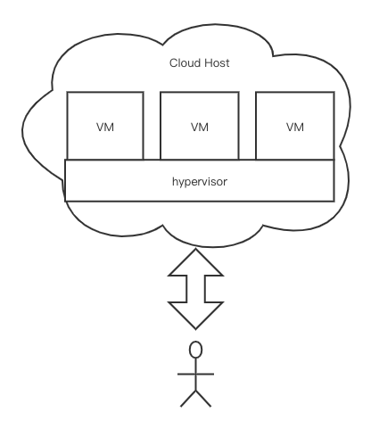
Threat Model
A hypervisor enforces the security boundaries between different virtual machines (VMs) running on the same physical machine
In the cloud, Whenever a user requires a new cloud instance, a VM is created on demand, and the user has full privileges inside the VM.
The hypervisor is the security boundary that separates different VMs
Once the attacker obtains hypervisor privileges, she also typically has full control over all other machines running on the same physical host.

Slide 5
NYX
A highly optimized, coverage-guided hypervisor fuzzer.
Fast snapshot restoration mechanism: allows to reload the system under test thousands of times per second
Novel mutation engine: use directed acyclic graphs (DAG), and affine types to express complex interactions

Slide 6
Recent Works
VDF :
Isolating individual QEMU device drivers into harnesses, coverage-guided
Problem :
Harness isolating individual device emulators requires significant manual effort
Not scale across different hypervisor implementation
HYPER- CUBE :
a blind fuzzer, no feedback mechanism, blind
Problem: Fails to uncover “interesting” (especially security-critical) behaviors in complex devices and interfaces within a hypervisor

Slide 7
Challenges 1
In a full system setting, we typically cannot compile all relevant components with a custom compiler to obtain code coverage.(observe)
we need to be able to run the target—even in the presence of memory corruptions and crashes. (recover)

Slide 8
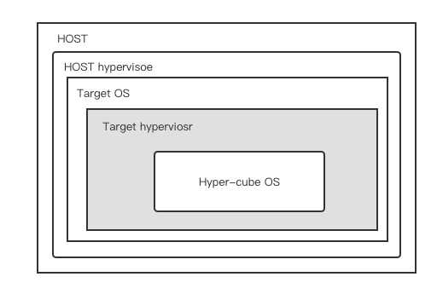
Solutions 1
we obtain code coverage information on the code running in our host hypervisor
To treacle crashes, come up with a setup consist of three different operating systems and two different hypervisor

Slide 9
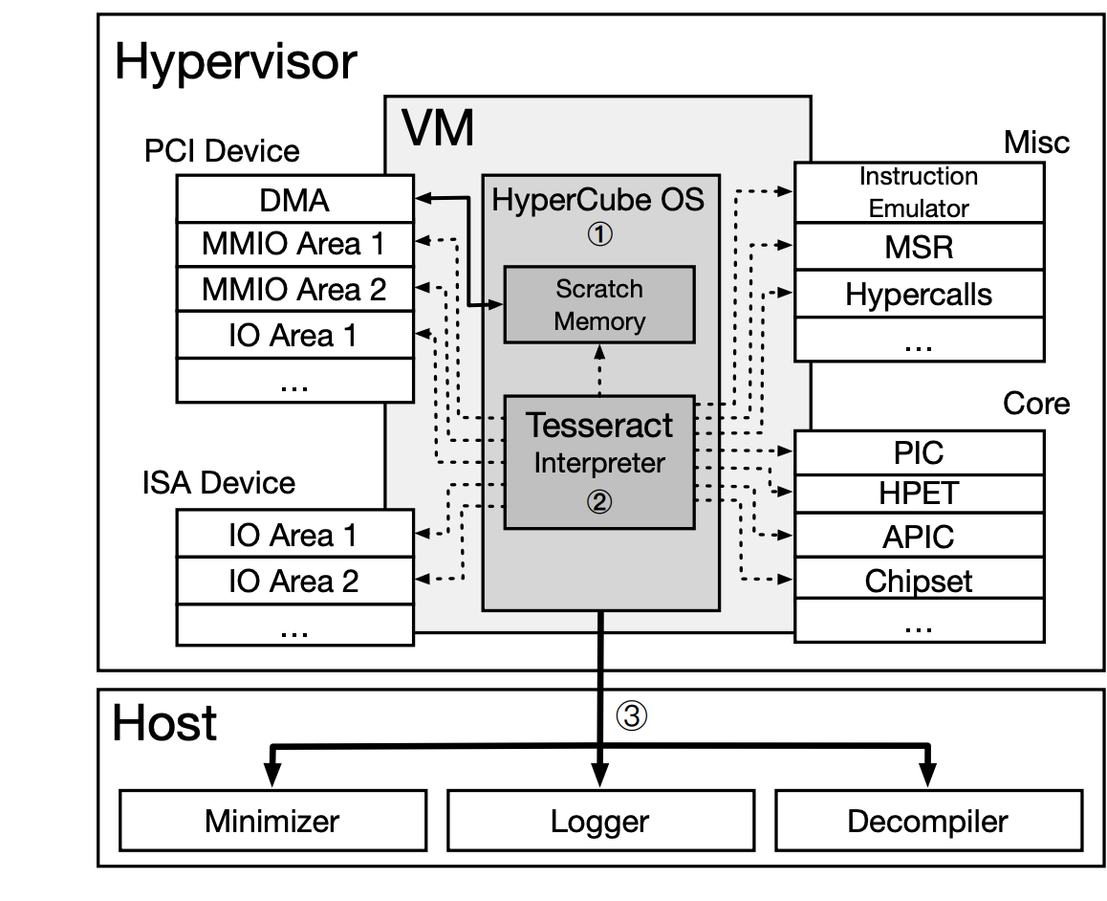
* Hyper-Cube OS
The largest part of HYPER-CUBE OS is concerned with enumerating the different interfaces that are available for fuzzing
TESSERACT
A decoder, performing random interactions with the hypervisor
The bytecode used as input is either given from the outside of the VM or produced by a pseudo random number generator inside of the interpreter.
After decoding the instruction, we call the corresponding opcode handler function

Slide 10
Challenges 2
Each of these components has a significant amount of state and seemingly non-deterministic behaviors such as timing interrupts.
Need to be able to interact with a diverse set of interfaces.

Slide 11
Solutions 2
Developed an extremely fast snapshot restoration mechanism that allows us to reload a whole VM image in the host hypervisor many thousands of times per second
Developed a mutation engine generates and mutates inputs that are effectively expressing multiple interactions
Implement nested virtualization to communicate with agent OS

Slide 12
Basic concepts

Slide 13
Trap-VM-Exit
VM-Exit: Any privileged operation that happens inside of the VM is trapped and control is transferred back to the hypervisor
Trap and emulate: hypervisor can emulate the privileged operation and return to the VM
Allow to emulate non-existing devices and to apply additional security check
Trap-and-Exit emulation can be slow

Slide 14
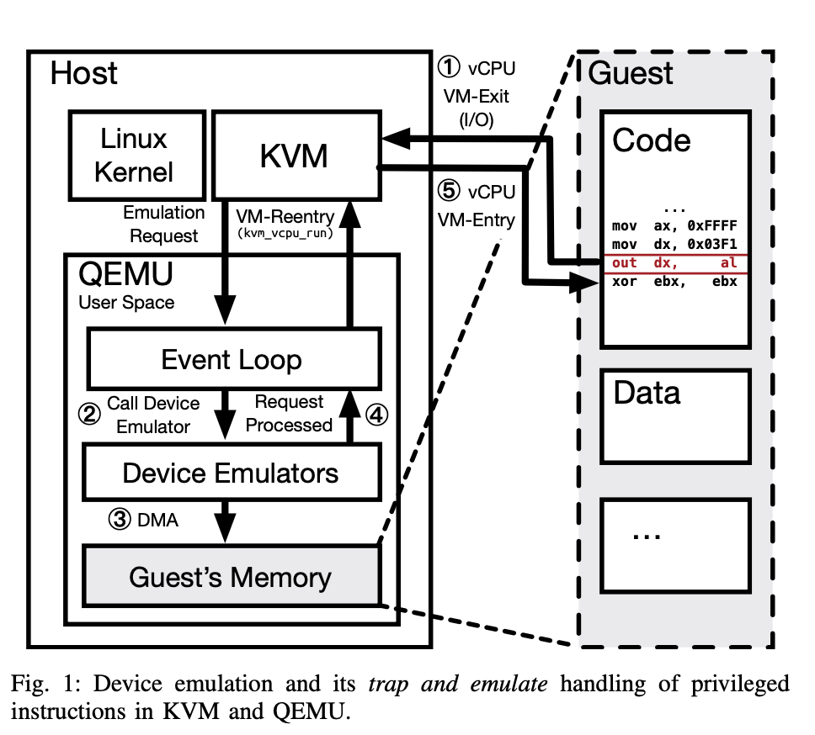
Device Emulation
A hypervisor has to emulate standard hardware such as an interrupt controller, a timer.
QEMU is a open source emulator that can execute hardware virtualization
KVM execute CPU and interrupt Virtualization
DMA: Direct Memory Access

Slide 15
Paravirtualization
Trap-and-Exit emulation can be slow
E.g. To trap access on MMIO pages, the hypervisor typically marks the corresponding pages as non-accessible. Accessing the MMIO page from within the virtual machine triggers a page fault.
If the OS running inside the hypervisor is aware that it is running in a virtualized environment, it can use these special paravirtualizel interfaces, instead of trying to access real hardware.
E.g. Use hypercall (syscall) instead of jumping from userland to ring 0, they jump directly to the hypervisor by triggering a VM- exit

Slide 16
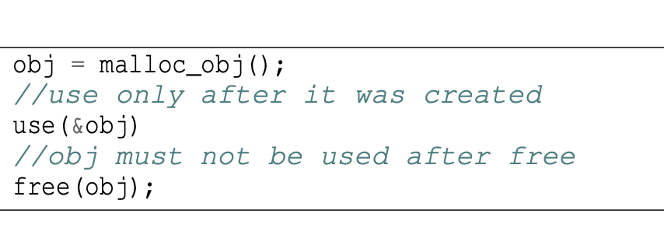
Affine Types
For example, by passing a previously freed pointer to the library, there will be a false positive crash.
Affine types are a class of type systems that ensure each value is used at most once. So that we can ensure that a resource is not reused after it was closed.
In the paper, they designed a new formalism based on affine types that allows to express these kinds of constraints

Slide 17
Design

Slide 18
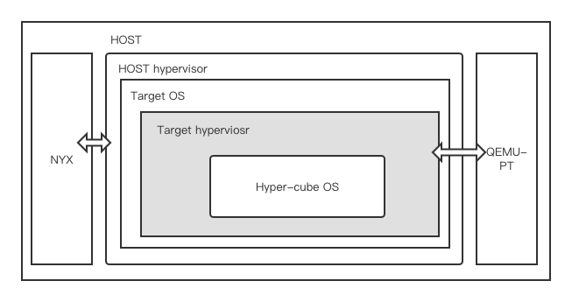
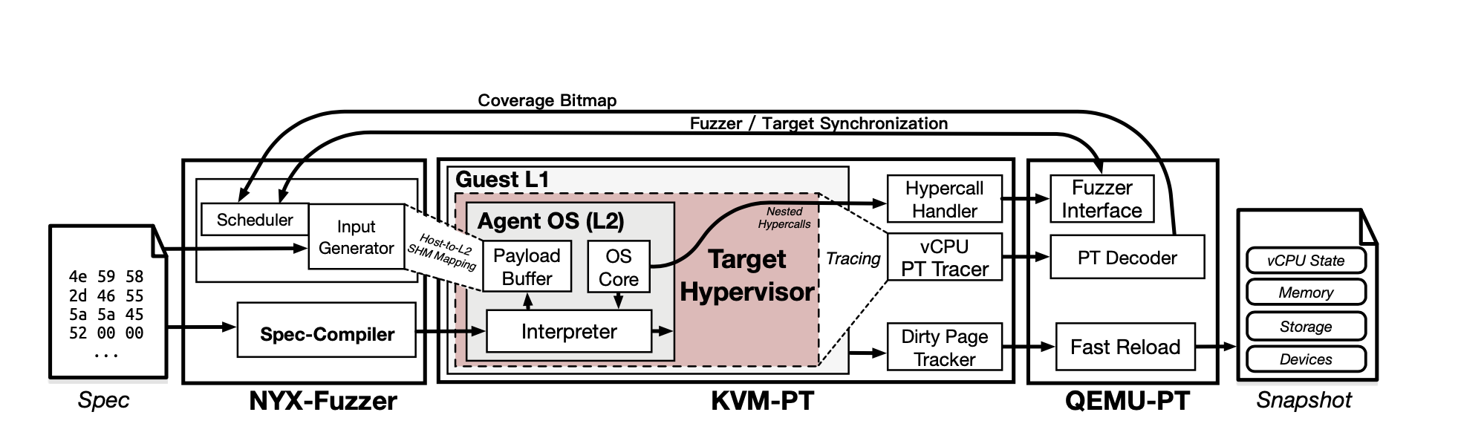
Overview

Slide 19
Fast Coverage
Use Intel-PT based tracing to obtain code coverage information with only a small performance overhead.
Coverage-tracer consists of two components:
the Intel-PT parser,
A disassembler that follows the trace through a disassembled control flow graph taken from a memory snapshot.
Introduced a caching layer. This layer can turn Intel-PT data directly into coverage information if the same trace fragments have been observed previously.

Slide 20
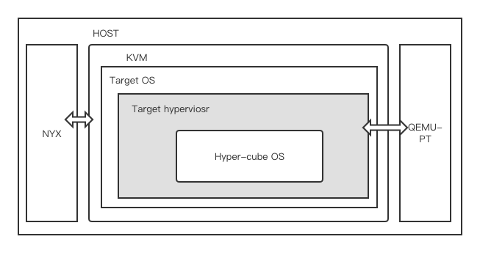
Fast Snapshot Reloads
Run the target software inside a KVM VM.
Run fuzzer is outside the VM, restore the VM to a prior state after triggering a crash
Extended QEMU-PT and KVM-PT with the ability to perform very fast VM reload operation (solve non-determinism)
KVM can efficiently identify only those page frames in memory that need to be reset. We maintain a full copy of the original state and an additional dirty page tracker that allows us to quickly reset only the dirty pages

Slide 21
Fast Snapshot Reloads
Fast Memory Resets
To create this snapshot, we implemented a hypercall that the agent uses to inform the fuzzer to create the incremental snapshot from which each test case will be started.
KVM’s technique requires us to walk a large bitmap to find all dirty pages,
Extended KVM-PT with the capability to store the addresses of dirty pages in an additional stack-like buffer.
To ensure that memory that is changed by QEMU-PT is also reset.
A second map where VM pages modified by QEMU-PT are also noted.

Slide 22
Fast Snapshot Reloads
Fast Device Resets
Each device emulator provides a specification for its state in form of a specific data structure
QEMU iterates this data structure to identify fields, integers, arrays, and so on
Instead, we log all writes once during this process and obtain a list of all memory used by the devices, use snapshot to reset them
Some devices require to run some custom code after each reset. Use QEMU-PT and call the original deserialization routine for these devices specifically

Slide 23
Fast Snapshot Reloads
Fast Disk Resets
The guest’s hard disk content is stored on the host’s hard disk in a so-called qcow file
Create a hashmap that stores the content of modified sectors. Every read access to the disk image is first checked against this hashmap, then against qcow file
Resetting the disk image is then as easy as zeroing out the small hashmap

Slide 24
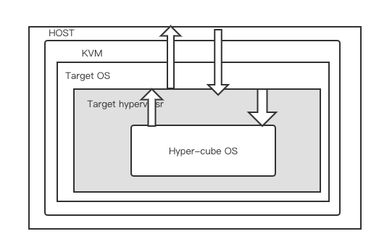
Nested Hypervisor Communication
Traditionally, to handle a write access to a port I/O address at L2, L0 has to handle the trap first, pass on the PIO exit reason to L1, and trap the VM re-entry at L1 and emulate it to continue execution in L2
VM-exit
VM-reentry
L0
L1
L2

Slide 25
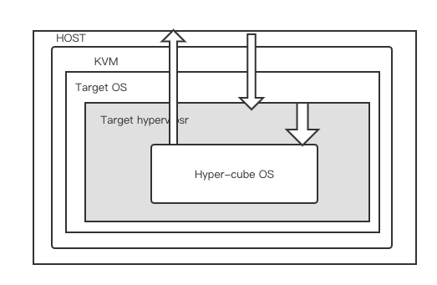
Nested Hypervisor Communication
They implemented special hypercalls and corresponding handlers that avoid being forwarded to the target hypervisor.
Also set up a section of shared memory to efficiently pass the inputs from the logic to the agent.
VM-exit
VM-reentry
L0
L1
L2

Slide 26
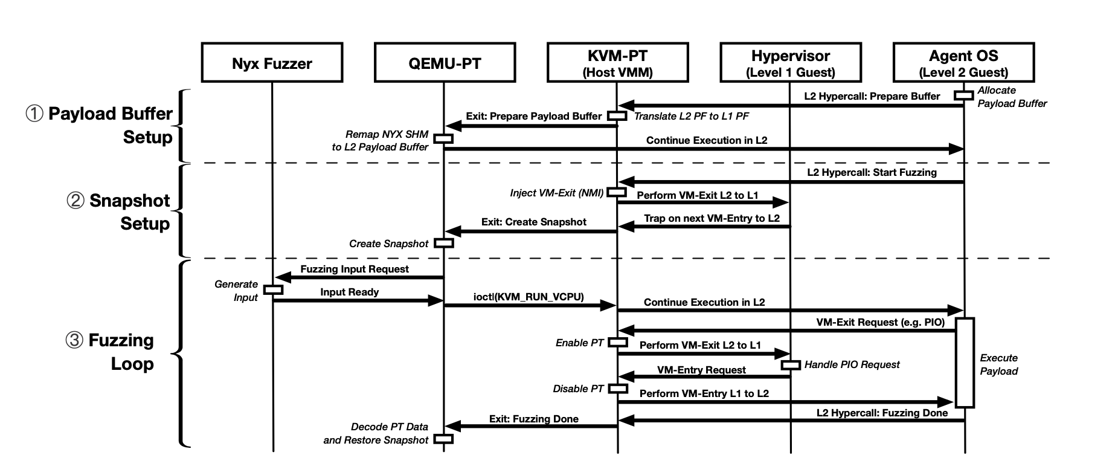
Nested Hypervisor Communication
L0
L1
L2
Agent OS use hyercall
pass all physical addresses of allocated memory region to the host
Then, The host translates all guest physical addresses creates a shared memory mapping

Slide 27
Nested Hypervisor Communication
L0
L1
L2
Agent OS (L2) executes a special hypercall to create the snapshot for the fuzzing loop

Slide 28
Nested Hypervisor Communication
L0
L1
L2
On each transition from L2 to L1, Intel- PT tracing is enabled
The shared memory is used to receive messages from the agent OS or to pass new generated inputs to the agent.

Slide 29
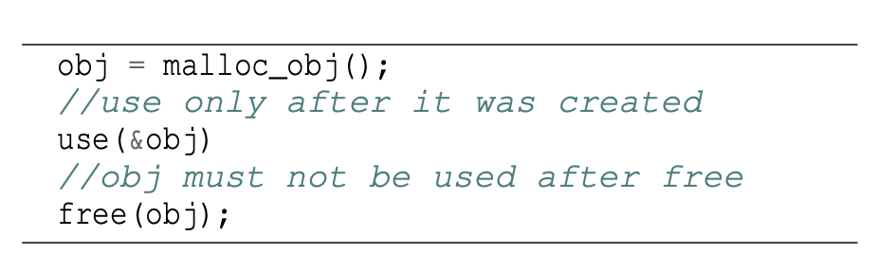
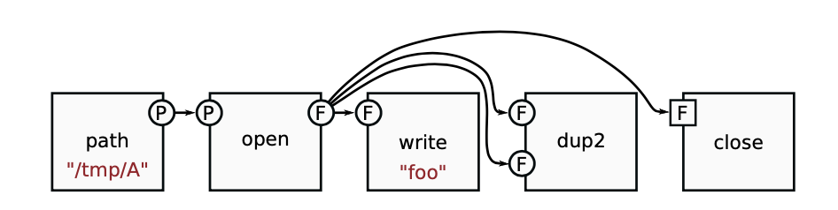
Affine Typed Byte-code Programs
Graph layout (u16 integers )
[n_new_path_id, p, n_open_id, p, f,n_write_id, f,
n_dup2_id, f, f, n_close_id, f].
Graph data
[7,"/tmp/A\0",4,"foo\0"]

Slide 30
Affine Typed Byte-code Programs
Aim to express general interactions with temporal create/use/delete/do-not-reuse constraints.
These graph are stored in shared memory
transpile these specifications into a single C-header interpreter for the bytecode

Slide 31
Evaluation

Slide 32
Questions
RQ 1. How does NYX compare to state-of-the-art approaches such as HYPER-CUBE and VDF?
RQ 2. Does coverage guidance improve generative fuzzing?
RQ 3. What are the performance gains provided by the structured mutation engine?
RQ 4. What is the performance impact of fast reloads?
RQ5. Can NYX find previously unknown vulnerabilities in well-tested parts of hypervisors?

Slide 33
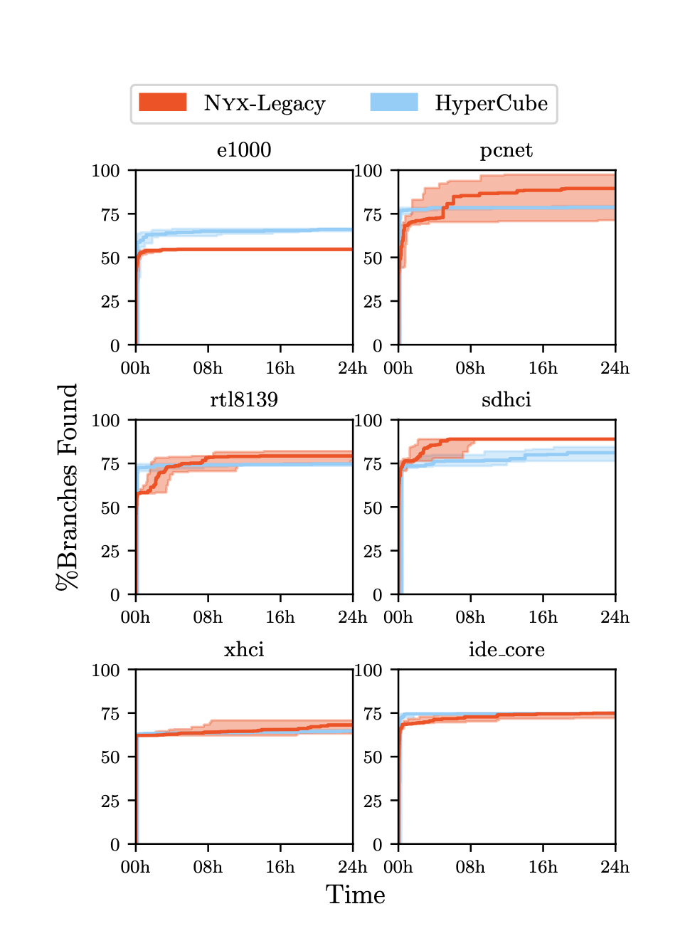
RQ1: NYX performance
Conduce experiments for 24 hours
Ran the target VM with Gcov, and restarted it every 10 minutes or after each crash to dump the coverage
Hyper-Cube dominated in the first few hours

Slide 34
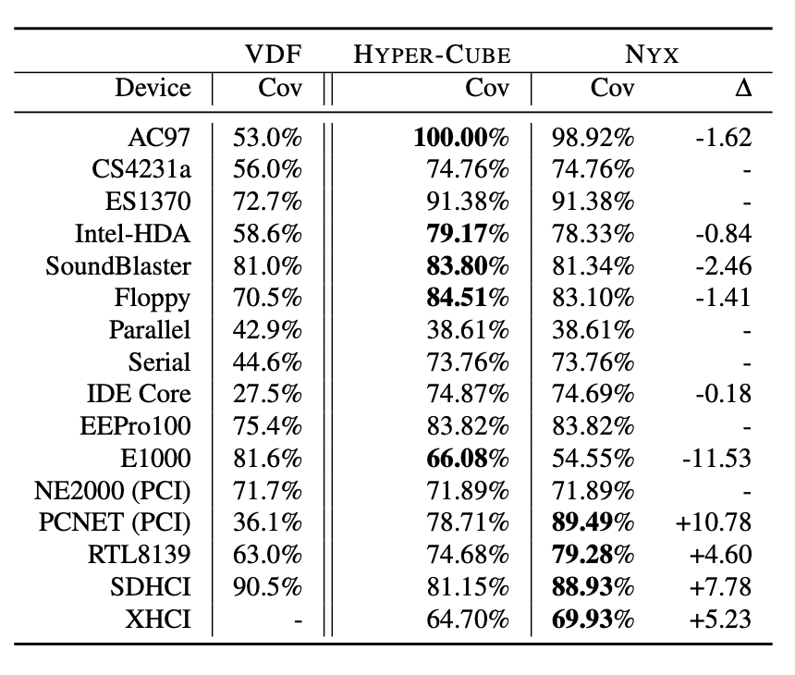
RQ1 & RQ2: Coverage guide
NYX easily surpasses VDF
In simple device, NYX and HYPER-CUBE perform identical or nearly identical
On the more complex devices, this effect is particularly pronounced in the complex examples where HYPER-CUBE stops making any progress very early

Slide 35
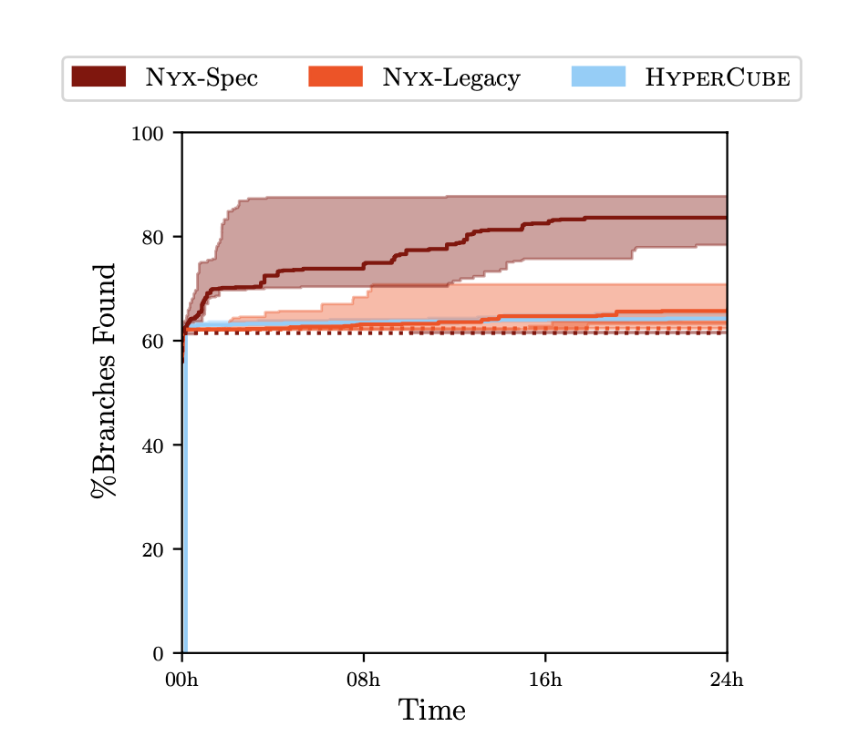
RQ3: Structured mutation engine
Built specifications that specifically target devices with complex data structures in the memory (like multiple link lists)
NYX dominate even in the first few hours
Disabling the coverage guidance mechanism of NYX, complex specifications added very little coverage

Slide 36
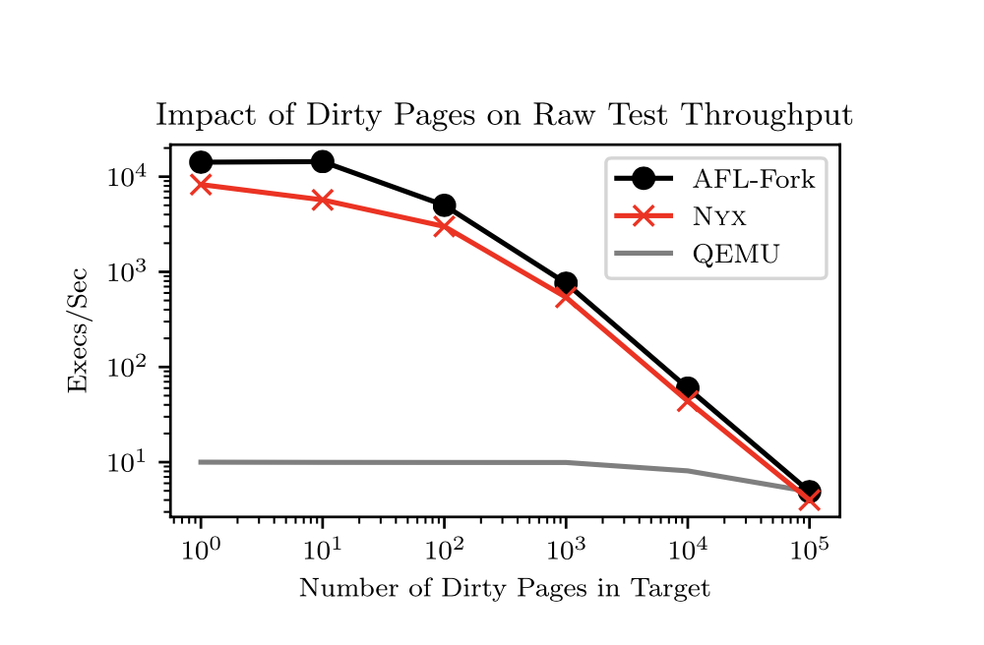
RQ4: Snapshot Reload
we created a small test application that dirties a given number of pages on each execution
QEMU always restores the full snapshot. Hence, the performance remains constant
While obtaining similar performance, NYX reloads perform a lot more.
Like :
reset devices’ state
shows up the number of pages reloaded

Slide 37
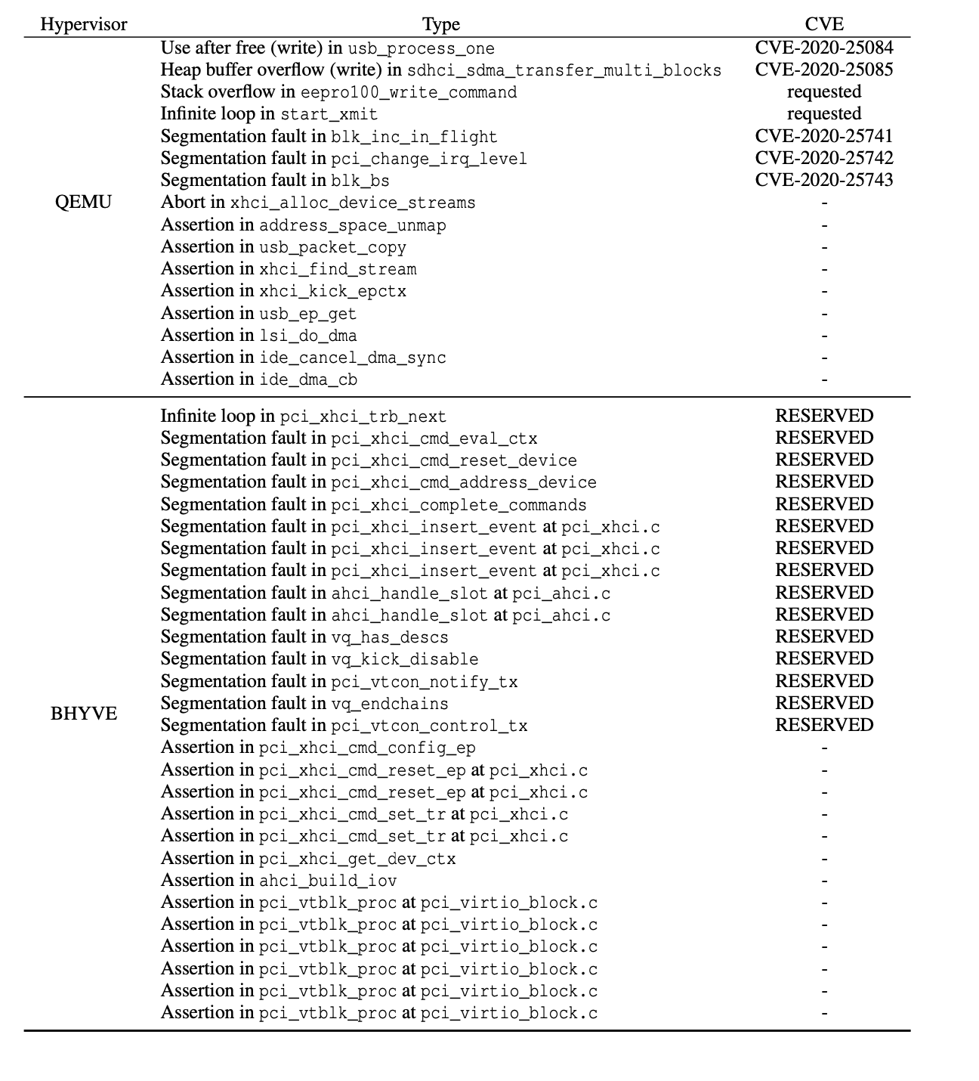
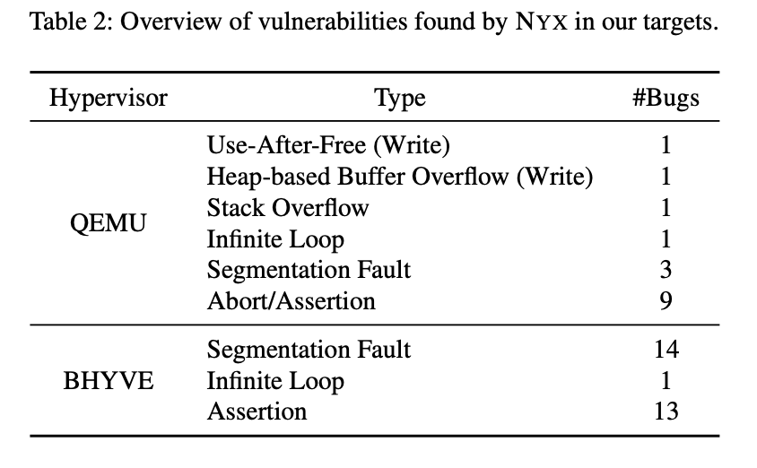
RQ5: Vulnerabilities

Slide 38
Related work & Discussion

Slide 39
Related work
Snapshots were already used in the context of testing.
Time-travel Testing of Android Apps: takes approximately nine seconds to restore a single snapshot
https://github.com/gamozolabs/chocolate_milk: can quickly reset the memory of VMs ,but does not support emulated devices.
Fuzz on hypervisor(blind fuzz)
Hyper-V
Attacking hypervisors via firmware and hardware. Black Hat USA, 2015.
…

Slide 40
Discussion
It is slightly more complex to setup than HYPER-CUBE
Designing a specification is quite similar to designing a grammar for well-known fuzzers
long-running interactive fuzzing: instead of generating small inputs outside of the VM, a large stream could be generated from a given seed inside the target VM.

Slide 41
Thanks

