Slide 1
GUARDIAN — Threat Detection for CCTV
Architecture & Results
Overview Briefing
How it works, how it was trained, and what it achieves
10-15 minute overview

Slide 2
GOAL
What GUARDIAN Does
Watch
Detect
Alert
Live camera feeds analyzed
continuously, frame by frame
Weapons AND threatening
behavior — not one alone
Immediate notification the
moment both signals align
A single weapon in view isn't an alert. A person standing still isn't an alert.
Both together, confirmed over time, is.
GUARDIAN — Overview Briefing
1

Slide 3
ARCHITECTURE
System Overview
Cameras
Detection
Engine
Tracking &
Behavior Analysis
Alert &
Dashboard
Live video sources
Finds weapons & people
Follows subjects over time
Surfaces confirmed threats
▸ Stronger people detection: a proven, off-the-shelf people-detector is fused
– alongside our custom weapon detector, so fewer people in frame go unnoticed.
▸ Supporting platform: secure role-based access, camera management, and a live
– operations dashboard all run alongside the detection pipeline.
GUARDIAN — Overview Briefing
2

Slide 4
THREAT LOGIC
How a Confirmed Alert Is Triggered
Weapon
Detected
+
Threatening
Behavior Detected
Same person, same moment
CONFIRMED ALERT
A weapon alone isn't an alert. A tense posture alone isn't an alert — only both together escalate.
GUARDIAN — Overview Briefing
3

Slide 5
TRAINING
How Both Models Were Trained
Collect &
Unify Data
Simulate CCTV
Conditions
Train
Deploy
Real weapon/behavior
footage, one label set
Blur, noise, compression,
low angles added
Detector learns weapons/
people; classifier learns behavior
Both models run live
in the pipeline today
▸ Both models are fully trained: the weapon/people detector and the behavior
– classifier are both trained end-to-end on real footage — results on the next two slides.
▸ Simple, deployable design: the behavior classifier runs on a compact CNN — simpler
– and faster to train and validate than a recurrent model.
GUARDIAN — Overview Briefing
4

Slide 6
RESULTS
Weapon & Person Detector — Performance
~95%
~94%
~91%
Detection Accuracy (mAP@50)
Precision
Recall
Across Gun / Knife / Suspect
Of flagged detections, correct
Of real targets, caught
▸ Trained on 11,996 unified images spanning gun, knife, and person detection, with
– CCTV-realistic augmentation (motion blur, low-light noise, compression artifacts).
GUARDIAN — Overview Briefing
5

Slide 7
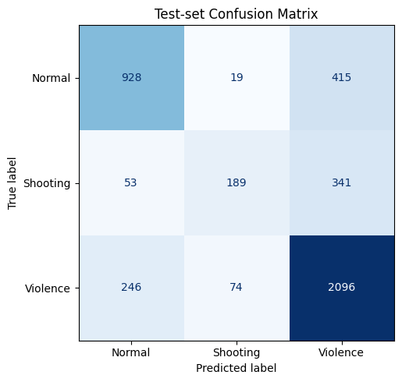
RESULTS
Behavior Classifier — Performance
~74%
29K+
87%
Overall Test Accuracy
Training Sequences
Violence Recall
Across Normal / Shooting / Violence
Built from real surveillance footage
Strongest-performing class
▸ Trained end-to-end on 29,000+ sequences built from real surveillance video.
▸ Known weak point: Shooting is often confused with Violence (see matrix) —
– the next data/tuning priority.
GUARDIAN — Overview Briefing
6

Slide 8
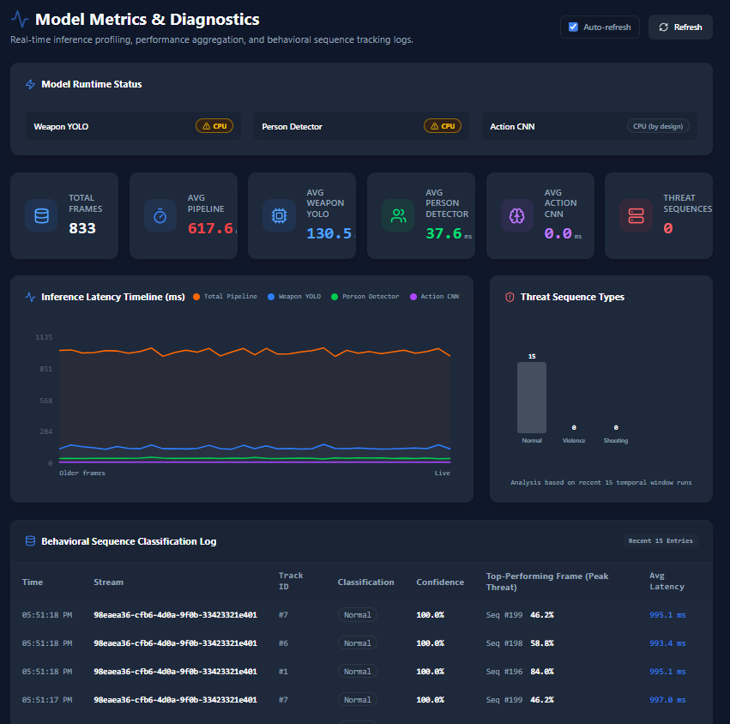
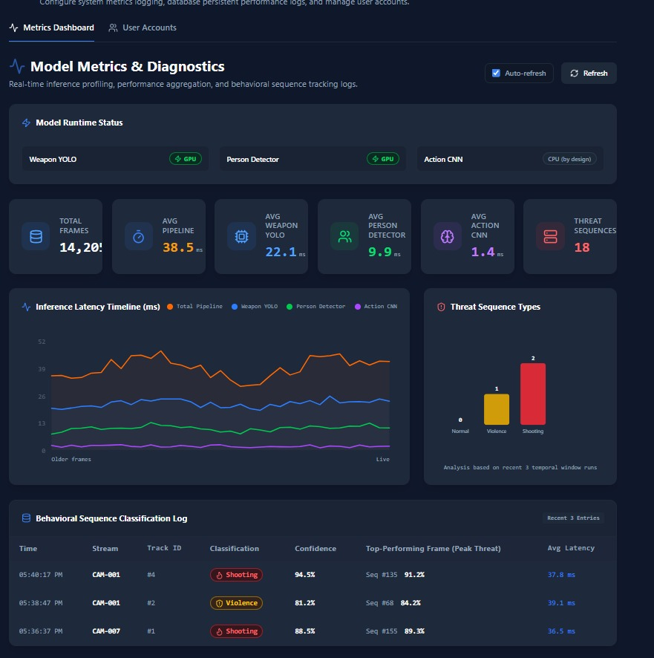
LIVE SYSTEM
Operating Metrics Dashboard
Current — CPU
Expected — GPU
Pipeline latency: 617.6 ms today (CPU) vs. 38.5 ms on the target GPU deployment.
GUARDIAN — Overview Briefing
7

Slide 9
NEXT STEPS
Where We Go From Here
Formal
benchmarking
Improve Shooting
recall
Pilot on live
cameras
Validate performance on a
held-out test set
More labeled examples for
the classifier's weak point
Validate in a real site
environment
Both models are trained and running end-to-end today.
The next milestone is a live pilot deployment.
GUARDIAN — Overview Briefing
8

Slide 10
Thank you
Questions & discussion
GUARDIAN — Overview Briefing
9

