Slide 1
Team mermAId
LEVERAGING AI/ML FOR PLASTIC MARINE DEBRIS
Shania Fernandes

Slide 2
Introduction to mermaidAI
Mermaids are creatures from folklore who are said to reside in the ocean and bestow boons. Likewise, mermaidAI aims to be a boon to oceans and marine life the world over.
At least 8 million tons of plastic end up in our oceans every year. Marine wildlife like fish and turtles are impacted the most. Plastic pollution has also been shown to affect climate change, food safety, as well as tourism.
This program will use AI to recognize and quantify elements of plastic pollution.
Much like the mythical mermaids who live underwater but also appear above the surface; mermaidAI supports 2 approaches:
Analysing data from remote-sensing satellites that work above water to detect pollution
Measuring water parameters at the surface, as well as imaging objects it recognises as debris underwater

Slide 3
1st Approach
The need of the hour is real-time measurements of marine pollutants and toxins. Satellite remote sensing covers large and remote areas, and maps and monitors water pollution of different types, characteristics, and concentrations.
Data obtained can be used to monitor and manage environmental impacts and understand what controls the spatial distribution of debris.
How it works:
Remote sensors capture variations in inherent optical properties (IOP) of water, such as absorption and scattering. Reflection, absorption, and transmittance of electromagnetic radiation are highly dependent on the concentrations, types, and presence of substances in water. Hence, ocean color represents the data which can be used to estimate the concentrations of water constituents.
mermaidAI will utilize the following:
Live data provided by Global Forest Watch, as well as
Data from AIRSAR Mission to add to the dataset
Using these, we aim to detect and classify marine debris found at any given location. This data will then be used to devise methods to clean up the ocean, and divert pollutants for safe disposal.

Slide 4
2nd Approach
Parameters measured:
Types of Plastic Trash:
Datasets used:
Datasets Used:
Remote water quality monitoring from the surface is done with multiple sensors that measure the most relevant water quality parameters, With this data, we can use AI to perform chemical leakage detection and levels of seawater pollution.
The undersea approach relies on high-powered cameras and AI to image and monitor debris in places previously inaccessible to humans. It has access to a dataset of pollutant images, and continues building upon it.
pH, dissolved oxygen (DO), oxidation-reduction potential (ORP), conductivity (salinity), turbidity, temperature and dissolved ions
Microplastics, Persistent Bioaccumulative and Toxic Substances (PBTs) And Plastics, among other kinds
EOSDIS Ocean Data
Global Drifter Database, NOAA
100,000+ images of plastic debris

Slide 5
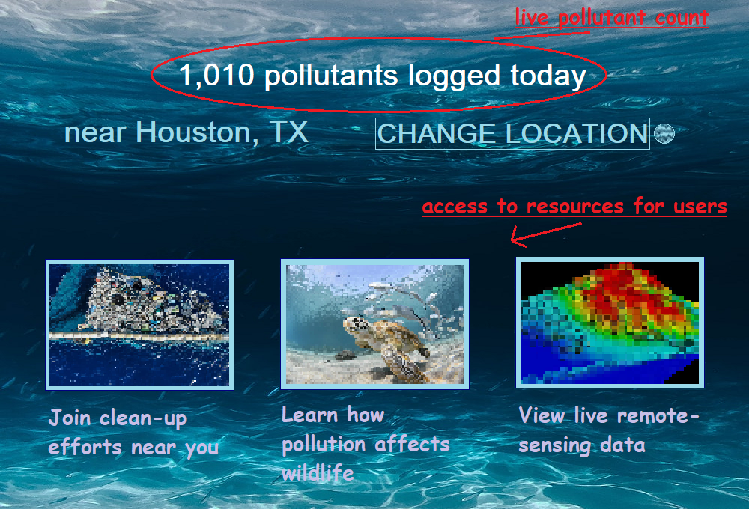
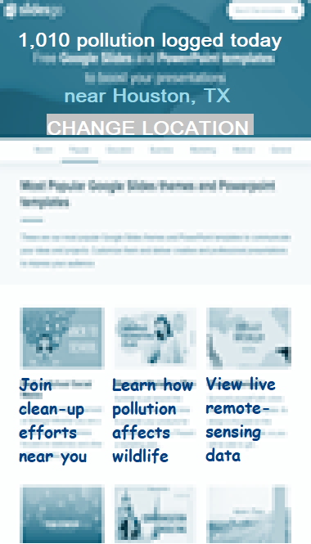
Public access via Dashboard
Information gathered by mermaidAI, such as volume of pollutants recorded, along with location will be available to the public, both on desktop and mobile.
Users will be presented with an easy-to-use interface; a prototype of which is illustrated here.
Few features included are:
Access to joint clean-up efforts in proximity
Facts about marine pollution’s impact on wildlife
Ability to view pollutant data in other locations, etc.

Slide 6
AI in reducing marine pollutants
ADVANTAGES
Giving public access to real-time data emphasises the need to act now, and provides them with means to make a difference
Allow for marine litter to be followed in real-time, enabling responses that are quick, targeted, and more effective
Predictive technology can also help understand the human actions and subsequent changing conditions that harm the oceans
AI can gather data from ocean locations that are hard or impossible to reach and thus, help protect species and habitats
LIMITATIONS
Immaturity in terms of TRL (Technology readiness levels)
Difficulty of achieving data harmonisation

Slide 7
Results and Future Scope
We hope mermaidAI makes a significant contribution towards measuring and controlling plastic waste. This approach aims to bring about the following positive changes:
Clean up our water to avoid consumption of 39,000 to 74,000 microplastic particles per human, per year
Protect our coral reefs, by reducing pollutants that smother coral reefs, make them more susceptible to disease and impede growth
Save >800 species of marine life that are harmed by debris, with impacts that include injury, illness, and death
In the future, we hope to make improvements to the public application, as well as continue to hone and perfect the ML model with new data. We hope to see this program applied to oceans around the world.

