Slide 1


Revealing Trends and Student Experience by Analyzing Pre- and Post-Survey Accelerator Results.
By SHANICE JERRIHO| DATA ANALYST
Follow the Code On GitHub:
https://github.com/Shanicenj/Braven

Slide 2

ANALYTICAL PROCESS
Guide through Visualization and Story-Telling Understand Student Experience at Braven
STEP 01
STEP 04
Brief Initial Summary/Overview of the Data
Review of NPS Score and Braven’s Likelihood of Recommendation
STEP 02
STEP 05
Evaluation of Coursework Complexity and Completion Time
Questions,
Next Steps and Recommendations
STEP 03
STEP 06
Assessment of Job-Search Efficiency Categories
Conclusion

Slide 3







Brief Overview
of
Survey Data
Surveys Were
Completed
Before &/or After the
Braven
Accelerator
The Following Analysis
is Based
on a
Subset
of Survey Data
Surveys were
Completed by
Rutgers University-Newark
And
San Jose State University
Campus Students
ALL Pre- and Post-
Accelerator
Surveys were
Initiated/Completed
Between August 2019
and February 2020
For Reference:
The Amount of Time A Survey Took to Complete Ranged from ~5 Minutes to ~3 Months. Question Raised on Data Entry/Software Error.

Slide 4

283
202
This Analysis
Will Focus on
202 Pre &
Post Survey Takers
Brief Overview
of
Survey Data Continued…
Total Survey Participants
Only 202 Participants Completed Both the Pre- and Post-Accelerator Survey. Analysis Will Be Primarily Based Around This Demographic
246 Participants Completed the Pre-Accelerator Survey, Where 44 Participants Did Not Take the Post-Accelerator Survey
239 Participants Completed the Post-Accelerator Survey, Where 37 Participants Did Not Take the Pre-Accelerator Survey
The 202 Students Who Initiated/Completed Both Surveys, Did So Between August 2019 – December 2019
For Reference:

Slide 5



Final Overview of Survey Data!
College Sites
Fields of Study
Braven Coursework Analysis
Rutgers University-Newark Had 62 Survey Participants
San Jose State University Had 140 Survey Participants
50 Different College Majors
Insight:
Most Common Majors Were: Business Management/Administration; Psychology; Biology; Communications; Computer Science
Insight:
There’s One Category Titled [Other] Which Consisted of 12 College Majors. I’m Unsure if These Majors Were Included in the Overall College Major Category.

Slide 6
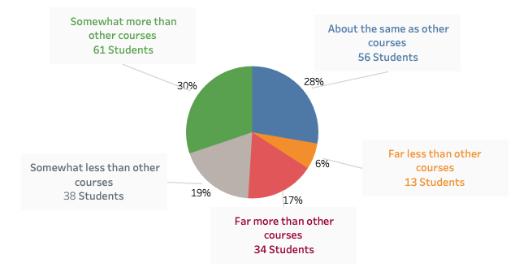

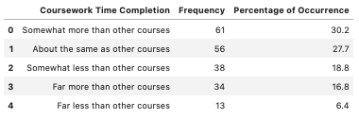
Braven Coursework + Time Completion
Compared to Other Courses
Total Students by Coursework Completion Time
Insight:
Students Recorded the Average Amount of Time They Were Likely to Spend on Completing Braven Coursework In Comparison to Their Other Courses via 5 Answers, spanning from Far Less than Other Courses- to - Far More than Other Courses.
30% Of Students Feels Braven Coursework Took Somewhat More Time than it Would to Complete Their Other Coursework,
While 6% of Students Feels Braven Coursework takes Far Less time to Complete than their Other Courses

Slide 7
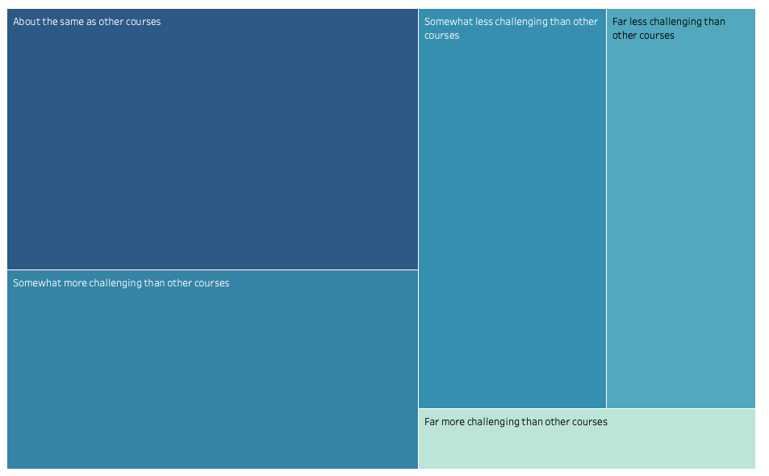

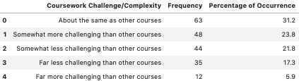
Braven Coursework + Challenge/Complexity
Compared to Other Courses
Coursework Challenge and Complexity Compared to Other Courses
63 Students
or
31%
44 Students
Or
22 %
35 Students
Or
17%
48 Students
or
24%
12 Students or 6%
Insight:
Students Recorded the Level of Difficulty they faced Completing Braven Coursework in Comparison to their other Coursework via 5 Answers, Scaled From Far Less than Other Courses – to - Far More Challenging than Other Courses.
31% Of Students Feels Braven Coursework Was About the Same Difficulty as their Other Courses
While 6% of Students Feels Braven Coursework is Far More Challenging than Other Courses

Slide 8
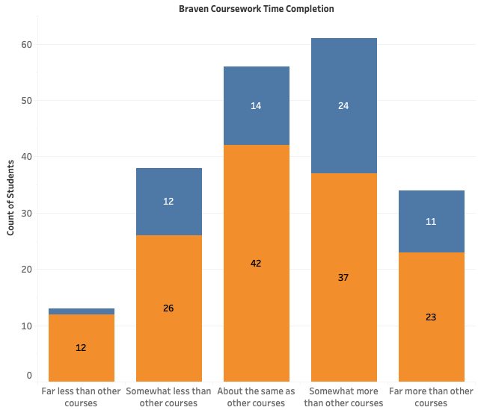
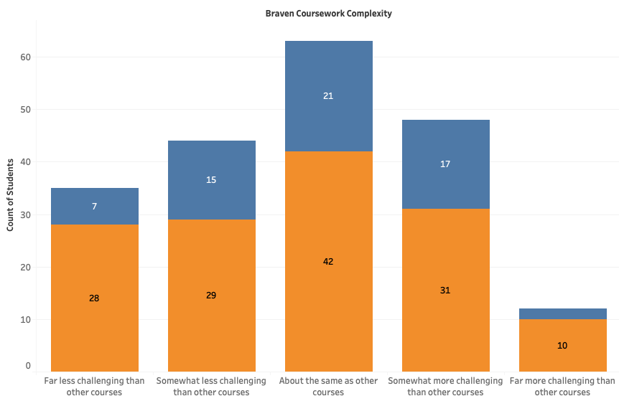

Distribution of Coursework Experience Across Sites
Coursework Time Completion By Site/Campus
Coursework Challenge and Complexity By Site/Campus
1
2
2
Insight:
While SJSU Has Significantly More Students, Despite this, the Trend Regarding Coursework Appears the Same for Both Sites.
For Reference
Students Recorded the Average Amount of Time They Were Likely to Spend on Completing Braven Coursework In Comparison to Their Other Courses via 5 Answers, spanning from Far Less than Other Courses- to - Far More than Other Courses.
Students Recorded the Level of Difficulty they faced Completing Braven Coursework in Comparison to their other Coursework via 5 Answers, Scaled From Far Less than Other Courses – to - Far More Challenging than Other Courses.
Job Search Analysis

Slide 9
JOB SEARCH EFFICIENCY MINDSET BEFORE & AFTER THE BRAVEN ACCELERATOR
What Are the Changes? What’s Braven’s Impact?
Ability to
Get the Job I Want
Ability to
Get the Job I Want
Having
What It
Takes to
Get a Good Job
Having
What It
Takes to
Get a Good Job
Successful
Job Search
Successful
Job Search
For Reference:
Students Recorded the Level of Confidence or Certainty About: Whether they Feel They Can Attain a Job, Whether they Feel they Can Get the Job They Want, and Whether they Believe they’ll Be Successful in Their Job Search. The Total 7 Possible Responses Were the Following:
7-Strongly Agree, 6- Agree, 5- Moderately Agree, 4-Neutral, 3-Moderately Disagree, 2- Disagree, 1-Strongly Disagree. Students Answered These 3 Questions Before and After Completing the Accelerator.

Slide 10
JOB SEARCH EFFICIENCY AFTER THE BRAVEN ACCELERATOR
What Has Changed?
Ability to Get the Job
You Want
Being Successful
at the Job Search
58% or 117 Students Increased Their Scaling Response Positively
28% or 56 Students Kept the Same Answer
14% or 29 Students Lowered their Rating
51% or 103 Students Increased Their Scaling Response Positively
32% or 65 Students Kept the Same Answer
17% or 34 Students Lowered their Rating
Have What it Takes To
Get a Good Job
57% or 116 Students Increased Their Scaling Response Positively
26% or 53 Students Kept the Same Answer
16% or 33 Students Lowered their Rating
Total = 99%
For Reference:
Students Recorded the Level of Confidence or Certainty About: Whether they Feel They Can Attain a Job, Whether they Feel they Can Get the Job They Want, and Whether they Believe they’ll Be Successful in Their Job Search. The Total 7 Possible Responses Were the Following:
7-Strongly Agree, 6- Agree, 5- Moderately Agree, 4-Neutral, 3-Moderately Disagree, 2- Disagree, 1-Strongly Disagree. Students Answered These 3 Questions Before and After Completing the Accelerator.

Slide 11
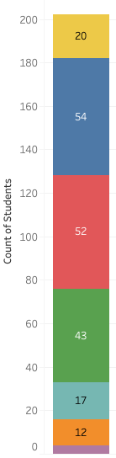
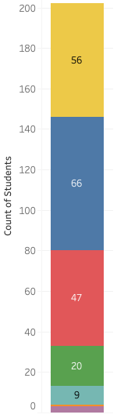
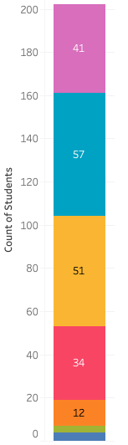
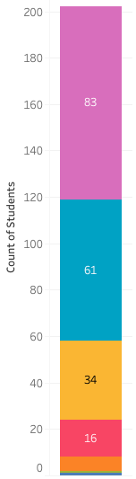
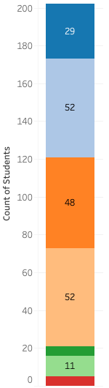
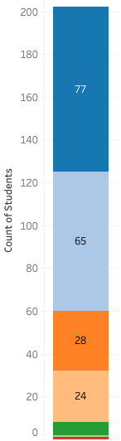
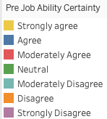
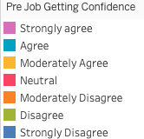
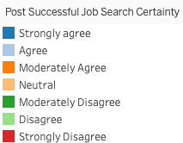
Deeper Dive Into the JOB SEARCH EFFICIENCY
BEOFRE & AFTER
the Braven ACCELERATOR
Insight:
ALL Strongly Agree and Agree Categories Observed a Positive Increase In Post-Survey Responses Compared to Pre-Survey Responses; Where ALL Strongly Disagree, Disagree, and Moderately Disagree Revealed a Decline.
ALL Categories Faced a Decrease in Moderately Agree and/or Neutral Responses.
Pre-Accelerator Survey:
Certain in Ability to
Find the Job I Want
Post-Accelerator Survey:
Certain in Ability to
Find the Job I Want
Pre-Accelerator Survey:
I Have the Ability to
Find a Good Job
Post-Accelerator Survey:
I Have the Ability to
Find a Good Job
Pre-Accelerator Survey:
Certainty in a Successful Job Search
Pre-Accelerator Survey:
Certainty in a Successful Job Search
Strongly Disagree Value = 4
Disagree Value = 1
Strongly Disagree Value = 3
Disagree Value = 3
Strongly Disagree Value = 4
Moderately Disagree = 6
Disagree Value = 1
Strongly Disagree Value = 1
Moderately Disagree = 11
Disagree Value = 5
Strongly Disagree Value = 5
Moderately Disagree = 6
Disagree Value = 1
Strongly Disagree Value = 1
NPS Score

Slide 12
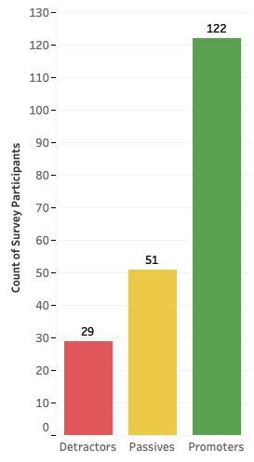

NPS Score Brief
NPS Score – Student Satisfaction
60.4%
24.2%
14.4%
Distribution of Students
Grouped By
Categorized Satisfaction
Promoters
122 Students Rated 9-10, Will Definitely Recommend Braven
Passives
51 Students Rated 7-8, May Possibly Recommend Braven
Detractors
29 Students Rated 0-6, Are Unlikely to Recommend Braven

Slide 13

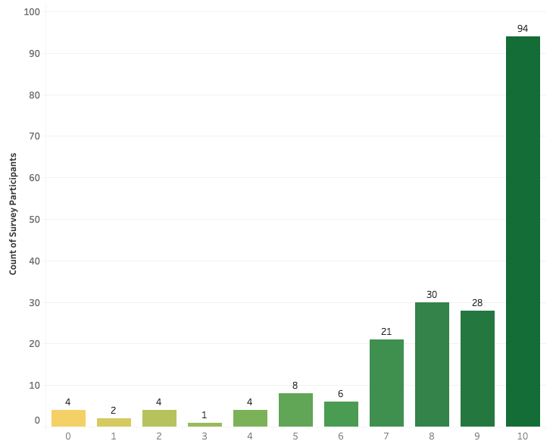

NPS SCORE
Distribution of Student
Ranking Reponses
Good, Yet Under the 2020 NPS Benchmark (71) for Education & Training Industry.
This Score Only Reflects 202 Students Who Completed Both Pre/Post Surveys.
46
Top 5 Most Common Rankings Were
10 = 94 Votes
8 = 30 Votes
9 = 28 Votes
7 = 21 votes
5 = 8 Votes
For Reference:
A Student Chooses On a Scale of 1-10, How Likely They Are to Recommend Braven.
1- Not Likely and 10-Being Most Likely.

Slide 14
DID ANY QUESTIONS ARISE? Yes!
What Would I Like To Know?!
SURVEY LENGTH 01
STUDENT RETENTION 04
Survey Response Rate and Data Quality are impacted by the Length of the Survey. As Survey Length Increases, Response Rate & Data Quality Decreases. What does the FULL Pre- and Post- Accelerator Surveys Entail?
What Happened to Students Who Did not complete Pre- or Post- Accelerator Surveys? Is that an Indicator of Late Enrollment or Student Withdrawal? Are Surveys Mandatory?
MENTOR SUPPORT 02
DATA QUALITY 05
How Often are Students Keeping Up with Scheduled Mentor Meetings, Coaching and etc. ?
Many Survey Completion Lengths Vary from Minutes to Months. Significant Outliers! Is there an issue With the Software? Data Entry Error?
BRAVEN X 03
SUVERY LENGTH PT2 06
How Many of Your Students Transition into Braven X Fellows?
Why New Jersey and California, as Opposed to New Jersey and NYC (Lehman)? I’m Interested in Chicago’s Data as Well!

Slide 15


Next Steps + Recommendations
What’s Next in Future Analysis to Come?
01
02
Evaluate the Data Workflow Diagram
Analyze Student Grades , Productivity During Accelerator, & Survey Completion Time
03
04
Review Other Student Demographic Such As: Freshman, Senior, Transfer etc.
Understand Student Career Goals & Aspirations
05
06
Dive Into NPS Detractors. Why Wouldn’t They Recommend Braven?
Complete Further Statistical Analysis and Analyze Next Semester’s Survey Results

Slide 16

Thank You
By:
Shanice Jerriho
Leaders Emerging From Everywhere,
Empowered to Excel Anywhere.
Contact
Me:
Follow the Code On GitHub:
https://github.com/Shanicenj/Braven
LinkedIn:
https://www.linkedin.com/in/shanicejerriho1/
Email:
ShaniceNJ1@gmail.com

