Slide 1


Green Pace
Security Policy Presentation
Developer: Shanine Efferson

Slide 2

OVERVIEW: DEFENSE IN DEPTH
This security policy will be used to define secure coding principles, standards and encryption practice for all developers to follow within Green Pace.

Slide 3
THREATS MATRIX
Likely Buffer overflow | Priority SQL Injection
Low priority Inconsistent code formatting | Unlikely Supply chain attack

Slide 4
10 PRINCIPLES
Validate Input Data
Heed Compiler Warnings
Architect and Design for Security Policies
Keep It Simple
Default Deny
Adhere to the Principle of Least Privilege
Sanitize Data Sent to Other Systems
Practice Defense in Depth
Use Effective Quality Assurance Techniques
Adopt a Secure Coding Standard

Slide 5
CODING STANDARDS
Avoid reading uninitialized memory
Ensure string storage has sufficient space
Sanitize data to prevent SQL injection
Avoid accessing freed memory
Avoid using pointers to nonexistent members
Use valid references, pointers, and iterators
Avoid casting to out-of-range enumeration value
Close files when they are no longer needed
Avoid abruptly terminating the program
Handle all exceptions

Slide 6
ENCRYPTION POLICIES
Encryption at Rest: Protects the stored data
Encryption in Flight: Protects data in transit
Encryption in Use: Protects data in active memory

Slide 7
TRIPLE-A POLICIES
Authentication: Used to verify user identity.
Authorization: Provides a user with specific access based on their authorization
Accounting: Keeps track of what a user does within the system.

Slide 8
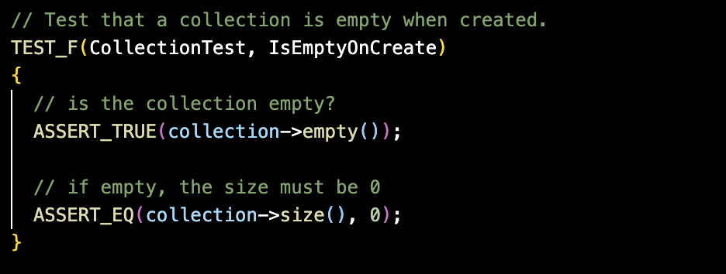
Is the collection empty after creation?
Initialize a new collection
Checks if collection is empty
Verify the collection size is 0
Expected result: Collection will be empty after creation (Positive test)

Slide 9
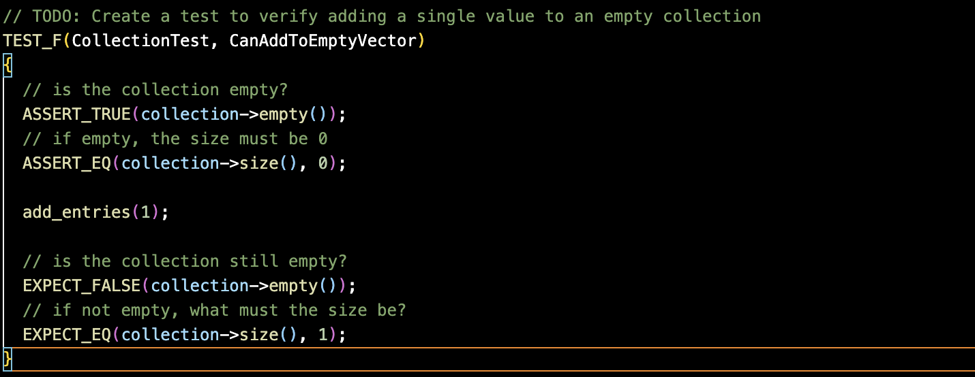
Can a single value be added to an empty collection?
Verify collection is empty
Confirm the size is 0
Insert a single value
Confirm the collection size is 1
Expected result: entry successfully accepts value (positive test)

Slide 10
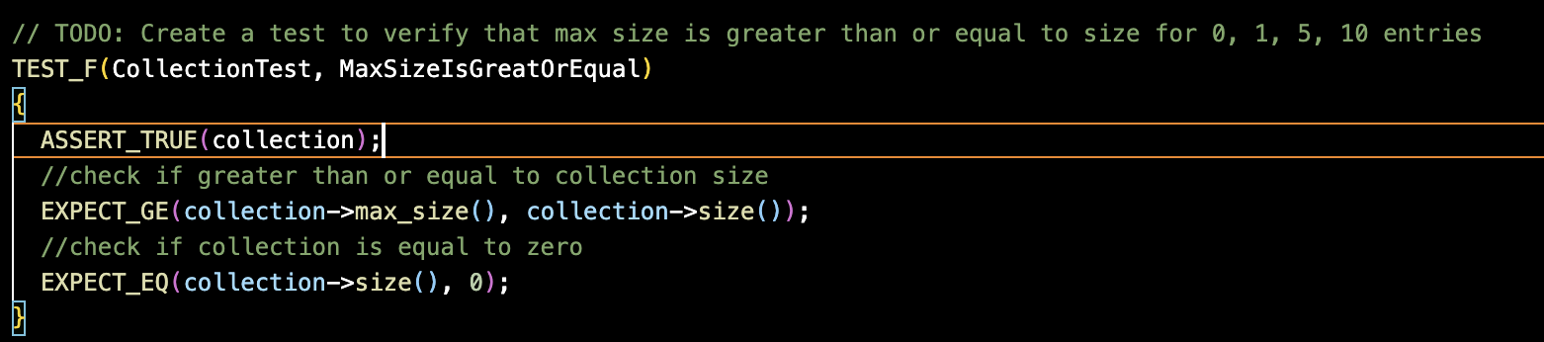
Is max size greater than or equal to size
Confirm the collection
Verify the max size
Check if the current size is 0
Expected result: collection doesn’t exceed the memory limit (positive test)

Slide 11
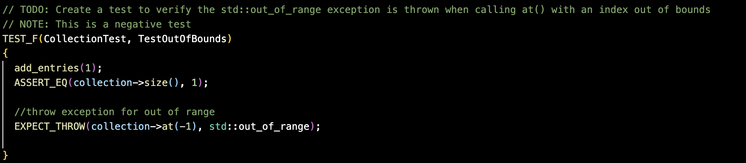
Is the collection out of bounds?
Add one entry to the collection
Throw an exception to create an error
Expected result: error is created (negative test)

Slide 12

AUTOMATION SUMMARY

Slide 13
TOOLS
DevSecOps Pipeline integrates development and security into an automated process.
Pre Production:
Parasoft C/C++test
Klocwork
Production:
CodeSonar

Slide 14
RISKS AND BENEFITS
Act Now or Wait
Problem – issues in secure coding and real time monitoring
Solution – testing, enhanced automation
Risk: data breaches, compliance failure

Slide 15
RECOMMENDATIONS
Security Gaps
No runtime threat detection
Limited testing
Inconsistent code practices

Slide 16
CONCLUSIONS
Adopt SEI CERT C++ secure coding standards
Use automated and analysis tools
Implement DevSecOps through the pipeline
Conduct security and coding training for consistency amongst developers

Slide 17
REFERENCES
CERT Division. (2023). SEI CERT C++ Coding Standard. Carnegie Mellon University. https://resources.sei.cmu.edu/library/subject-areas/c-cpp/
Google. (n.d.). Google Test Documentation. https://github.com/google/googletest

