Slide 1
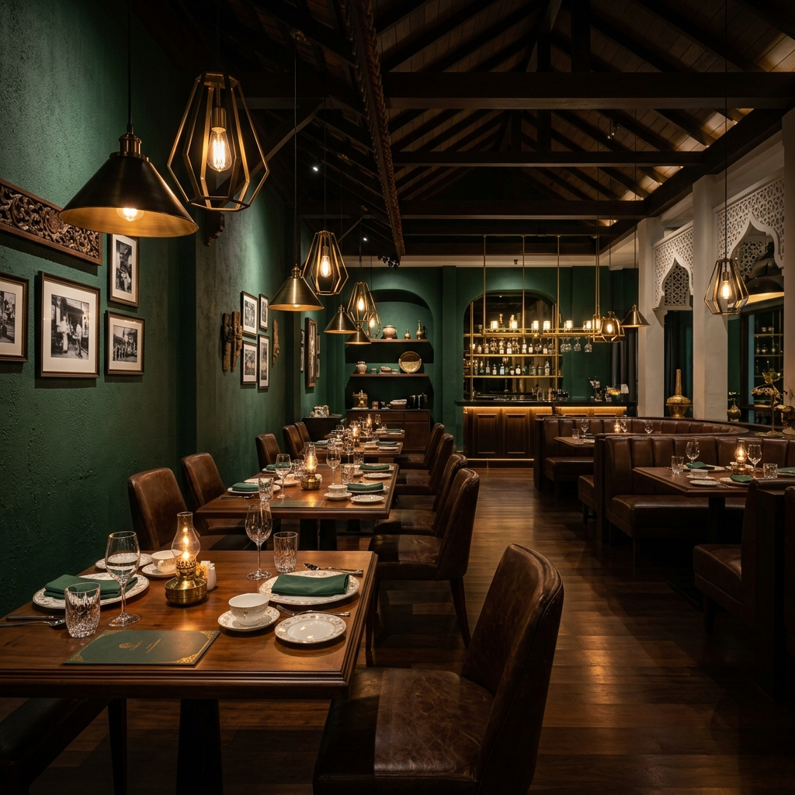
AL SAFA AR DINING
Task 1: Interactive AR Digital Menu Proposal (80-Item Database)
Course: Introduction to Multimedia Technology (BMD12083) Prepared for: Raffles University Johor Bahru Submitted by: Shanjaay (Student ID: 202420058)

Slide 2
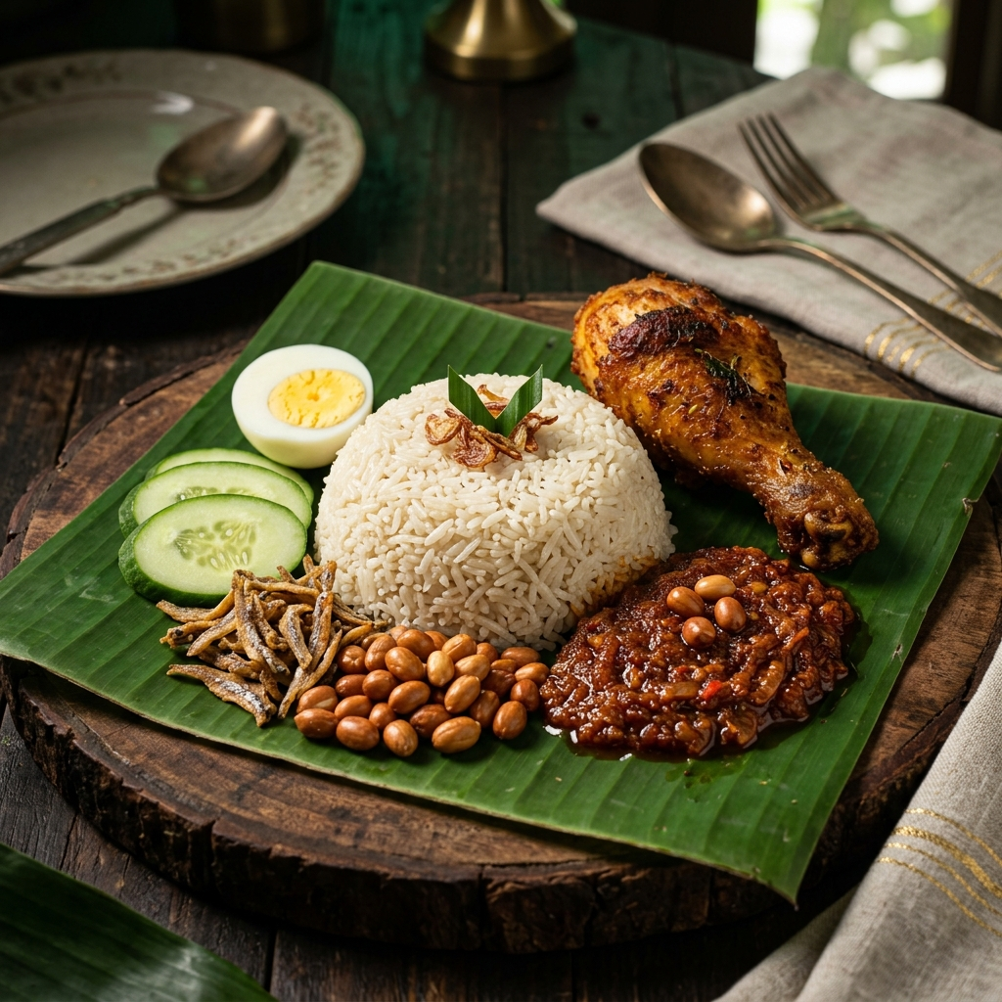
AL SAFA AR DINING
Project Introduction
Mamak Food Culture: Traditional menus lack interactive visual contexts and customization transparency, leading to orders that fail to match user customized tastes.
The Solution: Al Safa AR Dining is a responsive web application offering a massive digital menu database containing all 80 items from Mamak_Menu_Malaysia.docx.
Real-Time Overlays: Allows customers to adjust specifications (egg yolk paste, cheese slices, chili rings, flooded curry) and watch changes update instantly.
Quality Aesthetics: A luxury obsidian black, midnight green, and gold accents design system optimized for modern ambient dining layouts.

Slide 3
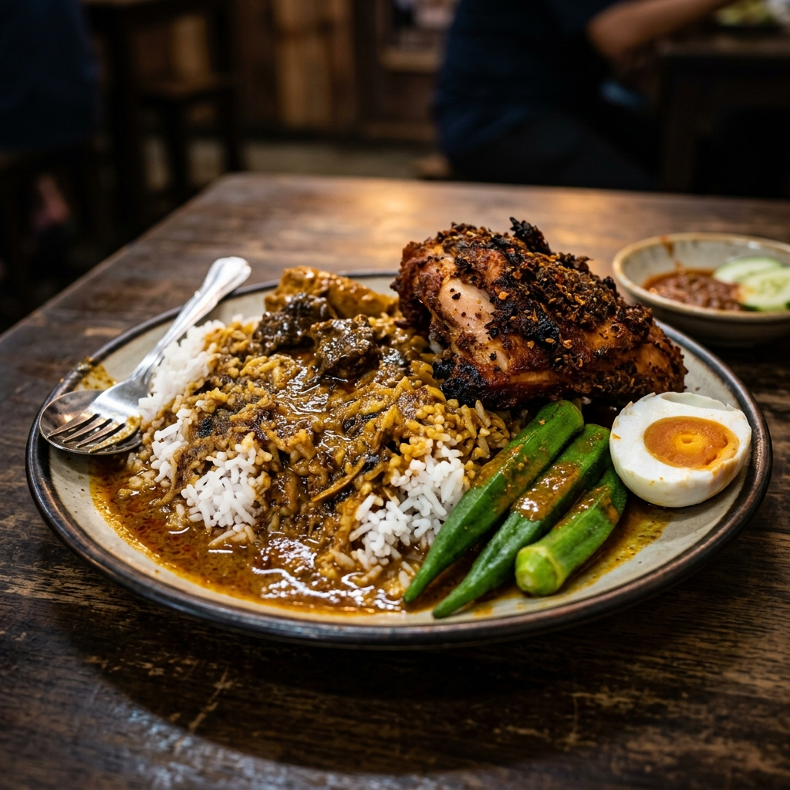
AL SAFA AR DINING
Comprehensive 80-Item Menu Database
Full Menu Integration: Loaded all 80 menu items from the official Mamak Menu database, ranging from RM1.95 (Teh O) up to RM16.90 (Nasi Goreng Special).
Categorized Navigation: Features 8 specific category filters: Roti/Flatbreads (15), Nasi Goreng (16), Noodles (9), Nasi Dishes (3), Sides/Lauk (5), Snacks/Desserts (6), Hot Drinks (10), Cold Drinks (11), and Specialty Drinks (5).
Visual Assets Mapping: High-fidelity renders act as structural templates to dynamically represent all 80 distinct items.

Slide 4
AL SAFA AR DINING
Real-Time Visual Customizers (AR Canvas)
FOOD CUSTOMIZERS (AR OVERLAYS)
DRINK SLIDERS & ZOOM DIALS
Roti Flatbreads: Programmatically overlays melted cheese grids, sunny egg yolks, or white condensed milk spirals.
Fried Rice & Noodles: Toggle spiciness (Mild, Medium, Extra Hot) to scatter red chili rings and apply red glow filters.
Curry Flood (Banjir): Adjust curry gravy height on the food plate visual using custom sliders.
Drinks Customizer: Ice level adjustments spawn transparent ice cubes; milk/rose cordial levels adjust opacity and tea/pink milk hues.
Milo Dinosaur: Adjust Milo powder slider to dynamically expand or scale the brown cocoa heap representation.
Zoom & Rotate: Perform 360-degree rotations and up to 1.8x scale transforms on 3D plate models.

Slide 5
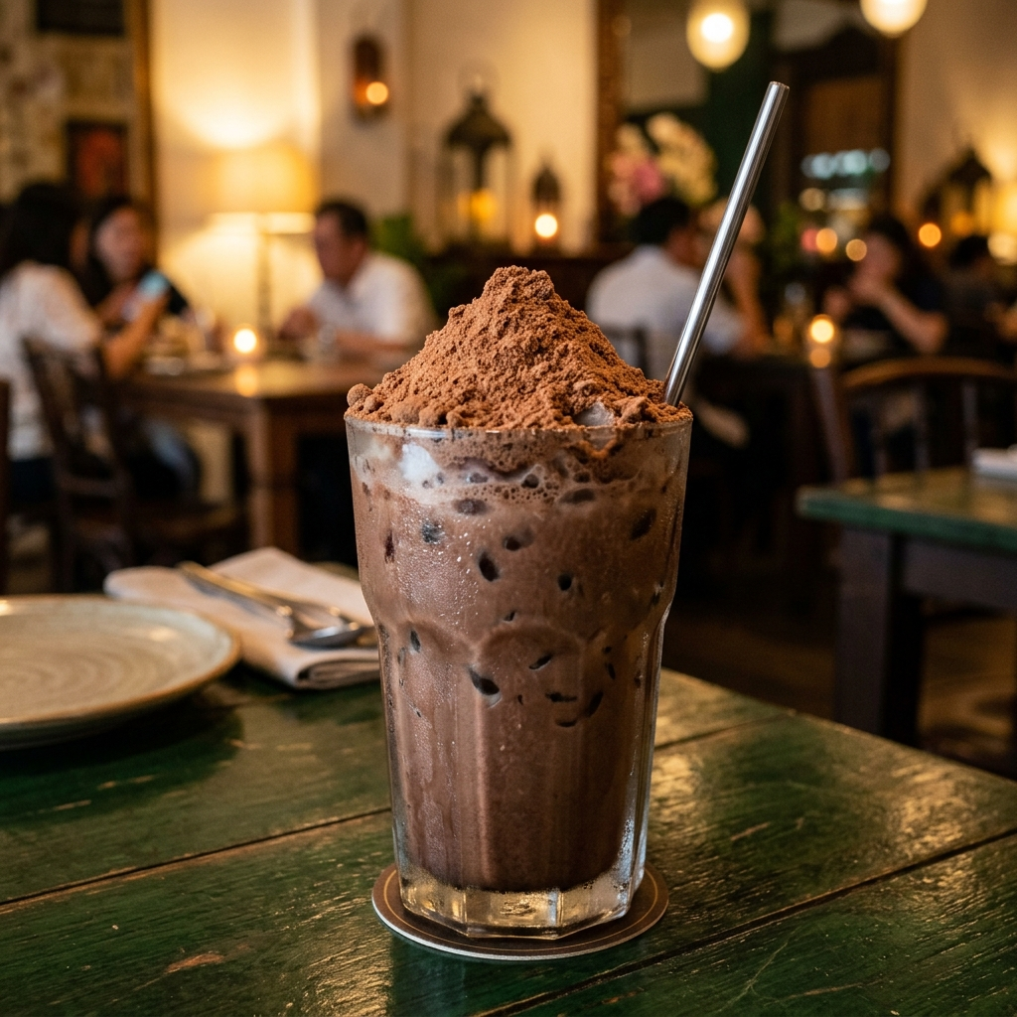
AL SAFA AR DINING
Technology & Software Stack
Application Framework: Flutter (Dart) for high-performance cross-platform web and mobile compilations.
Design & Modeling: Figma for high-fidelity UI layout vectors, and Blender for 3D modeling of foods.
Asset Compilation: Adobe Photoshop for texture editing; image generation and processing.
Interactive Engine: Programmatic transformation matrices and custom overlay painters simulating spatial camera views.

Slide 6
AL SAFA AR DINING
Project Cost & Budget Estimation
Software Licensing: Adobe Creative Cloud & Blender (RM 250 / Month - Student License)
Hardware Resources: High-Performance GPU rendering workstation (RM 4,500 - One-time)
Assets & Hosting: Web deployment server and cloud assets storage (RM 120 / Month)
Printed Marketing: NFC-integrated QR wooden table stands (RM 400 - One-time)
Estimated Total Project Budget: RM 5,770 (Initial setup and first 3 months operating costs)

Slide 7
AL SAFA AR DINING
Project Development Timeline
PHASE / TASK | DURATION | DELIVERABLES
Phase 1: Planning & Research | Weeks 1 - 3 | Project proposal, storyboard drafts, user journey maps.
Phase 2: Asset Production | Weeks 4 - 7 | 3D food models, background plates, photography styling.
Phase 3: App Development | Weeks 8 - 11 | Flutter structure, interactive AR simulator logic, UI cards.
Phase 4: Testing & Presentation | Weeks 12 - 13 | User testing, design journal slides, final project reflection.

Slide 8
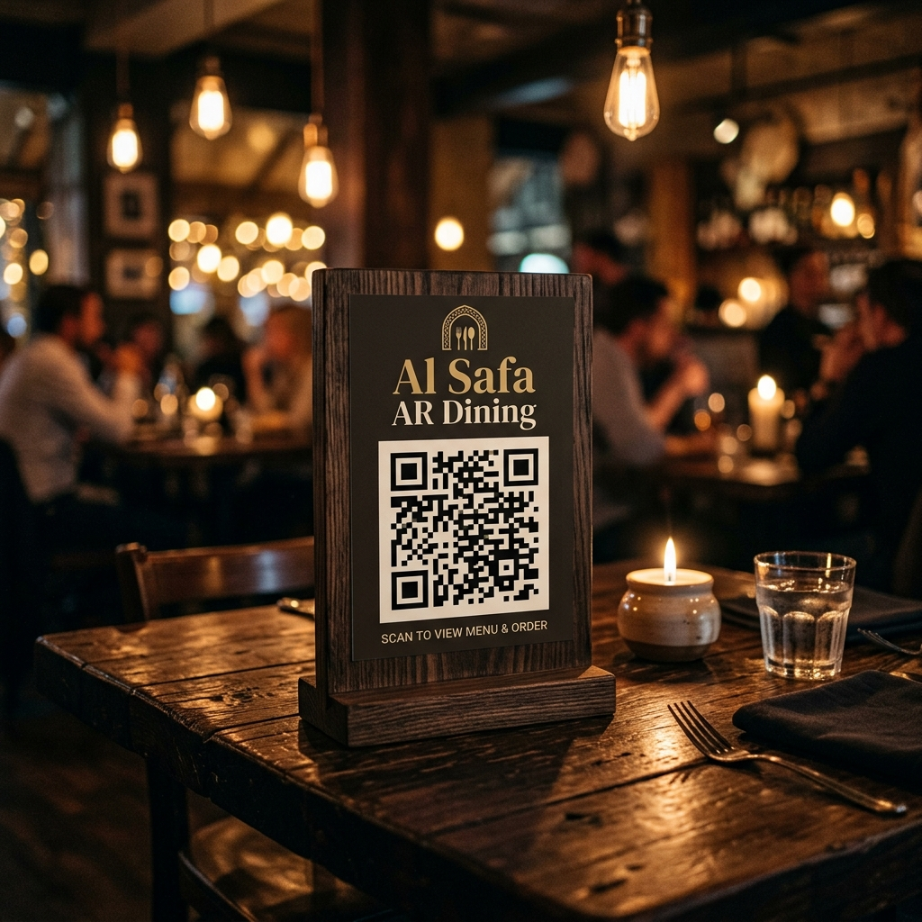
AL SAFA AR DINING
Sketches & User Storyboard
1. Scan QR Stand: Customer scans the wooden table QR stand, which launches the camera scanner and unlocks Table 12.
2. Browse Menu: User is presented with a premium layout containing 80 categorized items.
3. Detail Selection: Patron selects a dish (e.g. Roti Canai), chooses toppings (egg/cheese) or spiciness.
4. Interactive Customizer: Taps 'VIEW IN AR' to adjust sliders (gravy banjir/sweetness) and verify visual representation changes in real-time.
5. Checkout & Confirmed: Order is placed directly to Table 12, estimating 5-10 minutes preparation.

