Slide 1
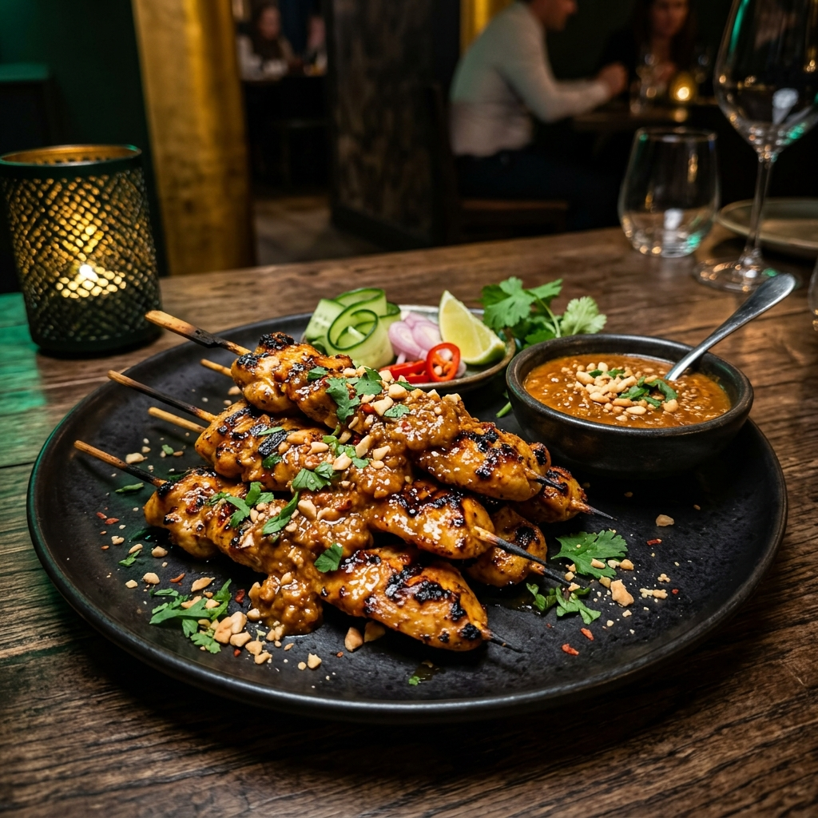
AL SAFA AR DINING
Task 2: Design Journal & Production Process (80-Item Menu)
Prepared by: Shanjaay (Student ID: 202420058) Assignment 3 - Production & Prototype Showcase

Slide 2
AL SAFA AR DINING
Stage 1: Brainstorming & User Pain Points
Mamak restaurants are often packed, causing order delays or misunderstandings regarding customizations.
Portion sizes and ingredients (like standard vs sharing curry) can be ambiguous, leading to food waste or under-ordering.
We brainstormed an AR tool allowing patrons to see exactly what they are ordering directly on their tables, modifying parameters beforehand.
The project evolved from simple 2D icons to a high-fidelity, interactive, and spatial visual components database representing 80 menu items.

Slide 3
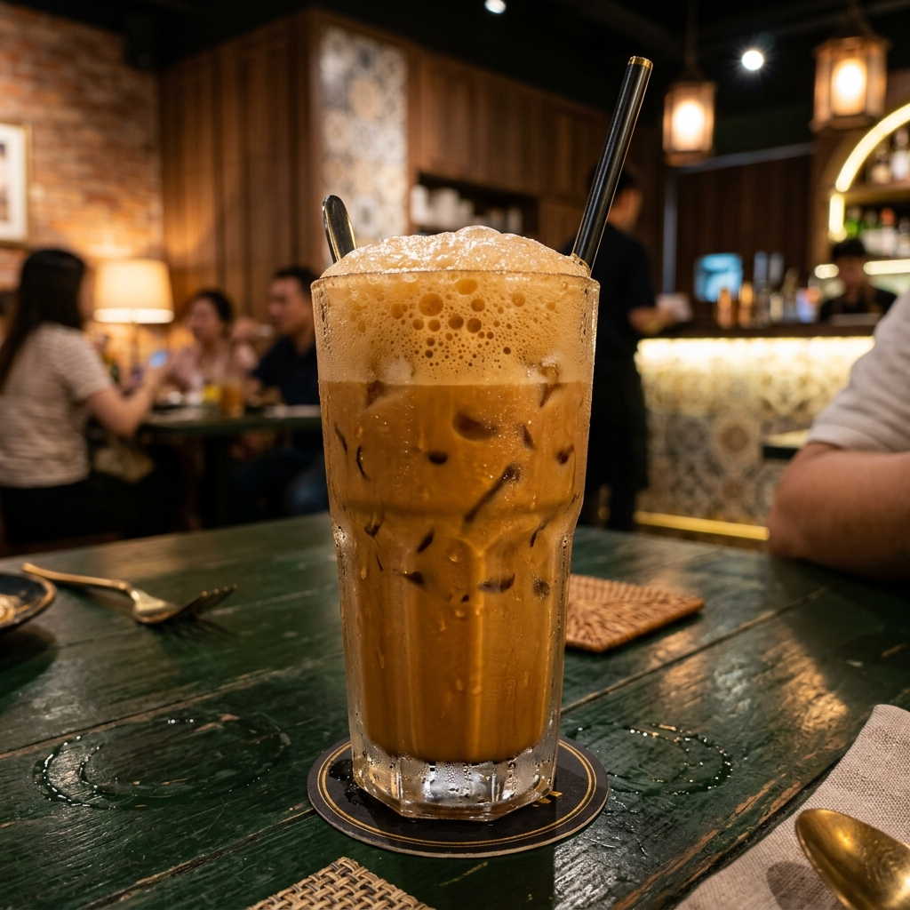
AL SAFA AR DINING
Stage 2: Style Guide & Moodboard
Primary Green (#0F2A1D): Midnight forest tone, representing Islamic-Mamak architectural heritage.
Accent Gold (#D4A24C): Luxurious brass glow, highlighting premium prices, callout pins, and active buttons.
Surface Obsidian (#121412): Modern, deep black background ensuring perfect visibility for translucent widgets.
Glassmorphism: Opacity of 70% with 20px backdrop blurs. Inner 0.5px white borders catch the ambient light.
Typography: Outfit for headings; Inter for structural readability in mobile AR canvases.

Slide 4
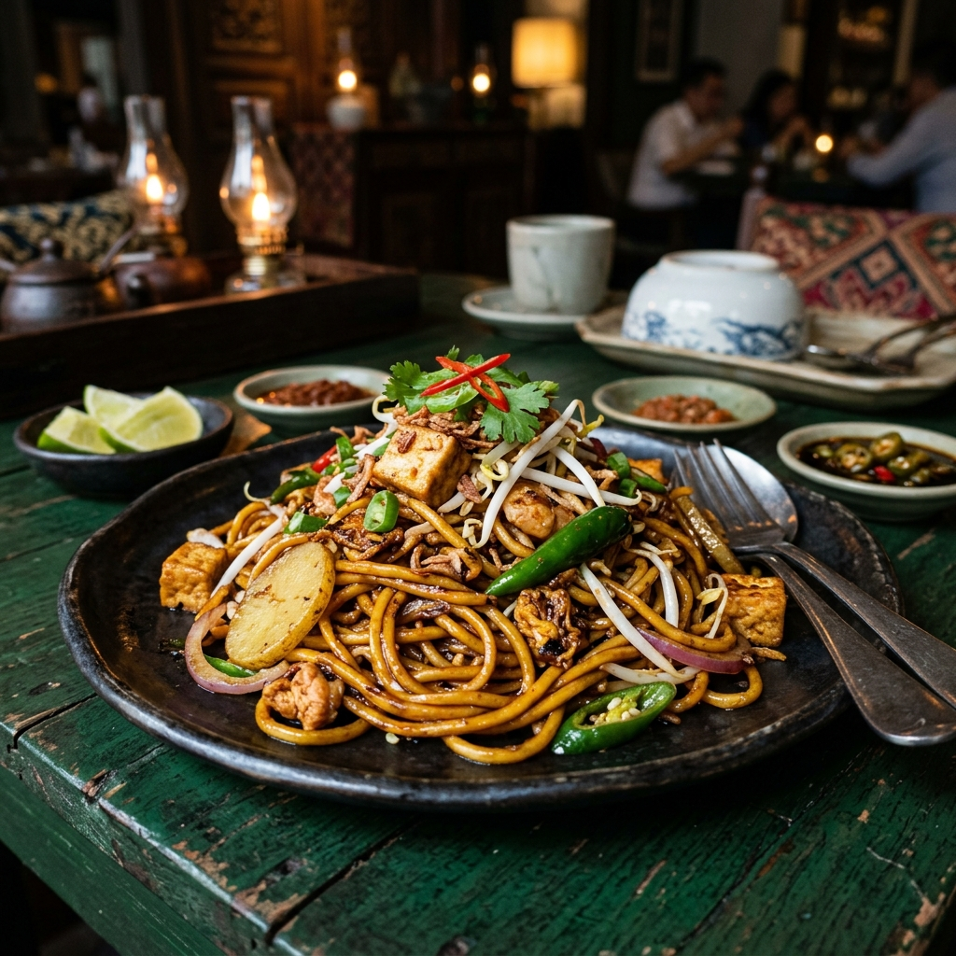
AL SAFA AR DINING
Stage 3: Behind the Scenes (Assets Creation)
1. 3D Food Modeling: Using Blender to sculpt Roti Canai folds, Roti Tisu cone cylinders, Mee Goreng noodles, and Teh Tarik froth layers.
2. Material & Shading: Applying procedural shaders with condensation and light refraction settings to capture food steam and gloss.
3. Multi-angle Rendering: Exporting model angles to support rotation inside the Flutter canvas.
4. Image Optimization: Converting large renders into web-optimized WebP assets (~30% size reduction) to ensure low-latency loading.

Slide 5
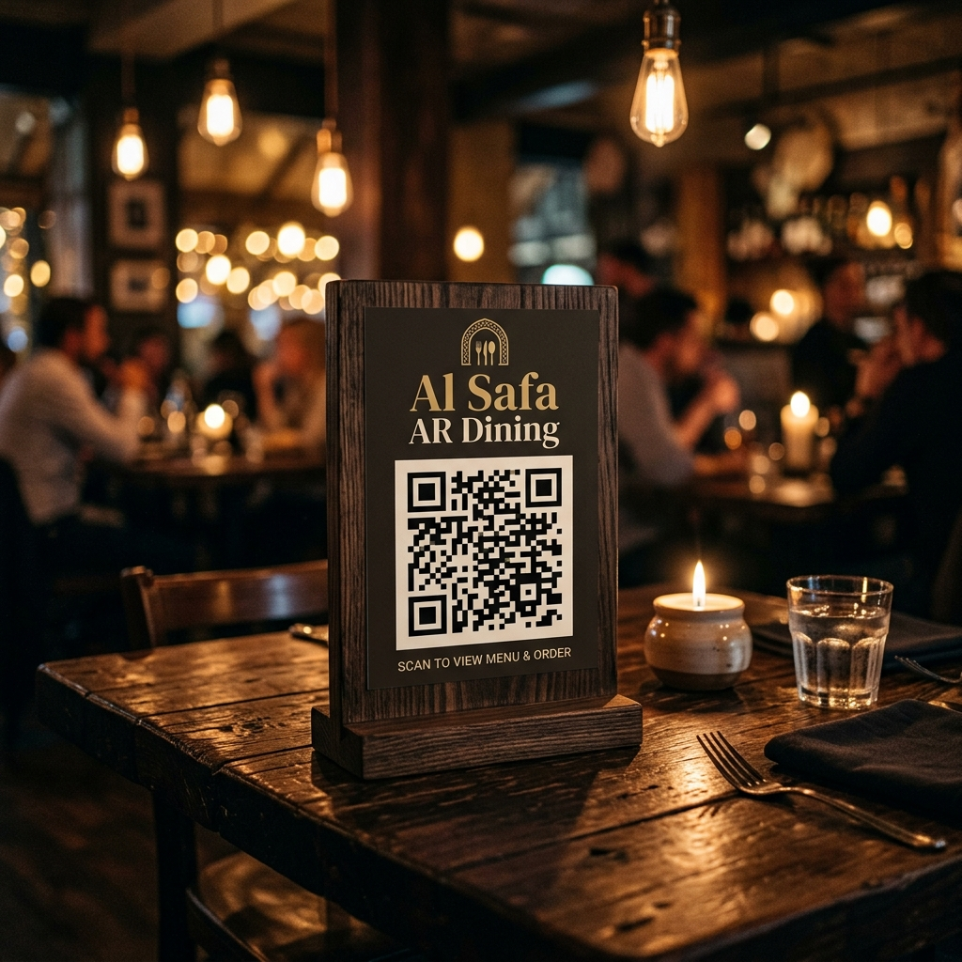
AL SAFA AR DINING
Stage 4: Interactive AR Prototype
QR Table Stand Scan: Opens a mock camera feed containing a golden boundary. Successfully matches the QR code to lock Table 12 context.
Visual Customizer Overlays: Sliders and toggles programmatically draw melted cheese grids, egg yolk centers, white condensed milk swirls, and red chili rings.
Curry Flood (Banjir): Slides adjust gravy layers on the food visual dynamically.
Nasi Lemak Callouts: Callout nodes overlay the coconut rice, sambal, and fried chicken, providing descriptions of slow-cooked recipes on tap.

Slide 6
AL SAFA AR DINING
Stage 5: Production & Flutter Implementation
1. State Management: Provider package coordinates cart states (quantities, notes, portion modifiers) globally across pages.
2. Custom Painters: The AR camera overlay and roti/milk toppings utilize CustomPainters to render vector outlines and grids at runtime.
3. Performance Tree-Shaking: Optimized compile-time icon shaking, asset configurations, and font caching reduces web bundles.
4. Glassmorphism Widgets: BackdropFilter and BoxDecoration combined to create high-end translucent glass cards.

