Slide 1
Employee Data Analysis using Excel
STUDENT NAME: SHANJANA.R
REGISTER NO:312204625, 98077CC6E220B7B81EC455EE0E4AAF77
DEPARTMENT: Commerce
COLLEGE : K.C.S Kasi Nadar College of Arts & Science

Slide 2
PROJECT TITLE
Employee Project management

Slide 3


AGENDA
Problem Statement
Project Overview
End Users
Our Solution and Proposition
Dataset Description
Modelling Approach
Results and Discussion
Conclusion
3/21/2024 Annual Review

Slide 4

PROBLEM STATEMENT
The problem is to identify
project wise analysis
Task wise analysis
Employee wise analysis

Slide 5

PROJECT OVERVIEW
To streamline the process, this analysis aims to identify the
project wise analysis task wise analysis employee wise analysis using Excel ,with the help of below mentioned tools in excel
Tablets
Pivot chart(line chart pie chart bar chart)
Slicers
Conditional formatting

Slide 6

WHO ARE THE END USERS?
Dashboard Overview
Employee Profiles
Project Assignments
Task Tracking
Performance Metrics

Slide 7

OUR SOLUTION AND ITS VALUE PROPOSITION
Advanced Analytical tool
Formulas and function
Pivot table
Visual representation
Charts and graphs
User -friendly interface
Accessibility
Ease of use
Scenario analysis
Used to analysis different situation
Comprehensive data management
Data organisation

Slide 8
Dataset Description
Data overview
Data is a collection of information gathered by observations, measurements, research or analysis. They may consist of facts, numbers, names, figures or even description of things. Data is organized in the form of graphs, charts or tables.
Data field
Project name
Task name
Assigned to
progress

Slide 9
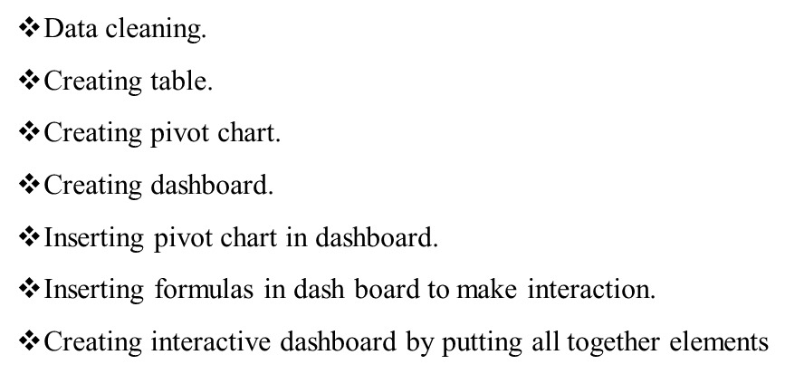
MODELLING
9

Slide 10

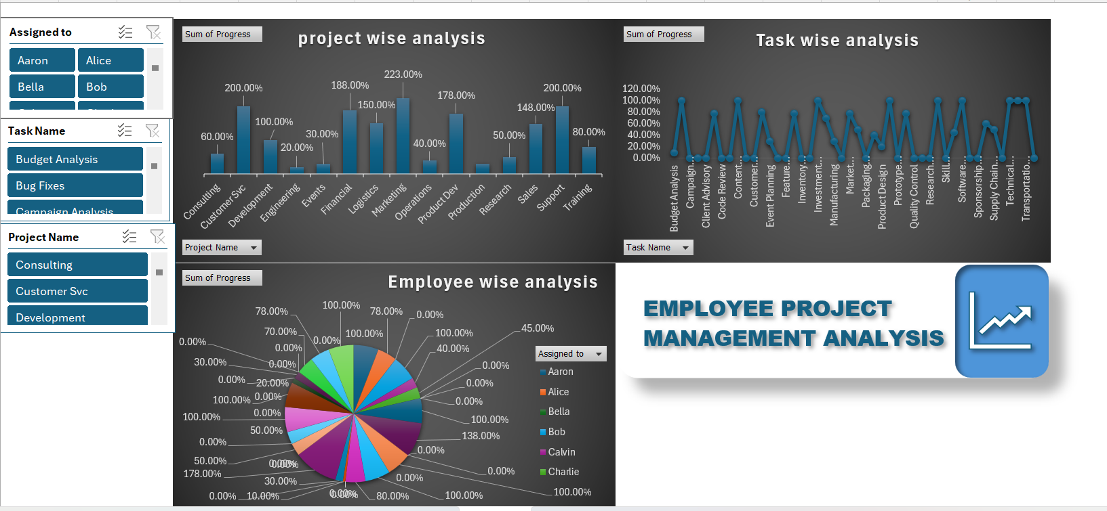
RESULTS
Employee Project Management
10

Slide 11
conclusion
The role of the Managing area of a company is vital in its development and growth since it is in charge of obtaining a good or bad response on the part of the human resources of the company. This is why it requires a high level of leadership in the people who run the company. Besides, it requires the establishment of a free-flowing communication system in the whole company that allows teamwork with the employees and the coordination of tasks that will contribute to achieving the proposed goals.

