Slide 1

DEPARTMENT OF
ARTIFICIAL INTELLIGENCE AND DATA SCIENCE
ACADEMIC YEAR 2025 - 2026
SEMESTER III
ARTIFICIAL INTELLIGENCE LABORATORY
MINI PROJECT REVIEW
<TITLE OF THE PROJECT>
REGISTER NUMBER | 2117240070291
NAME | SHANJITHKRISHNA V
YEAR | 2nd YEAR
SECTION | AI&DS E
FACULTY IN-CHARGE | Ms BHAVANI M

Slide 2
PROBLEM STATEMENT
Artificial Intelligence (AI) enables machines to simulate human intelligence through learning, reasoning, and decision-making. One foundational concept in AI is probabilistic modeling, which governs systems that rely on chance and statistical behavior. This project explores a slot machine simulation using Python and Flask, demonstrating weighted randomness and real-time feedback. The problem lies in designing an interactive system that accurately reflects probabilistic outcomes while engaging users through a web interface. The expected result is a responsive simulation that tracks spins, evaluates win conditions, and calculates win rates. This project showcases AI principles in a simplified, educational, and visually intuitive format.

Slide 3
THEORETICAL BACKGROUND
  Slot machine simulations rely on probabilistic modeling, a core concept in AI used to represent uncertainty and randomness. The algorithm uses weighted random selection to mimic real-world slot behavior.
  Literature on Monte Carlo methods and game theory supports this approach for fairness and statistical accuracy. Alternative algorithms include uniform random sampling and Markov chains, but weighted selection offers better control over symbol frequency. The chosen algorithm uses random.choices() with predefined weights.
  For example, selecting three symbols like 🍋🍋🍋 with equal weights yields a win. This method ensures realistic outcomes, efficient computation, and clear logic suitable for interactive web simulations.

Slide 4
IMPLEMENTATION AND CODE
Link to code in Git-hub Repository
List | Git-hub Repository Links
Implementation of Code Link | https://github.com/Shanjithx/Slot-Machine-using-Python.git
Word Document Report Link | https://github.com/Shanjithx/Slot-Machine-using-Python.git
PPT Link | https://github.com/Shanjithx/Slot-Machine-using-Python.git

Slide 5
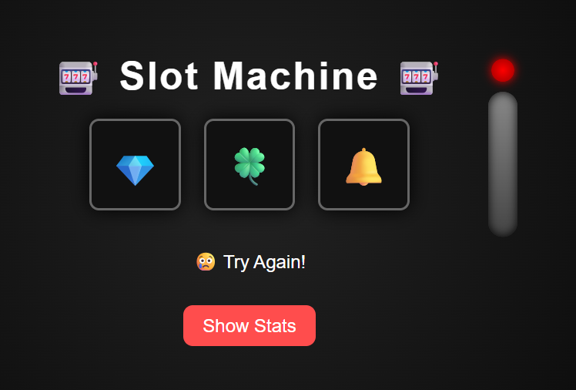
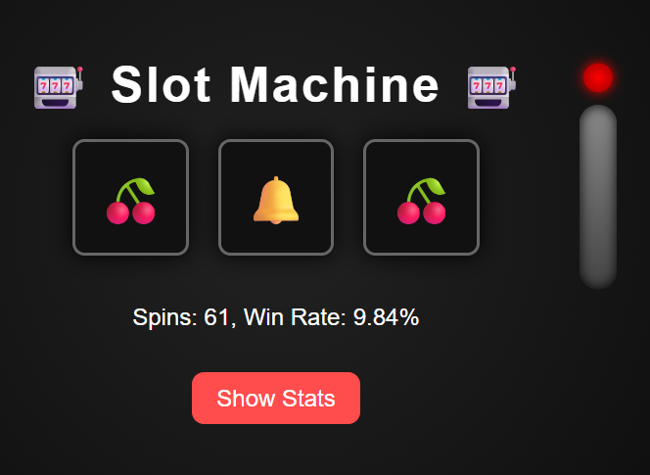
OUTPUT AND RESULTS

Slide 6
OUTPUT AND RESULTS
The slot machine interface displays three reels with emoji symbols. When the user clicks “Spin,” the reels update with randomly selected symbols based on weighted probabilities. A message indicates win or loss, and below it, the system shows total spins and win rate. For example, matching 🍋🍋🍋 triggers a win message and updates statistics. The system responds instantly, offering a smooth user experience. Future enhancements include adding spin animations, sound effects, persistent user sessions, and a leaderboard. Long-term goals involve multiplayer support, database integration, and adaptive difficulty based on user behavior, making the simulation more engaging and intelligent.

Slide 7
REFERENCES
Flask Documentation – Web Framework https://flask.palletsprojects.com/
HTML & CSS Design and Build Websites – Jon Duckett
Monte Carlo Methods in Financial Engineering – Paul Glasserman
Game Development with Python and Pygame – Sean Mc

