Slide 1
Data Science WorkFlow
Problem statement, Analysis, Approach and Results.

Slide 2
Outline
The Problem
Exploratory Analysis
Approach
Results

Slide 3
The Problem

Slide 4
Problem statement
TFI has provided a dataset with 137 restaurants in the training set, and a test set of 100000 restaurants. The data columns include the open date, location, city type, and three categories of obfuscated data: Demographic data, Real estate data, and Commercial data. The revenue column indicates a (transformed) revenue of the restaurant in a given year and is the target of predictive analysis.
Target variable - revenue

Slide 5
Description of DataSet
Features Information:
Id : Restaurant id.
Open Date : opening date for a restaurant
City : City that the restaurant is in. Note that there are unicode in the names.
City Group: Type of the city. Big cities, or Other.
Type: Type of the restaurant. FC: Food Court, IL: Inline, DT: Drive Thru, MB: Mobile
P1, P2 - P37: There are three categories of these obfuscated data. Demographic data are gathered from third party providers with GIS systems. These include population in any given area, age and gender distribution, development scales. Real estate data mainly relate to the m2 of the location, front facade of the location, car park availability. Commercial data mainly include the existence of points of interest including schools, banks, other QSR operators.
Revenue: The revenue column indicates a (transformed) revenue of the restaurant in a given year and is the target of predictive analysis. Please note that the values are transformed so they don't mean real dollar values.

Slide 6
Exploratory Analysis

Slide 7
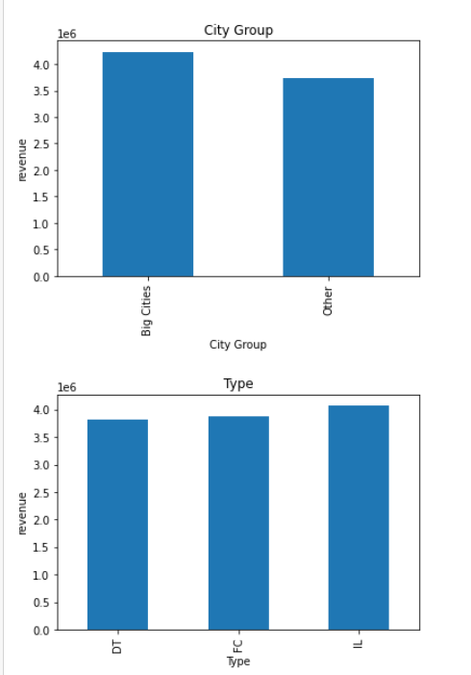
Exploratory Analysis
Analyzing the categorical columns

Slide 8
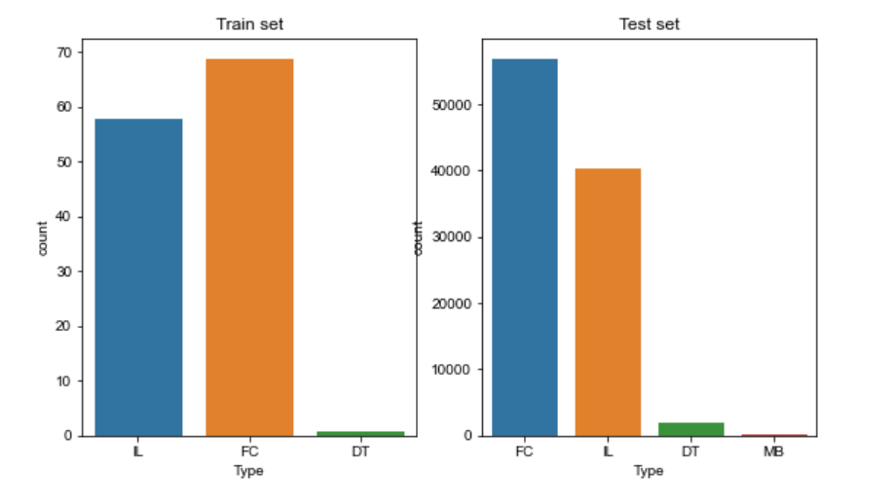
Exploratory Analysis
Comparing test and train dataset, we found MB type is not available in train set. So we need to make sure data split is uniform.

Slide 9
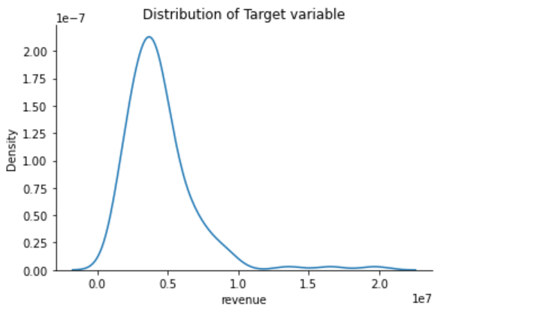
Exploratory Analysis
Our target variable in the dataset is right skewed, has multiple outliers towards the right, as evident from the plots

Slide 10
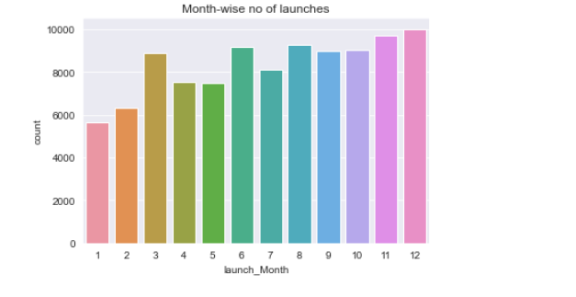
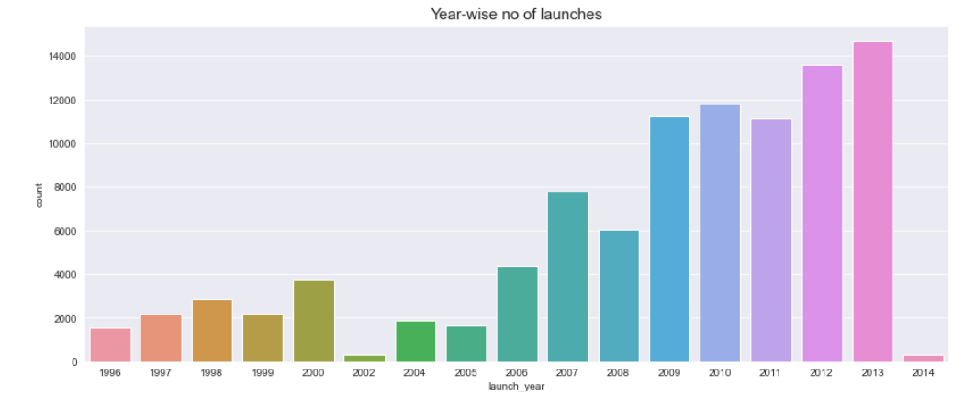
Exploratory Analysis
Split the Open Date feature to months and years to find the relationship with revenue

Slide 11
Approach

Slide 12
Data Preprocessing
Removing the Outliers in revenue, so that normal distribution will be achieved.
Open Date featue to split to months and years to find the count of launch of restaurants revenue in months and years.
Combine the test and train data to achieve the uniform spread of data and split them as before
Remove the ID columns in the data set.

Slide 13
Description
Now that the data has been preprocessed, we’ll be creating 2 different models to fit and train our data, so that we can predict the revenue
Models:
Artifical Neural Network with 3 hidden layers and 1 output layer
Long Short term Memory networks with 3 hidden layers and 1 output layer

Slide 14
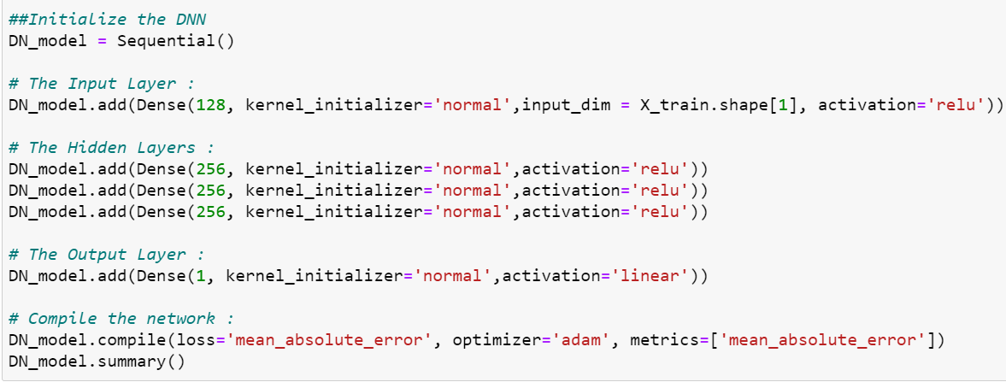
Model 01
Deep Neural Network with 3 hidden layers and 1 output layer using Keras API.

Slide 15
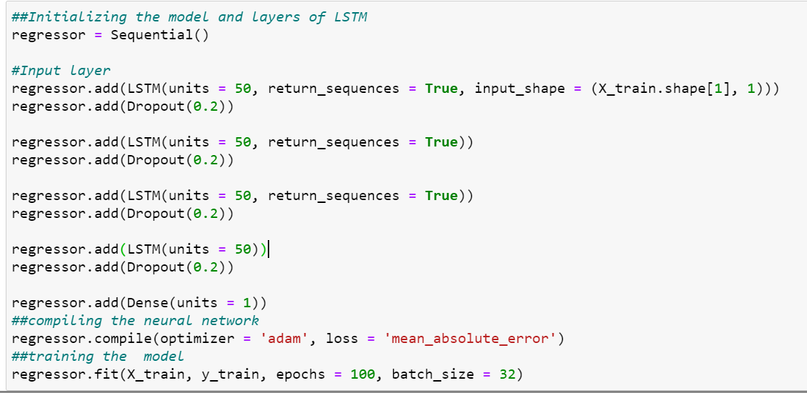
Model 02
LSTM model has been built with 3 hidden layers and 1 Output layer using Keras API.

Slide 16
Results

Slide 17
Model 1 MAE :1417161.6009615385
Model 2 MAE value : 3943612.410447047
Model 1 has less error when compared Model 2 and got better accuracy when compared with test data.

Slide 18
Thank You.

Slide 19
References
Please check the jupyter notebook: RestaurantRevenue_Prediction.ipynb
Dataset: https://www.kaggle.com/c/restaurant-revenue-prediction/

