Slide 1


PROJECT-2
Tesla Stock Analysis Using R & R-Studio

Slide 2
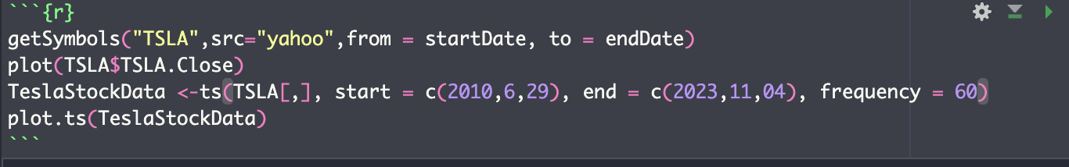
Data Source
The data has been extracted from yahoo finance from 06/29/2010 to 11/04/2023 for tesla stock

Slide 3
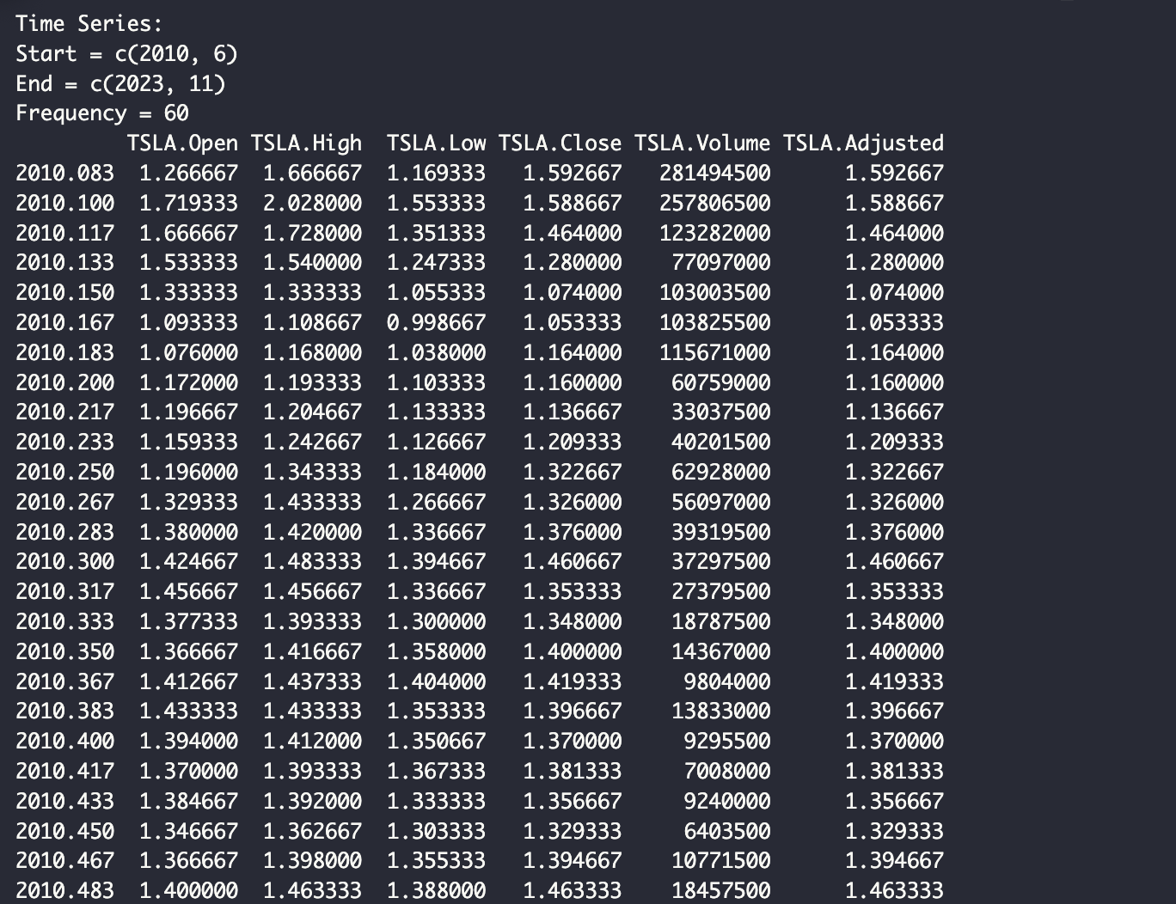
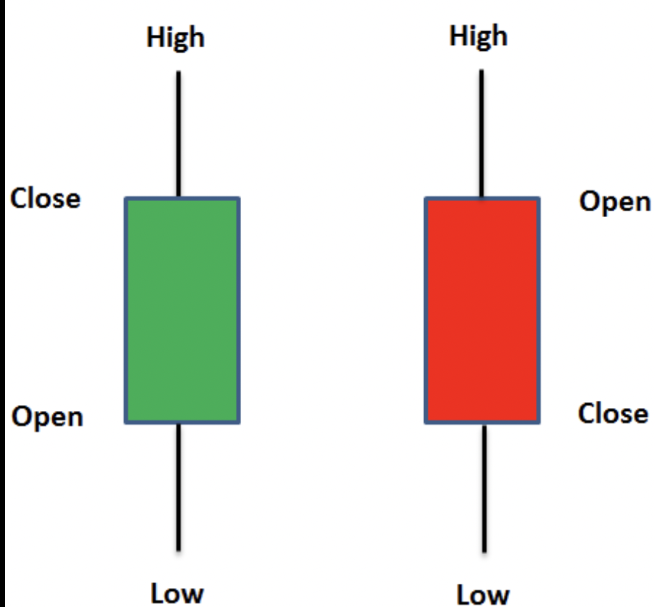
Sample Data
The dataset Includes following variables
1- Date
2-Open price
3-Highest price
4-Lowest Price
5-Closing price
6- Trade Volume
7- Adjusted

Slide 4
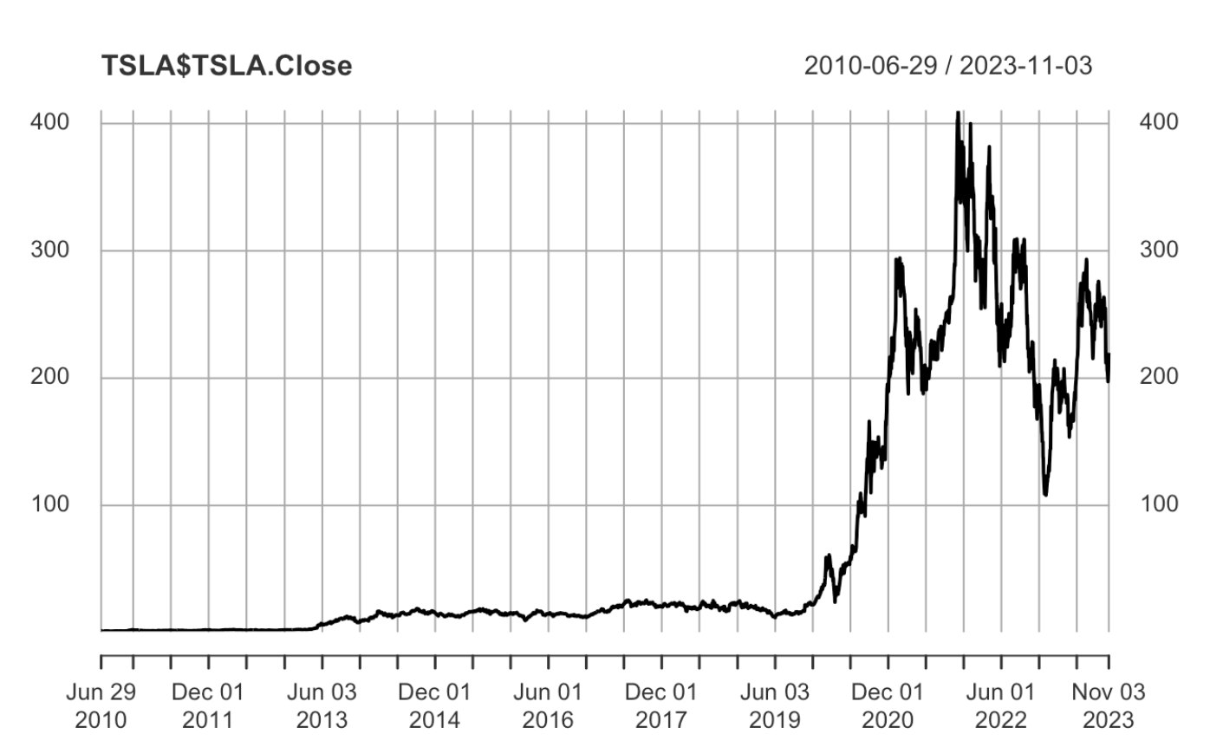
Over the years Tesla Stock Performance

Slide 5

Key Insights For Tesla Stock
If you bought tesla stock worth $100 & forgot that money The value of your money could be $1,855,800 in 2023.
The stock showed exponential growth of 18,558.59% in 13 years.

Slide 6
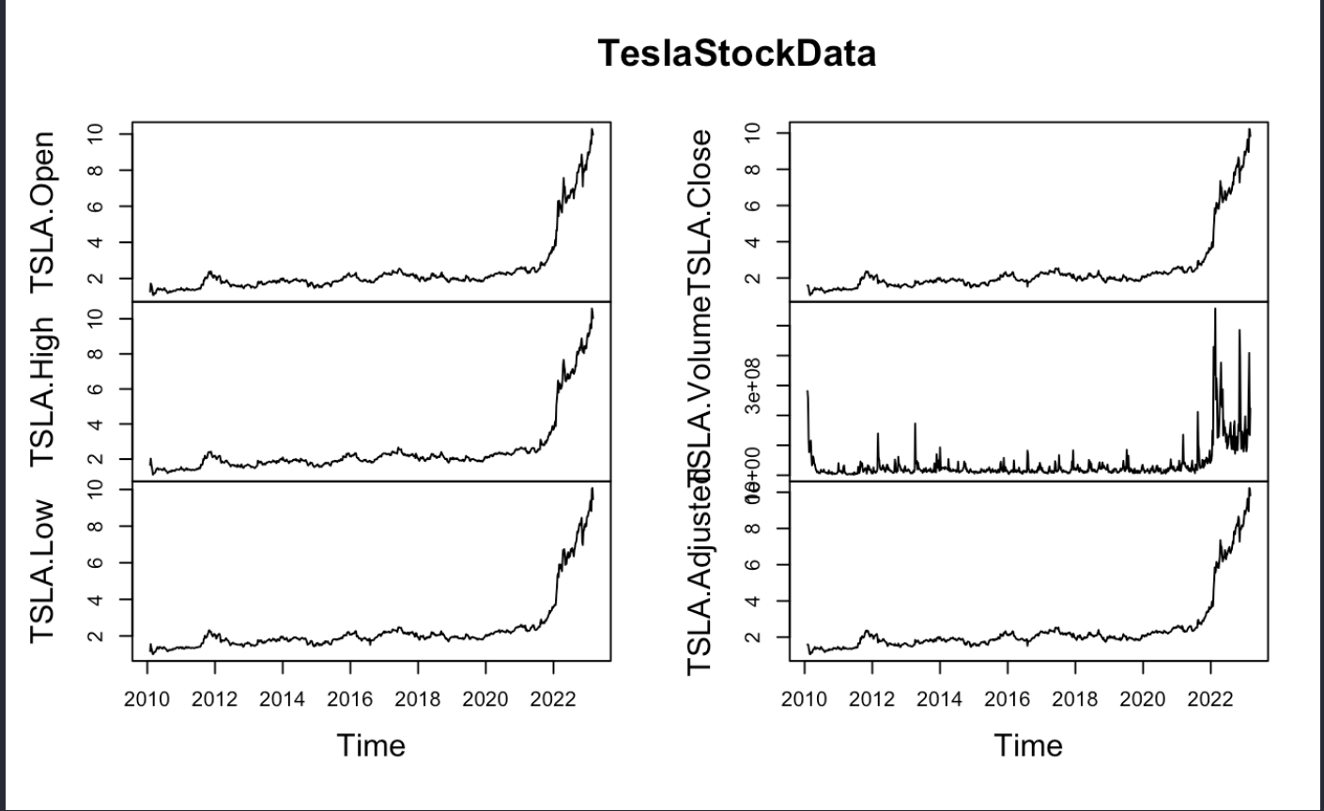
Tesla Stock Chart per Column

Slide 7
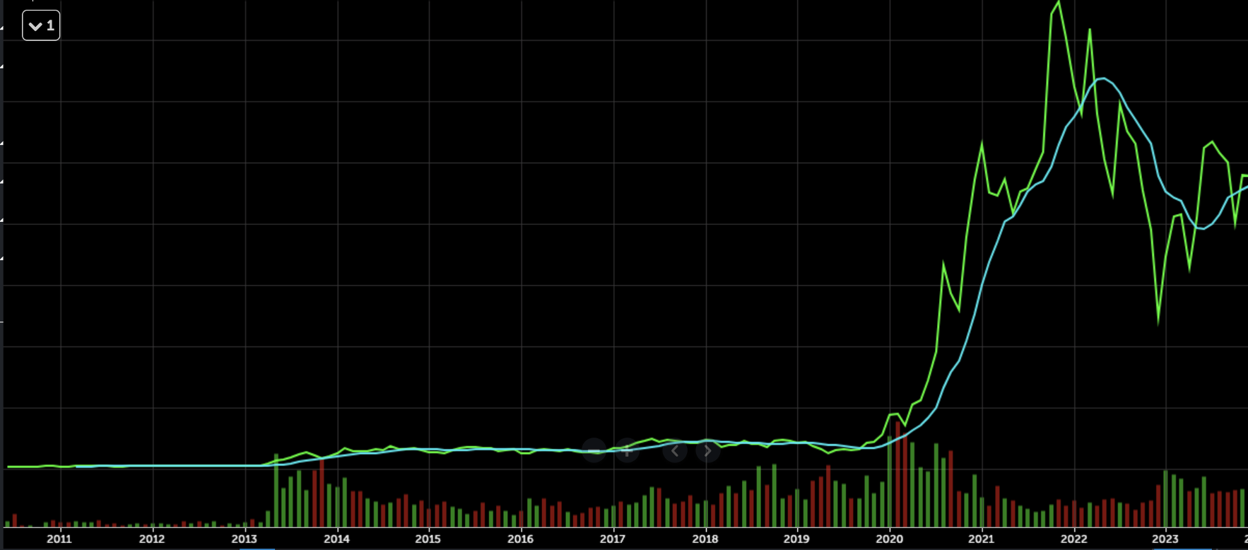
Price Movement With Simple Moving Average and Volume

Slide 8
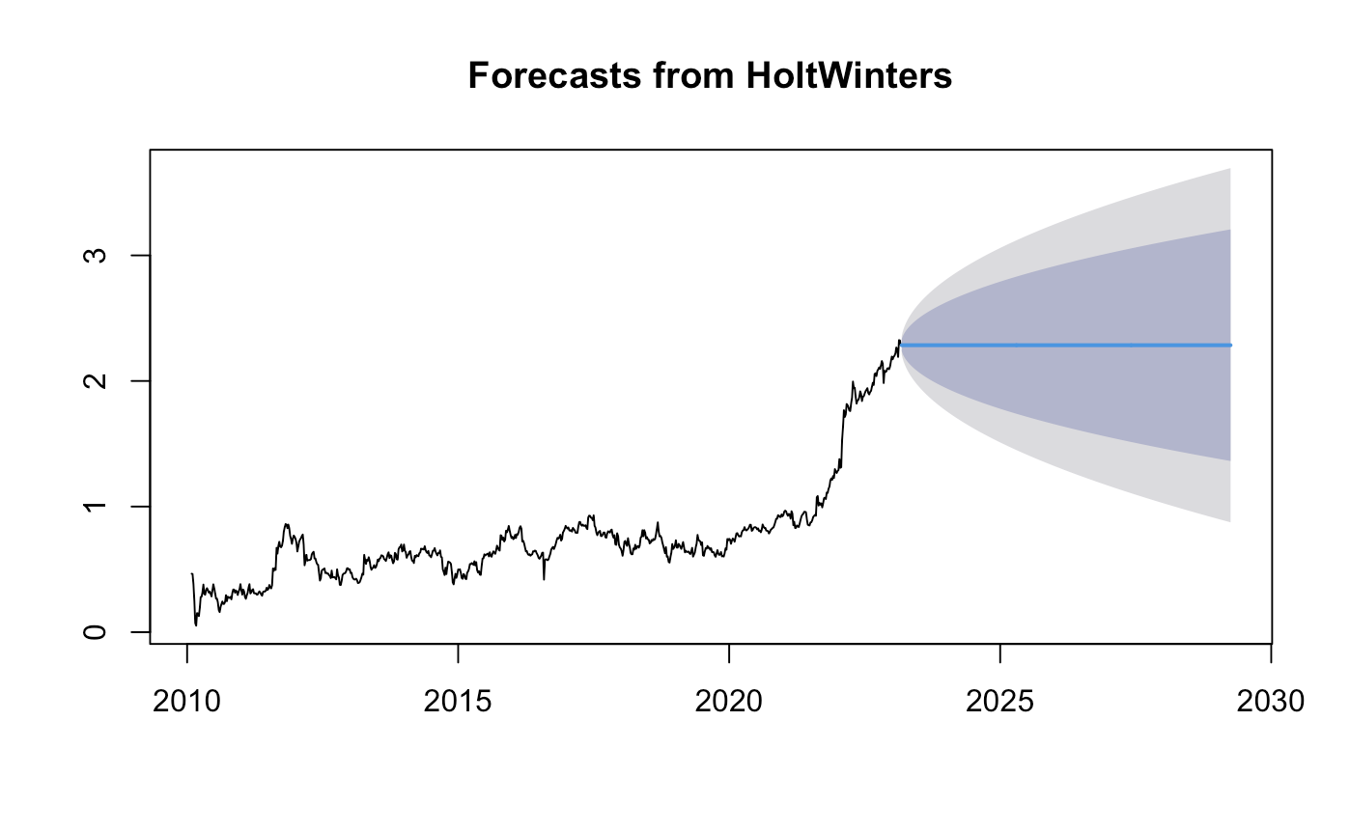
Forecasts using Holt's Exponential Smoothing
The Holt-Winters algorithm is a time-series forecasting method that uses exponential smoothing to make predictions based on past observations. The method considers three components of a time series: level, trend, and seasonality, and uses them to make forecasts for future periods.

Slide 9
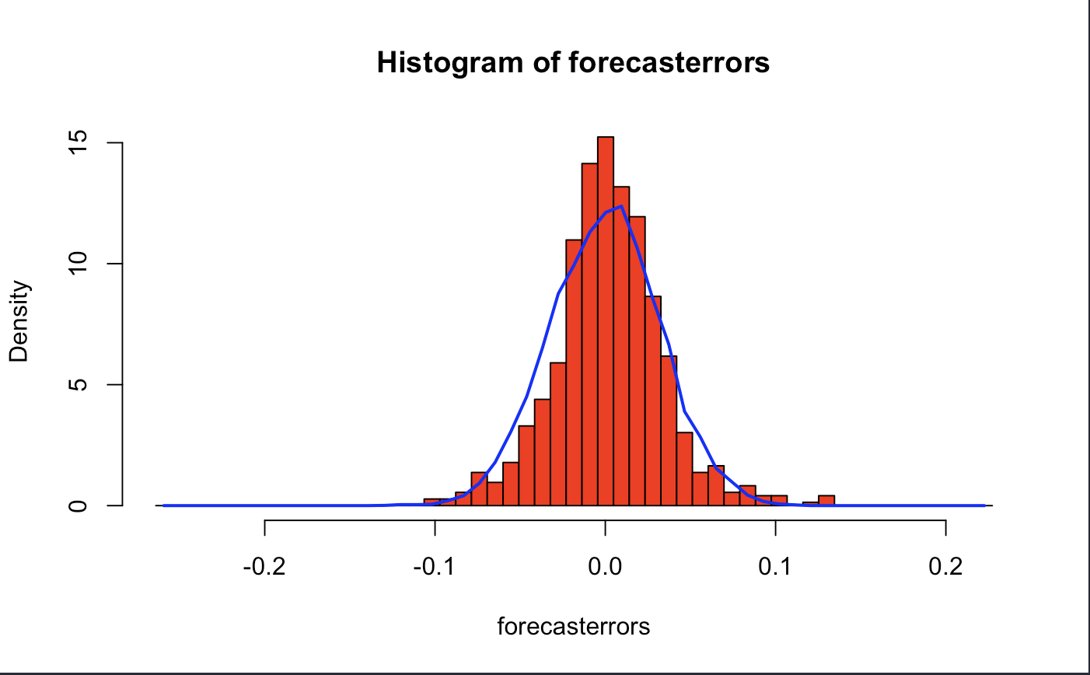
Distribution For Forecast error
# in other words, if there are correlations between forecast errors for
# successive predictions, it is likely that the simple exponential smoothing forecasts could be improved upon by
To check whether the forecast errors are normally distributed with mean zero, we can plot a histogram of the forecast
#errors, with an overlaid normal curve that has mean zero and the same standard deviation as the distribution
To check whether the forecast errors are normally distributed with mean zero, we can plot a histogram of the forecast
#errors, with an overlaid normal curve that has mean zero and the same standard deviation as the distribution
# it is plausible that the forecast errors are normally distributed with mean zero.The time plot of forecast errors shows
#that the forecast errors have roughly constant variance over time.
#The histogram of forecast errors show that it is plausible that the forecast errors are normally distributed with mean
#zero and constant variance.

Slide 10
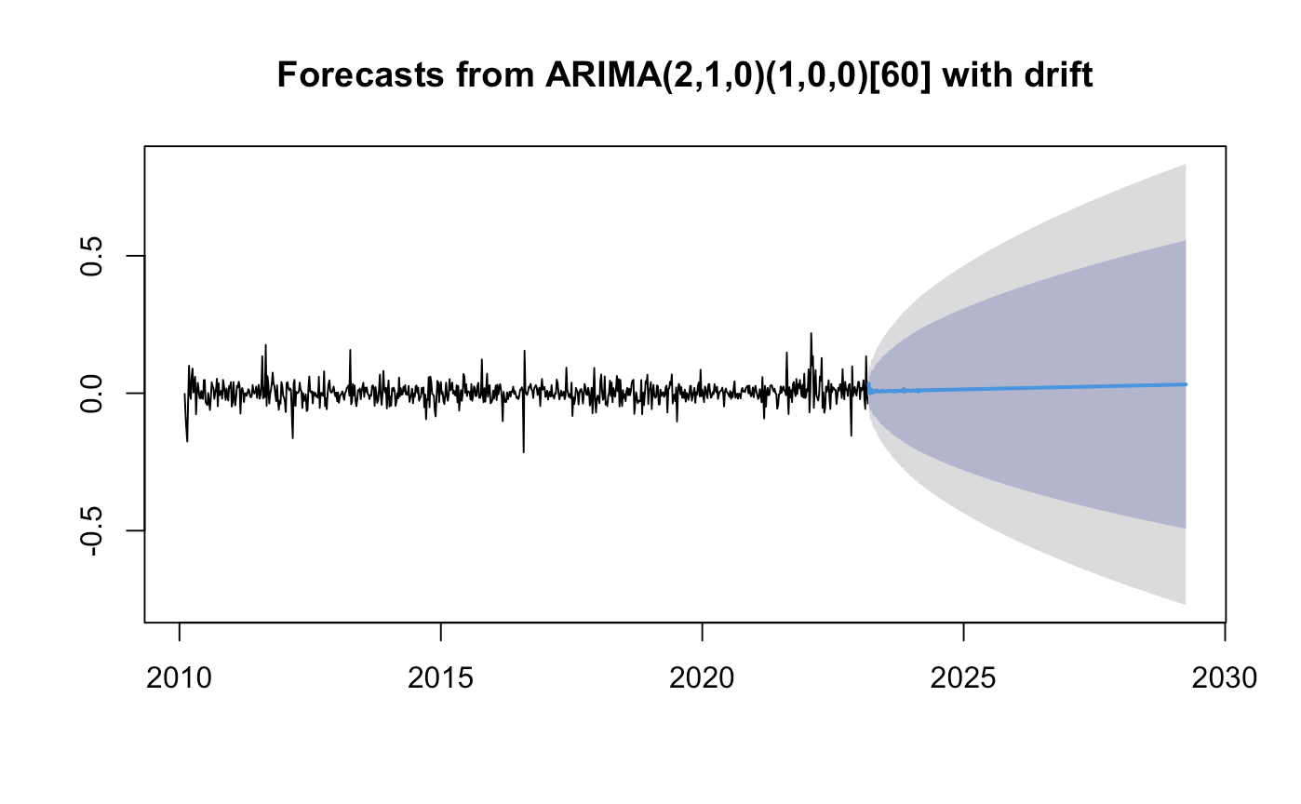
ARIMA Model
#While exponential smoothing methods do not make any assumptions about correlations between successive values
#of the time series, in some cases you can make a better predictive model by taking correlations in the data into
# An autoregressive integrated moving average, or ARIMA, is a statistical analysis model that uses time series data to either better understand the data set or to predict future trends. A statistical model is autoregressive if it predicts future values based on past values.
#irregular component of a time series, that allows for non-zero autocorrelations in the irregular component.

Slide 11
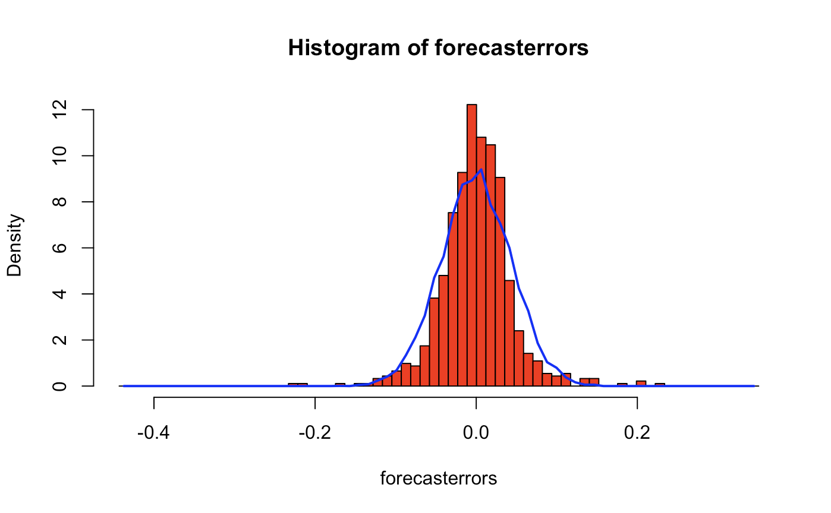
Distribution For Forecast error

