Slide 1
Phishing Awareness: Stay Safe in the Digital World
Introduction: The Digital Threat Landscape
Cybercriminals are constantly evolving, devising new tactics to steal personal and financial information. Phishing is one of the most prevalent and dangerous cyber threats, using deceptive emails, fake websites, and fraudulent messages to trick individuals into revealing sensitive data. Recognizing and avoiding phishing attempts is crucial in today’s interconnected world.

Slide 2
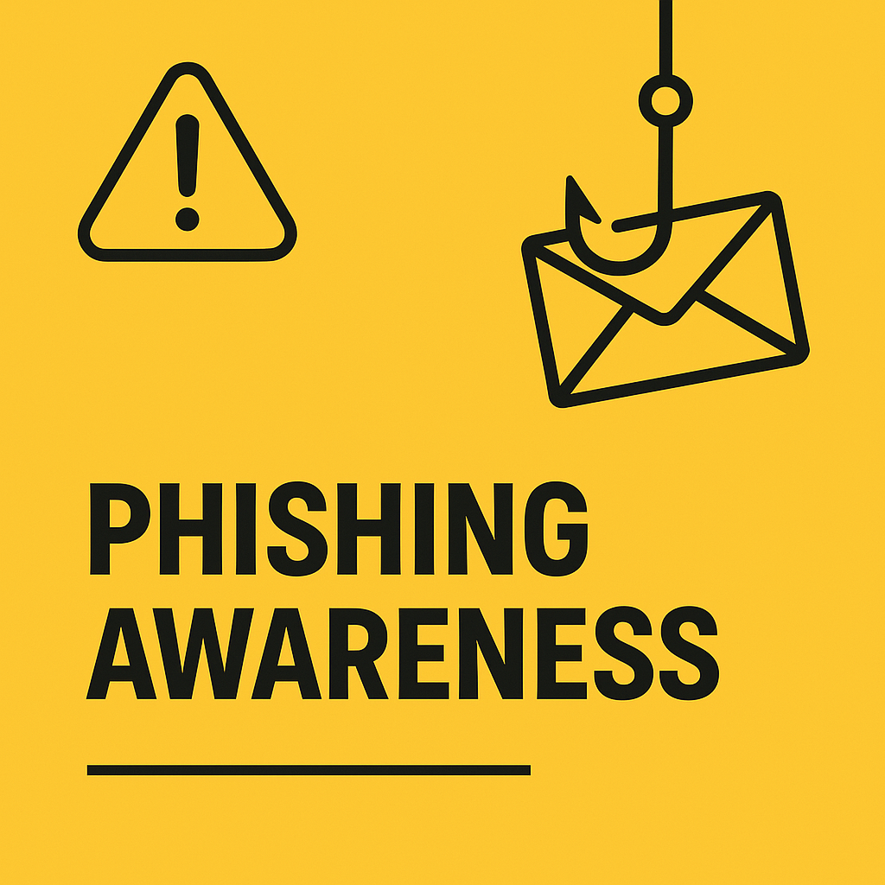
Understanding Phishing
What is Phishing?
Phishing is a cybercrime where attackers disguise themselves as trustworthy entities to steal confidential information. This can be done through:
Emails impersonating banks or service providers.
Fake login pages mimicking real websites.
Deceptive phone calls requesting personal details.

Slide 3
Types of Phishing Attacks
Email Phishing – Mass emails pretending to be from trusted sources.
Spear Phishing – Targeted attacks on specific individuals or organizations.
Whaling – Targeting high-profile figures like executives.
Vishing (Voice Phishing) – Fraudulent phone calls aimed at extracting sensitive information.
Smishing (SMS Phishing) – Fake messages containing malicious links.

Slide 4
The Impact of Phishing
Financial Losses
Unauthorized transactions and drained bank accounts.
Corporate lawsuits and regulatory fines.
Identity Theft
Stolen personal details can be used for fraud, loans, and illegal activities.
Data Breaches
Organizations risk losing sensitive customer data and intellectual property.
Fact: Over 90% of data breaches start with a phishing attack.

Slide 5
How to Recognize Phishing Attempts
suspicious Email Indicators
Generic greetings like “Dear Customer.”
Poor grammar and spelling errors.
Urgent or threatening messages pressuring immediate action.
Unusual sender addresses or domains.
Fake Website Detection
Always check the URL (e.g., "paypa1.com" instead of "paypal.com").
Look for "https://" and a secure padlock icon.
Be cautious of pop-ups asking for personal details.
Common Social Engineering Tactics
Pretexting: Creating a false scenario to obtain information.
Baiting: Offering incentives (e.g., free downloads) that contain malware.
Tailgating: Physically following authorized personnel to restricted areas.

Slide 6
Protecting Yourself Against Phishing
Verify Senders: Always confirm email senders before responding.
1
Hover Over Links: Check for inconsistencies before clicking.
2
Enable Multi-Factor Authentication (MFA): Adds an extra layer of security.
3
Use Strong Passwords: Never reuse passwords across accounts.
4
Stay Informed: Regular cybersecurity training can help detect new threats.
5

Slide 7
Conclusion: Be Cyber Smart
By staying vigilant and educated, you can reduce the risk of falling victim to phishing scams. Cybersecurity is a shared responsibility—spread awareness and practice safe online habits.
By Madasi Kuruva Shankar

