Slide 1

Microsoft
Engage 2022
Face Recognition
Intern Engage is a program for engineering students across India graduating in 2024. It is designed to provide a platform for engineering students to accelerate their growth and foster industry-relevant skills through mentorship, coding challenges, workshops and networking opportunities.

Slide 2

Table of Content:
Approach
Imp Links
Architecture
About Me
Technologies Used

Slide 3


3 Factor Authentication
Add an additional layer of security to the old 2FA, with the help of Facial Recognition.
Factor-1: Basic Email + Password Authentication.
Factor-2: Use Microsoft authenticator to get a TOTP.
Factor-3: Facial Biometrics of the user were used to
validate his presence.

Slide 4
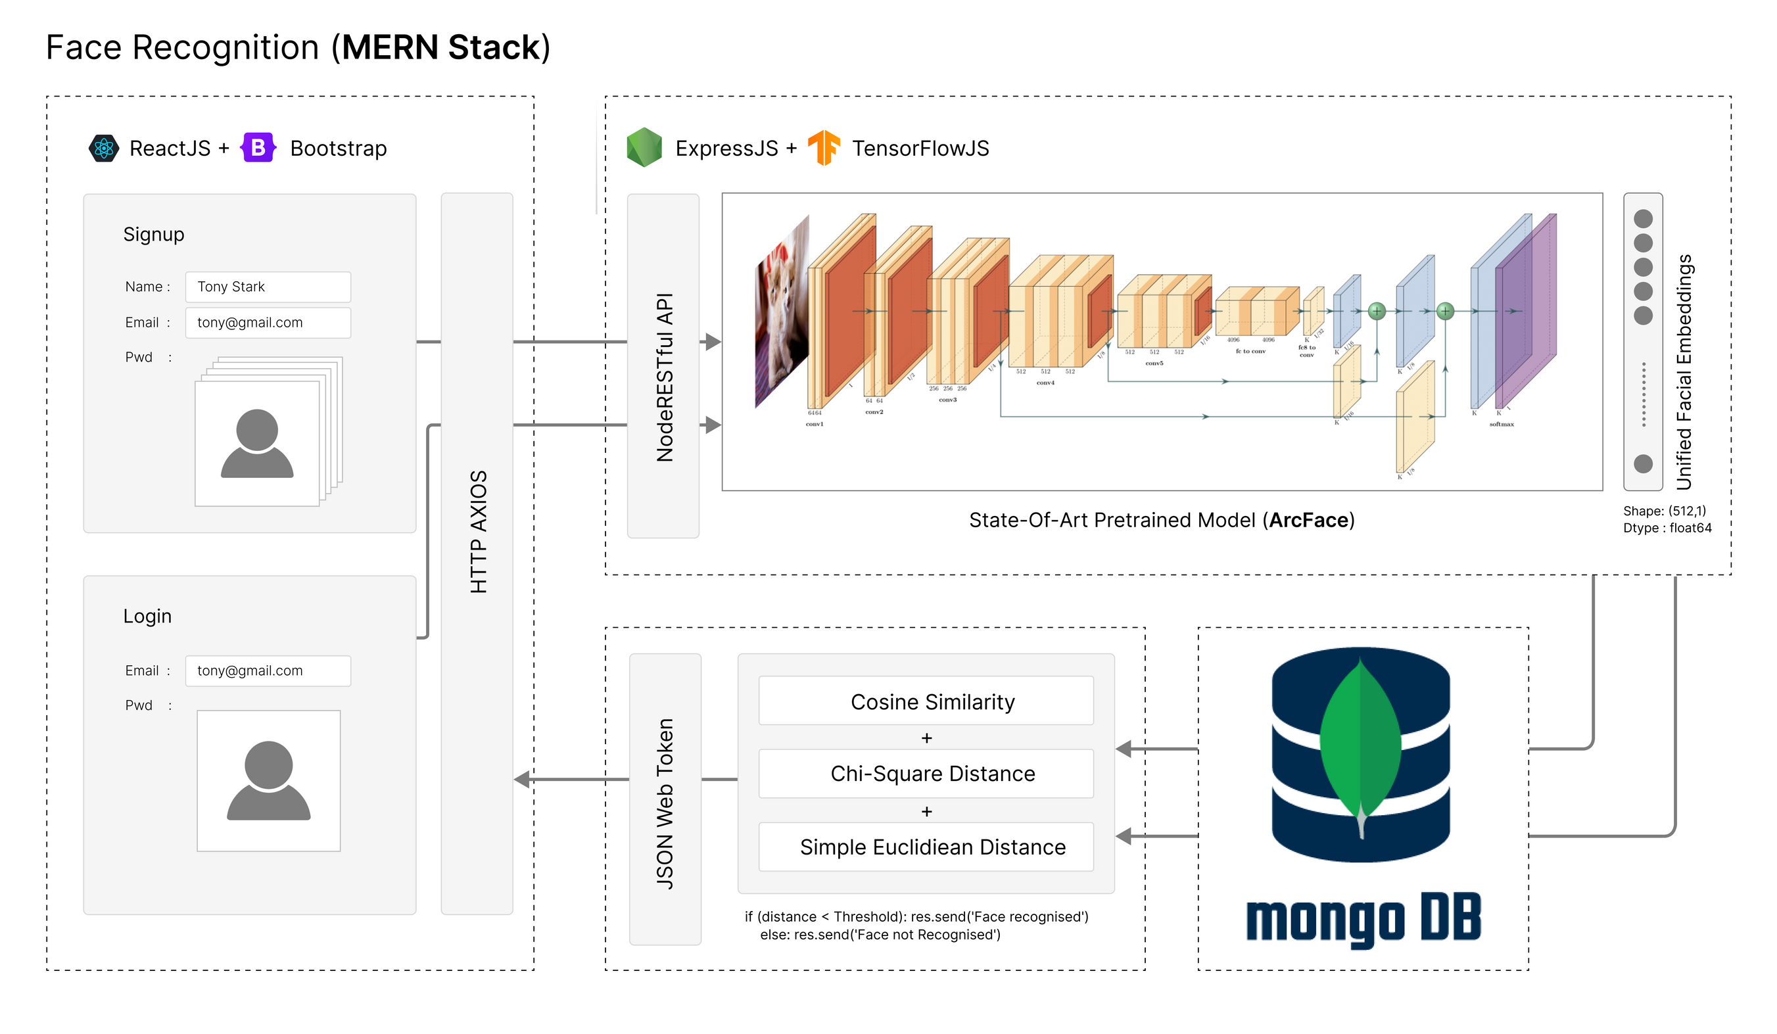
Architecture (FaceRecognition+ Mern Stack)

Slide 5



Technologies Used
Frontend
ReactJS + Bootstrap
Backend
Node.js + Express.js + TensorFlow.js
Database
MongoDB (NOSQL)

Slide 6


Imp Links
Microsoft Azure: microsoft-engage-facerecognition.azurewebsites.net
Google GCP: engage-facerecognition.web.app
GitHub: github.com/Shankar203/Microsoft-Engage-FaceRecognition
Linktree (All Links): linktr.ee/microsoft_engage_facerecog

Slide 7




gowrishankarirwog@gmail.com
github.com/Shankar203
linkedin.com/in/gowri-shankar-p-b4b489203
facebook.com/gowrishankar.penugonda.75

Slide 8

Fauget
Thank You
For Watching
End of Presentation

