Slide 1
Abnormality Classification in Gastrointestinal Tract through Endoscopic Imagery using Deep Learning
Under the Guidance of:
Dr. Jayabharathy J
Associate Professor
DEPARTMENT OF COMPUTER SCIENCE AND ENGINEERING
Puducherry Technological University
Puducherry
Project members:
Senthil Kumar
Ponn Siva Shankar
Yogeshwaran

Slide 2
AGENDA
Introduction
Literature review
Existing System
Architecture of existing system
Limitations of existing system
Problem Definition
Objective of the proposed system
Architecture of proposed system
Module description
Input and Output
Hardware and Software requirements
Implementation
Plan of action
Conclusion
Reference

Slide 3
INTRODUCTION
Gastrointestinal Tract
The GI tract is the pathway food takes from your mouth, through the esophagus, stomach, small and large intestine
Endoscopy
Endoscopy is one of these procedures, it is often used to examine the GI tract embedding a tube with a camera within it

Slide 4
Motivation
Nearly two million patients die of gastrointestinal diseases worldwide. Image endoscopy is one of the latest technologies in the medical imaging field for the diagnosis of gastrointestinal diseases, such as stomach ulcers, bleeding, and polyps
The novelty of the proposed methodology lies in developing a system for diagnosis of gastrointestinal diseases

Slide 5
Literature review
SL .No | Title & Referenced Authors | Problem Statement | Algorithms & Techniques used | Datasets | Metrics | Limitations
1. | EndoL2H: Deep Super-Resolution for Capsule Endoscopy Yasin Almalioglu , Graduate Student Member, IEEE, Kutsev. December 2020 | To improve the low resolution image to high resolution image to improve the visual of the image | Spatial Attention-Based Super Resolution cGAN High Fidelity Loss Function | The dataset was divided into three subsets: 17, 220 images for training, 2, 000 images for validation, and 2, 000 for testing | PSNR, SSIM, LPIPS, and GMSD The result image was sharper and more informative than before. The image was clear and sharper according various standards. | This only converts low resolution image to high resolution image.
2. | Registration of Consecutive Frames From Wireless Capsule Endoscopy for 3D Motion Estimation , IEEE PAPER Marina Oliveira ,Helder Araujo , (Member, Ieee) August 2021 | To capture the image from the capsule frame by frame. To estimate the trajectory for the capsule to reconstruct the path for easy detection of abnormalities. | Direct (pixel-based) , feature based, artificial intelligence strategies. | The data used for this assessment is the Mirocam dataset obtained with our novel experimental setup | MEIR, MPIR, SIFT, SURF, MSER, and LIOP The resulted image was cross checked with manual data and its almost same and visually correct. | The detection of the travel track of capsule was hard. This only captures and predicts the photo for the data.

Slide 6
3. | A Learning Based Microultrasound System for the Detection of Inflammation of the Gastrointestinal Tract IEEE TRANS MED IMAGING Shufan yang , christina lemke January 2021 | To detect inflammation in GI tract | Inception V3 | B-Scan Generation US Data samples | The Inception V3 model used several techniques for optimizing the network for better model adaptation. It is computationally less expensive. It uses auxiliary | the requirement of more data to overcome possible overfitting and more computational resource. The fundamental way to solve these 2 problem for computer vision system is to use sparsely connected architecture to replace the fully connected one
4. | Improving Low-Resolution Image Classification by Super-Resolution with Enhancing High-Frequency Content , IEEE PAPER Liguo Zhou, Guang Chen, Mingyue Feng 2020 | Improving Low-Resolution Image Classification by Super-Resolution with Enhancing High-Frequency Content | Convelutional neural network | Endoscopy video review | Compared with other state-of-the-art super-resolution methods, the experiment results show that our method can recover more high frequency contents in high-resolution image reconstructing | Only improves the image quality

Slide 7
5. | Informative frame classification for endoscopy video SCIENCE DIRECT By Jung Hwan Oh 2010 | Aims to classify unwanted images from the endoscopic test video | edge-based and clustering-based | Endoscopic test video. | two informative frame classification techniques are greater than 90% and 95% | This method only gives us the informative image and does not classify abnormalities.
6. | Color-based template selection for detection of gastric abnormalities in video endoscopy SCIENCE DIRECT By Hussam Ali Febuary 2020 | Aims to predict gastric abnormalities using colour detection. | Color-based segmentation method has been applied for abnormal area selection. | Endoscopic test videos. | method achieves 86.6% accuracy | This detects based on colour differences. Miss classification of abnormalities is a possibility

Slide 8
Existing System
Input data: The dataset endoscopic test are given to machine.
Dataset:
K-vasir dataset contains 3000 images
80% of the dataset is divided for training and 20% for validation
Task at hand: Low resolution image is mapped to high resolution images
Algorithm used: Super resolution algorithms

Slide 9
Architecture of Existing System
CNN
PREPROCESSING
DATA AGUMENTATION
EXTRACT THE FEATURES
SPLIT THE TRAIN_TESTING PROCESS
LOAD THE DATASET
Reducing noise, resizing images
EDGE DETCTION, COLOUR IDENTIFICATION
APPLY CNN
Output
EVALUATING METRICS
VALIDATE THE FEATURES
CLASSIFY THE RESULTS

Slide 10
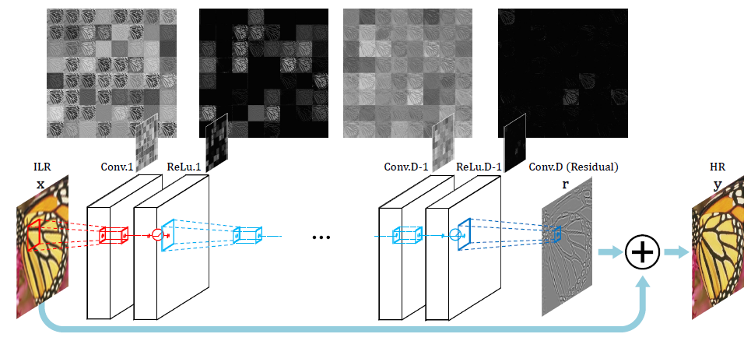
Super-Resolution Working

Slide 11
Super Resolution Algorithm
The low-resolution images are divided into three separate images with three RGB channels.
Then the three images are trained by a convolutional neural network to obtain three output images.
Finally, the obtained three images are fused to obtain the final high-resolution image reconstruction.
More colour features and high frequency information can be obtained by using RGB multi-channel as the input image, which is more effective in SR reconstruction.
The evaluation indexes such as the peak signal-to-noise ratio (PSNR) and structural similarity (SSIM) are measured.

Slide 12
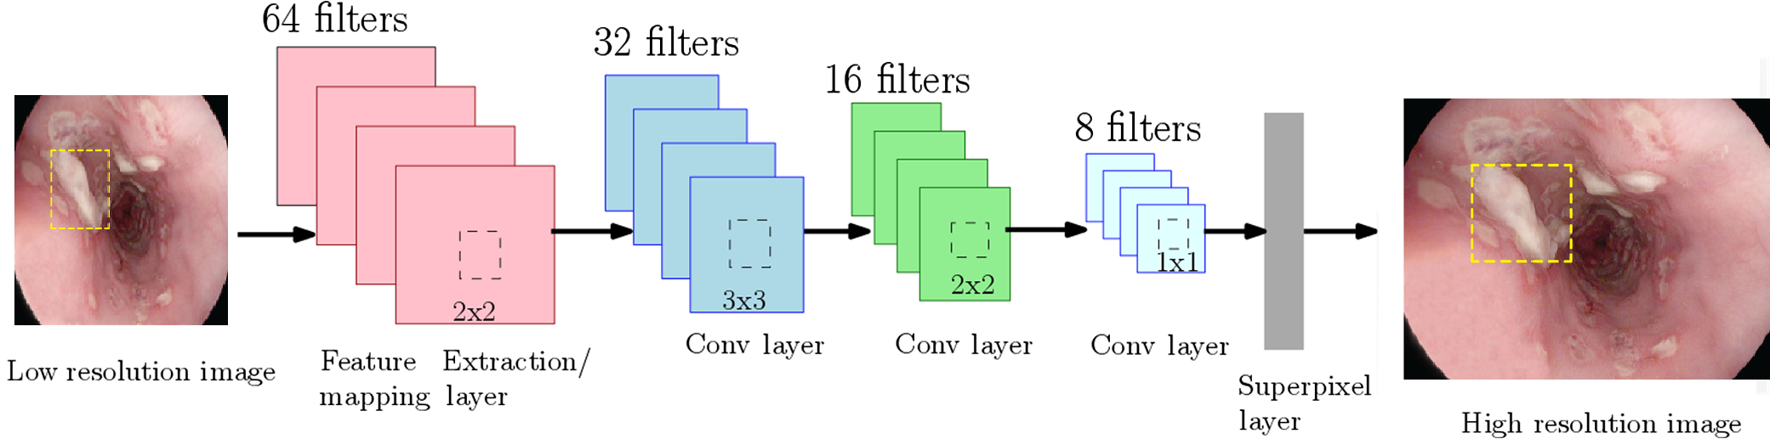

Slide 13

Metrics
Precision = TP/(TP+FP)
The precision value lies between 0 and 1.
Recall = TP/(TP+FN)
True Positive (TP) — model correctly predicts the positive class (prediction and actual both are positive).
True Negative (TN) — model correctly predicts the negative class (prediction and actual both are negative).
False Positive (FP) — model gives the wrong prediction of the negative class (predicted-positive, actual-negative).
False Negative (FN) — model wrongly predicts the positive class (predicted-negative, actual-positive).
F1 score gives the same weightage to recall and precision.

Slide 14
Limitation Of Existing System
This model only changes the resolution of the image from low to high
The detection of abnormalities is done manually
The detection of abnormalities takes lots of concentration, time and effort to diagnose the disease
Even when the image is converted into high resolution picture there are chances of misdiagnosing

Slide 15
PROBLEM DEFINITION
Esophageal, stomach, and colorectal cancers account for 2.8 million new cases and 1.8 million deaths worldwide per year.
Due to its complex nature of gastrointestinal infections, gastroscopy instruments are not suitable for identifying and examining gastrointestinal infections.
Our study helps doctors to identify these gastrointestinal infections with the help of our deep learning model which uses CNN-LSTM hybrid model.

Slide 16
OBJECTIVE OF THE PROPOSED SYSTEM
To convert low resolution images to high resolution and classify the abnormalities in endoscopic images into different classes using CNN-LSTM-SR

Slide 17
Architecture Of Proposed System
CNN-LSTM-SR
PREPROCESSING
LOAD THE DATASET
SUPER RESOLUTION ALGORITHM
EXTRACT THE FEATURES
SPLIT THE TRAIN_TESTING PROCESS
USING GAN MODEL
EDGE DETCTION, COLOUR IDENTIFICATION
APPLY CNN LSTM RESNET 152
Output
EVALUATING METRICS
VALIDATE THE FEATURES
CLASSIFY THE RESULTS

Slide 18
Module Description
Pre-Processing
We resize all image into same size to train our system. All image should be of same size for better training.
Filtering important images from the dataset
We remove unwanted noises from the image.
Gan model
A category-guided feature generation (CFG) module is proposed to generate the refined global and local category-guided features for the segmentation. The GAN model algorithm is used to generate the global and local category-guided features.

Slide 19
Feature Extraction
Feature is extracted by CNN-LSTM model
Some of the features are edge detection, Gray scaling, brightness, sharpness etc.
Splitting Of the Dataset
The dataset in splited into:
80% training dataset
20% testing dataset

Slide 20
Applying CNN LSTM resnet152
Convolution: The purpose of convolution is to extract features from the input image. It preserves the spatial relationship between pixels by learning image features using small squares of input data. It is usually followed by Relu.
Relu: It is an element-wise operation that replaces all negative pixel values in the feature map by zero. Its purpose is to introduce non-linearity in a convolution network.
Pooling: Pooling (also called downsampling) reduces the dimensionality of each feature map but retains important data.
LSTM: Long short-term memory is an artificial neural network used in the fields of artificial intelligence and deep learning. Unlike standard feedforward neural networks, LSTM has feedback connections. Such a recurrent neural network can process not only single data points, but also entire sequences of data.
Fully-connected layer: It is a multilayer perceptron that uses the softmax function in the output layer. Its purpose is to use features from previous layers for classifying the input image into various classes based on training data.
ResNet152: Deeper neural networks are more difficult to train. We present a residual learning framework to ease the training of networks that are substantially deeper than those used previously. We explicitly reformulate the layers as learning residual functions with reference to the layer inputs, instead of learning unreferenced functions. We provide comprehensive empirical evidence showing that these residual networks are easier to optimize, and can gain accuracy from considerably increased depth.

Slide 21
Classification
Lesion location mining method is used for classification in CNN-LSTM with RESNET 152 model
The classification labels are:
dyed-lifted-polyps
dyed-resection-margins
Esophagitis
normal-z-line
polyps
ulcerative-colitis

Slide 22
Metrics
Precision = TP/(TP+FP)
The precision value lies between 0 and 1.
Recall = TP/(TP+FN)
True Positive (TP) — model correctly predicts the positive class (prediction and actual both are positive).
True Negative (TN) — model correctly predicts the negative class (prediction and actual both are negative).
False Positive (FP) — model gives the wrong prediction of the negative class (predicted-positive, actual-negative).
False Negative (FN) — model wrongly predicts the positive class (predicted-negative, actual-positive).
F1 score gives the same weightage to recall and precision.

Slide 23
Input and output
Input:
The continuous picture of an endoscopic test is given to the machine
3000 images of GI tract with abnormalities
This dataset is used from kaggle
Output:
Labelled pictures in a confusion matrix

Slide 24
Hardware and software requirements
Hardware requirements:
RAM: Minimum 4GB
ROM:256 GB
Software requirements:
Operating System: 64 Bit(Windows 8/10/11)
Platform : Python , Google Colab , jupyter notebook

Slide 25
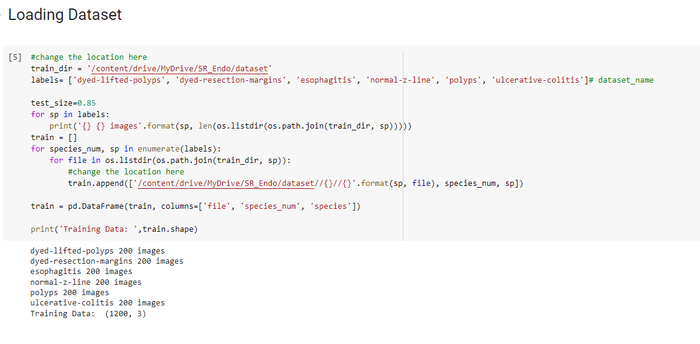
Implementation Of Existing System

Slide 26
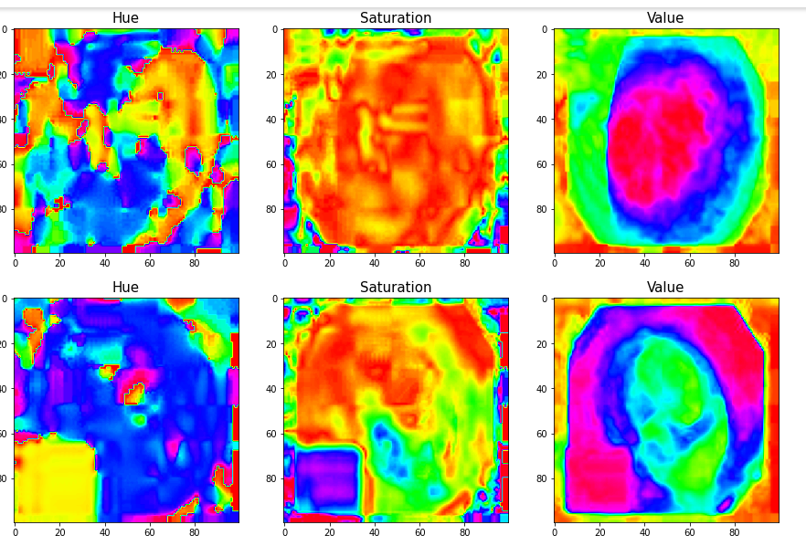
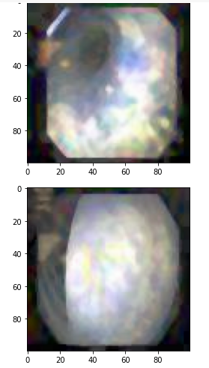
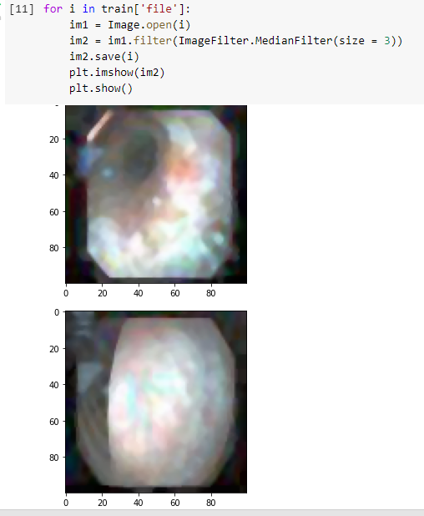
HSV SRGAN
SRGAN
Super Resolution Image

Slide 27
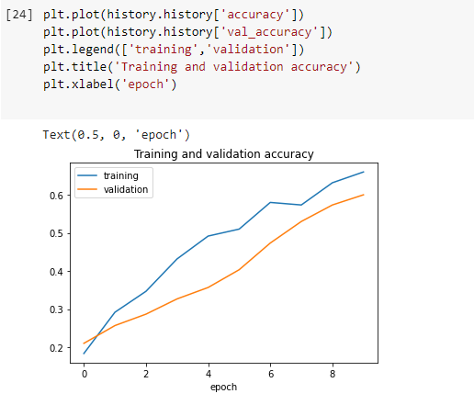
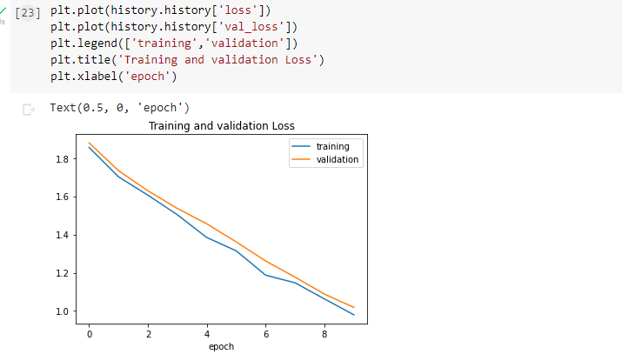
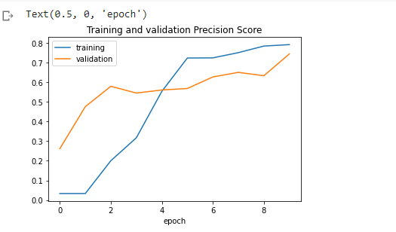
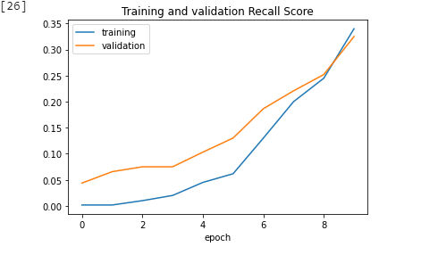

Slide 28
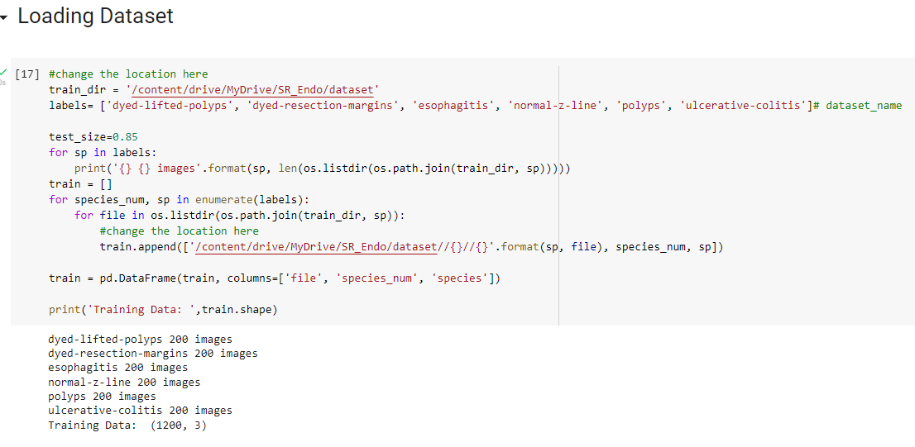
Implementation of proposed work

Slide 29
HSV SRGAN
SRGAN
Super Resolution Image

Slide 30
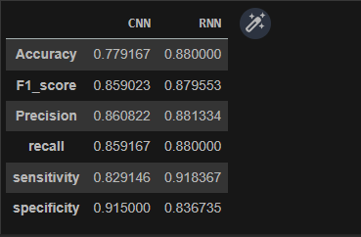
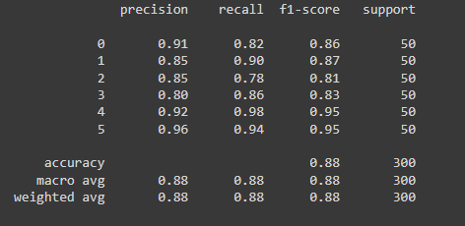
Classification report
Comparison Table

Slide 31
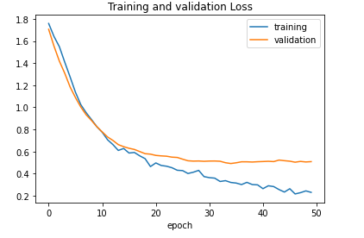
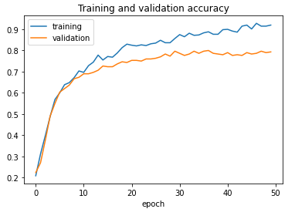
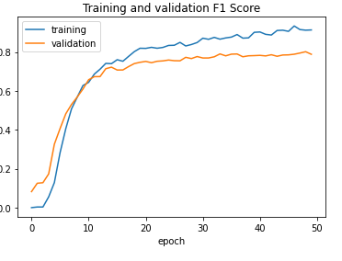
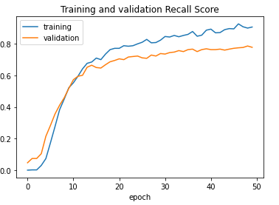
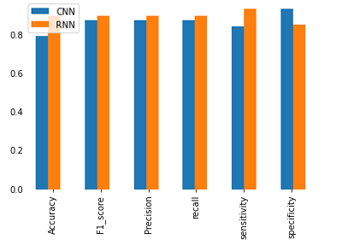
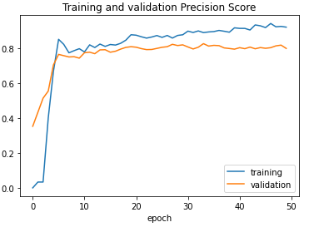

Slide 32
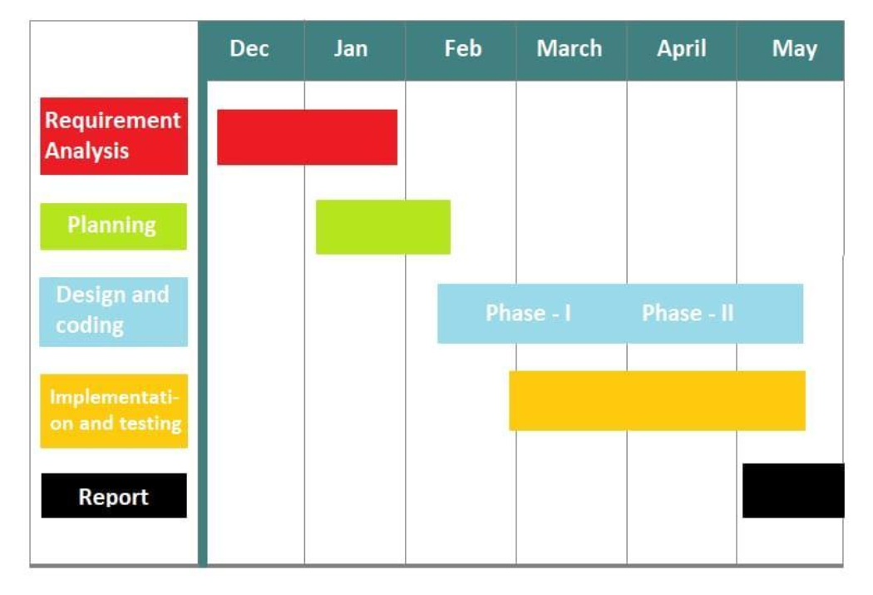
PLAN OF ACTION

Slide 33
CONCLUSION
Gastrointestinal tract abnormalities are very hard to notice and easy to misdiagnose. The proposed system helps us in identifying the abnormalities and give a universal diagnose. This save much times and effort for the specialist instead of manual diagnose.

Slide 34
REFERENCES
J. Park et al., “Recent development of computer vision technology to improve capsule endoscopy,” Korean Society of Gastrointestinal Endoscopy, Clincal Endoscopy, vol. 52, no. 4, p. 328, 2019.
M. Pellisé et al., “Impact of wide-angle, high-definition endoscopy in the diagnosis of colorectal neoplasia: A randomized controlled trial,” ,ScienceDirect ,Gastroenterology, vol. 135, no. 4, pp. 1062–1068, Oct. 2019.
V. Subramanian, J. Mannath, C. Hawkey, and K. Ragunath, “High definition colonoscopy vs. Standard video endoscopy for the detection of colonic polyps: A meta-analysis,”,Thieme, Endoscopy, vol. 43, no. 06, pp. 499–505, Jun. 2011.

Slide 35
F. Mahmood, R. Chen, and N. J. Durr, “Unsupervised reverse domain adaptation for synthetic medical images via adversarial training,” IEEE Transactions on Medical Imaging, vol. 37, no. 12, pp. 2572–2581, Dec. 2018.
F. Mahmood and N. J. Durr, “Deep learning and conditional random fields-based depth estimation and topographical reconstruction from conventional endoscopy,”, ScienceDirect Medical Image Analysis, vol. 48, pp. 230–243, Aug. 2018.
C. F. Sabottke and B. M. Spieler, “The effect of image resolution on deep learning in radiography,” RSNA, Radiolofy, Artificial Intelligence., vol. 2, no. 1, Jan. 2020, Art. no. e190015

Slide 36
THANK YOU

