Slide 1
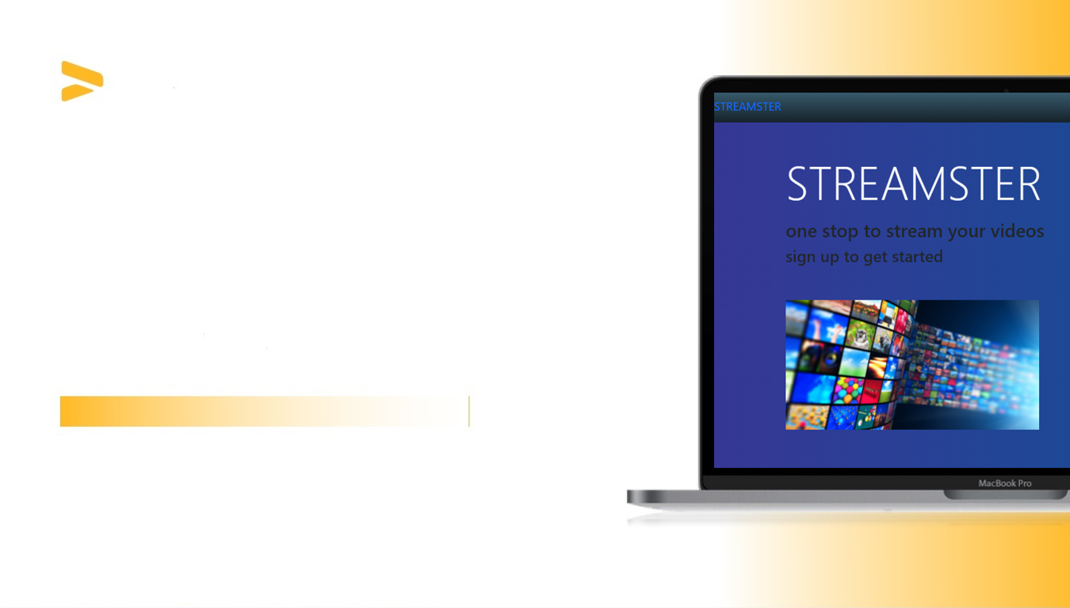
ELEC 6861-HIGHER LAYER TELECOMMUNICATION PROTOCOLS &
ENCS 691k-CLOUD NETWORKING AND SERVICE PROVISIONING
CONTENT DELIVERY NETWORK IN CLOUD
NAME | STUDENT ID
AJAY KUMAR LAKSHMIPURA VIJAYKUMAR | 40168544
KARANJOT SINGH KOCHAR | 40161109
BHAVANI SHANKAR REDDY ANNU | 40168191

Slide 2

INTRODUCTION
WHY CDN?
ABOUT OUR APPLICATION
1. To increase content availability and redundancy
2. Enhance website load time
3. Improve website security
Streamster is a web application to stream videos that runs on a Content Delivery Network (CDN).
There are two main components in the CDN, origin server and replica server.
The origin server pushes the videos to the replica servers where the end-users can stream the videos.

Slide 3
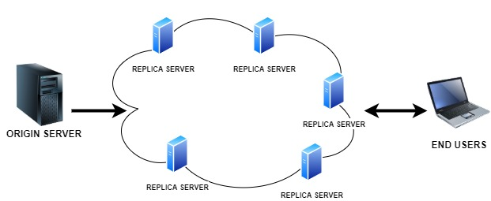
SYSTEM ARCHITECTURE OF CDN

Slide 4

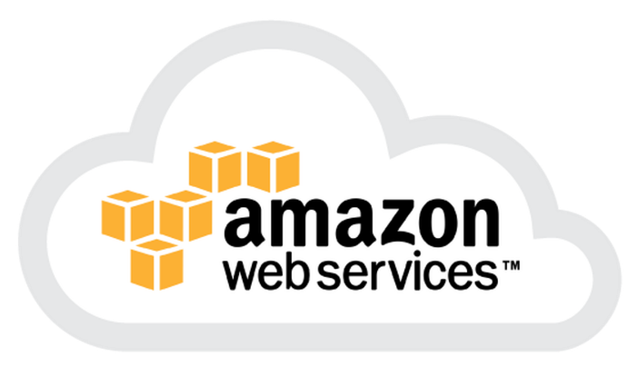


TECHNOLOGIES USED
BACKEND
FRONTEND
WEB SERVER
CLOUD COMPUTING PLATFORM

Slide 5

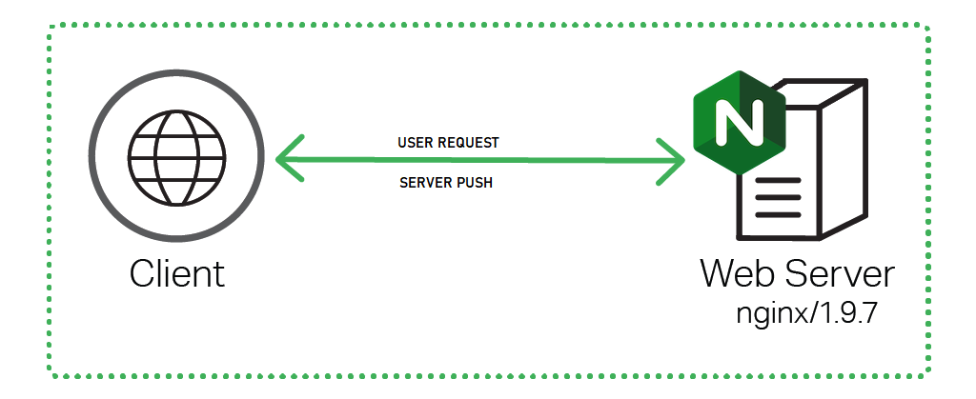
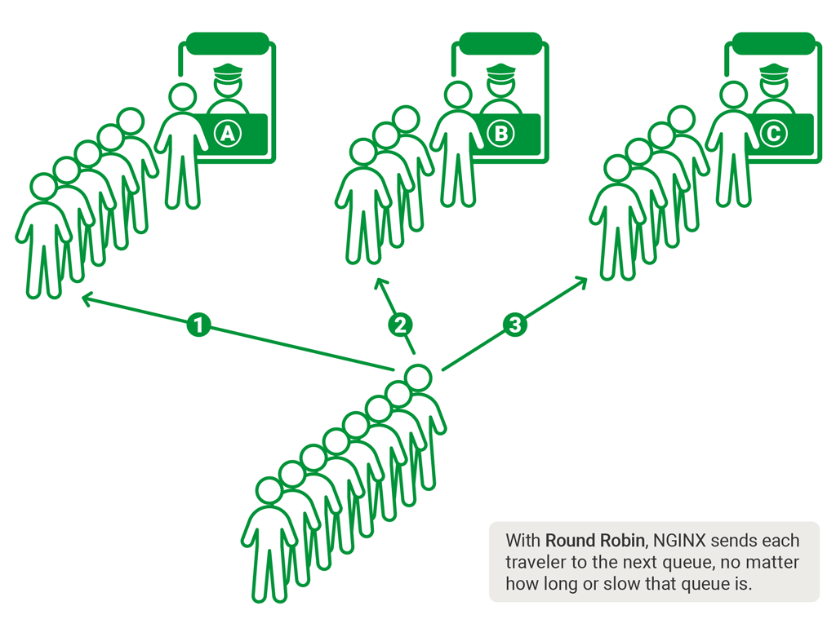
ACCOMPLISHMENTS
1. Server Push
2. Controller (Algorithm)

Slide 6
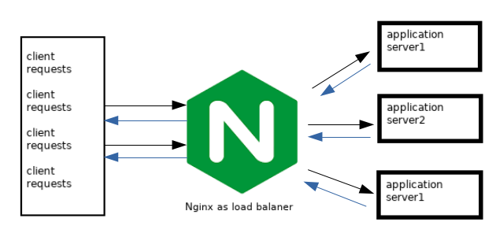
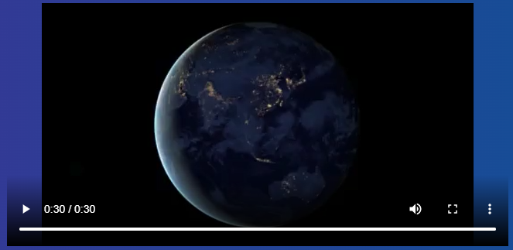
3. Redirection of end-user request by the controller
ACCOMPLISHMENTS
4. Video streaming at the user end

Slide 7

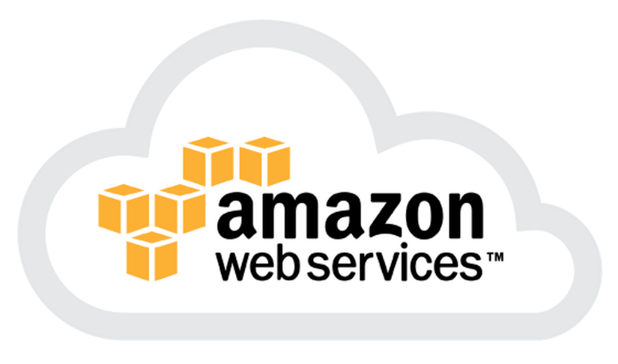
5. Http/2 Application Layer Protocol
ACCOMPLISHMENTS
6. Deployed in AWS EC2 Instance
https://ec2-34-212-226-230.us-west-2.compute.amazonaws.com/

Slide 8
ADDITIONAL FEATURES
Deployed on Pythonanywhere cloud
VIDEO DOWNLOAD
PLAYBACK SPEED

Slide 9
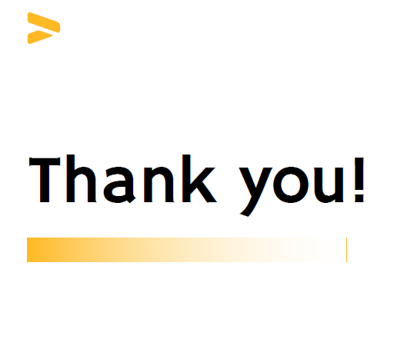

Slide 10
REFERENCES
https://docs.djangoproject.com/en/4.0/
https://nginx.org/en/docs/
https://docs.python.org/3/
https://www.openssl.org/docs/manmaster/man1/openssl.html
https://docs.aws.amazon.com/

