Slide 1
🚗
CAN Bus Intrusion Detection System
Gaadi ke andar ke network ko hackers se kaise bachaayein — simple Hinglish explanation
Team: Uma Shankar · Priyanshu Raj · Ruby Kumari
Supervisor: Mr. Deepak Pathak
Dev Bhoomi Uttarakhand University · B.Tech CSE · 2026–27
Notes:
Namaste! Aaj hum apna major project dikhayenge: CAN Bus Intrusion Detection System. Simple shabdon mein - gaadi ke andar jo computers aapas mein baat karte hain, unke beech koi hacker fake message na ghusa de, uska pata lagane wala system humne banaya hai.

Slide 2
Problem: CAN bus par koi ‘password’ nahi hota
Modern car mein 70+ chhote computers (ECUs) hote hain — sab ek hi taar par: CAN bus
⚙️
🛑
🎛️
💡
🛡️
Engine
Brakes
Speedometer
Lights
Airbag
CAN bus (ek shared taar)
😈 Hacker
OBD-II port se
CAN mein na sender ka naam, na lock. Jo bhi taar se juda hai woh koi bhi message bhej sakta hai — jaise ‘speed = 200’ ya ‘brake off’.
CAN Bus IDS · DBUU B.Tech CSE Major Project
2
Notes:
Gaadi mein engine, brake, speedometer jaise kaam alag-alag ECUs karte hain, aur sab ek hi CAN bus taar par messages bhejte hain. Problem yeh hai ki CAN 1980s ka design hai - usme authentication ya encryption nahi hai. Matlab agar koi hacker OBD port ya kisi hacked device se jud jaaye, toh woh fake messages bhej sakta hai aur baaki ECUs unhe sach maan lenge.

Slide 3
Hacker kya-kya kar sakta hai: 3 tarah ke attacks
Humara system inhi ko pakadne ke liye train hua hai
🌊
🎲
🎭
DoS (Flood)
Fuzzy
Spoofing
Bus ko itne saare high-priority messages se bhar do ki asli messages pahunch hi na paayein.
Random ID aur random data wale messages bhejo — dekho gaadi kaise react karti hai.
Kisi asli ECU ki nakal karke fake value bhejo, jaise speedometer = maximum.
Jaise phone line par lagataar spam calls.
Jaise har button ek saath dabaana.
Jaise kisi aur ki awaaz mein phone karna.
CAN Bus IDS · DBUU B.Tech CSE Major Project
3
Notes:
Teen main attacks hain. DoS mein hacker bus ko messages se bhar deta hai. Fuzzy mein random messages bhejta hai. Spoofing sabse chalak hai - woh kisi asli ECU ki nakal karta hai, jaise speedometer ko maximum dikhana. Spoofing ke andar ek aur mushkil type hai, 'masquerade', jismein asli message hata kar fake daal diya jaata hai, toh timing bhi normal lagti hai.

Slide 4
Solution: ek ‘smart guard’ jo bus sunta hai
Yeh system sirf sunta hai (passive) — kabhi gaadi ko message nahi bhejta. Har message ko check karke batata hai: Normal hai, attack hai, ya kuch shak wala hai.
👂
🔍
🏷️
💬
Sunna
Pakadna
Naam dena
Samjhana
CAN messages live ya recorded log se padhna
Ajeeb (abnormal) message turant detect karna
Attack type batana: Fuzzy / Spoofing / DoS / Unknown
SHAP se batana ki alert kyun aaya + live dashboard
CAN Bus IDS · DBUU B.Tech CSE Major Project
4
Notes:
Humara system ek security guard jaisa hai jo bus par chupchaap baitha sab sunta hai. Important baat: yeh kabhi koi message nahi bhejta, isliye gaadi ko koi khatra nahi. Iske chaar kaam hain: sunna, ajeeb cheez pakadna, attack ka naam batana, aur samjhana ki alert kyun aaya.

Slide 5
System kaam kaise karta hai — step by step
Har ek CAN message in 6 steps se guzarta hai (milliseconds mein)
📥
🧮
🌲
🤖
⚖️
🚨
1. Message
aaya
2. 25 clues
nikaale
3. Isolation
Forest
4. XGBoost
5. Hybrid
faisla
6. Alert +
Dashboard
CAN log / bus se frame padha
Timing, payload, traffic pattern
‘Kya yeh normal jaisa hai?’
‘Agar attack hai toh kaunsa?’
Normal / Attack / Unknown
SQLite mein save, SHAP reason
Example: hacker ne speedometer ID 0x0D0 ke extra messages bheje → us ID ka traffic share achaanak badh gaya → XGBoost ne bola ‘Spoofing’ → dashboard par Critical alert + reason dikha.
CAN Bus IDS · DBUU B.Tech CSE Major Project
5
Notes:
Yeh poora flow hai. Message aata hai, usse 25 features yaani clues nikalte hain. Pehla model Isolation Forest sirf normal traffic dekh kar seekha hai, woh batata hai ki message ajeeb hai ya nahi. Doosra model XGBoost batata hai ki agar attack hai toh kaunsa. Phir hybrid rules final faisla lete hain, aur alert dashboard par explanation ke saath aata hai.

Slide 6
Data: asli gaadi ka recorded CAN traffic
ROAD dataset — Oak Ridge National Laboratory (USA), ek real car dynamometer par record
27.4 M
41
0.4 %
CAN messages process kiye
recordings (12 normal drive + 29 attack)
test data mein attack messages — baaki sab normal
Data ko teen hisson mein baanta (bina cheating ke):
Train — model yahan se seekhta hai
Validation — settings/thresholds yahan tune hote hain
Test — sirf ek baar, final result ke liye (har access log hua)
⚠️ HCRL dataset (DoS wala)
Iski files is PC par available nahi thi, isliye DoS aur cross-dataset test abhi run nahi hue. Code ready hai.
CAN Bus IDS · DBUU B.Tech CSE Major Project
6
Notes:
Humne ROAD dataset use kiya - yeh asli gaadi ka data hai, 2.7 crore se zyada messages. Attack messages bahut kam hain, sirf 0.4 percent, isliye accuracy ka koi matlab nahi - sab ko normal bol do toh bhi 99.6 percent accuracy aa jaayegi. Data ko train, validation, test mein aise baanta ki future ka data training mein na ghuse. HCRL dataset ki files available nahi thi, yeh hum honestly limitation mein likhte hain.

Slide 7
Har message se 25 ‘clues’ (features) nikaale
Jaise detective chhote-chhote saboot jodta hai
📦
Payload clues
⏱️
Timing clues
🪟
Window clues
Message ke 8 bytes ki value
Data kitna random hai (entropy)
Pichhle same-ID message se kitne bits badle
Pichhle message ke baad kitna time
Same ID kitni der baad aayi
ID apne normal time se kitna hat ke hai
Last 100 messages mein speed (frames/sec)
Ek hi ID ka kitna hissa hai
Kitni alag-alag IDs dikh rahi hain
Khaas baat: training aur live dono mein ek hi code features banata hai — isliye live system wahi dekhta hai jo model ne seekha.
CAN Bus IDS · DBUU B.Tech CSE Major Project
7
Notes:
Har message se 25 clues nikalte hain. Payload clues batate hain data kaisa hai. Timing clues batate hain message kitni jaldi aaya - spoofing mein extra messages aate hain toh timing badal jaati hai. Window clues last 100 messages ka pattern dekhte hain. Aur hum ek hi code training aur live dono mein use karte hain - ise train-serve consistency kehte hain, humare test ne prove kiya ki dono ke results bilkul same hain.

Slide 8
Do ‘dimaag’ milkar faisla lete hain
Hybrid model = Isolation Forest + XGBoost
🌲
🤖
Stage 1: Isolation Forest
Stage 2: XGBoost classifier
Sirf NORMAL traffic dekh kar seekha
Jo cheez normal jaisi na lage, use ‘ajeeb’ bolta hai
Fayda: naya, anjaana attack bhi pakad sakta hai
Attack examples dekh kar seekha
Batata hai: Normal / Fuzzy / Spoofing (+ DoS)
Har answer ke saath probability deta hai
Final faisla (hybrid rules):
Dono kehte ‘sab theek’
NORMAL
XGBoost ko attack pe pakka yakeen
ATTACK (naam ke saath)
Isolation Forest ko shak, XGBoost confused
UNKNOWN / SUSPICIOUS
CAN Bus IDS · DBUU B.Tech CSE Major Project
8
Notes:
Pehla dimaag Isolation Forest hai - isne sirf normal traffic dekha hai, toh jo bhi alag lage use ajeeb bolta hai. Doosra dimaag XGBoost hai - isne attacks dekhe hain, toh attack ka naam bata sakta hai. Agar pehle ko shak hai par doosra confused hai, toh hum zabardasti label nahi lagate - 'Unknown/Suspicious' bolte hain. Yeh naye attacks ke liye useful idea hai.

Slide 9
Results: kitna achha kaam karta hai?
Test data: 61.2 lakh messages, jinmein 24,510 attack — model ne yeh pehle kabhi nahi dekha
Matlab: Hybrid ~64% attack messages pakadta hai aur 1000 normal messages mein sirf ~1 galat alarm. Akela Isolation Forest 23 galat alarm deta hai — isliye XGBoost zaroori hai.
CAN Bus IDS · DBUU B.Tech CSE Major Project
9
Notes:
Yeh test data par result hai jo model ne kabhi nahi dekha. Simple rules sirf 3 percent attacks pakadte hain. Isolation Forest akela 12 percent pakadta hai par bahut galat alarm deta hai - 1000 mein 23. XGBoost aur hybrid lagbhag 64-67 percent attacks pakadte hain aur 1000 mein sirf 1 galat alarm. Macro-F1 hybrid ka 0.886 hai. Saare numbers saved result files se hain, kuch bhi haath se nahi likha.

Slide 10
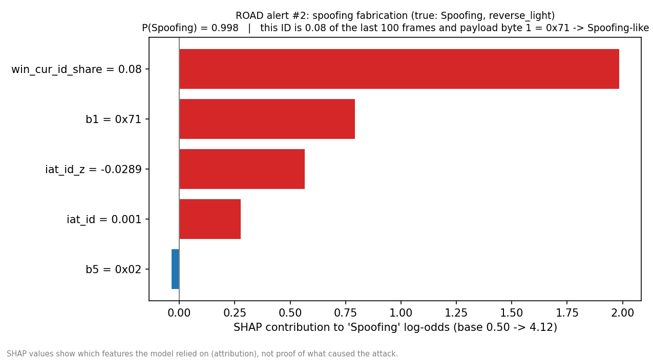
Alert kyun aaya? SHAP se explanation
Model ko black-box nahi chhoda
Is alert mein model ne kya dekha:
Lal bar = attack ki taraf dhakela
ID 0x0D0 ka share 8% — normal se zyada, yaani extra messages ghuse
Ek explanation ~11 ms mein — har alert ke liye live
⚠️ SHAP batata hai model ne kis cheez par bharosa kiya — yeh attack ka ‘proof’ nahi hai.
CAN Bus IDS · DBUU B.Tech CSE Major Project
10
Notes:
Har alert ke saath hum SHAP explanation dikhate hain. Is example mein model ne dekha ki ID 0x0D0 last 100 messages ka 8 percent hai, jo normal se zyada hai - yaani extra fake messages aaye. SHAP game theory se aata hai aur exact batata hai kis feature ne kitna contribute kiya. Isi se humne ek galti bhi pakdi - model kabhi-kabhi gaadi ki speed wale byte par bhi bharosa kar raha tha, jo asli attack signal nahi hai.

Slide 11
Live dashboard aur speed
Laptop par real-time — asli CAN bus se kai guna tez
16,573
4,505
16.5 ms
messages/second process (pipeline)
max messages/second ek 500 kbps CAN bus par
95% messages ka faisla itne time mein
Dashboard ke 7 tabs (Streamlit):
📡
Live Monitor
📊
Attack Analytics
🔎
Alert Detail + SHAP
🗂️
Event History
🏆
Model Performance
❤️
System Health
ℹ️
About + Safety
CAN Bus IDS · DBUU B.Tech CSE Major Project
11
Notes:
Hamara pipeline laptop par 16 hazaar se zyada messages per second handle karta hai, jabki ek CAN bus maximum lagbhag 4500 bhej sakti hai - matlab kaafi headroom hai. 95 percent messages ka faisla 16.5 millisecond mein ho jaata hai. Dashboard mein 7 tabs hain - live monitoring, analytics, har alert ki detail SHAP ke saath, history aur CSV export, model results, system health aur safety info.

Slide 12
Humne kya seekha (important findings)
Sirf achhe numbers nahi — imaandaar analysis
✅
XGBoost hi asli hero hai
⏱️
Timing vs payload — dono zaroori
Akele Isolation Forest se har sahi alarm par ~50 galat alarm aate the.
Sirf timing se extra-message attacks 99.8% pakde, par ‘masquerade’ 0%. Payload se masquerade pakda gaya.
🔎
SHAP ne model ki galti pakdi
❓
Naya attack abhi bhi mushkil
Model ek speed-wale byte par bharosa kar raha tha — 97% galat alarm isi ID par the.
Jo coolant-temperature attack training mein nahi tha, use koi version nahi pakad paaya.
CAN Bus IDS · DBUU B.Tech CSE Major Project
12
Notes:
Chaar badi seekh. Ek - XGBoost hi system ko practical banata hai. Do - timing features extra messages wale attack pakadte hain aur payload features masquerade pakadte hain, dono chahiye. Teen - SHAP aur error analysis ne dikhaya ki model kuch hadd tak gaadi ki situation yaad kar raha tha, attack nahi - yeh humne isliye pakda kyunki test mein poori nayi recordings rakhi thi. Chaar - bilkul naya attack abhi bhi miss hota hai.

Slide 13
Limitations aur aage kya
Jo nahi hua, woh bhi saaf-saaf
⚠️
Limitations
🚀
Future work
Sirf ROAD dataset (ek gaadi) par test
HCRL / DoS aur cross-dataset run nahi hua (data nahi tha)
Raspberry Pi par test nahi hua (hardware nahi tha)
Har attack ki sirf 3 recordings
HCRL milte hi same scripts se DoS + cross-dataset
Timing aur payload ke liye do alag detectors
LSTM jaisa sequence model naye attacks ke liye
Raspberry Pi 4 par in-vehicle gateway test
CAN Bus IDS · DBUU B.Tech CSE Major Project
13
Notes:
Hum limitations chhupate nahi. Sirf ek dataset par test hua, HCRL files available nahi thi, aur Raspberry Pi hardware nahi tha - lekin dono ke liye code aur guide ready hai. Aage hum alag detectors, sequence model aur Pi par real gateway test karna chahenge.

Slide 14
Khud chala ke dekho: project kaise run karein
VS Code terminal mein (Windows)
1
Folder kholo
cd C:\major_project\can-ids
2
Environment on karo
.\.venv\Scripts\Activate.ps1
3
Dashboard chalao
streamlit run app/dashboard.py
4
Tests (optional)
pytest
Browser mein localhost:8501 → Live Monitor → demo/road_max_speedometer_attack_3 chuno → speed 5× → Start. Alerts live aane lagenge!
CAN Bus IDS · DBUU B.Tech CSE Major Project
14
Notes:
Project chalana bahut aasaan hai. Folder kholo, environment activate karo, aur streamlit command chalao. Browser mein dashboard khulega. Demo file chuno aur Start dabao - attack log virtual bus par replay hoga aur alerts live dikhenge. Models aur demo data repo mein hi hain, toh koi dataset download nahi karna padta.

Slide 15
🛡️
Dhanyavaad! Questions?
Ek line mein: humne ek passive, explainable IDS banaya jo gaadi ke CAN messages ko real-time check karke attack pakadta hai — aur saath mein batata hai kyun.
Safety: yeh sirf research prototype hai — sirf recorded data / virtual bus par, kabhi asli gaadi se connect nahi kiya.
Notes:
Bas itna hi! Summary - humara system sunta hai, pakadta hai, naam batata hai aur samjhata hai, aur yeh poori tarah safe aur passive hai. Aapke sawaalon ka swagat hai.

